Slide 1
Exceptional Control Flow:
System Calls, Page Faults etc.
Slides adapted from: Gregory Kesden and Markus Püschel of Carnegie Mellon University

Slide 2
Control Flow
Processors do only one thing:
  From startup to shutdown, a CPU simply reads and executes (interprets) a sequence of instructions, one at a time
  This sequence is the CPU’s control flow (or flow of control)
Physical control flow
<startup>
inst₁
inst₂
inst₃
…
inst_{n}
<shutdown>
Time

Slide 3
Altering the Control Flow
Up to now: two mechanisms for changing control flow:
  Jumps and branches
  Call and return
  React to changes in program state
Insufficient for a useful system:
Difficult to react to changes in system state
  Data arrives from a disk or a network adapter
  Instruction divides by zero
  User hits Ctrl-C at the keyboard
  System timer expires
System needs mechanisms for “exceptional control flow”

Slide 4
Exceptional Control Flow
Exists at all levels of a computer system
Low level mechanisms
  1. Exceptions
    Change in control flow in response to a system event
    (i.e., change in system state)
    Implemented using combination of hardware and OS software
Higher level mechanisms
  2. Process context switch
    Implemented by OS software and hardware timer
  3. Signals
    Implemented by OS software
  4. Nonlocal jumps: setjmp() and longjmp()
    Implemented by C runtime library

Slide 5
Exceptions
An exception is a transfer of control to the OS kernel in response to some event (i.e., change in processor state)
  Kernel is the memory-resident part of the OS
  Examples of events: Divide by 0, arithmetic overflow, page fault, I/O request completes, typing Ctrl-C
User code
Kernel code
Event
I_current
Exception
I_next
Exception processing
by exception handler
Return to I_current
Return to I_next
Abort

Slide 6
Exception Tables
(also known as Interrupt Vector)
Exception
numbers
Code for
exception handler 0
Each type of event has a
unique exception number k
k = index into exception table
(a.k.a. interrupt vector)
Handler k is called each time
exception k occurs
Exception
Table
Code for
exception handler 1
0
1
Code for
exception handler 2
2
...
n-1
...
Code for
exception handler n-1

Slide 7
(partial) Taxonomy
ECF
Asynchronous
Synchronous
Interrupts
Traps
Faults
Aborts

Slide 8
Asynchronous Exceptions (Interrupts)
Caused by events external to the processor
  Indicated by setting the processor’s interrupt pin
  Handler returns to “next” instruction
Examples:
  Timer interrupt
    Every few ms, an external timer chip triggers an interrupt
    Used by the kernel to take back control from user programs
  I/O interrupt from external device
    Hitting Ctrl-C at the keyboard
    Arrival of a packet from a network
    Arrival of data from a disk

Slide 9
Synchronous Exceptions
Caused by events that occur as a result of executing an instruction:
  Traps
    Intentional
    Examples: system calls, breakpoint traps, special instructions
    Returns control to “next” instruction
  Faults
    Unintentional but possibly recoverable
    Examples: page faults (recoverable), protection faults (unrecoverable), floating point exceptions
    Either re-executes faulting (“current”) instruction or aborts
  Aborts
    Unintentional and unrecoverable
    Examples: illegal instruction, parity error, machine check
    Aborts current program

Slide 10
Fault Example: Page Fault
int a[1000];
main ()
{
a[500] = 13;
}
User writes to memory location
That portion (page) of user’s memory
is currently on disk
80483b7: c7 05 10 9d 04 08 0d movl $0xd,0x8049d10
User code
Kernel code
Exception: page fault
movl
Copy page from disk to memory
Return and reexecute movl

Slide 11
Fault Example: Invalid Memory Reference
int a[1000];
main ()
{
a[5000] = 13;
}
80483b7: c7 05 60 e3 04 08 0d movl $0xd,0x804e360
User code
Kernel code
Exception: page fault
movl
Detect invalid address
Signal process
Sends SIGSEGV signal to user process
User process exits with “segmentation fault”

Slide 12
Traps: System Calls
Each x86-64 system call has a unique ID number
Examples:
Number | Name | Description
0 | read | Read file
1 | write | Write file
2 | open | Open file
3 | close | Close file
4 | stat | Get info about file
57 | fork | Create process
59 | execve | Execute a program
60 | _exit | Terminate process
62 | kill | Send signal to process

Slide 13
System Call Example: Opening File
User calls: open(filename, options)
Calls __open function, which invokes system call instruction syscall
00000000000e5d70 <__open>:
...
e5d79: b8 02 00 00 00 mov $0x2,%eax # open is syscall #2
e5d7e: 0f 05 syscall # Return value in %rax
e5d80: 48 3d 01 f0 ff ff cmp $0xfffffffffffff001,%rax
...
e5dfa: c3 retq
User code
Kernel code
%rax contains syscall number
Other arguments in %rdi, %rsi, %rdx, %r10, %r8, %r9
Return value in %rax
Negative value is an error corresponding to negative errno
syscall
Exception
cmp
Open file
Returns

Slide 14
System call
Applications should be prevented to directly access hardware such as
  Physical memory,
  disk,
  network,
  halt
But nevertheless, they need to access these resources in a controlled way:
  Read/write their own memory
  Access the files that they have permission
  Access the network for its own communications
  Halt
Processors run at different security levels:
  User level:
  Kernel-level:

Slide 15
Privileged instructions
At kernel level, CPU can execute certain instructions (such as halt) that directly access hardware.
At user-level the use of privileged instructions are not allowed by hardware.
User applications do not include privileged instructions.
Only System Call code includes privileged instructions.

Slide 16
System calls
Programming interface to the services provided by the OS
  A set of functions (“API” (Application Programming Interface)) provided by the OS to the user applications
  Allow the user applications to access hardware in a controlled way
System calls are functions that can directly access hardware

Slide 17
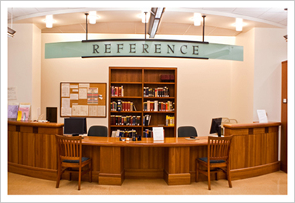

Library example

Slide 19
System Calls
Process Control
  Load, execute and, abort
  create and terminate process
File management
  create file, delete file
  open, close, read, write, seek
Device Management
  request device, release device
  read, write, reposition
Information Maintenance
  get/set time or date, get/set system data
Communication
  create, delete communication connection
  send, receive messages

Slide 20
Most common System API
Most common system API
  POSIX API (most versions of UNIX, Linux, and Mac OS X)
  Win32 API for Windows
On Unix, Unix-like and other POSIX-compliant operating systems, popular system calls are open, read, write, close, wait, exec, fork, exit, and kill

Slide 21
Most common System API
Most common system API
  POSIX API (most versions of UNIX, Linux, and Mac OS X)
  Win32 API for Windows
POSIX (IEEE 1003.1, ISO/IEC 9945)
  Very widely used standard based on (and including) C-language
  Defines both
    system calls and
    compulsory system programs together with their functionality and command-line format
      E.g. ls –w dir prints the list of files in a directory in a ‘wide’ format
  Complete specification is at http://www.opengroup.org/onlinepubs/9699919799/nframe.html
Win32 (Microsoft Windows based systems)
  Specifies system calls together with many Windows GUI routines
    VERY complex, no really complete specification

Slide 22
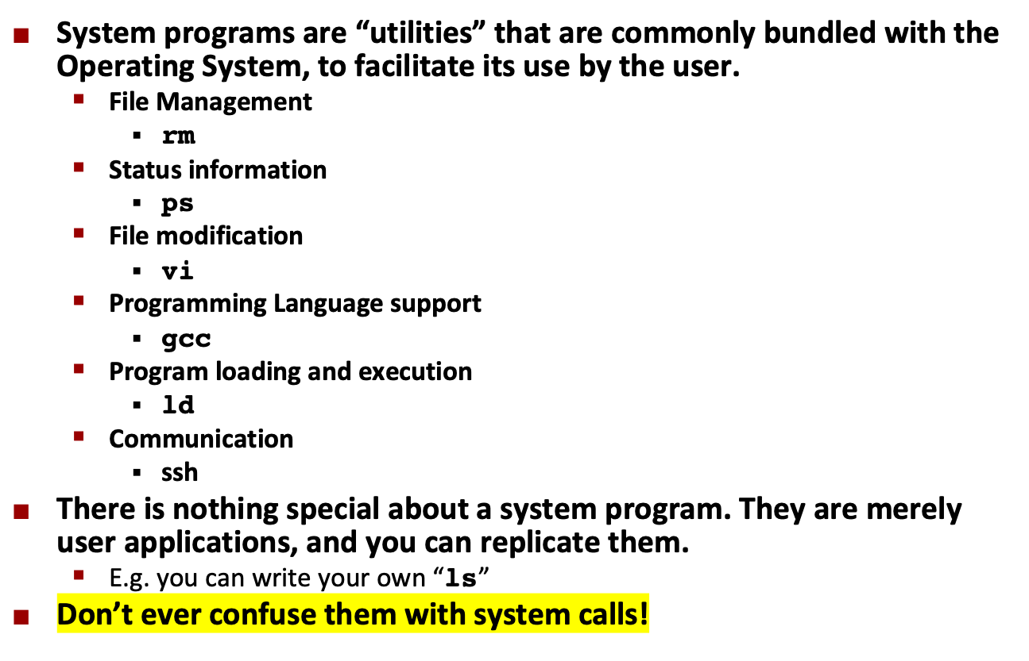
System programs

