Slide 1
File Abstraction
https://sehitoglu.web.tr/filedemo/
Most of the following slides are adapted from slides of Randy Bryant of Carnegie Mellon Univ.

Slide 2
UNIX File Abstraction
In UNIX, the file is the basic abstraction used for I/O
  Used to access disks, CDs, DVDs, USB and serial devices, network sockets, even memory!

Slide 3
Unix I/O and C Standard I/O
C Standard
  Most useful for reading/writing files in applications
  Provides buffering between program and actual files
Unix I/O
  Lower level
  Required for system and network programming
fopen fdopen
fread fwrite fscanf fprintf sscanf sprintf fgets fputs fflush fseek
fclose
C application program
Standard I/O
functions
open read
write lseek
stat close
Unix I/O functions
(accessed via system calls)

Slide 4
Unix I/O Overview
A Linux file is a sequence of m bytes:
  B₀ , B₁ , .... , B_{k} , .... , B_{m-1}
Cool fact: All I/O devices are represented as files:
  /dev/sda2 (/usr disk partition)
  /dev/tty2 (terminal)
Even the kernel is represented as a file:
  /boot/vmlinuz-3.13.0-55-generic (kernel image)
  /proc (kernel data structures)

Slide 5
Unix I/O Overview
Elegant mapping of files to devices allows kernel to export simple interface called Unix I/O:
  Opening and closing files
    open()and close()
  Reading and writing a file
    read() and write()
  Changing the current file position (seek)
    indicates next offset into file to read or write
    lseek()
B₀
B₁
• • •
B_{k-1}
B_{k}
B_{k+1}
• • •
Current file position = k

Slide 6
Opening Files
Opening a file informs the kernel that you are getting ready to access that file
Returns a small identifying integer file descriptor
  fd == -1 indicates that an error occurred
int fd; /* file descriptor */
if ((fd = open("/etc/hosts", O_RDONLY)) < 0) {
perror("open");
exit(1);
}

Slide 7
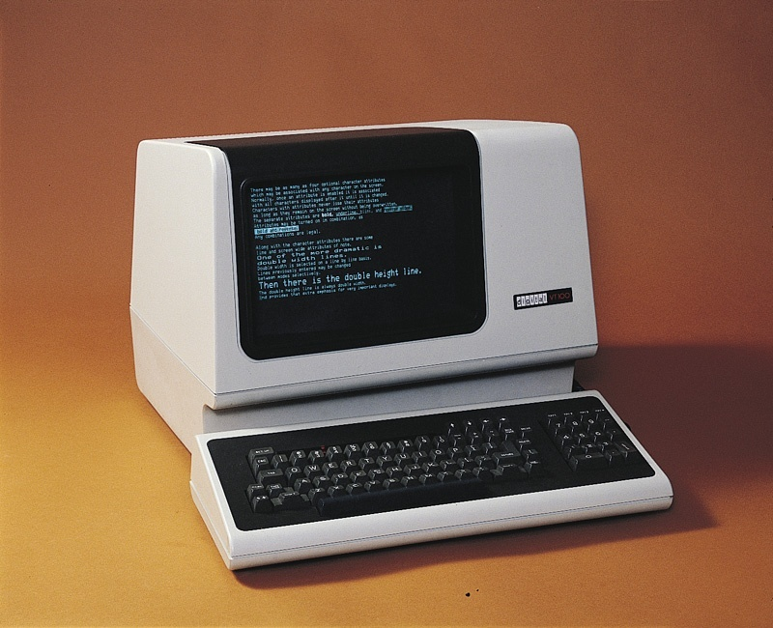
stdin, stdout, stderr
In UNIX, every process has three “special” files already open:
  standard input (stdin) – filehandle 0
  standard output (stdout) – filehandle 1
  standard error (stderr) – filehandle 2
By default, stdin and stdout are connected to the terminal device of the process.
  Originally, terminals were physically connected to the computer by a serial line
  These days, we use “virtual terminals” using ssh
VT100 terminal

Slide 8
Standard I/O Streams
Standard I/O models open files as streams
  Abstraction for a file descriptor and a buffer in memory.
  Similar to buffered RIO (later)
C programs begin life with three open streams
(defined in stdio.h)
  stdin (standard input)
  stdout (standard output)
  stderr (standard error)
#include <stdio.h>
extern FILE *stdin; /* standard input (descriptor 0) */
extern FILE *stdout; /* standard output (descriptor 1) */
extern FILE *stderr; /* standard error (descriptor 2) */
int main() {
fprintf(stdout, "Hello, world\n");
}

Slide 9
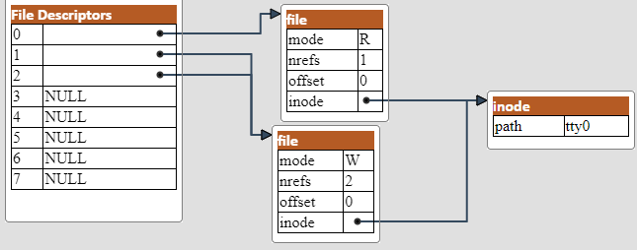
How the Unix Kernel Represents Open Files
0 (stdin)
1 (stdout)
2 (stderr) points to terminal.
Tty (teletype) is the terminal represented as a file
Offset (File position) is maintained per open file
Nrefs keeps the number of links incoming from the file descriptor tables.

Slide 10
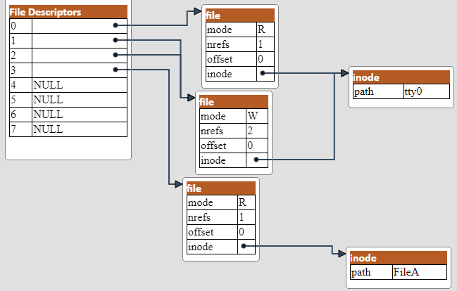
How the Unix Kernel Represents Open Files
After: fd1=open(FileA);
fd1=3
points to FileA.
FileA is the opened file

Slide 11
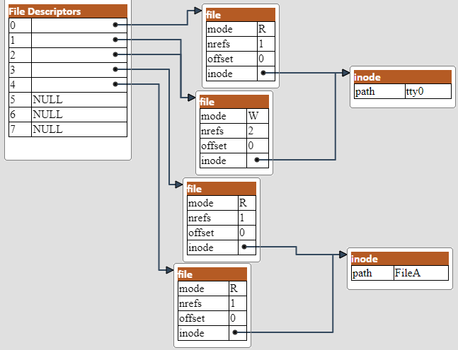
How the Unix Kernel Represents Open Files
After: fd1=open(FileA); fd2=open(FileA)
fd1=3
fd2=4
both
point to FileA.
But they keep separate offset values
FileA is the opened file

Slide 12
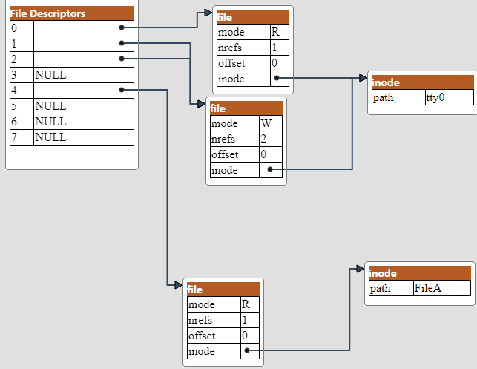
How the Unix Kernel Represents Open Files
After: fd1=open(FileA); fd2=open(FileA); close(fd1);
File descriptr 3 is now set to NULL
FileA is the opened file

Slide 13
How the Unix Kernel Represents Open Files
After: fd1=open(FileA); fd2=open(FileA); close(fd1); close(fd2);
File descriptr 4 is now set to NULL

Slide 14
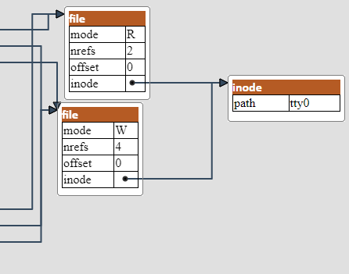
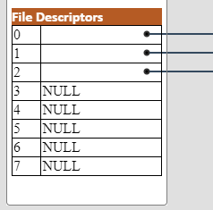
How the Unix Kernel Represents Open Files
After: fd1=open(FileA); fd2=open(FileA); close(fd1); close(fd2);
Parent’s
File descriptr table
..copied into
Child’s
File descriptr table
Note that nrefs are doubled!
Parent and child share the SAME offset!

Slide 15
Shell redirection
The shell allows stdin, stdout, and stderr to be redirected (say, to or from a file).
  > ./myprogram > somefile.txt
    Connects stdout of “myprogram” to somefile.txt
  > ./myprogram < input.txt > somefile.txt
    Connects stdin to input.txt and stdout to somefile.txt
  > ./myprogram 2> errors.txt
    Connects stderr to errors.txt
In this case, the shell simply opens the file, making sure the file handle is 0, 1, or 2, as appropriate.
  Problem: open() decides what the file handle number is.
  How do we coerce the filehandle to be 0, 1, or 2?

Slide 16
Shell redirection: Initial state
stdout prints to the display of the terminal as default.
File descriptr 4 is now set to NULL

Slide 17
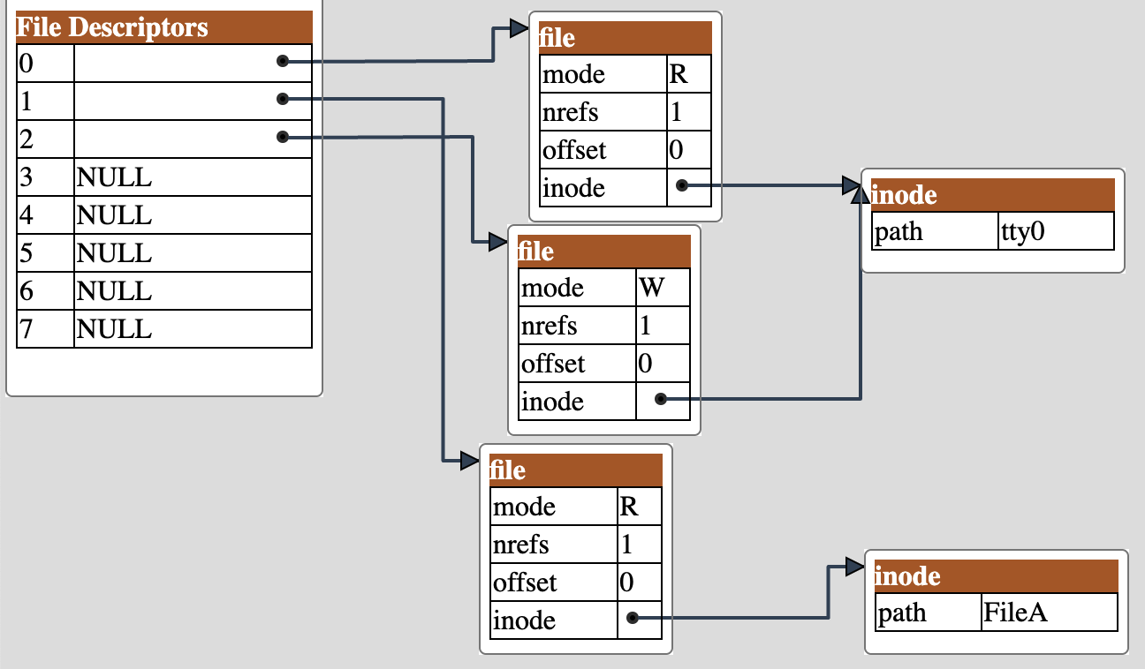
Shell redirection: Desired state
stdout prints to FileA.
File descriptr 4 is now set to NULL
But the Descriptor table is kernel space, and we cannot modify it directly.
Need to use system calls!

Slide 18
Before dup()
stdout prints to the display of the terminal as default.
File descriptr 4 is now set to NULL
#include <unistd.h>
int dup(int filedes);
  //dup() returns lowest available file descriptor, now referring to whatever filedes refers to
  newfd = dup(1); // newfd will be 3.

Slide 19
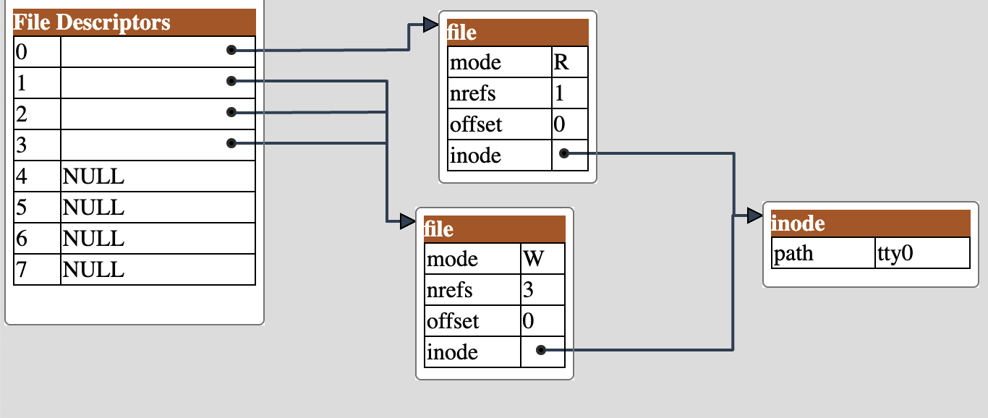
After dup()
Newfd=dup(1);
Newfd=3 points to stdout
#include <unistd.h>
int dup(int filedes);
  //dup() returns lowest available file descriptor, now referring to whatever filedes refers to
  newfd = dup(1); // newfd will be 3.

Slide 20
Shell redirection – after opening FileA
foofd = open(”FileA)
foofd=3 points to FileA
#include <unistd.h>
int dup2(int oldfd, int newfd);
  //Copies descriptor table entry oldfd to entry newfd
  int foofd = open(”FileA", O_WRONLY); //foofd becomes 3.
  if (dup2(foofd, stdout)>0) printf(“printing to foo.txt\n”);

Slide 21
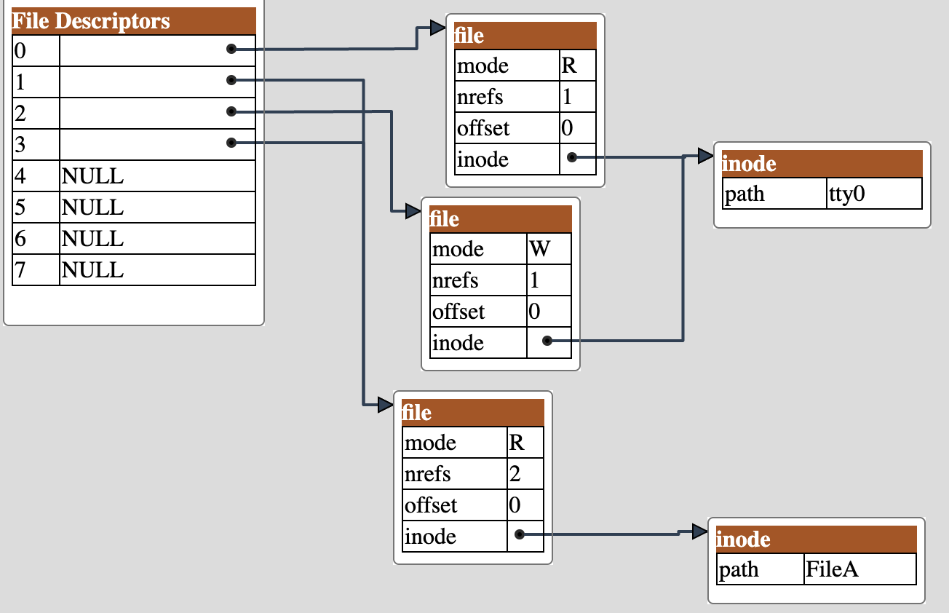
Shell redirection – after dup2()
foofd = open(”FileA)
foofd=3 points to stdout
#include <unistd.h>
int dup2(int oldfd, int newfd);
  //Copies descriptor table entry oldfd to entry newfd
  int foofd = open(”FileA", O_WRONLY); //foofd becomes 3.
  if (dup2(foofd, stdout)>0) printf(“printing to foo.txt\n”);

Slide 22
Shell redirection – after dup2()
Newfd=dup(1);
Newfd=3 points to stdout
#include <unistd.h>
int dup2(int oldfd, int newfd);
  //Copies descriptor table entry oldfd to entry newfd
  int foofd = open(”foo.txt", O_WRONLY); //foofd becomes 3.
  if (dup2(foofd, stdout)>0) printf(“printing to foo.txt\n”);

Slide 23
dup() and dup2()pseudocode
dup(fd) returns lowest available file descriptor, now referring to whatever oldfd refers to refers to.
  dup2(oldfd,newfd) copies descriptor table entry oldfd to entry newfd.
//Descriptor table
void *DT[maxFd];
int dup2(int oldfd, int newfd){
DP[newfd]=DP[oldfd];
return(newfd);
}
//Descriptor table
void *DT[maxFd];
int dup(int oldfd){
//get the lowest available
//file descriptor
  newfd = lowestFd(DT);
  DT(newfd)=DT(oldfd);
  return(newfd);
  }
If oldfd is not a valid file descriptor, then the call fails, and newfd is not closed.
If oldfd is a valid file descriptor, and newfd has the same value as oldfd, then dup2() does nothing, and returns newfd.
http://sehitoglu.web.tr/filedemo/

Slide 24
I/O and Redirection Example
#include "csapp.h"
int main(int argc, char *argv[])
{
int fd1, fd2, fd3;
char c1, c2, c3;
char *fname = argv[1];
fd1 = open(fname, O_RDONLY, 0);
fd2 = open(fname, O_RDONLY, 0);
fd3 = open(fname, O_RDONLY, 0);
dup2(fd2, fd3);
read(fd1, &c1, 1);
read(fd2, &c2, 1);
read(fd3, &c3, 1);
printf("c1 = %c, c2 = %c, c3 = %c\n", c1, c2, c3);
return 0;
}
ffiles1.c
What would this program print for file containing “abcde”?

Slide 26
I/O and Redirection Example
#include "csapp.h"
int main(int argc, char *argv[])
{
int fd1, fd2, fd3;
char c1, c2, c3;
char *fname = argv[1];
fd1 = Open(fname, O_RDONLY, 0);
fd2 = Open(fname, O_RDONLY, 0);
fd3 = Open(fname, O_RDONLY, 0);
Dup2(fd2, fd3);
Read(fd1, &c1, 1);
Read(fd2, &c2, 1);
Read(fd3, &c3, 1);
printf("c1 = %c, c2 = %c, c3 = %c\n", c1, c2, c3);
return 0;
}
c1 = a, c2 = a, c3 = b
dup2(oldfd, newfd)
ffiles1.c
What would this program print for file containing “abcde”?

Slide 27
Master Class: Process Control and I/O
#include "csapp.h"
int main(int argc, char *argv[])
{
int fd1;
int s = getpid() & 0x1;
char c1, c2;
char *fname = argv[1];
fd1 = Open(fname, O_RDONLY, 0);
Read(fd1, &c1, 1);
if (fork()) { /* Parent */
sleep(s);
Read(fd1, &c2, 1);
printf("Parent: c1 = %c, c2 = %c\n", c1, c2);
} else { /* Child */
sleep(1-s);
Read(fd1, &c2, 1);
printf("Child: c1 = %c, c2 = %c\n", c1, c2);
}
return 0;
}
ffiles2.c
What would this program print for file containing “abcde”?

Slide 29
Master Class: Process Control and I/O
#include "csapp.h"
int main(int argc, char *argv[])
{
int fd1;
int s = getpid() & 0x1;
char c1, c2;
char *fname = argv[1];
fd1 = Open(fname, O_RDONLY, 0);
Read(fd1, &c1, 1);
if (fork()) { /* Parent */
sleep(s);
Read(fd1, &c2, 1);
printf("Parent: c1 = %c, c2 = %c\n", c1, c2);
} else { /* Child */
sleep(1-s);
Read(fd1, &c2, 1);
printf("Child: c1 = %c, c2 = %c\n", c1, c2);
}
return 0;
}
Child: c1 = a, c2 = b
Parent: c1 = a, c2 = c
Parent: c1 = a, c2 = b
Child: c1 = a, c2 = c
Bonus: Which way does it go?
ffiles2.c
What would this program print for file containing “abcde”?

Slide 30
Buffering in Standard I/O
Standard I/O functions use buffered I/O
Buffer flushed to output fd on “\n” or fflush() call
printf("h");
printf("e");
printf("l");
printf("l");
printf("o");
buf
printf("\n");
h
e
l
l
o
\n
.
.
fflush(stdout);
write(1, buf, 6);

Slide 31
Standard I/O Buffering in Action
You can see this buffering in action for yourself, using the always fascinating Unix strace program:
#include <stdio.h>
int main()
{
printf("h");
printf("e");
printf("l");
printf("l");
printf("o");
printf("\n");
fflush(stdout);
exit(0);
}
linux> strace ./hello
execve("./hello", ["hello"], [/* ... */]).
...
write(1, "hello\n", 6...) = 6
...
_exit(0) = ?
strace: a debugging tool in Linux.
When you start a program using strace, it prints a list of system calls made by the program.

Slide 32
Fork Example #2 (Earlier Lecture)
Key Points
  Both parent and child can continue forking
void fork2()
{
printf("L0\n");
fork();
printf("L1\n");
fork();
printf("Bye\n");
}
Bye
L1
Bye
Bye
L0
L1
Bye

Slide 33
Fork Example #2 (modified)
Removed the “\n” from the first printf
  As a result, “L0” gets printed twice
void fork2a()
{
printf("L0");
fork();
printf("L1\n");
fork();
printf("Bye\n");
}
Bye
L0L1
Bye
Bye
L0L1
Bye

Slide 34
Repeated Slide: Reading Files
Reading a file copies bytes from the current file position to memory, and then updates file position
Returns number of bytes read from file fd into buf
  Return type ssize_t is signed integer
  nbytes < 0 indicates that an error occurred
  short counts (nbytes < sizeof(buf) ) are possible and are not errors!
char buf[512];
int fd; /* file descriptor */
int nbytes; /* number of bytes read */
/* Open file fd ... */
/* Then read up to 512 bytes from file fd */
if ((nbytes = read(fd, buf, sizeof(buf))) < 0) {
perror("read");
exit(1);
}

Slide 35
Dealing with Short Counts
Short counts can occur in these situations:
  Encountering (end-of-file) EOF on reads
  Reading text lines from a terminal
  Reading and writing network sockets or Unix pipes
Short counts never occur in these situations:
  Reading from disk files (except for EOF)
  Writing to disk files

Slide 36
For Further Information
The Unix bible:
  W. Richard Stevens & Stephen A. Rago, Advanced Programming in the Unix Environment, 2nd Edition, Addison Wesley, 2005
    Updated from Stevens’ 1993 book
Stevens is arguably the best technical writer ever.
  Produced authoritative works in:
    Unix programming
    TCP/IP (the protocol that makes the Internet work)
    Unix network programming
    Unix IPC programming
https://github.com/shihyu/Linux_Programming/tree/master/books

Slide 37
CS:APP Book code
The Computer Systems: A Programmer's Perspective book (used in CENG331) has a nice source code and examples.
I highly suggest that you download and play with the code examples in the link provided below.
In particular, they have written Wrappers for most system calls that makes it easy to understand the concept without getting bogged down in error checking!
http://csapp.cs.cmu.edu/3e/code.html

Slide 38
Bonus material
The following slides are provided as extra and is not part of the course coverage.
Enjoy!

Slide 39
System Call Error Handling
On error, Linux system-level functions typically return -1 and set global variable errno to indicate cause.
Hard and fast rule:
  You must check the return status of every system-level function
  Only exception is the handful of functions that return void
Example:
if ((pid = fork()) < 0) {
fprintf(stderr, "fork error: %s\n", strerror(errno));
exit(-1);
}

Slide 40
Error-reporting functions
Can simplify somewhat using an error-reporting function:
void unix_error(char *msg) /* Unix-style error */
{
fprintf(stderr, "%s: %s\n", msg, strerror(errno));
exit(-1);
}
if ((pid = fork()) < 0)
unix_error("fork error");
Note: csapp.c exits with 0.

Slide 41
Error-handling Wrappers
We simplify the code we present to you even further by using Stevens-style error-handling wrappers:
NOT what you generally want to do in a real application
pid_t Fork(void)
{
pid_t pid;
if ((pid = fork()) < 0)
unix_error("Fork error");
return pid;
}
pid = Fork();

