Slide 1
CENG 477
Introduction to Computer Graphics
Images, Cameras, Displays

Slide 2
Images and Displays
Computer graphics is all about creating and displaying images
A video is nothing but an image sequence
A computer game is nothing but many images rendered at rapid succession
As such, we should first understand what an image is and how it is displayed

Slide 3


Image
An image, or a digital image, is an intensity distribution over a bounded two dimensional region
More formally, $I:ℝ^{2} → …$
$$I$$
height
width

Slide 4
Image
In practice, we place two restrictions in order handle images on a computer:
  Discretization
  Data type

Slide 5

Discretization
Discretization is the partitioning of the image region to a non-overlapping grid
Each cell is called a pixel (short for picture element)
$$I$$
Pixel
height
width

Slide 6
Discretization
The total number of pixels in an image called image resolution
The same term is used for display devices as well
$$I$$
height
width

Slide 7

Data Type
Data type represents what can be stored in a pixel
  Bitmaps: $I:ℝ^{2} →\{0,1\}$
  Grayscale: $I:ℝ^{2} →\{0,1, …, 255\}$
  Color: $I:ℝ^{2} →\left\{0,1, …, 255\right\}3$
  Color (generalized): $I:ℝ^{2} →ℝ3$

Slide 8
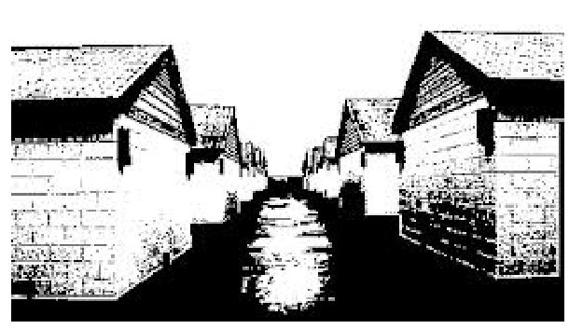
Bitmap
A sample bitmap image (1 bpp):
Notes:
Each pixel can only be black and white.

Slide 9
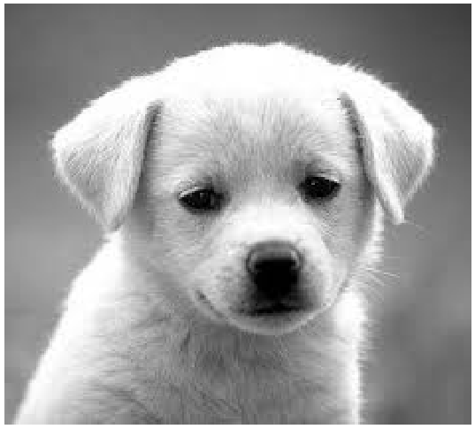
Grayscale
A sample grayscale image (8 bpp):
Notes:
Each pixel has a pixel value between 0 and 255 0 being dark 255 being white

Slide 10
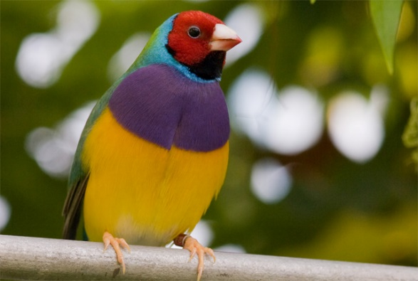
Color
A sample color image (24 bpp):
Notes:
Each pixel has a RGB value (100,155,255)

Slide 11
Color
In color images, each pixel has three components: red, green, blue
Their relative contribution determines the actual color
$$I$$
height
width

Slide 12
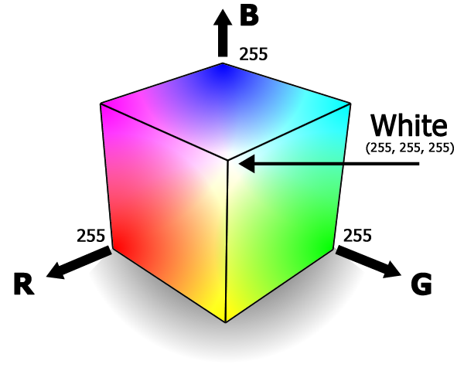
Color
Typically, each color value is an 8-bit integer in [0, 255] range
This corresponding space is called the RGB color cube
medialooks.com

Slide 13
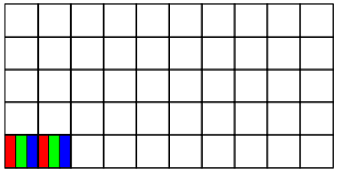
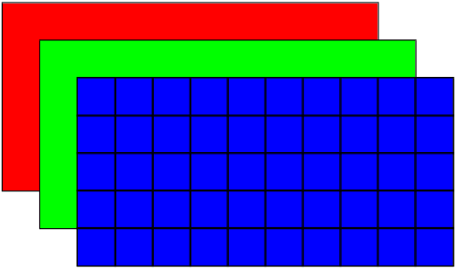
Storage
These colors can be stored as interleaved or as planar in an image file
Interleaved
Planar

Slide 14

Image Formats
Images generated by a CG program can be sent to a display device or written to an image file
Scene
Description
File
CG Program (Rendering)
Output
Image
File

Slide 15
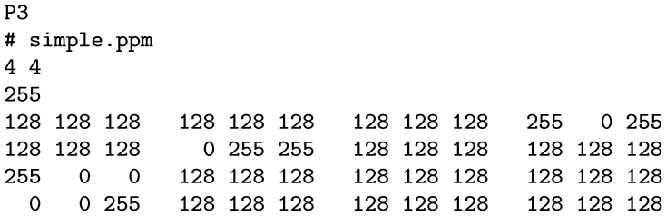
Image Formats
There are hundreds of image formats perhaps the best well-known being the JPEG format
A very simple image format is the PPM format:
Notes:
In this format, the part until 255 (included) is called the header section.
4 and 4 part means the width and height (16 pixels in total).
255 is the max value a pixel can have.
And the test is the RGB values for each pixel

Slide 16
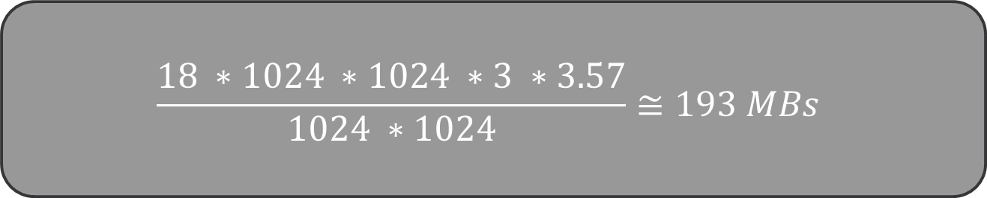
Image Formats
Despite being simple, the PPM format is very inefficient due to lack of compression
How many MBs would an 18 megapixel (MP) plain PPM image would occupy?
$$\frac{18 ∗1024 ∗1024 ∗3 ∗3.57}{1024 ∗1024}≅193 MBs$$
Notes:
Assuming each pixel value is equally likely and each pixel is followed by a single character of white space (blank, tab, or newline):
1 (for white space) + (10 * 1 + 90 * 2 + 156 * 3) / 256 = 3.57 -> This value is the average bytes a pixel would occupy. So we multiply this with 3 (since there are 3 colors) and 18 megapixel and then divide it with 1024*1024 since we want the result in megabyte.

Slide 17

Image Formats
3.57 in this formula comes from the expected number of bytes that each component will occupy:
The last +1 is for the whitespace between the components
$$\frac{10 ∗1+90 ∗2+156 ∗3}{256}+1≅3.57$$

Slide 18
Image Formats
If we used binary PPM (each component is 1 byte and there is no white space) this produce a file size of 54 MBs for an 18 MP image (still too much)
For this reason, compressed image formats are available
  Lossless compression
  Lossy compression

Slide 19
Lossless Compression
With lossless compression, a decoder will read the exact information that an encoder wrote to a file
Various lossless compression techniques are used such as Huffman encoding, run-length encoding, etc.
A well-known lossless image format is the PNG format
Efficient for computer generated images but not for natural (photographic) images due to presence of noise
Lossless file formats can be converted to each other without any degradations
  PNG → BMP → PNG (both PNGs will be the same)

Slide 20
Lossy Compression
In lossy compression, numerical match between the input and output is not required
Some information is lost to improve compression efficiency
However, lossy formats can still be visually lossless
The most well-known lossy format is the JPEG format
Reading a JPEG image and writing it back to the disk will most likely produce a slightly degraded result
  Therefore, in an image processing pipeline lossy formats should be used only at the end

Slide 21
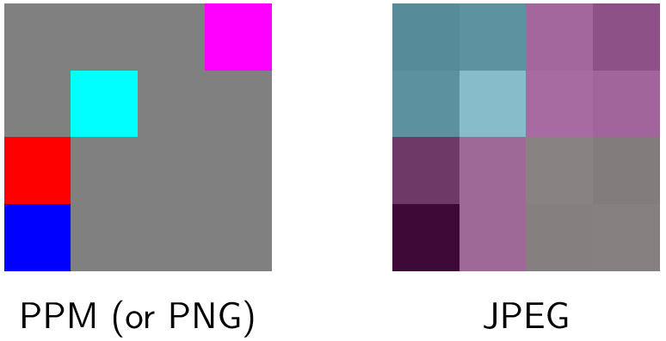
Lossy vs Lossless
Assume we encode and decode this data as PPM and JPEG:

Slide 22
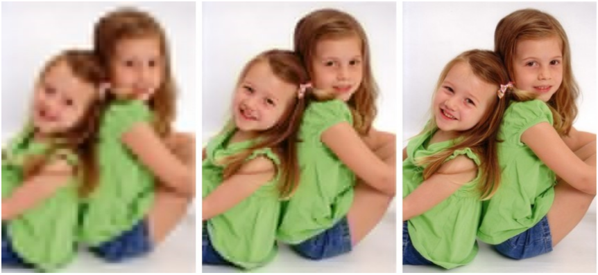
JPEG Quality
A JPEG image with different quality settings:

Slide 23
Video
If we need to save a large number of successive frames, storing them as a video is a better option
The size of the video file will be much smaller than the sum of the individual frames
Video compression
(h264, h265, etc.)
Individual frames
Video file
Notes:
Spacial similarity -> pixel groups is similar. Spatial similarity in computer graphics, vision, and data analysis refers to the principle that nearby points or objects in a defined space (2D image space or 3D world space) are likely to share similar properties or relationships.(1 frame)
Temporal similarity -> Temporal Coherence (Temporal Similarity) is the observation that in a sequence of rendered frames (an animation or video), there is very little change between one frame and the next, especially when the frame rate is high.(Multiple frames)

Slide 24
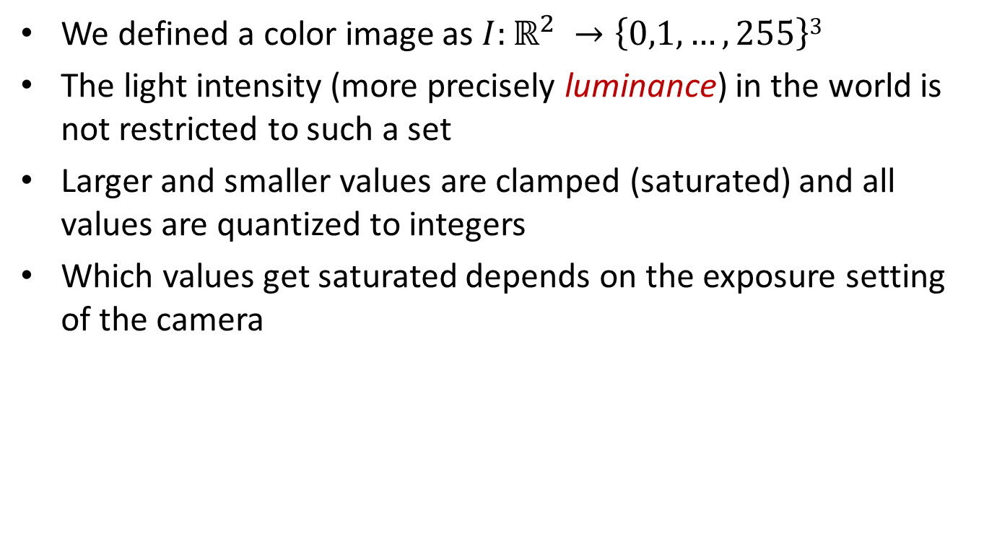
Image Capture
We defined a color image as $I:ℝ^{2} →\left\{0,1, …, 255\right\}3$
The light intensity (more precisely luminance) in the world is not restricted to such a set
Larger and smaller values are clamped (saturated) and all values are quantized to integers
Which values get saturated depends on the exposure setting of the camera

Slide 25
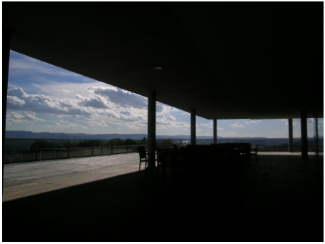
Image Capture
A low exposure image:
Notes:
A low exposure image is a photograph that has received less light than what a light meter considers to be a neutral or "correct" exposure, while a high exposure image is one that has received significantly more light.

Slide 26
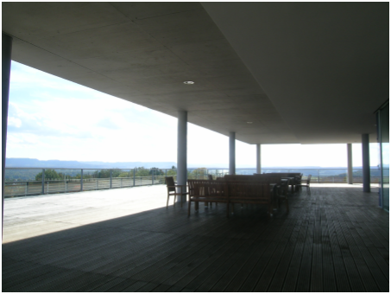
Image Capture
A high exposure image:

Slide 27



Dynamic Range
Dynamic range (DR) is defined as the ratio of the highest luminance to the lowest luminance in a given scene
A real scene may have a dynamic range of 10000:1 or more
A camera somehow has to fit this range to [0, 255]
$$DR= \frac{Lmax}{Lmin}$$
$$Lmax$$
$$Lmin$$

Slide 28
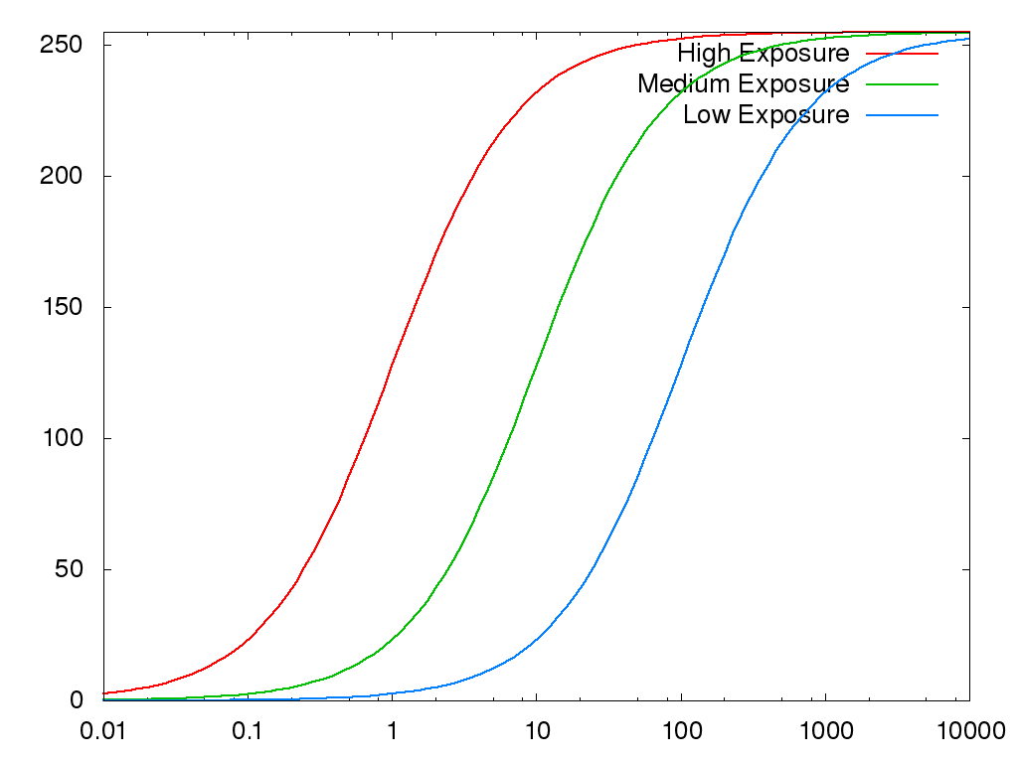
Exposure Control
Cameras control their exposure to decide on a proper range:
Pixel Value
Luminance
Notes:
The difference between a pixel value and luminance is that a pixel value is a digital representation of data stored in a file, while luminance is a physical measurement of light in the real world or emitted by a display. So what high exposure does is it gives a bright image for low luminance input.

Slide 29
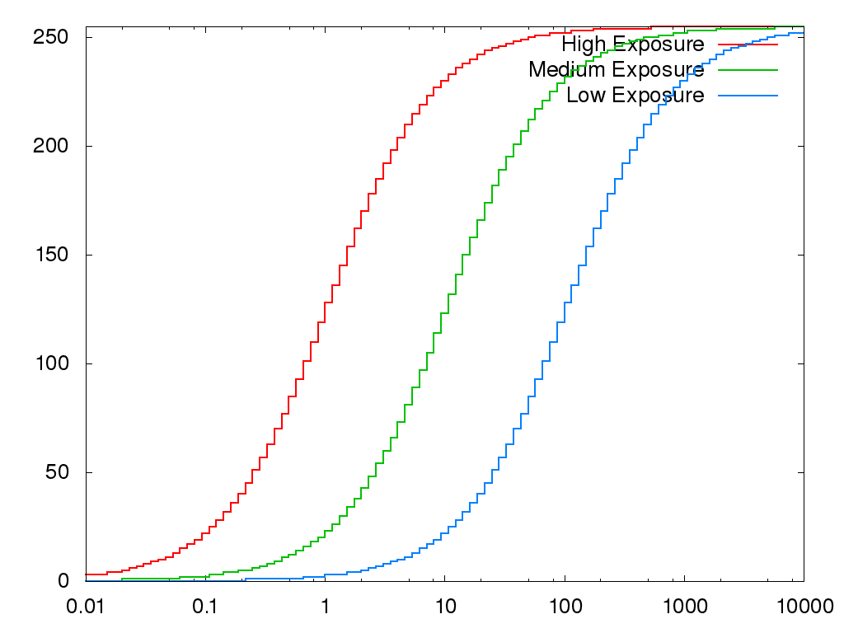
Quantization
With quantization, world luminance to pixel value mapping looks like this:
Pixel Value
Luminance
Notes:
In reality most cameras use this (not the previous one).

Slide 30
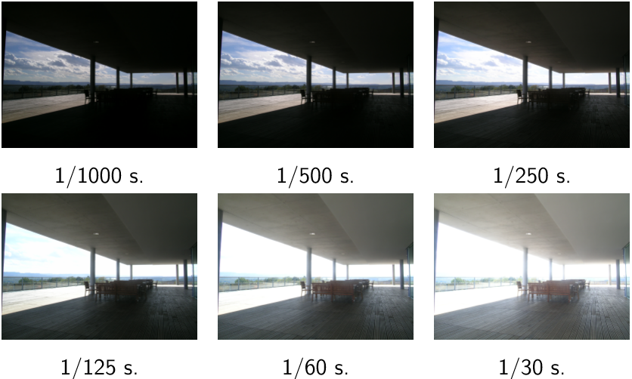
HDR
What if we want to capture (or render) the world as it is without mapping to [0, 255] range?
We can capture multiple exposures and merge them to create an HDR image
Notes:
Single capture is not enough to take all of the data, so we take multiple images and then combine them into a HDR image.
HDR image -> An High Dynamic Range (HDR) image is a digital image that contains a significantly greater range of luminosity (brightness and contrast) and color information than a standard image.
The purpose of HDR is to represent a visual scene in a way that is closer to what the human eye perceives, where details are visible simultaneously in both very bright areas (highlights) and very dark areas (shadows). This is done with taking multiple images with high exposure and low exposure and combining them.

Slide 31
HDR
HDR image capture process:
HDR Image
Merge
Notes:
Generally speaking, images with higher exposure values take longer to capture than images with lower exposure values, because the primary way to increase total exposure is to increase the shutter speed (exposure time).

Slide 32
HDR
Unfortunately, HDR images cannot be directly displayed on standard display devices
They must be tonemapped first (see Chapter 23 in our textbook):
HDR Image
Tonemap
LDR Image
Display
Notes:
HDR images cannot be displayed directly on a Standard Dynamic Range (SDR) monitor because the image data contains a wider range of brightness and color values than the display hardware is physically capable of showing.
Tone mapping is a critical image processing technique used to compress the extended brightness (dynamic range) of an HDR image into the smaller range that an SDR display or print medium can successfully show, while striving to preserve the visual details and perceived contrast of the original scene.

Slide 33
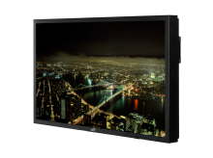
HDR
HDR images can also be saved in HDR file formats such as .hdr and .exr
Novel HDR displays allow direct display of HDR imagery:
LDR Image
Display
Tonemap
HDR Image
Standard display
Display
HDR display

Slide 34
HDR
HDR images can also be saved in HDR file formats such as .hdr and .exr
Novel HDR displays allow direct display of HDR imagery:
LDR Image
Display
See http://hdr.sim2.it/ for more info on HDR displays
Tonemap
HDR Image
Standard display
Display
HDR display

Slide 35
Rendering
Why this matters for CG?
In CG, we generate images just like a camera captures images
Our artificial scene may have luminance values not limited to [0, 255] range
As such, we have to mimic what the camera does
  Except for creating multiple exposures
  Our rendering result can directly be a floating point image with a high dynamic range
  It needs to be tone mapped prior to display on a regular monitor
Tone mapping example: https://szimek.github.io/webgl-hdr/

Slide 36
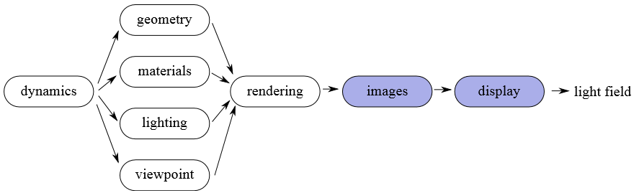
Display Devices
Generated images are sent to a display device via the video card
Therefore, understanding the basic properties of display devices is important

Slide 37
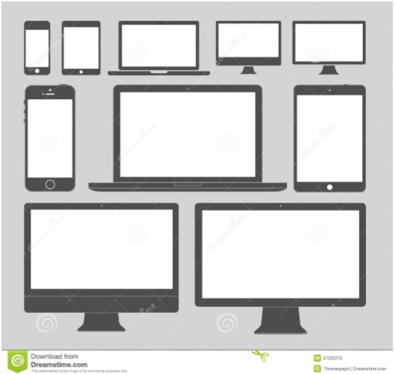
Display Devices
There are numerous types of display devices
But they all share some basic properties
CRT
Plasma
LCD
LED
OLED
E-ink
…

Slide 38
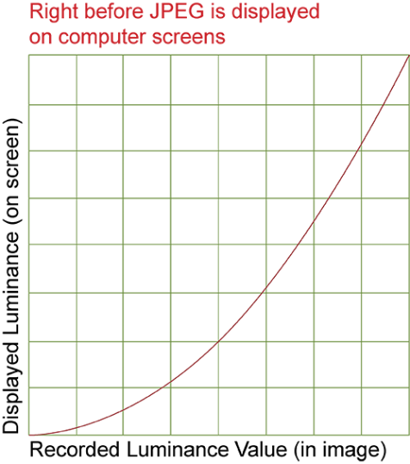
Display Devices
The digital RGB signals sent from the video card are translated into analog voltages in the display device
  A regular display device expects 8-bit per color channel input
These voltages determine the luminance emitted from each pixel
However, voltage to luminance relationship is nonlinear
Output luminance
Image pixel value
Notes:
Here is the flow;
Digital signal representing the RGB value of a pixel (8 bits per color) -> Analog Voltages in the display device -> Luminance coming out of display device based on the incoming voltage value (not linear)

Slide 39

Gamma
This nonlinearity is called the display gamma
  E.g. twice the pixel value (twice the voltage) does not result in twice the luminance
Also, zero RGB value does not mean zero luminance due to leaking light and reflections off the screen
A simplified display model is:
$$Lout=cVγ+b$$
Output
luminance
Contrast
Voltage
(proportional
to pixel value)
Gamma
Brightness
Notes:
c = 1 and b = 0 in simplest format. So that we get L_out = V^(gamma)

Slide 40
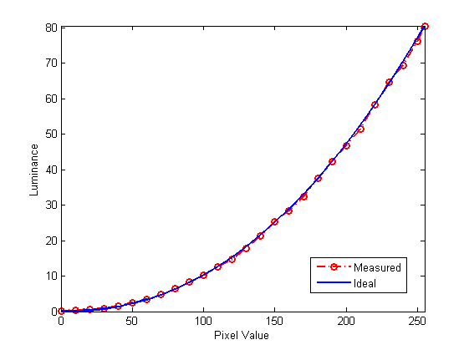
Gamma
Measured gamma of a NEC Spectraview 241 monitor calibrated to the sRGB profile:
Measurements are taken at intervals of 10
Ideal is a gamma value of 2.2

Slide 41
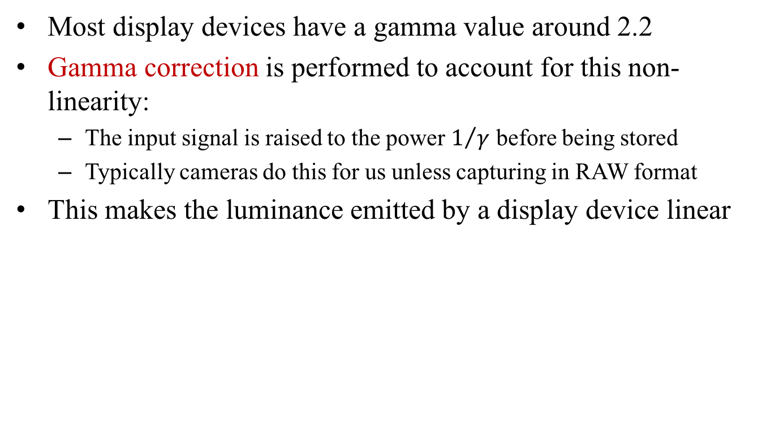
Gamma Correction
Most display devices have a gamma value around 2.2
Gamma correction is performed to account for this non-linearity:
  The input signal is raised to the power $1/γ$ before being stored
  Typically cameras do this for us unless capturing in RAW format
This makes the luminance emitted by a display device linear

Slide 42
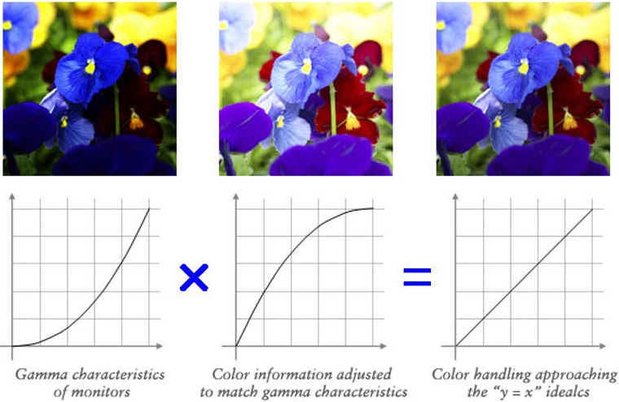
Gamma Correction

Slide 43
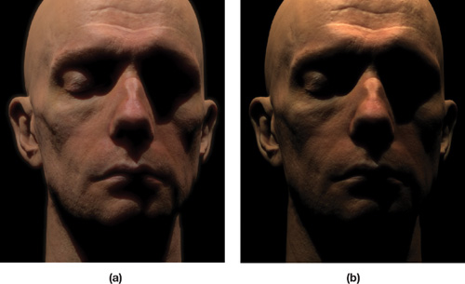
Gamma Correction
In CG, we must also apply gamma correction as the last step of the rendering process
Without gamma correction, we may obtain unnaturally dark images
nvidia.com
Notes:
This means that before saving the image, we must apply the gamma correction to the image so that we do not see unnaturally dark images.

Slide 44
Gamma Correction
In CG, we must also apply gamma correction as the last step of the rendering process
Without gamma correction, we may obtain unnaturally dark images
See
https://developer.nvidia.com/gpugems/GPUGems3/gpugems3_ch24.html
for more information
nvidia.com

