Slide 1
CENG 477
Introduction to Computer Graphics
Modeling Transformations

Slide 2

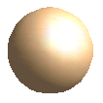

Modeling Transformations
Model coordinates to World coordinates:
World coordinates:
All shapes with their
absolute coordinates
and sizes.
y_{world}
Model coordinates:
All shapes with their
local coordinates
and sizes.
x_{world}
z_{world}

Slide 3
Basic Geometric Transformations
Used for modeling, animation as well as viewing
What to transform?
  We typically transform the vertices (points) and vectors describing the shape (such as the surface normal)
This works due to the linearity of transformations
Some, but not all, transformations may preserve attributes like sizes, angles, ratios of the shape

Slide 4
Translation
Simply move the object to a relative position
P'
T
P

Slide 5
Rotation
A rotation is defined by a rotation axis and a rotation angle
For 2D rotation, the parameters are rotation angle (θ) and the rotation point (x_{r}, y_{r})
We reposition the object in a circular path around the rotation point (pivot point)
y_{r}
a
x_{r}

Slide 6
Rotation
P'
When (x_{r}, y_{r})=(0,0) we have:
r
P
The original coordinates are:
Substituting them in the
first equation we get:
In the matrix form we have:

Slide 7
Rotation
Rotation around an arbitrary point (x_{r}, y_{r})
These equations can be written as matrix operations (we will see when we discuss homogeneous coordinates)
P'
r
P
(x_{r},y_{r})

Slide 8
Scaling
Changes the size of an object
Input: scaling factors (s_{x}, s_{y})
P'
P
non-uniform vs.
uniform scaling

Slide 9
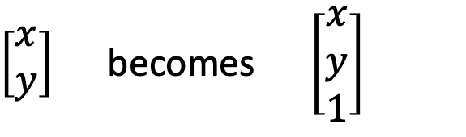
Homogenous Coordinates
Translation is additive, rotation and scaling is multiplicative (and additive if you rotate around an arbitrary point or scale around a fixed point)
Goal: Make all transformations as matrix operations
Solution: Add a third dimension
$\left[\begin{matrix}x \\ y\end{matrix}\right]$ becomes $\left[\begin{matrix}x \\ y \\ 1\end{matrix}\right]$

Slide 10
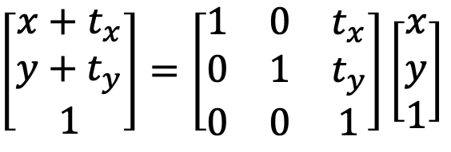
Homogenous Coordinates
Translation then becomes a 3x3 matrix:
$\left[\begin{matrix}x+t_{x} \\ y+t_{y} \\ 1\end{matrix}\right]=\left[\begin{matrix}1 & 0 & t_{x} \\ 0 & 1 & t_{y} \\ 0 & 0 & 1\end{matrix}\right]\left[\begin{matrix}x \\ y \\ 1\end{matrix}\right]$

Slide 11
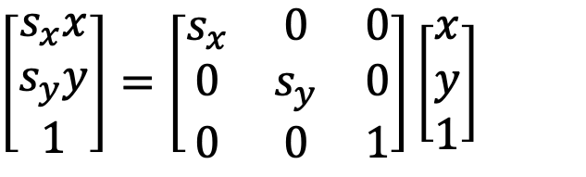
Homogenous Coordinates
Scaling will also be a 3x3 matrix:
$\left[\begin{matrix}s_{x}x \\ s_{y}y \\ 1\end{matrix}\right]=\left[\begin{matrix}s_{x} & 0 & 0 \\ 0 & s_{y} & 0 \\ 0 & 0 & 1\end{matrix}\right]\left[\begin{matrix}x \\ y \\ 1\end{matrix}\right]$

Slide 12
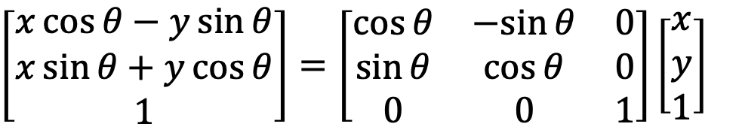
Homogenous Coordinates
And the same for rotation:
$\left[\begin{aligned}x\cos{θ}−y\sin{θ} \\ x\sin{θ}+y\cos{θ} \\ 1\end{aligned}\right]=\left[\begin{matrix}\cos{θ} & −sin{θ} & 0 \\ \sin{θ} & \cos{θ} & 0 \\ 0 & 0 & 1\end{matrix}\right]\left[\begin{matrix}x \\ y \\ 1\end{matrix}\right]$

Slide 13


Homogenous Coordinates
Scaling the homogeneous coordinates by the same factor does not change 2D point that they represent
In general:
$$\left[\begin{matrix}x \\ y \\ 1\end{matrix}\right]=\left[\begin{matrix}2x \\ 2y \\ 2\end{matrix}\right]$$
$$\left[\begin{matrix}x \\ y \\ h\end{matrix}\right]=\left[\begin{matrix}x/h \\ y/h \\ 1\end{matrix}\right]$$

Slide 14
Homogenous Coordinates
This is because the real 2D point is the projection of the line formed in the homogeneous space onto w = 1 plane
The entire line represents the same 2D point
The original (non-homogeneous) point resides on the w=1 plane
w
All points along this line
in HC represent the same
point, p₁
y
p₂
p₁
w = 1
x

Slide 15
Transformations in HC
Translation:
Rotation:
Scaling:

Slide 16




Transforming Vectors
Vectors can be rotated and scaled
But translating a vector does not change it! Why?
  A vector is a difference between two points
  These two points translate the same way
  So the vector remains the same
Mathematically this can be achieved by setting the last coordinate of a vector to 0 (the last coordinate of points should be 1)
$$\left[\begin{matrix}x \\ y \\ 1\end{matrix}\right]$$
$$\left[\begin{matrix}x \\ y \\ 0\end{matrix}\right]$$
2D point
$$\left[\begin{matrix}x \\ y\end{matrix}\right]$$
in HC is equal to
2D vector
$$\left[\begin{matrix}x \\ y\end{matrix}\right]$$
in HC is equal to

Slide 17
Composite Transformations
Often, objects are transformed multiple times
Such transformations can be combined into a single composite transformation
E.g. Application of a sequence of transformations to a point:

Slide 18
Composite Transformations
Composition of the same types of transformations is simple
E.g. translation:

Slide 19
Composite Transformations
Rotation and scaling are similar:

Slide 20
Rotation Around a Pivot Point
Let’s rotate the object around its center
Step 1: Translate the object so that the pivot point moves to the origin

Slide 21
Rotation Around a Pivot Point
Step 2: Rotate around origin

Slide 22
Rotation Around a Pivot Point
Step 3: Translate the object so that the pivot point is back to its original position

Slide 23
Rotation Around a Pivot Point
The composite transformation is equal to their successive application:

Slide 24
Scaling w.r.t. a Fixed Point
The idea is the same:
  Translate to origin
  Scale
  Translate back

Slide 25
Order of matrix compositions
Matrix composition is not commutative. So, be careful when applying a sequence of transformations.
Pivot
Pivot
1
2
2
1
Rotation and translation
Translation and rotation

Slide 26
Other Transformations
Reflection: special case of scaling

Slide 27
Other Transformations
Shear: Deform the shape like shifted slices (or deck of cards). Can be in x or y direction
(0,1)
(1,1)
(2,1)
(3,1)

Slide 28
3D Transformations
Similar to 2D but with an extra z component
We assume a right handed coordinate system
With homogeneous coordinates we have 4 dimensions
Basic transformations: Translation, rotation, scaling
z
y
x
y
x
z
x
z
y
Equivalent ways of thinking about a right-handed CS

Slide 29


Translation
Move the object by some offset:
y
x
z
y
x
z

Slide 30



Rotation
Rotation around the coordinate axes
Positive angles represent counter-clockwise (CCW) rotation when looking along the positive half towards origin
y
y
y
y
y
y
x
x
x
x
x
x
z
z
z
z
z
z
x-axis
y-axis
z-axis

Slide 31
Rotation Around Major Axes
Around x:
Around y:
Around z:

Slide 32



Rotation Around a Parallel Axis
Rotating an object around a line parallel to one of the axes: Translate to a major axis, rotate, translate back
E.g. rotate around a line parallel to x-axis:
y
y
y
y
x
(y_{p}, z_{p})
x
x
x
z
z
z
z
Translate
Rotate
Translate back

Slide 33

Rotation Around an Arbitrary Axis
Step 1: Translate the object so that the rotation axis passes though the origin
Step 2: Rotate the object so that the rotation axis is aligned with one of the major axes
Step 3: Make the specified rotation
Step 4: Reverse the axis rotation
Step 5: Translate back
y
x
z

Slide 34
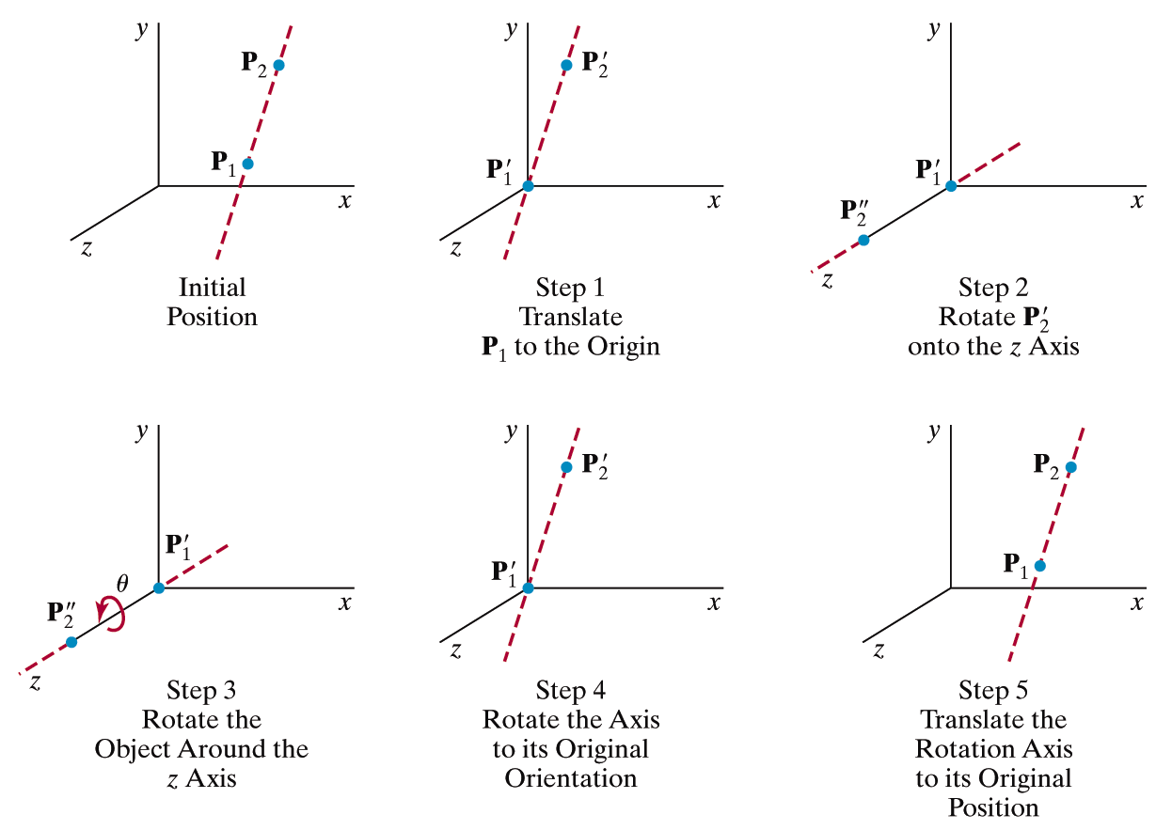
Rotation Around an Arbitrary Axis

Slide 35
Rotation Around an Arbitrary Axis
First determine the axis of rotation:
u is the unit vector along v:

Slide 36
Rotation Around an Arbitrary Axis
Next translate P₁ to origin:

Slide 37
Rotation Around an Arbitrary Axis
Then align u with one of the major axis (x, y, or z)
This is a two-step process:
  Rotate around x to bring u onto xz plane (CCW)
  Rotate around y to align the result with the z-axis (CW)
y
y
u
α
x
x
β
u
z
z
We need cosine and sine of angles α and ß

Slide 38
Rotation Around an Arbitrary Axis
We need cosine and sine of angles α and ß:
y
u_{y}
u = u_{x} + u_{y} + u_{z} = u_{x} + u’
u'
u
α
x
u_{x}
u_{z}
z

Slide 39
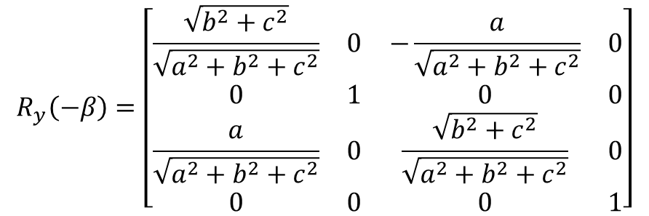

Rotation Around an Arbitrary Axis
We need cosine and sine of angles α and ß:
y
$$R_{y}\left(−β\right)=\left[\begin{matrix}\frac{\sqrt{b^{2}+c^{2}}}{\sqrt{a^{2}+b^{2}+c^{2}}} & 0 & −\frac{a}{\sqrt{a^{2}+b^{2}+c^{2}}} & 0 \\ 0 & 1 & 0 & 0 \\ \frac{a}{\sqrt{a^{2}+b^{2}+c^{2}}} & 0 & \frac{\sqrt{b^{2}+c^{2}}}{\sqrt{a^{2}+b^{2}+c^{2}}} & 0 \\ 0 & 0 & 0 & 1\end{matrix}\right]$$
u_{x}
x
β
z
u
Note that $\sqrt{a^{2}+b^{2}+c^{2}}=1$

Slide 40
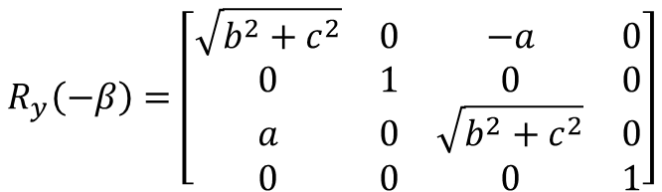
Rotation Around an Arbitrary Axis
We need cosine and sine of angles α and ß:
y
u_{x}
$$R_{y}\left(−β\right)=\left[\begin{matrix}\sqrt{b^{2}+c^{2}} & 0 & −a & 0 \\ 0 & 1 & 0 & 0 \\ a & 0 & \sqrt{b^{2}+c^{2}} & 0 \\ 0 & 0 & 0 & 1\end{matrix}\right]$$
x
β
z
u

Slide 41
Rotation Around an Arbitrary Axis
Putting it all together:
$$R(θ)=T(x_{1},y_{1},z_{1})⋅R_{x}(−α)⋅R_{y}(β)⋅R_{z}(θ)⋅R_{y}(−β)⋅R_{x}(α)⋅T(−x_{1},−y_{1},−z_{1})$$
This is the actual desired
rotation. Other terms are
for alignment and undoing
the alignment

Slide 42
Alternative Method
Assume we want to rotate around the unit vector u:
We create an orthonormal basis (ONB) uvw:
1) To find v, set the smallest
component of u (in an
absolute sense) to zero and
swap the other two while
negating one:
E.g. if u = (a, b, c) with c
being the smallest absolute
value then v = (-b, a, 0)
y
y
u
v
u
This corresponds to projecting
the vector to the nearest major plane
and rotating it 90° along the axis
perpendicular to that plane
x
x
w
z
z
2) w = u x v
3) Normalize v and w
Note that we are just finding one of the infinitely many solutions

Slide 43
Alternative Method
Now rotate uvw such that it aligns with xyz
  call this transform M
Rotate around x (u is now x)
Undo the initial rotation: call this M⁻¹
Finding M⁻¹ (rotating xyz to uvw) is trivial:
How to transform x = [1 0 0 0]^{T}
such that it turns into [u_{x} u_{y} u_{z} 0]^{T}
Similar for the y and z axis
Verify that this matrix transforms x to u, y to v, and z to w

Slide 44
Alternative Method
Finding M is also trivial as M⁻¹ is an orthonormal matrix (all rows and columns are orthogonal unit vectors)
For such matrices, inverse is equal to transpose:

Slide 45


Alternative Method
The final rotation transform is:
We assumed that the origin of uvw is the same as the origin of xyz
Otherwise, we should account for this difference:
$$M^{−1}R_{x}(θ)M$$
$$T^{−1}M^{−1}R_{x}(θ)MT$$
Undo the
translation
Translate the origin
of uvw to xyz

Slide 46

Scaling
Change the coordinates of the object by scaling factors
y
x
z
y
x
z

Slide 47


Scaling w.r.t. a Fixed Point
Translate to origin, scale, translate back
y
y
x
y
y
x
x
x
z
z
z
z
Translate
Scale
Translate back

Slide 48



Reflection
How about reflection over an arbitrary plane?
Reflection over the major planes:
y
y
y
x
x
x
z
z
z
Notes:
Step 1: Translate a point that is on the plane to the origin
Step 2: Rotate the plane normal such that it coincides with a major axis (e.g. z-axis)
Step 3: Reflect the object over the xy-plane
Step 4: Undo step 2
Step 5: Undo step 1

Slide 49


Transforming Normals
When we transform an object, what happens to its normals?
Do they get transformed by the same matrix or does it require a different one?
y
Scale by:
y
$$n=\left[\begin{aligned}1/√2 \\ 1/√2 \\ 0\end{aligned}\right]$$
$$n=\left[\begin{aligned}3/√2 \\ 1/√2 \\ 0\end{aligned}\right]$$
1
1
1
x
3
x

Slide 50
Transforming Normals
After the transformation the normal is no longer perpendicular to the object
Also it is not a unit vector anymore
y
Scale by:
y
$$n=\left[\begin{aligned}1/√2 \\ 1/√2 \\ 0\end{aligned}\right]$$
$$n=\left[\begin{aligned}3/√2 \\ 1/√2 \\ 0\end{aligned}\right]$$
1
1
1
x
3
x

Slide 51
Transforming Normals
Rotation and translation has no problems
But, since all transformations are combined into a single matrix M, we should consider the general case.
We must have n.(b-a) = n.v = 0 and this relationship should be preserved after the transformation
n
v
b
a

Slide 52
Transforming Normals
That is n.v = 0 and n'.v' = 0 where v' = Mv and n' = Zn
Z is the matrix we are looking for
How to compute Z?
n
v
b
a

Slide 53
Transforming Normals
n.v = n^{T}v = 0
n'.v' = n'^{T}v' = n'^{T} Mv = n^{T}Z^{T}Mv = 0
If Z^{T}M = I (identity) the relationship will be preserved
So Z = (M⁻¹)^{T}
Note that this is equal to (M^{T})⁻¹ as (M⁻¹)^{T}= (M^{T})⁻¹ for a square (n by n) matrix M
n
v
b
a

Slide 54
Another Derivation
Remember the plane equation:
If the plane is transformed by a matrix M:
Observe that Au.v = (Au)^{T}v = u^{T}A^{T}v = u.(A^{T}v)
(x – p).n = 0
n
(Mx – Mp).n’ = 0
M(x – p).n’ = 0
M(x – p).n’ = (x – p).n
x
p
M(x – p).n’ = (x – p).(M^{T}n’) = (x – p).n
M^{T}n’ = n
n’ = (M^{T})⁻¹n = (M⁻¹)^{T}n

Slide 55
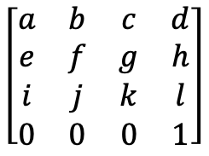
Transforming Normals
Note that normals (like any other vector) are not affected by translation
So it is sufficient to apply the inverse transpose to the upper 3x3 portion of the modeling matrix
The 3x1 normal vector can be multiplied with the inverse transpose of this part only (if you use the full 4x4 matrix and 4x1 normal with w = 0, you must ignore the value of the resulting w component)
$$\left[\begin{matrix}a & b & c & d \\ e & f & g & h \\ i & j & k & l \\ 0 & 0 & 0 & 1\end{matrix}\right]$$

Slide 56
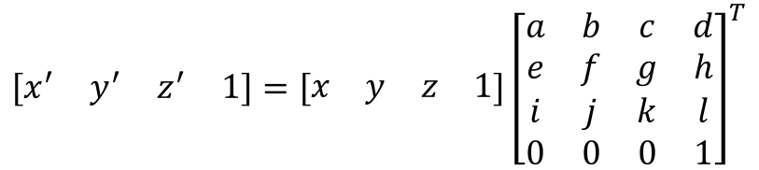

A Word on Notation
Until now, we performed transformations by multiplying our points from the right:
Another notation is to multiply from the left:
$$\left[\begin{matrix}x^{′} \\ y^{′} \\ z^{′} \\ 1\end{matrix}\right]=\left[\begin{matrix}a & b & c & d \\ e & f & g & h \\ i & j & k & l \\ 0 & 0 & 0 & 1\end{matrix}\right]\left[\begin{matrix}x \\ y \\ z \\ 1\end{matrix}\right]$$
$$\left[\begin{matrix}x^{′} & y^{′} & z^{′} & 1\end{matrix}\right]=\left[\begin{matrix}x & y & z & 1\end{matrix}\right]{\left[\begin{matrix}a & b & c & d \\ e & f & g & h \\ i & j & k & l \\ 0 & 0 & 0 & 1\end{matrix}\right]}^{T}$$
Note that in this case
everything is transposed

Slide 57
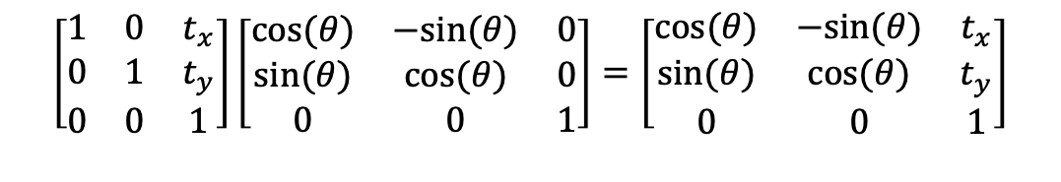

A Word on Terminology
Imagine a 2D rotation matrix such as:
Transforming an object by this matrix will not change its shape
If we also apply translation:
The shape will remain intact
$$\left[\begin{matrix}cos⁡(θ) & −sin⁡(θ) & 0 \\ sin⁡(θ) & cos⁡(θ) & 0 \\ 0 & 0 & 1\end{matrix}\right]$$
$$\left[\begin{matrix}1 & 0 & t_{x} \\ 0 & 1 & t_{y} \\ 0 & 0 & 1\end{matrix}\right]\left[\begin{matrix}cos⁡(θ) & −sin⁡(θ) & 0 \\ sin⁡(θ) & cos⁡(θ) & 0 \\ 0 & 0 & 1\end{matrix}\right]=\left[\begin{matrix}cos⁡(θ) & −sin⁡(θ) & t_{x} \\ sin⁡(θ) & cos⁡(θ) & t_{y} \\ 0 & 0 & 1\end{matrix}\right]$$

Slide 58
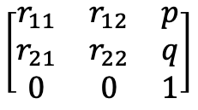
A Word on Terminology
In general, an arbitrary sequence of rotation and translation matrices will have the following form:
Such transformations are called rigid-body transformations
A shape may be rotated and translated but its form is not altered in any way
$$\left[\begin{matrix}r_{11} & r_{12} & p \\ r_{21} & r_{22} & q \\ 0 & 0 & 1\end{matrix}\right]$$
where p, q may contain the effect of
rotation as well

Slide 59
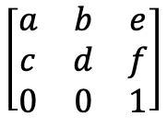
A Word on Terminology
Imagine also adding scaling to the mix
The matrix will now look like:
Such transformations will not necessarily preserve lengths and angles, but parallel lines will remain parallel
$$\left[\begin{matrix}a & b & e \\ c & d & f \\ 0 & 0 & 1\end{matrix}\right]$$
where a, b, c, d contain the effect of
rotation and scaling combined, and e, f
contain the effects of all three
Original
Rotation
Rotation and scaling

Slide 60
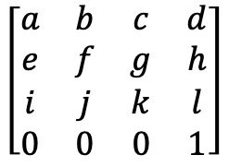
A Word on Terminology
Such transformations are called affine transformations
An arbitrary sequence of rotation, translation, scaling, and shearing will produce an affine transformation
Note that we still have some degrees of freedom left in the last row of our matrix. In 3D this will look like:
By using this we can create projective transformations in which parallel lines may no longer be parallel
$$\left[\begin{matrix}a & b & c & d \\ e & f & g & h \\ i & j & k & l \\ 0 & 0 & 0 & 1\end{matrix}\right]$$

