Slide 1
CENG 477
Introduction to Computer Graphics
Viewing Transformations

Slide 2
Introduction
Until now, we learned how to position the objects in the 3D world space by modeling transformations
With viewing transformations, we position the objects on a 2D image as seen by a camera with arbitrary position and orientation
Composed of three parts:
  Camera (or eye) transformation
  Projection transformation
  Viewport transformation

Slide 3
Introduction
With viewing transformations, we are now transitioning from the backward rendering pipeline (aka. ray tracing) to forward rendering pipeline (aka. object-order, rasterization, z-buffer)
Camera
Camera
Backward rendering
Forward rendering

Slide 4
Camera Transformation
Goal: Given an arbitrary camera position e and camera vectors uvw, determine the camera coordinates of points given by their world coordinates
u
What are the coordinates of this
cube with respect to the uvw CS?
v
y
e
w
(0,0,0)
x
z

Slide 5
Camera Transformation
Transform everything such that uvw aligns with xyz
Then simply read off the xyz values
  These are your uvw values!
y
v
u
u
y
v
e
(0,0,0)
e
x
w
(0,0,0)
w
x
z
z

Slide 6

Camera Transformation
Step 1: Translate e to the world origin (0, 0, 0)
y
v
u
e
x
z
w
$$T= \left[\begin{matrix}1 & 0 & 0 & −e_{x} \\ 0 & 1 & 0 & −e_{y} \\ 0 & 0 & 1 & −e_{z} \\ 0 & 0 & 0 & 1\end{matrix}\right]$$

Slide 7

Camera Transformation
Step 2: Rotate uvw to align it with xyz:
$$R= \left[\begin{matrix}u_{x} & u_{y} & u_{z} & 0 \\ v_{x} & v_{y} & v_{z} & 0 \\ w_{x} & w_{y} & w_{z} & 0 \\ 0 & 0 & 0 & 1\end{matrix}\right]$$
y
We already learned
how to do this in
modeling transformations!
v
u
e
x
w
z

Slide 8
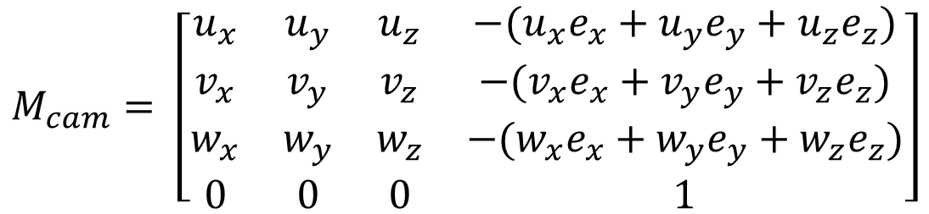
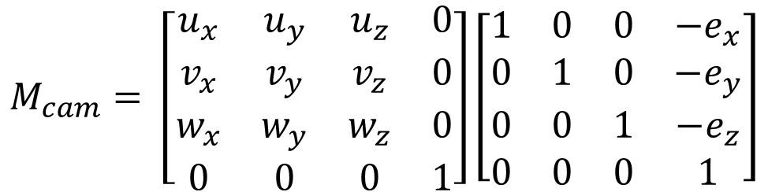
Camera Transformation
The composite camera transformation is:
$$M_{cam}= \left[\begin{matrix}u_{x} & u_{y} & u_{z} & 0 \\ v_{x} & v_{y} & v_{z} & 0 \\ w_{x} & w_{y} & w_{z} & 0 \\ 0 & 0 & 0 & 1\end{matrix}\right]\left[\begin{matrix}1 & 0 & 0 & −e_{x} \\ 0 & 1 & 0 & −e_{y} \\ 0 & 0 & 1 & −e_{z} \\ 0 & 0 & 0 & 1\end{matrix}\right]$$
$$M_{cam}= \left[\begin{matrix}u_{x} & u_{y} & u_{z} & −(u_{x}e_{x}+u_{y}e_{y}+u_{z}e_{z}) \\ v_{x} & v_{y} & v_{z} & −(v_{x}e_{x}+v_{y}e_{y}+v_{z}e_{z}) \\ w_{x} & w_{y} & w_{z} & −(w_{x}e_{x}+w_{y}e_{y}+w_{z}e_{z}) \\ 0 & 0 & 0 & 1\end{matrix}\right]$$

Slide 9
Camera Transformation
When points are multiplied with this matrix, their resulting coordinates will be with respect to the uvw-e coordinate system (i.e. the camera coordinate system)
Next, we need to apply a projection transformation
This is the part that replaces tracing rays from the camera:
  We are now projecting the objects on the image plane
  Tracing rays from the camera into the scene: backward rendering
    Also known as pixel-order rendering
  Projecting the scene on the image plane: forward rendering
    Also known as object-order rendering
Forward rendering is much faster as we generally have fewer objects than pixels

Slide 10
Projection Transformation
Projection transformations depend on the shape of the viewing volume
Two most commonly used transformations are:
  Orthographic (parallel) projection
  Perspective projection
Projection plane
Center of projection
Projection plane
Center of projection
Orthographic
Perspective

Slide 11
Orthographic Projection
Defined by a rectangular viewing volume
Objects inside this volume will be visible (unless they are occluded by other objects)
The near plane of this volume represents our image plane
y
v
z
w
(r, t, -f)
(0, 0, 0)
(l, b, -n)
u
x

Slide 12
Orthographic Projection
In orthographic (and perspective) projection, our first goal is to transform a given viewing volume to the canonical viewing volume (CVV):
CVV is also known as the normalized device coordinates (NDC)
y
y
v
(1, 1, 1)
z
w
(r, t, -f)
z
(0, 0, 0)
(0, 0, 0)
(l, b, -n)
(-1, -1, -1)
u
x
x
Note that n and f are typically given as distances which are
always positive and because we are looking towards the –z direction,
the actual coordinates become –n and -f
Think of it as compressing a box

Slide 13
Orthographic Projection
In orthographic (and perspective) projection, our first goal is to transform a given viewing volume to the canonical viewing volume (CVV):
y
y
v
(1, 1, 1)
z
w
(r, t, -f)
z
(0, 0, 0)
(0, 0, 0)
(l, b, -n)
(-1, -1, -1)
u
x
x
Also note the change in the z-direction. This makes objects
further away from the camera to have larger z-values. In
other words, CVV is a left-handed coordinate system.

Slide 14

Orthographic Projection
We need to map the box with corners at (l, b, -n) and (r, t, -f) to the (-1, -1, -1) and (1, 1, 1) of the CVV
This is accomplished by the following matrix:
$$M_{orth}= \left[\begin{matrix}\frac{2}{r −l} & 0 & 0 & −\frac{r+l}{r −l} \\ 0 & \frac{2}{t −b} & 0 & −\frac{t+b}{t −b} \\ 0 & 0 & −\frac{2}{f−n} & −\frac{f+n}{f −n} \\ 0 & 0 & 0 & 1\end{matrix}\right]$$
Make sure you understand how to derive this!

Slide 15
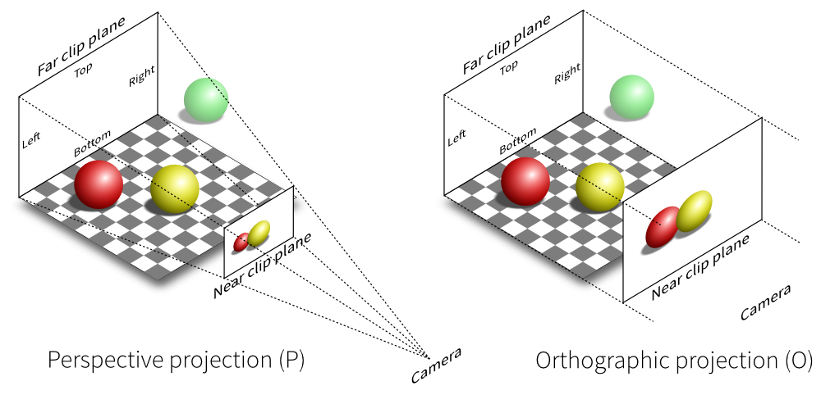
Perspective Projection
Perspective projection models how we see the real world
  Objects appear smaller with distance
script-tutorials.com

Slide 16
Perspective Projection
We still have the same 6 parameters
t
l
Camera
b
r
Near
distance (n)
Far
distance (f)

Slide 17
Perspective Projection
To map to the canonical viewing volume (CVV), we take a two step approach:
  Step 1: Map perspective to orthographic viewing volume
  Step 2: Map orthographic to CVV
y
(1, 1, 1)
(r, t, -f)
(0, 0, 0)
z
(l, b, -n)
(l, b, -n)
(-1, -1, -1)
(r, t, -n)
x
Think of this as compressing a box where
you have to apply more pressure towards the back
We already know how to
perform the second step!

Slide 18




Perspective Projection
The key observation is that more distant objects should shrink proportional to their distance to the camera
Here is a side view (therefore x is constant):
y
$$\frac{y^{′}}{y}=\frac{−n}{z}$$
$$y^{′}=\frac{−n}{z}y$$
z
x
The same geometrical config.
applies to the x dimension as well:
(x, t, -n)
(x, y, z)
(x, y’, -n)
$$\frac{x^{′}}{x}=\frac{−n}{z}$$
$$x^{′}=\frac{−n}{z}x$$
(x, 0, 0)
(x, 0, -n)
(x, 0, -f)
What is y’?
Let’s ignore the z dimension
for the moment

Slide 19

Perspective Projection
How to represent this as a matrix multiplication?
The problem is our matrix now contains the coordinates of the transformed points
This requires a different matrix for each point being transformed
  Very inefficient and requires too much bookkeeping
$$M_{}= \left[\begin{matrix}−n/z & 0 & 0 & 0 \\ 0 & −n/z & 0 & 0 \\ 0 & 0 & … & … \\ 0 & 0 & 0 & 1\end{matrix}\right]$$

Slide 20


Perspective Projection
Homogeneous coordinates (HC) comes to the rescue here
Remember that in HC:
So if the transformation manages to put –z into the last component, we can achieve the desired result (of course after doing the homogeneous divide, also known as perspective divide)
$$\left[\begin{matrix}x \\ y \\ z \\ 1\end{matrix}\right]=\left[\begin{matrix}kx \\ ky \\ kz \\ k\end{matrix}\right]$$
$$\left[\begin{matrix}−nx/z \\ −ny/z \\ … \\ 1\end{matrix}\right]=\left[\begin{matrix}nx \\ ny \\ … \\ −z\end{matrix}\right]$$

Slide 21

Perspective Projection
This can also be represented as a matrix multiplication thanks to homogeneous coordinates:
Why does this work?
$$M_{p2o}= \left[\begin{matrix}n & 0 & 0 & 0 \\ 0 & n & 0 & 0 \\ 0 & 0 & A & B \\ 0 & 0 & −1 & 0\end{matrix}\right]$$

Slide 22


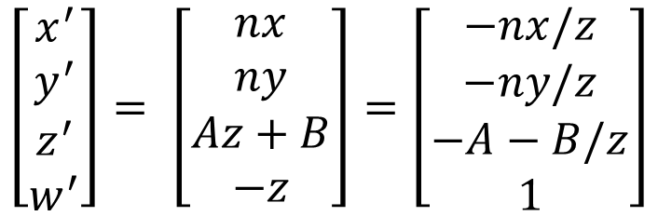
Perspective Projection
Let’s multiply a point [x, y, z, 1]^{T} with this matrix:
$$\left[\begin{matrix}x^{′} \\ y^{′} \\ z^{′} \\ w^{′}\end{matrix}\right]= \left[\begin{matrix}n & 0 & 0 & 0 \\ 0 & n & 0 & 0 \\ 0 & 0 & A & B \\ 0 & 0 & −1 & 0\end{matrix}\right]\left[\begin{matrix}x \\ y \\ z \\ 1\end{matrix}\right]$$
$$\left[\begin{matrix}x^{′} \\ y^{′} \\ z^{′} \\ w^{′}\end{matrix}\right]= \left[\begin{matrix}nx \\ ny \\ Az+B \\ −z\end{matrix}\right]$$
Remember that in homogenous coordinates, scaling all components by
the same factor does not change the point. So divide by the last comp.
$$\left[\begin{matrix}x^{′} \\ y^{′} \\ z^{′} \\ w^{′}\end{matrix}\right]= \left[\begin{matrix}nx \\ ny \\ Az+B \\ −z\end{matrix}\right]=\left[\begin{matrix}−nx/z \\ −ny/z \\ −A−B/z \\ 1\end{matrix}\right]$$

Slide 23
Perspective Projection
For the z-axis, we have the following constrains:
  (–n) maps to (–n)
  (–f) maps to (–f)
We can solve for A and B using these constrains
(r, t, -f)
(l, b, -n)
(l, b, -n)
(r, t, -n)

Slide 24





Perspective Projection
Remember that we had:
Now plug (-n) and (-f) and solve for the unknowns:
$$z^{′}=−A−B/z$$
$$−n=−A+B/n$$
$$A=f+n$$
$$−f=−A+B/f$$
$$B=fn$$
Note that there is a catch here: A and B are computed such that after dividing by z (perspective divide), the z range remains in [-n, -f]. So before the divide the range goes to [-n², -f²]. Application of the orthographic matrix brings the range to [-n, f]. Finally the perspective divide brings the range to [-1, 1].

Slide 25

Perspective Projection
The final perspective to orthographic matrix becomes:
Note that this was Step 1
In Step 2, we multiply this matrix with the orthographic to canonical viewing volume transformation matrix
$$M_{p2o}= \left[\begin{matrix}n & 0 & 0 & 0 \\ 0 & n & 0 & 0 \\ 0 & 0 & f+n & fn \\ 0 & 0 & −1 & 0\end{matrix}\right]$$

Slide 26


Perspective Projection
The final perspective transformation matrix is:
$$M_{per}=M_{orth}M_{p2o}$$
$$M_{per}= \left[\begin{matrix}\frac{2n}{r −l} & 0 & \frac{r+l}{r −l} & 0 \\ 0 & \frac{2n}{t −b} & \frac{t+b}{t −b} & 0 \\ 0 & 0 & −\frac{f+n}{f−n} & −\frac{2fn}{f −n} \\ 0 & 0 & −1 & 0\end{matrix}\right]$$

Slide 27


Perspective Divide
Note that after the perspective projection, w coordinates of transformed points may not be 1 (typically –z)
For the perspective projection to take effect, each point is divided by its w coordinate before the next stage
This is called the perspective divide
In the forward pipeline, this step is done after clipping
  We can ignore this for now and assume that perspective divide immediately follows the matrix multiplication
$\left[\begin{matrix}x \\ y \\ z \\ w\end{matrix}\right]$
Perspective divide
$\left[\begin{matrix}x/w \\ y/w \\ z/w \\ 1\end{matrix}\right]$

Slide 28
Viewport Transformation
After perspective transformation (and perspective divide), all objects inside the viewing volume are transformed into CVV
Viewport transformation maps them to the screen (window) coordinates
(n_{x}-1, n_{y}-1)
Viewport
y
(1, 1, 1)
(0, 0, 0)
z
n_{y}
(-1, -1, -1)
x
(0, 0)
n_{x}

Slide 29

Viewport Transformation
x values in range [-1,1] are transformed to [-0.5, n_{x}-0.5]
y values in range [-1,1] are transformed to [-0.5, n_{y}-0.5]
z values in range [-1,1] are transformed to [0,1] for later use in depth testing
$$M_{vp}= \left[\begin{matrix}\frac{n_{x}}{2} & 0 & 0 & \frac{n_{x}−1}{2} \\ 0 & \frac{n_{y}}{2} & 0 & \frac{n_{y}−1}{2} \\ 0 & 0 & \frac{1}{2} & \frac{1}{2}\end{matrix}\right]$$
Note that we don’t need to preserve the w component anymore

Slide 30



Viewport Transformation
The viewport can be positioned relative the origin of the window (or the entire screen) on which are we rendering:
Viewport
$${(x}_{min},y_{min})$$
$$y_{min}$$
$$x_{min}$$
Window

Slide 31
Viewport Transformation
This makes it possible to render different 3D elements on different parts of the window
Viewport for the 3D scene
Viewport for a GUI
Window

Slide 32
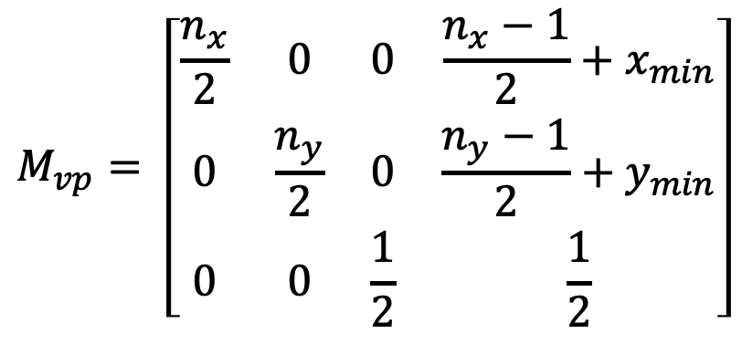
Viewport Transformation
Thus, the final viewport transform can be defined as:
$$M_{vp}= \left[\begin{matrix}\frac{n_{x}}{2} & 0 & 0 & \frac{n_{x}−1}{2}+x_{min} \\ 0 & \frac{n_{y}}{2} & 0 & \frac{n_{y}−1}{2}+y_{min} \\ 0 & 0 & \frac{1}{2} & \frac{1}{2}\end{matrix}\right]$$

Slide 33



Demystifying the Z Transform
Let’s clarify what happens to z at each step along the way:
Original z value in range [-n, -f]
$$M_{p2o}$$
z mapped to [-n², -f²]
$$M_{per}$$
$$M_{orth}$$
z mapped to [-n, f]
z mapped to [0, 1]
Perspective divide
z mapped to [-1, 1]
Viewport transform

Slide 34
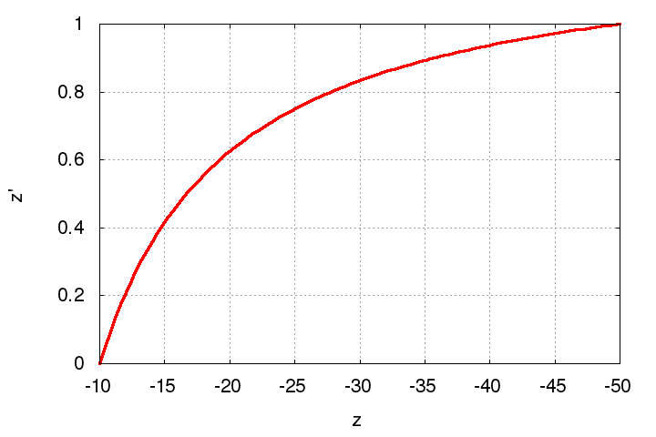
Z-Fighting
Note that the z-values get compressed to [0, 1] range from the [-n:-f] range
Observe how it looks for n = 10 and f = 50

Slide 35
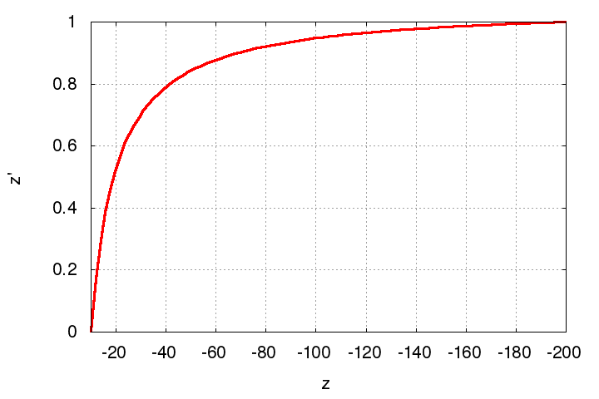
Z-Fighting
Note that the z-values get compressed to [0, 1] range from the [-n:-f] range
Observe the same for n = 10 and f = 200
Problematic especially if
the output z values are quantized
(i.e. fixed point values in [0, 1] range)

Slide 36
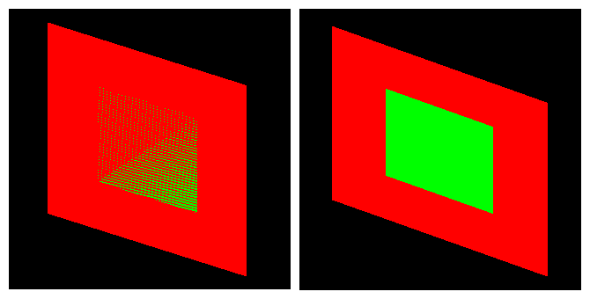
Z-Fighting
The compression is more severe for with larger depth range
This may cause a problem known as z-fighting:
  Objects with originally different z-values get mapped to the same final z-value (due to limited precision) making it impossible to distinguish which one is in front and which one is behind

Slide 37
Z-Fighting
The compression is more severe for with larger depth range
This may cause a problem known as z-fighting:
  The problem is even worse if the input z-values are very close to begin with

Slide 38
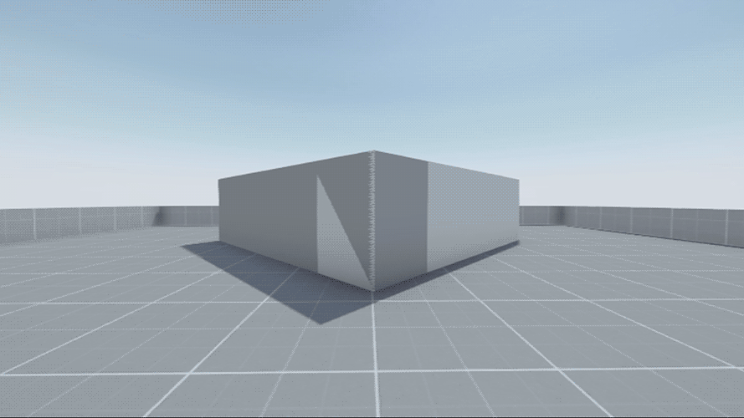
Z-Fighting
http://wiki.reflexfiles.com/

Slide 39
Z-Fighting
To avoid z-fighting, the depth range should be kept as small as possible for keeping the compression less severe
Also use floating point depth buffer if possible

Slide 40

Summary
A point [x_{w}, y_{w}, z_{w}]^{T} in the world coordinate system can be transformed to its viewport coordinates by:
$$\left[\begin{matrix}x_{vp} \\ y_{vp} \\ z_{vp}\end{matrix}\right]=M_{vp}M_{per}M_{cam}\left[\begin{matrix}x_{w} \\ y_{w} \\ z_{w} \\ 1\end{matrix}\right]$$
perspective divide

Slide 41
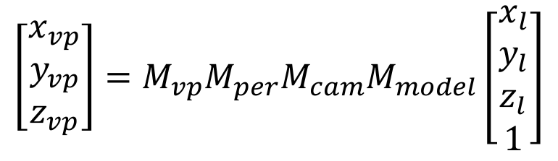
Summary
If the point is defined in its local coordinate system and we are given modeling transformations we use:
$$\left[\begin{matrix}x_{vp} \\ y_{vp} \\ z_{vp}\end{matrix}\right]=M_{vp}M_{per}M_{cam}M_{model}\left[\begin{matrix}x_{l} \\ y_{l} \\ z_{l} \\ 1\end{matrix}\right]$$
perspective divide

Slide 42
Summary
Remember that we transform only the vertices
We must reconstruct the triangles (or other primitives) from their projected coordinates
We must decide:
  If a primitive is fully or partially outside the viewing volume (culling and clipping)
  Which pixels belong to a primitive (rasterization)
  Which fragment of which primitive is closest to the viewer (depth testing)
  How to compute the color for each pixel, etc. (fragment shading)
Questions of this type are what we will focus on in the following weeks

