Slide 1
CENG – 477
Introduction to Computer Graphics
Rasterization

Slide 2
Rasterization
Rasterization is concerned with creating fragments from vertices
It works in screen coordinates – thus it is the next step after the viewport transform
Goal: Given a set of vertices which fragments must be “turned on” to create the primitive:

Slide 3
Rasterization
Subproblems:
  How to deal with different primitives
  How to make it fast
  How to interpolate color and other attributes
We’ll start with line rasterization

Slide 4
Line Rasterization
Several methods exist
Option: Treat the line as a thin rectangle and turn on pixels that are inside this rectangle
Too thin rectangle
Too thick rectangle
May cause gaps in the line
Line thickness varies

Slide 5
Line Rasterization
Adjusting the line thickness could be problematic; different slopes may require different thicknesses
Converting the line to a rectangle may be inefficient as well
t=1
t=1
this segment is > 1
thus may contain more
than 1 pixel

Slide 6

Line Rasterization
Therefore we need another solution
We can use line equations to decide which pixels belong the line
Assume that we want to draw a line between two screen coordinates: (x₀, y₀) to (x₁, y₁)
Assume that the slope of the line, m, is in range (0, 1]
$$m= \frac{y_{1}−y_{0}}{x_{1}−x_{0}}$$
(x₁, y₁)
Which pixels should we draw?
(x₀, y₀)

Slide 7

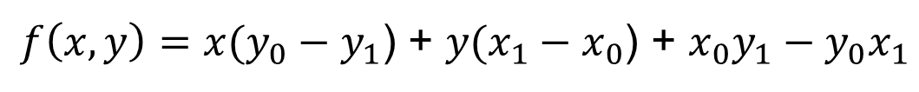


Line Equation
Let’s first remember the implicit line equation:
We can derive it from geometry:
$f\left(x, y\right)=x(y_{0}−y_{1}$) + $y(x_{1}−x_{0}$) + $x_{0}y_{1}−y_{0}x_{1}$
n
p₁
$$n. {[x_{1}−x_{0}\text{, }y_{1}−y_{0}]}^{T}=0$$
p
(x₁, y₁)
$n=[y_{0}−y_{1}$, $x_{1}−x_{0}]$
p₀
(x₀, y₀)
$$f\left(p\right)=\left(p −p_{0}\right).n=0$$
What is the meaning of f(p) = 0, f(p) > 0 and f(p) < 0

Slide 8
The Basic Algorithm
The basic algorithm is as follows:
Because the slope is in (0, 1], we always go right and sometimes go up (assuming that x₀ < x₁ and y₀ < y₁)
y = y₀
for x = x₀ to x₁ do:
draw(x, y)
if (some condition) then:
y = y + 1

Slide 9
The Midpoint Algorithm
Assume we have just drawn (x, y). Which pixel to draw next?
Compute the midpoint of the next pixel
If the midpoint is on or above the line choose the right pixel (E: east)
If the midpoint is below the line, choose the top right pixel (NE: north-east)
y = y₀
for x = x₀ to x₁ do:
draw(x, y)
if f(x+1, y+0.5) < 0 then:
y = y + 1
NE
(x, y)
E
We call these pixels E and NE

Slide 10
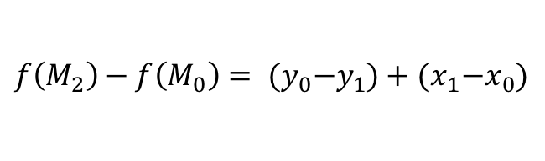
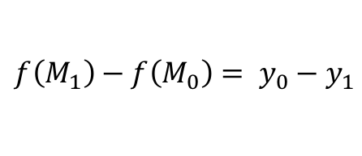
The Midpoint Algorithm
This algorithm works well but requires evaluating the line equation at every iteration
Can be optimized with an incremental algorithm:
If we selected E, in the next iteration we need the value of f(M₁)
If we selected NE, in the next iteration we need f(M₂)
Both can be computed from f(M₀)
M₂
$$f\left(M_{1}\right)−f\left(M_{0}\right)= y_{0}−y_{1}$$
M₀
NE
$$f\left(M_{2}\right)−f\left(M_{0}\right)= {(y}_{0}−y_{1})+{(x}_{1}−x_{0})$$
M₁
(x, y)
E

Slide 11
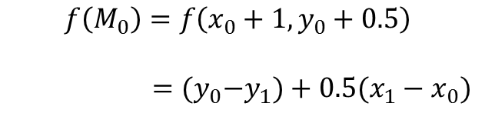
The Midpoint Algorithm
This algorithm works well but requires evaluating the line equation at every iteration
Can be optimized with an incremental algorithm:
In other words, if we know f(M), we can compute the next f(M) by simple integer arithmetic
What is the first f(M)?
Note that f(x₀, y₀) = 0 as it is the starting point of the line
M₂
M₀
NE
$$f\left(M_{0}\right)=f\left(x_{0}+1,y_{0}+0.5\right)$$
$={(y}_{0}−y_{1})+{0.5(x}_{1}−x_{0})$
M₁
(x₀, y₀)
E

Slide 12
The Midpoint Algorithm
So the overall algorithm is:
y = y₀
d = (y₀ – y₁) + 0.5(x₁ – x₀)
for x = x₀ to x₁ do:
draw(x, y)
if d < 0 then: // choose NE
y = y + 1
d += (y₀ – y₁) + (x₁ – x₀)
else: // choose E
d += (y₀ – y₁)

Slide 13
The Midpoint Algorithm
For max efficiency, f(x, y) = 0 is written as 2f(x, y) = 0. This entirely eliminates floating point operations:
y = y₀
d = 2(y₀ – y₁) + (x₁ – x₀)
for x = x₀ to x₁ do:
draw(x, y)
if d < 0 then: // choose NE
y = y + 1
d += 2[(y₀ – y₁) + (x₁ – x₀)]
else: // choose E
d += 2(y₀ – y₁)

Slide 14
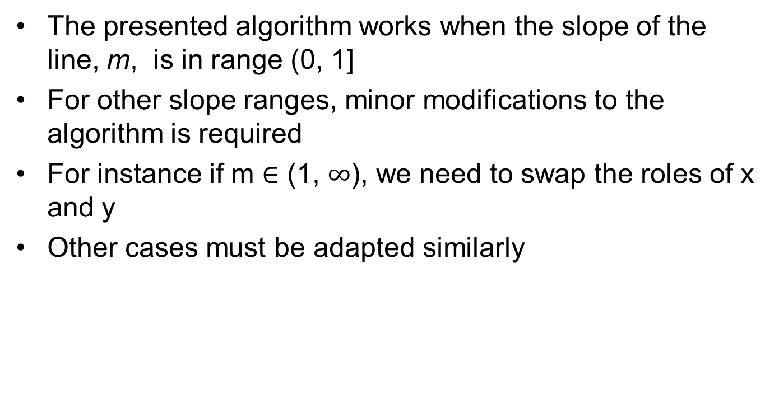
The Midpoint Algorithm
The presented algorithm works when the slope of the line, m, is in range (0, 1]
For other slope ranges, minor modifications to the algorithm is required
For instance if m $∈$ (1, $∞$), we need to swap the roles of x and y
Other cases must be adapted similarly

Slide 15
Float vs Integer
The midpoint algorithm was originally developed by Pitteway in 1967
Floating point arithmetic was very expensive at the time
Does it still matter?
We implemented both algorithms and drew one million lines each between 1000 and 1400 pixels long:
  Test run on Intel Core i7 CPU at 3.2 GHz
  Compiled with g++ and –O2 option
  Basic algorithm: 7.2 seconds
  Optimized algorithm: 3 seconds
  So it still makes a difference!

Slide 16
Interpolating Attributes
What if the two end points of the line have a different color?
The color across the line must smoothly change:

Slide 17
Interpolating Attributes
What if the two end points of the line have a different color?
The color across the line must smoothly change:

Slide 18
Interpolating Attributes
(x₁, y₁)
(x₀, y₀)
(x, y)
x – x₀
x₁ – x₀

Slide 19


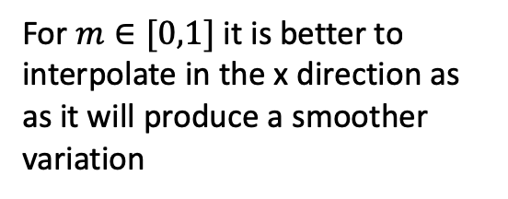

Interpolating Attributes
Assume that the color of the endpoints are c₀ and c₁
The color of an intermediate point should be:
At any pixel (x, y), we can compute it based on the horizontal or vertical distance of the pixel to the first endpoint:
$$c=\left(1 − α\right)c_{0}+αc_{1}$$
where $α$ is the interpolation variable
For $m∈[0,1]$ it is better to
interpolate in the x direction as
as it will produce a smoother
variation
$$α=\frac{x−x_{0}}{x_{1}−x_{0}}$$

Slide 20



Interpolating Attributes
Assume that the color of the endpoints are c₀ and c₁
The color of an intermediate point should be:
It can also be computed incrementally
$$c=\left(1 − α\right)c_{0}+αc_{1}$$
where $α$ is the interpolation variable
$$α\left(x_{0}+1\right)=α_{1}=\frac{1}{x_{1}−x_{0}}$$
$$α\left(x_{0}+2\right)=α_{2}=α_{1}+\frac{1}{x_{1}−x_{0}}$$

Slide 21
Algorithm with Interpolation
Algorithm with color interpolation:
y = y₀
d = 2(y₀ – y₁) + (x₁ – x₀)
c = c₀
dc = (c₁ – c₀) / (x₁ – x₀) // skip α; directly compute color increment
for x = x₀ to x₁ do:
draw(x, y, round(c))
if d < 0 then: // choose NE
y = y + 1
d += 2[(y₀ – y₁) + (x₁ – x₀)]
else: // choose E
d += 2[(y₀ – y₁)]
c += dc

Slide 22
Triangle Rasterization
Initially all we have is the screen coordinates of three vertices
(x₁, y₁)
(x₀, y₀)
(x₂, y₂)

Slide 23
Triangle Rasterization
From them we compute line equations for the edges:
$f_{01}\left(x, y\right)=x(y_{0}−y_{1}$) + $y(x_{1}−x_{0}$) + $x_{0}y_{1}−y_{0}x_{1}$
$f_{12}\left(x, y\right)=x(y_{1}−y_{2}$) + $y(x_{2}−x_{1}$) + $x_{1}y_{2}−y_{1}x_{2}$
f₀₁
(x₁, y₁)
$f_{20}\left(x, y\right)=x(y_{2}−y_{0}$) + $y(x_{0}−x_{2}$) + $x_{2}y_{0}−y_{2}x_{0}$
(x₀, y₀)
f₁₂
f₂₀
(x₂, y₂)

Slide 24
Triangle Rasterization
We then walk across the viewport to determine inside pixels:
(x₁, y₁)
(x₀, y₀)
(x₂, y₂)

Slide 25
Triangle Rasterization
For efficiency we may only walk within the bounding box of the triangle:
For each pixel we visit, we must make an inside test with respect to all three edges
We can simply plug-in the (x, y) value of the visited pixel to each line equation
If all are negative, the pixel is inside the triangle
(x₁, y₁)
(x₀, y₀)
(x₂, y₂)

Slide 26
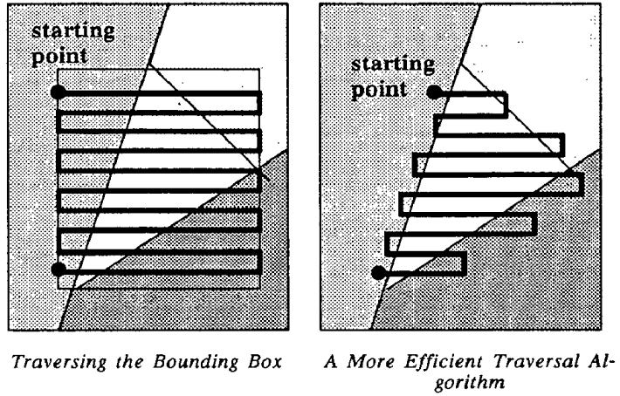
Triangle Rasterization
We can also go to the next scanline if we exit the triangle
This is known as Pineda rasterization
Pineda, J. (1988, June). A parallel algorithm for polygon rasterization. In Proceedings of the 15th annual conference on Computer graphics and interactive techniques (pp. 17-20).

Slide 27
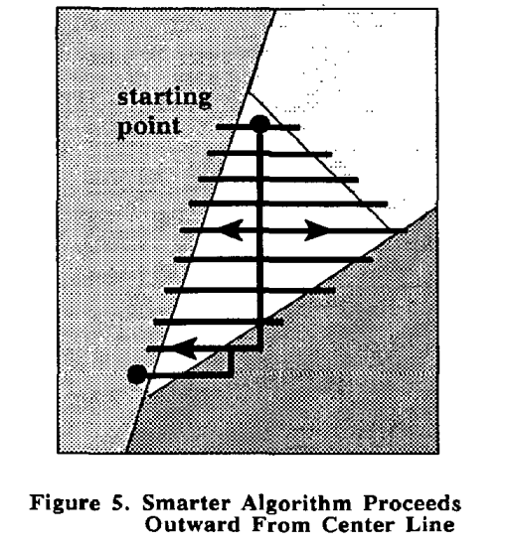
Triangle Rasterization
We can also go from the center to outward
See also:
https://www.mathematik.uni-marburg.de/~thormae/lectures/graphics1/code_v2/RasterPoly/index.html
Pineda, J. (1988, June). A parallel algorithm for polygon rasterization. In Proceedings of the 15th annual conference on Computer graphics and interactive techniques (pp. 17-20).

Slide 28

Triangle Rasterization
Using barycentric coordinates will help us with interpolation of attributes
What are the barycentric coordinates of (x, y)?
(x₁, y₁)
(x₁, y₁)
A₂
(x₀, y₀)
(x, y)
(x₀, y₀)
A₀
A₁
A = A₀ + A₁ + A₂
(x₂, y₂)
(x₂, y₂)
$α=\frac{A_{0}}{A},β=\frac{A_{1}}{A},$ $γ=\frac{A_{2}}{A}$

Slide 29




Triangle Rasterization
We don’t actually need to compute the areas as the bases are shared and will cancel out
$α=\frac{A_{0}}{A},β=\frac{A_{1}}{A},$ $γ=\frac{A_{2}}{A}$
What are the barycentric coordinates of (x, y)?
f₀₁
(x₁, y₁)
$$α=\frac{f_{12}(x,y)}{f_{12}(x_{0},y_{0})}$$
A₂
(x₀, y₀)
A₀
f₁₂
$$γ=\frac{f_{01}(x,y)}{f_{01}(x_{2},y_{2})}$$
A₁
$$β=\frac{f_{20}(x,y)}{f_{20}(x_{1},y_{1})}$$
f₂₀
A = A₀ + A₁ + A₂
(x₂, y₂)

Slide 30

Overall Algorithm
Note that the computation of the barycentric coordinates can also be made incremental for greater efficiency
for y = y_{min} to y_{max} do:
for x = x_{min} to x_{max} do:
$α={f_{12}(x,y)}/{f_{12}(x_{0},y_{0})}$
$β={f_{20}(x,y)}/{f_{20}(x_{1},y_{1})}$
$γ={f_{01}(x,y)}/{f_{01}(x_{2},y_{2})}$
if $α≥0$ and $β≥0$ and $γ≥0$ then:
c = $α$c₀ + $β$c₁ + $γ$c₂
draw(x, y, round(c))

Slide 31
Summary
The result of rasterization is a set of fragments (pixel-to-be) for each primitive
Each fragment has interpolated values of attributes:
  Color values
  Texture coordinates
  Depth value
  Normals
  Or any user-defined attribute for vertices
The next stage in the life of a fragment is to go through the fragment pipeline

