Slide 1
CENG 477
Introduction to Computer Graphics
Representing Curves and Surfaces

Slide 2
Introduction
There are no perfectly straight lines or flat faces in nature!
Therefore, representing and generating smooth shapes is a requirement in many CG applications
Rendering will still use lines and triangles but their vertices will be sampled from a curve or surface

Slide 3
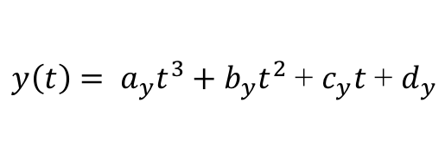
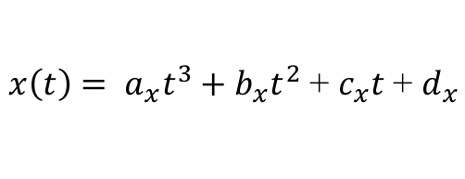
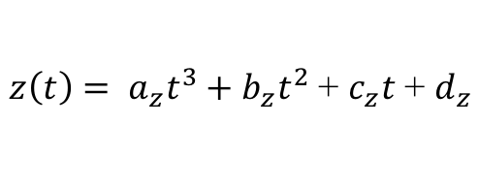
Curves
There are many ways to represent curves:
  must be practical (easy to manage and render)
  must be flexible (general enough to be used in various modeling tasks)
A good compromise is cubic polynomials
Each x, y, z coordinate is expressed as a cubic polynomial with potentially different coefficients (t is the parameter)
$x\left(t\right)= a_{x}t^{3}+b_{x}t^{2}$ + $c_{x}t$ + $d_{x}$
$y\left(t\right)= a_{y}t^{3}+b_{y}t^{2}$ + $c_{y}t$ + $d_{y}$
$z\left(t\right)= a_{z}t^{3}+b_{z}t^{2}$ + $c_{z}t$ + $d_{z}$

Slide 4




Curves
For a given t value, $q\left(t\right)=[x\left(t\right) y\left(t\right) z\left(t\right)]$represents the 3D position along the curve
Similar to rays in ray tracing except that it may follow a curvy path instead of a straight one!
The $t$ parameter is taken to be in range $[0, 1]$
$$q(0.5)$$
$$q(0)$$
$$q(1)$$

Slide 5
Cubic Polynomials
As cubic polynomials have 4 unknowns (per component), we need 4 constraints to find them
Different curves are distinguished by different constraints
  Hermite curves: 2 end points + 2 tangent vectors
  Bezier curves: 2 end points + 2 control points
  Splines: 4 control points (for each piece of the curve)

Slide 6
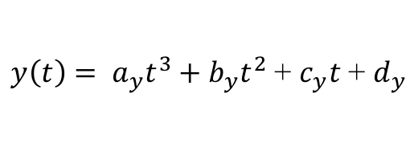
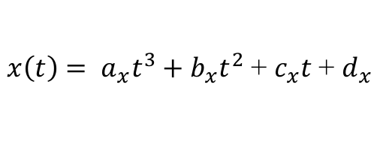

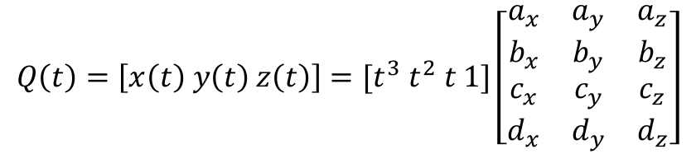
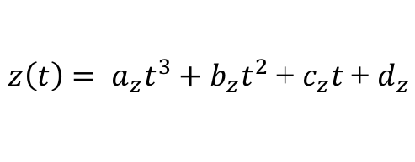
Matrix Form
Cubic polynomials are conveniently expressed in matrix form:
$x\left(t\right)= a_{x}t^{3}+b_{x}t^{2}$ + $c_{x}t$ + $d_{x}$
$y\left(t\right)= a_{y}t^{3}+b_{y}t^{2}$ + $c_{y}t$ + $d_{y}$
$z\left(t\right)= a_{z}t^{3}+b_{z}t^{2}$ + $c_{z}t$ + $d_{z}$
$$Q\left(t\right)=\left[x\left(t\right) y\left(t\right) z\left(t\right)\right]=[t^{3} t^{2} t 1]\left[\begin{matrix}a_{x} & a_{y} & a_{z} \\ b_{x} & b_{y} & b_{z} \\ c_{x} & c_{y} & c_{z} \\ d_{x} & d_{y} & d_{z}\end{matrix}\right]$$
$$Q\left(t\right)=TC$$

Slide 7

Matrix Form
We will also need the derivative of this curve to specify tangent vectors
$$\frac{dQ\left(t\right)}{dt}=Q^{′}\left(t\right)=\frac{dT}{dt}C=\left[3t^{2} 2t 1 0\right]C$$

Slide 8
Constraints
Imagine that we want to specify certain geometrical constraints such as:
  Start point
  End point
  Start direction (i.e. tangent vector at start point)
  End direction (i.e. tangent vector at end point)
We need to split the matrix C into two to allow embedding of these constraints

Slide 9
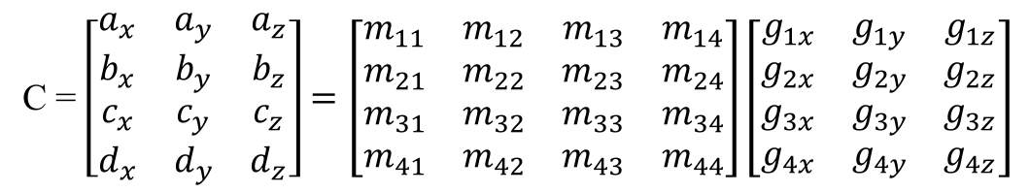



Constraints
Rewrite $C=MG$, where $G$ represents the geometry constraints
Here, $M$ is called the basis matrix
$G$ is called the geometry or the constraints matrix
Different types of curves differ in $M$ and $G$
C = $\left[\begin{matrix}a_{x} & a_{y} & a_{z} \\ b_{x} & b_{y} & b_{z} \\ c_{x} & c_{y} & c_{z} \\ d_{x} & d_{y} & d_{z}\end{matrix}\right]=\left[\begin{matrix}m_{11} & m_{12} & m_{13} & m_{14} \\ m_{21} & m_{22} & m_{23} & m_{24} \\ m_{31} & m_{32} & m_{33} & m_{34} \\ m_{41} & m_{42} & m_{43} & m_{44}\end{matrix}\right]\left[\begin{matrix}g_{1x} & g_{1y} & g_{1z} \\ g_{2x} & g_{2y} & g_{2z} \\ g_{3x} & g_{3y} & g_{3z} \\ g_{4x} & g_{4y} & g_{4z}\end{matrix}\right]$
$$M$$
$$G$$

Slide 10
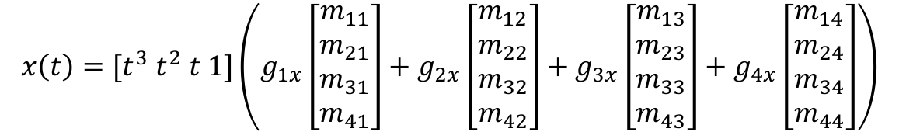

Constraints
Note that $Q\left(t\right)=TMG$
For instance:
$$x\left(t\right)=[t^{3} t^{2} t 1]\left(g_{1x}\left[\begin{matrix}m_{11} \\ m_{21} \\ m_{31} \\ m_{41}\end{matrix}\right]+g_{2x}\left[\begin{matrix}m_{12} \\ m_{22} \\ m_{32} \\ m_{42}\end{matrix}\right]+g_{3x}\left[\begin{matrix}m_{13} \\ m_{23} \\ m_{33} \\ m_{43}\end{matrix}\right]+g_{4x}\left[\begin{matrix}m_{14} \\ m_{24} \\ m_{34} \\ m_{44}\end{matrix}\right]\right)$$

Slide 11
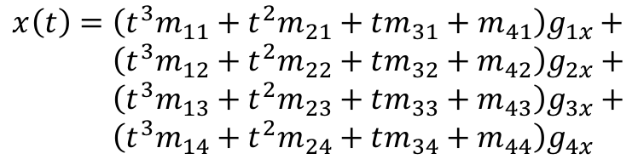
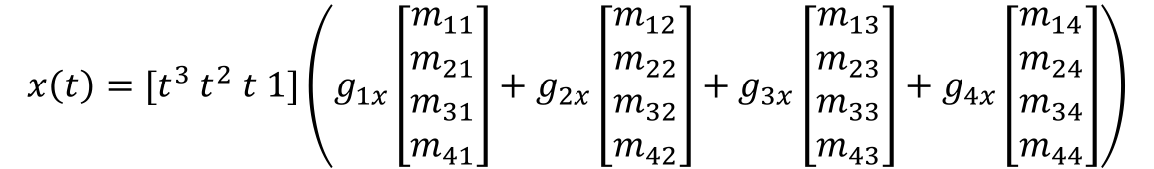
Blending Functions
Rewriting this gives us:
That is, the curve is a weighted sum of the elements of the geometry matrix
$$x\left(t\right)=[t^{3} t^{2} t 1]\left(g_{1x}\left[\begin{matrix}m_{11} \\ m_{21} \\ m_{31} \\ m_{41}\end{matrix}\right]+g_{2x}\left[\begin{matrix}m_{12} \\ m_{22} \\ m_{32} \\ m_{42}\end{matrix}\right]+g_{3x}\left[\begin{matrix}m_{13} \\ m_{23} \\ m_{33} \\ m_{43}\end{matrix}\right]+g_{4x}\left[\begin{matrix}m_{14} \\ m_{24} \\ m_{34} \\ m_{44}\end{matrix}\right]\right)$$
$$x\left(t\right)=\left(t^{3}m_{11}+t^{2}m_{21}+tm_{31}+m_{41}\right)g_{1x}+$$
$\left(t^{3}m_{12}+t^{2}m_{22}+tm_{32}+m_{42}\right)g_{2x}+$
$\left(t^{3}m_{13}+t^{2}m_{23}+tm_{33}+m_{43}\right)g_{3x}+$
$\left(t^{3}m_{14}+t^{2}m_{24}+tm_{34}+m_{44}\right)g_{4x}$

Slide 12
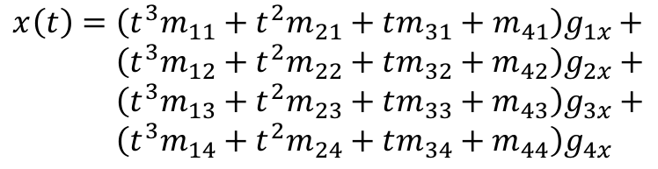


Blending Functions
The weights are each cubic polynomials of $t$
These polynomials are called blending functions
$$x\left(t\right)=\left(t^{3}m_{11}+t^{2}m_{21}+tm_{31}+m_{41}\right)g_{1x}+$$
$\left(t^{3}m_{12}+t^{2}m_{22}+tm_{32}+m_{42}\right)g_{2x}+$
$\left(t^{3}m_{13}+t^{2}m_{23}+tm_{33}+m_{43}\right)g_{3x}+$
$\left(t^{3}m_{14}+t^{2}m_{24}+tm_{34}+m_{44}\right)g_{4x}$
$$B_{1x4}=T_{1x4}M_{4x4}$$
Vector of
blending functions

Slide 13
Two Important Curves
Now we will see how this background can be used to define two types of curves:
  Hermite curves
  Bezier curves
Both curves can draw the same curves (they are equally powerful) but they have different geometry constraints

Slide 14





Hermite Curves
The constraints of Hermite curves are:
  Two end points: $P_{1}$ and $P_{4}$
  Two tangent vectors: $R_{1}$ and $R_{4}$
$$R_{4}$$
$$P_{4}$$
$$R_{1}$$
$$P_{1}$$

Slide 15




Hermite Curves
The geometry matrix then becomes:
To find $M$ remember that the curve in matrix form we have:
And for derivative:
$$G= \left[\begin{matrix}P_{1} \\ P_{4} \\ R_{1} \\ R_{4}\end{matrix}\right]=\left[\begin{matrix}P_{1x} & P_{1y} & P_{1z} \\ P_{4x} & P_{4y} & P_{4z} \\ R_{1x} & R_{1y} & R_{1z} \\ R_{4x} & R_{4y} & R_{4z}\end{matrix}\right]$$
$$Q\left(t\right)=TMG$$
$$Q′\left(t\right)=T′MG$$

Slide 16
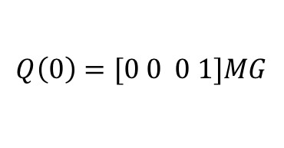


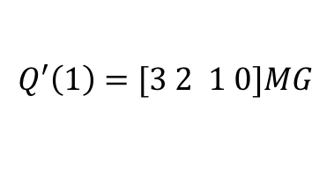
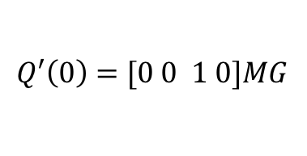
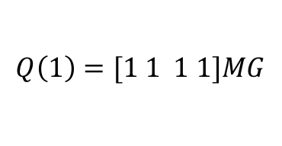
Hermite Curves
We can now plug in values for the $t$ parameter
  Compute $Q\left(0\right), Q\left(1\right), Q^{′}\left(0\right), Q′(1)$
This is the same as:
$$Q\left(0\right)=[0 0 0 1]MG$$
$$Q\left(1\right)=[1 1 1 1]MG$$
$$Q′\left(0\right)=[0 0 1 0]MG$$
$$Q′\left(1\right)=[3 2 1 0]MG$$
$$\left[\begin{matrix}Q(0) \\ Q(1) \\ Q′(0) \\ Q′(1)\end{matrix}\right]=\left[\begin{matrix}0 & 0 & 0 & 1 \\ 1 & 1 & 1 & 1 \\ 0 & 0 & 1 & 0 \\ 3 & 2 & 1 & 0\end{matrix}\right]MG$$

Slide 17
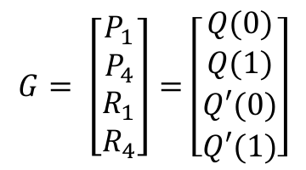

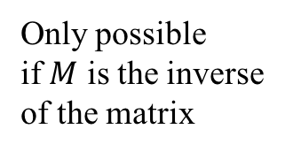
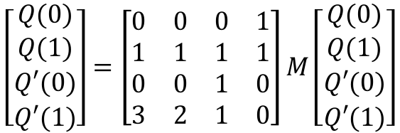
Hermite Curves
Remember that $G$ was equal to:
So we have:
$$G= \left[\begin{matrix}P_{1} \\ P_{4} \\ R_{1} \\ R_{4}\end{matrix}\right]=\left[\begin{matrix}Q(0) \\ Q(1) \\ Q′(0) \\ Q′(1)\end{matrix}\right]$$
$$\left[\begin{matrix}Q(0) \\ Q(1) \\ Q′(0) \\ Q′(1)\end{matrix}\right]=\left[\begin{matrix}0 & 0 & 0 & 1 \\ 1 & 1 & 1 & 1 \\ 0 & 0 & 1 & 0 \\ 3 & 2 & 1 & 0\end{matrix}\right]M\left[\begin{matrix}Q(0) \\ Q(1) \\ Q′(0) \\ Q′(1)\end{matrix}\right]$$
Only possible
if $M$ is the inverse
of the matrix
Same

Slide 18

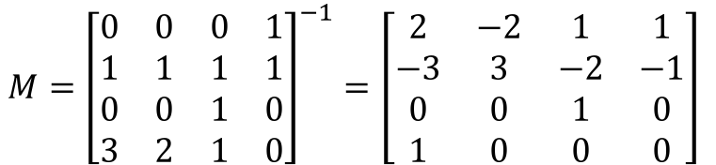
Hermite Curves
Therefore, Hermite curves have the following basis matrix:
This yields the following blending functions:
$$M={\left[\begin{matrix}0 & 0 & 0 & 1 \\ 1 & 1 & 1 & 1 \\ 0 & 0 & 1 & 0 \\ 3 & 2 & 1 & 0\end{matrix}\right]}^{−1}=\left[\begin{matrix}2 & −2 & 1 & 1 \\ −3 & 3 & −2 & −1 \\ 0 & 0 & 1 & 0 \\ 1 & 0 & 0 & 0\end{matrix}\right]$$
$$B= {\left[\begin{matrix}2t^{3}−3t^{2}+1 \\ −2t^{3}+3t^{2} \\ t^{3}−2t^{2}+t \\ t^{3}−t^{2}\end{matrix}\right]}^{T}$$
Let’s plot these
with gnuplot and
do some experimentation
with Matlab!

Slide 19
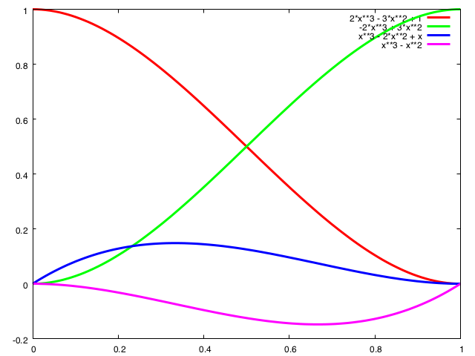
Hermite Blending Functions

Slide 20
Bezier Curves
Bezier curves can draw the same curves as Hermite curves
They are defined using control points instead of derivatives
Two control points are interpolated and two control points are approximated

Slide 21
Bezier Curves
The curve lies entirely within the convex-hull of these four points
This is useful for clipping, culling, and intersection tests as the convex-hull can be tested first instead of each line segment

Slide 22

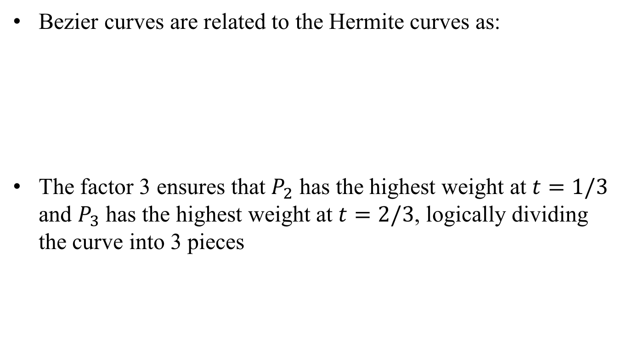

Bezier Curves
Bezier curves are related to the Hermite curves as:
The factor 3 ensures that $P_{2}$ has the highest weight at $t=1/3$ and $P_{3}$ has the highest weight at $t=2/3$, logically dividing the curve into 3 pieces
$$R_{1}=3(P_{2}−P_{1})$$
$$R_{4}=3(P_{4}−P_{3})$$

Slide 23

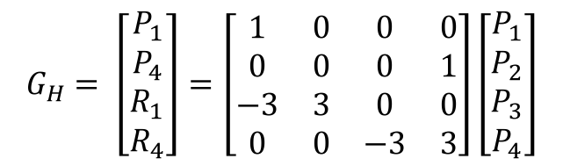
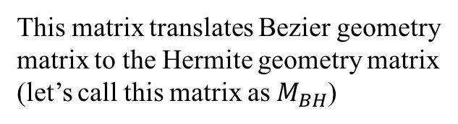
Bezier Curves
In matrix form, this relationship can be express as:
$$G_{H}= \left[\begin{matrix}P_{1} \\ P_{4} \\ R_{1} \\ R_{4}\end{matrix}\right]=\left[\begin{matrix}1 & 0 & 0 & 0 \\ 0 & 0 & 0 & 1 \\ −3 & 3 & 0 & 0 \\ 0 & 0 & −3 & 3\end{matrix}\right]\left[\begin{matrix}P_{1} \\ P_{2} \\ P_{3} \\ P_{4}\end{matrix}\right]$$
$$G_{B}$$
This matrix translates Bezier geometry
matrix to the Hermite geometry matrix
(let’s call this matrix as $M_{BH}$)

Slide 24


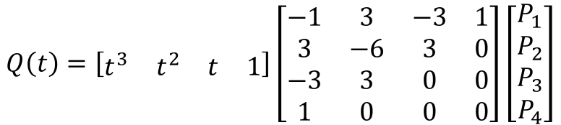

Bezier Curves
Then Bezier curves can be defined as:
$$Q\left(t\right)=TM_{H}G_{H}=TM_{H}M_{BH}G_{B}$$
$$Q\left(t\right)=TM_{B}G_{B}$$
where
$$M_{B}=M_{H}M_{BH}$$
$$Q\left(t\right)=\left[\begin{matrix}t^{3} & t^{2} & t & 1\end{matrix}\right]\left[\begin{matrix}−1 & 3 & −3 & 1 \\ 3 & −6 & 3 & 0 \\ −3 & 3 & 0 & 0 \\ 1 & 0 & 0 & 0\end{matrix}\right]\left[\begin{matrix}P_{1} \\ P_{2} \\ P_{3} \\ P_{4}\end{matrix}\right]$$

Slide 25

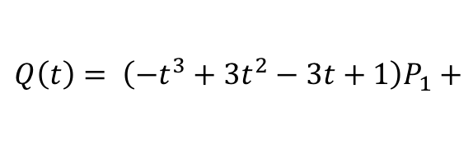

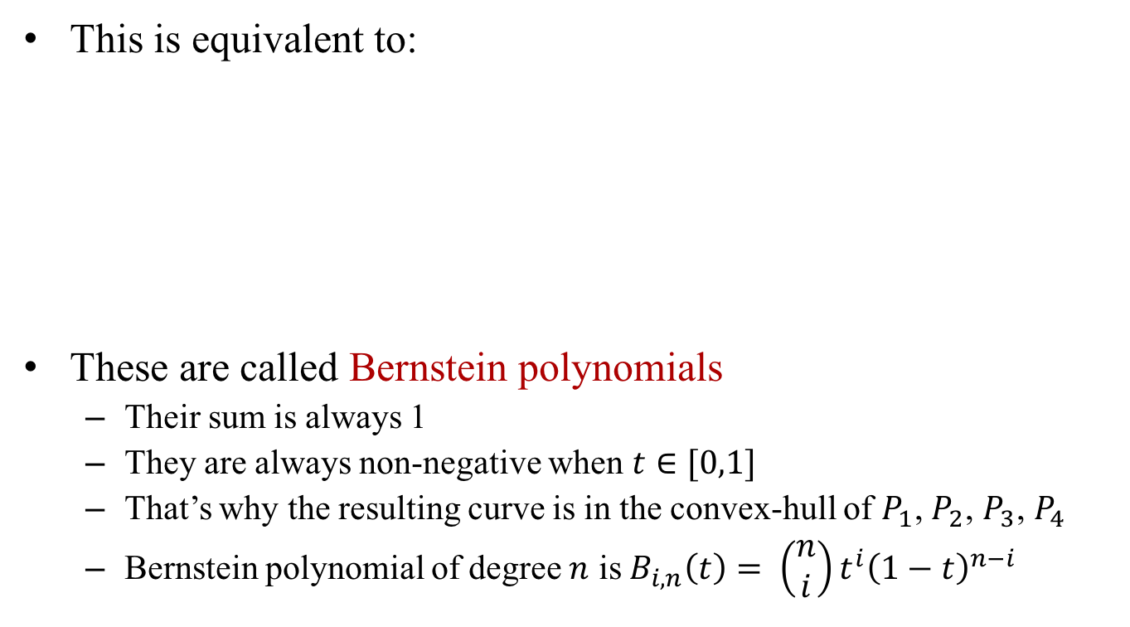





Bezier Curves
This is equivalent to:
These are called Bernstein polynomials
  Their sum is always 1
  They are always non-negative when $t∈[0,1]$
  That’s why the resulting curve is in the convex-hull of $P_{1}$, $P_{2}$, $P_{3}$, $P_{4}$
  Bernstein polynomial of degree $n$ is $B_{i,n}\left(t\right)= \left(\begin{matrix}n \\ i\end{matrix}\right)t^{i}{\left(1−t\right)}^{n−i}$
$$Q\left(t\right)= \left(−t^{3}+3t^{2}−3t+1\right)P_{1}+$$
$${(1−t)}^{3}P_{1}+$$
$$\left(3t^{3}−6t^{2}+3t\right)P_{2}+$$
=
$${3t(1−t)}^{2}P_{2}+$$
$$\left(−3t^{3}+3t^{2}\right)P_{3}+$$
$$3t^{2}(1−t)P_{3}+$$
$$\left(t^{3}\right)P_{4}$$
$$t^{3}P_{4}+$$

Slide 26

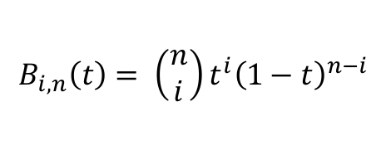
Bezier Curves
Bezier curve is the sum of Bernstein polynomials
$$Q\left(t\right)={(1−t)}^{3}P_{1}+{3t(1−t)}^{2}P_{2}+3t^{2}(1−t)P_{3}+t^{3}P_{4}$$
$$Q\left(t\right)=\sum_{i=0}^{n}{B_{i,n}\left(t\right)P_{i+1}}$$
$$B_{i,n}\left(t\right)= \left(\begin{matrix}n \\ i\end{matrix}\right)t^{i}{\left(1−t\right)}^{n−i}$$

Slide 27
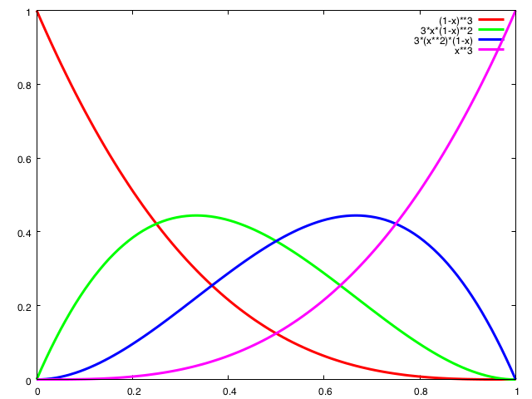
Bernstein Polynomials

Slide 28
Continuity
Until now, we learned to draw a single curve segment
If we want to combine multiple curve segments, we must ensure maintaining continuity
Curve 1
Curve 2

Slide 29
Types of Continuity
No continuity:
  The curves do not meet
C0 continuity:
  The end points meet, also know as positional continuity

Slide 30
Types of Continuity
C1 continuity:
  The curves meet and have identical tangent vectors at the connection
C2 continuity:
  The curves meet and have identical curvature at the connection
  The curvature is defined as the rate of change of tangents

Slide 31
Types of Continuity
Imagine a camera moving along a curve with multiple segments
  No continuity: camera will make jumps between segments
  C0 continuity: camera velocity may suddenly change
  C1 continuity: camera acceleration may suddenly change
  C2 continuity: camera motion will appear smooth
In general, maintaining C2 continuity is desired

Slide 32



Maintaining Continuity
Imagine having two Hermite curves:
C1 continuity can be maintained if $P_{4}=Q_{1}$ and $R_{4}=T_{1}$
$$G_{l}=\left[\begin{matrix}P_{1} \\ P_{4} \\ R_{1} \\ R_{4}\end{matrix}\right]$$
$$G_{r}=\left[\begin{matrix}Q_{1} \\ Q_{4} \\ T_{1} \\ T_{4}\end{matrix}\right]$$

Slide 33



Maintaining Continuity
Similarly for two Bezier curves:
C1 is ensured if $P_{4}=Q_{1}$ and $P_{4}−P_{3}=Q_{2}−Q_{1}$
$$G_{l}=\left[\begin{matrix}P_{1} \\ P_{2} \\ P_{3} \\ P_{4}\end{matrix}\right]$$
$$G_{r}=\left[\begin{matrix}Q_{1} \\ Q_{2} \\ Q_{3} \\ Q_{4}\end{matrix}\right]$$

Slide 34
Maintaining Continuity
What if we want to maintain C2 continuity?
Unfortunately, neither Hermite nor Bezier curves can guarantee C2 continuity
For this we have a new type of curve called splines

Slide 35
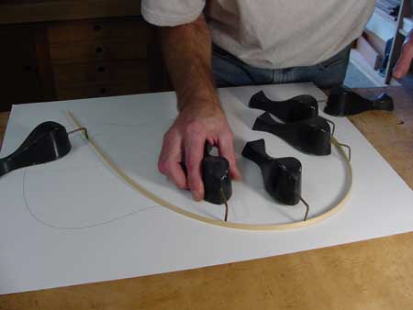
Splines
The term spline was used to refer to flexible metal strips used by draftspersons to design the surfaces of airplanes, cars, and ships, etc.
core77.com

Slide 36
Splines
The splines, due to physical properties of the metal strips, had second order (C2) continuity
Its mathematical equivalent is natural cubic splines
Splines have one more degree of continuity than that is afforded by Hermite and Bezier curves
There are other types of splines:
  B-Splines
  Uniform Nonrational B-Splines
  Nonuniform Nonrational B-Splines
  Nonuniform Rational B-Splines
  Beta-Splines
  V-Splines

Slide 37












Natural Cubic Splines
Defined by n+1 control points
The spline, consisting of n curves, interpolates all of these points
$$S_{2}(t)$$
$$S_{0}(t)$$
$$P_{1}$$
$$P_{4}$$
$$P_{3}$$
$$P_{2}$$
$$S_{n−1}(t)$$
$$P_{n−1}$$
$$P_{0}$$
$$S_{1}(t)$$
$$S_{3}(t)$$
$$P_{n}$$

Slide 38



Natural Cubic Splines
The spline is defined as:
Each curve is a cubic polynomial:
$$S\left(t\right)= \left\{\begin{matrix}S_{0}\left(t\right), & t_{0}≤t≤t_{1} \\ S_{1}\left(t\right), & t_{1}≤t≤t_{2} \\ ⋮ & \\ S_{n−1}\left(t\right), & t_{n−1}≤t≤t_{n}\end{matrix}\right.$$
$$S_{0}\left(t\right)=a_{0}t^{3}+b_{0}t^{2}+c_{0}t+d_{0}$$
There are a total
of 4n unknowns!
$$⋮$$
$$S_{n−1}\left(t\right)=a_{n−1}t^{3}+b_{n−1}t^{2}+c_{n−1}t+d_{n−1}$$

Slide 39




Natural Cubic Splines
The end points of the curves must meet (C0 cont.) and their first two derivatives must be equal (C1 and C2):
This gives us 3n – 3 equations
$$S_{i−1}\left(t_{i}\right)=S_{i}(t_{i})$$
$$S_{i−1}^{′}\left(t_{i}\right)=S_{i}^{′}(t_{i})$$
$$i=1…n−1$$
$$S_{i−1}^{′′}\left(t_{i}\right)=S_{i}^{′′}(t_{i})$$

Slide 40
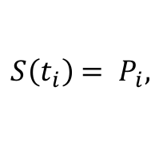
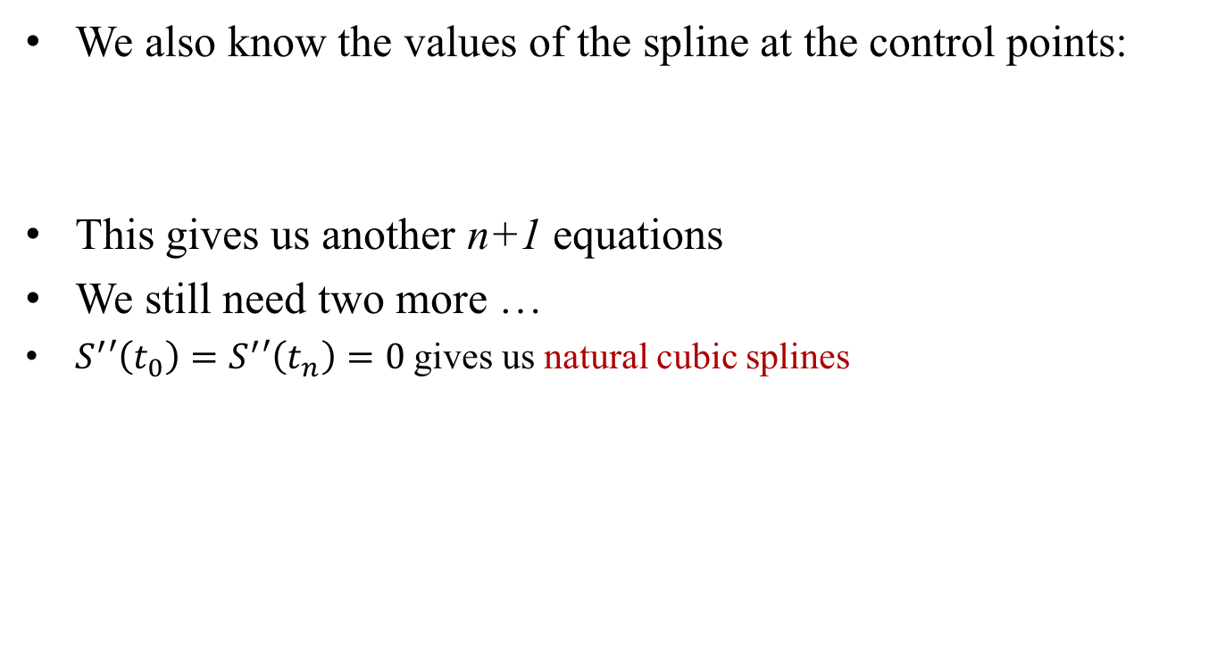

Natural Cubic Splines
We also know the values of the spline at the control points:
This gives us another n+1 equations
We still need two more …
  $S^{′}′\left(t_{0}\right)=S^{′}′\left(t_{n}\right)=0$ gives us natural cubic splines
$$S\left(t_{i}\right)= P_{i},$$
$$i=0…n$$

Slide 41





Computing Polynomials
Let’s call the second derivatives at control points as:
For natural cubic spline we have $Z_{0}=Z_{n}={[0 0 0]}^{T}$
How does $S′′(t)$ look like?
$$Z_{i}=S^{′′}(t_{i})$$
$S(t)$
$S′(t)$
$S′′(t)$

Slide 42
















Computing Polynomials
$S′′(t)$ will be piecewise-linear
$$Z_{3}$$
$$S_{i}^{′′}\left(t\right)=Z_{i}\frac{t−t_{i+1}}{t_{i}−t_{i+1}}{+Z}_{i+1}\frac{t−t_{i}}{t_{i+1}−t_{i}}$$
$$Z_{1}$$
$$Z_{0}=0^{T}$$
$$Z_{4}$$
$$Z_{n}=0^{T}$$
$$Z_{n−1}$$
$$Z_{2}$$
$$t_{0}$$
$$t_{1}$$
$$t_{2}$$
$$t_{3}$$
$$t_{4}$$
$$t_{n−1}$$
$$t_{n}$$
This derivation is largely inspired from Arne Morten Kvarving’s slides on cubic splines

Slide 43


Computing Polynomials
$S′′(t)$ will be piecewise-linear
$$Z_{3}$$
$$S_{i}^{′′}\left(t\right)=Z_{i+1}\frac{t−t_{i}}{h_{i}}+Z_{i}\frac{t_{i+1}−t}{h_{i}}$$
$$Z_{1}$$
where $h_{i}=t_{i+1}−t_{i}$
$$Z_{0}=0^{T}$$
$$Z_{4}$$
$$Z_{n}=0^{T}$$
$$Z_{n−1}$$
$$Z_{2}$$
$$t_{0}$$
$$t_{1}$$
$$t_{2}$$
$$t_{3}$$
$$t_{4}$$
$$t_{n−1}$$
$$t_{n}$$

Slide 44





Computing Polynomials
At this point, we need to integrate twice to obtain $S(t)$
$$S_{i}^{′′}\left(t\right)=Z_{i+1}\frac{t−t_{i}}{h_{i}}+Z_{i}\frac{t_{i+1}−t}{h_{i}}$$
$$S_{i}^{′}\left(t\right)=Z_{i+1}\frac{{(t−t_{i})}^{2}}{{2h}_{i}}+Z_{i}\frac{{(t_{i+1}−t)}^{2}}{{−2h}_{i}}+C_{i}$$
$$S_{i}\left(t\right)=Z_{i+1}\frac{{(t−t_{i})}^{3}}{{6h}_{i}}+Z_{i}\frac{{(t_{i+1}−t)}^{3}}{{6h}_{i}}+C_{i}t+D_{i}$$
$$S_{i}\left(t\right)=Z_{i+1}\frac{{(t−t_{i})}^{3}}{{6h}_{i}}+Z_{i}\frac{{(t_{i+1}−t)}^{3}}{{6h}_{i}}+E_{i}(t−t_{i})+F_{i}(t_{i+1}−t)$$
where$C_{i}=E_{i}−F_{i}$ and $D_{i}=F_{i}t_{i+1}−E_{i}t_{i}$

Slide 45



Computing Polynomials
At this point, the only unknowns are $Z_{i}$, $Z_{i+1}$, $E_{i}$ and $F_{i}$
Plug-in the values at the control points:
From here, we can determine $E_{i}$ and $F_{i}$
$$S_{i}\left(t\right)=Z_{i+1}\frac{{(t−t_{i})}^{3}}{{6h}_{i}}+Z_{i}\frac{{(t_{i+1}−t)}^{3}}{{6h}_{i}}+E_{i}(t−t_{i})+F_{i}(t_{i+1}−t)$$
$$S_{i}\left(t_{i}\right)= P_{i}=Z_{i}\frac{{h_{i}}^{2}}{6}+F_{i}h_{i}$$
$$S_{i}\left(t_{i+1}\right)= P_{i+1}=Z_{i+1}\frac{{h_{i}}^{2}}{6}+E_{i}h_{i}$$

Slide 46


Computing Polynomials
This gives us:
Finally, we need to compute the $Z_{i}$ terms
We know that $Z_{0}=Z_{n}={[0 0 0]}^{T}$
$$S_{i}\left(t\right)=Z_{i+1}\frac{{(t−t_{i})}^{3}}{{6h}_{i}}+Z_{i}\frac{{(t_{i+1}−t)}^{3}}{{6h}_{i}}+\left(\frac{P_{i+1}}{h_{i}}−\frac{Z_{i+1}h_{i}}{6}\right) (t−t_{i})+$$
$$\left(\frac{P_{i}}{h_{i}}−\frac{Z_{i}h_{i}}{6}\right) (t_{i+1}−t)$$

Slide 47


Computing Polynomials
We did not use the constraint that the first derivatives at the control points are equal; so take the derivative
$$S_{i}^{′}\left(t\right)=Z_{i+1}\frac{{(t−t_{i})}^{2}}{{2h}_{i}}−Z_{i}\frac{{\left(t_{i+1}−t\right)}^{2}}{{2h}_{i}}+\frac{1}{h_{i}}\left(P_{i+1}−P_{i}\right)−\frac{h_{i}}{6}\left(Z_{i+1}−Z_{i}\right)$$
$$B_{i}$$
$$S_{i}^{′}\left(t_{i}\right)=−Z_{i}\frac{h_{i}}{2}+B_{i}−\frac{h_{i}}{6}Z_{i+1}+\frac{h_{i}}{6}Z_{i}$$

Slide 48


Computing Polynomials
Repeat this for the previous (or the next) segment:
$$S_{i−1}^{′}\left(t\right)=Z_{i}\frac{{(t−t_{i−1})}^{2}}{{2h}_{i−1}}−Z_{i−1}\frac{{\left(t_{i}−t\right)}^{2}}{{2h}_{i−1}}+\frac{1}{h_{i−1}}\left(P_{i}−P_{i−1}\right)−\frac{h_{i−1}}{6}\left(Z_{i}−Z_{i−1}\right)$$
$$B_{i−1}$$
$$S_{i−1}^{′}\left(t_{i}\right)=Z_{i}\frac{h_{i−1}}{2}+B_{i−1}−\frac{h_{i−1}}{6}Z_{i}+\frac{h_{i−1}}{6}Z_{i−1}$$

Slide 49


Computing Polynomials
Now equate the segments at the control points:
$$S_{i}^{′}\left(t_{i}\right)=S_{i−1}^{′}\left(t_{i}\right)$$
$$−Z_{i}\frac{h_{i}}{2}+B_{i}−\frac{h_{i}}{6}Z_{i+1}+\frac{h_{i}}{6}Z_{i}=Z_{i}\frac{h_{i−1}}{2}+B_{i−1}−\frac{h_{i−1}}{6}Z_{i}+\frac{h_{i−1}}{6}Z_{i−1}$$
$$−{3Z}_{i}h_{i}+{6B}_{i}−h_{i}Z_{i+1}+h_{i}Z_{i}={3Z}_{i}h_{i−1}+{6B}_{i−1}−h_{i−1}Z_{i}+h_{i−1}Z_{i−1}$$
${6(B}_{i}−B_{i−1})=h_{i−1}Z_{i−1}$ +${ 2(h_{i−1}+h_{i})Z}_{i} + h_{i}Z_{i+1}$

Slide 50


Computing Polynomials
We can set up n-1 equations in this form and we also have n-1 unknowns (from $Z_{1}$ to $Z_{n−1}$)
In the above equation, plug $i=1…n−1$, and solve the resulting system
${6(B}_{i}−B_{i−1})=h_{i−1}Z_{i−1}$ +${ 2(h_{i−1}+h_{i})Z}_{i} + h_{i}Z_{i+1}$

Slide 51






Computing Polynomials
Setup the system such that we have the $Ax=b$ form
$$\left[\begin{matrix}v_{1} & h_{1} & 0 & … & & \\ h_{1} & v_{2} & h_{2} & & & \\ 0 & h_{2} & v_{3} & h_{3} & & \\ ⋮ & & & ⋱ & & \\ & & & & v_{n−2} & h_{n−2} \\ & & & & h_{n−2} & v_{n−1}\end{matrix}\right]\left[\begin{matrix}Z_{1,x} \\ Z_{2,x} \\ Z_{3,x} \\ ⋮ \\ \\ Z_{n−1,x}\end{matrix}\right]=\left[\begin{matrix}b_{1} \\ b_{2} \\ b_{3} \\ ⋮ \\ \\ b_{n−1}\end{matrix}\right]$$
$$h_{i}=t_{i+1}−t_{i}$$
Note that we are solving for the x-components
We need to solve for y- and z-components if our curve is 3 dimensional
$$v_{i}=2(h_{i−1}+h_{i})$$
$$b_{i}={6(B}_{i,x}−B_{i−1,x})$$
$$B_{i,x}=\frac{1}{h_{i}}\left(P_{i+1,x}−P_{i,x}\right)$$

Slide 52

Sample Output
P = {(1, 1), (2, 3), (3, 2), (4, 5), (5, 1), (6, 3), (7, 2)}
T = {0, 1, 2, 3, 4, 5, 6}

Slide 53




Parametric Bicubic Surfaces
Generalization of parametric cubic curves
Recall $Q\left(t\right)=TMG$
First replace $t$ by $s$ such that $Q\left(s\right)=SMG$
Now allow the points in $G$ to vary along a curve parametrized by $t$
$$Q\left(s, t\right)=SMG(t)$$
$$\begin{matrix}G_{1x}(t) & G_{1y}(t) & G_{1z}(t)\end{matrix}$$
$$Q\left(s, t\right)=SM\left[\begin{matrix}G_{1}(t) \\ G_{2}(t) \\ G_{3}(t) \\ G_{4}(t)\end{matrix}\right]$$

Slide 54



Parametric Bicubic Surfaces
We can setup separate equations for x, y, and z:
$$Q_{x}\left(s, t\right)=SM\left[\begin{matrix}G_{1x}(t) \\ G_{2x}(t) \\ G_{3x}(t) \\ G_{4x}(t)\end{matrix}\right]$$
$$Q_{y}\left(s, t\right)=SM\left[\begin{matrix}G_{1y}(t) \\ G_{2y}(t) \\ G_{3y}(t) \\ G_{4y}(t)\end{matrix}\right]$$
$$Q_{z}\left(s, t\right)=SM\left[\begin{matrix}G_{1z}(t) \\ G_{2z}(t) \\ G_{3z}(t) \\ G_{4z}(t)\end{matrix}\right]$$

Slide 55


Parametric Bicubic Surfaces
Now for a fixed $t=t_{1}$, $Q(s,t_{1})$ is a curve because $G(t_{1})$ is constant
Allowing $t$ to take on a different value, $t_{2}$, where $t_{2}−t_{1}$ is very small, $Q(s,t_{2})$ is a slightly different curve
Repeating this arbitrarily many times gives you a large set of curves, which is our surface
Called bicubic if $G_{i}(t)$ are themselves cubic
…

Slide 56







Derivation
Assume that $G_{i}(t)$ themselves are defined by:
$$G_{i}\left(t\right)=TMZ_{i}$$
$$G_{i}\left(t\right)=TM\left[\begin{matrix}Z_{i1} \\ Z_{i2} \\ Z_{i3} \\ Z_{i4}\end{matrix}\right]$$
$$\begin{matrix}Z_{i1x} & Z_{i1y} & Z_{i1z}\end{matrix}$$
$$G_{ix}\left(t\right)=TM\left[\begin{matrix}Z_{i1x} \\ Z_{i2x} \\ Z_{i3x} \\ Z_{i4x}\end{matrix}\right]$$
$$G_{iy}\left(t\right)=TM\left[\begin{matrix}Z_{i1y} \\ Z_{i2y} \\ Z_{i3y} \\ Z_{i4y}\end{matrix}\right]$$
$$G_{iz}\left(t\right)=TM\left[\begin{matrix}Z_{i1z} \\ Z_{i2z} \\ Z_{i3z} \\ Z_{i4z}\end{matrix}\right]$$

Slide 57


Derivation
Remember that we have:
To combine them into a single equation, take the transpose of $G_{ix}\left(t\right)$, which is equal to itself due to its being a scalar:
$$Q_{x}\left(s, t\right)=SM\left[\begin{matrix}G_{1x}(t) \\ G_{2x}(t) \\ G_{3x}(t) \\ G_{4x}(t)\end{matrix}\right]$$
$$G_{ix}\left(t\right)=TM\left[\begin{matrix}Z_{i1x} \\ Z_{i2x} \\ Z_{i3x} \\ Z_{i4x}\end{matrix}\right]$$
$${G_{1x}\left(t\right)}^{T}=G_{1x}\left(t\right)=\left[\begin{matrix}Z_{11x} & Z_{11x} & Z_{13x} & Z_{14x}\end{matrix}\right]M^{T}T^{T}$$
$${G_{2x}\left(t\right)}^{T}=G_{2x}\left(t\right)=\left[\begin{matrix}Z_{21x} & Z_{21x} & Z_{23x} & Z_{24x}\end{matrix}\right]M^{T}T^{T}$$
$${G_{3x}\left(t\right)}^{T}=G_{3x}\left(t\right)=\left[\begin{matrix}Z_{31x} & Z_{31x} & Z_{33x} & Z_{34x}\end{matrix}\right]M^{T}T^{T}$$
$${G_{4x}\left(t\right)}^{T}=G_{4x}\left(t\right)=\left[\begin{matrix}Z_{41x} & Z_{41x} & Z_{43x} & Z_{44x}\end{matrix}\right]M^{T}T^{T}$$

Slide 58

Derivation
Remember that we have:
To combine them into a single equation, take the transpose of $G_{ix}\left(t\right)$, which is equal to itself due to its being a scalar:
$$Q_{x}\left(s, t\right)=SM\left[\begin{matrix}G_{1x}(t) \\ G_{2x}(t) \\ G_{3x}(t) \\ G_{4x}(t)\end{matrix}\right]$$
$$G_{ix}\left(t\right)=TM\left[\begin{matrix}Z_{i1x} \\ Z_{i2x} \\ Z_{i3x} \\ Z_{i4x}\end{matrix}\right]$$
$$\left[\begin{matrix}G_{1x}\left(t\right) \\ G_{2x}\left(t\right) \\ G_{3x}\left(t\right) \\ G_{4x}\left(t\right)\end{matrix}\right]=\left[\begin{matrix}\begin{matrix}Z_{11x} & Z_{11x} & Z_{13x} & Z_{14x}\end{matrix} \\ \begin{matrix}Z_{21x} & Z_{21x} & Z_{23x} & Z_{24x}\end{matrix} \\ \begin{matrix}Z_{31x} & Z_{31x} & Z_{33x} & Z_{34x}\end{matrix} \\ \begin{matrix}Z_{41x} & Z_{41x} & Z_{43x} & Z_{44x}\end{matrix}\end{matrix}\right]M^{T}T^{T}$$

Slide 59




Derivation
This gives us:
Similarly for y and z:
$$Q_{x}\left(s, t\right)=S\left[\begin{matrix}m_{11} & m_{12} & m_{13} & m_{14} \\ m_{21} & m_{22} & m_{23} & m_{24} \\ m_{31} & m_{32} & m_{33} & m_{34} \\ m_{41} & m_{42} & m_{43} & m_{44}\end{matrix}\right]\left[\begin{matrix}\begin{matrix}Z_{11x} & Z_{11x} & Z_{13x} & Z_{14x}\end{matrix} \\ \begin{matrix}Z_{21x} & Z_{21x} & Z_{23x} & Z_{24x}\end{matrix} \\ \begin{matrix}Z_{31x} & Z_{31x} & Z_{33x} & Z_{34x}\end{matrix} \\ \begin{matrix}Z_{41x} & Z_{41x} & Z_{43x} & Z_{44x}\end{matrix}\end{matrix}\right]M^{T}T^{T}$$
$$M$$
$$G_{x}$$
$$Q_{y}\left(s, t\right)=SMG_{y}M^{T}T^{T}$$
$$Q_{z}\left(s, t\right)=SMG_{z}M^{T}T^{T}$$

Slide 60









Hermite Surfaces
For Hermite surfaces, $M$ is the Hermite basis matrix
The elements of the geometry matrix ($G_{x}$, $G_{y}$, $G_{z}$) store how each component changes with respect to t:
$$R_{11}=dQ(0, 0)/ds$$
$$P_{11}=Q(0, 0)$$
$$P_{41}=Q(1, 0)$$
…
$$R_{41}=dQ(1, 0)/ds$$
$$P_{14}=Q(0, 1)$$
$$P_{44}=Q(1, 1)$$
$$R_{14}=dQ(0, 1)/ds$$
$$R_{44}=dQ(1, 1)/ds$$

Slide 61


Hermite Surfaces
How the starting point ($P_{1}$) changes with respect to t:
$$G_{x}=\left[\begin{matrix}Q_{x}(0, 0) & Q_{x}(0, 1) & \frac{dQ_{x}(0, 0)}{dt} & \frac{dQ_{x}(0, 1)}{dt} \\ … & … & … & … \\ … & … & … & … \\ … & … & … & …\end{matrix}\right]$$

Slide 62


Hermite Surfaces
How the end point ($P_{4}$) changes with respect to t:
$$G_{x}=\left[\begin{matrix}… & … & … & … \\ Q_{x}(1, 0) & Q_{x}(1, 1) & \frac{dQ_{x}(1, 0)}{dt} & \frac{dQ_{x}(1, 1)}{dt} \\ … & … & … & … \\ … & … & … & …\end{matrix}\right]$$

Slide 63


Hermite Surfaces
How the starting tangent vector ($R_{1}$), defined with respect to $s$, changes with respect to t:
$$G_{x}=\left[\begin{matrix}… & … & … & … \\ … & … & … & … \\ \frac{dQ_{x}(0, 0)}{ds} & \frac{dQ_{x}(0, 1)}{ds} & \frac{d^{2}Q_{x}(0, 0)}{dsdt} & \frac{d^{2}Q_{x}(0, 1)}{dsdt} \\ … & … & … & …\end{matrix}\right]$$

Slide 64


Hermite Surfaces
How the ending tangent vector ($R_{4}$), defined with respect to $s$, changes with respect to t:
$$G_{x}=\left[\begin{matrix}… & … & … & … \\ … & … & … & … \\ … & … & … & … \\ \frac{dQ_{x}(1, 0)}{ds} & \frac{dQ_{x}(1, 1)}{ds} & \frac{d^{2}Q_{x}(1, 0)}{dsdt} & \frac{d^{2}Q_{x}(1, 1)}{dsdt}\end{matrix}\right]$$

Slide 65

Hermite Surfaces
So the entire geometry matrix looks like:
$$G_{x}=\left[\begin{matrix}Q_{x}(0, 0) & Q_{x}(0, 1) & \frac{dQ_{x}(0, 0)}{dt} & \frac{dQ_{x}(0, 1)}{dt} \\ Q_{x}(1, 0) & Q_{x}(1, 1) & \frac{dQ_{x}(1, 0)}{dt} & \frac{dQ_{x}(1, 1)}{dt} \\ \frac{dQ_{x}(0, 0)}{ds} & \frac{dQ_{x}(0, 1)}{ds} & \frac{d^{2}Q_{x}(0, 0)}{dsdt} & \frac{d^{2}Q_{x}(0, 1)}{dsdt} \\ \frac{dQ_{x}(1, 0)}{ds} & \frac{dQ_{x}(1, 1)}{ds} & \frac{d^{2}Q_{x}(1, 1)}{dsdt} & \frac{d^{2}Q_{x}(1, 1)}{dsdt}\end{matrix}\right]$$

Slide 66




Hermite Surfaces
$$G_{x}=\left[\begin{matrix}0 & 5 & 5 & 5 \\ 0 & 5 & 5 & 5 \\ 0 & 0 & 0 & 0 \\ 0 & 0 & 0 & 0\end{matrix}\right]$$
$$G_{y}=\left[\begin{matrix}0 & 0 & 0 & 0 \\ 5 & 5 & 0 & 0 \\ 5 & 5 & 0 & 0 \\ 5 & 5 & 0 & 0\end{matrix}\right]$$
$$G_{z}=\left[\begin{matrix}0 & 0 & 5 & 5 \\ 0 & 0 & 5 & 5 \\ 0 & 0 & 0 & 0 \\ 0 & 0 & 0 & 0\end{matrix}\right]$$

Slide 67



Bezier Surfaces
Remember that Bezier curves was defined using Bernstein polynomials:
Their extension to surfaces is straightforward:
$$Q\left(t\right)=\sum_{i=0}^{n}{B_{i,n}\left(t\right)P_{i+1}}$$
$$B_{i,n}\left(t\right)= \left(\begin{matrix}n \\ i\end{matrix}\right)t^{i}{\left(1−t\right)}^{n−i}$$
$$Q\left(s, t\right)=\sum_{i=0}^{n}{\sum_{j=0}^{m}{B_{i,n}\left(s\right)B_{i,m}\left(t\right)P_{i+1}}}$$

Slide 68

Bezier Surfaces
Similar to a Bezier curve, a Bezier surface interpolates the end points and approximates the interior control points

Slide 69

Bezier Surfaces
Complex models can be created using Bezier surfaces
In such models, the entire surface is composed of multiple Bezier surfaces, known as patches
Gumbo Model

Slide 70

Bezier Surfaces
Such patches allows tessellating a surface at the desired level of detail depending on viewing distance or other parameters
OpenGL tessellation shaders provide hardware support for this

