Slide 1
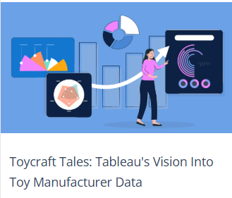
ToyCraft Tales: Tableau's Vision into Toy Manufacturer Data

Slide 2
Project Overview
Objective: Implement Business Intelligence using Tableau
Data Collection from databases
Data Preparation and Visualization
Building Dashboards and Stories

Slide 3
Data Collection & Extraction
Collected dataset from a source database
Stored structured data in a DB
Performed SQL queries to clean and analyze
Connected database with Tableau

Slide 4
Data Preparation
Cleaned and transformed the raw data
Created calculated fields and parameters
Merged datasets if required
Prepared final dataset for visualization

Slide 5
Data Visualizations
Bar Charts, Pie Charts, Line Graphs created
Used filters, parameters for interactivity
Customized visual properties for clarity
Ensured accuracy and insight-rich visuals

Slide 6
Dashboard Design
Combined visualizations in a dashboard
Made dashboards responsive and interactive
Ensured design consistency and readability

Slide 7
Story Feature in Tableau
Created story points using dashboards
Built a narrative to explain insights
Included text descriptions and transitions
Highlighted key trends and business impact

Slide 8
Conclusion
BI project provided data-driven insights
Used Tableau features effectively
Improved understanding of trends & KPIs
Ready for real-world BI implementation

