Slide 1
AI-Based Plagiarism
Detection System
Notes:
Introduce the B.Tech final-year viva presentation: an AI-based plagiarism detection framework designed specifically for short text documents using semantic similarity and NLP.

Slide 2
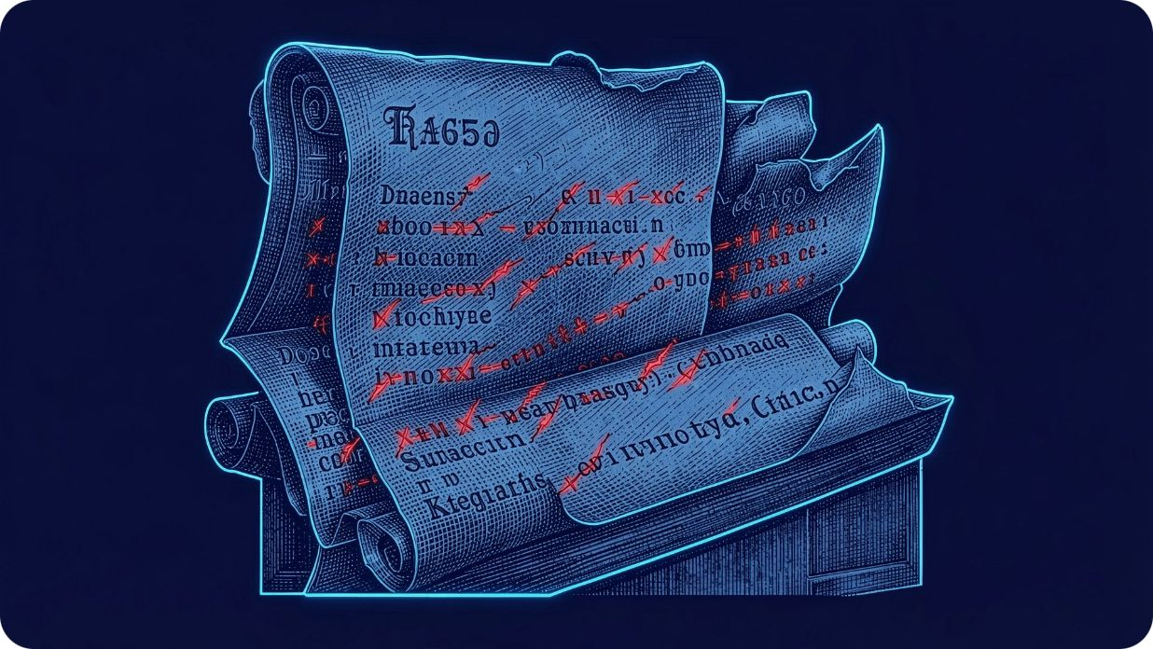
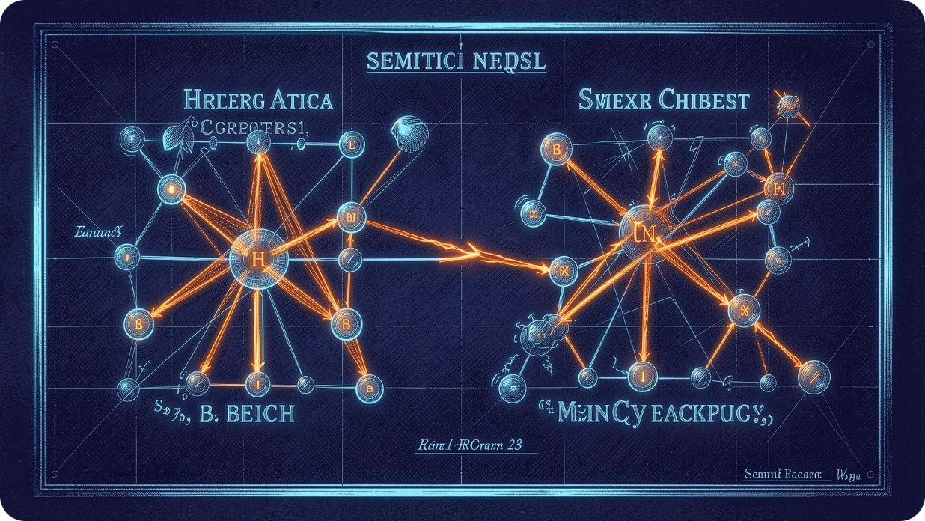
THE PROBLEM
Exact matching misses rewritten plagiarism
Digital assignments, reports, and online content are expanding rapidly.
CONVENTIONAL STRING MATCH
PROPOSED SEMANTIC NLP
Traditional tools compare exact words or phrases; paraphrased or rewritten passages can evade word matching.
NLP plus semantic similarity compares meaning and context.
Notes:
Explain the core limitation of legacy tools: string matching looks only for verbatim words. Our semantic solution evaluates contextual meaning through NLP embeddings.

Slide 3

PROJECT OBJECTIVES
The system turns originality checking into a repeatable workflow
Detect plagiarism in short text documents.
Prepare text with NLP preprocessing.
Compare sentence meaning, not only vocabulary.
Generate similarity scores and highlight suspicious passages.
Produce a report that reduces manual checking and supports academic integrity.
Notes:
Review the five key objectives: short-text optimization, preprocessing rigor, semantic contextual embeddings, granular highlighting, and defensible audit reporting.

Slide 4
SYSTEM ARCHITECTURE
From uploaded text to a defensible plagiarism report
1
Input text or uploaded document
2
Text extraction and preprocessing
3
Sentence segmentation
4
NLP feature or text-embedding generation
5
Semantic similarity analysis
6
Similarity score calculation
7
Plagiarism detection
8
Highlighted matches and final report
Reference document database feeds the semantic comparison module.
Notes:
Walk through the architecture in two passes: preprocessing and embedding (top row), followed by database correlation, scoring, thresholding, and reporting (bottom row).

Slide 5
DATA PIPELINE
Preprocessing makes comparison efficient
01
02
03
Raw text → clean text
Lowercase conversion and symbol cleanup
Tokenization and sentence segmentation
04
05
06
Stop-word handling
Lemmatization or stemming
Feature-ready processed text
Notes:
Detail each preprocessing stage: extraction, case folding, tokenization, stop-word removal, and lemmatization to ensure vector models receive clean syntactic units.

Slide 6
CORE NLP METHODOLOGY
Semantic similarity compares meaning and context
TEXT TO SIMILARITY SCORE
APPROACHES & INTERPRETATION
Text becomes a numerical representation called an embedding.
Sentence A → embedding vector
Sentence B → embedding vector
Vectors → cosine similarity score
Cosine similarity compares the direction of two text vectors.
Possible approaches: TF-IDF, word embeddings, sentence embeddings, BERT, and Sentence-BERT.
Score close to 1 → highly similar; score close to 0 → low similarity.
Notes:
Explain how embeddings represent text and how cosine similarity compares vector direction to identify semantic similarity.

Slide 7
A threshold separates original, similar, and suspicious text
User enters or uploads text
Document processing and sentence extraction
Semantic embedding generation
Comparison with reference documents
Similarity scoring
Threshold-based classification
Matching or paraphrased content identified
Plagiarism report generated
Similarity Score: 82% — example/demo value only; not an experimental result.
Notes:
Describe the threshold-based workflow from user input through report generation. The 82% similarity score is an example/demo value only, not an experimental result.

Slide 8
VERIFICATION INTERFACE
A dashboard makes sentence-level evidence visible
Auditors inspect aggregate similarity alongside fine-grained, color-coded sentence analysis.
INSPECTION SUMMARY
SENTENCE-LEVEL AUDIT TRAIL
82%
Sentence | Submitted Text Analysis | Sim Score | Verdict
S-01 | "Deep neural networks identify patterns in raw data." | 94% | Red Flag
S-02 | "Model convergence depends on tuning learning rates." | 87% | Red Flag
S-03 | "Our methodology collected samples across two lab trials." | 52% | Review
S-04 | "The observed delta in output voltage was 1.4 millivolts." | 18% | Original
OVERALL SIMILARITY (DEMO)
Document: project_submission_v2.txt
Word Count: 348 words · 14 sentences
Flagged Sentences: 9 / 14 (64%)
Illustrative demo test metrics for evaluation walkthrough.
Evidence highlighting: Green (<40% original), Yellow (40–75% review), Red (>75% suspicious match).
Notes:
Demonstrate how the examiner dashboard breaks down overall document similarity into transparent, sentence-by-sentence evidence rows with specific matched citations.

Slide 9

APPLICATION & EVOLUTION
Semantic detection expands where originality checking can work
Advantages
Future scope
Paraphrase detection; faster analysis; scoring; highlighting; reduced manual verification.
Larger documents; internet-wide comparison; multilingual support; PDF/DOCX input; deep-learning analysis; AI-generated-content detection; cloud deployment; mobile access; real-time scanning.
Applications
Schools; colleges; universities; research institutions; online examinations; publishing; report verification.
Notes:
Summarize advantages, applications, and future scope for semantic plagiarism detection.

Slide 10
PROJECT CONCLUSION
Meaning-aware verification for academic integrity
By pairing NLP preprocessing with dense neural embeddings and cosine similarity, the system detects rewritten and paraphrased plagiarism that bypasses legacy word matching.
THANK YOU
Questions & Discussion
Notes:
Conclude the viva presentation: reiterate that semantic comparison provides defensible, interpretable evidence, and invite questions from the panel.

