Slide 1
Vi-Soft
Quality Control Management Solution

Slide 2
Content list
Abbreviations
Technology
Architecture
Solution Overview
Business Processes
Administration roles

Slide 3
Abbreviations - technology stack
HTML - HyperText Markup Language
CSS - Cascading Style Sheets
JS - JavaScript
SPA - Single Page Application
HTTPS - HyperText Transfer Protocol Secure
WAF - Web Application Firewall
2FA - Two Factor Authentication
SFTP - SSH File Transfer Protocol
SSH - Secure SHell
SSO - Single sign-on
DB - Data Base
NLB - Network Load Balancer
SQL - Structured Query Language
noSQL - not only SQL
CRUD - Create, Read, Update, Delete

Slide 4
Abbreviations - business
QMS - Quality Management System
QC - Quality Control
QA - Quality Assurance
NCR - Non-Conformance Request / Report
POC - Proof Of Concept
RFI - Request For Information
CAR - Corrective Action Request
PAR - Preventive Action Request
OBS

Slide 5
Technology
High performing load balancer.
Scale out and handle more users than you can with a single server.
The redundancy – if one server fails, others are available to ensure the application stays online.
HTML+JS+CSS, Web Based SPA (Single Page Application)
No software installation required, just use your browser (supported evergreen browsers only, like Google Chrome, Mozilla Firefox, etc.)
Ability to work with many device types include PC, smartphones, laptops etc.
Client dependent on the server through API only.
Asynchronous, stateless Web server with the higher ability to horizontal scalability, which allows implementing microservices architecture and active health checks.
NoSQL schema less database which can store any types of data structures in the same collection.
Based on the highly customizable and very flexible microservices + SPA architecture, that provides quick time to market solution.

Slide 6









Architecture
WAF
Authentication
HTTPS
Authentication
App servers pool
DB servers pool
HTTPS
CRUD
End user QC/QA etc.
Keep alive service
HTTPS
payload
NLB
HTTPS payload
Lab Results
Manual Processing
E-mail server
Lab orders
SFTP server
Lab Results
Automatic Results processing

Slide 7
Solution Overview
Integrated permission levels
Self registration
Create new system account/use the third-party authentication service like Google/Facebook
Account activation by email verification
Optional, activate multi-factor authentication (2FA) via email/Smartphone Application
Accept license agreement
Payment
Trial period
Pay via one of payment services or credit/debit card
Authentication
System account/SSO via the third-party solutions
multi-factor authentication (2FA), if activated
Authentication
Based on roles
Global Admin (system root permissions)
Domain Admin (domain root permissions)
Project Admin (CRUD permissions on his projects and manage regular users)
Regular user (has permissions granted by Project Admin)

Slide 8
Solution Overview
Make it possible for a project admin to define its project information by himself
Easily fill online Forms/Checklists of any kind to support your business flow
Export Forms to Excel/PDF (for final Signatures)
Attach and save any documentation (Signed Document, ISO, etc.)
Track Activity by –
Exporting data to a Report
Easily search for data using built in search engine
Analyze data Online
Lab orders management (SII, Isotop, Magma)
Multilingual Support
English
Hebrew
Russian

Slide 9
Business Processes
Project Tree management
Project Contacts Management
Preliminary Control
Work Checklists Management
NCR (Non-Conformance Request / Report)
POC (Proof of concept)
Lab Orders and Lab Results management
Supervision Reports
RFI (Request For Information)
Reporting and Analytics

Slide 10
Administration roles
Administration role - Global admin
Root permissions on the system
Administration role - Domain admin
Root permissions on the system domain (Israel, Russia, etc…)
Administration role - Project admin
Should be able to create/update a project data
Create a project
Create a logo for QC company if needed
Create a project tree + relevant structures
Create a lab to send orders to + create a form to be sent to the lab.
Create users for the project, only lower role
Create checklists, or use existing.
Create lab test codes, or use existing.
Create a format for checklist forms

Slide 11
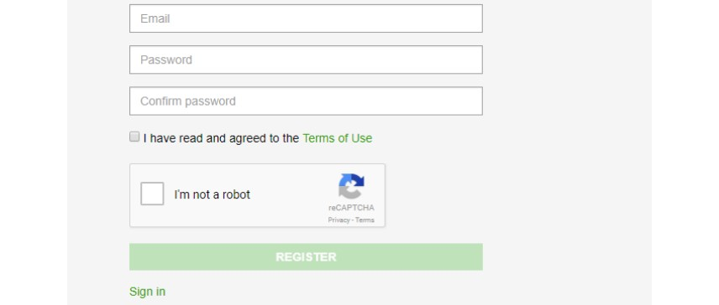

Slide 12
