Slide 1
Yocto Practice
Yaron Daniel

Slide 2
Practice
Exercise1:
create and add new layer to your project – name it ‘meta-student’ – verify that layer added .
Copy file core-image-minimal.bb (use find command ) to your recipe core inside your layer (recipes-core/images/) , name it student-image.bb
Build the image with this recipe
Run runqemu slirp nographic (from separate terminal)

Slide 3
Practice
Solution Execursie1
Bitbake-layers create-layer ~/meta-student
Bitbake-layers add-layer ~/meta-student
Bitbake-layers show-layers
Mkdir –p ~/meta-student/recipes-core/images
From ~/poky : find . –name core-image-minimal*
Cp ./meta/recipes-core/images/core-image-minimal.bb ~/meta-student/recipes-core/images/student-image.bb
Bitbake student-image
runqemu slirp nographic (from separate terminal in ~/poky , need to run . Oe before)

Slide 4
Practice
Exercise2:
Create a new toolchain for your project (use sdk slide)
Please note this operation can take ~1 hour and addition size of 60 G
Edit simple hellow-world.c that do some print to screen and save
Compile it use your cross-compiler sdk (gcc-*) – follow the sdk slide .
Verify you have executable file .

Slide 5
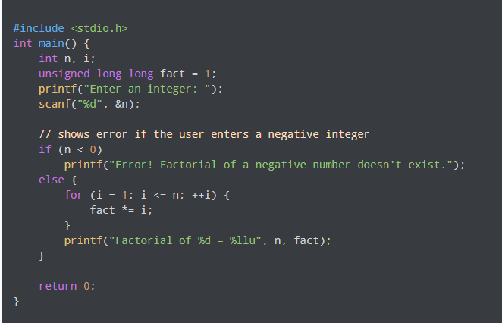
Practice
Solution Execursie2
Follow the steps according in SDK slide
Vim /tmp/factorial.c
Copy the below to this file and save
x86_64-linux-gnu-gcc /tmp/factiorial.c –o factioral

Slide 6
Practice
Exercise3:
Step1:
Add new recipe inside the layer from ex1 , call it recipe-<name_app> that implement the below :
Compile the file
Install the file to /usr/bin
Install the application to the image – in the image you create in ex1
Build and run the emulator
Check that you can run the application in the target
Hint : check ‘meta-skeleton’ for template.
Step2:
Add new recipe that called ‘recipe-init’
In this task need to use sysvinit init-manager , follow the below:
Create .bb file that add an init script to your image
The init script will run the app from ex1 and direct log as follow name_app > /tmp/log.txt
Hint : use template file recipes-init that copied to docker in /var/yocto/practice/recipes-init
Build and run the emulator
Print the log : cat /tmp/log.txt

Slide 7
Practice
Solution Execursie3
Step1
From ~/poky
Mkdir –p ../meta-student/recipes-apps/factiorial/hellow-single/
Cp –rf meta-skeleton/recipes-skeleton/hellow-single/* ../meta-student/recipes-apps/factiorial/
Mv ../meta-student/recipes-apps/factiorial/hello_1.0.bb ../meta-student/recipes-apps/factiorial/factiorial_1.0.bb
Edit factiorial – change all the hello world to factiorial (compile and install)
Mv ../meta-student/recipes-apps/factiorial/files/helloworld.c ../meta-student/recipes-apps/factiorial/files/factiorial.c
Edit the code ../meta-student/recipes-apps/factiorial/files/factiorial.c
Add to image : student-image.bb -> add to vatiable IMAGE_INSTALL:append = “factiorial”
Bitbake student-image
Runqemu slirp nographic
Run application

Slide 8
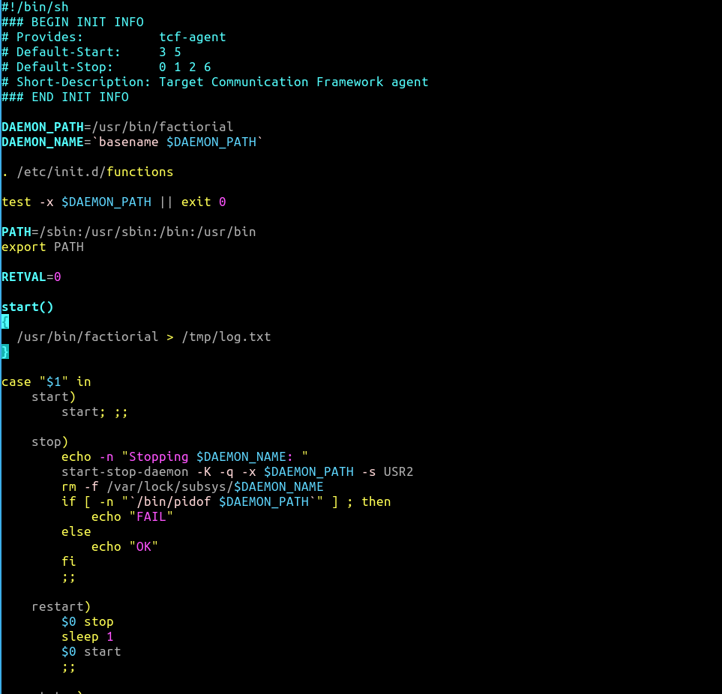
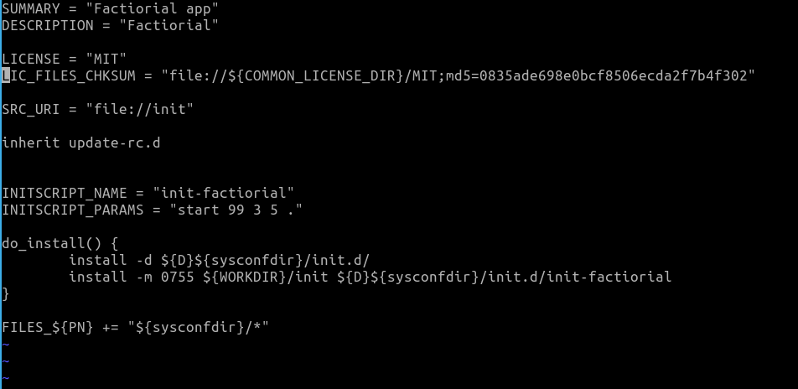
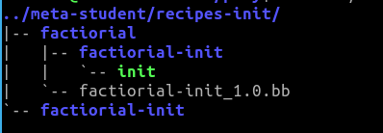
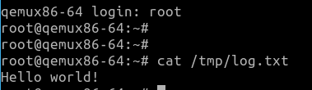
Practice
Continue Solution Execursie3
Step2
Mkdir –p ../meta-student/recipes-init/factiorial/factiorial-init
Copy recipe .bb init template to ../meta-student/recipes-init/factiorial/
Copy init script template to ../meta-student/recipes-init/factiorial/factiorial-init/
Edit recipe and rename according the app
Edit the init according.
Add the recipe to image in your layer
Build and run

Slide 9
Practice
Exercise4:
Step1:
Create bbclass and call it debug_tools
Write inside it all the debug tools you want to it : stress-ng, valgrind
Step2:
Add to your custom image the debug_tools by use inherit
Build and run
Check that you have these tools in your image

Slide 10
Practice
Solution Exercise4:
Step1
Mkdir ../meta-student/classes
Vim ../meta-student/classes/student_debug_tools.bbclass
IMAGE_INSTALL:append = “ stress-ng valgrind”
Step 2
Add this line to the recipe for image Inherit += “student_debug_tools”
Build image
Run these tools to check if they are running and exist

Slide 11
Practice
Exercise5:
Step1:
Change the recipe-init script that the application will direct the print to /dev/kmsg – kernel log
Build and run
Note that you should see the print of the app to the screen and not just the log ? Why?
Step2:
Configure the kernel following the below , you can use 2 methods : devtool or create fragment and manually add it to bbappend.
Disable the print of the kernel log to the screen by configuration of the log level in kernel configuration.
Search for variable CONSOLE_LOGLEVEL_DEFAULTS
Build and run
Hint : use template file recipes-kernel that copied to docker : /var/yocto/practice/recipes-init

Slide 12
Practice
Solution Exercise5:
Step1: edit ../meta-student/recipes-init/factiorial/factiorial-init/init and change path from /tmp/log.txt
to /dev/dmesg
Step2:
Method1:
Devtool modify linux-yocto
Devtool menuconfig linux-yocto
Menu->Kernel hacking->printk and dmesg options->default console loglevel – change to 4
Devtool finish linux-yocto ../meta-student
Build student-image
run
Method2
Bitbake linux-yocto –c menuconfig
Change the CONSOLE_LOGLEVEL to 4
Save and exit
Bitbake linux-yocto –c diffconfig
Mkdir ../meta-student/recipes-kernel/linux/linux-yocto
Cp the fragment output from the last command to ../meta-student/recipes-kernel/linux/linux-yocto , name it with meaning name
Edit or copy linux-yocto_%.bbappend and add the fragment name to it
build

