Slide 1
Stripe
Yaroslav Zhyvotovskyi

Slide 2
Plan
Overview
The problem
How it works
Encountering problems
Code
Link
Sources

Slide 3

Overview
Stripe is used online and in person to accept payments, send payouts, automate financial processes, and ultimately grow revenue.

Slide 4
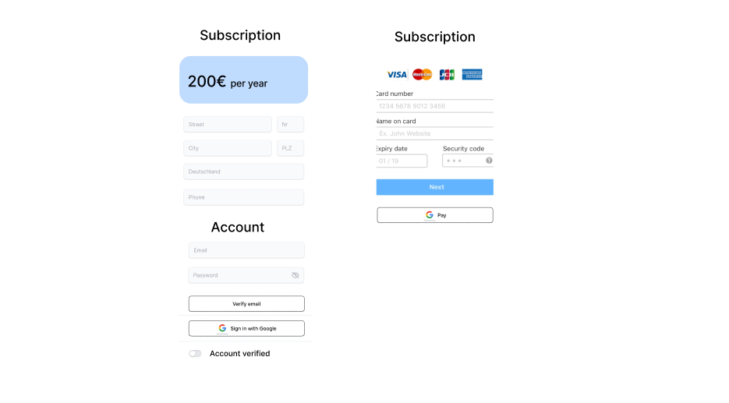
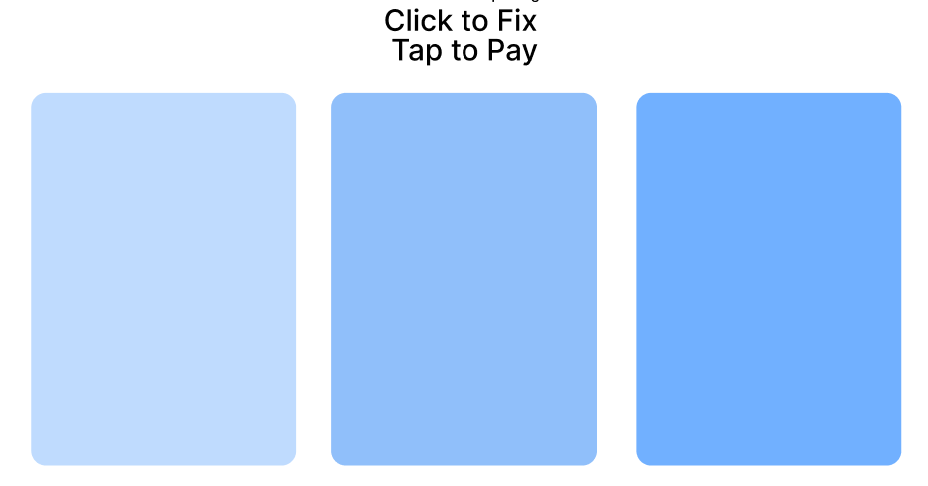
The problem
3 types of subscription, centralized management, something prebuilt(I’m lazy)

Slide 5
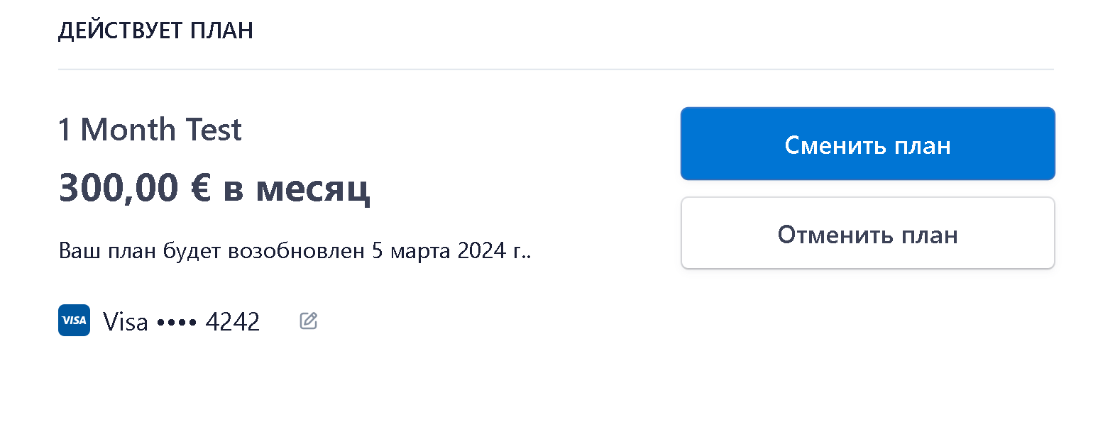
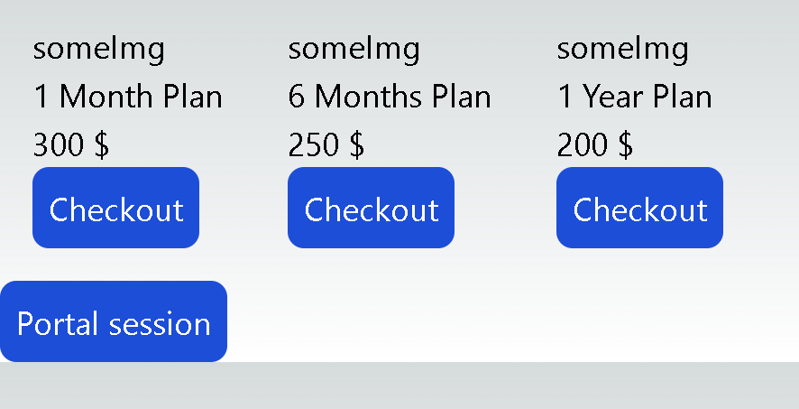
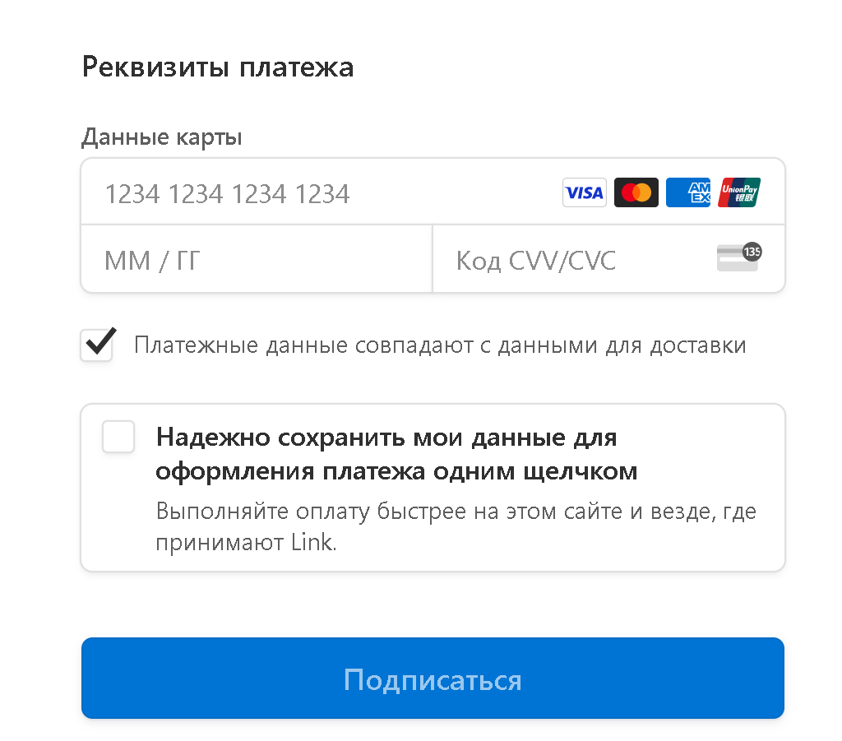
How it works
Portal (manage)
Checkout (pay)

Slide 6
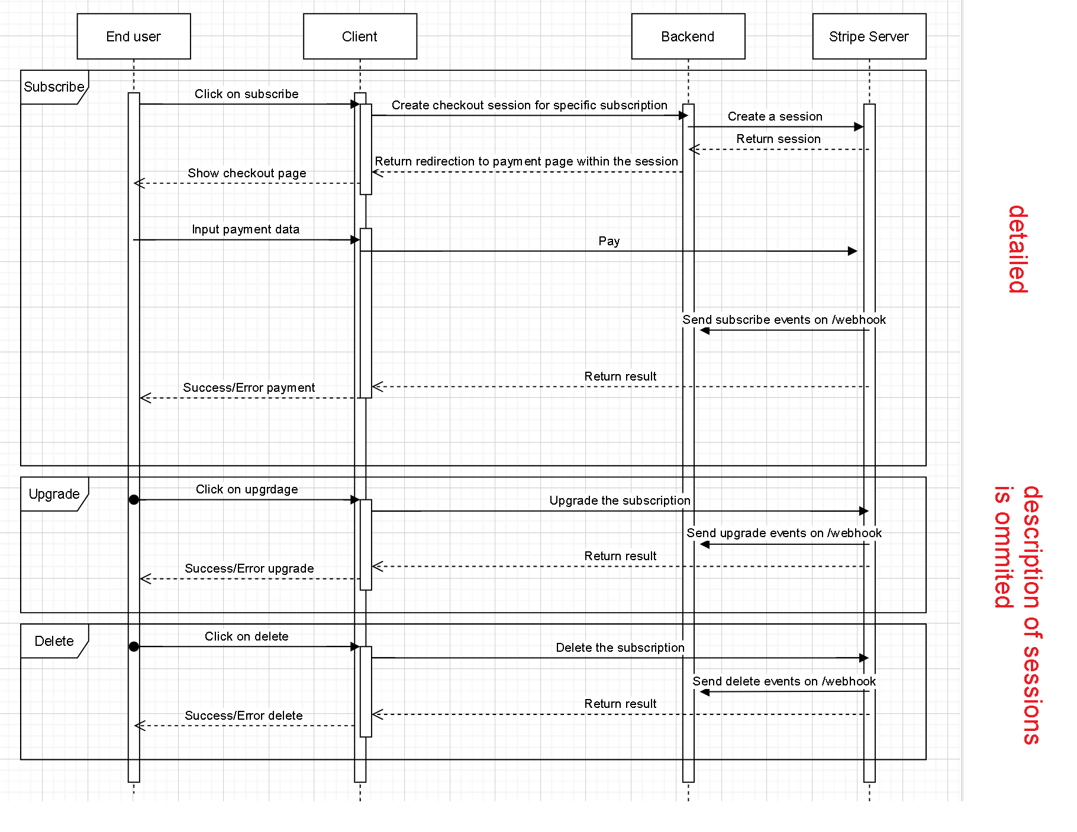
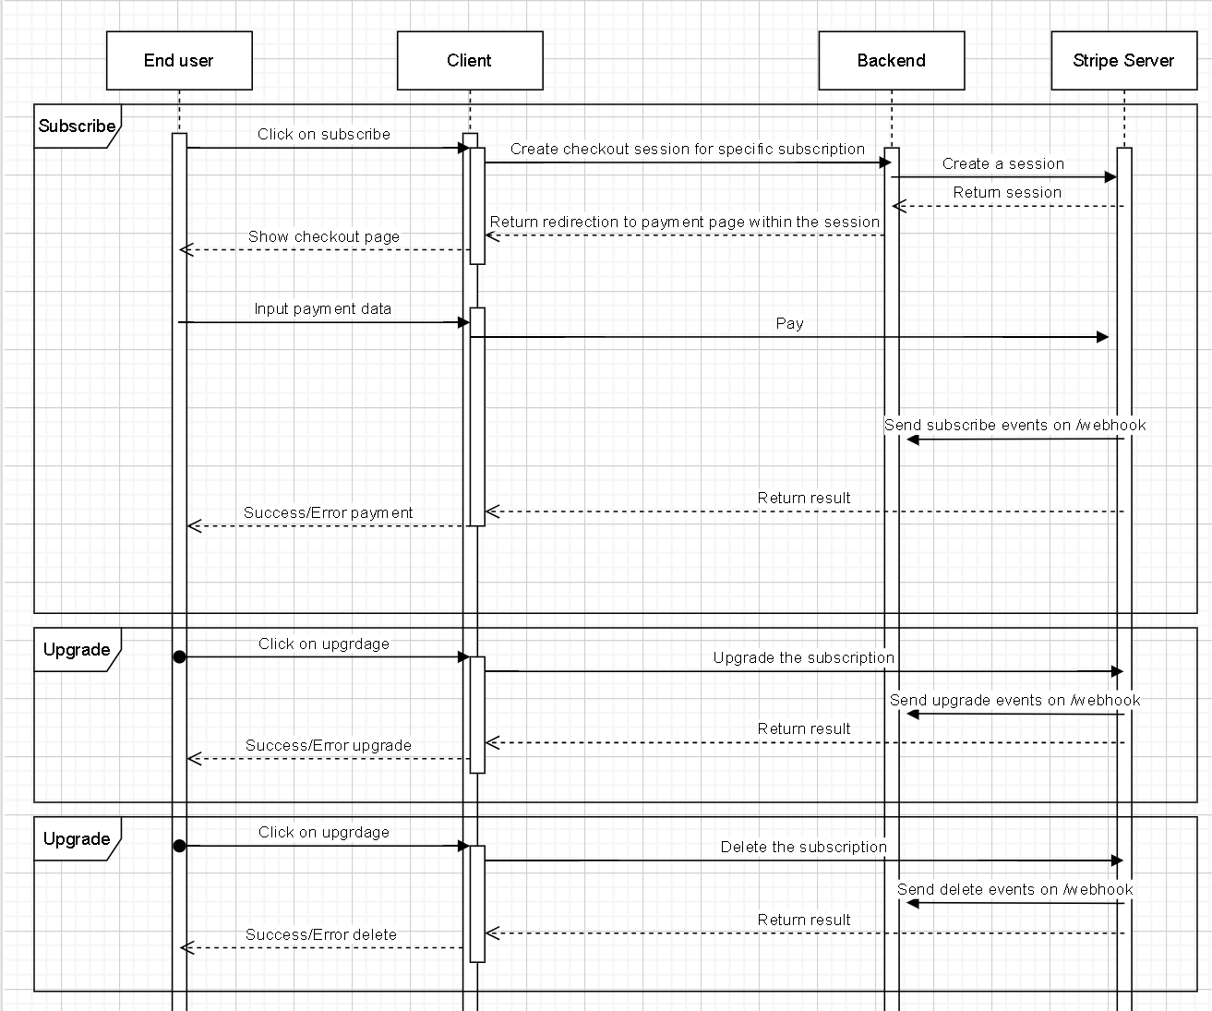
How it works - technical
Sessions
Events
Webhook

Slide 7
The problems you are going to encounter
1) Checkout page:
1. You can enter any email => email divergence (pre-population).
2. Backend can generate checkout session with
the email from auth context, so the frontend can pre-populate the form with email.
But if there is "Google pay", there you can choose any google account => email divergence
(turn off google/apple/link payments)
2) Portal page:
1. You can enter the email that you possess, but if someone entered your email
in checkout session => they overwrite your subscription (verify email)
2. Backend can generate portal session only after checkout
redirection => only after checkout (verify email)
3. If email doesn't belongs to you => can't enter portal page, cancel only
via bank (verify email)

Slide 8

Email divergence

Slide 9
Code
https://stripe.com/docs/checkout/quickstart
https://github.com/yaroslavsf/stripe-subscription

Slide 10
Sources
https://stripe.com/en-ch - off site
https://stripe.com/docs/api - api reference

