Slide 1
VLSI: Very Large Scale Integration
(Digital Integrated Circuits)
M.B. Ghaznavi-Ghoushchi
Dept. of Electrical Engineering
Shahed University
Tehran – IRAN
Lecture #22
©Copyright 2006 M.B. Ghaznavi-Ghoushchi
2006

Slide 2
Lecture#22: Micromagic in Action
In depth tutorial and step-by-step guide to using micromagic

Slide 3
Outline
2X4 Decoder

Slide 4
2X4 Decoder
2X4 Decoder

Slide 5
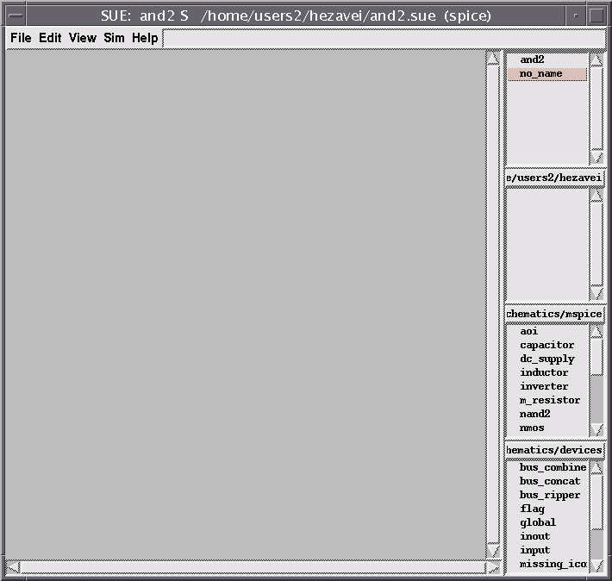
2X4 Decoder
CLI: sue
GUI: File -> New Schematic... -> and2

Slide 6
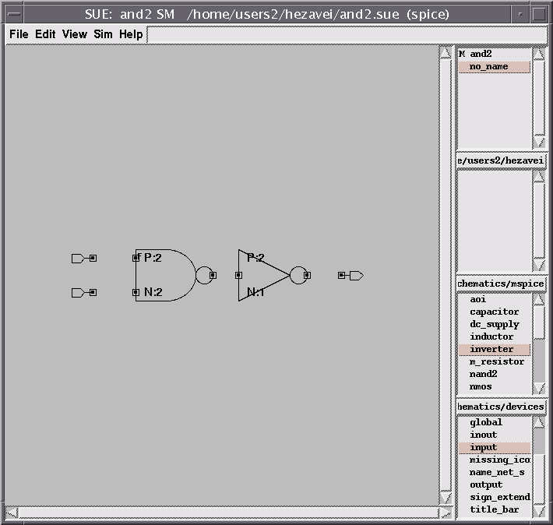
2X4 Decoder
GUI: From the right hand side toolbar choose "nand2" and "inverter" and from the lower one choose "input" and "output" and locate them on the screen in the following order.

Slide 7

2X4 Decoder
GUI: For making the connections you can either use the "add wire" command from the "Edit" menu or use the hot-key "w" or in this case simply press the BUT-2 on the input/output of the devices and drag them.

Slide 8
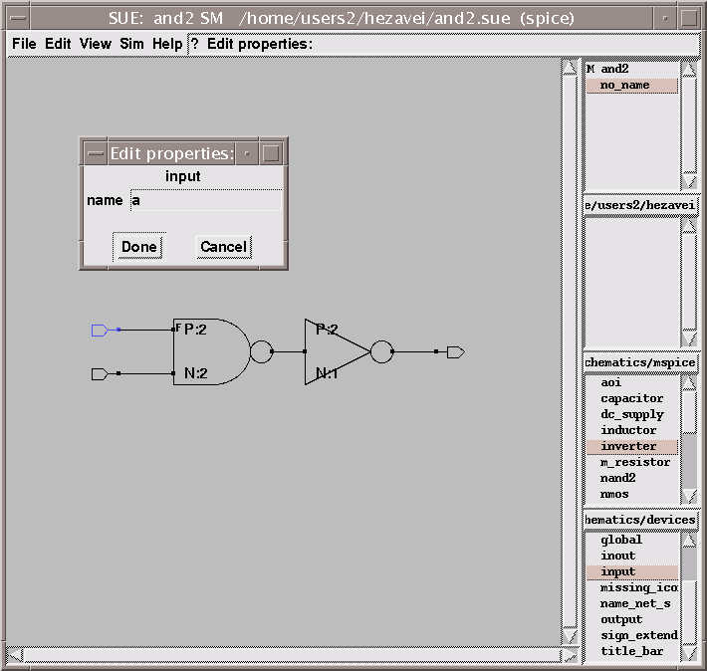
2X4 Decoder
GUI: You are able to access and edit the parameters of the devices by double clicking on them, here we we show the property menu for one of the inputs. We call the inputs "a" and "b" and the output "o"

Slide 9
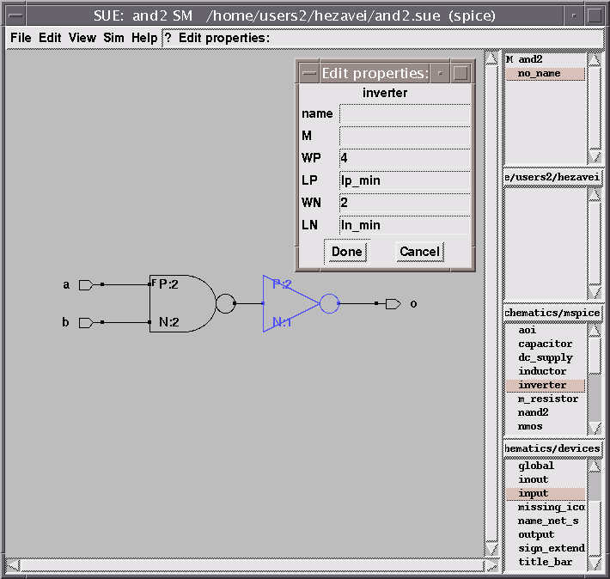
2X4 Decoder
GUI: Here we change the sizing of the inverter and chage the WP/WN = 4/2

Slide 10
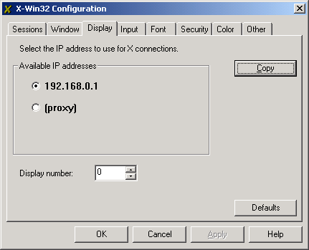
2X4 Decoder
Note: Your schematic is ready and you can save it. We need to extract the netlist and then it is possible to load the lay out of the circuit in MAX.
GUI:
  From "Sim" Menu choose "Change simulation mode" and change it to "Sim"
  From "Sim" Menu choose "Sim Netlist" ... This will create a and2.sim file.
  From "Sim" Menu choose "MAX Cross Probe Init"
  If your connection is via x-win32, (refer to CAD Tools PPT#17):
    For example if your X-connection IP is 192.168.0.1 enter and your display number is 0, then:
    192.168.0.1:0.0 is the number you will used in this step.

Slide 11
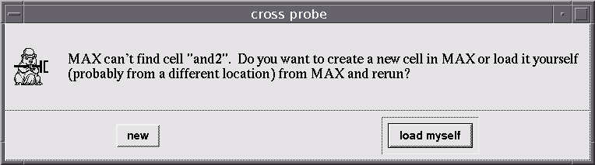
2X4 Decoder
Note: In most cases MAX window will come up with the following message:
GUI: Press "Load myself" Now from "Tool" Menu choose " Layout Generator", select and2.sim (or your design name). Hit Ok. The following window will pop up, which lets you change a couple of parameters.

Slide 12
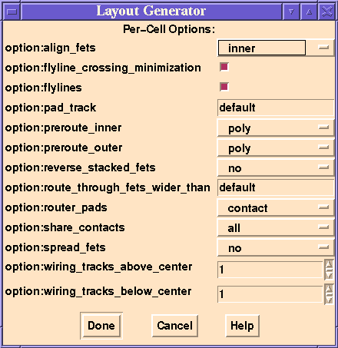
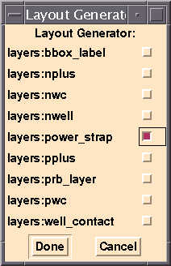
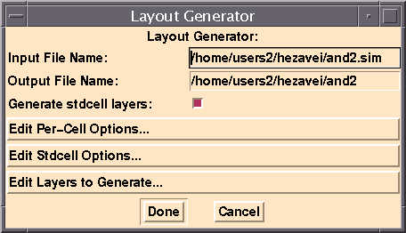
2X4 Decoder
Note: Let's take a look at "Edit Per-Cell Options". Note it lets you fold the PFETS and NFETS when desired. We are not changing anything in this one so press "Cancel".
Now go to "Edit Layers to Generate Option". For simplicity we just keep the "power_strap" and turn the other boxes including the wells off.

Slide 13
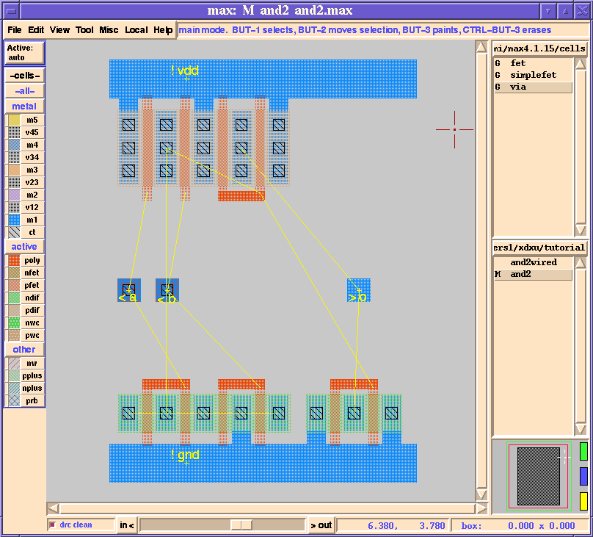
2X4 Decoder
Note: Now the actual layout of the two-input AND gate will come up with the flylines, which help you keep track of the connections according to your design in SUE . Here wiring should be done manually following the flylines.

Slide 14
2X4 Decoder
Note:
First if you like to move the "a", "b" and "o", you can:
  Select them all by selecting them first (drawing a rectangle around them, using But-1)
  Move them to the desired position while pressing But-2.
Then for wiring:
  You can use the "wire" command from "Edit" menu or the hot-key "w".
  Click on the point you want to start wiring like the poly. The mouse pointer will turn into a pencil.
  Start wiring, each click of But-1 will set a corner.
  Click the But-2 at the end of the wire.
Note: But-3 drops a menu.
  You can choose VIAs from the right hand side toolbar or use the drop menu during wiring.

Slide 15
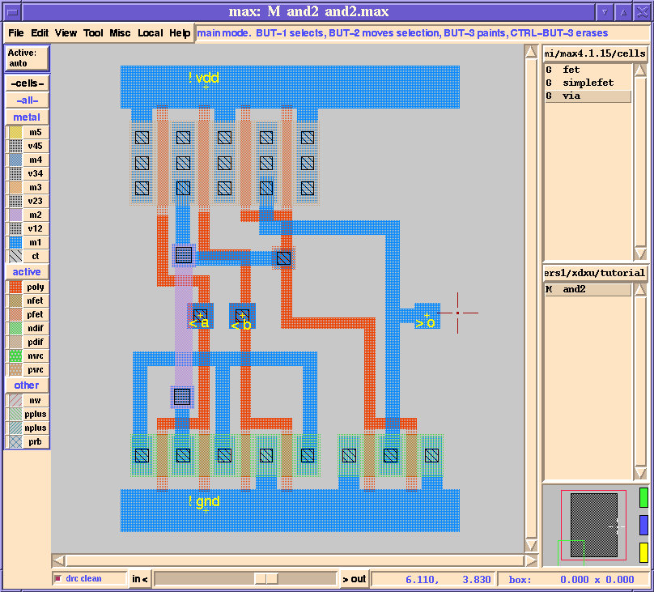
2X4 Decoder
Note: Your finally your AND gate may look like this:

Slide 16
2X4 Decoder
Note: Now you need to expand the input/outputs of your designed cell
This is usually done by expanding metal2
Now we want to extend the input/outputs with Metal2.
  You can use the "wire" command from "Edit" menu or the hot-key "w".
  Click on input "a" . The mouse pointer will turn into a pencil.
  Click the But-3. From the menu you can choose "drop via, UP".
  By Clicking But-1 you can place the via on the desired place and continue wiring using Metal2.
  Do the same for input "b" and output "o"

Slide 17
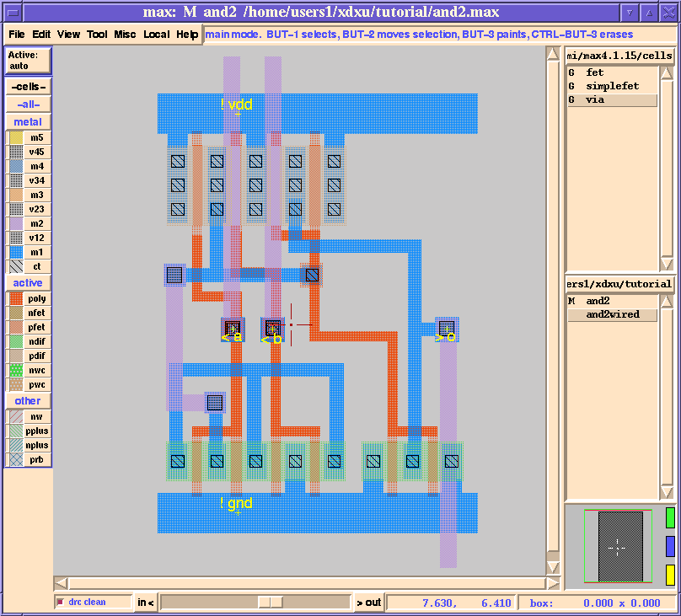
2X4 Decoder

Slide 18
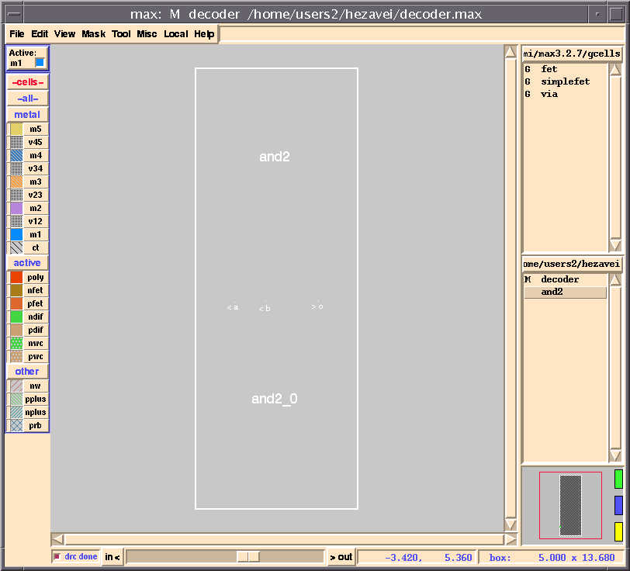
2X4 Decoder
GUI: Save your work, using "File" Menu.
Create a new MAX file with the name "decoder" (File -> New)
Use Shift-But-1 and click on "and2" on the right hand list. The unexpanded and2 will be shown. Place it on the screen.

Slide 19
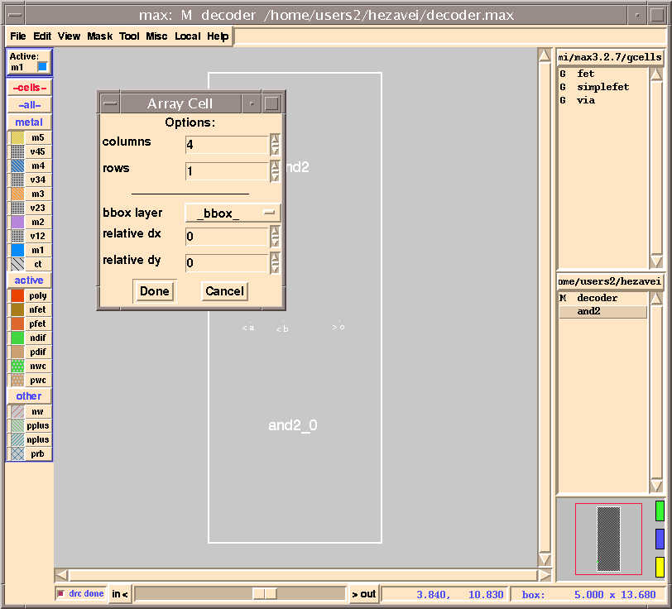
2X4 Decoder
GUI: Make sure your and2 cell is highlighted
From the "Edit" menu choose "Array Cell". We are making a 4-column,1-row

Slide 20
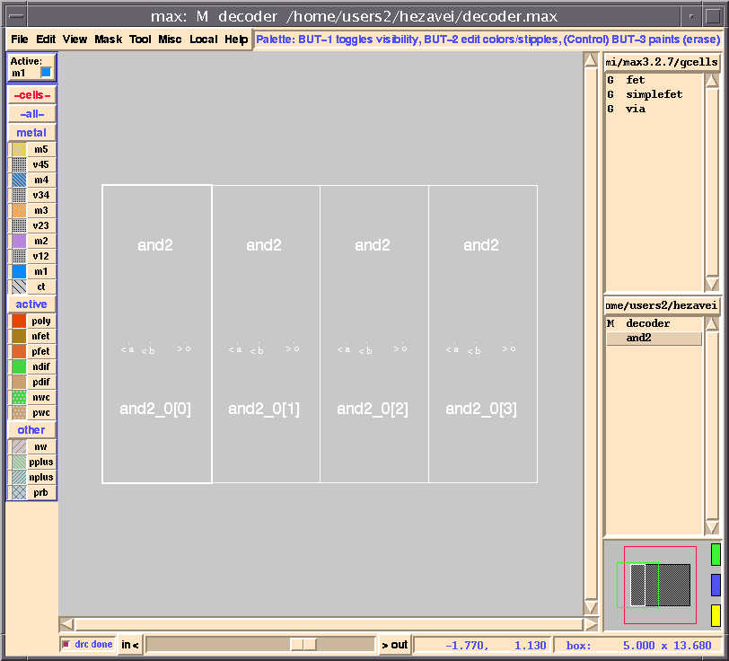
2X4 Decoder
Note: Which looks like this:

Slide 21
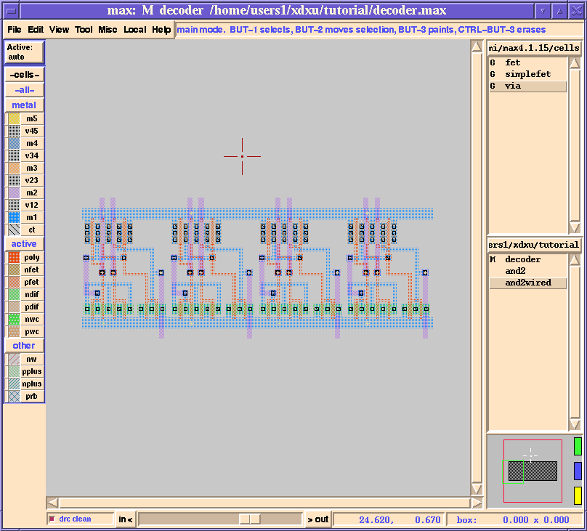
2X4 Decoder
GUI: You can view the internals by choosing "Internals, Show Area" from "View" menu or use hot-key "i“. Hiding would be "Internals, Hide Area" from "View" or use hot-key "h"

Slide 22
2X4 Decoder
Note: Now create an inverter by your self

Slide 23
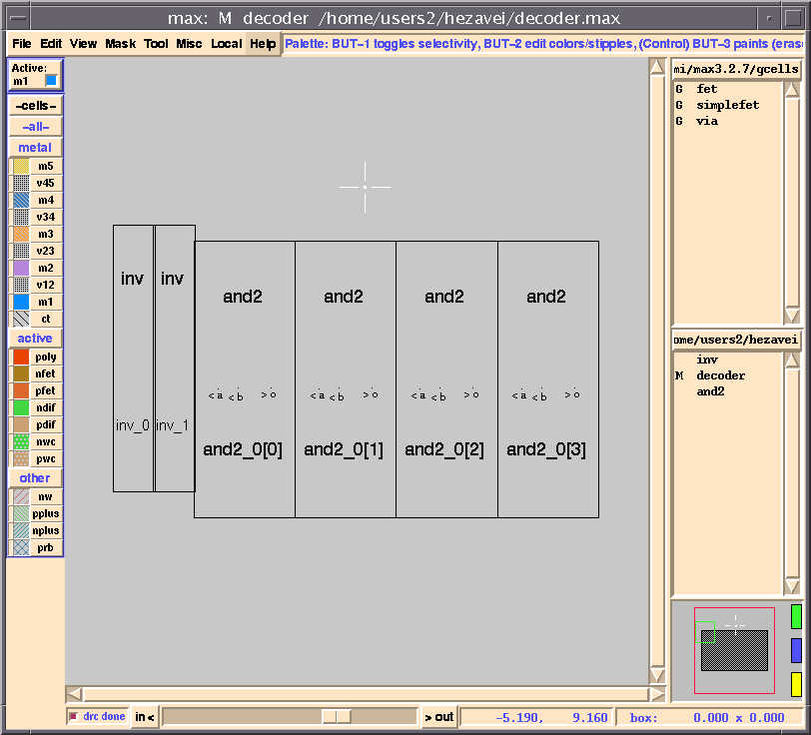
2X4 Decoder
GUI: From the right hand list choose "inv" by pressing "Shift-But-1". Two inverters are needed.

Slide 24
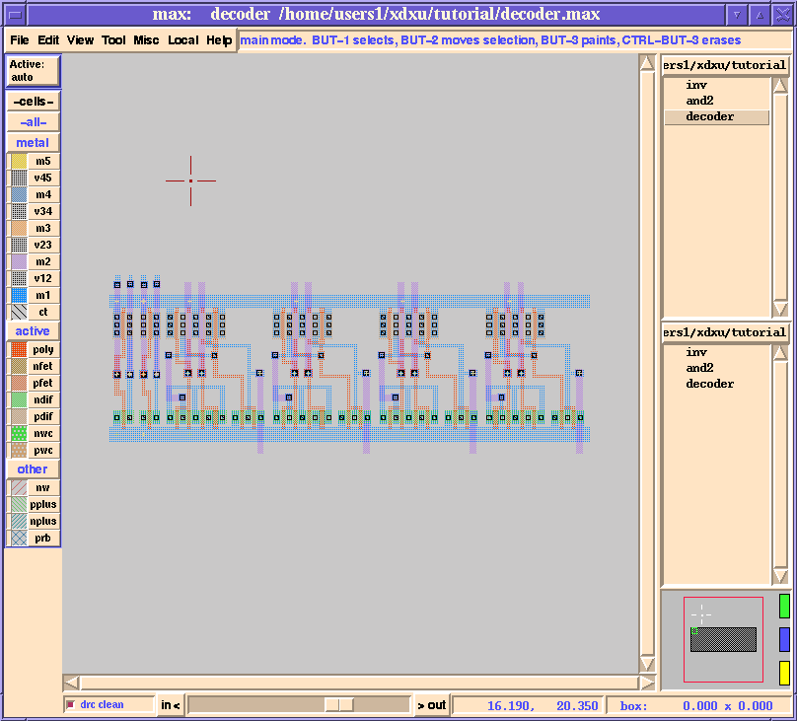
2X4 Decoder
Note: layout internal view

Slide 25
2X4 Decoder
Note:
Highlight the topmost cell you have now (just draw a big box around the whole thing), then
  flip the cell upside down by typing "r", or from the menu Edit->Flip/Rotate->Flip Upside-Down
  rotate the cell once [90 degrees clockwise] by typing "r", or from the menu Edit->Flip/Rotate->Rotate
This results in a rotated design

Slide 26
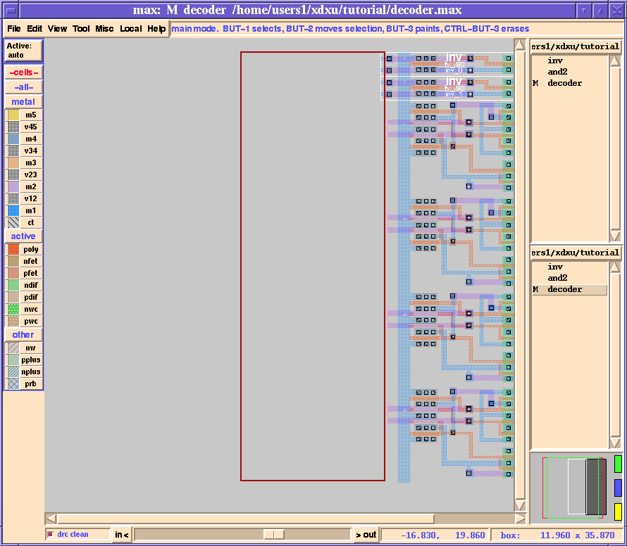
2X4 Decoder
Note: You'll have the following figure. Next draw a rectangle as in the following figure. Note that it overlaps the Metal1 layers on it's top right-hand corner.

Slide 27
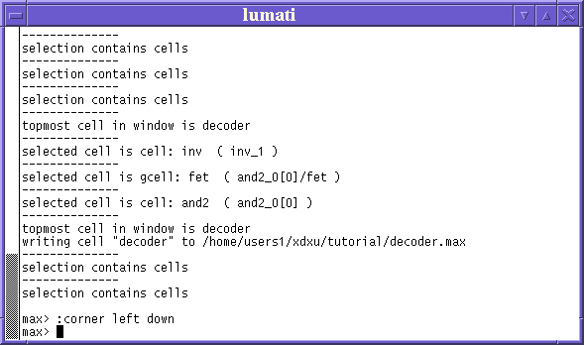
2X4 Decoder
CLI: Now we want to use a text command:
  Point to the max-text window (Shown below)
  Type:
    :corner left down
    (Don't forget the ":") The wiring is done automatically.
NOTE: For the text commands you can check "Text Commands" form "Help" menu.

Slide 28
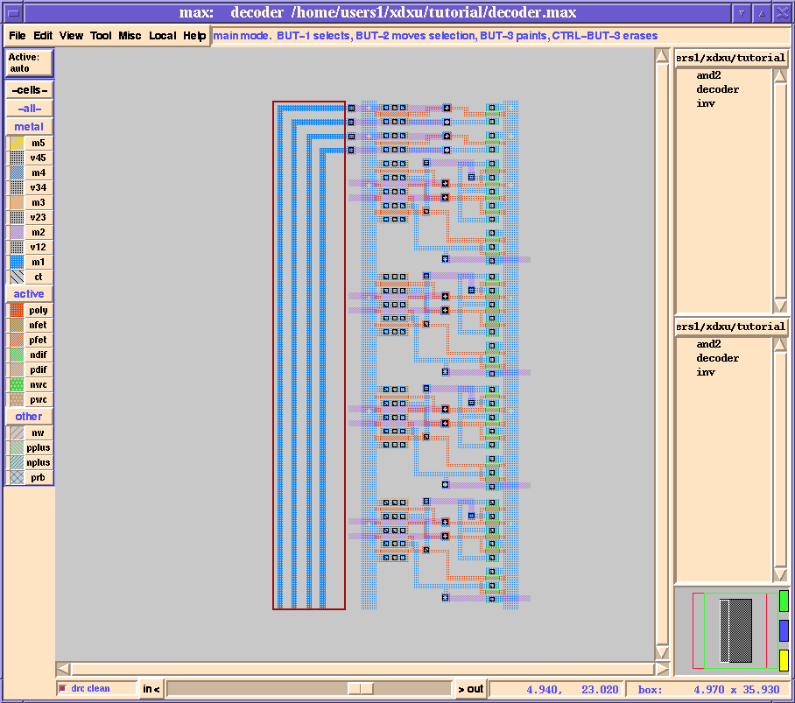
2X4 Decoder

Slide 29
2X4 Decoder
CLI: Now you can finish wiring and labeling and have the final layout as follows:
  Labeling on metal2 (purple):
  On the left: 2 Inputs (in1 and in0, from top to bottom)
  On the right: 4 Outputs (out3, out2, out1 and out0, from top to bottom )
  Save your design

Slide 30
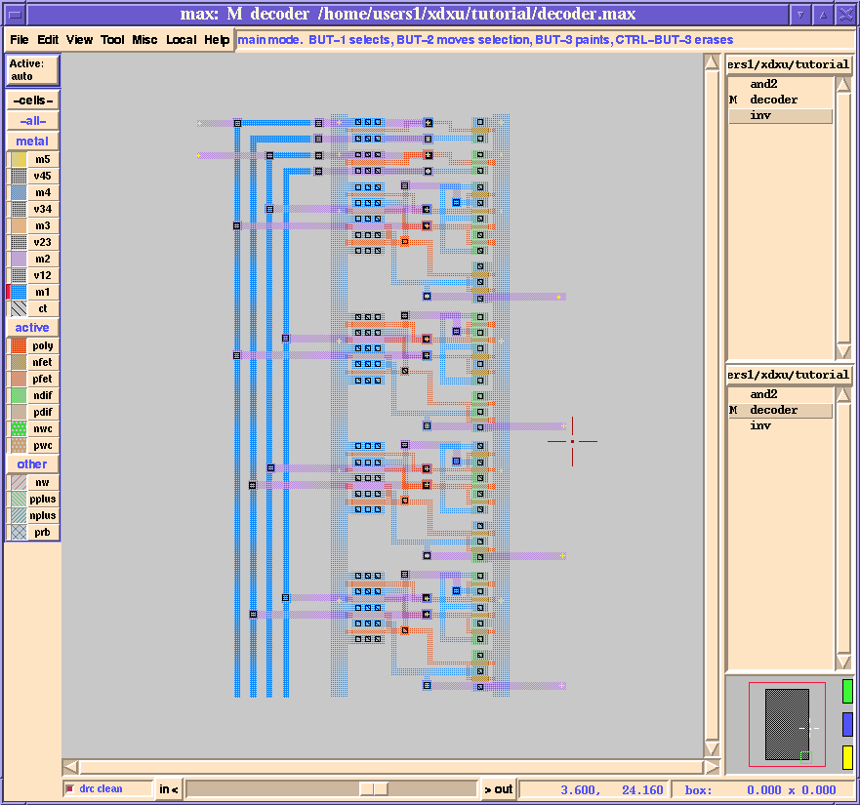
2X4 Decoder

Slide 31
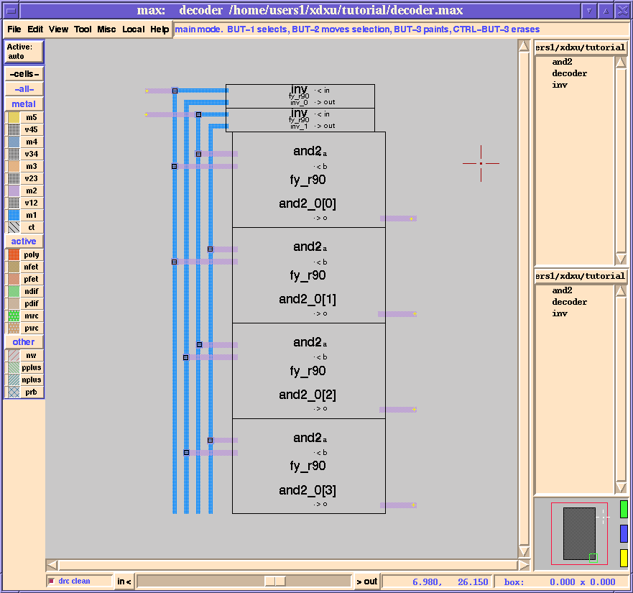
2X4 Decoder

Slide 32
2X4 Decoder
Note: The color of lines outside of the rectangular sections cells (toggle viewable vi hotkeys ‘I’, ‘h’) are some bit tint than inside that sections.
This is comes from the fact that the cells are not flattened.
Note: Now, we need to flatten out the and2 cells and inverter cells. Select everything in view, click Misc->Flatten Cells (don't touch options) and click Done.

Slide 33
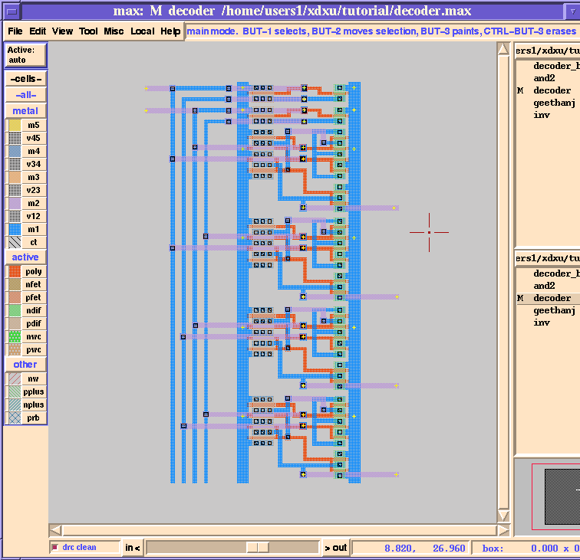
2X4 Decoder
Note: You'll see the following. Compare the colors with those before flattening.

Slide 34
2X4 Decoder
Note:
As you can see, there're many little yellow + signs (which are labels) spread all over the layout. Most of them belong to those and2 and inverter cells before the topmost cell is flattened.
You want to erase unnecessary labels. The following shows a fast way of doing that:
Draw a box to surround unwanted plus'es. You may need to do this more than once (But remember to leave out one label on VDD and one on GND)
CLI: Then in the max terminal, enter
max> :erase labels

Slide 35
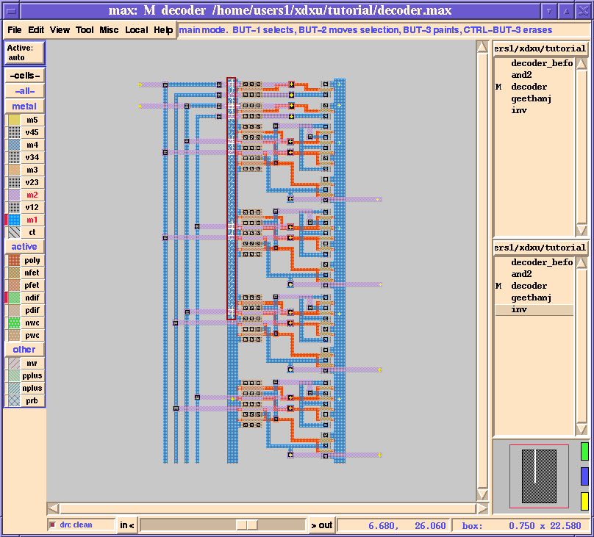
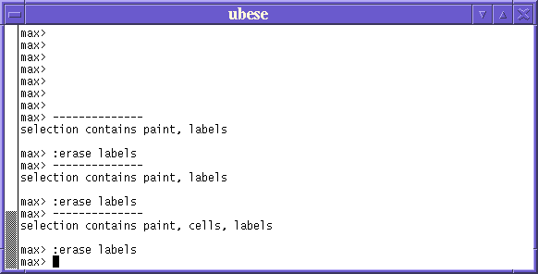
2X4 Decoder
Note: Labels

Slide 36
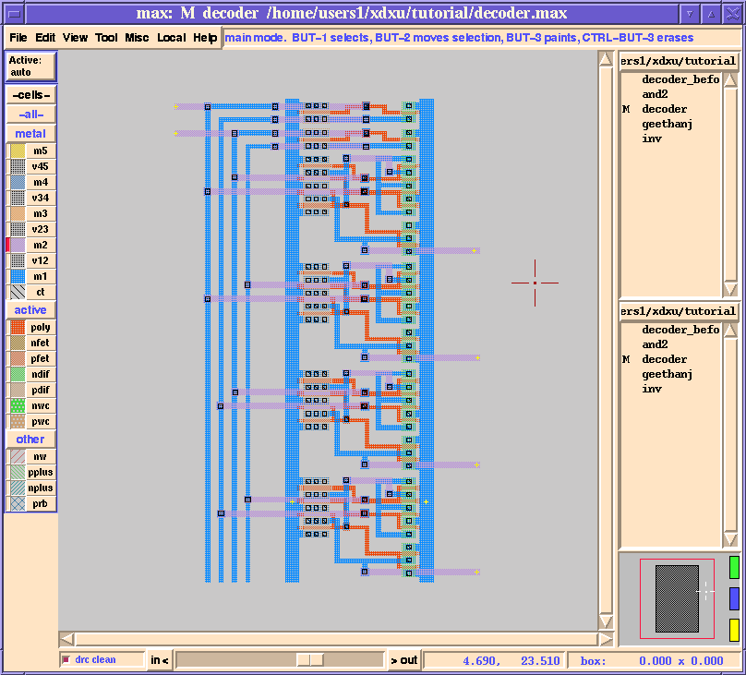
2X4 Decoder
Note: Labels

Slide 37
2X4 Decoder
Note: Extraction of net-list
Micromagic comes with atool called ext2spice
ext2spice - convert hierarchical ext extracted-circuit files to input files for spice
Ext2spice will convert an extracted circuit from the hierarchical representation in the ext(5) format produced by Magic to the flat representation in spice format suit- able for input to the SPICE circuit-level simulator. The root of the tree to be extracted is the file root.ext; it and all the files it references are recursively flattened. The result is a single, flat representation of the circuit network that is written to the file root.spice. Equivalences between the node numbers required by SPICE and the node names from the extracted circuit appear as comments in the SPICE deck of the form ``** NODE: num = name''.
Nodes are output as explicit capacitors to ground, if their capacitance exceeds the threshold for capacitance specified on the command line. In addition, if a node's lumped resistance exceeds the threshold specified with the -r flag (see extcheck for details), all connections from transistors to that node are made through an explicit resistor whose resistance is half of the lumped node resistance. One terminal of the resistor will be the node; the other will be a dummy node that exists solely to connect the resistor and transistor terminals together.

Slide 38
2X4 Decoder
Note: Extraction of net-list
Don't forget to save your design.
You're almost ready for SPICE simulation now. Let's now extract the layout to a .ext file. Click Local->extract it, and a file called "decoder.ext" is created. (What is a .ext file for? )
From this point on, you can leave Max alone for a while.
Use ext2spice to build your HSPICE input netlist file. Add the HSPICE transisitor models to the netlist file. Finally, add your HSPICE experiment to the end of the netlist files and save the file with a .sp file extension. Please hand in the final HSPICE .sp input file.
I will deliver a shell script to do this for you on fly.

Slide 39
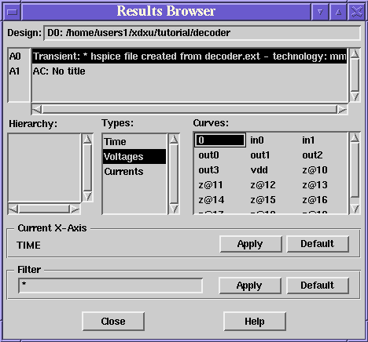
2X4 Decoder
Note: Hspice simulation
Use "Avan Waves" window and a "Result Browser" window. Select "Transient: * hspice file....", and you'll see

Slide 40
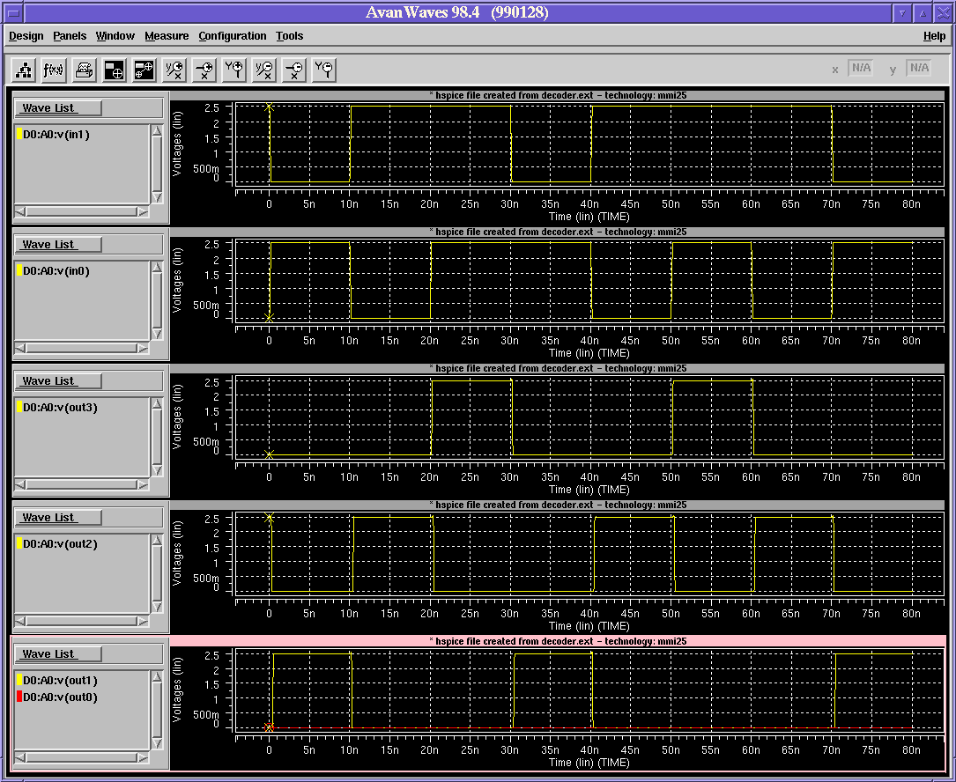
2X4 Decoder
Note: Hspice simulation
The "Avan Waves" window can display the voltage curves at various inputs and outputs into a single panel or different panels:

