Slide 1

Department Of Computer Science and Engineering
STUDENT PERFORMANCE ANALYSIS SYSTEM USING
MACHINE LEARNING TECHNIQUES
Project Guide
Dr. G. Madhavi
Team Members (BATCH 14)
Ms.Naga Venkata Asritha Karodi - 16031A0523
Ms.Dedeepya Yarra - 16031A0554
Mr.Durga Sai Prasad Kundera - 16031A0529
Mr.Sampath Kumar Mudakala - 16031A0545

Slide 2
CONTENTS
Abstract
Introduction
Literature Review
Modules
System Analysis & Design
Architecture
Software Tools
Status of work
References

Slide 3
Problem Statement
Keeping track of and estimating the performance of huge number of students in an educational institution is very difficult
Abstract :
Educational institutions now a days are producing a vast amount of data that can be analysed to enhance the status of the present day education system. Such data when organised in a well defined manner can be used to predict values that help in the improvement of a student’s performance. Student Performance Analysis System (SPAS) facilitates students to perform the above specified task using results obtained by them in the exams. Based on the predictions made by the system the students can be encouraged and guided by professors to improve their scores which in turn increases the pass percentage of the class. SPAS show cases the importance of data analysis in the field of education system and how it helps in improving the system as a whole. The main idea of the project relies on using Decision tree classifier algorithm in supervised learning, as the input provided is student dataset containing labelled data and from which numeric values are predicted with at most accuracy.
Phase 1
Phase 2
Phase 3
Phase 4
Problem and data understanding
System Analysis and design
Implementation and Testing
Evaluation of results
Fig.1 Methodology

Slide 4
Introduction
Students are the main assets of schools and Universities.
Academic performance achievement is the level of achievement of the student’s education goal that can be measured and tested through examination ,assessments and other forms of measurements.
The student academic performance is usually stored in different forms like files,records,documents etc.,But the increasing amount of the student data in each institution has made it difficult to analyse each student’s performance
using the traditional static techniques.
This difficulty has created a necessity for a tool that can easily extract the useful information from student data and this can be used to predict each student performance.
The tool which can be used for this purpose is our project i.e., Student Performance Analysis System(SPAS).
Here we use an algorithm called descion tree classifier which we create a tree and prune the data based on information gain ,gini index and entropy and finally predicts the Grades of students

Slide 5
Literature Review
A background study is done to review the similar existing systems used to perform student performance analysis.
Three existing systems are chosen because they are similar to the proposed system.
Name | Description | Drawbacks
Faculty support System (FSS) | This system uses WEKA .Although it is a cost effective one but it is difficult for normal users to understand the algorithm techniques such as classification,regression.. | It can be used only by the people who are familiar with WEKA tool.
Student Performance Analyser(SPA) | This is a web based software.It takes a threshold value to which the students performance is compared. | Exact results are not provided
Intelligent Mining and Decision Support System(InMinds) | This system also uses WEKA .It analyses the performance obased on the graphs and charts produced by the WEKA tool. | It can be used only by the people who are familiar with WEKA tool.
Student Performance Analysis System(SPAS) | This system used rule based analysis for performance analysis | Its not dynamic in nature

Slide 6
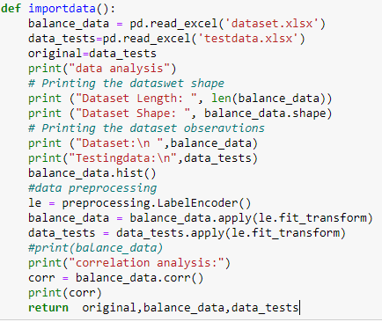
Project Modules : -
1. Importing dataset , preprocessing and understanding dataset:

Slide 7
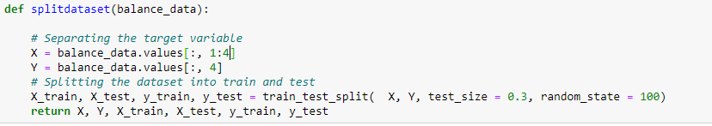
2. Splitting data into training and testing dataset

Slide 8
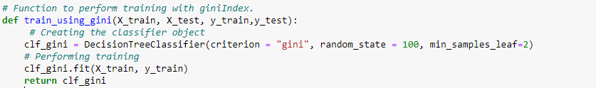
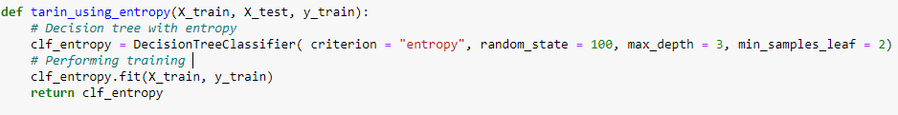
3. Training dataset using Gini Index
4. Training dataset using Entropy

Slide 9
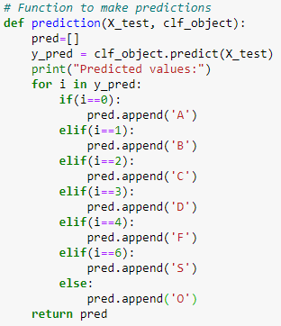
5. Prediction module

Slide 10
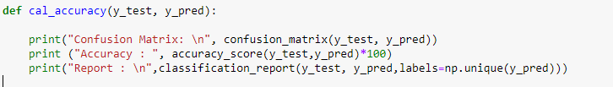
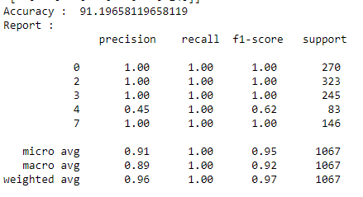
6. Score Factors of decision tree classifiers which includes
accuracy,precision,recall,f1score,support,macro average, weighted average, confusion matrix

Slide 11
Classifier | Accuracy score
J48 | 58.3
Simple cart | 59.1
Random Forest Algorithm | 45.7
Descion Tree classifier | 91.19

Slide 12
Front end modules:
1.Dash:
To use Dash, we need the following packages: dash, dash-renderer, dash-html-components, dash-core-components, and plotly. These packages also have various dependencies. You can install them with:
conda install -c conda-forge dash
conda install -c conda-forge dash-renderer
conda install -c conda-forge dash-html-components
conda install -c conda-forge dash-core-components
2. FLASK INSTALLATION :
Flask is a lightweight WSGI web application framework. It is designed to make getting started quick and easy, with the ability to scale up to complex applications. It began as a simple wrapper around Werkzeug and Jinja and has become one of the most popular Python web application frameworks.
Flask offers suggestions, but doesn’t enforce any dependencies or project layout. It is up to the developer to choose the tools and libraries they want to use. There are many extensions provided by the community that make adding new functionality easy.
3. Languages used for front end are:
Php, bootstrap, HTML, JavaScript

Slide 13
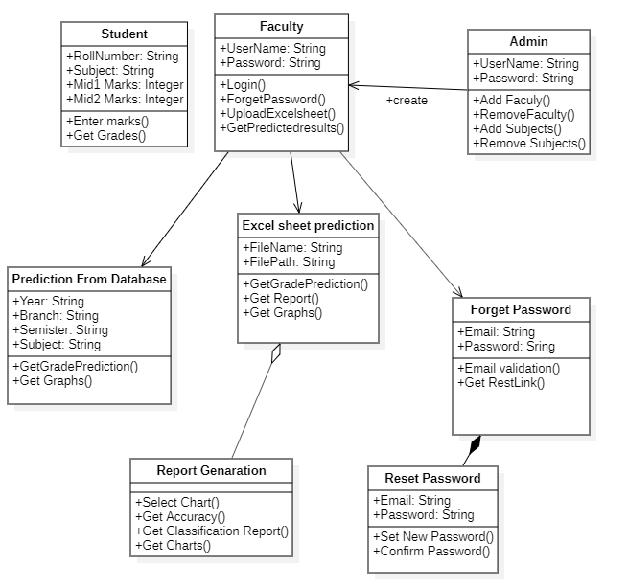
System analysis and Design
Class diagram

Slide 14
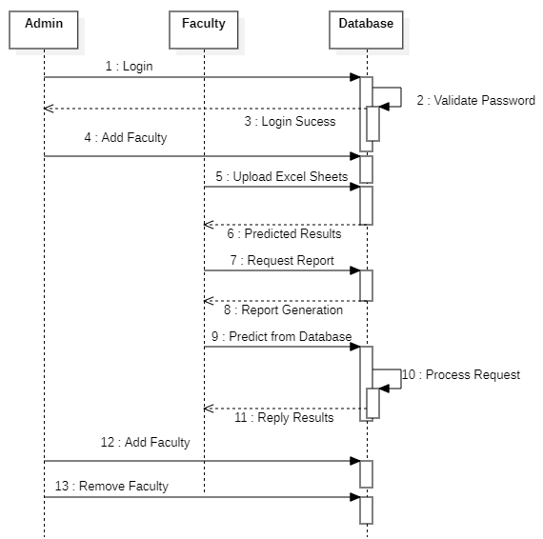
Sequence diagram

Slide 15
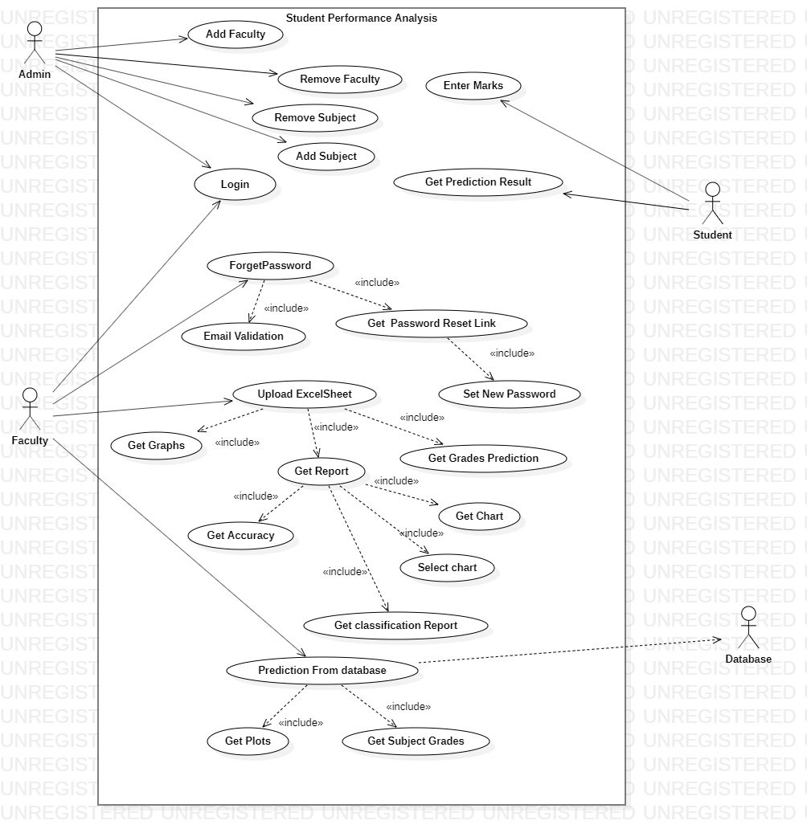
Use Case diagram

Slide 16

System Architecture
Admin database
STUDENT PERFORMANCE
ANALYSIS
SYSEM
Student Database
User
User Interface
Faculty Database

Slide 17
Software Tools
Anaconda
Anaconda is a free and open-source distribution of the Python and R programming languages for scientific computing (data science, machine learning applications, large-scale data processing, predictive analytics, etc.), that aims to simplify package management and deployment.
Xampp
XAMPP is a free and open-source cross-platform web server solution stack package developed by Apache Friends, consisting mainly of the Apache HTTP Server, MariaDB database, and interpreters for scripts written in the PHP and Perl programming languages.
Atom
Atom is a desktop application built with HTML, JavaScript, CSS, and Node.js integration. It runs on Electron, a framework for building cross platform apps
Packages used
numpy
pandas
sqlalchemy
sklearn
matplotlib
dash
flask

Slide 18
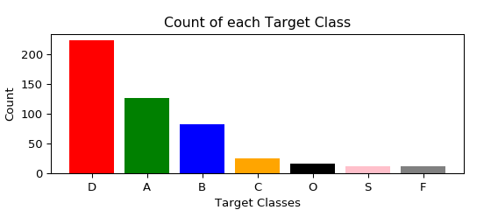
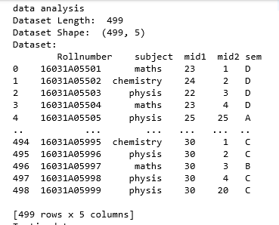
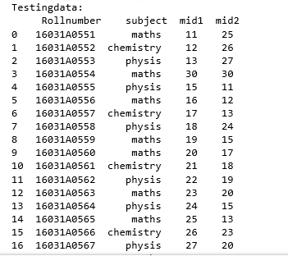
Status Of Work
Training data
Testing data
Training data analysis

Slide 19
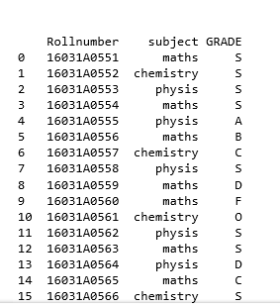
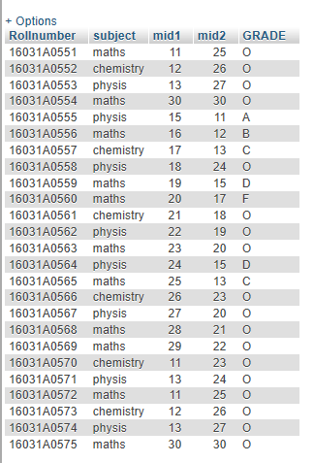
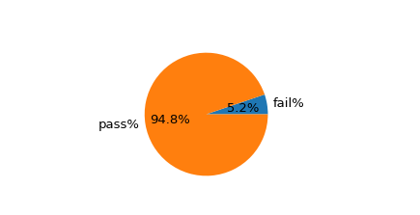
Predicted results database
Predicted results
Predicted pass percentage

Slide 20
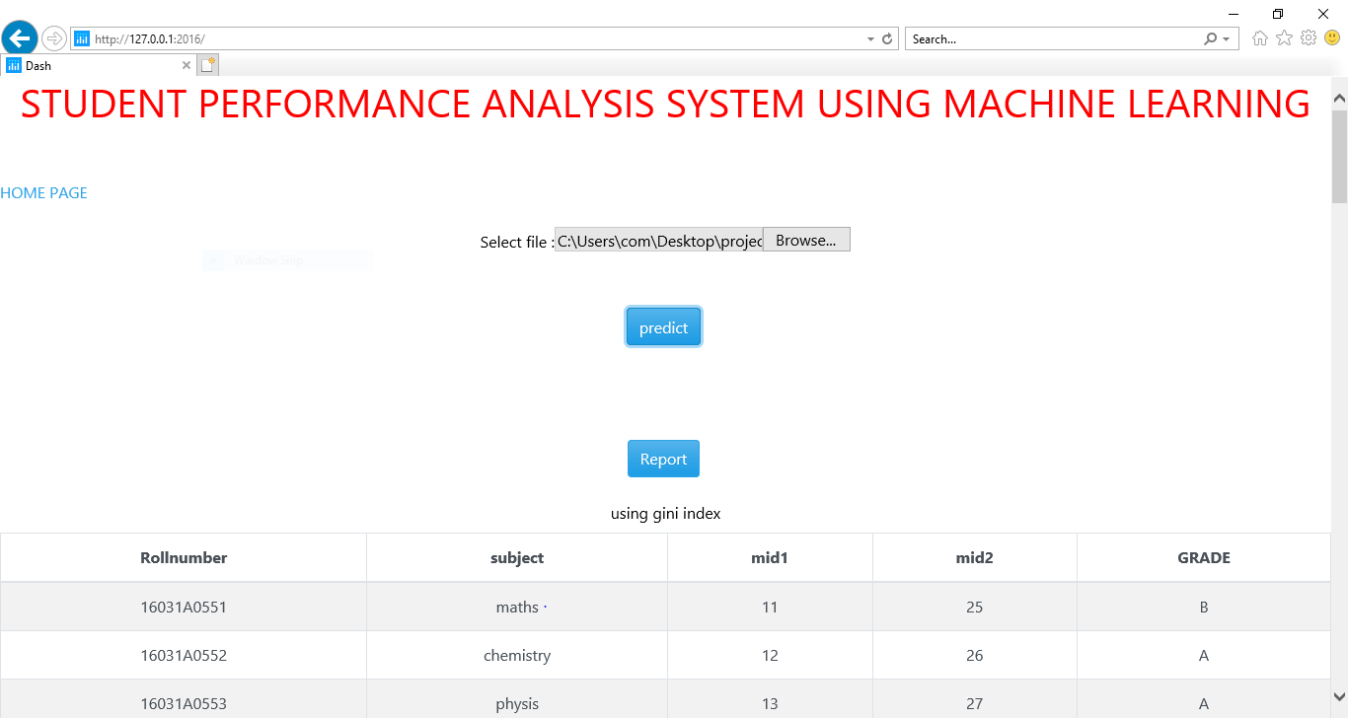

Slide 21
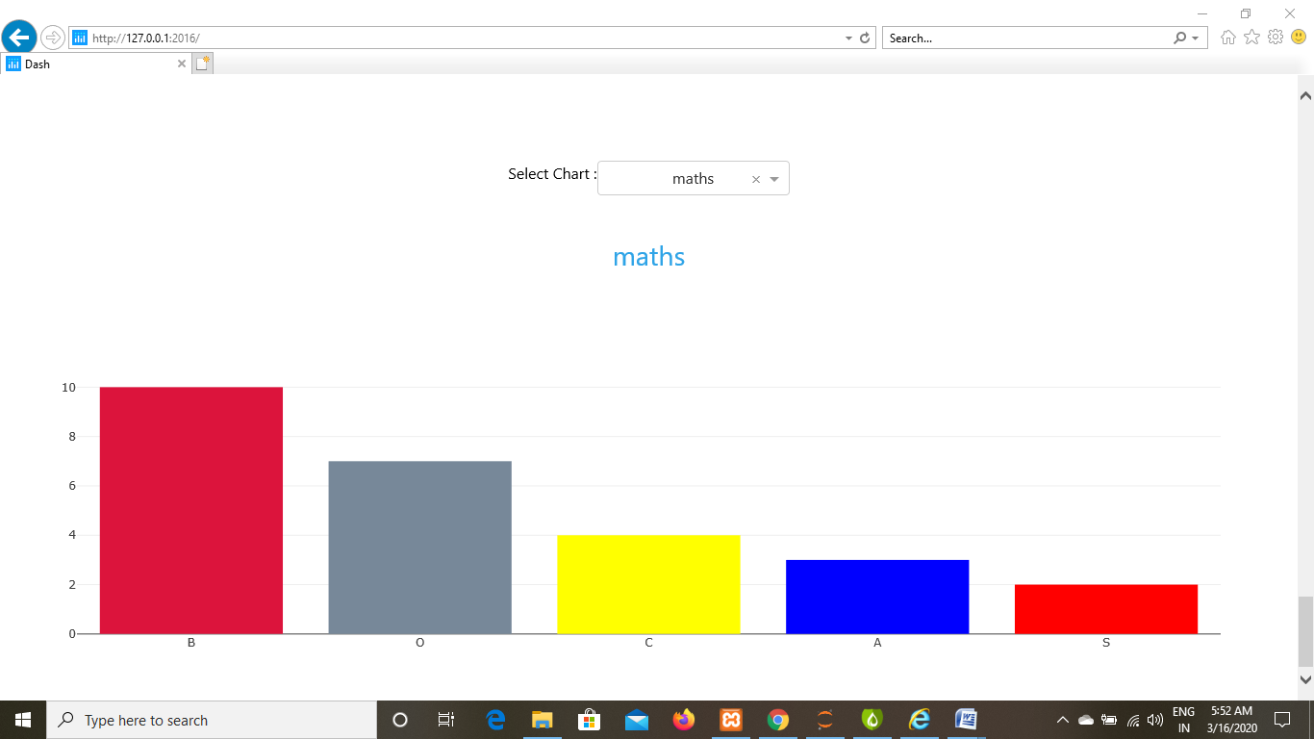

Slide 22
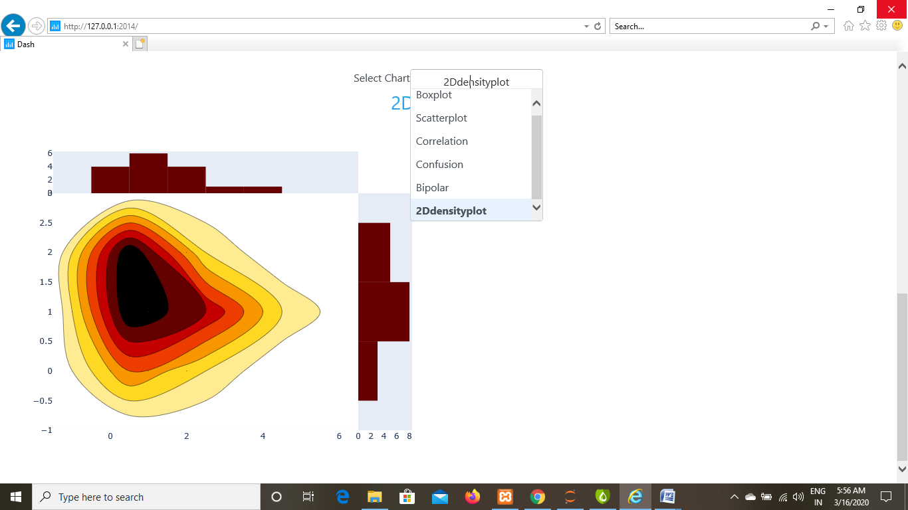

Slide 23
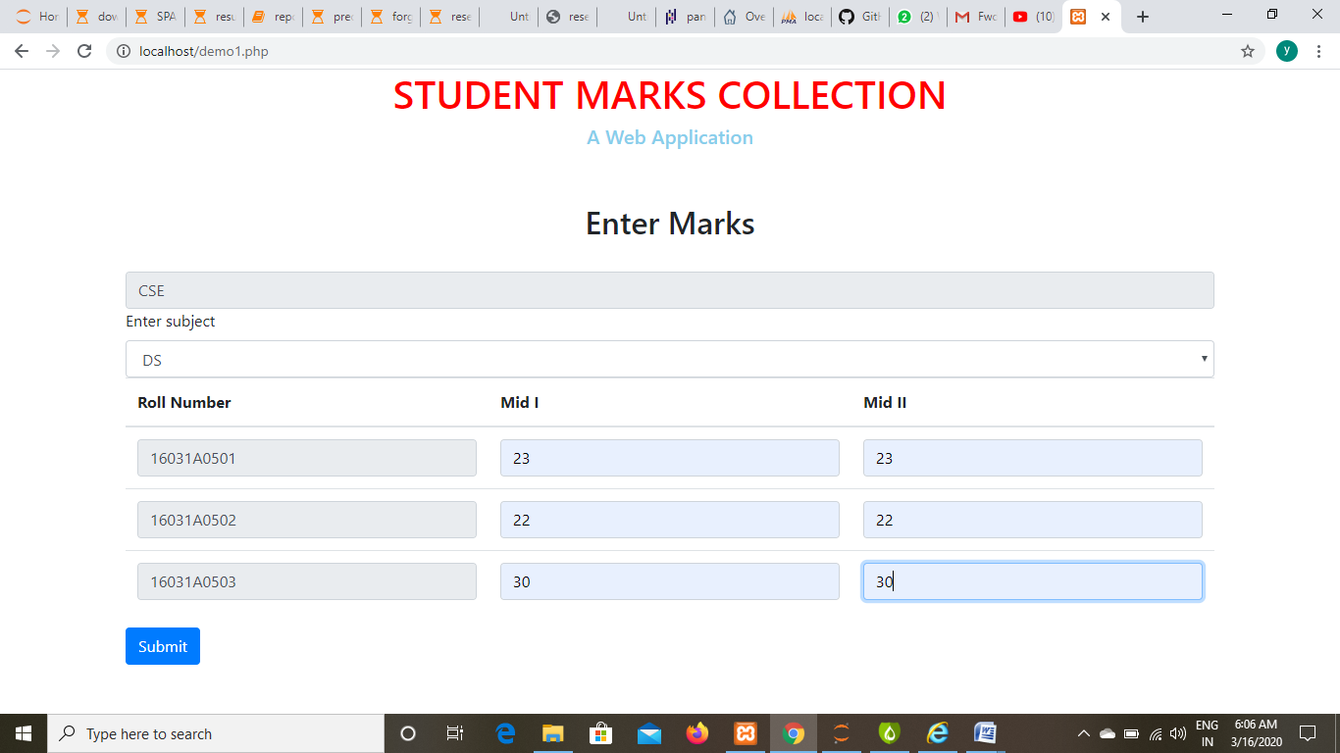

Slide 24
The project concentrates on the development of a system for student performance analysis. A data mining technique, classification algorithm is applied in this project to ensure the prediction of the student performance in courses is possible. The main contribution of the SPAS is that it assists the lecturers in conducting student performance analysis. The system assists lecturers in identifying the students’ that are predicted to fail in the course . Other than that, SPAS assist lecturers’ to retrieve information of their students’ performance throughout the semesters
Conclusion : -

Slide 25
REFERENCES :
[1] J. Shana, and T. Venkatacalam, “A framework for dynamic Faculty Support System to analyse student course data”, International Journal of Emerging Technology and Advanced Engineering, Vol. 2, No. 7, 2012, pp.478-482.
[2] Quality Assurance Division (2010). InMinds: Intelligent Mining and Decision Support System. University Malaysia Sarawak, UNIMAS [Online].
[3] SPA (2013). What is SPA Standard? SPA Student Performance Analyser [Online]. Available: https://www.studentperformanceanalyser.com.au/spa/about.html
[4] V. Kumar, and A. Chadha, “An empirical study of the applications of data mining techniques in higher education”, International Journal of Advanced Computer Science and Applications (IJACSA), Vol. 2, No..3, 2011, pp. 80-84.

Slide 26

Any Queries ?

