Slide 1
DBMS PROJECT · RESEARCH MANAGEMENT
01
Authors researchers
ResearchHub
02
Publications papers
03
Documents files
04
Citations links
Research Management & Analytics System
05
Research Analytics answers
DBMS project using PostgreSQL and MongoDB for publications, authors, documents, citations, and research analytics.
Student Name · Roll Number · Course · College/University · Academic Year
DATA FLOW
Notes:
Introduce ResearchHub as a DBMS project that separates reliable relational records from flexible analytics data.

Slide 2




SYSTEM CONTEXT
ResearchHub separates reliable relational data from flexible analytics data
PostgreSQL
MongoDB
→
ResearchHub
Authors · Publications · Documents · Citations
Publication Metadata · Research Events
→
Analytics Dashboard
Problem: Researchers, multi-author publications, documents, citation relationships, statistics, and analytics.
PostgreSQL: Structured relational data with integrity and transactional consistency.
MongoDB: Flexible metadata, embedded publication details, and event or analytics data.
Outcome: Both stores feed a unified analytics dashboard.
Notes:
Explain the split: PostgreSQL protects the core relational model, while MongoDB keeps metadata and event-oriented analytics flexible. The dashboard is the shared output.

Slide 3
DATA MODEL
The ER model resolves authorship, documents, and self-referencing citations
AUTHORS
DOCUMENTS
author_id PK · name · email · affiliation · created_at. Stores researchers.
document_id PK · publication_id FK · document_type · file_path · uploaded_at. One publication can have many documents. PUBLICATIONS 1:M DOCUMENTS.
PUBLICATIONS
publication_id PK · title · abstract · publication_date · journal · doi · created_at. Stores papers.
CITATIONS
citation_id PK · citing_document_id FK · cited_document_id FK · cited_at. Both FKs point to DOCUMENTS, creating a self-referencing citation graph. DOCUMENTS self-reference through CITATIONS.
Document A cites Document B
PUBLICATION_AUTHORS
publication_id FK · author_id FK · author_order; composite PK (publication_id, author_id) resolves the M:N author-publication relationship. AUTHORS M:N PUBLICATIONS through PUBLICATION_AUTHORS.
Notes:
Emphasize that PUBLICATION_AUTHORS resolves the many-to-many relationship, while CITATIONS uses two foreign keys back to DOCUMENTS to create a self-referencing graph.

Slide 4
ResearchHub – Database Tables & Attributes
AUTHORS
PUBLICATIONS
Attribute | Data Type | Constraint
author_id | SERIAL | PK
name | VARCHAR(150) | NN
email | VARCHAR(255) | UQ
affiliation | VARCHAR(200) | —
created_at | TIMESTAMP | DEF
Attribute | Data Type | Constraint
publication_id | SERIAL | PK
title | VARCHAR(300) | NN
abstract | TEXT | —
publication_date | DATE | —
journal | VARCHAR(200) | —
doi | VARCHAR(100) | UQ
PUBLICATION_AUTHORS
DOCUMENTS
CITATIONS
Attribute | Data Type | Constraint
publication_id | INT | PK, FK
author_id | INT | PK, FK
author_order | INT | CHK > 0
Attribute | Data Type | Constraint
document_id | SERIAL | PK
publication_id | INT | FK
document_type | VARCHAR(50) | CHK
file_path | TEXT | —
uploaded_at | TIMESTAMP | DEF
Attribute | Data Type | Constraint
citation_id | SERIAL | PK
citing_document_id | INT | FK
cited_document_id | INT | FK
cited_at | TIMESTAMP | DEF
PK = Primary Key | FK = Foreign Key | UQ = Unique | NN = Not Null | CHK = Check | DEF = Default

Slide 5
NORMALIZATION
Normalization removes redundancy before analytics begins
1NF: atomic values; no repeating author groups.
2NF: remove partial dependencies from the composite bridge key in publication_authors.
3NF: keep author attributes such as affiliation in AUTHORS, not in publication rows.
BCNF: every determinant is a candidate key.
4NF: separate independent multivalued relationships: Publication → Authors; Publication → Topics.
BEFORE
AFTER
authors = "Asha, Rahul"
publication_authors
one bridge row per author
Result: fewer insertion, update, and deletion anomalies.
Notes:
Walk the ladder from atomic values to independent multivalued relationships. The bridge-table example makes the change from repeating text to relational rows concrete.

Slide 6
POSTGRESQL · DDL
PostgreSQL constraints make the model enforceable
Constraint | Purpose
PRIMARY KEY | Identifies rows.
FOREIGN KEY | Preserves relationships.
UNIQUE | Protects email and doi.
NOT NULL | Rejects missing required data.
CHECK | Validates author_order > 0.
DEFAULT | Sets CURRENT_TIMESTAMP.
ON DELETE CASCADE | Removes dependent bridge rows safely.
CREATE TABLE authors (author_id SERIAL PRIMARY KEY, name TEXT NOT NULL, email TEXT UNIQUE, created_at TIMESTAMP DEFAULT CURRENT_TIMESTAMP);
CREATE TABLE publications (publication_id SERIAL PRIMARY KEY, title TEXT NOT NULL, doi TEXT UNIQUE);
CREATE TABLE publication_authors (publication_id INT REFERENCES publications ON DELETE CASCADE, author_id INT REFERENCES authors ON DELETE CASCADE, author_order INT CHECK (author_order > 0), PRIMARY KEY (publication_id, author_id));
Constraints reject invalid data at write time.
Notes:
Point out that the DDL makes correctness executable: invalid values and broken relationships are rejected at write time, rather than discovered later in analytics.

Slide 7
SQL OPERATIONS
CRUD and joins turn normalized tables into useful answers
INSERT
SELECT
INNER JOIN
LEFT JOIN
Rahul Kumar from LPU
Filter authors by affiliation
Only matching rows from both tables
All left rows; matched right or NULL
UPDATE
DELETE
RIGHT JOIN
FULL OUTER JOIN
Change affiliation by author_id
Respect cascade behavior
All right rows; matched left or NULL
All rows from both; NULL where no match
SELECT p.title, a.name
FROM publications p
INNER JOIN publication_authors pa ON p.publication_id = pa.publication_id
INNER JOIN authors a ON pa.author_id = a.author_id;
The join connects publications → publication_authors → authors to list every paper with its researchers.
Notes:
Use the four CRUD cards as the operational vocabulary, then show how the three-table INNER JOIN turns normalized structure into a useful answer.

Slide 8
QUERY PATTERNS
Aggregation and set logic answer multi-publication questions
SELECT author_id, COUNT(*) AS publications
FROM publication_authors
GROUP BY author_id
HAVING COUNT(*) >= 2;
SELECT author_id FROM publication_authors
WHERE publication_id = 1
UNION
SELECT author_id FROM publication_authors
WHERE publication_id = 2;
SELECT author_id
FROM authors
WHERE author_id IN (
SELECT author_id
FROM publication_authors
GROUP BY author_id
HAVING COUNT(*) > 2
);
GROUP BY + HAVING
Counts publications per author, then keeps authors with at least two.
SET LOGIC
UNION combines IDs; also distinguish UNION ALL, INTERSECT, and EXCEPT.
SUBQUERY
The viva distinction: non-correlated subqueries are independent; correlated subqueries depend on the outer row.
Notes:
Contrast the three patterns: aggregation filters grouped results, set operations compare result sets, and a subquery supplies a condition to the outer query.

Slide 9
ANALYTICS SQL
Window functions rank authors without losing row detail
RANKED-AUTHOR QUERY
WINDOW TOOLKIT
SELECT a.name, COUNT(*) AS publication_count, RANK() OVER (ORDER BY COUNT(*) DESC) AS author_rank FROM authors a JOIN publication_authors pa ON a.author_id = pa.author_id GROUP BY a.author_id, a.name;
KEY DISTINCTION — GROUP BY aggregates rows. A window function calculates across related rows without collapsing the result set.
ROW_NUMBER() · RANK() · DENSE_RANK()
SUM() OVER() · AVG() OVER() · COUNT() OVER()
CTE: WITH author_counts AS (...) SELECT * FROM author_counts; Readable complex logic. Recursive CTEs can trace citation chains.
Document A → Document B → Document C → Document D
Notes:
Land the distinction between aggregation and windows. The result can preserve author-level detail while adding rank, count, or other calculations across the related rows.

Slide 10
OPTIMIZATION + DOCUMENT DATA
Optimization is visible in the execution plan, while MongoDB stays flexible
POSTGRESQL OPTIMIZATION
MONGODB FLEXIBILITY
EXPLAIN ANALYZE SELECT * FROM publications WHERE doi = '...';
CREATE INDEX idx_publications_doi ON publications(doi);
{"title":"Publication title","authors":[{"name":"Author name"}],"topics":["topic"]}
Concepts: documents, embedded documents, arrays, references, CRUD, and indexes.
MongoDB complements PostgreSQL rather than replacing it.
Plan reveals: planner choice, cost, sequential scan vs index scan, and execution time.
Indexing: B-tree · Hash · GIN · GiST · BRIN · covering indexes · ANALYZE · Autovacuum · pg_stat_statements
Notes:
Show that optimization is observable rather than abstract: EXPLAIN ANALYZE exposes the planner and execution cost. MongoDB then adds flexible document-shaped metadata.

Slide 11
RESEARCH ANALYTICS
Aggregation turns publication metadata into decisions
MONGODB PIPELINE
ANALYTICS DASHBOARD
db.publications.aggregate([
{$match: {year: 2026}},
{$unwind: "$authors"},
{$group: {_id: "$authors.name", publications: {$sum: 1}}},
{$sort: {publications: -1}}
])
Other operators: $project reshapes fields; $lookup joins collections; $facet supports multiple analytical views.
AUTHORS
PAPERS
CITATIONS
120
350
1,250
PUBLICATIONS BY YEAR
TOP AUTHORS
CITATION TRENDS
Ranked author list from aggregation
Trend view · citation activity over time
Dashboard view · year-by-year comparison
1 · author ranking
2 · author ranking
3 · author ranking
Viva checklist: ER modelling; 1NF–BCNF and 4NF; DDL/DML; keys and constraints; joins; GROUP BY/HAVING; windows; CTEs; subqueries; set operations; indexes; EXPLAIN ANALYZE; MongoDB CRUD/aggregation; research analytics.
Thank You
Questions?
Notes:
Close by connecting the pipeline to decisions: filter, unwind, group, and sort publication metadata, then surface the results through KPIs, rankings, year comparisons, and citation trends.

Slide 12
RESEARCHHUB · PROJECT SUMMARY
One system, two data models, many useful answers
The project connects sound database design with practical research analytics.
Architecture & modelling
Integrity & SQL foundations
Performance & analytics
PostgreSQL for structured relational data
MongoDB for flexible metadata and analytics
ER modelling for authors, documents, and relationships
Normalization through BCNF/4NF
Indexing and EXPLAIN ANALYZE
MongoDB CRUD and aggregation
Research analytics that turn metadata into decisions
DDL/DML, keys, and constraints
Joins, subqueries, and set operations
GROUP BY/HAVING for grouped questions
CTEs and window functions for layered analysis

Slide 13
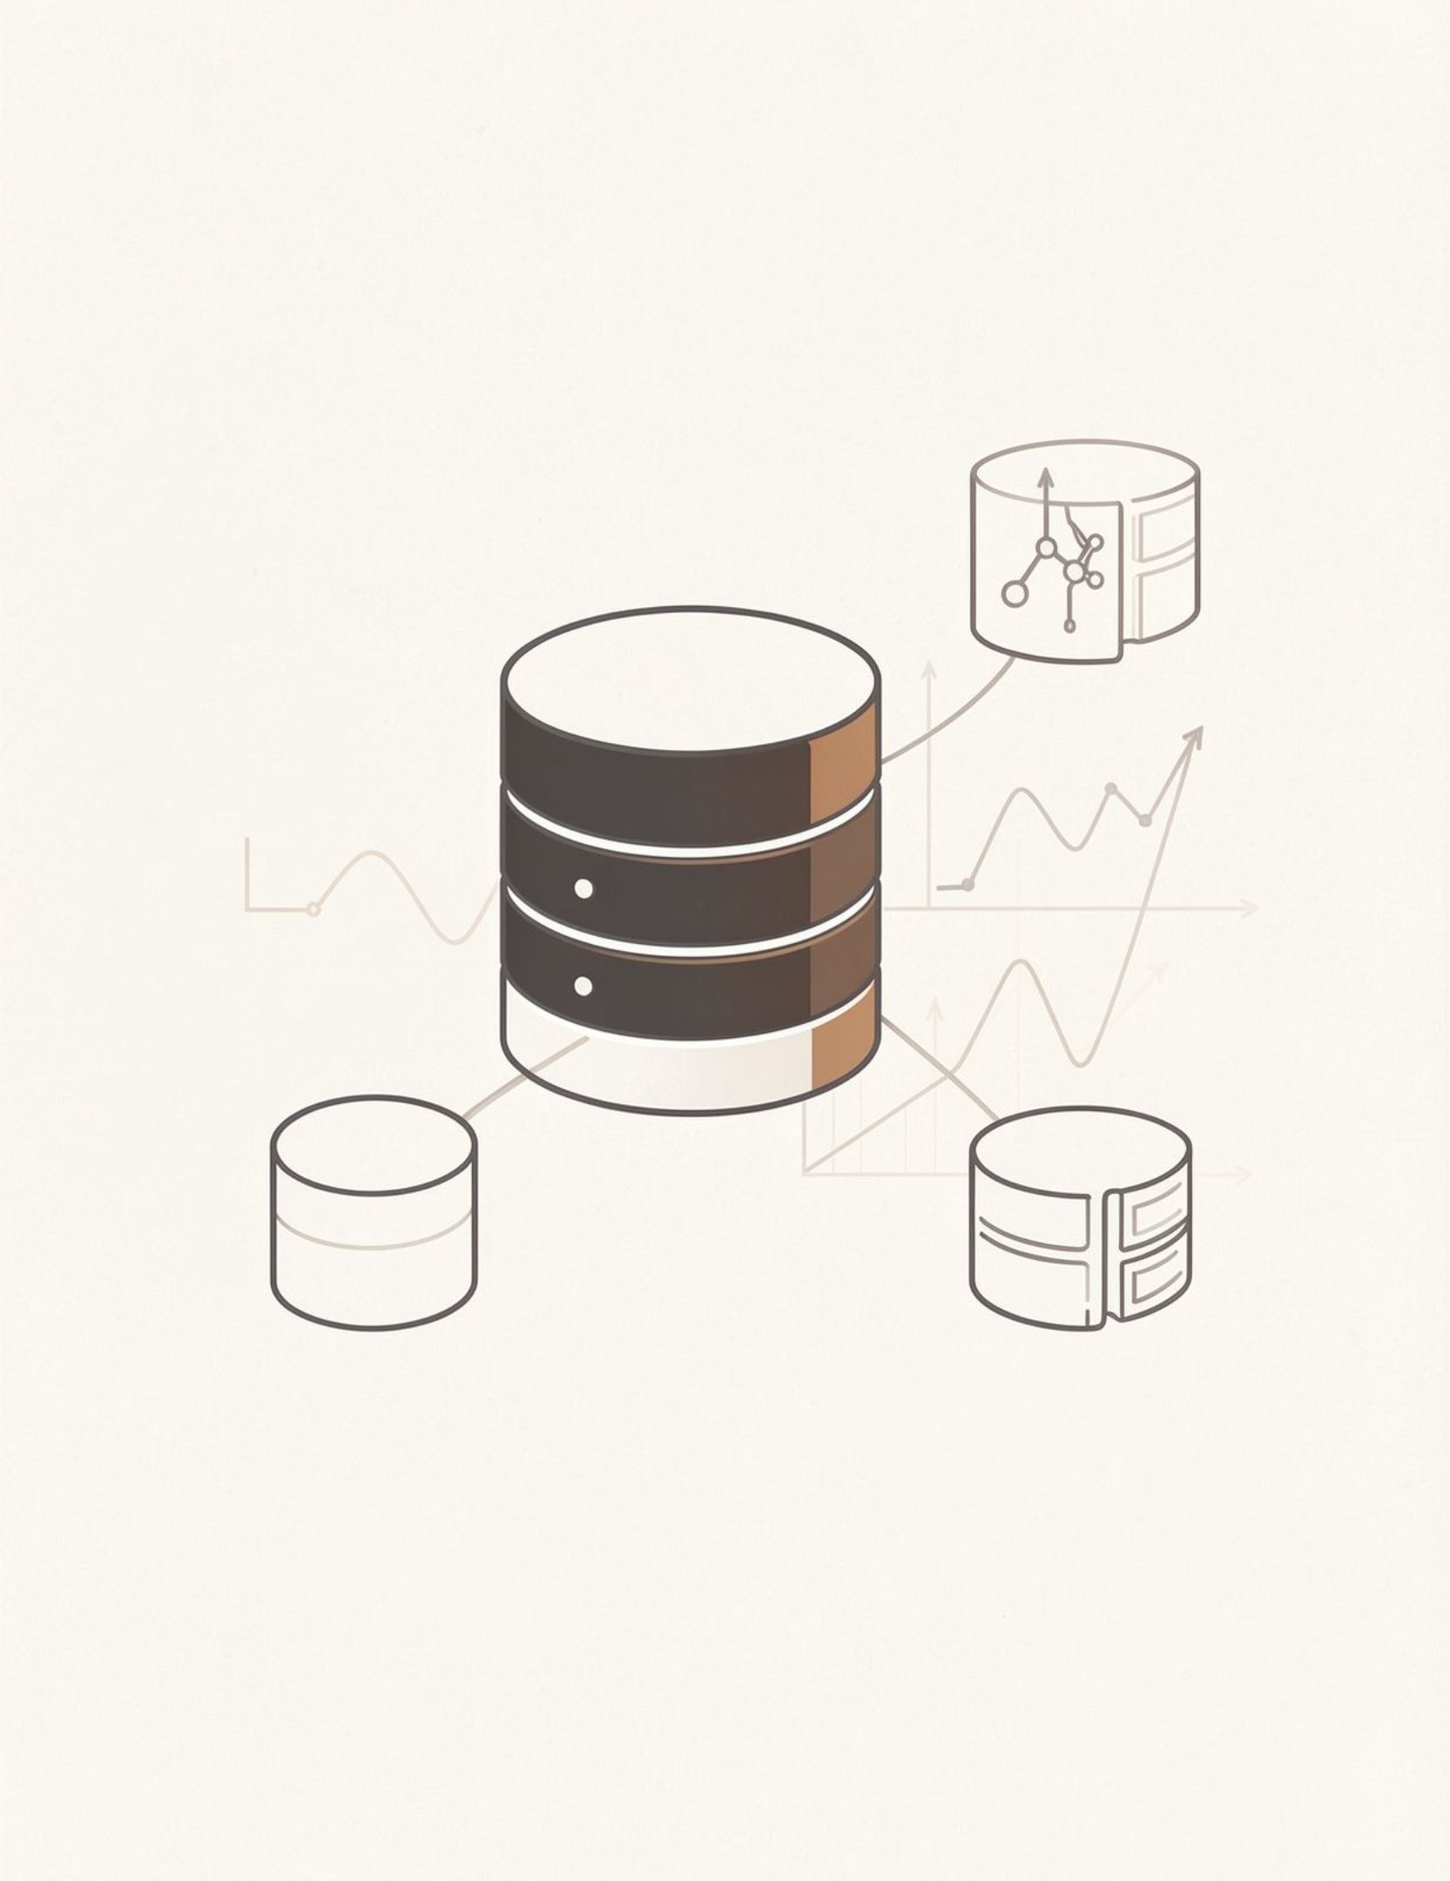
RESEARCHHUB · DATABASE MANAGEMENT SYSTEMS
Thank You
Questions?
Let’s discuss the architecture, queries, and research insights.

