Slide 1
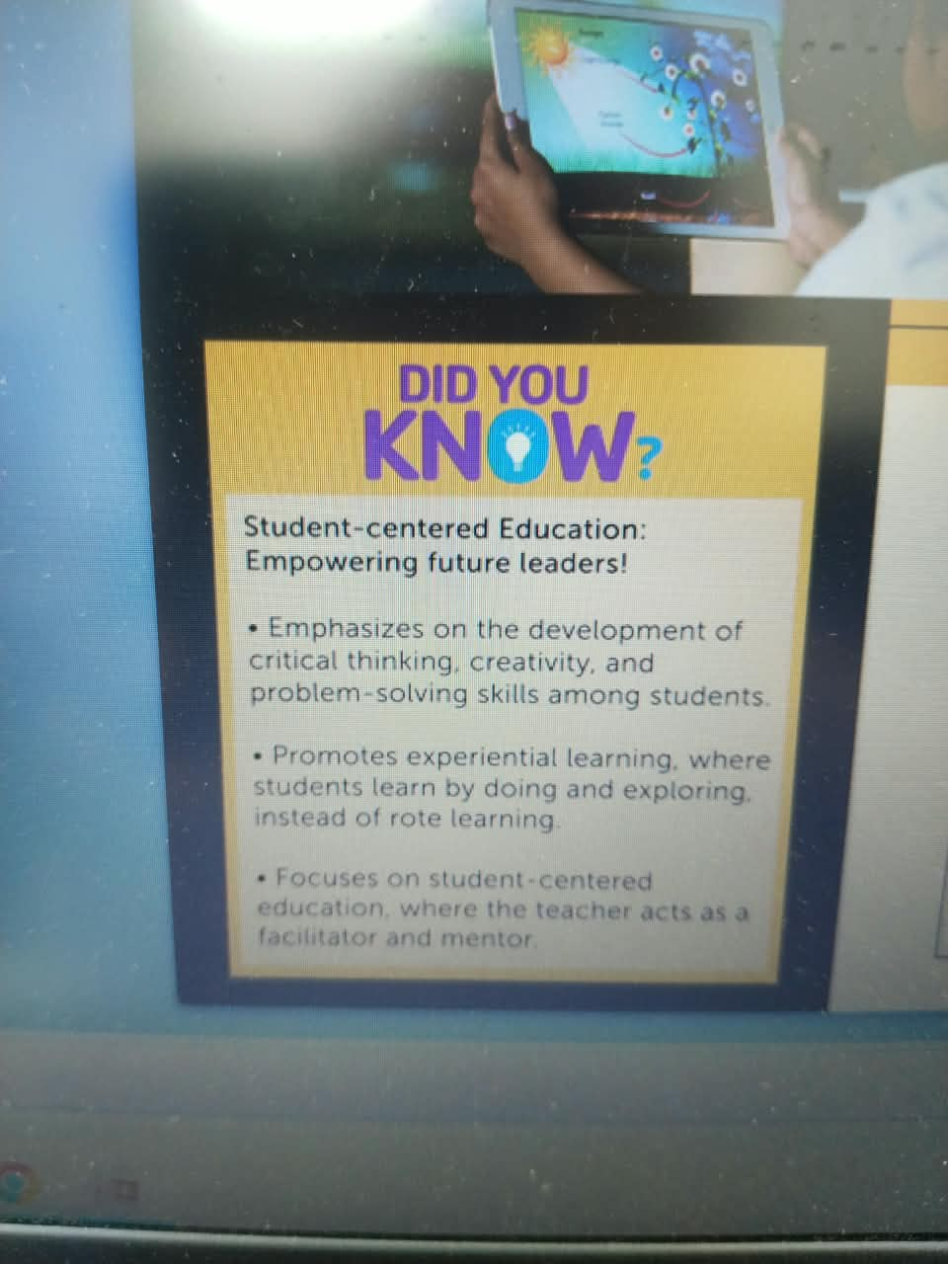
Edufirst
Make Education More Engaging, Effective and Accessible
A learner-centered and teacher-empowered platform built for the future of education.
• Combines AI, learning science, curriculum mapping, and real-time analytics.
• Supports students, teachers, parents, and school management in one experience.
• Turns daily academic activity into visible growth and timely action.
• Demo feature: student dashboard and personalized learning view.
Call to action: Experience the future of learning.
Demo: https://electroniceducare.com

Slide 2
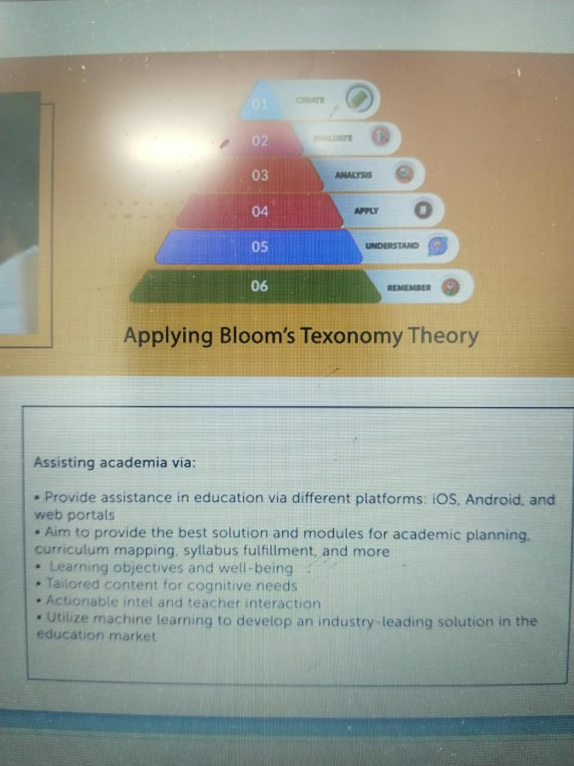
Edufirst
Learner-Centered. Teacher-Empowered. Future-Ready.
Learning that understands every student and gives teachers faster, clearer support.
• Builds critical thinking, creativity, problem-solving, self-identity, and collaboration.
• Promotes experiential learning through doing, exploring, practice, and reflection.
• Uses adaptive content, evidence-based observations, and knowledge-gap tracking.
• Reduces correction time and gives teachers instant feedback, lesson insights, and progress signals.
• Demo feature: AI-powered student progress and knowledge-gap report.
Call to action: See how learning becomes personal.
Demo: https://electroniceducare.com

Slide 3
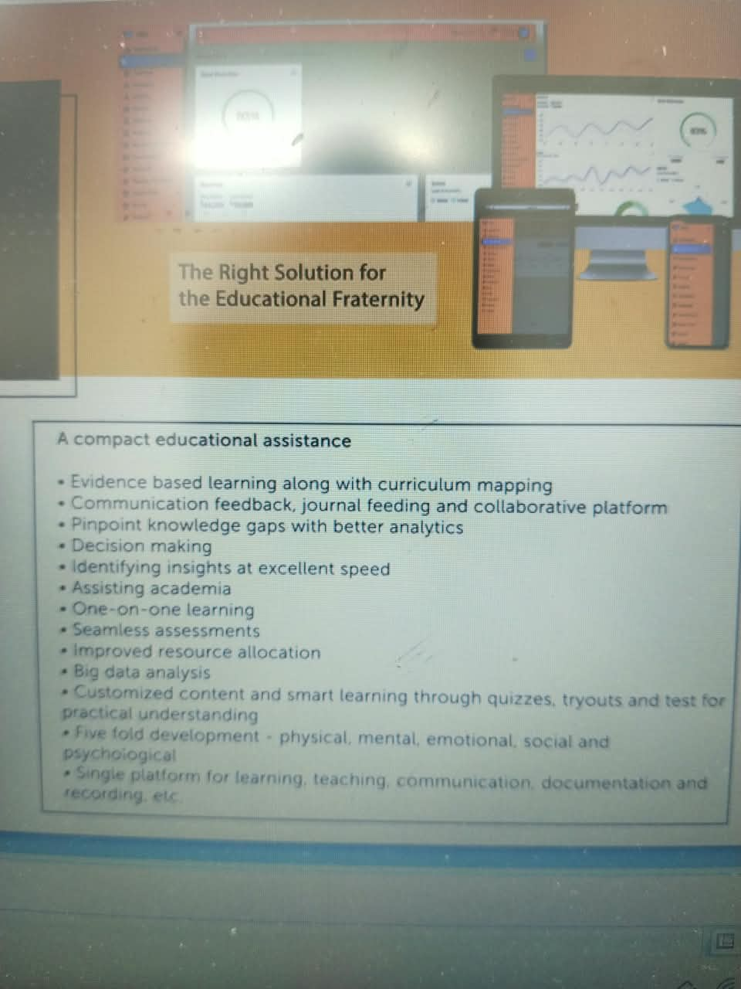
Edufirst
One Connected Ecosystem
One platform for learning, teaching, communication, documentation, assessment, and reporting.
• Supports web, Android, and iOS access for schools and families.
• Connects performance, attendance, homework, assessments, feedback, reports, and records.
• Keeps teachers, parents, students, and management aligned through real-time updates.
• Replaces scattered tools with an organized digital workflow.
• Demo feature: admin, teacher, parent, and student connected dashboard.
Call to action: Connect every role in the school.
Demo: https://electroniceducare.com

Slide 4
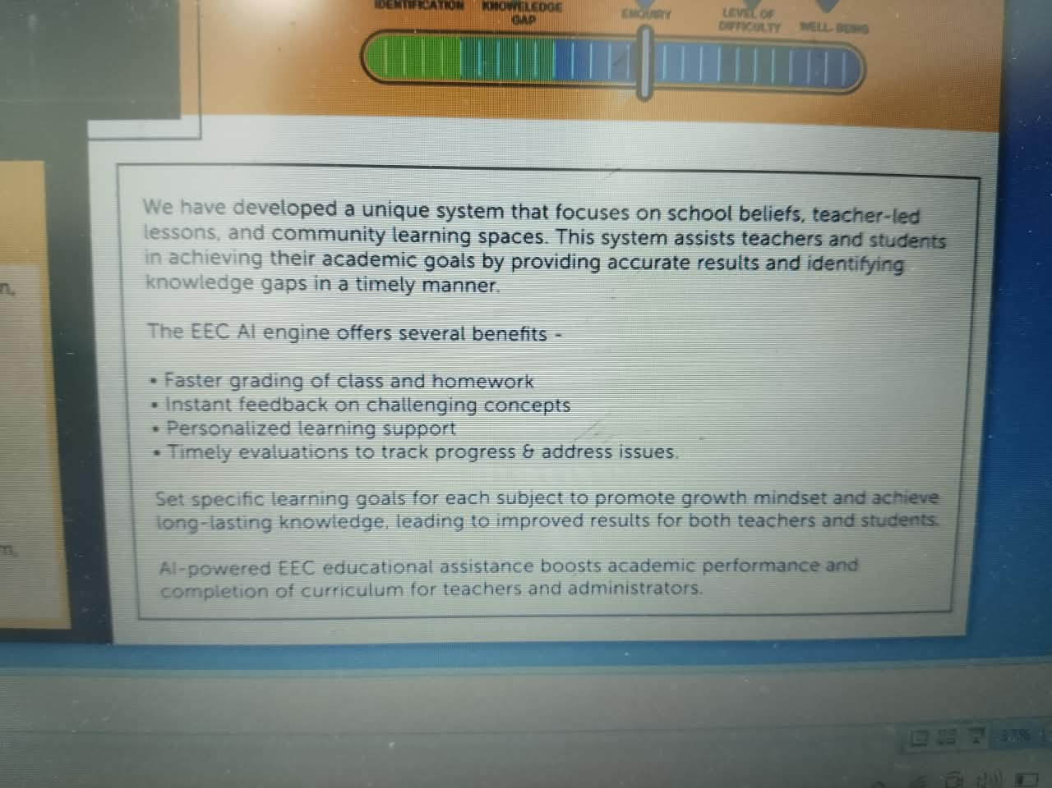
Edufirst
A Live Workflow
From classroom activity to real-time insight, every step becomes measurable and useful.
• Students complete lessons, homework, quizzes, tests, and activities.
• Teachers record performance, feedback, observations, and learning behavior.
• The AI engine identifies difficulty level, knowledge gaps, enquiry needs, and well-being indicators.
• Students receive targeted learning paths while parents and management receive actionable insights.
• Demo feature: live performance tracking from assignment to feedback.
Call to action: Watch the workflow in action.
Demo: https://electroniceducare.com

Slide 5
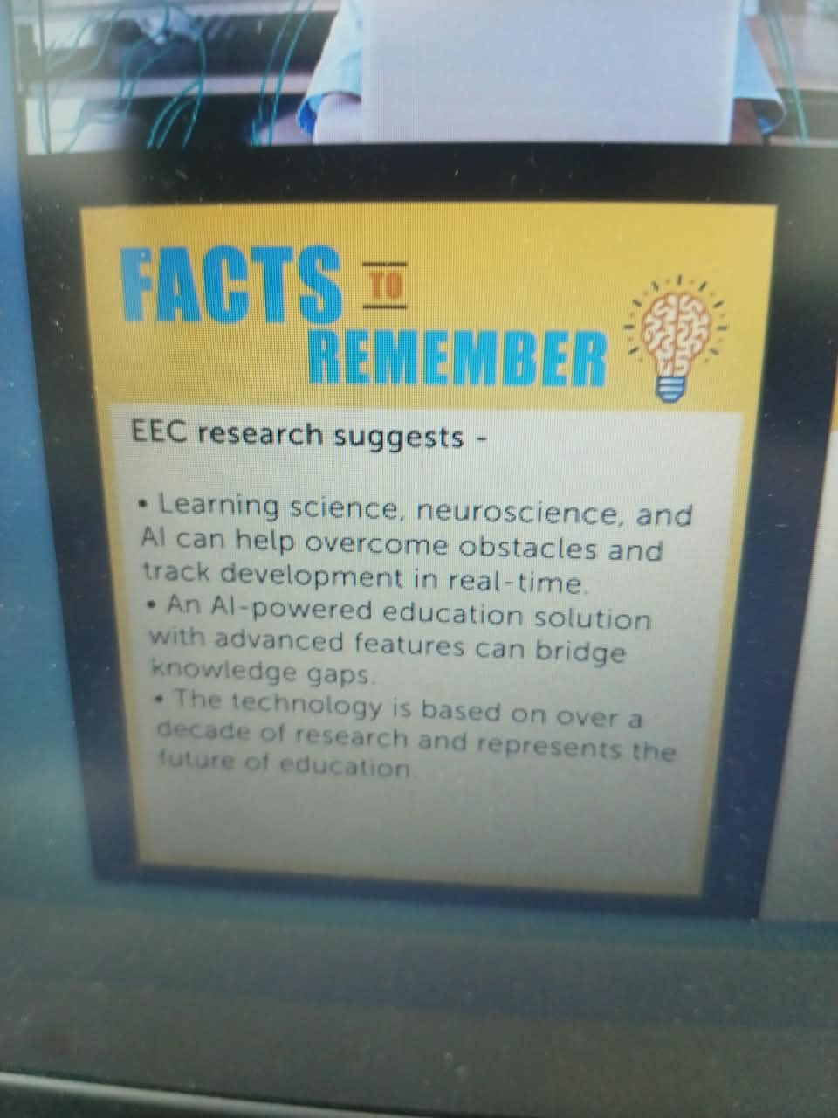
Edufirst
Safe and Practical Implementation
Built for real schools, real classrooms, and real constraints.
• Compact hybrid solution for proficiency-based learning.
• Works with formative, summative, and backward curriculum mapping.
• Supports gradual adoption where technical infrastructure is limited.
• Improves documentation, secure records, communication, planning, and resource allocation.
• Demo feature: school setup, class setup, and curriculum mapping module.
Call to action: Start with a practical pilot.
Demo: https://electroniceducare.com

Slide 6
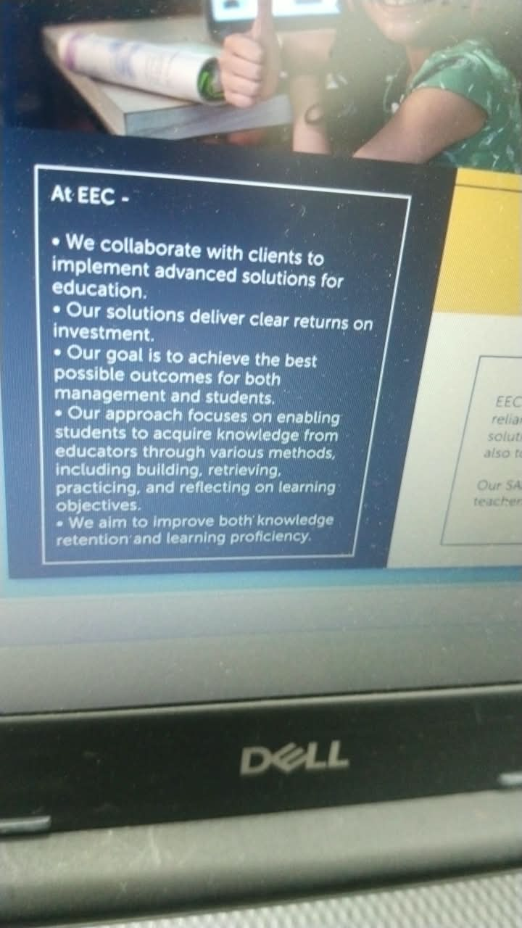
Edufirst
The Give Back Mission
Technology should become a bridge for education, not a barrier.
• Collaborates with institutions to implement advanced education solutions.
• Supports young minds through teacher guidance and daily proficiency development.
• Helps students build, retrieve, practice, and reflect on learning objectives.
• Aims to improve knowledge retention, learning proficiency, confidence, and outcomes.
• Demo feature: community or school partnership support module.
Call to action: Partner with us to create impact.
Demo: https://electroniceducare.com

Slide 7
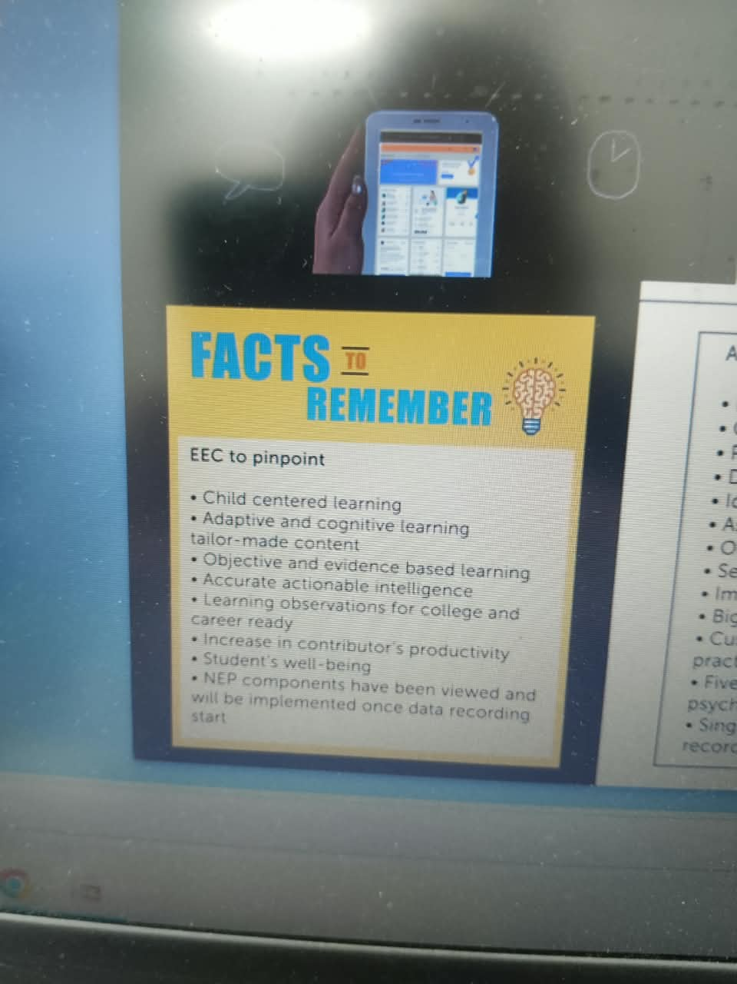
Edufirst
Demo Link
Explore how Edufirst supports learning, teaching, analytics, and school management.
• Student learning dashboard.
• Teacher grading, feedback, and AI teaching tools.
• Parent communication, attendance, homework, and updates.
• AI-powered learning-gap analysis and curriculum progress.
• Admin analytics, reporting, and institution-wide decision support.
Call to action: Scan or click to view the demo.
Demo: https://electroniceducare.com

Slide 8
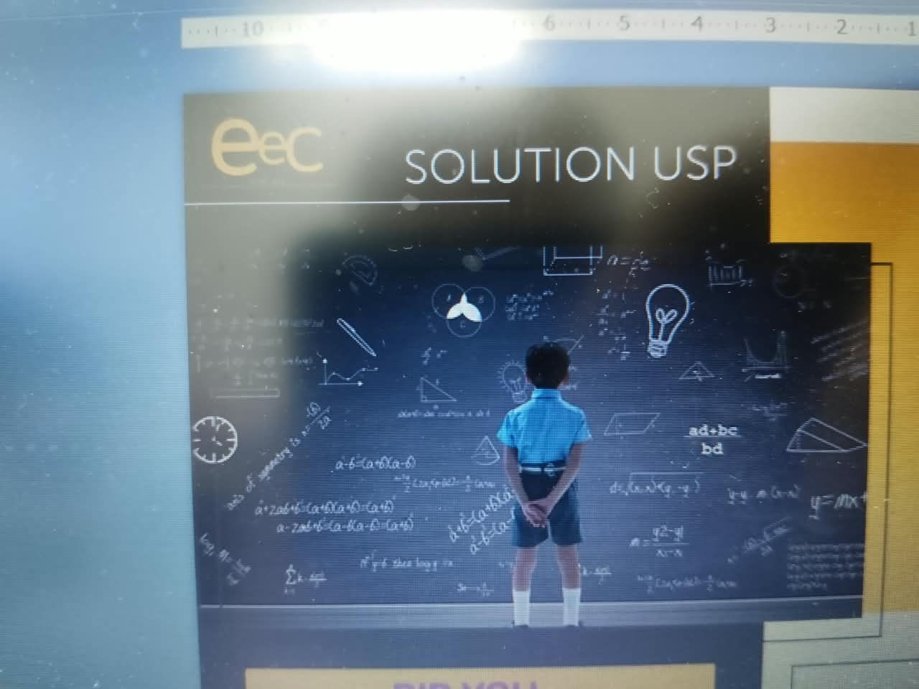
Edufirst
Building the Future of Education, One Learner at a Time
Edufirst brings AI, neuroscience, analytics, and human teaching together.
• Identifies gaps, personalizes support, improves communication, and speeds up decisions.
• Makes education more adaptive, practical, inclusive, and deeply human.
• Prepares schools for today, tomorrow, and the newer times to come.
• Demo feature: full ecosystem overview and final product walkthrough.
Call to action: Let us build future-ready schools together.
Demo: https://electroniceducare.com

