Slide 1
Tom Ferko DSC 530 Final Project

Slide 2
The Dataset
For this exploration I used a realtor active house dataset taken from Kaggle
It had over 500k rows of housing data. After cleaning I ended up with just under 300k rows
Cleaning ended up being a constant process. I would get to a later stage of analysis only to find that I needed to clean more observations out because missing data was breaking functions

Slide 3
The Variables
In the dataset there were a handful of variables that I would be running analysis on
Price – the selling price of a house
Bed – how many bedrooms it contains
Bath – how many bathrooms it contains
Acre_lot – how large is the land, if there is land at all
House_size – square footage of the house
There were a handful of other variables in the dataset, but these ended up being superfluous to the analysis and were then ignored

Slide 4
The Variables, a closer look
When running analysis, the most important variable becomes the price, it is the basis of the analysis and the primary variable being looked at. It is also the independent variable when running statistical models
Bed and bath are both self-explanitory, number of beds and baths can affect the price of a home, but it's interesting to see how much an affect it will have.
Acre lot and house size are probably the more important variables as they have a direct impact on price. Though it will be interesting to run a comparison of acre lots vs non acre lots (condos)

Slide 5
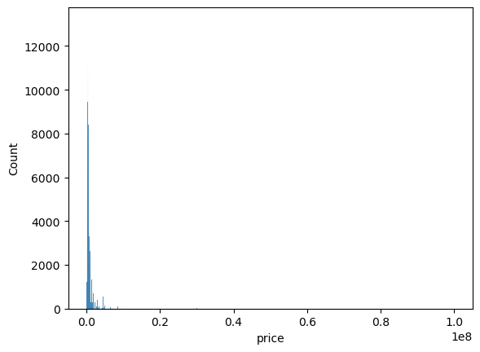
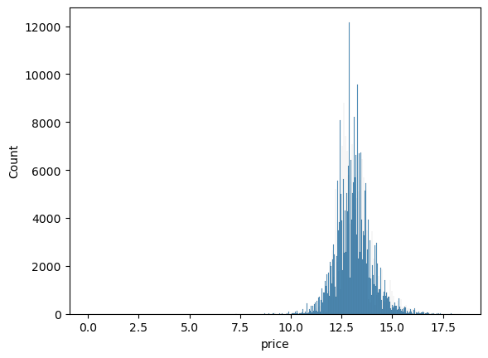
Price
When looking at the distributions of price, we see something interesting (left)
The distribution of price is looking very poor and not normal at all
So we take the log of the price (right) and start to see a much better distribution appear

Slide 6
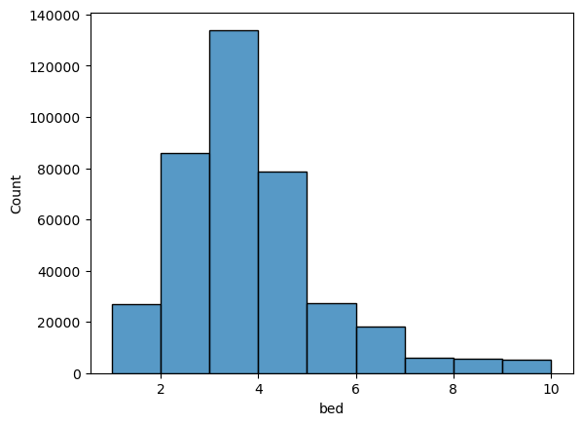
Bedrooms
As rooms are more finite it’s a bit easier to view the distribution of bedrooms
We see it has a fairly normal distribution that leans a bit left and has a longer right tail
I limited sample to only up to 10 bedrooms as there were many houses outside of that throwing off the distribution and causing problems with the majority of the data

Slide 7
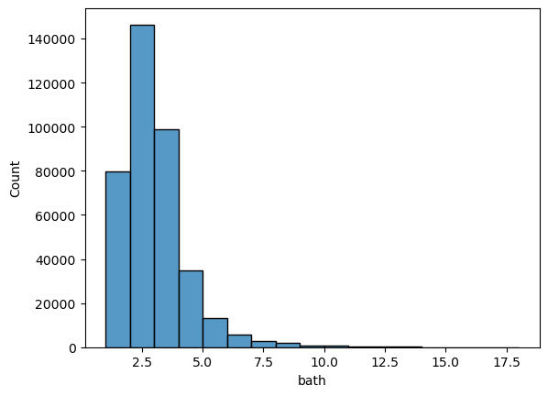
Bathrooms
Bathroom distributions ended up very similar to bedrooms, though the outliers were limited to 20 instead of 10
Again a fairly normal left leaning right tailed distribution

Slide 8
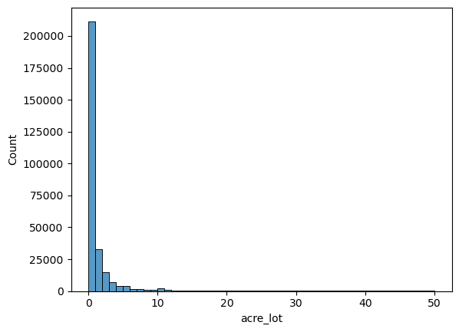
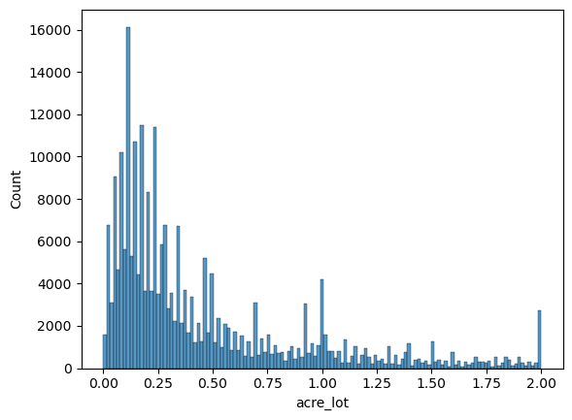
Lot size
Lot size varied greatly as shown on the left though over 50% of the distribution was less than 2 acres of land
So I broke down that distribution separately and we get a much cleaner view of the breakdown of acrage
While this does give us a better idea of what the distribution is, it is still only about 66% of the sample so there is still a large sample outside of that

Slide 9
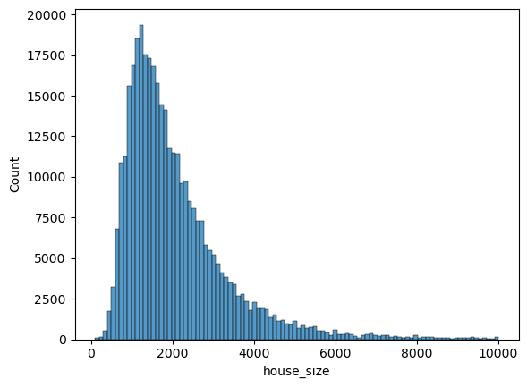
House Sq Ft
Probably the cleanest distribution we get a really nice looking bell curve that lines up with about what we would expect house sizes to be
Again I limited outliers above 10k sqft as it started to really throw of the curve and distort the majority of the data and didn’t accurately represent the data as a whole

Slide 10
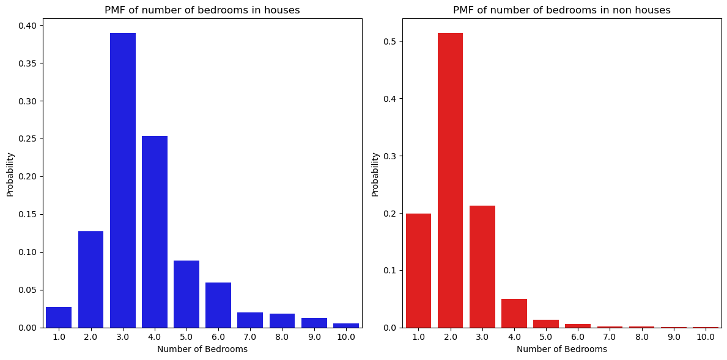
Comparing houses to non-houses
In the data the acre_lot being blank was a signifier of a condo, or high rise home that did not specifically own the land it was on. This turned out to be an interesting place for deeper analysis
Here we can see the difference in number of bedrooms between houses and non-houses
As one would expect the non-houses tend to skew smaller with over 50% of the sample at 2 bedrooms while about 40% of the house sample has 3 bedrooms

Slide 11
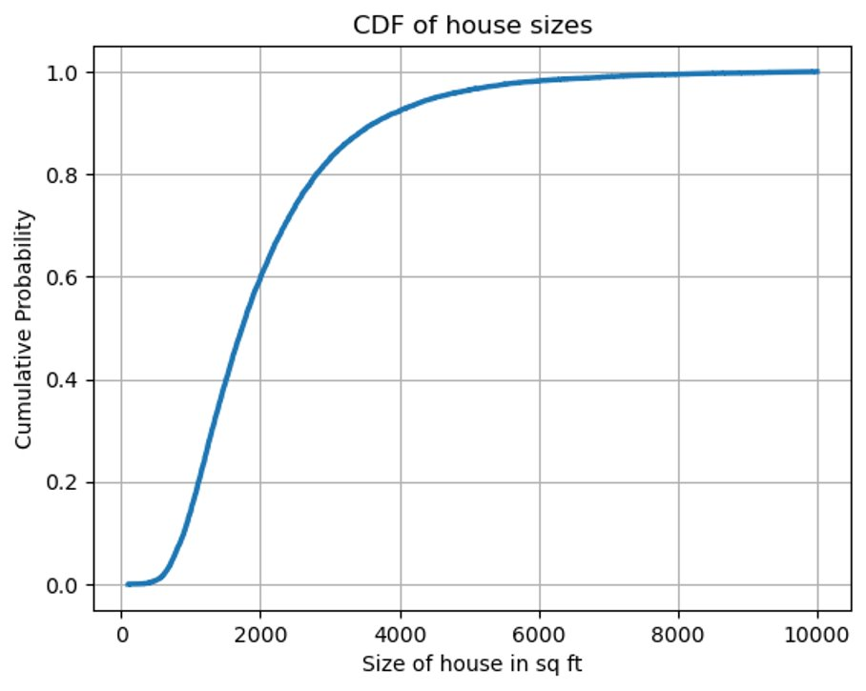
House Size CDF
A CDF representation of house sizes gives an idea of the overall percentage of the size of home
About 60% of the sample have a size of 2k sqft or smaller
And the 90th percentile is for 4k or higher

Slide 12
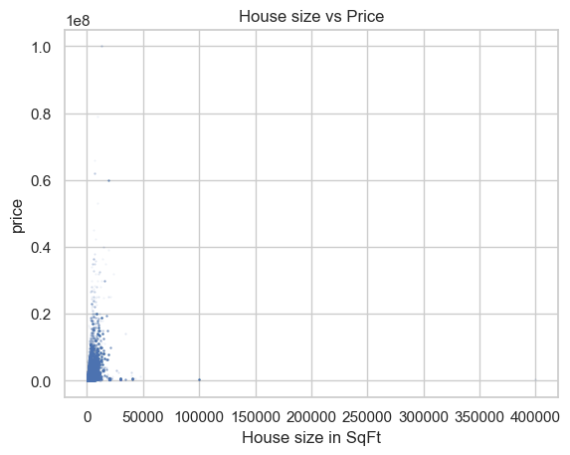
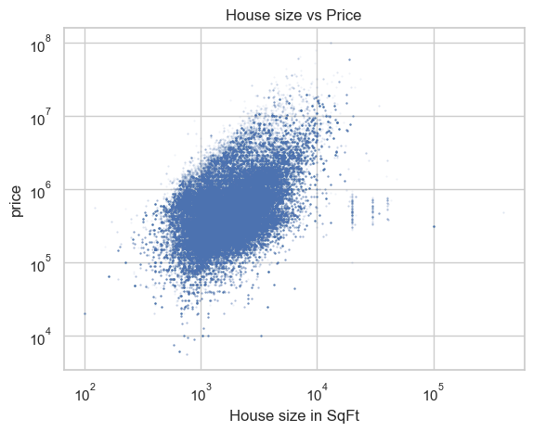
House size vs price
The data on price and size was so skewed because of the large values that the plot was translated into its log form to better see the relationship between variables
We can see a fairly strong positive correlation between the two variables, and when analysed with Pearson's correlation we see that it has a value of 0.336 indicating a strong linear relationship

Slide 13
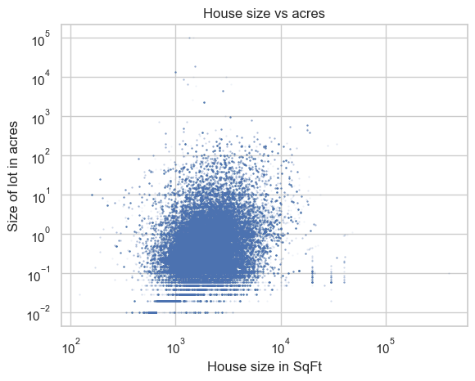
House size vs Acres
Looking at this plot its much more difficult to discern a correlation between variables
When running pearson's we see a value of –2.14 indicating a strong negative relationship, though we can see from the plot it doesn’t look to be that way
When running Spearman's we get a value of 0.23 indicating that there is a fairly strong non-linear relationship between size of house and lot size

Slide 14
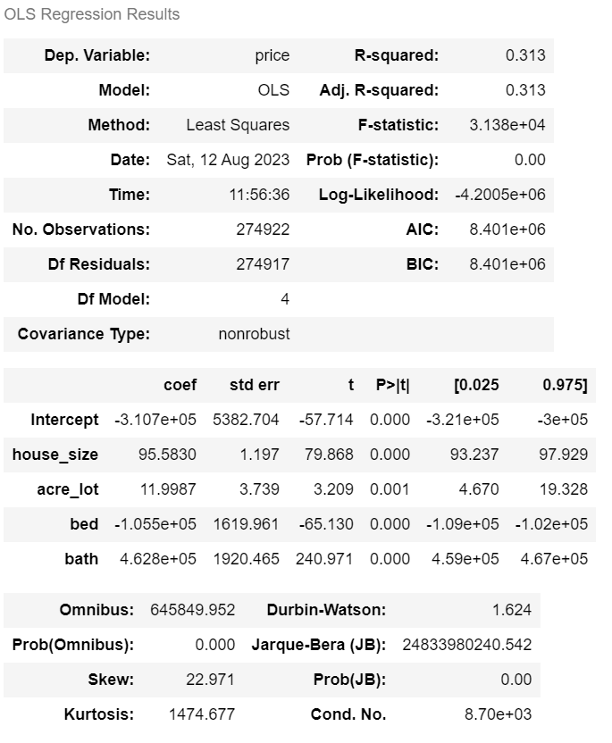
Regression Model
The regression model was fit to the data resulting in a fairly strong fit.
The dependent variable being the price informed by size, bed, bath, and acrage
These variables manage to cover about 30% of the variance in the price and each variable is statistically significant

Slide 15
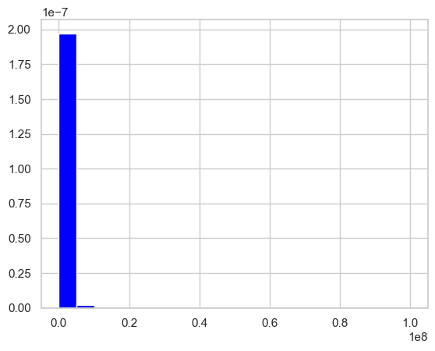
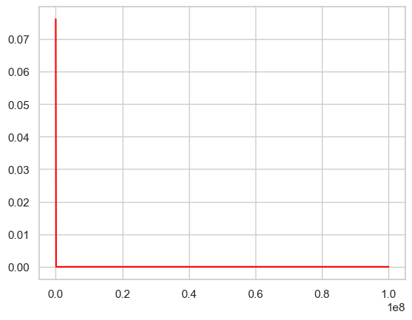
Analytical Model
I tried getting the prices to fit into a pareto distribution, but I could not quite get it to work.
The left was supposed to be the distribution, and the right would have been the pareto, but the model just wasn’t working out the way I wanted it to. It could be that the data itself wasn’t meant to be fit to that model

Slide 16
Closing
This was a very large dataset and I think I worked fairly well with it. Though I feel like a deeper cleaning might have help things, I was mostly just trying to preserve the differences in the observations by keeping minimal removals
Outliers were a big struggle in the data, massive houses and insane prices threw of many of the plots and required that I limit the outliers in order to really examine the core data

