Slide 1
GULF SOUTH CENTER · HACKATHON 2026 · ROUND 2
EGI Workbench.
A research decision-support tool built on the Mississippi Health Equity Gap Index — 82 counties, three federal pillars, one auditable composite.
Round 1 produced the index.
Round 2 produced the tool.
Nhoojah Maharjan · egi-workbench.vercel.app
Notes:
5-MINUTE VERSION (15 sec): "Hi, I'm Nhoojah Maharjan. This is EGI Workbench — a research decision-support tool built on the Mississippi Health Equity Gap Index I developed in Round 1. Round 1 produced the index. Round 2 produced the tool." 10-MINUTE VERSION (30 sec): Same opening + acknowledge the room: "Thank you to the Gulf South Center and Corey for the opportunity to be back for Round 2. What I'll walk you through today is how I took the static county-level ranking from Round 1 and turned it into a working tool that a Center program officer could actually use to allocate resources."

Slide 2
01 · THE PROBLEM
A ranking is not a decision.
Round 1 answered the analytical question: where in Mississippi is the gap between health need and health resources largest? It produced a defensible county-level composite — but the deliverable was a static notebook and a CSV.
The Gulf South Center doesn't need another ranking. They need a tool that lets a program officer walk into a foundation meeting Tuesday morning with defensible county-level evidence and a recommendation she can argue for.
“Where should the Center invest, and why those counties?”
EGI WORKBENCH · HACKATHON 2026 · NHOOJAH MAHARJAN
02 / 13
Notes:
5-MIN (30 sec): "Round 1 produced a static ranking. But a ranking is not a decision. A program officer at the Gulf South Center doesn't just need to know which county is worst — she needs to decide where to invest, and walk into a foundation meeting with defensible evidence. That's the problem Round 2 solves." 10-MIN (45 sec): Add: "I kept asking myself: who actually uses this? And the honest answer is a program officer with a Tuesday meeting and a $2M decision. Everything I built is shaped by that question. If a feature didn't help her, I cut it."

Slide 3
02 · TARGET USERS
Three roles, three workflows.
PRIMARY USER
STEWARD
VERIFIER
Sarah Chen
Dr. Marcus Thompson
Visiting Researcher
Program Officer
Methodology Steward
External Collaborator
Builds county cohorts. Generates funder-ready PDF reports. Drives the $2M Tuesday meeting.
Governs the index. Edits source descriptions and decision rationales. Verifies robustness.
View-only access. Verifies findings before grant submissions. Cannot modify cohorts.
EGI WORKBENCH · HACKATHON 2026 · NHOOJAH MAHARJAN
03 / 13
Notes:
5-MIN (30 sec): "The Center has three kinds of users. Program officers like Sarah Chen who build cohorts and write grants. Methodology stewards like Dr. Thompson who govern the index itself. And external collaborators who verify findings before meetings. The app has three real auth roles mapped to these three workflows — not security theater, an actual organizational model." 10-MIN (60 sec): Add: "I want to be honest about why I built three roles instead of one. A single role doesn't model the Center's structure — they have professional governance over methodology, and they bring in outside reviewers. Five roles would have been invented. Three is the smallest number that maps to real workflows. Adding a fourth would be a one-line change in lib/auth.ts."

Slide 4
03 · THE HEADLINE FINDING (FROM ROUND 1)
Issaquena.
Most underserved county on the EGI.
EGI 87.4
0 / 1,206
HRSA-HPSA
out of 100 — highest underservedness score in MS, +30.6 vs state mean of 56.8
zero attributed primary-care providers serving a population of 1,206 residents
federally designated Health Professional Shortage Area — external corroboration
The methodology is validated by an independent federal designation. That matters.
EGI WORKBENCH · HACKATHON 2026 · NHOOJAH MAHARJAN
04 / 13
Notes:
5-MIN (30 sec): "Quick anchor from Round 1: Issaquena County ranks #1 on the EGI with a score of 87.4, more than 30 points above the state mean. It has zero attributed primary-care providers for 1,206 residents. And — this is the validation — it's independently designated by HRSA as a Health Professional Shortage Area. The federal government, working from completely different data, came to the same conclusion. That's what makes the methodology defensible." 10-MIN (45 sec): Add: "I want to be clear about why this matters: anyone can build a composite score and rank counties. The question is whether you'd stake a grant on it. Having a federal HPSA designation independently confirm the headline gives the Center something to point at when a foundation challenges the methodology."

Slide 5
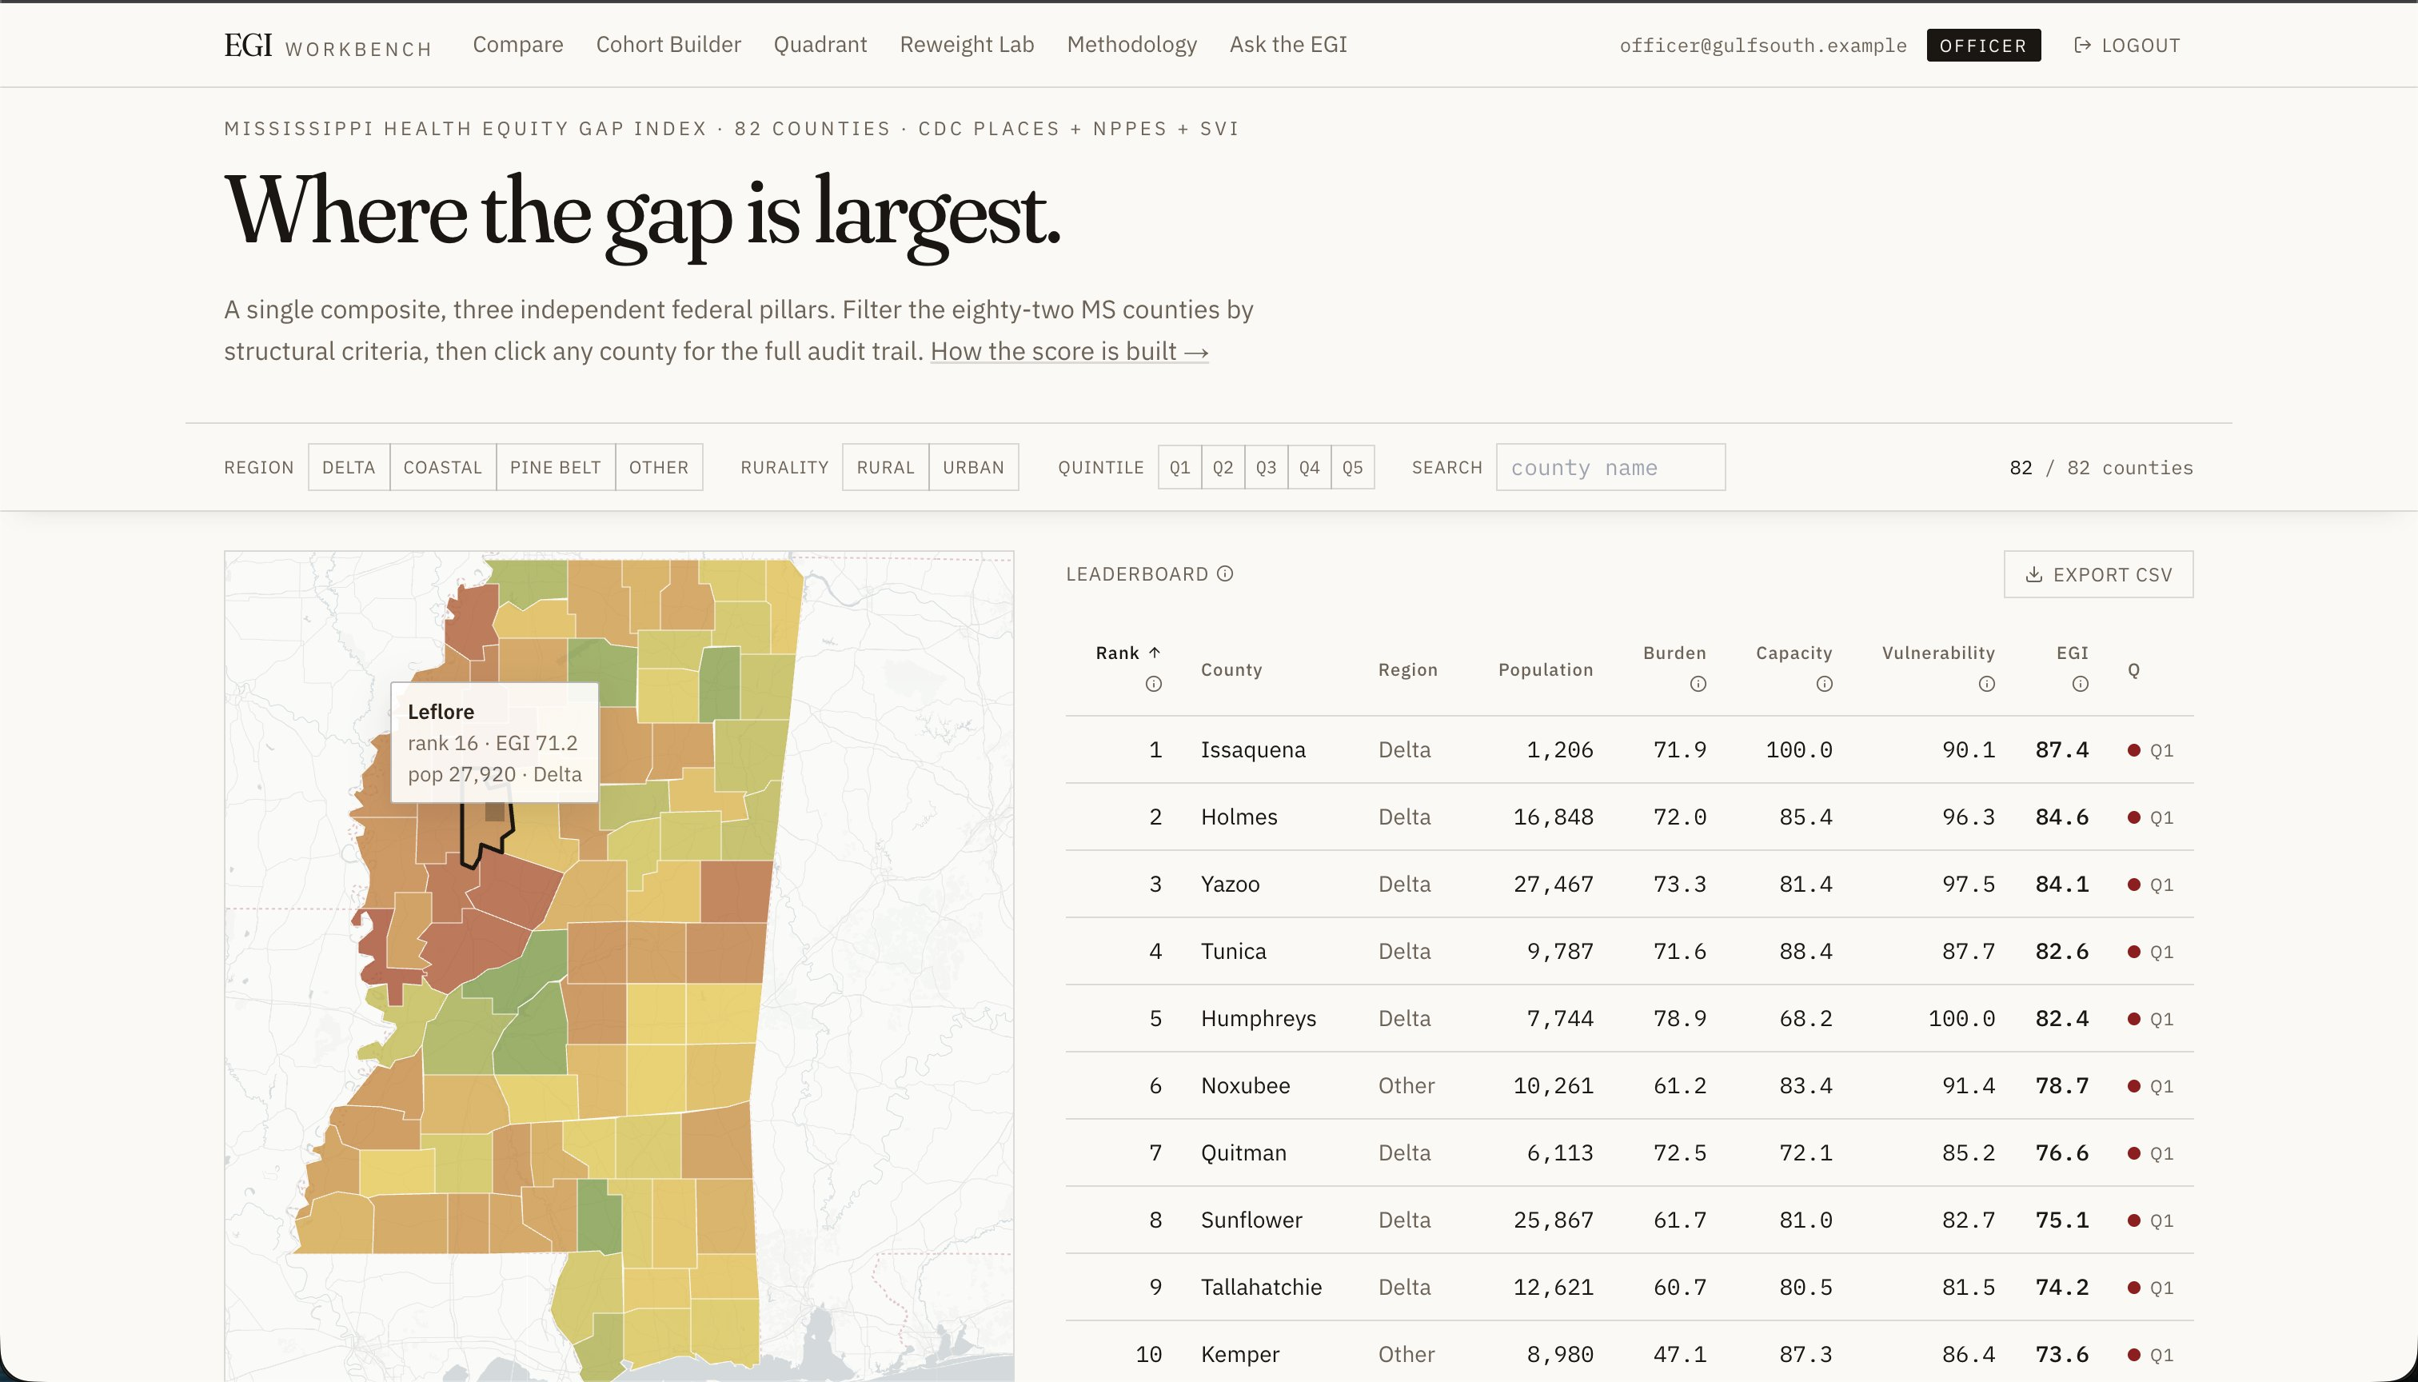
04 · THE PRODUCT
Where the gap is largest.
Landing page — map + leaderboard, filtered by region, rurality, quintile.
EGI WORKBENCH · HACKATHON 2026 · NHOOJAH MAHARJAN
05 / 13
Notes:
5-MIN (30 sec): "This is what users see when they log in. A choropleth of all 82 Mississippi counties on the green-yellow-red equity gradient — the Delta band reads in red immediately — alongside a sortable leaderboard. Filters at the top reshape both panes in real time. Click any county or any row to drill in." 10-MIN (45 sec): Add: "The visual hierarchy is intentional. The headline 'Where the gap is largest' is in serif display type — this is a research publication, not a dashboard. Every number in the leaderboard uses tabular numerals so the digits align column-by-column. Editorial typography is part of the credibility story."

Slide 6
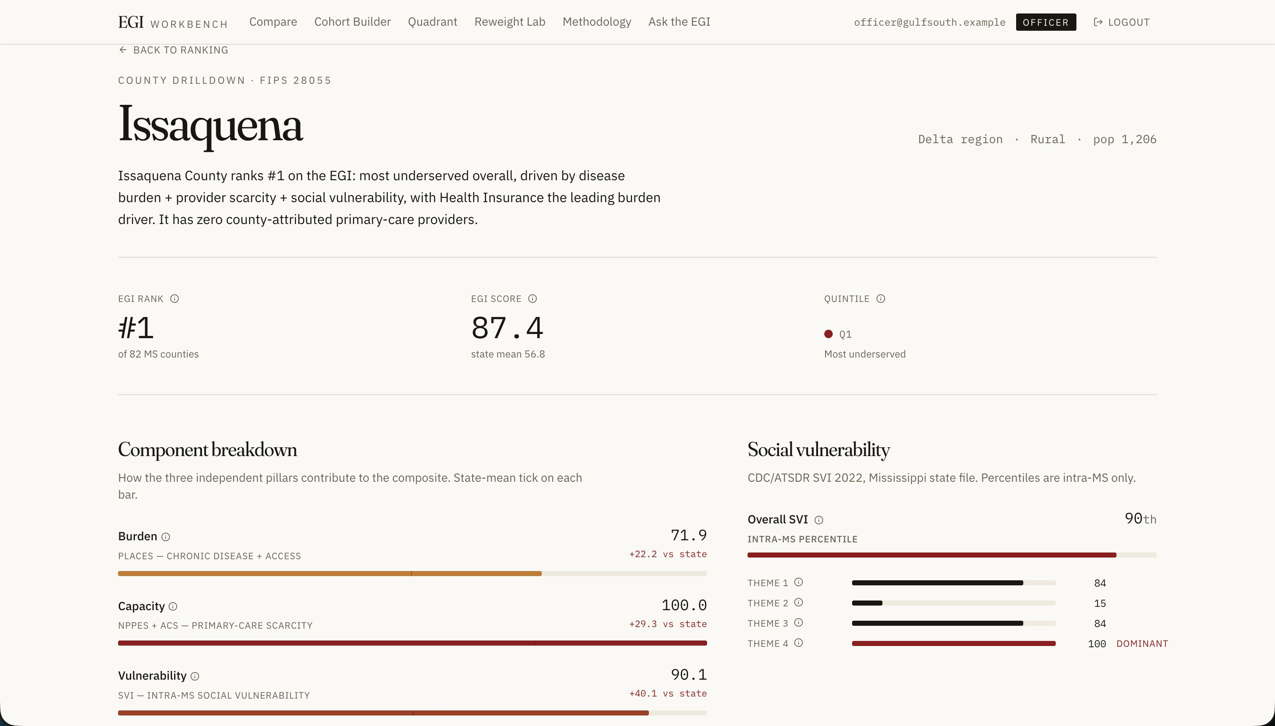
04 · THE PRODUCT · DRILLDOWN
Why is it ranked here?
County drilldown — every number is auditable to its SQL source and decision rationale.
EGI WORKBENCH · HACKATHON 2026 · NHOOJAH MAHARJAN
06 / 13
Notes:
5-MIN (30 sec): "Click Issaquena and you get the full audit. Three component bars — burden, capacity, vulnerability — each showing how this county compares to the state mean. The SVI panel shows Housing & Transport as the dominant theme at 100th percentile. The provider mix callout shows zero providers in any of the six primary-care taxonomies. Every number has an info icon that opens the SQL query that produced it." 10-MIN (45 sec): Add: "This is what I mean when I say a researcher can defend this in front of a foundation. There's no hand-waving. If a program officer is asked 'where does the 87.4 score come from?' she can show them the exact query. That auditability runs through every surface in the app."

Slide 7
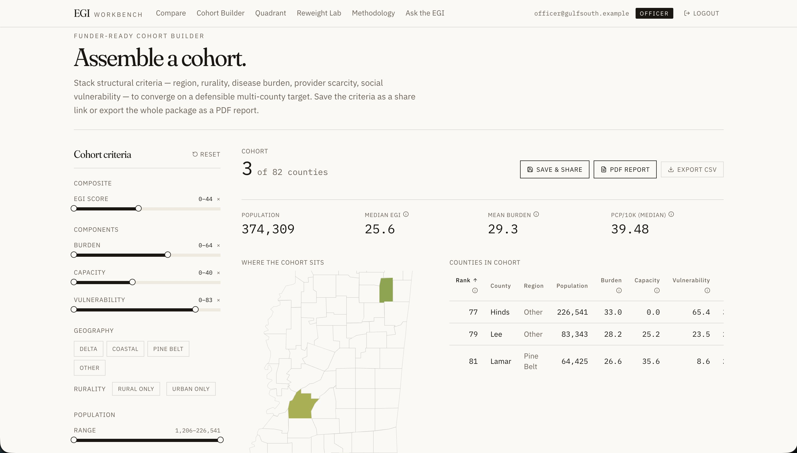
04 · THE PRODUCT · COHORT BUILDER
Assemble a defensible target.
Stack structural criteria. Export to PDF or CSV. This is what walks into the Tuesday meeting.
EGI WORKBENCH · HACKATHON 2026 · NHOOJAH MAHARJAN
07 / 13
Notes:
5-MIN (45 sec): "This is the centerpiece of the tool. Sarah Chen filters down to Delta-region, rural counties with high disease burden — and lands on seven counties, combined population 160,000, median EGI 65, well above the state mean. The map highlights the cohort. The summary stats show the cohort's burden drivers — obesity, high blood pressure, diabetes — relative to the state mean. One click: PDF report or CSV export. This is the deliverable that goes into the foundation meeting." 10-MIN (75 sec): Add: "The PDF report isn't a screenshot dump — it's a multi-page document with the methodology section, the per-county breakdown with charts, the data sources with retrieval dates, and the SQL queries that produced each number in an appendix. A foundation can hand it to their methodology reviewer and the entire pipeline is reproducible. Also note: cohort criteria are encoded in the URL. Sarah can text her colleague a link and they see the same view. No state library — just URL params."

Slide 8
05 · TECHNICAL APPROACH
Right tool for the data.
STACK
DECISIONS THAT MATTER
Next.js 15 App Router, TypeScript strict, Node runtime
SQLite via better-sqlite3, opened readonly:true
Vercel KV for sessions, saved cohorts, rate limiting
Tailwind + shadcn/ui for design system
Recharts + d3-geo for interactive + PDF charts
@react-pdf/renderer for multi-page cohort reports
Groq Llama 3.3 70B for AI-assisted query
Why SQLite over Postgres. 12,000 rows, read-only, ships with deploy. Postgres adds latency for zero benefit.
Why readonly:true at the connection. Defense-in-depth — even a query that bypassed our validators couldn’t write.
Why URL-based filter state. Survives reload, back-button, link-sharing. State library would add a layer.
Why FIPS-keyed pipeline. Adding Alabama is one line: state_fips = '01'. Frontend unchanged.
EGI WORKBENCH · HACKATHON 2026 · NHOOJAH MAHARJAN
08 / 13
Notes:
5-MIN (45 sec): "The stack is deliberately conservative. Next.js 15, TypeScript, SQLite, Tailwind, Vercel. What matters more than the choices is why I made them. SQLite — not Postgres — because the data is 12,000 rows of static federal data. Postgres would have added complexity for no benefit. The connection is opened read-only as defense-in-depth: even if the AI page somehow generated a destructive query, the connection itself would reject it. Filter state lives in the URL, not Redux, so a researcher can share a link. And the pipeline is FIPS-keyed throughout, so adding another state is one line of Python." 10-MIN (90 sec): Walk through each decision more deliberately. "When I see SQLite vs Postgres in production, the honest test is: would you ship this with concurrent writes? No. So Postgres is the wrong tool. The AI safety story is three layers — the LLM system prompt restricts to SELECT, server-side regex rejects anything that gets through, and the connection itself is readonly. That third layer is the one that matters because it's the only one that doesn't depend on me having written the validator correctly."

Slide 9
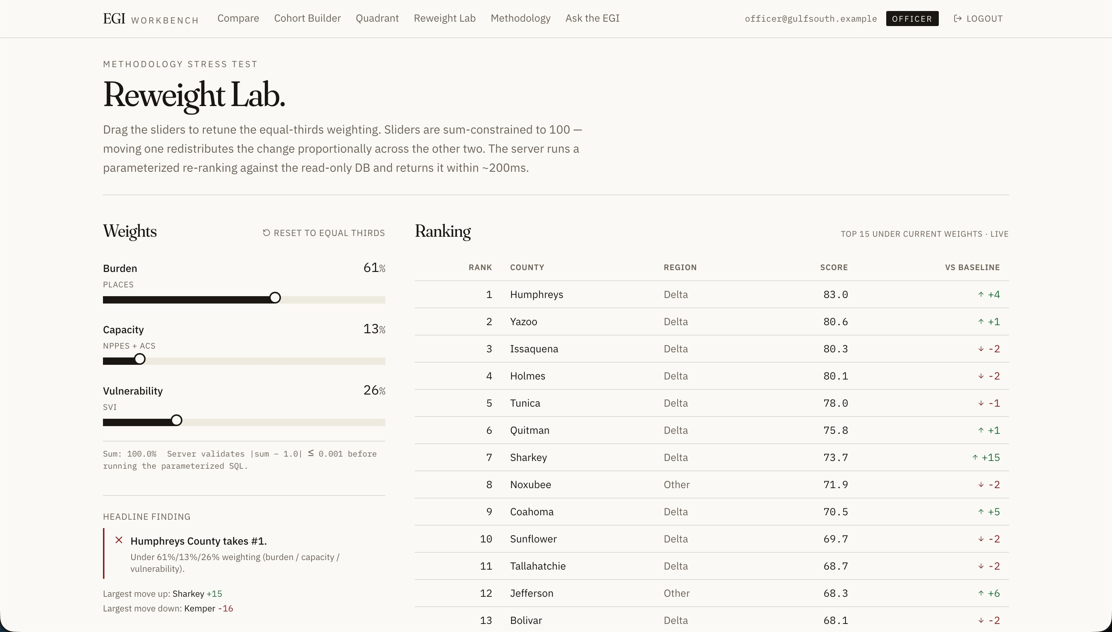
06 · WORKFLOW DESIGN + DATA ORGANIZATION
Methodology under stress test.
Reweight Lab — three sliders, parameterized SQL, real-time re-ranking against the read-only DB.
EGI WORKBENCH · HACKATHON 2026 · NHOOJAH MAHARJAN
09 / 13
Notes:
5-MIN (45 sec): "This is the workflow that earns the methodology its credibility. The three sliders let a methodology steward stress-test the index — push burden up, pull capacity down, see what happens to the ranking. The server runs a parameterized version of the EGI view against the read-only database in about 200 milliseconds. Here at 61/13/26 you can see Humphreys overtakes Issaquena. The headline ranking moves under enough pressure — but the Methodology page shows that across three reasonable weightings, six of the top ten counties appear in all three lists. That's the robust core." 10-MIN (75 sec): Add: "On data organization: nine tables in a normalized schema. FIPS as the primary join key everywhere. A v_equity_gap_index SQL view encapsulates the composite — every surface in the app queries that view, so methodology changes propagate to every page without touching frontend code. The reweight endpoint inlines the view's CTEs and parameterizes the weights — you can't just SELECT FROM the view because the view hard-codes equal thirds. That was an architectural decision worth explaining."

Slide 10
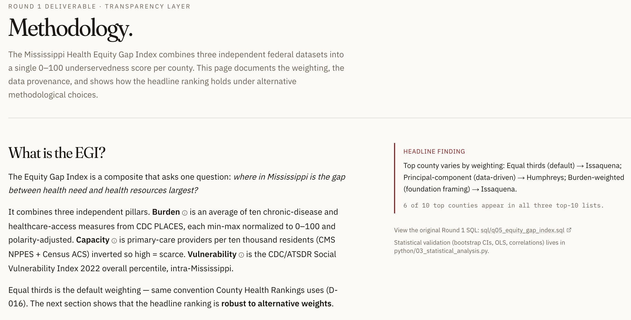
07 · KEY FEATURE · METHODOLOGY (TRANSPARENCY LAYER)
Every methodological choice is documented.
The Methodology page surfaces the index's anatomy — three pillars, data provenance, and the headline finding under alternative weights.
EGI WORKBENCH · HACKATHON 2026 · NHOOJAH MAHARJAN
10 / 13
Notes:
5-MIN (skip this slide entirely — jump straight to bonus coverage): N/A 10-MIN (45 sec): "This is the credibility anchor. Every methodological choice the index makes is documented on a single page. The composite is three pillars — burden, capacity, vulnerability — each min-max normalized and polarity-adjusted. The default weighting is equal thirds, which matches County Health Rankings convention. But the headline finding callout in the corner is the most important thing on this page: under three different weighting schemes, the top county changes — but six of the top ten counties appear in all three lists. That's the robust core. Next slide shows that comparison."

Slide 11
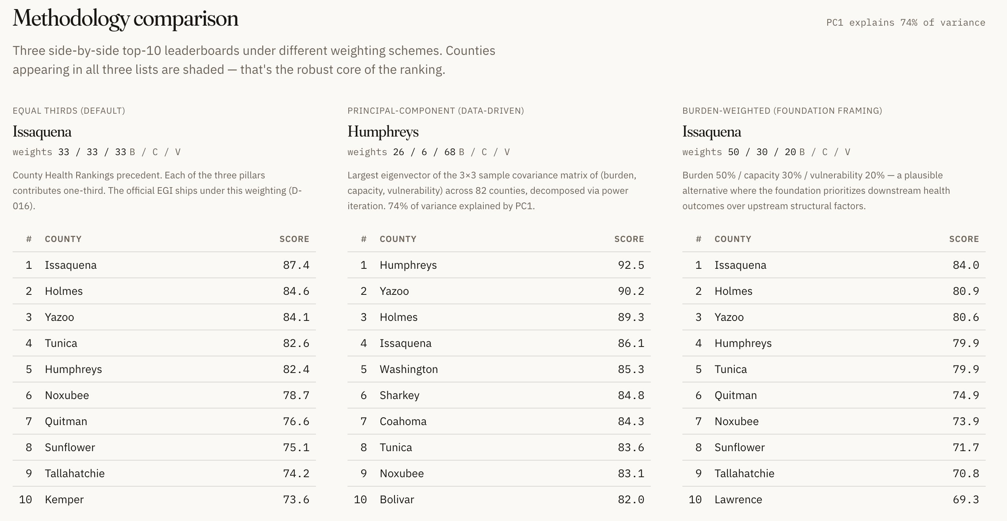
07 · KEY FEATURE · THREE-WAY METHODOLOGY COMPARISON
Three methodologies, one robust core.
Equal thirds (default) · Principal-component (data-driven, 74% variance) · Burden-weighted (foundation framing).
EGI WORKBENCH · HACKATHON 2026 · NHOOJAH MAHARJAN
11 / 13
Notes:
5-MIN (skip — only show if 10-min): N/A 10-MIN (60 sec): "Three side-by-side leaderboards under different weighting schemes. The PCA one is computed via power iteration on the 3-by-3 covariance matrix of the components — 74% of variance explained by the first principal component, which is itself a finding worth surfacing. Look at the names: Issaquena, Holmes, Yazoo, Humphreys, Tunica appear in every list. The headline 'six of ten top counties appear in all three top-10 lists' — that's the answer to a foundation reviewer who asks 'are you sure these are the right weights?' Equal thirds is the default because that matches County Health Rankings convention, but the data-driven alternative produces the same robust core. The methodology is defensible."

Slide 12
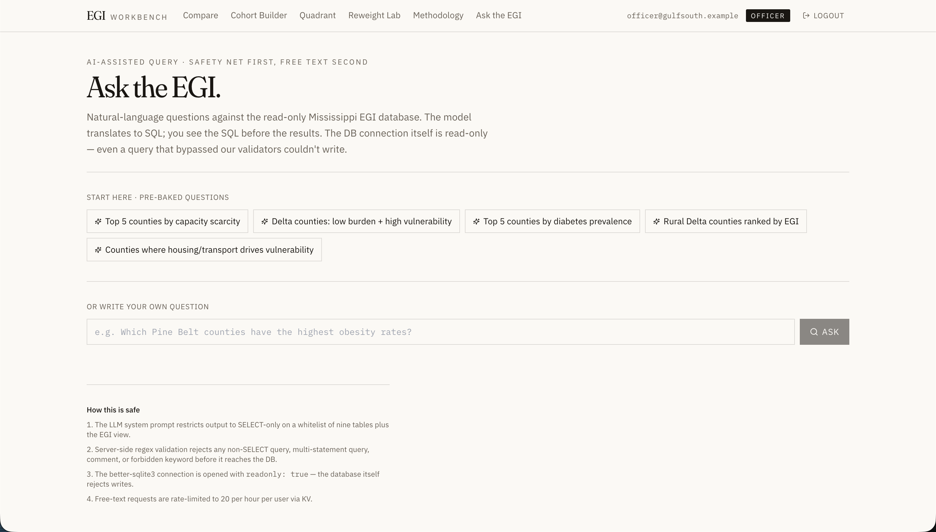
08 · KEY FEATURE · AI-ASSISTED QUERY
Ask the EGI in plain English.
Groq Llama 3.3 70B translates natural language to read-only SQL. Three-layer safety net — system-prompt whitelist, regex validation, readonly DB connection.
EGI WORKBENCH · HACKATHON 2026 · NHOOJAH MAHARJAN
12 / 13
Notes:
5-MIN (15 sec, optional — point at the slide): "Quick visual: every bonus from the instructions, addressed in the code. Auth, RBAC, real-time responsiveness, accessibility, AI features, scalability — all there." 10-MIN (45 sec): "I want to be honest about the bonus list. It would have been easy to half-implement everything — fake auth, decorative real-time, an AI that generates SQL but isn't sandboxed. I tried to make each one earn its place. Auth is mapped to three real roles. Real-time means sub-200ms responsiveness on every interaction, not WebSockets for the sake of it. The AI page has three layers of safety because anything less would be a hazard, not a feature."

Slide 13
09 · FUTURE WORK · AND THE ASK
What I'd build next.
01
Intervention simulator
02
Multi-state expansion
03
Time-series tracking
Pick a cohort. Add hypothetical providers. See how the EGI shifts. The API contract is sketched in lib/types.ts.
FIPS-keyed pipeline supports it in under a day per state. Add a state selector to the nav.
Add snapshot_year to measurement tables. Parameterize the view. Swap headline cards for sparklines.
Round 1 produced the index. Round 2 produced the tool. I’d like to put this in front of the Center.
EGI WORKBENCH · HACKATHON 2026 · NHOOJAH MAHARJAN
13 / 13
Notes:
5-MIN (30 sec): "Three things I'd build next: an intervention simulator that lets a researcher add hypothetical providers to a cohort and watch the EGI shift in real time — the API contract is sketched in lib/types.ts. Multi-state expansion, which is under a day per state because the pipeline is FIPS-keyed. And time-series tracking, which is a clean schema extension. To close: Round 1 produced the index. Round 2 produced the tool. I'd like to put this in front of the Center." 10-MIN (60 sec): Add depth on each: "The intervention simulator is the one I'm most excited about because it answers a question the Center actually has — 'where would one more nurse practitioner have the most equity impact?' That requires literature on provider-to-outcome elasticity, which I couldn't compress into the weekend. But it's the natural next layer on top of what's here. The closing ask is genuine — this isn't a portfolio piece, it's a tool, and the only way to know if it's useful is to put it in front of the people I built it for."

