Slide 1
GULF SOUTH CENTER · HACKATHON ROUND 2
EGI Workbench.
A research decision-support tool built on the Mississippi
Health Equity Gap Index.
Nhoojah Maharjan
LIVE: app-two-pi-29.vercel.app
May 26, 2026 · USM Asbury Hall 116
1 / 12

Slide 2
EGI WORKBENCH
Gulf South Center · Hackathon Round 2
THE PROBLEM WE CHOSE
Mississippi's worst-county question.
Mississippi ranks worst in the US on most major state health rankings.
Round 1 produced the Mississippi Health Equity Gap Index — a county-level
composite ranking all 82 counties on disease burden (CDC PLACES), provider
capacity (CMS NPPES + Census ACS), and social vulnerability (CDC/ATSDR SVI).
Issaquena County ranked #1. Independently a federally-designated HPSA —
the math reproduced what the federal designation already said.
But ranking alone doesn't solve a problem.
The Gulf South Center has to decide where to invest.
82
MS counties
9 tables · 19 documented decisions · 5 federal datasets
2 / 12

Slide 3
EGI WORKBENCH
Gulf South Center · Hackathon Round 2
TARGET USER
Sarah Chen, Program Officer.
Sarah works at the Gulf South Center for Community-Engaged Health Research
and Innovation.
She has a Tuesday meeting with a private foundation considering a $2M rural
health investment in Mississippi.
She needs to walk in with defensible county-level evidence: which counties,
why those, what's the methodology, what are the alternative interpretations,
and what's the audit trail back to source data.
Three roles model the Center's actual structure — Program Officer,
Methodology Steward, External Collaborator.
ROLES IN THE TOOL
Program Officer
Builds cohorts. PDF reports. Cannot edit methodology.
Methodology Steward
Officer permissions + edit data sources, decisions.
External Collaborator
Read-only. Banner: viewing as collaborator.
3 / 12

Slide 4
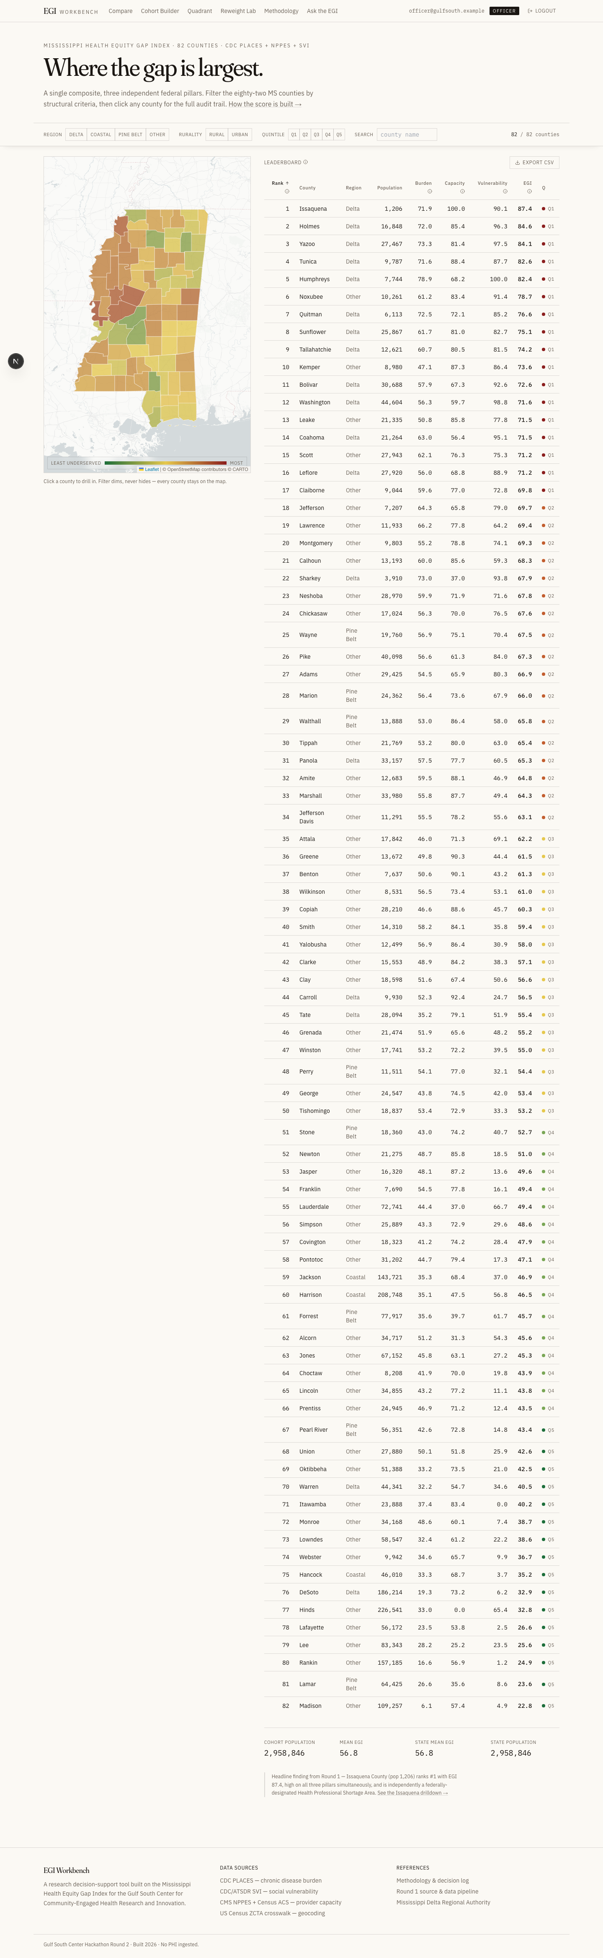
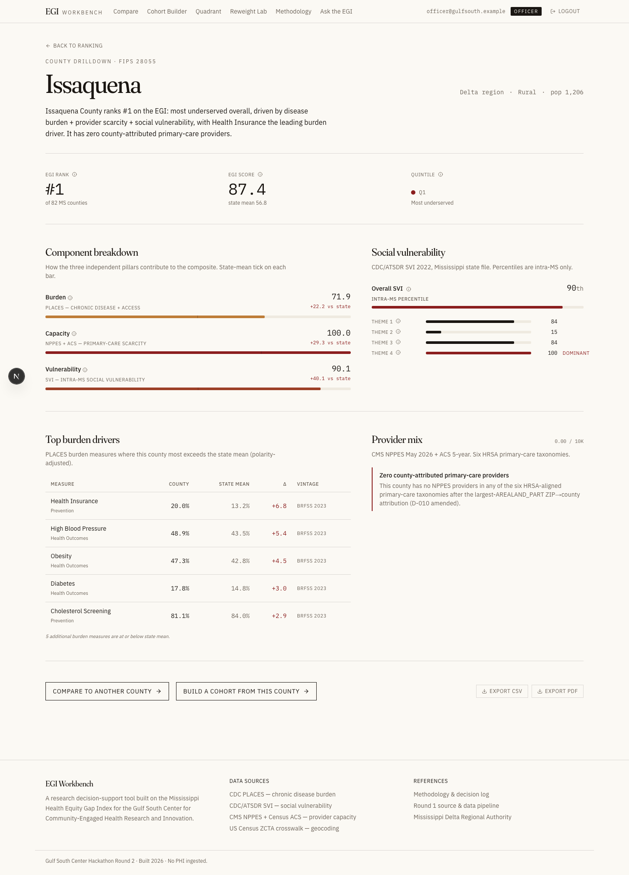
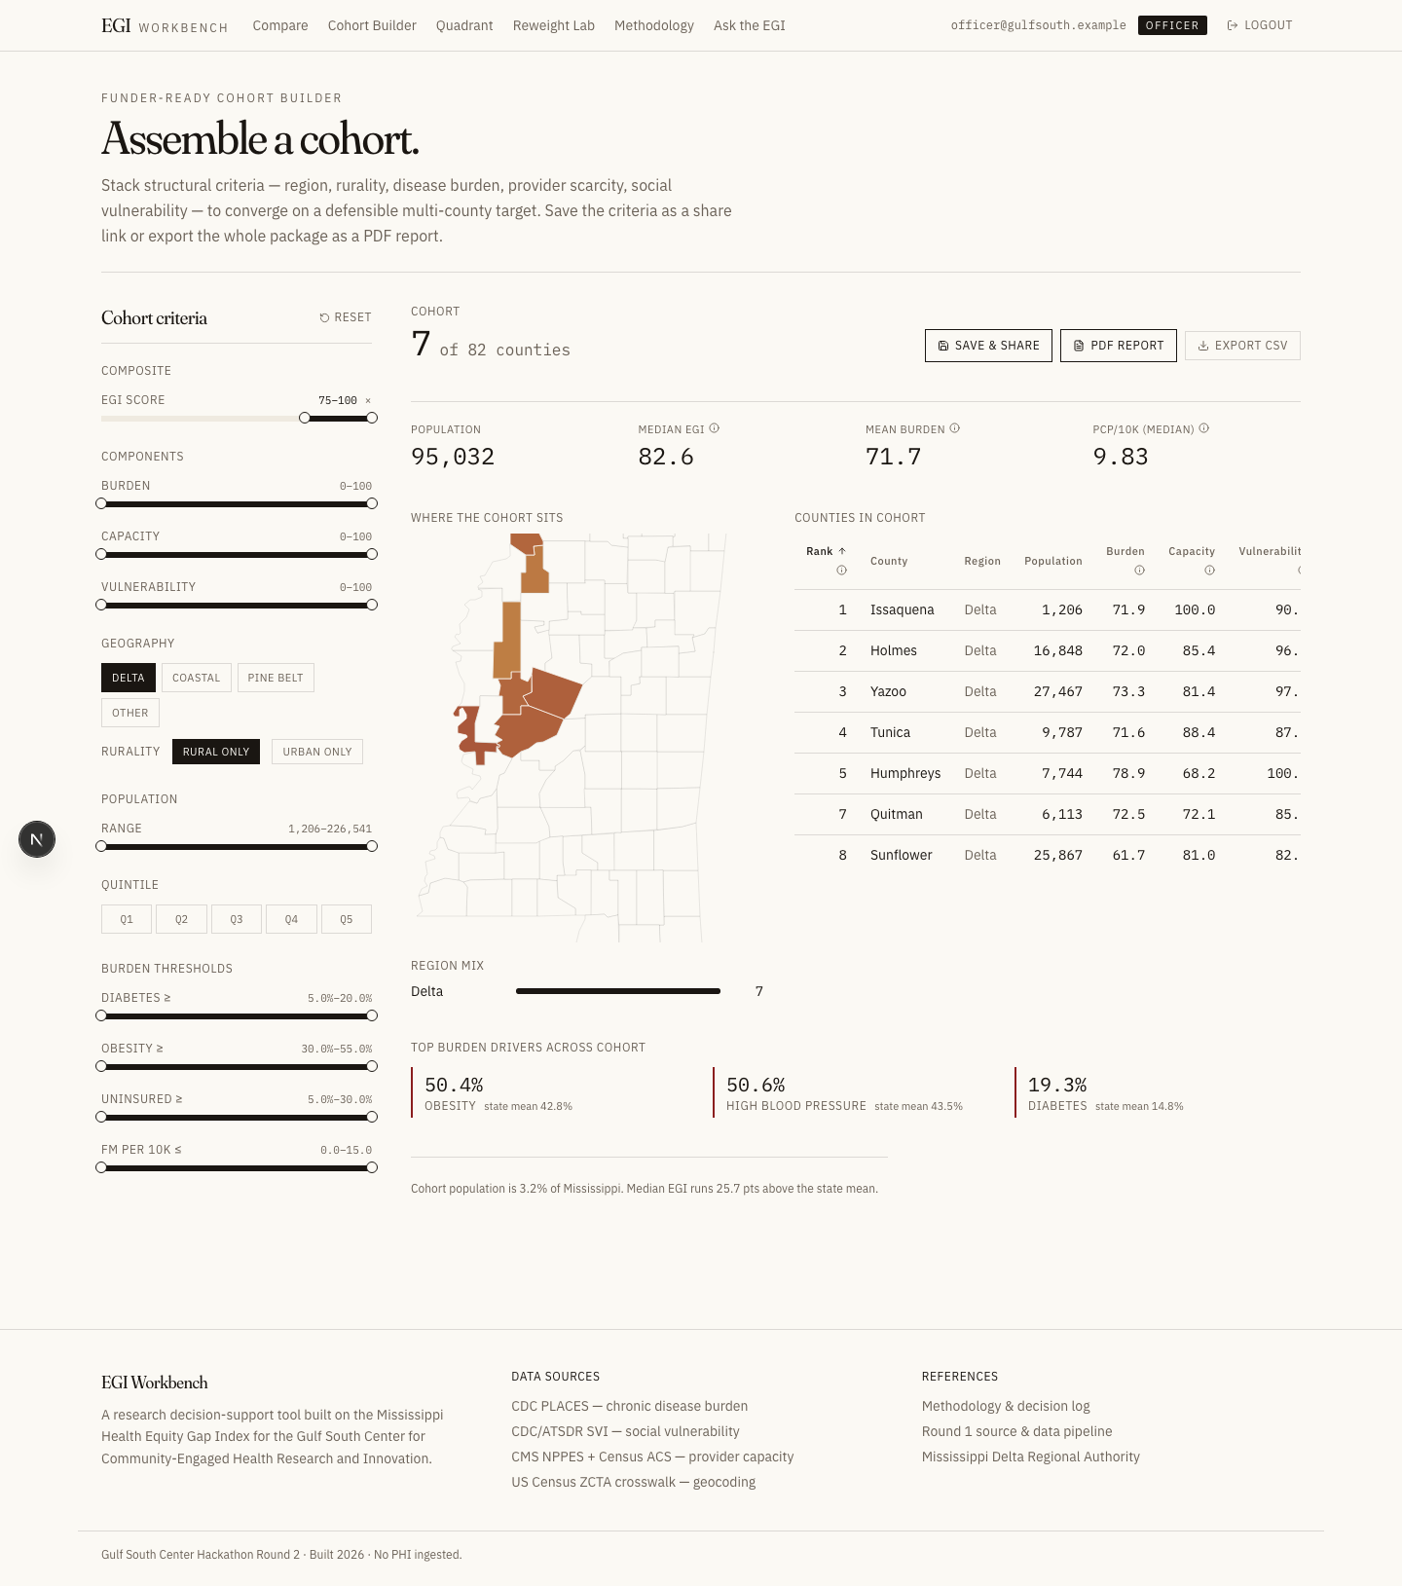
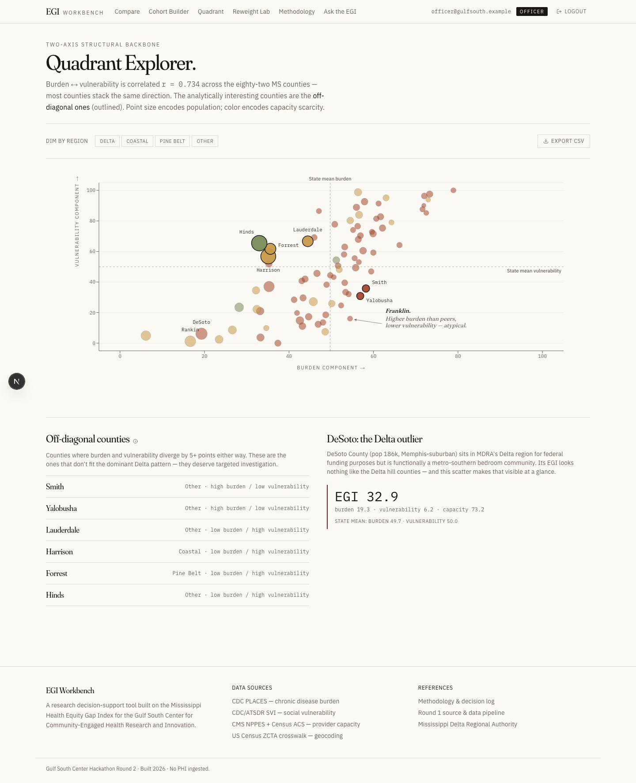
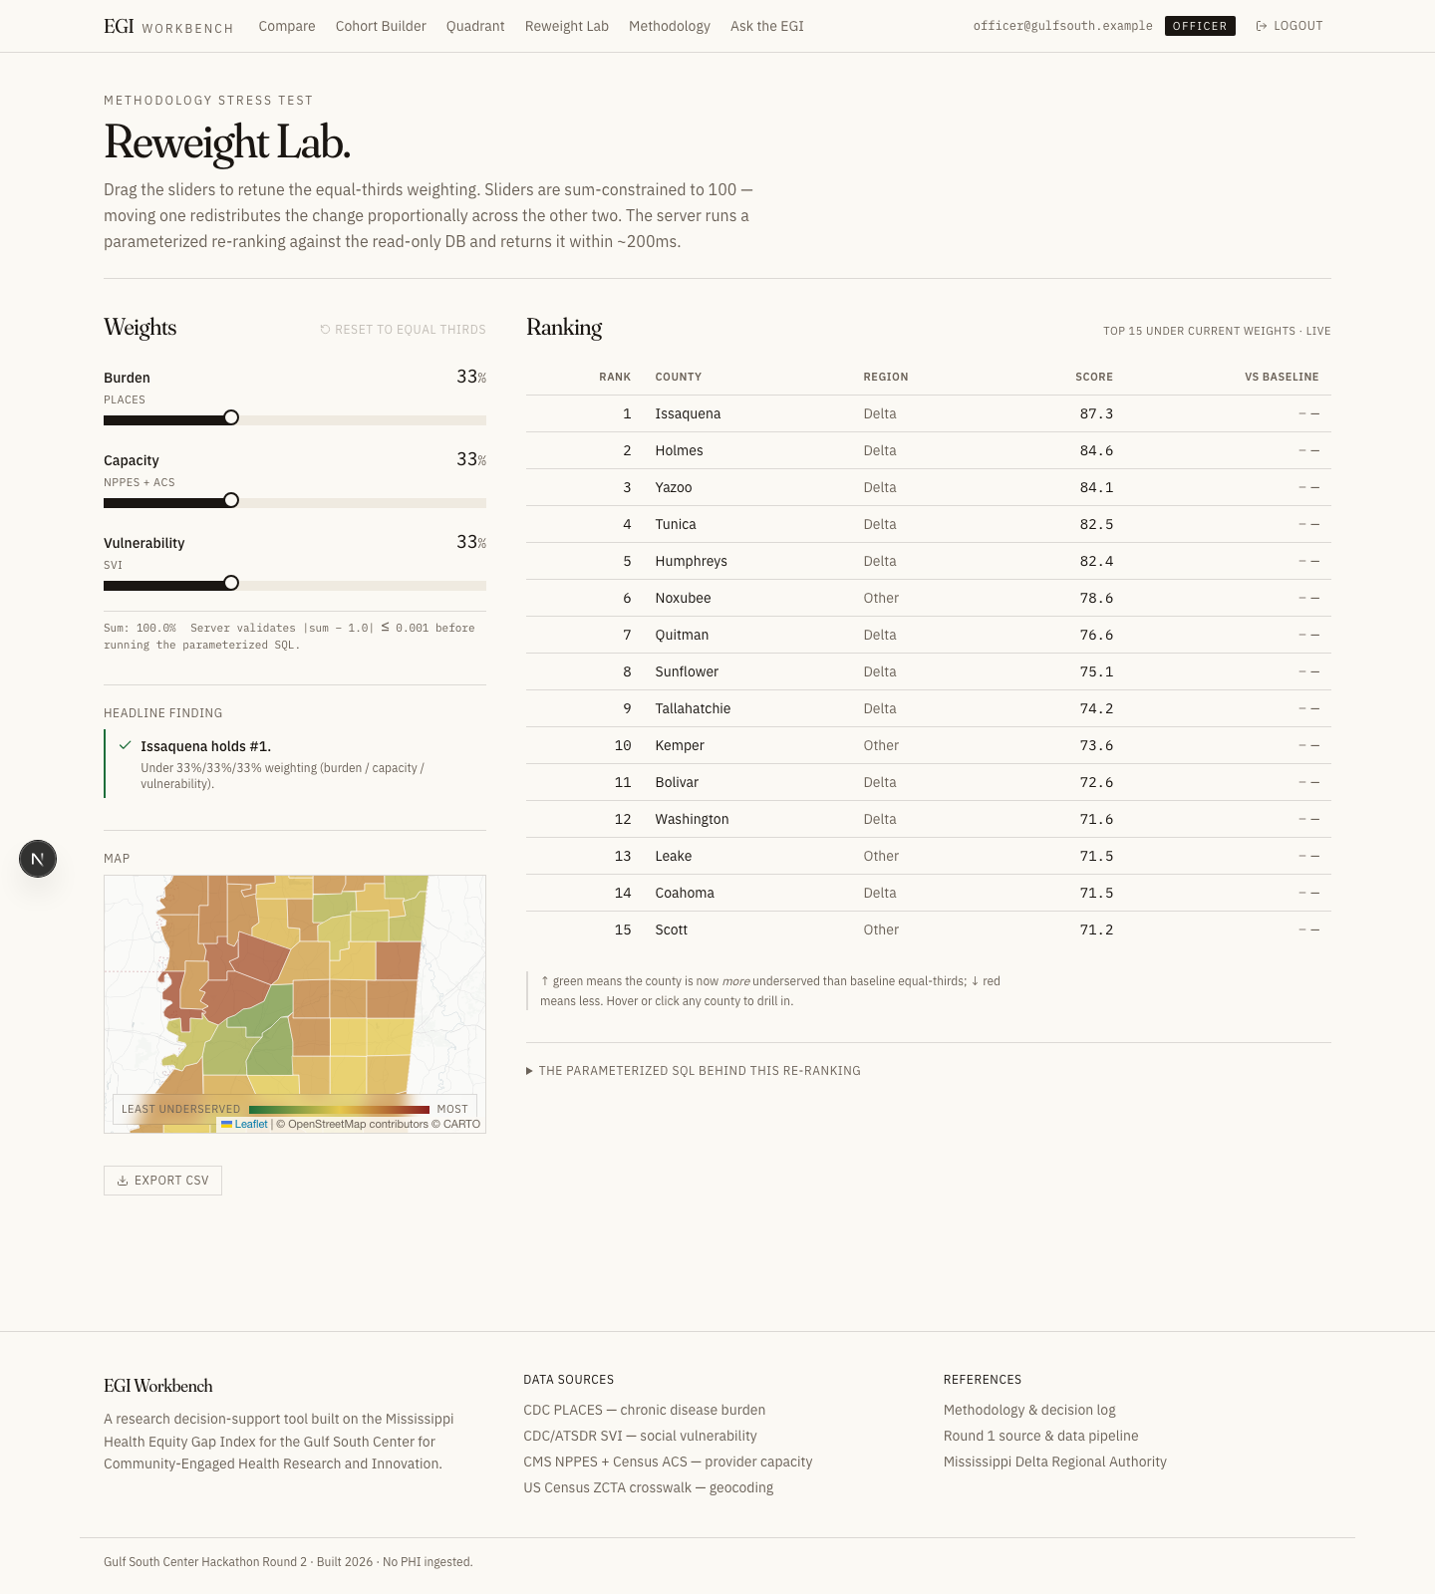
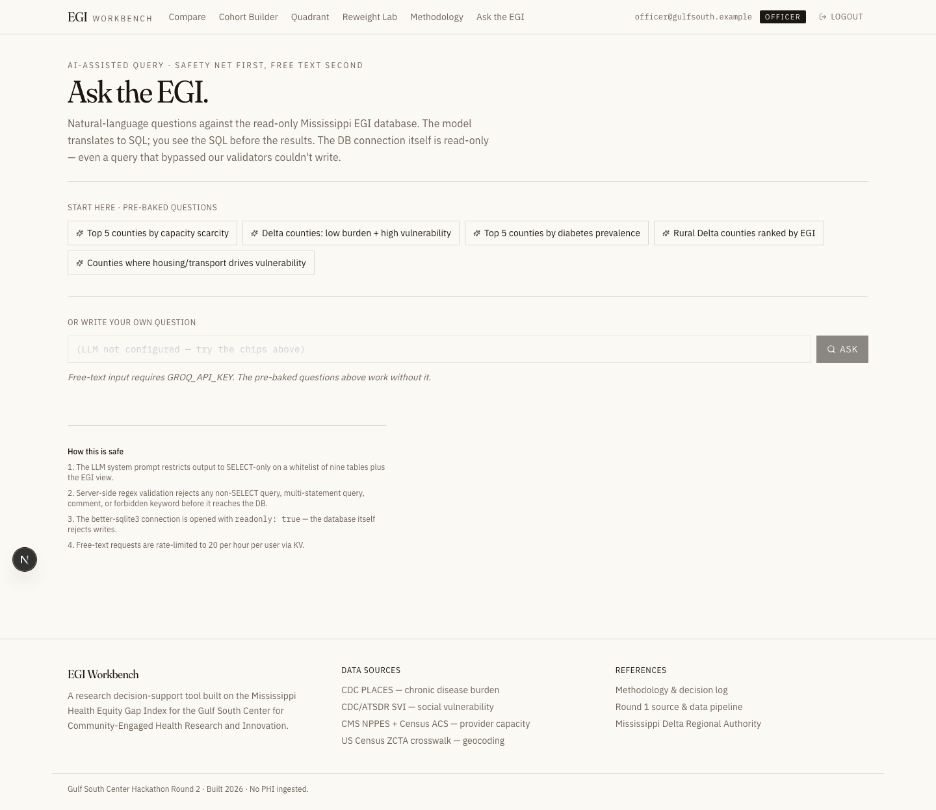
EGI WORKBENCH
Gulf South Center · Hackathon Round 2
APPLICATION OVERVIEW
Seven surfaces. One AI page.
Landing / Map
County Drilldown
Cohort Builder
4 / 12
Quadrant Explorer
Reweight Lab
Ask the EGI (AI)

Slide 5
EGI WORKBENCH
Gulf South Center · Hackathon Round 2
DEMO · LANDING
Where the gap is largest.
1 in 5 Mississippi counties scores in the top quintile of underservedness.
All 5 of the top 5 are in the Delta.
Filter the 82 counties by region, rurality, quintile, or full-text
search. The map dims (never hides) non-matches; the leaderboard
re-sorts in real time; URL search params keep state shareable.
Click any county to drill in.
HEADLINE FROM ROUND 1
Issaquena County (pop 1,206) ranks #1 with EGI 87.4 — high on all three
pillars simultaneously. Independently a federally-designated HPSA — the
math reproduced what the federal designation already said.
5 / 12

Slide 6
EGI WORKBENCH
Gulf South Center · Hackathon Round 2
DEMO · COUNTY DRILLDOWN
Every number, traceable.
Header with rank, score, quintile. Component breakdown with state-mean
tick lines. Top burden drivers showing which PLACES measures most
exceed the state average for this county. Provider mix by HRSA taxonomy.
Every metric has an ℹ icon — click for source, decision rationale,
and the SQL snippet that produced the number.
ISSAQUENA, FOR EXAMPLE
"Issaquena has zero attributed primary-care providers across all six
HRSA taxonomies — a structural healthcare-access gap."
Generated dynamically from data by lib/insights.ts.
6 / 12

Slide 7
EGI WORKBENCH
Gulf South Center · Hackathon Round 2
DEMO · COHORT BUILDER
Assemble a cohort.
Stack structural filters — region, rurality, EGI score range, all
three component ranges, population, advanced burden thresholds like
diabetes ≥ 15%.
Live county count. Median EGI vs state. Dominant SVI theme.
Top burden driver across the cohort.
Officer / Steward roles can Save & Share — saves the criteria to
Vercel KV and returns a share token that any role can open.
PDF Report generates a foundation-ready document with embedded
methodology, county table, and the source SQL in the appendix.
7 / 12

Slide 8
EGI WORKBENCH
Gulf South Center · Hackathon Round 2
DEMO · REWEIGHT LAB
Stress-test the methodology.
Three sum-constrained sliders — burden / capacity / vulnerability.
Drag one, the other two redistribute proportionally.
Server runs a parameterized re-ranking against the read-only DB
(inlined view CTE chain with ? placeholders — never string concat)
and returns the new top-10 + rank changes in under 200ms.
The headline indicator answers the killer Q&A question:
Is Issaquena's #1 robust to alternative weightings?
DEMO MOMENT
Drag vulnerability to 100%. The top reshuffles. Sarah can now tell the
foundation: "Issaquena holds under most weightings — except pure-vuln."
8 / 12

Slide 9
EGI WORKBENCH
Gulf South Center · Hackathon Round 2
DEMO · ASK THE EGI (AI)
AI with three layers of defense.
Natural-language → SQL via Groq Llama 3.3 70B. The SQL is shown
before the result — that's the transparency mechanism.
HOW IT'S SAFE
1. System prompt
Restricts the LLM to SELECT-only on 9 whitelisted tables + the EGI view.
2. Server validator
Regex rejects non-SELECT, multi-statement, comments, forbidden keywords.
3. Read-only DB
better-sqlite3 connection opened with readonly: true. Even a query that bypassed the validators couldn't write.
Plus 5 starter chips with hand-written SQL — the demo-day safety net.
If Groq is down or rate-limited, the chips still work.
9 / 12

Slide 10
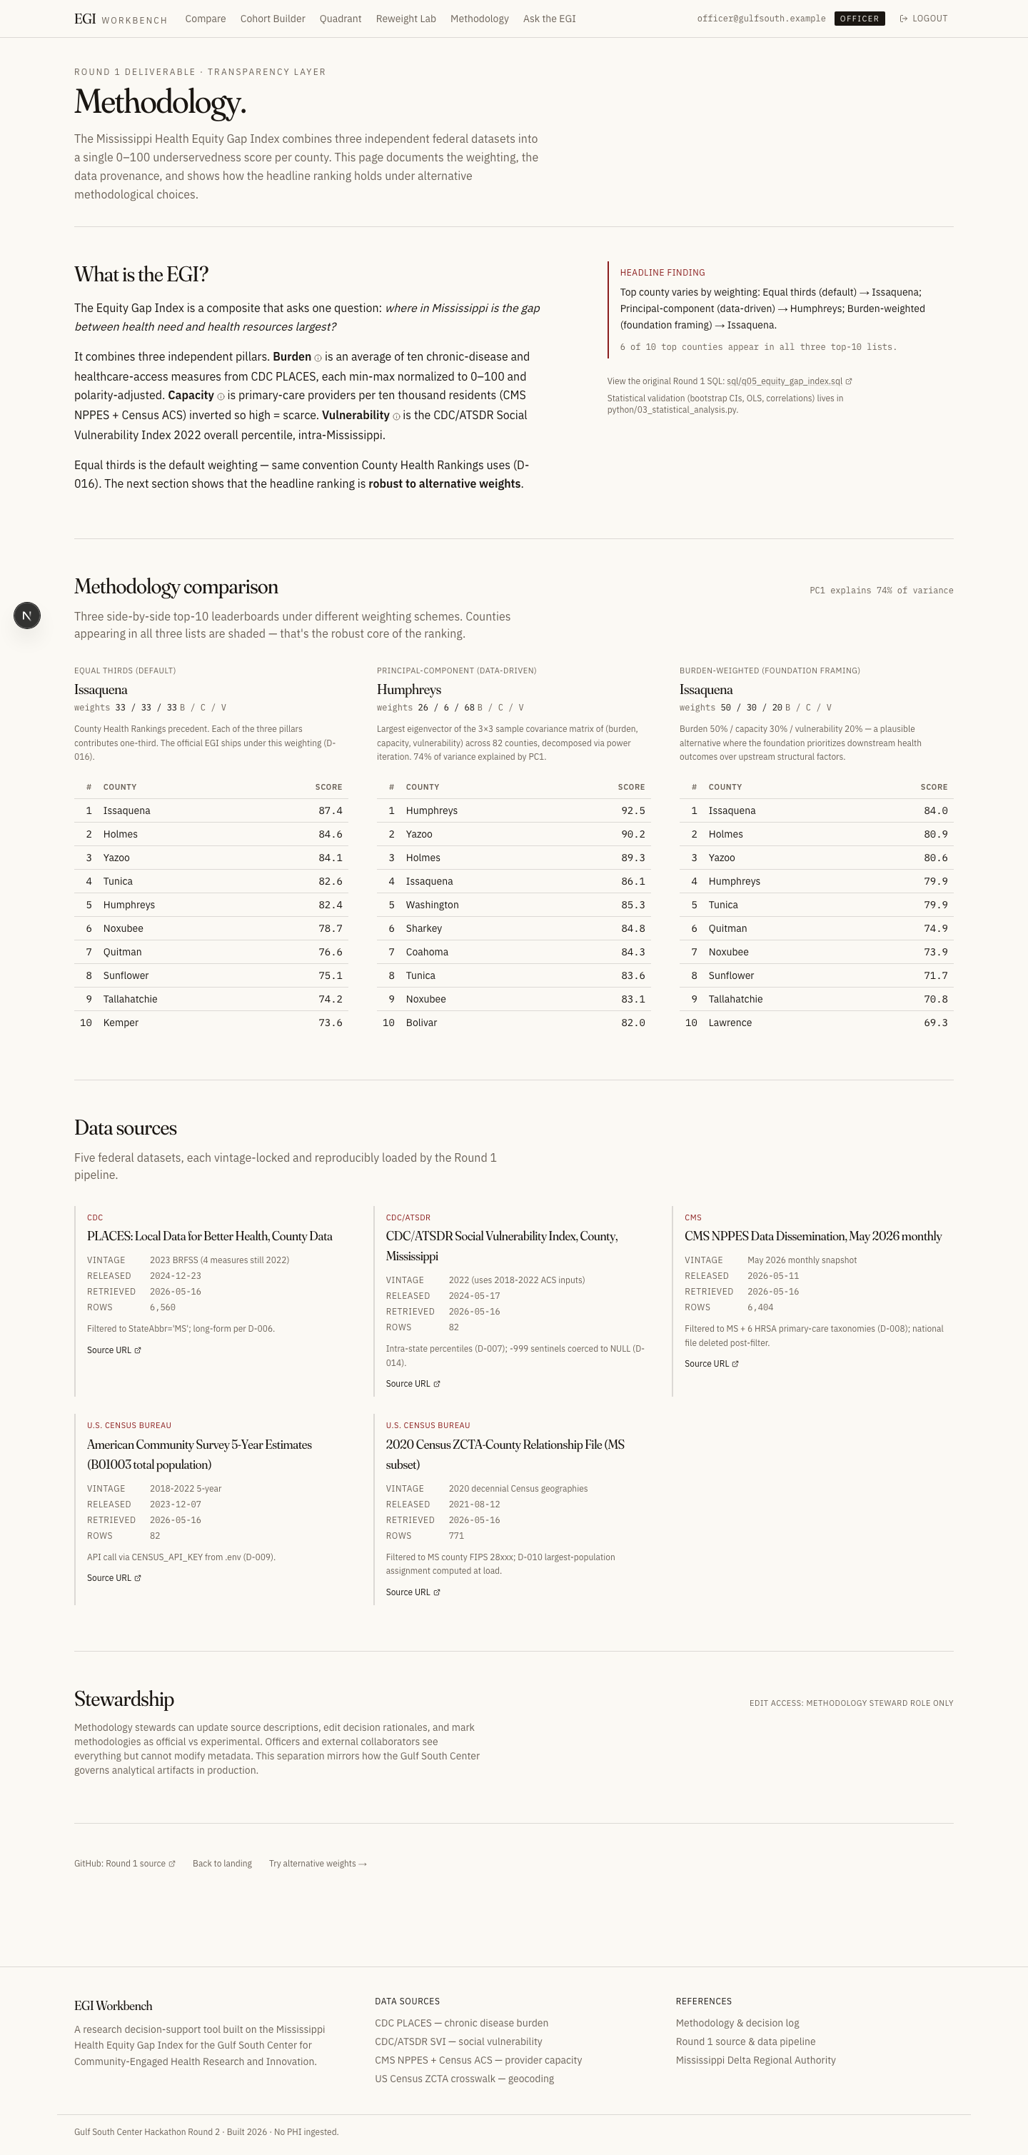
EGI WORKBENCH
Gulf South Center · Hackathon Round 2
DEMO · METHODOLOGY
The headline is robust.
Three weighting schemes side-by-side:
Equal thirds (default — Round 1)
Data-driven PCA (first principal component of the 3-component matrix)
Burden-weighted (50/30/20 — a plausible foundation framing)
Six counties appear in every top-10 list — Issaquena, Holmes, Yazoo,
Tunica, Humphreys, Quitman. That's the robust core of the index.
Every data source has a card: vintage, retrieval date, rows loaded,
source URL. Stewardship view (steward role only) for editing the
metadata in production.
10 / 12

Slide 11
EGI WORKBENCH
Gulf South Center · Hackathon Round 2
ARCHITECTURE
Right tool, right scale.
STACK
SCALE STORY
Framework
Next.js 15 App Router · Node runtime
Add another state (Alabama)
Language
TypeScript strict — end-to-end typed APIs
Re-run load_data.py with state_fips='01'. Frontend works unchanged.
Primary DB
SQLite via better-sqlite3 (readonly: true)
Cache / sessions
Vercel KV (Redis) · in-memory fallback
Styling
Tailwind · custom CSS vars · editorial palette
Scale to national (3,143 counties)
Charts / map
Recharts · react-leaflet · d3-geo (for PDF)
SQLite holds to 100k rows. We're at 12k — 8x headroom. Beyond that, swap lib/db.ts for pg.
PDF
@react-pdf/renderer — embedded methodology
AI
Groq SDK · Llama 3.3 70B Versatile (free tier)
Time-series support
Auth
Custom sessions · scrypt · HMAC cookies · KV
Add snapshot_year column. Parameterize the view. Swap headline cards for sparklines.
Fonts
Fraunces + IBM Plex Sans + IBM Plex Mono
Real-time / live data
Wrong primitive for annual federal data. Architecture supports WebSocket if ever needed.
11 / 12

Slide 12
EGI WORKBENCH
Gulf South Center · Hackathon Round 2
CLOSING
Round 1 produced the index.
Round 2 produced the tool.
We'd like to put this in front of the Center.
DATA SOURCES
BUILT WITH
CDC PLACES 2023 · CDC/ATSDR SVI 2022 · CMS NPPES May 2026 ·
US Census ACS 2018–2022 5-year · US Census 2020 ZCTA crosswalk
Next.js 15 · TypeScript · SQLite · Vercel KV ·
Recharts · react-leaflet · Groq · Tailwind
12 / 12

