Slide 1
Project
Image rectification

Slide 2
Image rectification

Slide 3
Coding
Calculating matrix to change basis
Determine new coordinates for every pixel using matrix
Place each pixel at the new coordinates

Slide 4

Testing

Slide 5
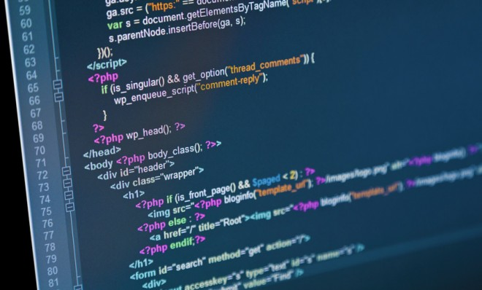
Web - presentation

Slide 6
Thank You for attention
Our team:
Yaryna Korduba
Vlad Velychko
Anton Tarasov
Myroslav Syvokhip
Yuliya Antonyshyn

