Slide 1
Project
Image rectification

Slide 2
Image rectification
The goal for this project is to remove perspective from an image of a flat surface.

Slide 3
Theory
We will synthesize a new image. This new image has never been captured by a camera.
The technique for carrying out this transformation makes use of the idea of a coordinate system.
Actually, it requires us to consider two coordinate systems and to transform between a representation within one system and a representation within the other.
The key of the algorithm is a change of a bases.
Forming the perspective-free image is easy once we have a function that maps pixel coordinates to the coordinates of the corresponding point in the plane of the whiteboard.

Slide 4
Coding
Calculating matrix to change basis
Determine new coordinates for every pixel using matrix
Place each pixel at the new coordinates

Slide 5

Testing
For testing we have some unittests with prepared images.
We compare image we have after transformation with one that should be.
Also we used unittests to check input coordinates and call the exception handling.
We tried to solve this problem without using special external solutions.
Our approach gave us about 15-20% percents of similarity between prepared images and rectified ones. The problem is that when our program maps coordinates to the new one and we create new image there are a lot of empty entries in the matrix representation of image. (black distortion).

Slide 6
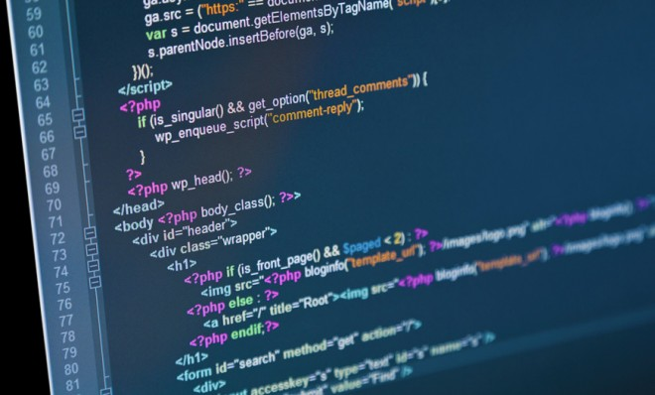
Web - presentation
To create a web application we used A Python Microframework – Flask. (With it we raise the server to which there are two requests).
There is a form on the HTML page that allows you to download the original image and enter a list of coordinates of 4 points, which we will use in our algorithm.
Our HTML code is connected to the script that displays
our chosen image on the page and script with which,
by clicking on the image, we find the coordinates
of the desired point.
After submitting the original one and the resulting
images are displayed on the page.

Slide 7
Thank You for attention
Our team:
Yaryna Korduba
Vlad Velychko
Anton Tarasov
Myroslav Syvokhip
Yuliya Antonyshyn

