Slide 1
Quantum-Assisted Multi-Asset Portfolio Construction
Prepared by: Yasaman Yaghoobi
WISER Quantum Summer Program | Project Sponsored by Vanguard

Slide 2
2
The scientific question
The problem contains two different mathematical structures, so we deliberately split the computation.
Continuous finance problem
Discrete support-selection problem
Continuous weights with budget and long-only constraints.
Quadratic covariance risk, concentration, cost, and impact.
Class, factor, liquidity, turnover, income, and stress limits.
Best handled by convex classical optimization and explicit auditing.
Which candidate trading coordinates are permitted to move?
Binary decisions admit a QUBO/Ising representation.
Fixed cardinality gives a well-defined feasible subspace.
The quantum layer proposes support; the exact finance model remains the source of truth.

Slide 3
3
The 10-step research workflow
Every stage resolved one failure mode before the next stage was trusted.
1
Finance model
2
QUBO / Ising
3
Data + costs
4
Classical ladder
5
Investor goals
→
→
→
→
5Q
QAOA sleeve
6
Common audit
7
Independent validation
9
Co-pilot
10
Scoring
→
→
→
→
Narrative: define realism → reduce carefully → experiment → compare → validate → explain → score.

Slide 4
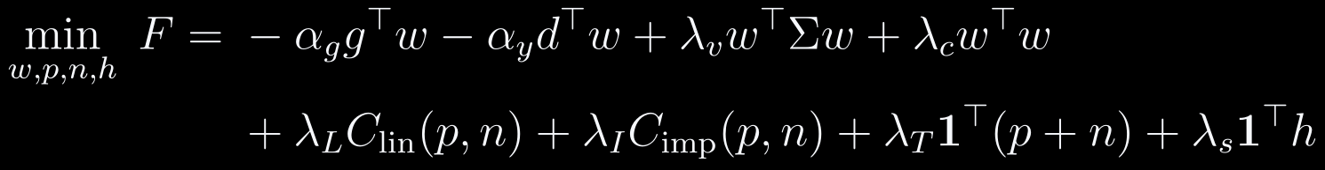
4
Step 1 — formulate the investable portfolio
The model rewards growth and income, but every attractive solution must survive an explicit policy rulebook.
Variables
Financial meaning
Why quadratic / convex?
w: final weights p,n: purchases and sales h: scenario-warning slack
Reward growth + income. Penalize variance, concentration, execution cost, market impact, turnover, and warning excess.
It is rich enough for the finance problem and structured enough for later independent QP reconstruction and KKT certification.

Slide 5

5
Step 2 — derive the quantum-compatible subproblem
The general fixed-trade-map derivation is exact theory; the final experiment uses a code-aligned active-rebalance surrogate.
General derivation → executed energy
Why not encode all weights directly?
Final active-rebalance QUBO used in Step 5Q:
Six bits per continuous weight already implies about 300 binary variables before auxiliaries.
The 50-asset universe is not a classical capacity limit; quantum resource pressure applies to the binary encoding.
Final QAOA: 11 screened coordinates, choose 6, then exact continuous refinement.
The QAOA energy ranks classically screened permissions. Exact trade sizes, scenario hinges, and the complete Step 1 rulebook are restored by continuous refinement.
Exact claim: best-of-20 QAOA matches the minimum of the executed 462-state reduced QUBO — not exhaustive exact-finance optimization over all 462 continuously refined supports.

Slide 6

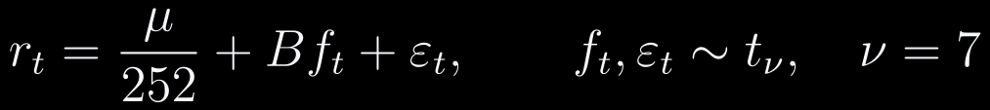
6
Step 3 — construct the financial input layer
The final claims use the reproducible synthetic branch; the historical branch remains available as a separate data path.
Key conventions from the data report
Historical means/covariance are annualized from daily data using 252 trading days.
Empirical-return weight in shrinkage: 0.35.
Final synthetic factor and idiosyncratic shocks use Student-t tails with 7 degrees of freedom.
Synthetic series length: 1,260 business days.
Base transaction-cost calibration: $10M portfolio, 3 execution days, 1% reference trade.
50 assets is a modeling choice for breadth and auditability, not the classical capacity limit.
Why these estimators?
Expected returns are shrunk toward priors to reduce estimation noise. Covariance is shrinkage-estimated and numerically projected to PSD before entering a convex risk term.

Slide 7
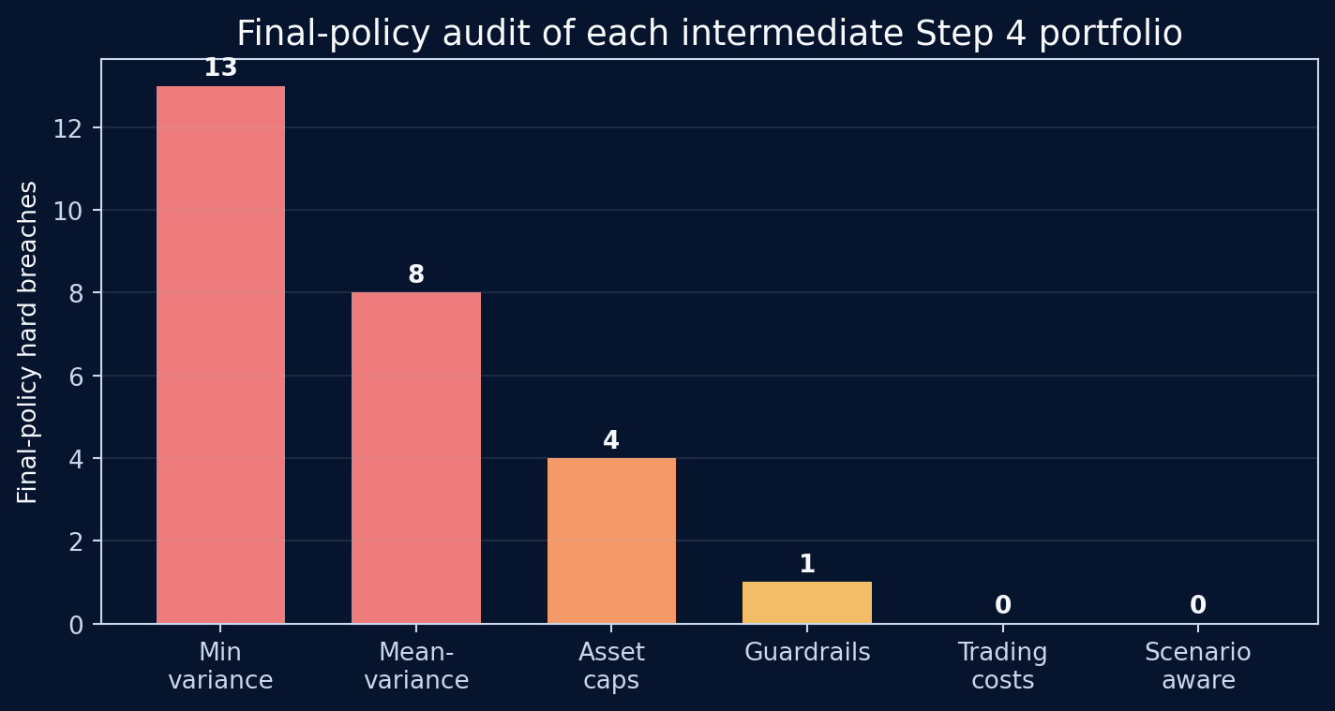
7
Step 4 — learn from a classical realism ladder
Each intermediate solution is audited against the final policy rulebook, even before that full rulebook is used in optimization.
What the ladder taught us
The minimum-variance solution had 13 final-policy breaches; mean-variance had 8.
Asset caps and guardrails reduced the problem but did not yet produce full policy compliance.
Trading-cost and scenario-aware stages were the first Step 4 portfolios with zero hard breaches.
Gross turnover remained above 100% until implementation realism entered the model.
The lesson: numerical convergence is not the same thing as investability.

Slide 8
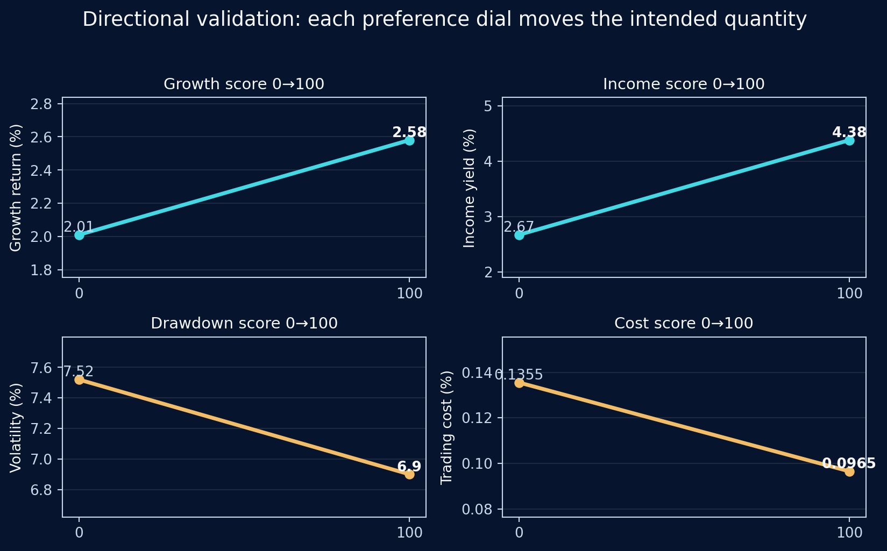
WISER Quantum Summer Program • Vanguard-sponsored
8
Step 5 — make investor preferences dimensionally meaningful
The hard problem was not creating sliders; it was making heterogeneous economic quantities comparable.
Selected profile
Growth 55, Income 55, Drawdown 70, Cost 60 → preference shares 22.9%, 22.9%, 29.2%, and 25.0%.

Slide 9
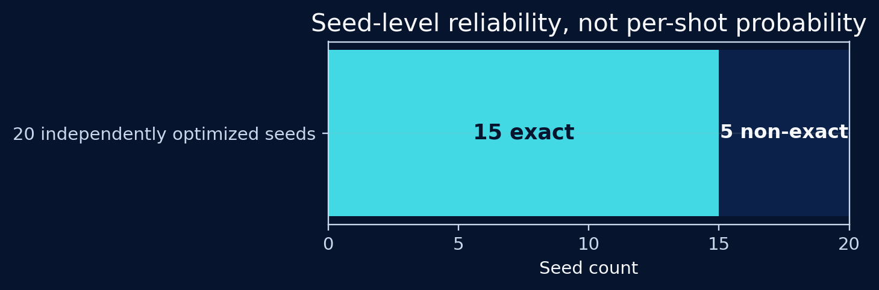
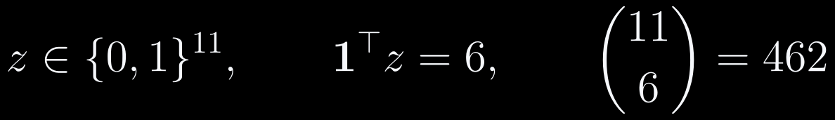
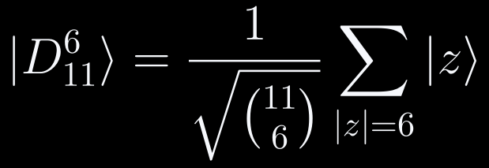
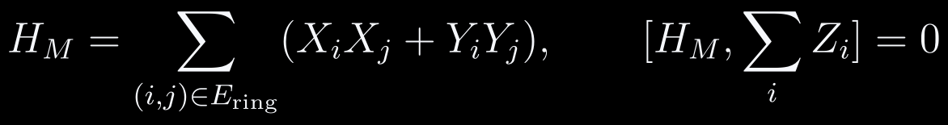
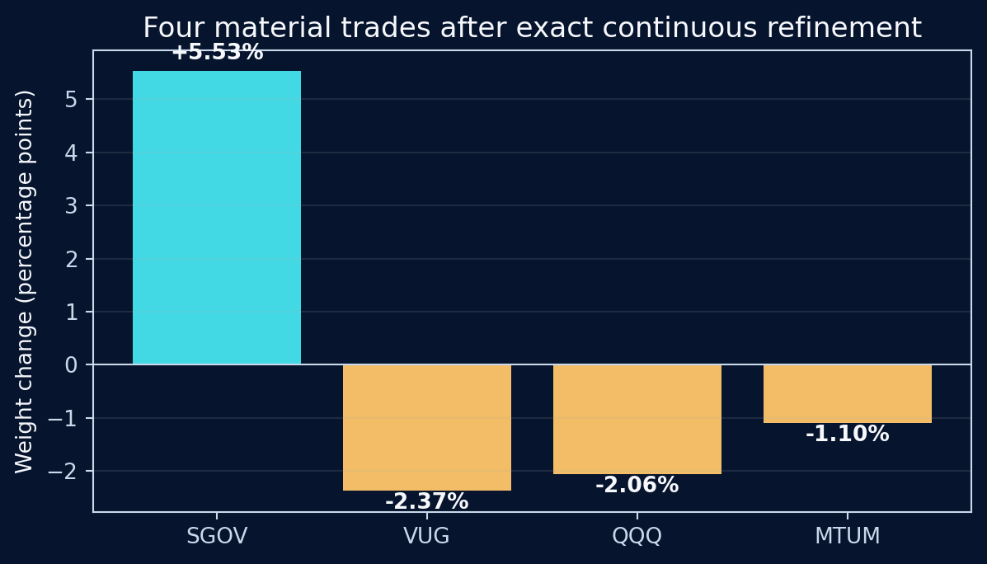
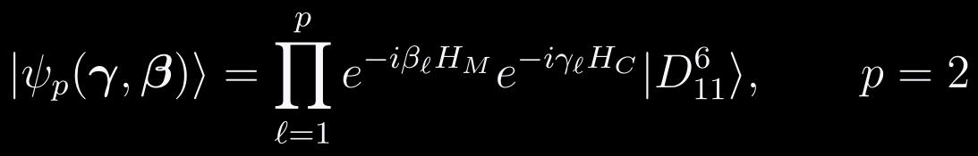
9
Step 5Q — fixed-cardinality QAOA on the active sleeve
The circuit explores only six-of-eleven supports; exactness refers to the executed reduced QUBO.
15/20 optimized seeds reached the exact reduced-QUBO optimum — seed-level reliability, not per-shot probability.
Why Dicke + XY matters
The initial state is already feasible, and the XY-ring mixer preserves Hamming weight, so the ideal circuit stays inside the 462-state six-excitation manifold.

Slide 10
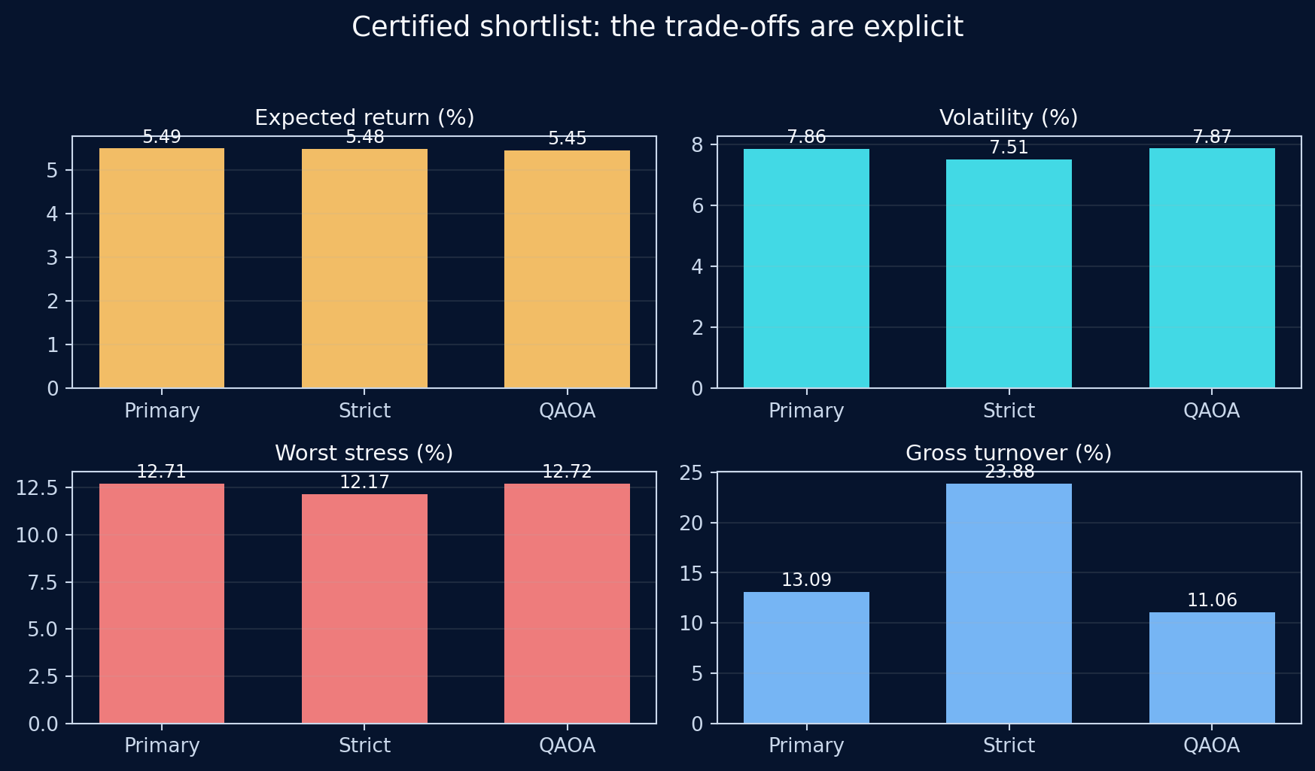
10
Step 6 — compare candidates under one common rulebook
The shortlist is a trade-off surface, not a contest where one algorithm must win every metric.
Implementation and governance
Primary cost 0.0020%
Warnings 5
Strict cost 0.0056%
Warnings 0
QAOA cost 0.0015%
Warnings 5
Primary: strongest base objective and slightly highest expected return.
Strict-warning: almost the same return with lower downside risk and no warning breaches.
QAOA: lowest turnover and cost among the certified three, but not the risk-adjusted winner.

Slide 11
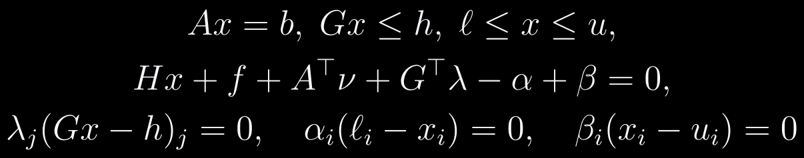
11
Step 7 — independent mathematical validation
Independent solver reconstruction under the same financial model is combined with convexity, KKT residuals, and exact reduced-QUBO ground truth.
Forward-path robustness: 1,000 common synthetic paths
Portfolio
5th-pct return
95th-pct DD
Loss freq.
Strict
-2.66%
13.96%
13.5%
Primary
-3.15%
14.91%
14.1%
QAOA
-3.19%
14.93%
14.6%
Strict has the strongest modeled downside profile among the equally validated shortlist.
Independent reconstruction
CVXPY rebuilt the QP. Clarabel reproduced the full-space classical solutions; OSQP reproduced the fixed-support QAOA refinement. Primary and strict audits had 130 constraints; QAOA had 174. All reported failures were zero.
Exact enumeration of all 462 supports: selected QAOA support = rank 1, zero energy gap.

Slide 12
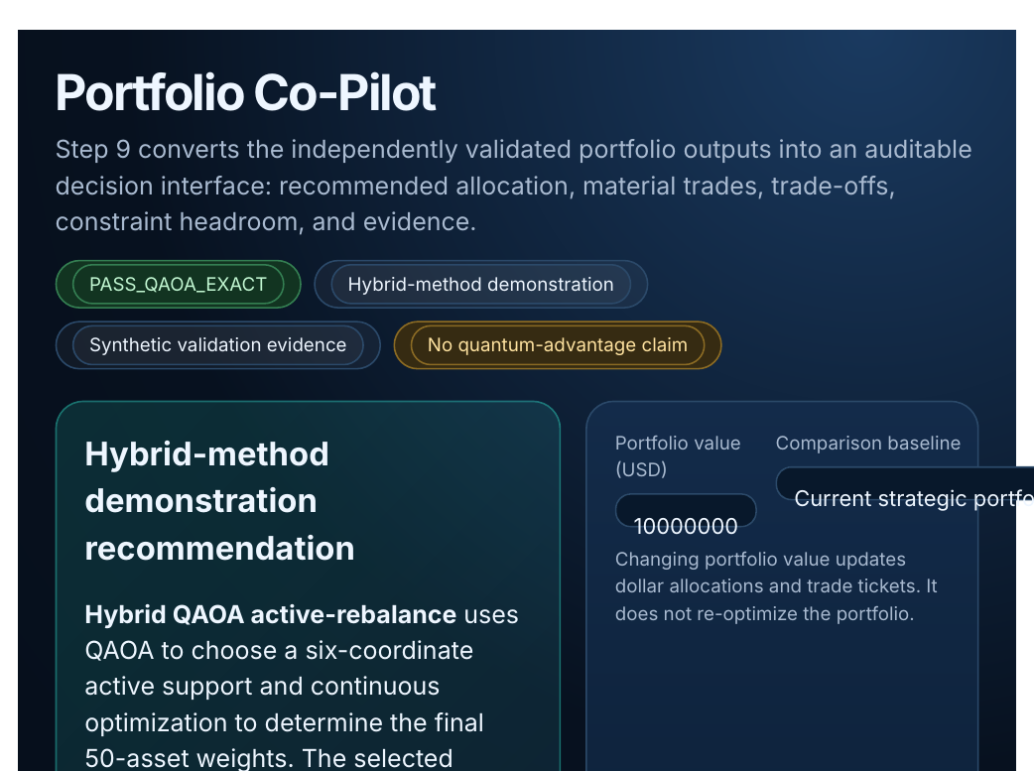
12
Step 9 — turn the optimizer into a decision interface
The co-pilot exposes the recommendation, trade-offs, compliance evidence, and provenance instead of hiding them in notebook cells.
Three questions the interface must answer
1 What allocation is recommended?
2 What changed versus the baseline?
3 Why is the result compliant?
The interface distinguishes six selected permissions from four executed material trades.
It surfaces Step 6 and Step 7 evidence rather than generating unsupported explanations.
It is a decision layer, not another optimizer.

Slide 13
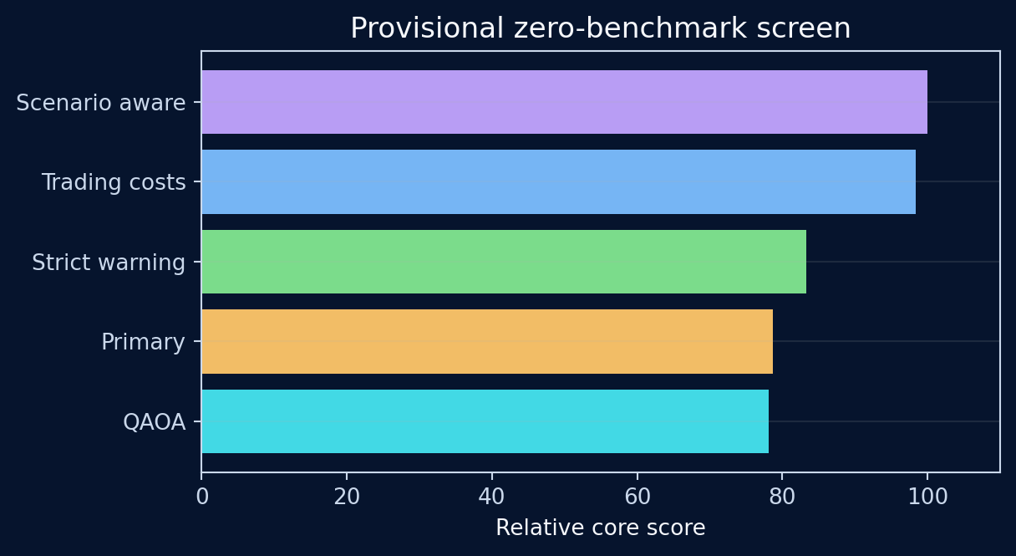

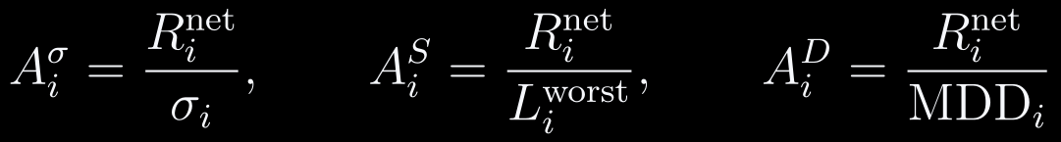
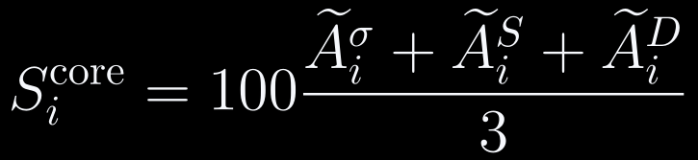
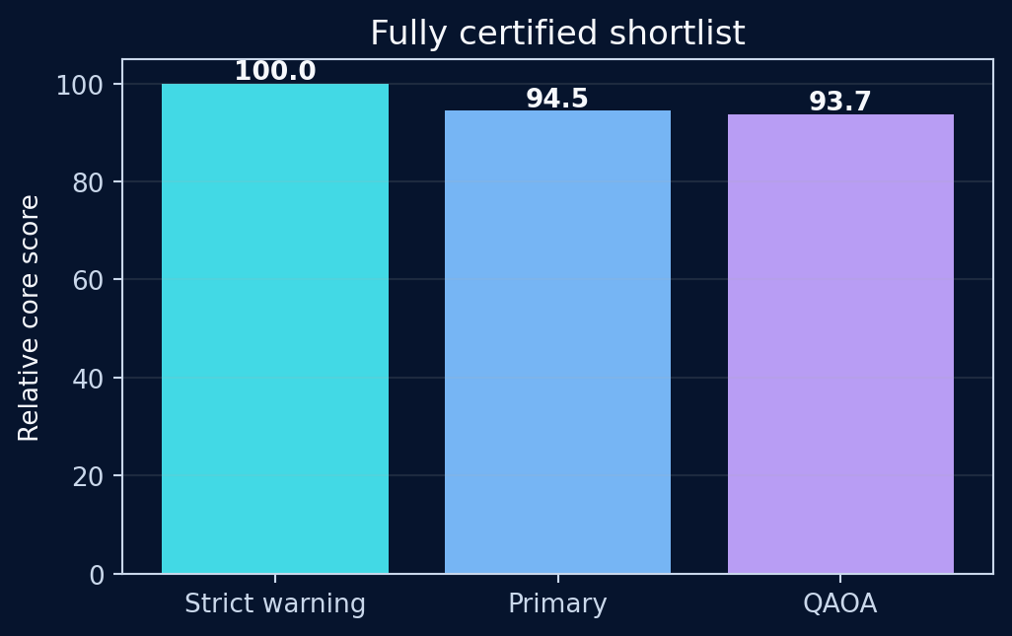
13
Step 10 — score only after feasibility is established
The provisional universe and the fully certified universe are defined mathematically, not rhetorically.
Score 100 is candidate-set normalization, not a probability, percentile, Sharpe ratio, or external official rating.

Slide 14
14
The bottlenecks shaped the architecture
Every additional layer in the final system exists because an earlier simplification failed a real test.
Quantum scale
Direct weight encoding is too large.
→ Screen to 11 meaningful binary permissions.
Finance realism
Simple optima violate policy / turnover.
→ Build the Step 4 constraint ladder and exact audit.
QUBO fidelity
Some non-quadratic terms are only local surrogates.
→ Recompute the exact financial objective after decoding.
Validation
Convergence does not prove correctness.
→ Use CVXPY, KKT residuals, and exact enumeration.
Interpretability
A support bitstring is not an executable portfolio.
→ Refine continuously and expose provenance in the co-pilot.

Slide 15
15
What we achieved — and what remains
The contribution is a disciplined hybrid decomposition with auditable evidence, not a claim of quantum superiority.
Wins
Limitations
Next research steps
50-asset finance-aware portfolio workflow.
Exact reduced optimum recovered in 15 of 20 QAOA seeds.
Independent continuous validation and exact binary benchmarking.
Decision interface and transparent scoring.
Final evidence is synthetic-model, not rolling historical out-of-sample performance.
The 462-state binary problem is classically easy.
The experiment uses a simulator, not quantum hardware.
No quantum-advantage claim is justified.
Rolling historical train-test validation.
Equal validation depth for Step 4 zero-breach leaders.
Larger active sleeves and hardware-aware circuits.
Compare against stronger classical discrete solvers as scale grows.
Final take-away: a real finance problem first, a carefully scoped quantum subproblem second, and independent evidence before any claim.

Slide 16
Thank you

Slide 17
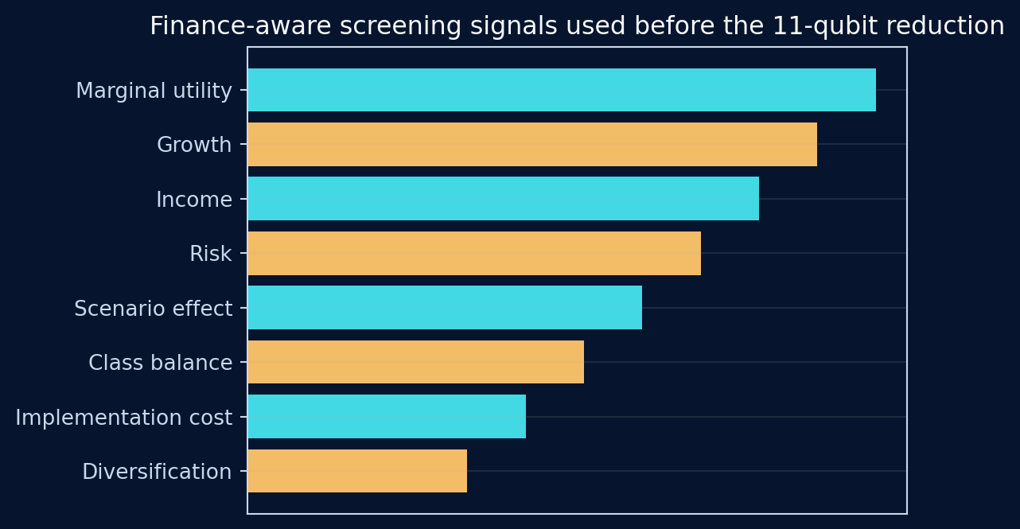
17
Appendix A — how the 11 candidates were screened
The screening stage is classical, auditable, and separate from the final optimizer.
Screening logic from the Step 5Q report
Scores combine normalized growth, income, standalone variance, scenario RMS loss, implementation burden, incumbent weight, marginal utility, and diversification information.
The screen retains both buy and sell opportunities; it does not simply select the highest-return assets.
The screen reduces the binary universe. It does not determine the final weights.
The complete 11-candidate order and component scores must be saved for reproducibility.

Slide 18
18
Appendix B — executed QUBO and exactness boundary
The final active-rebalance energy is a support-ranking surrogate; the complete finance model is restored after decoding.
What “exact” means
All 462 six-of-eleven QUBO energies are enumerated exactly.
Best-of-20 QAOA has rank 1 and zero gap for that reduced QUBO.
Only a limited set of QAOA/high-ranked supports is continuously refined.
Therefore the experiment does not prove the same support minimizes the exact refined financial objective over all 462 supports.
Executed final QUBO
Linear term: squared normalized active-selection score plus a small cost burden adjustment.
Pairwise terms: signed proxy-trade balance plus normalized covariance and impact interactions.
Final active-balance strength = 1.0; QAOA aggregation = 0.25.
Scientific interpretation: QAOA is a structured candidate generator inside a classically screened local neighborhood; the exact continuous finance model remains the final source of truth.

Slide 19
19
Appendix C — data, units, and horizon conventions
Assumptions are declared so the numerical evidence can be reproduced and interpreted correctly.
Historical branch
Final synthetic evidence branch
Adjusted-price simple daily returns.
EWMA expected-return estimate annualized by 252.
Expected total return shrunk toward ticker priors with empirical weight 0.35.
Ledoit-Wolf covariance shrinkage on a common sample; annual covariance = 252 × daily covariance.
Tiny negative eigenvalues are floored to maintain PSD.
1,260 simulated business-day observations.
Student-t common-factor and idiosyncratic shocks with 7 degrees of freedom.
Synthetic dates are labels, not historical market observations.
Base impact calibration uses $10M portfolio value, 3 execution days, and a 1% reference trade.
Final numerical claims in the presentation refer to this synthetic-model evidence.

Slide 20
20
Appendix D — independent QP validation evidence
For a convex QP, KKT residuals plus primal feasibility provide an optimality certificate up to numerical tolerance.
Recorded audit results
Primary global: 130 constraints, 0 failures, max violation 2.22×10⁻¹⁶.
Strict global: 130 constraints, 0 failures, max violation 7.77×10⁻¹⁶.
QAOA fixed support: 174 constraints, 0 failures, max violation 1.04×10⁻¹⁷.
Stored-versus-independent weight differences are at numerical precision.

Slide 21
21
Appendix E — scoring sensitivity and certification boundary
The ranking is transparent but depends on the declared benchmark and on which candidates have equivalent evidence.
Across 66 core-weight combinations, Step 4 scenario-aware wins 58/66 in the all-zero-breach universe and Step 4 trading-cost wins 8/66. Strict-warning wins all 66 within the fully certified shortlist. A benchmark above roughly 3.15–3.5% can switch the provisional leader.

