Slide 1

Context information in Zero-Trust
In

Slide 2
Agenda

Slide 3
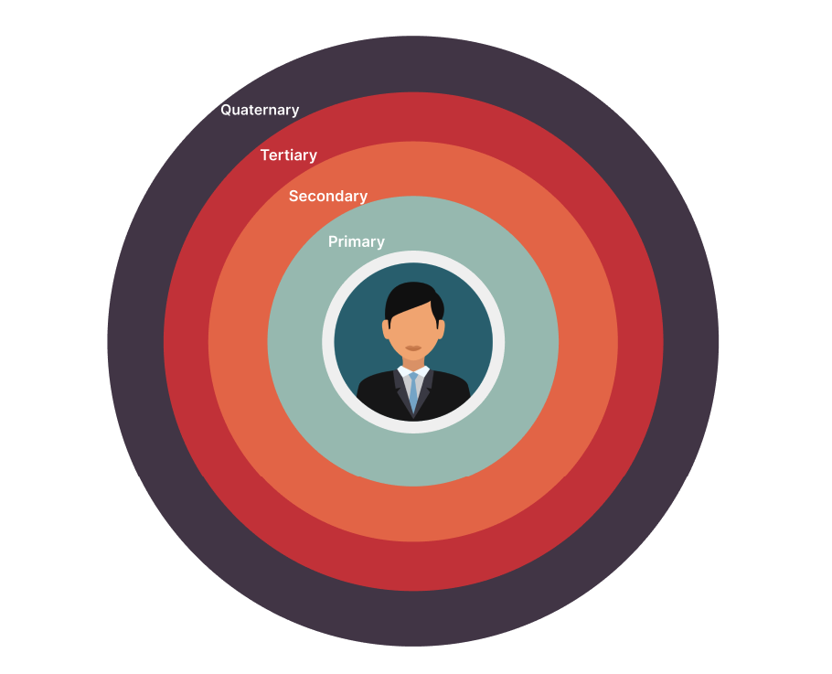
Overview

Slide 4
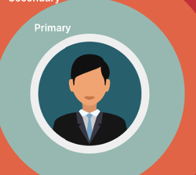
Primary:
What bank gives you to prove who you are
What bank takes you to prove who you are

Slide 5
Primary:
What bank gives you to prove who you are
Name (First name, Middle name, Last name)
User and password
ID badges
Employee number
What bank takes you to prove who you are
Name / Address
Social Security number
Account numbers
Phone Number/ Email Address

Slide 6
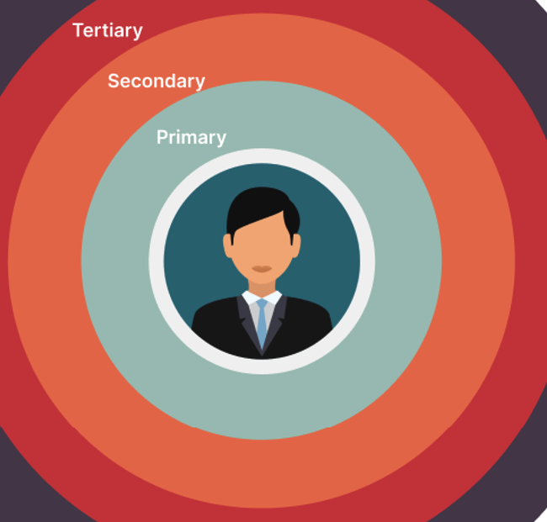
Secondary:
Who is around?
Who can vouch for you?
Whom do you know?
Who can steal?

Slide 7
Secondary:
Private meeting
Bank management
Customer service representatives
Loan officers
Compliance officers
Human resources department
Information technology department
Marketing department
Bank
Private meeting
Bank tellers
Financial Advisor
Customers
Bank security personnel
Administrative Staff
Other personnel (cleaners)
Who is around?

Slide 8
Secondary:
2. Who can vouch for you?
Direct supervisor or manager
Colleagues
Branch manager
Human resource personnel
Executive management
An existing bank customer
Bank employees
Co-signers
Training or workshop facilities
Employees from social or events
External partners

Slide 9
Secondary:
3. Whom do you know?
4. Who can steal?
Direct supervisor or manager
Colleagues within my department
Employees in other departments
Branch manager
Regular Customers
Support Staff
Human resources personnel
Customer service representative
Compliance officers
Dishonest employees
Customers
Hackers or Cybercriminals
Threats from insider
Scammers
Targeted data breach

Slide 10
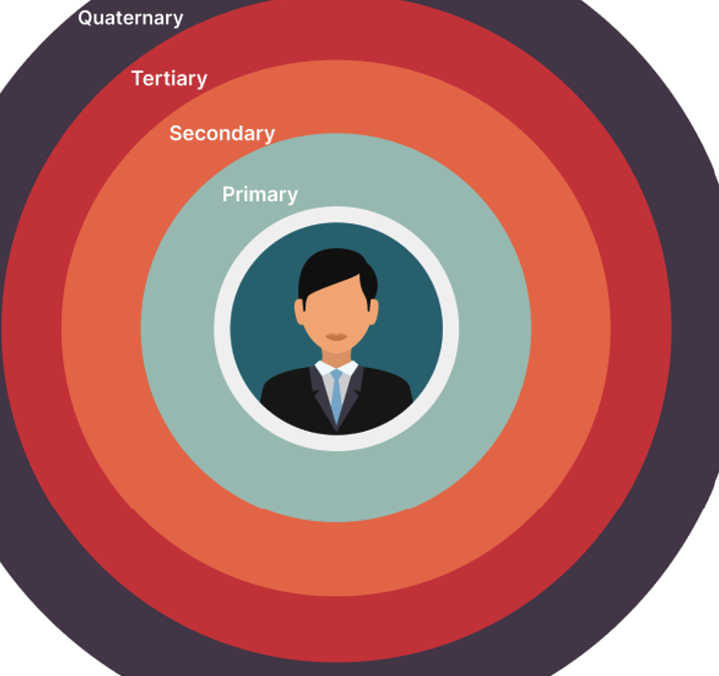
Tertiary:
What device do you have?
What are you doing?
What are the proximal details
What are the history of the task, user

Slide 11
Tertiary:
What device do you have?
Computer or laptop
Smartphone
Tablet
Multi-function printers or scanners
E-readers
POS
Security devices like an access card
Teleconferencing equipment such as video cameras
Office equipment
A signature capture pad
Software applications
Networks and IT infrastructure
Cybersecurity tools
Database

Slide 12
Tertiary:
2. What are you doing?
Bank Teller:
Responsible for processing transactions
Balance cash drawer
Assist customers with their inquiries.
Customer Service Representatives
Loan Officer
Financial Advisor
Branch Manager
Bank clerk
IT Specialists
Work on software and network systems
Maintain the databases and services.
Bank manager
Associate broker

Slide 13
Proximal:
Where are you / Where have you been? / Where are you doing?
Inside the bank
Meeting in the bank
Bank
Your own office
Manager’s room
Conference room
Monitoring room
Security room
Safe deposit room
Bank vault room
Outside of the bank
Work-related
Workshop/ seminar outside of the bank
Meeting in another branch
Meeting in other companies
Café
Mission
Personal
Home
Travel
Outside of country
Café, University, Club, or other public places

Slide 14
Proximal:
2. Travel patterns
Work-related/ personal
What is your history of travelling?
Is it the high-risk destinations?
Is it unusual or suspicious activity?
Why are you there?
Personal
Vacation
Weekend
Weekdays
Leave
Work-related
Training
Workshop
Mission
Meeting

Slide 15
Proximal:
4. Have you been there before?
No
Yes (Less or more than n times)
5. Time
Access to information
Being in a specific location that before mentioned
Holidays
Weekend
Weekdays
Day
Night
Whether the same period has been repeated or not.

Slide 16
History:
What are you asking for?
2. What are you looking at?
Bank teller
Customer service representative
Loan Officer
Financial Advisor
IT
Customer Inquiries
Supervisor guidance
Training or development
Technical support
Communication with other colleagues
Talking about time or schedule with the manager
Calling security
The need to have a higher level of access
Asking for performance feedback
Team meeting
3. What did you ask before?
Yes
How many times
No

Slide 17
Thank you

