Slide 1

Azure Bank Modernization Initiative: Banking capstone project

Slide 2
Project Overview: Azure Bank Modernization
Key Technologies
Azure Functions, Blob Storage, ADLS Gen2, Azure SQL, Cosmos DB, Azure Event Grid, Azure Service Bus, Python, PySpark, CI/CD.
This project focuses on building an end-to-end Azure-based Banking Data Platform that ingests, processes, stores, and analyzes banking data in a secure and scalable cloud environment.
The solution integrates multiple Azure services—such as Storage Accounts, Event Grid, Service Bus, Azure Functions, Databricks, and Synapse—to automate data ingestion, enable real-time event processing, and support advanced analytics like fraud detection, transaction insights, and customer 360 reporting.
The platform follows an enterprise-grade architecture ensuring reliability, security, and cost-efficiency.

Slide 3
PART 02
Day 1: Architecture and Data Ingestion

Slide 4
Architectural Overview: Lambda Architecture
Real-Time Stream Ingestion
Batch Ingestion
ETL & Transformation
Event-driven ingestion from ATM/UPI logs via Event Grid, Azure Function, and Cosmos DB for immediate insights.
Bulk data handling of core banking batch files using Blob Storage/ADLS for comprehensive data analysis.
PySpark ETL processing with Synapse/Azure SQL DWH for refined data to support reporting and BI.

Slide 5
Setup and Deliverables
Azure Data Lake Storage Gen2 (ADLS Gen2)
Creating containers for raw transaction, customer, ATM, and UPI data.
Azure Event Grid and Service Bus Configuration
Enabling Event Grid subscriptions and setting up high-volume Service Bus queues for real-time orchestration.
Python Function for Ingestion
Validating file metadata and pushing ingestion requests to Storage Queue.

Slide 6
PART 02
Day 2: Transformation Layer & NoSQL Operational Store

Slide 7
Queue-Triggered Azure Functions
Data Validation and Transformation
Suspicious Pattern Detection
01
02
Validate incoming raw banking data
Clean and standardize records
Transform data for analytics
Detect suspicious or abnormal transaction patterns
Store validated separate layers
Loading file content, validating schema, deduplicating transactions, and classifying transaction types.
Implementing rule-based detection for rapid multiple withdrawals and other anomalies.
Purpose: Identify potential fraud activities using rule-based checks.

Slide 8
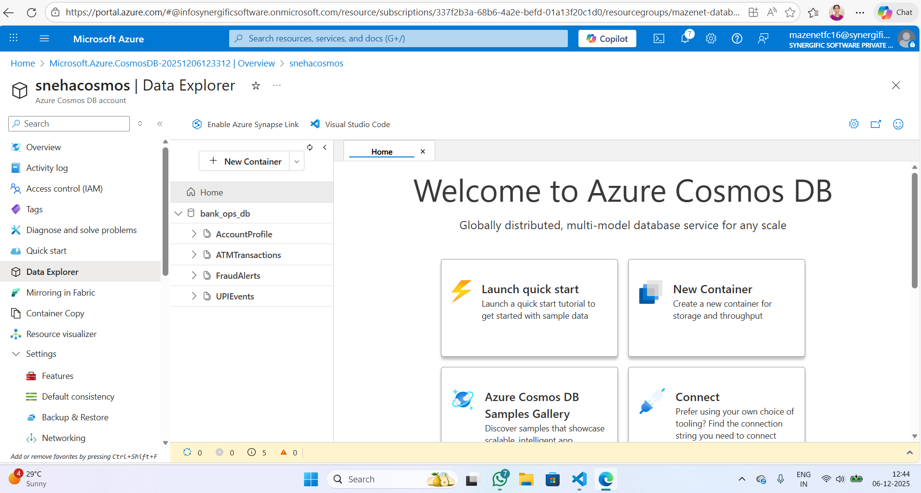
Operational Data Store (Cosmos DB)
Collection Design
AccountProfile, ATMTransactions, UPIEvents, and FraudAlerts collections for low-latency lookups.
Partition Key Strategy
Using CustomerID for AccountProfile and TransactionID for event collections for efficient querying.
Cosmos DB collections and partition
DB Name: bank_ops_db
keys:AccountProfile — partition key: /CustomerID
ATMTransactions — partition key: /TransactionID
UPIEvents — partition key: /TransactionID
FraudAlerts — partition key: /AccountNumber

Slide 9
PySpark Data Clean Pipeline
Ingestion and Normalization
Reading raw data from Cosmos DB and batch files in ADLS, cleansing, and normalizing columns.
Merging and Storage Layers
Consolidating ATM and UPI streams into Fact Transactions, writing to Bronze, Silver, and Gold delta lake layers.
Layers Created:
Bronze Layer → Raw data (original files)
Silver Layer → Cleaned & validated data
Gold Layer → Aggregated & analytics-ready data
Purpose:
Improves organization
Supports incremental processing
Enables clean auditing of each stage

Slide 10
PART 04
Day 3: Data Warehouse (Azure SQL / Synapse SQL Pool)

Slide 11
PySpark ETL Jobs for Data Warehouse
Load Logic
01
Loading refined data from the Silver layer and applying business logic for dimension and fact table population.
Intermediary Format
02
Utilizing Delta Lake for reliable and ACID-compliant data operations during ETL processing.
Data Synchronization
03
Using MERGE/UPSERT operations to efficiently load and update dimension and fact tables.

Slide 12
Scheduled Data Synchronization Mechanism
Timer-Triggered Azure Functions
Automating the synchronization of customer master data and account status updates.
Trigger Conditions:
ATM withdrawals above a threshold (e.g., ₹50,000+)
High number of UPI transactions in short time
Login attempts from unusual locations or devices
Transactions outside normal customer behavior patterns

Slide 13
PART 05
Day 4: Real-Time Alerts, Security & CI/CD

Slide 14
Focuses on processing raw and validated banking data using Azure Databricks. The goal is to clean, transform, enrich and prepare the data for analytics and reporting.
In this stage, Spark is used to load ingested data from the data lake, apply business rules, remove duplicates, standardize formats, join reference datasets, and generate curated (gold) datasets.
This ensures the data is accurate, structured, and ready for dashboards, risk scoring, fraud analytics, and machine-learning workloads.
Azure Databricks provides scalable distributed processing, version-controlled notebooks, and seamless integration with Delta Lake, which helps maintain data consistency and reliability across the pipeline.

Slide 15
Real-Time Fraud Alerts
✔ Behavior Analysis
Check customer’s past spending behavior
Detect unusual withdrawal patterns
Event Trigger
Anomaly Detection
Action
High-value transactions generate events to Event Grid for immediate analysis.
AzureFunction analyzes transactions against rules (location, frequency, time).
Alerts inserted into Cosmos DB and customer SMS/email notifications via Service Bus.
✔ Output
Save fraud event into CosmosDB
Send message to Service bus for notifications

Slide 16
CI/CD Pipeline Setup
Focused on implementing a CI/CD pipeline to automate code deployment across environments such as Dev, Test, and Production.
Azure DevOps Pipelines and Repos are used to store the project code, track changes, and automate builds and releases.
The pipeline pulls the latest code from the repository, installs dependencies, runs validation checks, and deploys Function Apps and Databricks notebooks to Azure automatically.
This ensures consistent deployments, reduces manual errors, and enables faster delivery of updates.
.

Slide 17
PART 06
Day 5: Reporting, Customer 360 & Final Demo

Slide 18
Customer 360 Analytical View
A unified analytical model combining multiple data sources to provide a complete customer profile.
Transaction History → FactTransactions (SQL DW)
Demographics & KYC → DimCustomer (SQL DW)
Device & Login Activity → Cosmos DB / FactCustomerActivity
Power BI Dashboards
Branch performance (KPIs, volume, revenue)
Daily transaction trends (real-time + historical)
ATM/UPI channel analytics (geo patterns, success rate, downtime)
Fraud analytics (alerts, anomalies, loss prevention)

Slide 19
End-to-End Testing and Demo Scenario
Uploading ATM CSV file and verifying event triggers.
PySpark cleans data from Cosmos DB transforming it and writing to SQL Data Warehouse (DW).
Power BI dashboards update with transaction data; generate real-time fraud alert.
Data Ingestion Verification
Transformation Validation
Reporting and Alerting

Slide 20
PART 07
Challenges

Slide 21
1.Azure DevOps Permissions & Access Issues
Difficulty accessing repositories, service connections, or pipelines due to missing permissions.
Needed to configure correct roles & security policies.
2. Creating Service Connection for Deployment
Setting up a service principal or Azure subscription connection was confusing.
Authentication failures when the pipeline tried to deploy resources.
3. Packaging & Deploying Azure Functions
Zip packaging step failed due to incorrect folder structure.
"Function app not found" or "Invalid runtime" errors during deploy.
Challanges
.
.

Slide 22
Integration Complexity
01
02
Challenge
Solution
Integrating diverse systems and technologies into a unified platform.
Adopting a modular architecture with clear interfaces and well-defined data flows.

Slide 23
PART 08
Conclusion: Transforming Banking with Data

Slide 24
Conclusion
This project successfully demonstrated how a modern banking data platform can be built using Azure services to enable secure, scalable, and automated data processing.
Across all stages—data ingestion, validation, transformation, storage, analytics, and CI/CD automation—the solution follows industry best practices and real enterprise architecture.
By integrating Azure Functions, Storage, Event Grid, Service Bus, Databricks/Synapse, Key Vault, and DevOps pipelines, the platform ensures reliable real-time processing, robust data quality, and end-to-end operational efficiency
With monitoring, alerting, and continuous deployment in place, the system supports ongoing improvements and provides a strong foundation for advanced use cases like fraud detection, customer 360 analytics, and regulatory reporting.
Overall, this project delivers a complete, production-ready cloud data platform that is secure, automated, and optimized for banking workloads.
01
02
03

Slide 25
Thank You

