Slide 1

COURT CASE HANDLING SYSTEM(CCHS)
Group No: 1
A.A.T.G.Abeysinghe 2014CS001
Devanarayana.S. 2014CS022
K.C.Edirisinghe 2014CS029
D.T.Fernando 2014CS034
K.Kirishjajini 2014IS043
H.N.A.Nilakshi 2014IS056
Supervisor- Dr. D. N. Ranasinghe
Mentor- Mr. R. N. Rajapaksha
Client- Registrar of Colombo District Courts
Notes:
Glølkl.gb

Slide 2
Introduction
Colombo District Court handles civil cases.
Civil Cases
Money Related
Land Cases
Family Problems

Slide 3

Money Related Cases
Money related cases –
a large number
most important type
complicated procedure
Currently the process takes place manually
CCHS will be developed for the court staff

Slide 4
Flow of activities after Automation
Case Registration
Stamp Duty
Summon Serving
Serve DS summons
Roll Court Proceeding
Defendant appears
Record Ex parte judgement
Decree Process
Roll Court Normal Proceedings
Inquiry Process
Stamp Duty
Inquiry made

Slide 5
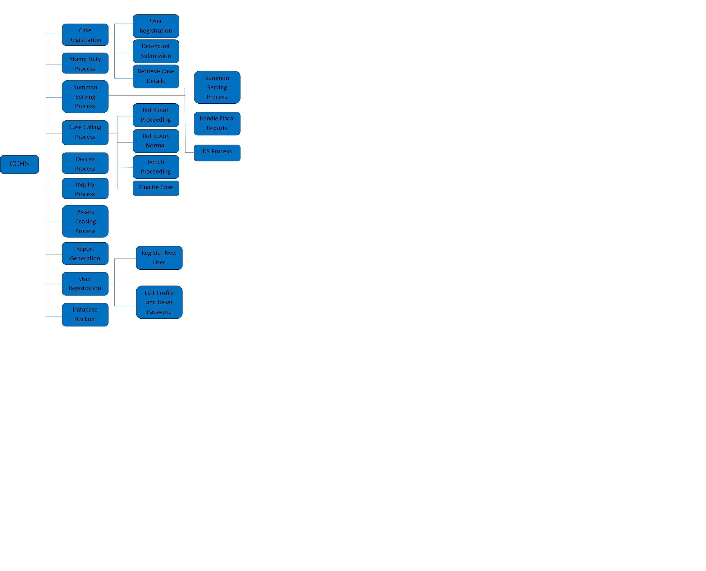
Introduction
Notes:
We will explain about each component as we go..

Slide 6
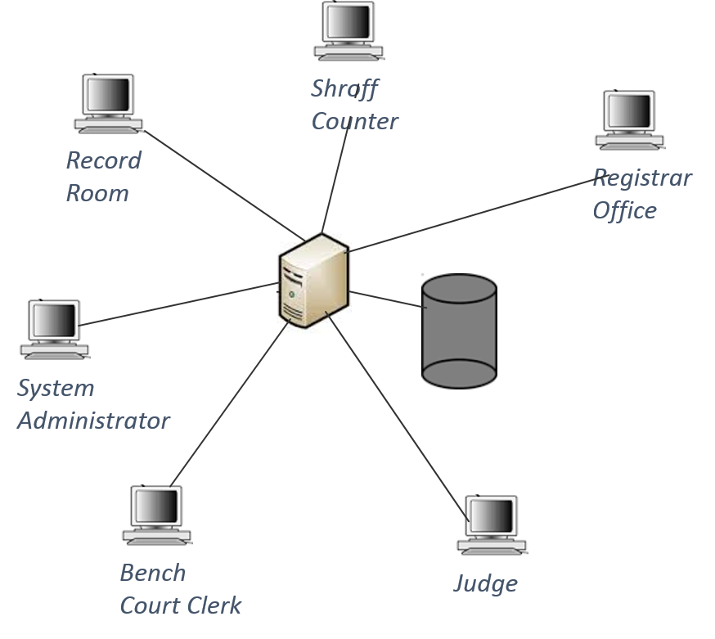
System Architecture
Same system architecture that we proposed earlier.

Slide 7
Progress
Component | Member Responsible | UI Design | Development | Validation | Testing | Deployment
Case Registration | Duneesha | Complete | Complete | Complete | Complete
Stamp Duty Process | Akila | Complete | Complete | Complete | Complete
Summon Serving Process | Tharushi | Complete | Complete | Complete | Complete
Case Calling Process | Kavindu | Complete | Complete | Complete | Complete
Decree Process | Kirishjajini | Complete | Complete
Inquiry Process | Subash | Complete | Complete
Asset Ceasing Process | Akila | Complete
Report Generation | Duneesha
User Registration | Tharushi | Complete | Complete | Complete | Complete

Slide 8




Technical Exposure
Development :- JavaSE using NetBeans
DBMS :- XAMPP
Report Generation :- Jasper Reports
Version Controlling :- GitHub
https://github.com/DuneeshaFernando/CCHS

Slide 9
Why did we select JavaSE?
We developed the software for the use of court staff
Outsiders(plaintiffs ad defendants) should not be given access to the system
Therefore this is developed as a LAN based system.
Access for the staff is not given through internet but through LAN based connection.
Provides high-level classes that are used for
Networking
Security
Database access
Graphical user interface (GUI) development

Slide 10
GitHub ScreenShot

Slide 11
Quality Assurance Mechanism
Best practices
1 - Commenting & Documentation
2 - Consistent Indentation
3 - Avoid Obvious Comments
4 - Code Grouping
5 - Consistent Naming Scheme
6 - DRY Principle
7 - Avoid Deep Nesting
8 - Limit Line Length
9 - File and Folder Organization
10 - Consistent Temporary Names
11 - Capitalize SQL Special Words
12 - Separation of Code and Data

Slide 12
Deployment Plan

Slide 13
 | May | June | July | Aug | Sep | Oct | Nov | Dec | Jan
Requirement Analysis and Design Document Submission
Database Design
Design and Development of record room process
Design and Development of Shroff counter process
Design and Development of summon serving process
Interim presentation
Design and Development of case calling process
Design and Development of decree issuing process
Design and Development of inquiry process
Design and Development of asset ceasing process
Report generation
Final presentation and Demonstration

Slide 14


