Slide 1
IMO Ranking Data Challenge
- Yasar Arafath

Slide 2
Problem Understanding
Countries are ranked according to the 15yr average score of the countries calculated for 3172 indicators.
Identify the indicators which play a vital role in determining the Mean Rank.

Slide 3
Data Cleaning – Step 1
Data Cleaning/Preprocessing:
  The data was found to be quite clean except for 180K null values.
  Used Python for data cleaning and feature engineering. Initially the data was reshaped by considering an indicator in each column and the respective values in the rows. And NULLS were imputed by the standard imputer.
  Merged the pivoted data obtained with Rank. And linear regression is run which resulted in poor output with very high RMSE. Even stepwise feature reduction wasn’t helping.
  Running XGBoost on the reshaped data resulted in inconsistent r-square and MAPE values for different validation sets.
  Changed the imputation methodology which now imputes min-1 or max+1 based on the correlation with Mean Rank and removed outliers.

Slide 4
Data Cleaning – Step 2
Data Cleaning/Preprocessing:
  Detected rank for each variable and replaced the scores with rank
  Null Scores are imputed by 0 or highest rank based on the correlation with target. If positively correlated, used highest Rank+1. And, if negatively correlated, used lowest -1 or Zero.
  Running XGBoost on the reshaped data gave consistent r-square of around 0.6 on different validation sets.
  Finalised the dataset as this is consistent and there is no possibility of outliers.

Slide 5
EDA
Computed the Correlations for both Ranks and Scores against Mean Rank.
Most of the variables were found to be a slightly modified version of surrounding variables.
Correlations exceeding +/-60, +/-55, +/-50 were Plotted for a deeper understanding.

Slide 6
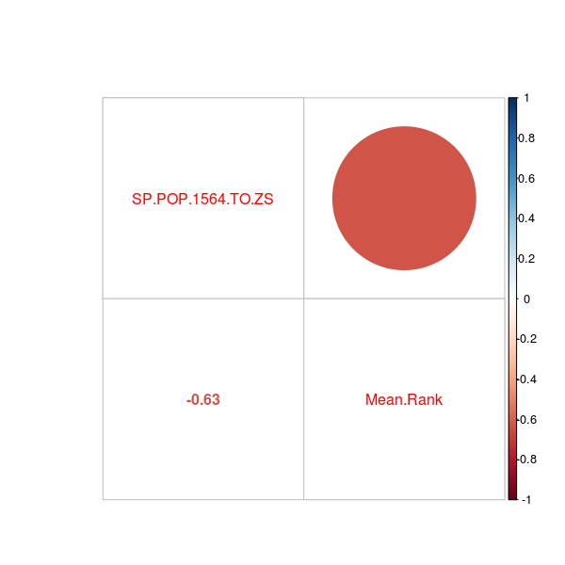
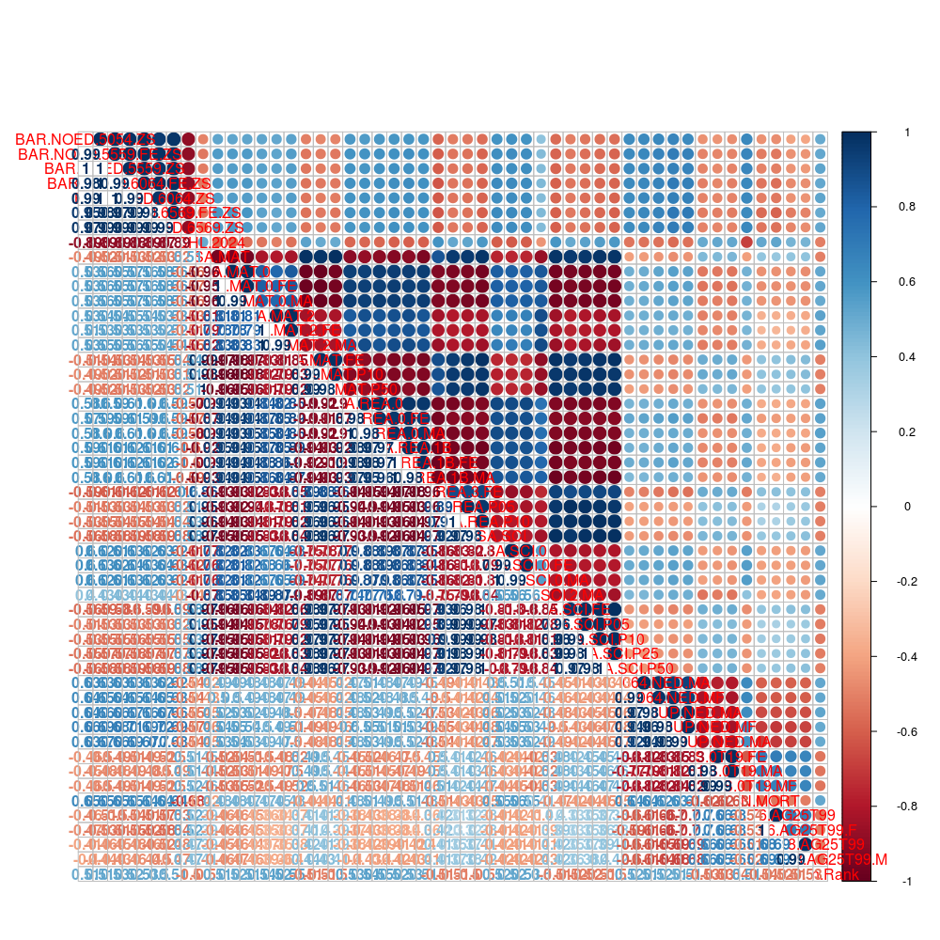
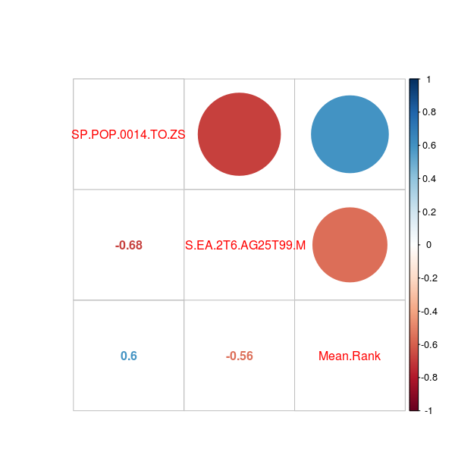
Mean Rank vs. Scores
Above 0.6
Above 0.5
Above 0.55

Slide 7
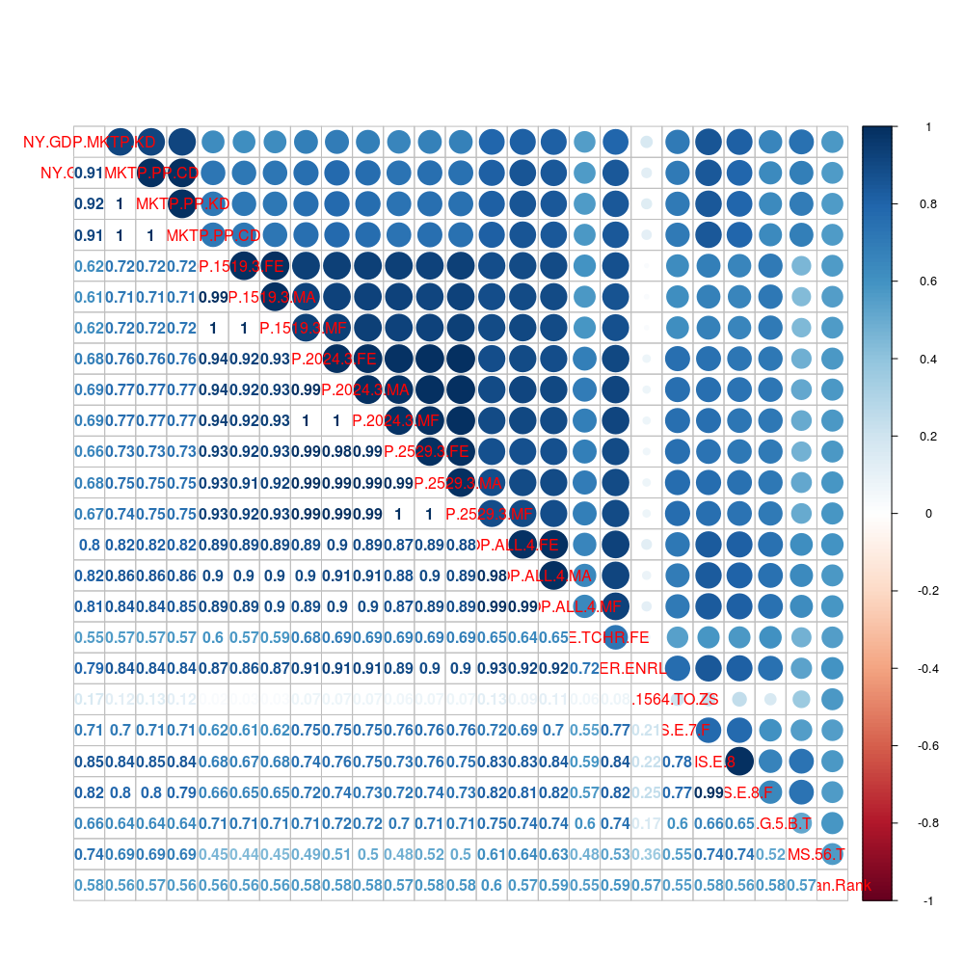
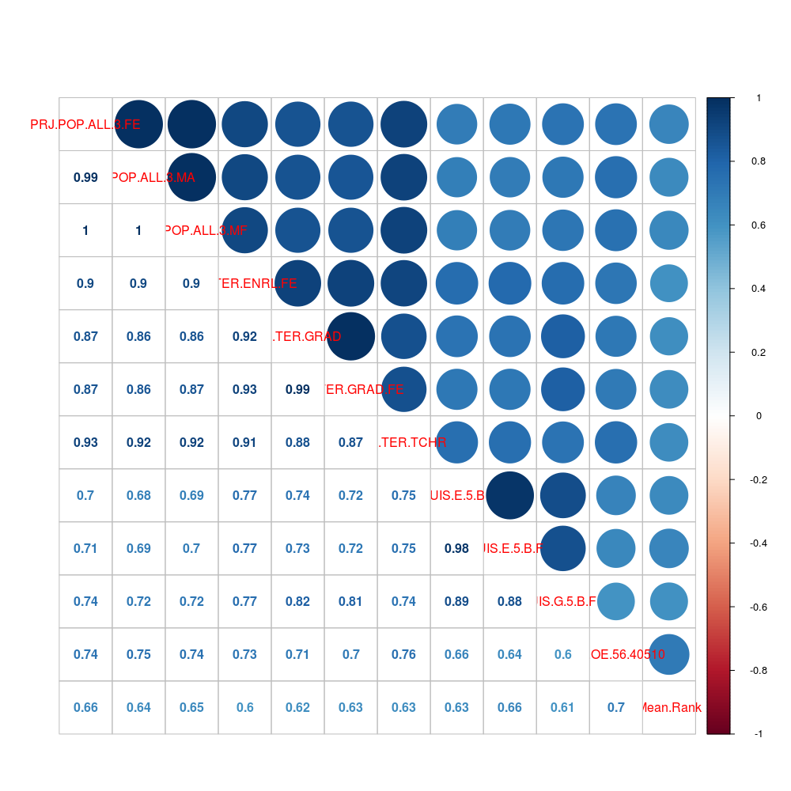
Mean Rank vs Other Ranks
Above 0.6
Above 0.55

Slide 8
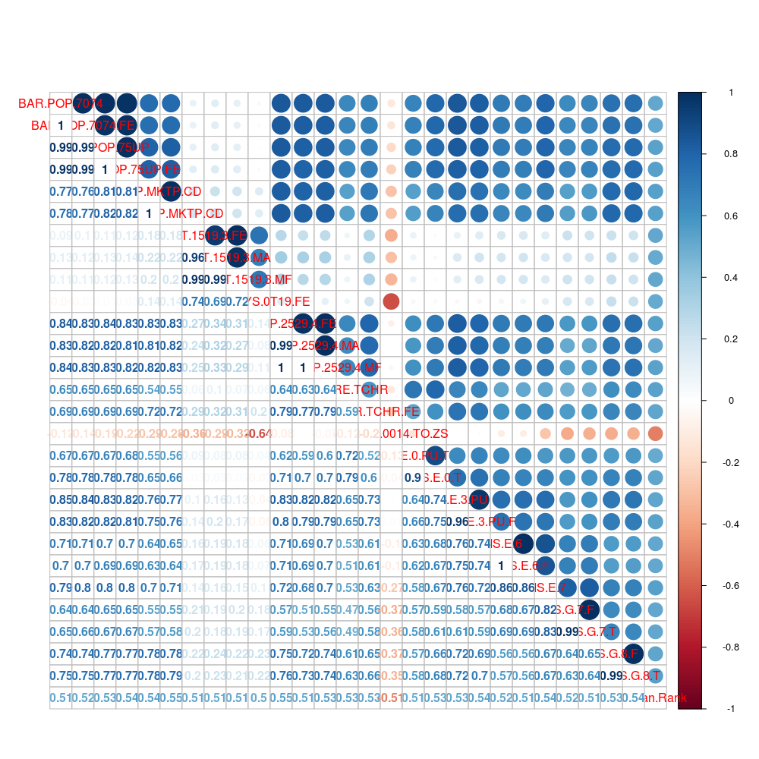
Mean Rank vs Other Ranks
Above 0.5

Slide 9
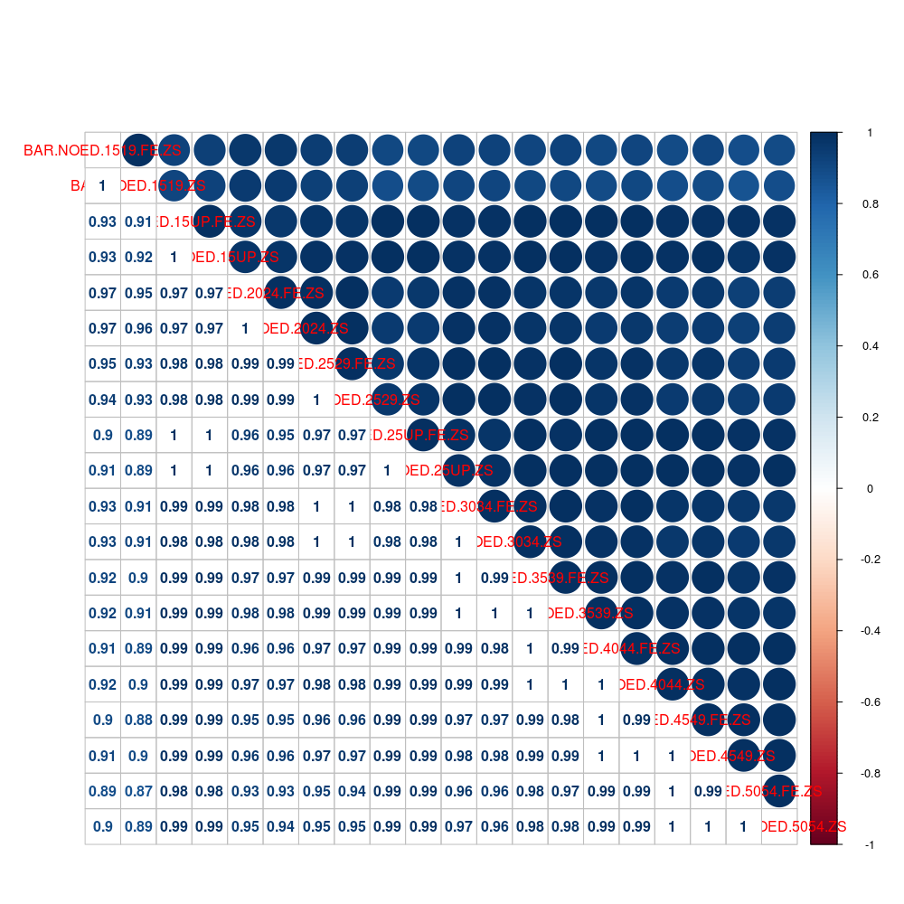
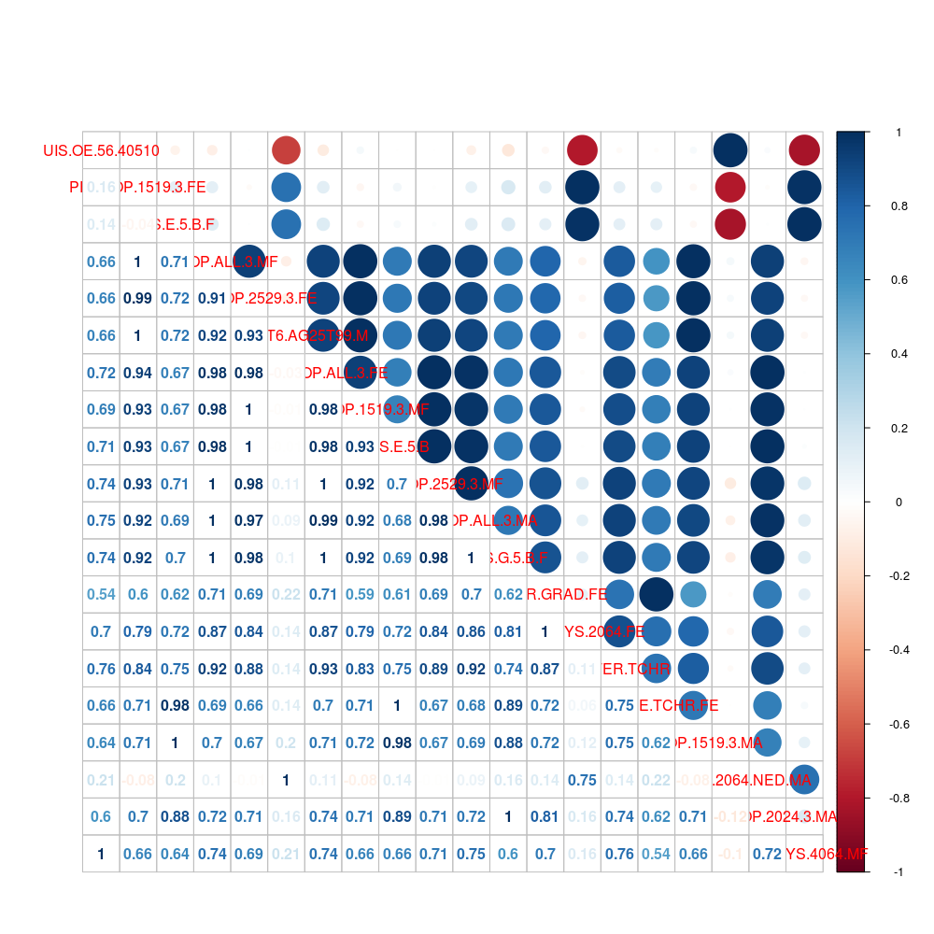
Important Features Extraction
Random Forest model is run on the dataset and it gave a decent r-square of 0.8 on validation.
The feature importances are extracted and EDA is performed on the top 20 features.

Slide 10
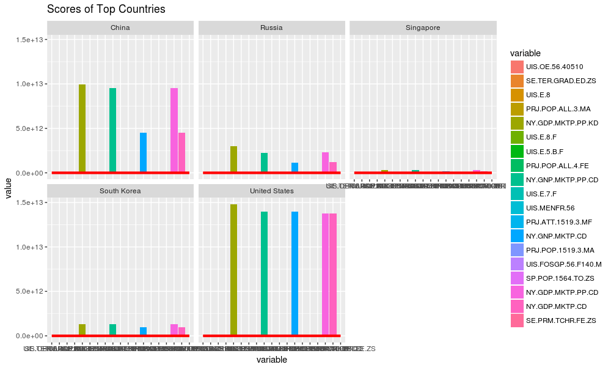
Scores for Top 5 Countries
* The Red Line is Mean Rank

Slide 11
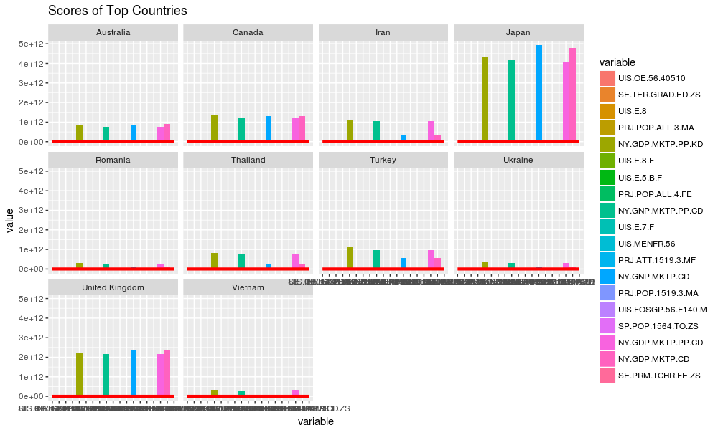
Scores of Next 10 Countries
* The Red Line is Mean Rank

Slide 12
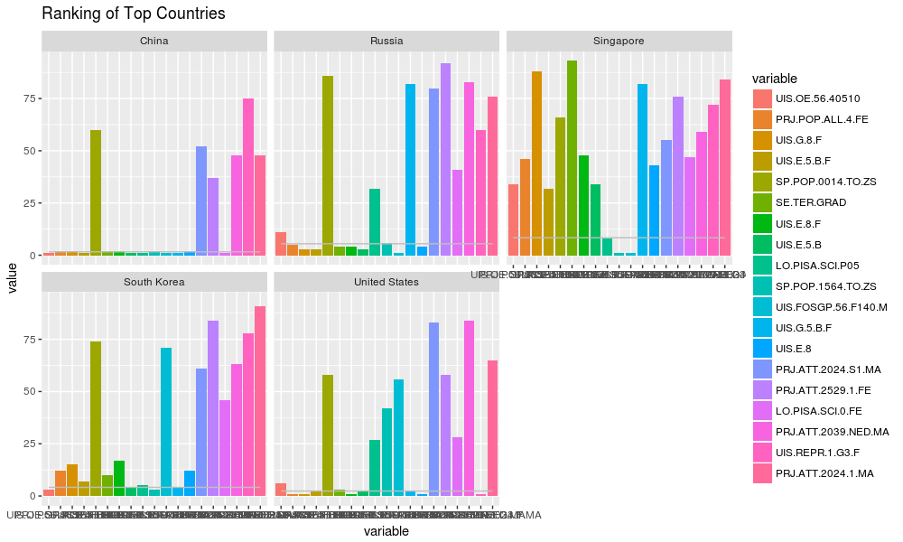
Ranks of Top 5 Countries
* The Gray Line is Mean Rank

Slide 13
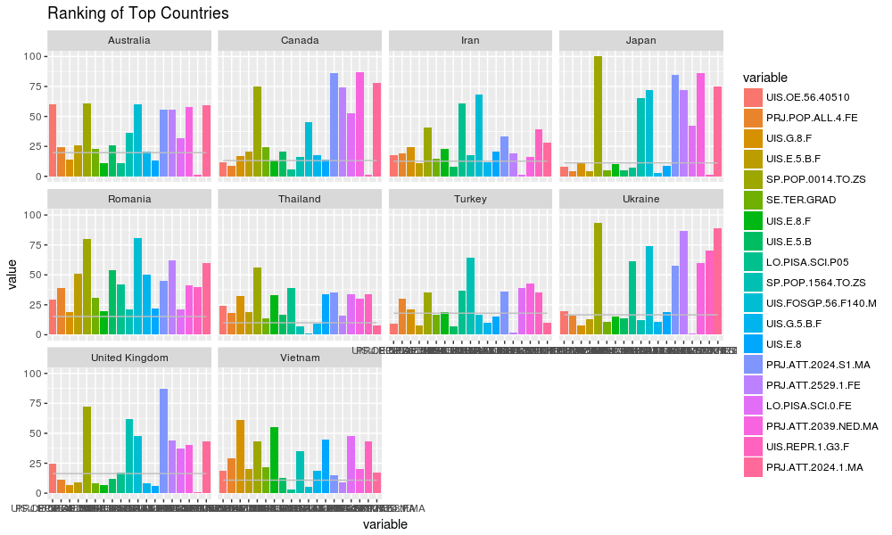
Ranks of Next 10 Countries
* The Gray Line is Mean Rank

Slide 14
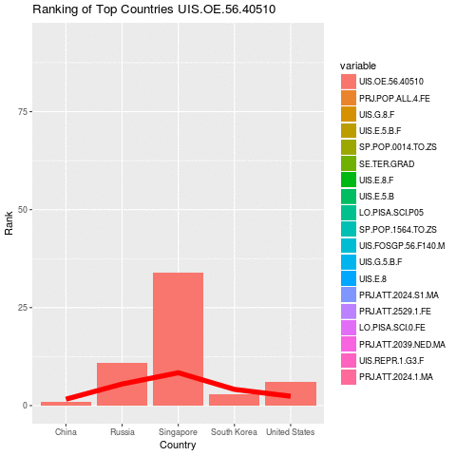
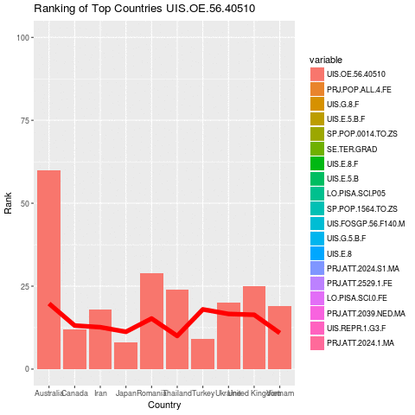
Mean Rank Vs Other Rank
* The Red Line is Mean Rank

Slide 15
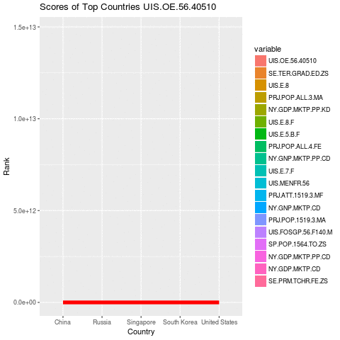
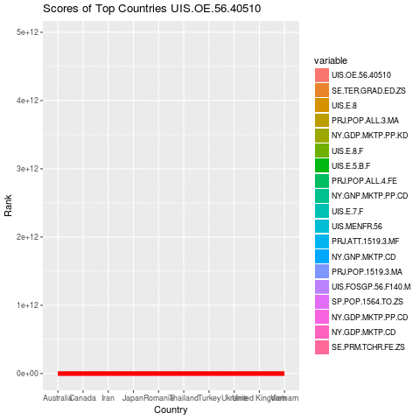
Mean Rank vs Other Scores

Slide 16
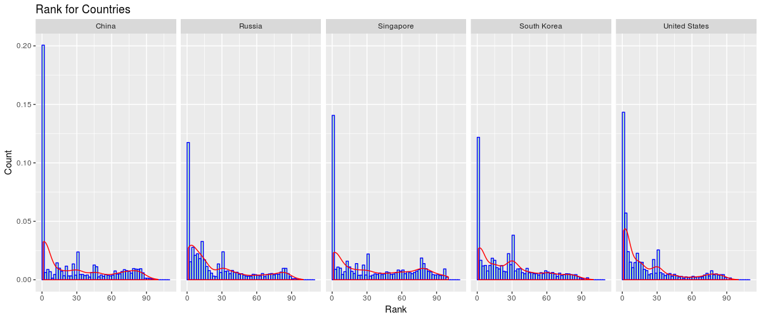
Rank Distribution for Various Indicators – Top 5 Countries

Slide 17
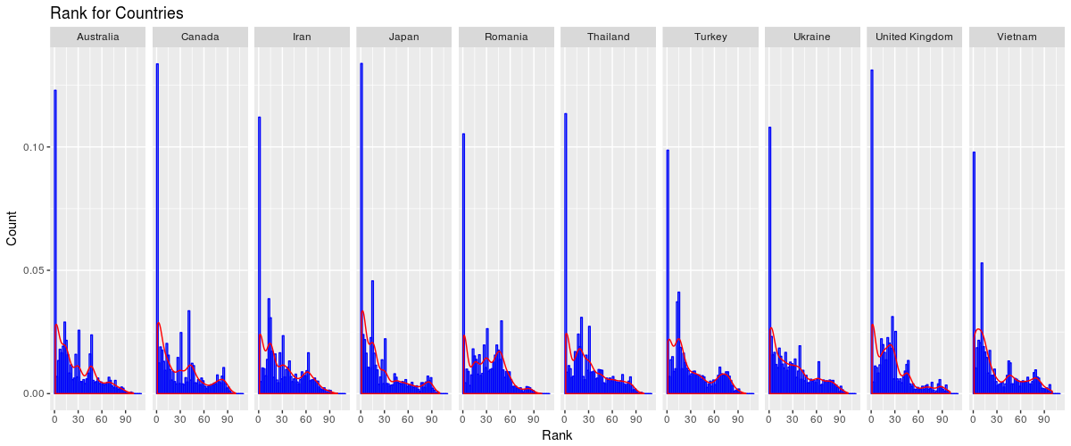
Rank Distribution for Various Indicators – Nest 10 Countries

Slide 18
Model
Used R for Modelling. Ran model on Scores Data, Rank data and concated data. Model on Rank data was found to perform consistently on different samples.
Deep Learning with H2O gave 55% accuracy. The second layer deep features are extracted.
CatBoost gave good results when run on Ranked features with r-square of 0.79 to 0.84, and MAPE of 19% to 24%. With the deep features, the scores dropped but were consistent with 0.8 to 0.82 r-square and 22% to 24% MAPE.

Slide 19
Binning and Model
Equal Width binning done using the Rice rule for choosing the number of bins.
Randomforest gave an accuracy of 22%
Catboost gave 35% accuracy

Slide 20
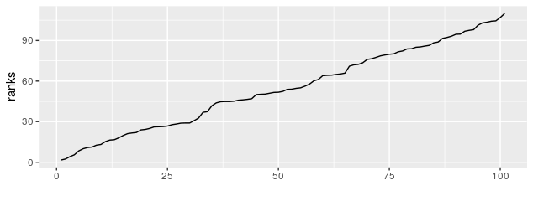
Distribution of Mean Rank
Looking at the distribution of mean rank, we can say that there is a sudden jump happening at Rank 30 and another one though not so steep, happens at 65. So we will divide the target to 3 groups and run the analysis.
The accuracies increased slightly at 55% for Randomforest and 58% for Catbost

