Slide 1
YBS 112
3. Hafta
18 Mart 2021

Slide 2
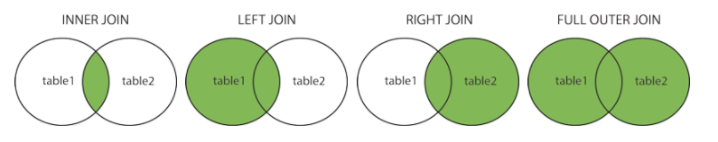
SQL JOIN
SELECT a.alan1,b.alan2,..
FROM tablo1_adi a
[INNER/LEFT/RIGHT/FULL] JOIN tablo2_adi b ON a.ortak_alan = b.ortak_alan

Slide 3
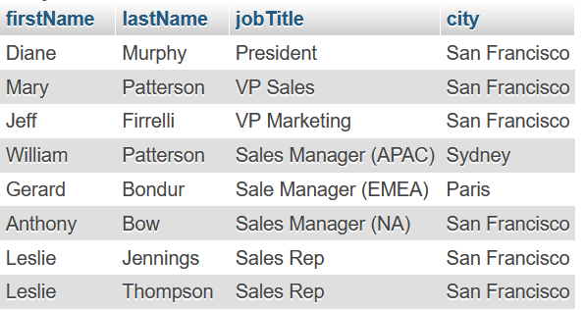
Örnek veritabanı sorgusu
SELECT e.firstName,e.lastName,e.jobTitle,o.city
FROM employees e
LEFT JOIN offices o ON e.officeCode = o.officeCode

Slide 4
SQL GROUP BY
SELECT alan1, alan2
FROM tablo_adi
GROUP BY alan1, alan2

Slide 5
SQL UPDATE
CustomerNo: 125 => salesRepEmployeeNumber (1611)
UPDATE tablo_adı SET alan_1=Deger WHERE …
UPDATE customers SET salesRepEmployeeNumber = 1611 WHERE customerNumber = 125

Slide 6
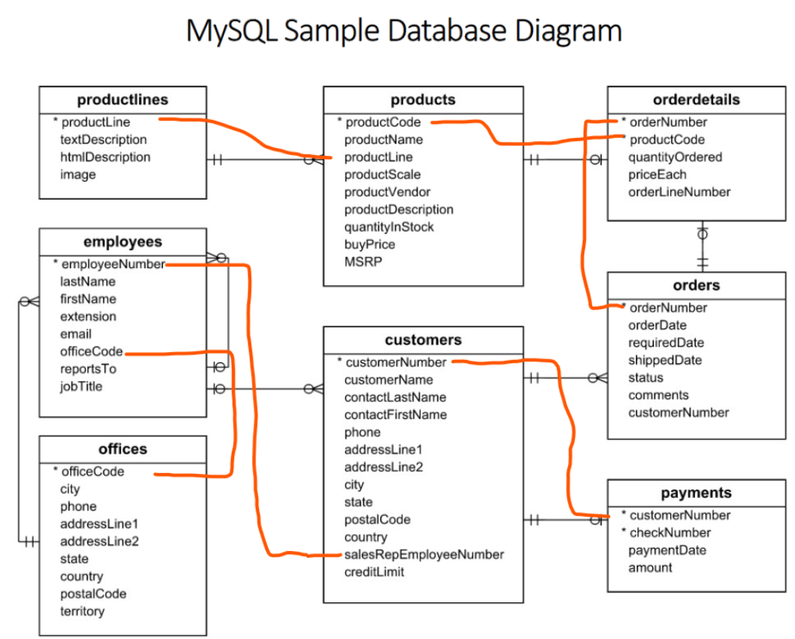

Slide 7
SQL COUNT, SUM, AVG
AVG: ORTALAMA
SELECT AVG(alan_adi) FROM tablo_adi GROUP BY alan_adi
SUM: TOPLAM
SELECT SUM(alan_adi) FROM tablo_adi GROUP BY alan_adi
COUNT: SAYI
SELECT COUNT(alan_adi) FROM tablo_adi GROUP BY alan_adi

Slide 8
Stokta en fazla bulunan ürün hangisidir?
SELECT * FROM products ORDER BY quantityInStock DESC LIMIT 1

Slide 9
Miktar olarak en fazla sipariş edilen model hangisidir?
SELECT productCode, SUM(quantityOrdered)
FROM orderdetails
GROUP BY productCode
ORDER BY sum(quantityOrdered) DESC
LIMIT 1

Slide 10
En fazla satılan ürünün ürünü kodu nedir?
SELECT a.productCode,b.productName,sum(a.quantityOrdered)
FROM orderdetails a
LEFT JOIN products b ON a.productCode = b.productCode
GROUP BY productCode
ORDER BY sum(quantityOrdered) DESC
LIMIT 1

