Slide 1
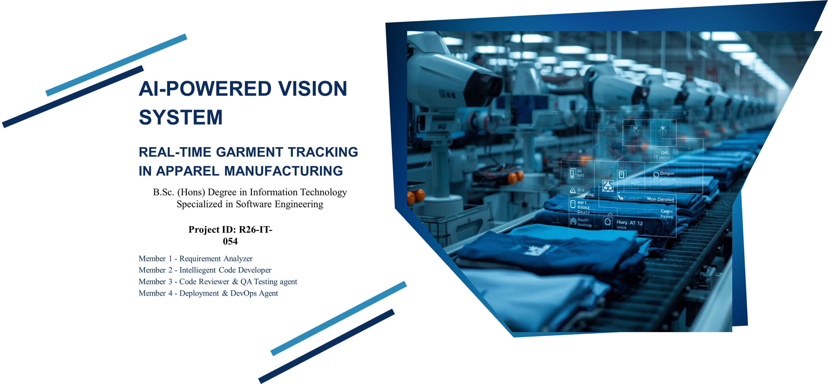

Slide 2
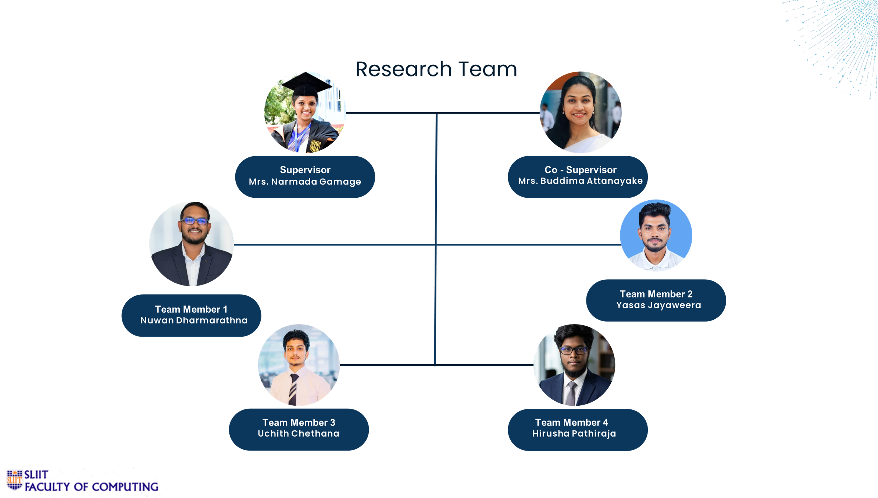

Slide 3

PANEL & SUPERVISOR FEEDBACK — POST-PROPOSAL REVIEW
Addressing Proposal Comments
1
Feature 2 Workload Division
2
Garment Size Dataset for Feature 4
  Feature 2 only handles Sewing Operator Area — dual-signal piece counting and IoT part
  Second member handles Quality Checker Area — counting good and rework pieces
  Build a size-labelled dataset covering UK, US, and EUR international sizing standards
  Required because the factory produces clothing for multiple international markets
3
Separate Datasets for Feature 1
4
Colour Prediction with Percentage (Feature 3)
  Create two distinct labelled video datasets: Sewing Operator Workflow + Quality Checker Workflow
  Enables independent model development for Feature 1's action-recognition component
  Model must return all detected garment colours with individual confidence percentages
  Replaces single dominant-colour output — provides richer inspection data
AI Vision System — R26-IT-054
3

Slide 4
GLOBAL CHALLENGE AND HOW OUR SYSTEM ADDRESSES IT
Problem Statement & The Global Solution
CHALLENGES IN APPAREL MANUFACTURING
OUR AI-POWERED SOLUTIONS
  Manual piece counting is slow and prone to human error
  No real-time per-operator cycle time or performance monitoring
  Quality defects are discovered too late in the production batch
  Garment size verification is manual and inconsistent across batches
  Colour and style checking relies entirely on human visual judgment
  Dual-signal AI piece counting — YOLOv8 garment detection + Pose wrist tracking
  Real-time cycle time analysis and KPI dashboard per operator session
  Automated quality inspection with instant PASS / REWORK / MISMATCH classification
  Pixel-calibrated garment size measurement — no physical contact required
  HSV + CNN hybrid colour and style recognition with percentage confidence output
→
AI Vision System — R26-IT-054
4

Slide 5
WHERE EXISTING RESEARCH FALLS SHORT — AND WHAT WE CONTRIBUTE
Novelty & Research Gap
RESEARCH GAPS
OUR NOVELTIES
01
No integrated AI monitoring solution exists for Sri Lankan apparel manufacturing environments
01
Dual-Signal Counting: YOLOv8 garment + Pose wrist tracking eliminates false piece counts
02
Real-time automated piece counting with false-count prevention in sewing lines is unsolved
02
IoT-integrated ESP32 for real-time operator-triggered rework and downtime event capture
VS
03
Combined colour, style, and size detection in a single garment pipeline does not exist
03
HSV + CNN hybrid detects multiple garment colours with confidence percentage per colour
04
Manual quality checking generates no structured, traceable, or machine-readable data records
04
Calibrated px/cm pipeline measures garment width and height without physical contact
AI Vision System — R26-IT-054
5

Slide 6

STAKEHOLDERS & USER PERSONAS
User Persona — Sewing Team Leader
KEY CHALLENGES
  Cannot track individual operator speed without disrupting workflow
  Manual counting stops production flow and causes target shortfalls
  No early warning when shift target is at risk
GOALS
Sewing Team Leader
  Real-time piece count and cycle time per operator station
  Instant alerts on rework and downtime events
  Shift progress tracking with projected completion time
Production Floor — Sewing Line
Primary Goal
Real-time piece count and cycle time per operator station
TECH INTERACTION
  Views live sewing dashboard on factory floor monitor
  Monitors KPI tiles: piece count, cycle time, shift %
  Receives event feed for rework and downtime incidents
AI Vision System — R26-IT-054
6

Slide 7

STAKEHOLDERS & USER PERSONAS
User Persona — Production Manager
KEY CHALLENGES
  Quality defects are discovered at end of batch — too late to prevent waste
  No structured data on garment size accuracy across the production line
  Colour and style compliance verified by eye with no historical records
GOALS
Production Manager
  Live quality metrics dashboard: PASS / REWORK / MISMATCH rates
  Garment size and colour compliance reports per production run
  Session-level inspection logs for audit and compliance purposes
Factory Management — Floor Office
Primary Goal
Live quality metrics dashboard: PASS / REWORK / MISMATCH rates
TECH INTERACTION
  Accesses quality inspection dashboard from the floor office
  Reviews inspection logs and size distribution charts
  Downloads session reports for quality compliance records
AI Vision System — R26-IT-054
7

Slide 8

STAKEHOLDERS & USER PERSONAS
User Persona — Team Supervisor
KEY CHALLENGES
  Requires clear and verifiable evidence of technical novelty
  Working prototype must demonstrate all four features cohesively
  Methodology and dataset quality must meet academic rigour standards
GOALS
Team Supervisor
  Research novelty demonstrated through a working live prototype
  Technically sound system architecture with documented methodology
  Dataset quality and annotation process rigorously documented
Academic Research — University
Primary Goal
Research novelty demonstrated through a working live prototype
TECH INTERACTION
  Reviews progress presentations and technical demonstrations
  Assesses system architecture, AI pipeline, and research novelty
  Evaluates dataset building process and model development plan
AI Vision System — R26-IT-054
8

Slide 9
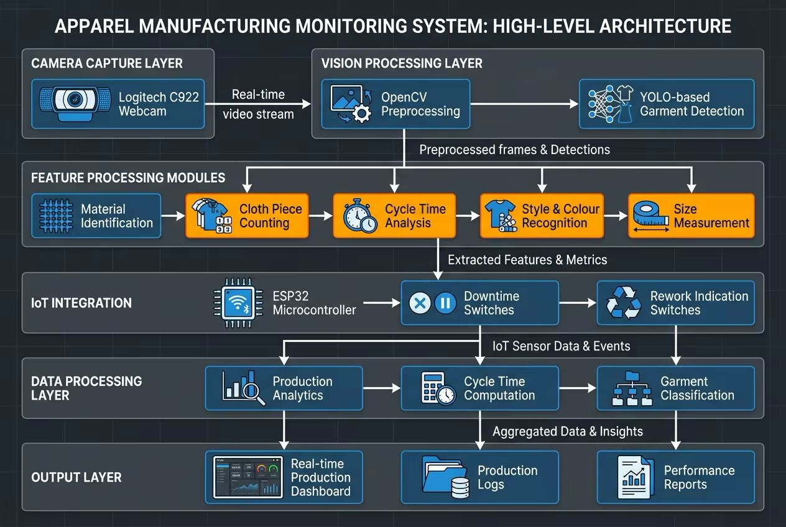
System Architecture Overview
AI Vision System — R26-IT-054
9

Slide 10
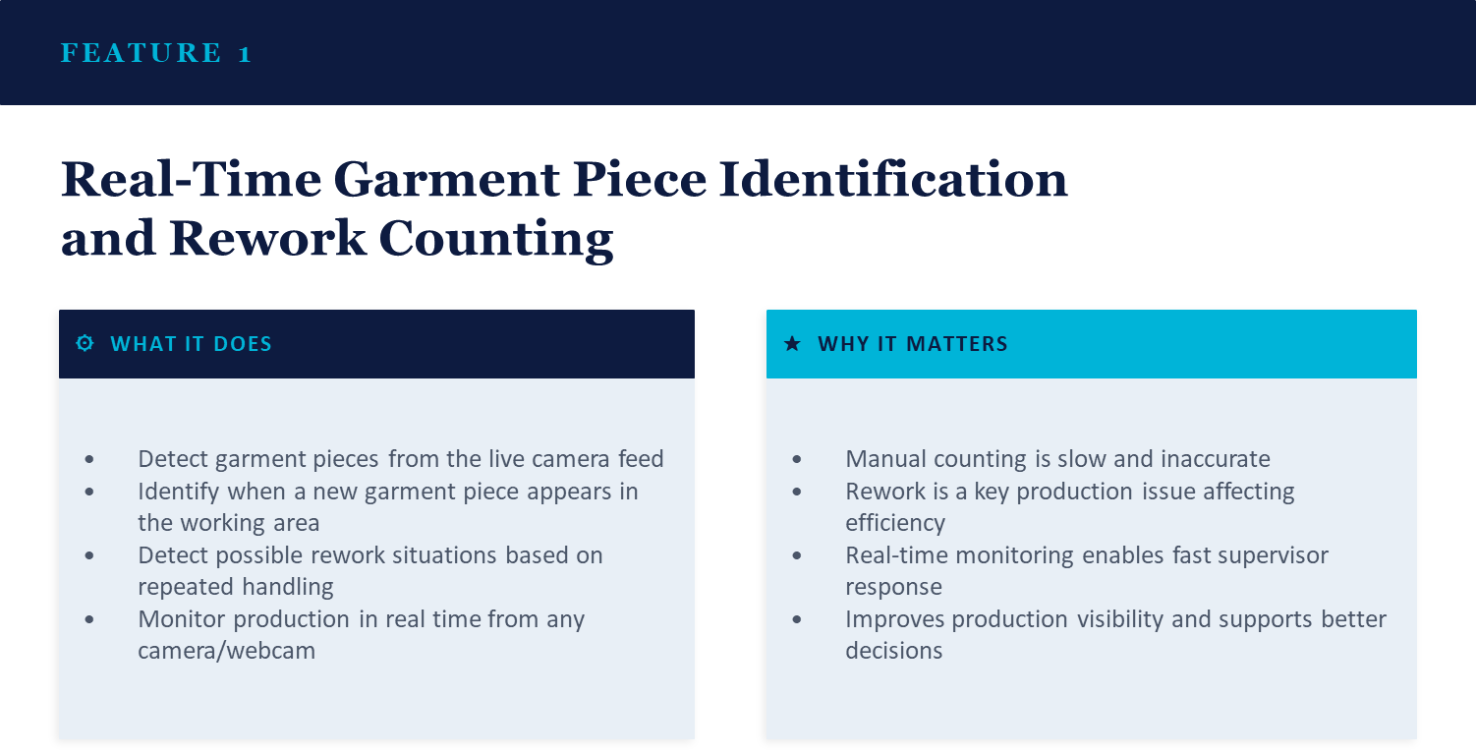

Slide 11
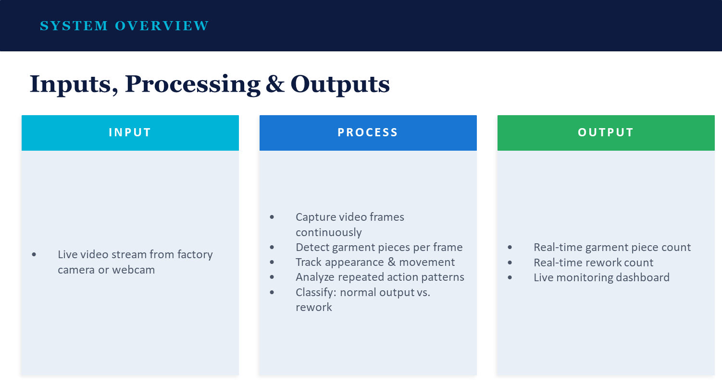

Slide 12
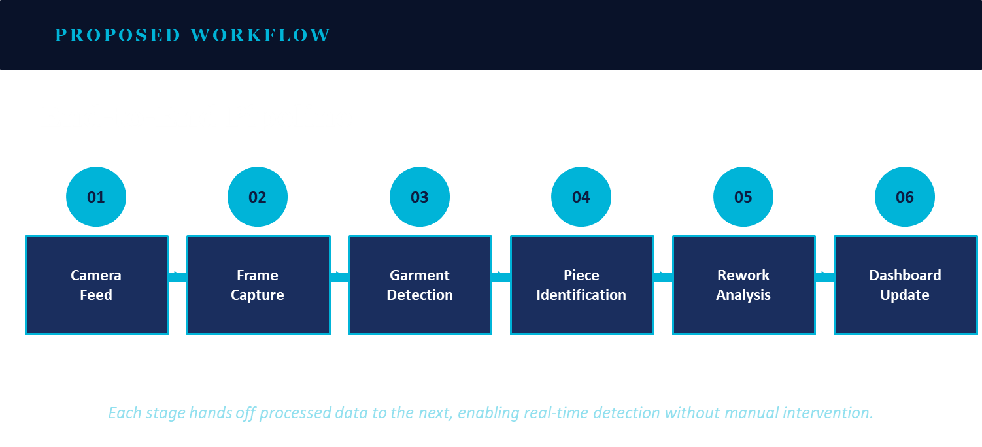

Slide 13
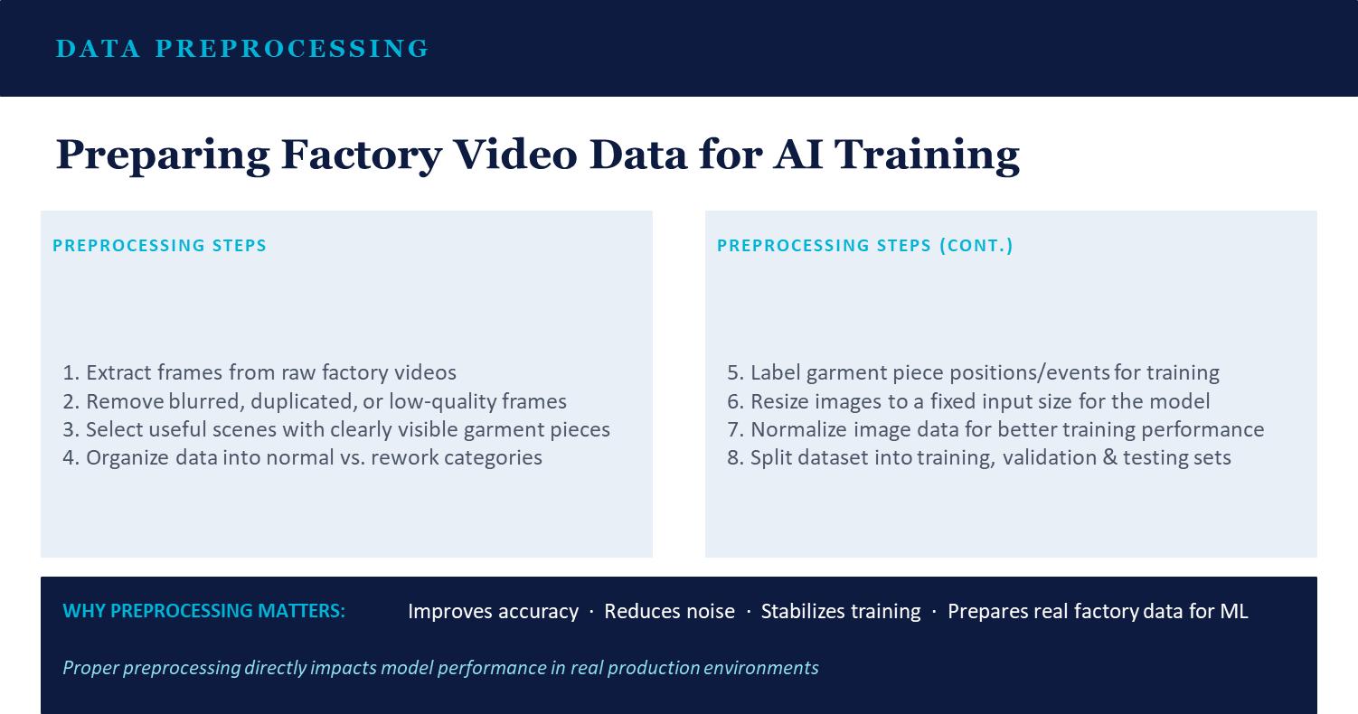

Slide 14
R26-IT-054 · FEATURE 2 · IT21255892
Feature 2
Vision-Based Piece Counting and Cycle Time Estimation
OBJECTIVE
RESEARCH PROBLEM
  Develop a vision-based system to detect completed garment piece events at a sewing workstation
  Count finished garment pieces automatically from workstation videos
  Estimate cycle time from completed-piece events
  Manual piece counting is slow and error-prone
  Real-time per-operator cycle time is difficult to measure manually
  In real factory videos, the output area is not always fixed or clearly visible
  A practical solution must work under different operator behaviors and workstation layouts
Feature 2 — Vision-Based Piece Counting & Cycle Time Estimation
8

Slide 15
R26-IT-054 · FEATURE 2 · IT21255892
Why the Counting Strategy Changed
INITIAL IDEA
WHY THIS WAS NOT RELIABLE
Define a fixed output zone in the workstation camera view. When the operator's hand or finished garment entered that zone, the counter would increment by one.
  Some operators have a clear output zone, but some do not
  Finished pieces are placed in different directions: right side, front, or bucket
  Garment pieces can pile up in the same place — causing wrong counts
  Operator posture changes naturally during sewing
  Head or body can block the sewing area
  Temporary pauses may create false count increments
CAMERA
OUTPUT
ZONE
+1
▶
▶
Hand or garment enters zone → counter increments
Design Decision: Fixed output-zone counting is not reliable in practical factory conditions. The component therefore moved to a state-based action recognition approach — a decision taken after real video review.
Feature 2 — Vision-Based Piece Counting & Cycle Time Estimation
9

Slide 16
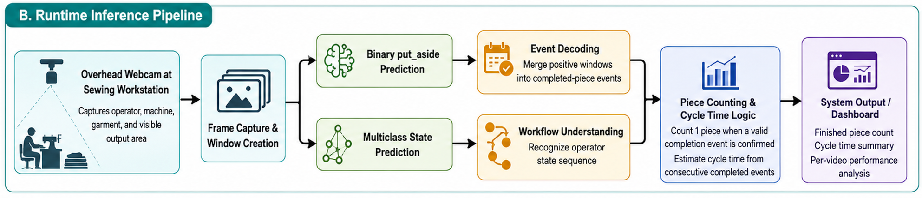
R26-IT-054 · FEATURE 2 · IT21255892
Current State-Based Counting Approach
idle_setup
→
sewing
→
put_aside
→
rest_pause
Preparing before sewing
Actively operating the machine
COUNT
Places finished garment aside
Short pause or rest
Figure: Runtime Inference Pipeline — frame capture → binary/multiclass prediction → event decoding → piece count → dashboard
WHY THIS APPROACH IS BETTER
CURRENT BASELINE MODELS
  Works across different operator layouts — no fixed zone required
  Less dependent on physical output area visibility
  Supports both piece counting AND cycle time estimation
  Binary put_aside model — main counting baseline (put_aside vs not)
  Multiclass state model — workflow understanding and future improvement
Feature 2 — Vision-Based Piece Counting & Cycle Time Estimation
10

Slide 17
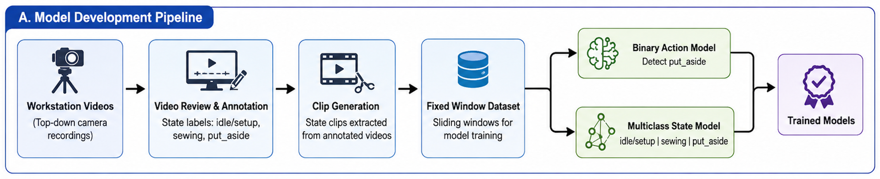
R26-IT-054 · FEATURE 2 · IT21255892
Dataset Preparation Process
Figure A: Model Development Pipeline — from raw workstation videos to trained models
VIDEO_INFO.CSV
STATE_SEGMENTS.CSV
Video metadata and quality assessment file
Workflow state annotation file per video segment
  Video ID, Operator ID, Duration, FPS
  Visibility: arms, shoulders, head, machine, output zone
  Occlusion level, lighting condition, placement direction
  Difficulty level and practical annotation notes
idle_setup
sewing
put_aside
rest_pause
  Video ID, Segment ID, state label
  Start frame, end frame, time range
  Visibility and confidence notes
Feature 2 — Vision-Based Piece Counting & Cycle Time Estimation
11

Slide 18
R26-IT-054 · FEATURE 2 · IT21255892
Model Selection & Benchmarking Pipeline
1
Fixed Output-Zone Logic
2
Binary put_aside Model
3
Multiclass State Model
  Initial idea for counting
  Rejected after real video analysis
  Not reliable in practical conditions
  Task: classify windows as put_aside or not_put_aside
  Main use: completed-piece event detection
  Result: strongest counting baseline so far
  Classes: idle_setup, sewing, put_aside
  Main use: workflow understanding
  Used for future transition-based counting
Benchmarking Flow
Fixed-Window
Dataset
Train Binary
Model
Train Multiclass
Model
Event/Transition
Decoding
Compare Count
Behavior
Analyze
Hard Cases
›
›
›
›
›
Chosen counting baseline: Binary put_aside model + event decoder
Chosen support model: Multiclass state model for workflow understanding
Feature 2 — Vision-Based Piece Counting & Cycle Time Estimation
12

Slide 19
R26-IT-054 · FEATURE 2 · IT21255892
Current Progress and Proof of Concept
COMPLETED WORK
CURRENT BEST BASELINE
  Reviewed workstation videos
  Defined workflow states
  Created video_info.csv
  Annotated state segments in state_segments.csv
  Generated state clips
  Built fixed-window dataset (window=16, stride=8)
  Trained binary put_aside model
  Trained multiclass state model
  Applied event decoding
  Evaluated counting baseline on validation videos
  Binary put_aside model is the main counting component
  Binary decoder provides the strongest count baseline so far
CURRENT BASELINE RESULT
~80%
overall validation count accuracy
  V018 — counted correctly
  V019 — main hard case (occlusion, unclear put_aside)
WHAT THIS MEANS
  The system provides a working proof of concept
  The feature is beyond the idea stage with measurable results
Feature 2 — Vision-Based Piece Counting & Cycle Time Estimation
13

Slide 20
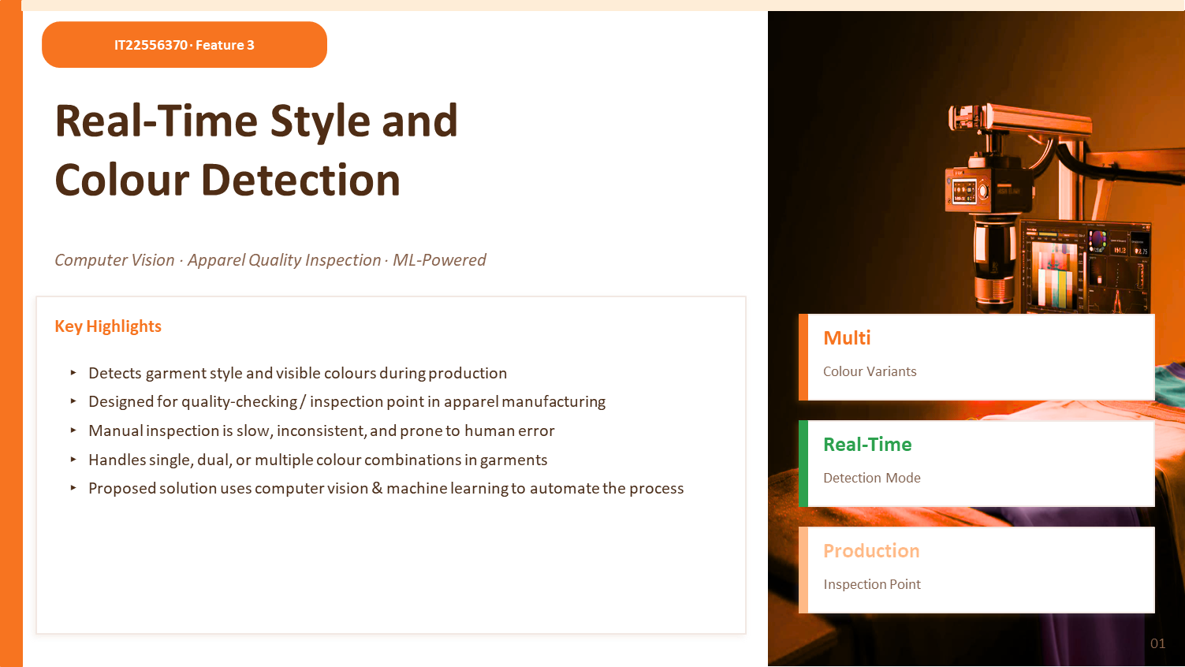
14

Slide 21
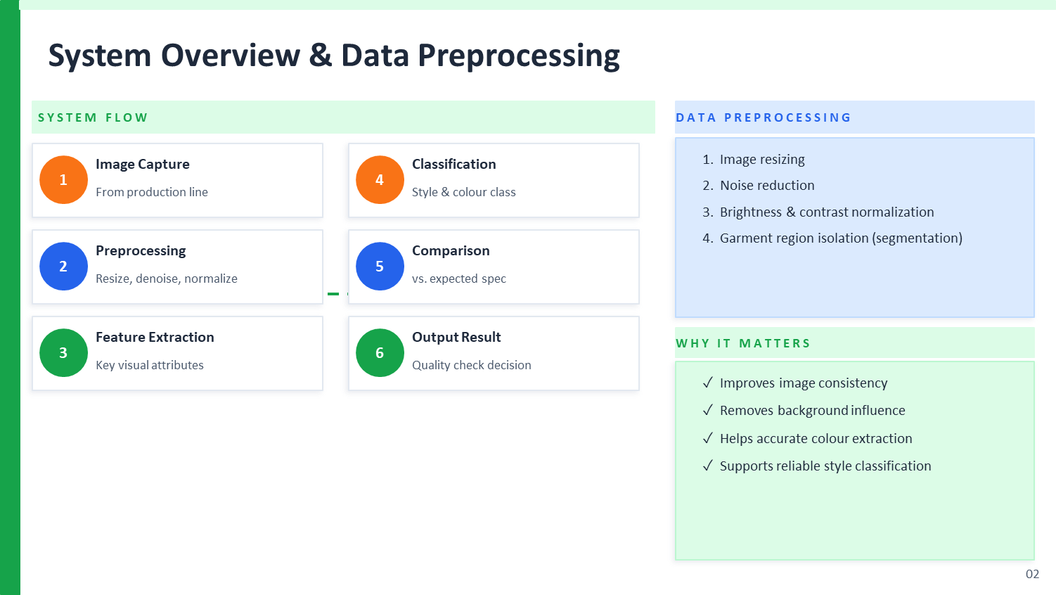
15

Slide 22
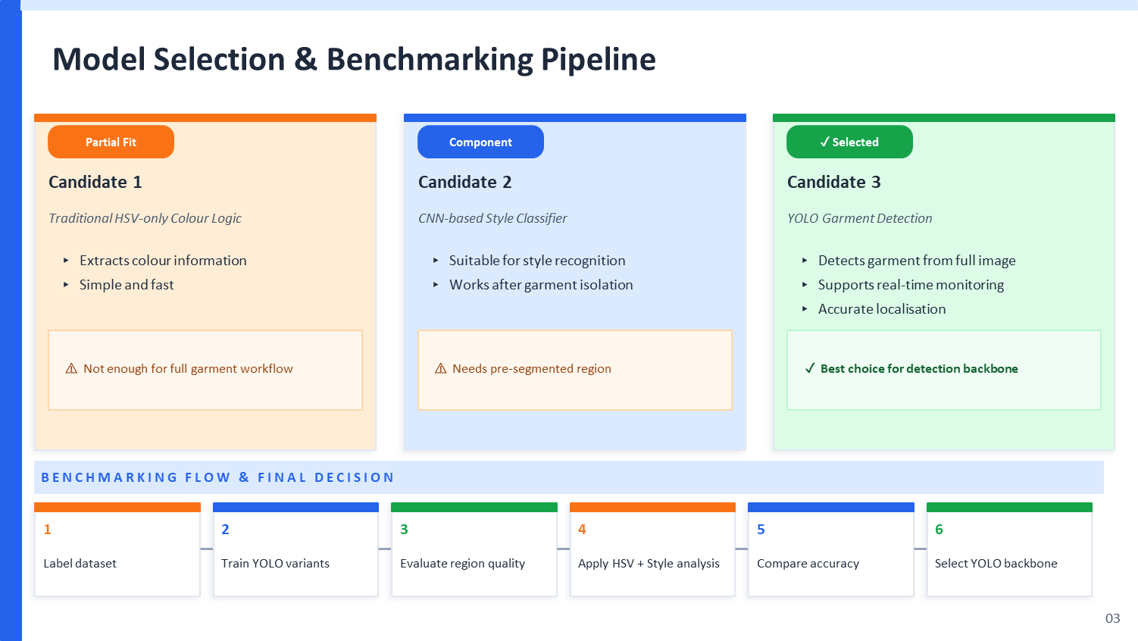
16

Slide 23
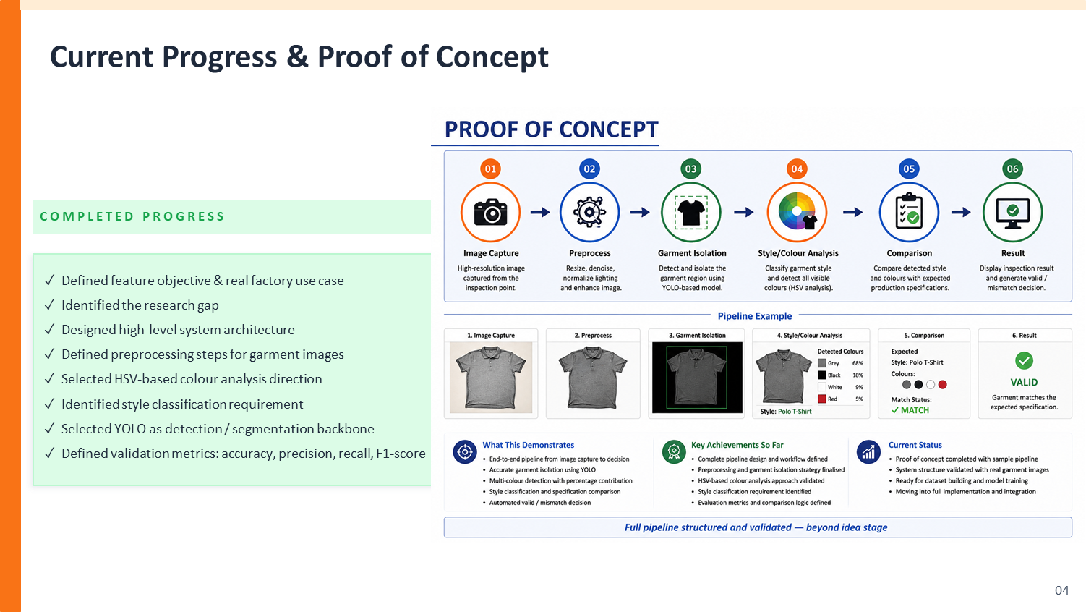

✓ Defined feature objective & real factory use case
✓ Identified the research gap
✓ Designed high-level system architecture
✓ Defined preprocessing steps for garment images
✓ Selected HSV-based colour analysis direction
✓ Identified style classification requirement
17

Slide 24
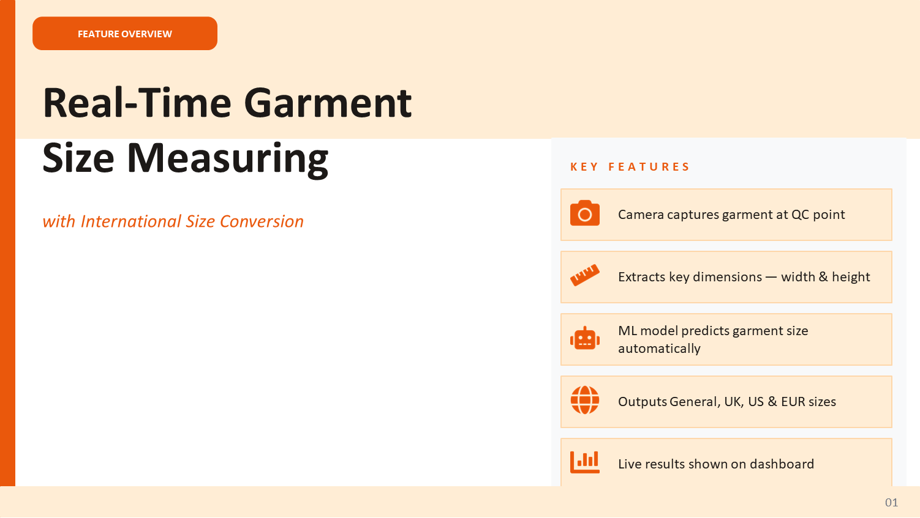
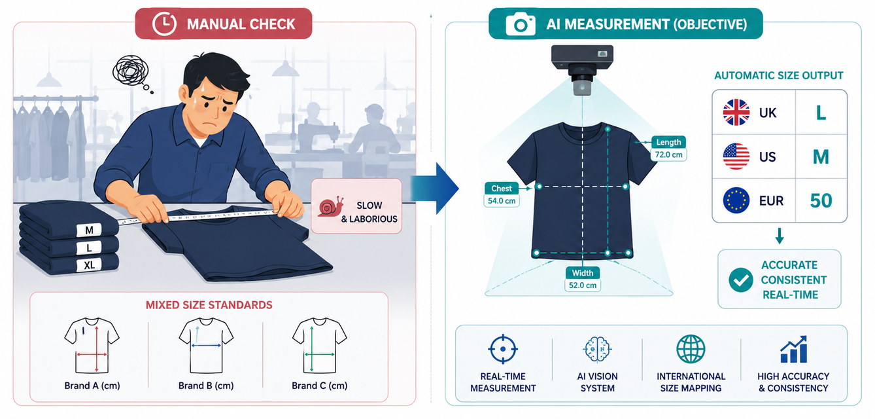

Slide 25
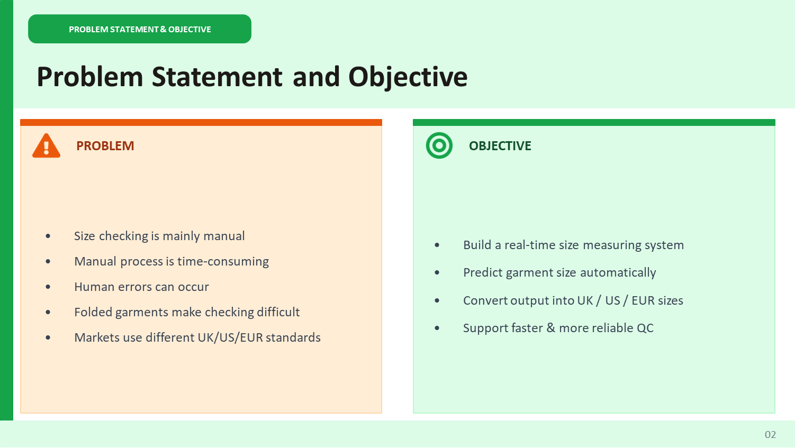

Slide 26
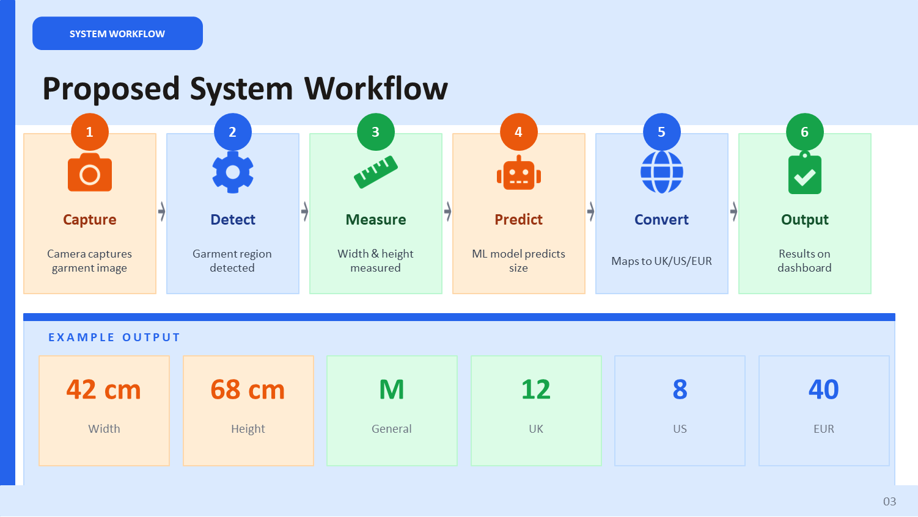

Slide 27
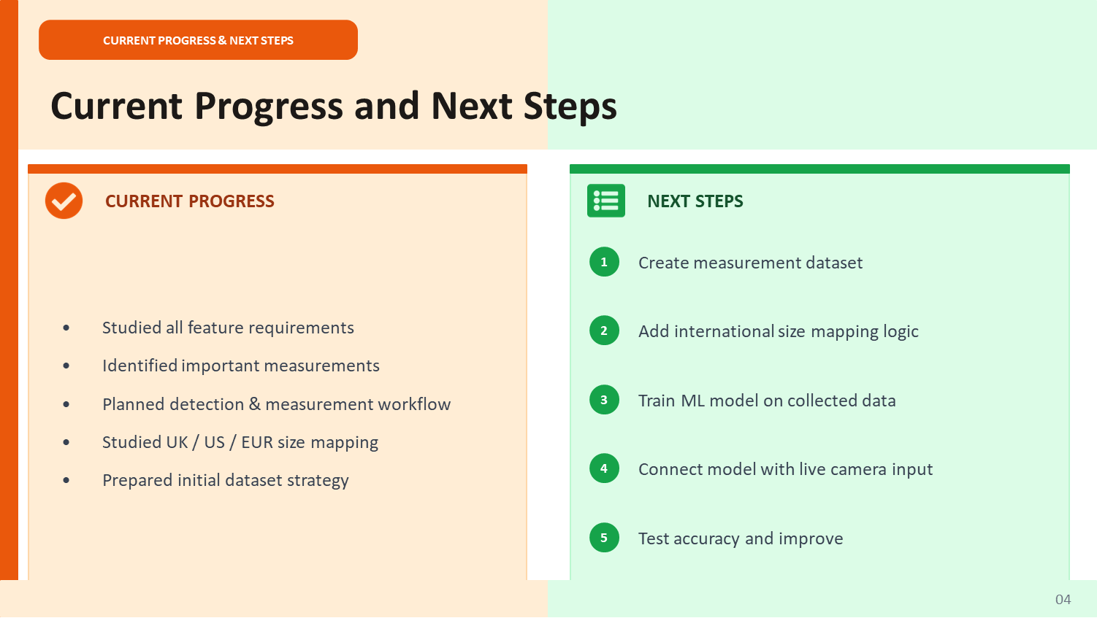

Slide 28


