Slide 1
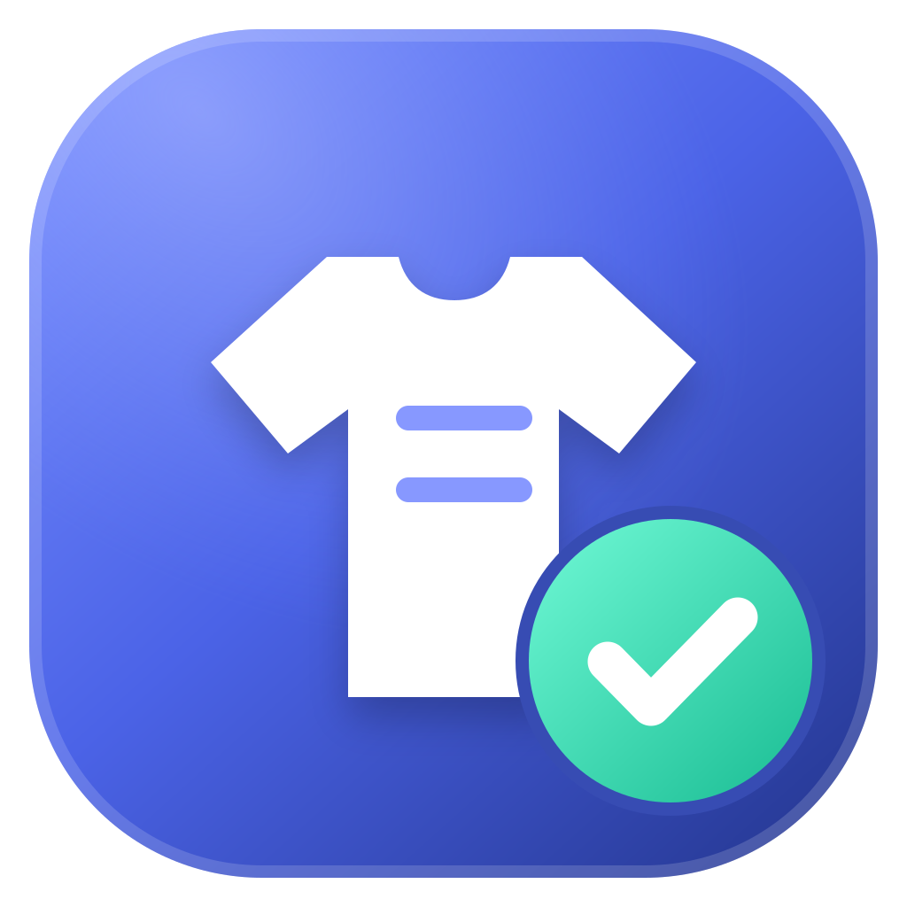
GARMENT INTELLIGENCE · INTEGRATED PRODUCTION RELEASE v3.1
One desktop application.
Four garment-vision components.
An offline, installable Electron + Python platform that counts, inspects and measures garments across the sewing, quality-checking and packing areas — while keeping each research member's frontend, backend, trained model and database independently owned and verifiable.
QUALITY CHECKING
Rework Counter
SEWING AREA
Production Monitoring
PACKING AREA
Style & Colour
PACKING AREA
Size Detection
Source verification 2026-08-29 · 128 automated tests passing · Windows & macOS installers · No cloud, no server, no factory IT
Notes:
0:00 - Opening. One desktop application, four garment-vision research components, running offline on the factory floor. Version 3.1 is the integrated production release, source-verified on 29 August 2026.

Slide 2
The Problem: Manual Production Tracking
An apparel line runs four separate manual checkpoints — and none of them leaves usable data behind.
1
Sewing area — tallied on a clipboard
0
garments with a measured cycle time under the manual baseline
Hourly piece counts are written by hand. Cycle time per garment is never captured at all, so line balancing and target setting run on estimates.
2
Quality & packing — judged by eye
4
disconnected manual checkpoints on a single production line
Good-versus-rework split, garment style, dominant colour and finished size are each verified visually at a different station, with no shared record.
3
Reporting — retyped at shift end
1×
per shift — rework and downtime recorded, from memory
Rework and downtime are reported from operator memory, then retyped into spreadsheets before a supervisor ever sees a number.
STAKEHOLDERS Sewing operator · Quality checker · Packing team · Line supervisor · Production / IE manager · Plant IT
Notes:
0:00-0:45. The problem. On an apparel line, four things get measured by hand: piece counts at the sewing station, good-versus-rework at quality checking, and style, colour and size at packing. The measurable pain point is the middle number: zero garments have a recorded cycle time, because nobody can hold a stopwatch on every piece. Rework and downtime are reported once a shift, from memory. Stakeholders run from the operator to the IE manager, and none of them can install a server room to fix it.

Slide 3
Research Gap and Project Objectives
Each component worked on its own. None of them was a product, and putting them together was the unsolved part.
RESEARCH GAP
OBJECTIVES
Shop-floor analytics assumes connectivity
1
Ship one offline desktop installer covering sewing, quality checking and packing.
Published systems are web or cloud dashboards needing a server, a network and factory IT. A sewing floor needs an offline installable application that runs on one PC.
2
Preserve each member's frontend, backend, checkpoint and database as independently verifiable assets.
Vision components ship as isolated prototypes
Each has its own repository, virtual environment, ports, checkpoint and database. Merging the code destroys authorship and model provenance; leaving them apart destroys the product.
3
Make every count evidence-based: a scene gate, a confirmed temporal transition and a hardware interlock, not a single frame.
4
Keep the AI runtime behind an authenticated boundary the user interface cannot reach.
Frame-wise counting over-counts
Classifying every frame as “sewing” also counts repair motion and unrelated scenes, and nothing ties the count to what the operator is actually doing at that moment.
5
Prove production readiness with automated policy tests and a reproducible release pipeline.
Notes:
0:45-1:30. The gap has three parts. Existing shop-floor analytics assumes a network and an IT department. Vision research ships as isolated prototypes that cannot be merged without destroying provenance. And counting from video frame by frame over-counts, because repair motion looks like sewing. So the objectives: one offline installer, four preserved and independently owned components, evidence-based counting, an authenticated boundary between the UI and the AI runtime, and automated proof of readiness.

Slide 4
One shell, four owned components, one authenticated boundary
QUALITY CHECKING
SEWING AREA
PACKING AREA
PACKING AREA
Rework Counter
Production Monitoring
Style & Colour Detection
Size Detection
Good-piece and rework-piece counting from live camera or video
Piece counting, cycle-time analysis, ESP32-C3 operator events
Style recognition, dominant-colour extraction, packing analytics
Marker-free measurement and production-size classification
AUTHENTICATED DESKTOP BOUNDARY
React renderer
Sandboxed, no Node access
Preload bridge
Typed, allow-listed IPC only
Electron main
Owns every privileged action
FastAPI sidecar
Random port + per-launch token
Trained models
Read-only, per feature
EVIDENCE-BASED COUNTING RULE · PRODUCTION MONITORING
Live camera
OpenCV, real device index
YOLOv8n gate
Is a workstation visible? 640×640
Temporal MobileNetV3
8 frames, 1.5 s, 224×224
Confirmed transition
SEWING ≥2.0 s → IDLE ≥0.6 s
+1 garment
Transactional, cycle time recorded
Operator interlock
Data and model isolation
An ESP32-C3 controller over Bluetooth: B records rework, C records downtime, D returns to normal. Counting pauses during rework, downtime and any controller outage — and the confirmed garment count is never reset by any of them.
Checkpoints stay read-only under models/<feature>. Each service writes only to its own folder in Electron's per-user data directory, so one member's records are unreachable from another's service and an app update cannot overwrite them.
Notes:
1:30-2:30. The solution is one Electron shell with a four-card selector. Top row: the four components and where they sit on the floor. Middle: the security boundary — React never reaches Python. Requests go renderer, preload, Electron main, and only main attaches the per-launch bearer token to a random loopback port. Below that, the counting rule that answers the over-counting gap: YOLO first asks whether a real workstation is even visible; only then does an eight-frame temporal MobileNetV3 classify sewing versus idle; a piece is counted only on a confirmed sewing-to-idle transition, and only while the operator controller says the mode is normal.

Slide 5
Integrated without merging and corrected
All four cards are implemented, wired to their own service, and open the original project behind them.
FEATURE CARD | FRONTEND OWNER | BACKEND OWNER | MODEL | STATUS
Rework Counter | garment-rework-frontend/ | garment-rework-backend/ | best.pt | Available
Production Monitoring | garment-counter-frontend/ | garment-counter-backend/ | best.pt + best_model.pt | Available
Style & Colour Detection | garment-style-colour-frontend/ | garment-style-colour-backend/ | best.pt | Available
Size Detection | garment-size-frontend/ | garment-size-backend/ | best_model.pt | Available
FEATURE CARD
FRONTEND OWNER
BACKEND OWNER
MODEL
STATUS
CLOSED IN v3.1
Windows camera selection now opens the same physical device it names, in DirectShow index order.
Style & Colour vision service exposes a real run_service() entry point, with separate API and vision logs.
Size Detection navigation no longer inherits the title-bar drag region, so its sidebar accepts clicks.
Shared runtimes, separate code
Development runs one Python 3.12 environment and one node_modules tree. Production freezes four independent executable sidecars into the installer. No backend imports or calls another backend, and adding an endpoint requires an owning-backend route, an IPC allow-list entry, a typed preload method and a policy test.
All four features share one centred, branded startup screen with retry and return actions.
OPEN BEFORE HANDOVER
Service lifecycle
Electron starts only the service the selected card needs, on a dynamic loopback port the feature UI never sees. Style & Colour keeps its original 8000 / 5050 API-plus-vision split, restricted to 127.0.0.1. Leaving a card releases its camera before the next one opens it.
Physical camera, lighting and ESP32 rehearsal on the presentation machine.
Code signing / notarisation credentials for outside-team distribution.
Notes:
2:30-3:30. Integration status. Every card is available and opens the original project, but nothing was merged: each member still owns their frontend folder, backend folder, checkpoint and database, and no backend can call another. Development shares one virtual environment and one node_modules; production freezes four separate sidecars into the installer. Version 3.1 was a corrective release that closed the four defects found on Windows — camera index ordering, the style/colour vision launcher, the size sidebar drag region, and an inconsistent startup screen. What remains is physical: a hardware rehearsal on the presentation machine and signing credentials.

Slide 6
Production Monitoring: Evidence-Based Counting
Everything below was executed against the integrated source, not asserted in a document.
NON-FUNCTIONAL REQUIREMENTS
74
Production Monitoring
backend tests passed
54
Electron, policy and
ownership tests passed
Security
Reliability
Context isolation, sandboxing and no Node access in the renderer; named IPC only, verified senders; the per-launch token never reaches React.
Serialised BEGIN IMMEDIATE writes, transactional piece and IoT events, active-session recovery after restart, bounded backoff reconnection.
0
ESLint warnings;
TypeScript passed
7
supplied artifacts pinned
by SHA-256 checksum
Performance
Data integrity
A classification roughly every 0.3 s over a 1.5-second window, five-prediction smoothing at a 0.55 confidence floor — on CPU.
Read-only checkpoints, per-user writable database outside the installed app, employee and line snapshots frozen into each session record.
ALSO VERIFIED
Size model loaded on real CPU; Style & Colour launcher loaded its YOLO model and started the live vision service.
Electron main, preload, React, Tailwind v4 and scoped feature CSS all compiled for production.
Release doctor validated scientific dependencies, all model files and branding; OpenCV pinned to 4.11.0.86 on Python 3.12.13.
Rework and Size model and database hashes match their supplied standalone projects exactly.
Portability
Maintainability
Signed Windows Setup EXE and macOS APP / ZIP / DMG at version 1.0.3; customers install no Python, Node.js or browser runtime.
Feature ownership enforced by tests: no backend-to-backend calls, no arbitrary URL fetching, every new route explicitly allow-listed.
Notes:
3:30-4:30. Evaluation. 74 backend tests and 54 Electron and policy tests pass; TypeScript and ESLint are clean; the size model loads on real CPU and the style/colour launcher genuinely starts its vision service. Seven supplied artifacts — five checkpoints and two seed databases — are pinned by SHA-256, and the rework and size hashes match the standalone projects byte for byte, which is how we prove provenance was preserved. On the right, the non-functional requirements: the security model, transactional reliability, CPU-level performance at roughly three classifications a second, data integrity, portability to a clean machine, and maintainability enforced by tests rather than convention.

Slide 7
Commercialisation Strategy & Demo Roadmap
The product sells because of what it does not need: no server, no network, no factory IT.
COMMERCIALISATION
DEMO ROADMAP
1
Licensed per workstation
Sold as a plant bundle or per area — sewing, quality checking or packing — so a line can start with one module and add the others.
1
Animated landing page into the four-card selector.
2
Rework Counter — good versus rework pieces on the live feed.
2
Low hardware floor
A commodity Windows PC, a USB camera and one ESP32-C3 controller per sewing station. No rewiring, no machine retrofit.
3
Production Monitoring — session, live count, cycle-time chart, and the ESP32 rework, downtime and reset buttons.
3
Recurring revenue
4
Style & Colour — style recognised, dominant colours extracted, history saved.
Annual support and a per-customer retraining service, since every plant sews its own styles on its own workstations.
5
Size Detection — garment measured at the calibrated camera height and classified.
4
Defensible asset
6
Analytics with filters, then the styled five-sheet Excel export.
Four preserved trained checkpoints plus the integration and security architecture that makes them one shippable product.
NEXT Hardware rehearsal on the target machine → signed installer → single-line pilot → full line rollout → multi-line plant reporting
Notes:
4:30-5:00. Commercialisation. This is licensed per workstation and can be sold one area at a time, and its strongest selling point is what it does not need — no server, no network, no IT department, just a PC, a camera and a five-dollar controller. Recurring revenue comes from support and per-customer retraining, because every plant sews its own styles. The demo now runs in this order: landing, then each of the four cards, then the filtered Analytics and Excel export. After that: hardware rehearsal, a signed installer, and a single-line pilot.

Slide 8

PP I warning letter and what changed since
Project R26-IT-054 · AI-Powered Vision System for Real-Time Garment Tracking in Apparel Manufacturing
ISSUES RAISED BY THE PANEL
IT22627582 · Pathiraja H.P.M.H.D.S.
Not working with synthetic data, and progress is below 50%.
IT22187796 · Jayarathna W.G.U.C.G.
Only one model (RF) was used, and no back-end implementation was provided.
ANSWERED IN THIS SUBMISSION
✓
Four trained models, not one — YOLOv8n workstation detector, temporal MobileNetV3 classifier, and the rework, style/colour and size detectors — each with its checkpoint pinned by SHA-256.
✓
A back end exists for every feature — Four independent FastAPI services with their own SQLite databases, started by Electron on isolated loopback ports.
✓
Verified, not asserted — 74 backend tests, 54 platform tests, TypeScript and ESLint clean, on the source verified 29 August 2026.
Letter of Warning, issued at Proposal Presentation I
Notes:
Closing / backup slide. The panel issued a warning at PP I on two points: synthetic data and progress below 50 percent for IT22627582, and a single RF model with no back end for IT22187796. This slide shows the letter and the direct answer: the submitted system now runs four trained models rather than one, every feature has a working FastAPI back end with its own database, and the whole thing is verified by 128 automated tests rather than asserted. REPLACE OR EXTEND the synthetic-data response before presenting — that point is not answered by the code in this repository.

