Slide 1
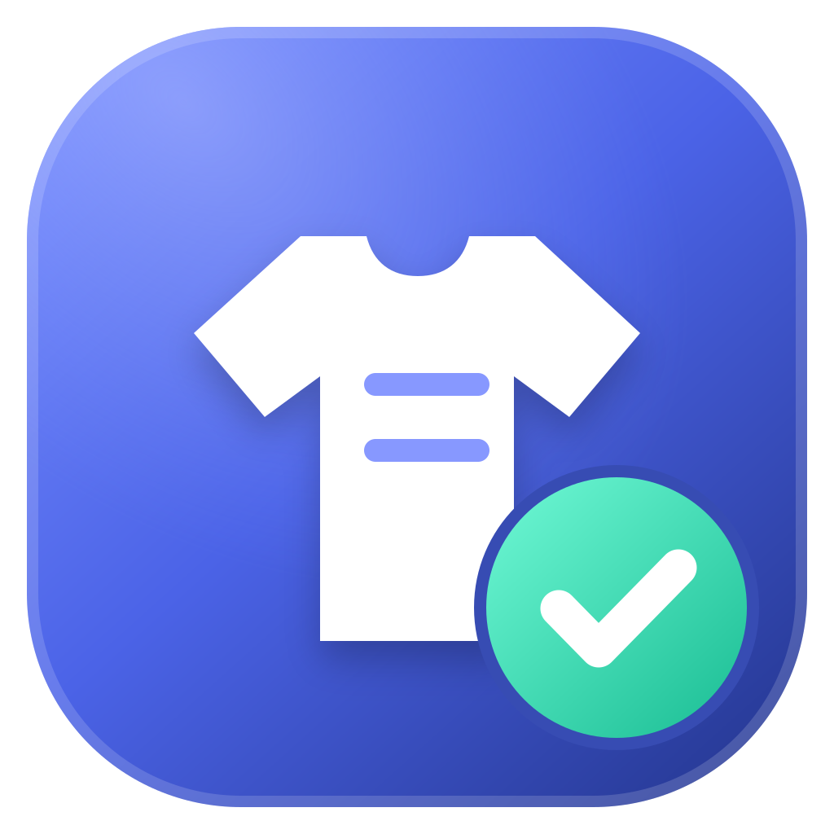
IT4010 RESEARCH PROJECT · FINAL PRESENTATION & VIVA
AI-Powered Vision System for
Real-Time Garment Tracking
in Apparel Manufacturing
Garment Intelligence 3.1 — four garment-vision components in one offline desktop application.
C1 PRODUCTION MONITORING
Dharmarathna P.W.A.N.
IT21255892
C2 STYLE & COLOUR DETECTION
Jayaweera M.P.Y.C.
IT22556370
C3 SIZE DETECTION
Jayarathna W.G.U.C.G.
IT22187796
C4 REWORK COUNTER
Pathiraja H.P.M.H.D.S.
IT22627582
Project ID R26-IT-054 · Supervisor: Ms. Narmada Gamage · Co-Supervisor: Ms. Buddhima Attanayaka · SLIIT
Notes:
Open with the title and the four components in production order. Name the team once; each component slide repeats its owner in the footer.

Slide 2
The problem, and the shape of the fix
Manual counts and visual checks make consistent production tracking difficult.
SEWING
QUALITY CHECKING
PACKING: STYLE
PACKING: SIZE
C1
Production
Monitoring
C2
Rework
Counter
C3
Style & Colour
Detection
C4
Size
Detection
THE PROBLEM
THE PROBLEM
THE PROBLEM
THE PROBLEM
Pieces counted by hand.
Cycle times need
separate measurement.
Good and rework pieces
need separate
manual tallies.
Workers check garment
style and colour
by eye.
Each garment needs
a manual dimension
and size check.
THE FIX
THE FIX
THE FIX
THE FIX
Counts completed pieces
and measures each
production cycle.
Records separate good
and rework counts
for quality tracking.
Recognises garment
style and colour and
saves the result.
Measures garment
dimensions and records
counts by size.
One offline desktop application
Camera-based analysis with local records
for all four checkpoints.
IT4010 Research Project · Final Presentation & Viva · R26-IT-054
2
Notes:
The main problem is that sewing, quality checking and packing rely on manual counts and visual checks. The four cards show how our components address each task. Production Monitoring counts completed pieces and measures cycle times. The Rework Counter records good and rework counts separately. Style and Colour Detection recognises garment styles and colours. Size Detection measures dimensions and records size counts. The shape of our fix is one offline desktop application, using camera-based analysis and local records across these four checkpoints.

Slide 3
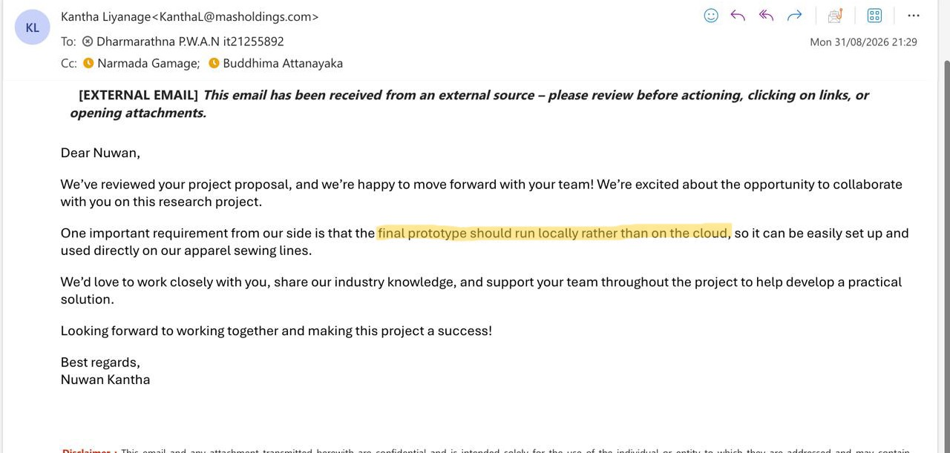
Client Requirements
WHAT REQUIRED
Local execution · Easy setup · Used directly on apparel sewing liness · Practical solution
IT4010 Research Project · Final Presentation & Viva · R26-IT-054
3
Notes:
Name each comment, say what changed in one sentence, point at the evidence column, move on. Replace rows 1-2 with your real PP2 comments and fill the two bracketed cells.

Slide 4

C1
Production Monitoring
SEWING AREA · VISION-BASED PIECE COUNTING AND CYCLE-TIME MEASUREMENT
Counts finished pieces at the sewing station and times every cycle.
DATA FLOW
Live camera
OpenCV device index
YOLO gate
workstation visible?
MobileNetV3
8 frames · 1.5 s
Transition
sewing → idle
SQLite + Excel
piece · cycle · event
THE COUNTING RULE
A piece counts only at a confirmed transition
Produces the line's output number — every other component is measured against it.
SEWING
IDLE / SETUP
+1 GARMENT
confirmed ≥ 2.0 s
confirmed ≥ 0.6 s
cycle time written
DEPENDENCIES
DESIGN CHOICES
Workstation camera, tested and resolved to a device index
ESP32-C3 connected with live notifications
Both checkpoints loaded and warmed
Validate the scene before classifying the activity
Count on a transition, never a single frame
Hardware interlock pauses counting at source
REWORK · DOWNTIME · controller disconnected
counting pauses — the confirmed count is never reset
TEST EVIDENCE
LIMITATIONS
74
2
1st
Counting thresholds are fixed — changing them needs revalidation.
Field accuracy against a manual count is not yet measured.
backend tests passing
models loaded on CPU
piece carries a cycle time
IT4010 Research Project · Final Presentation & Viva · R26-IT-054
IT21255892 · Dharmarathna P.W.A.N.
4
Notes:
The counting rule is the research contribution. A piece counts only at a confirmed sewing-to-idle transition, only while a real workstation is visible, and only while the controller reports normal mode. Point at the red bar: rework, downtime and a disconnected controller all pause counting, and none of them ever resets the confirmed count.

Slide 5

C2
Style and Colour Detection
PACKING AREA · REAL-TIME STYLE AND COLOUR RECOGNITION WITH PRODUCTION DECISION SUPPORT
Style and colour from one overhead webcam — and the overtime decision that follows.
DATA FLOW
Overhead webcam
packing zone only
YOLOv8n
27 ms / frame, CPU
Capture gate
see below
Colour
table & skin removed
SQLite → forecast
style · colour · time
THE CAPTURE GATE
Every frame is filtered — the model is asked last
Says what was made — and whether the order will finish on time.
every frame
differs from the empty table
DEPENDENCIES
DESIGN CHOICES
not moving · settled 0.3 s
One overhead webcam — no GPU, no tags on garments
Empty, still table for ~1 s at startup
Own YOLOv8n — 4 classes, 3,033 images
YOLOv8n on CPU, so a factory PC is enough
Fix the capture gate, not the model size
Agreement across frames beats one confident frame
no hand or face over it
3 of 7 frames agree, 80 %
1 CAPTURE → locked until removed
empty table → never classified
TEST EVIDENCE
LIMITATIONS
0.958
37
107/107
Closed class set — no background class, so an untrained garment is forced into one of four.
Colour and field accuracy unmeasured; vision service still binds to all addresses.
mAP · P 0.962 · R 0.955
captures in 5.5 min, 0 errors
component tests passing
IT4010 Research Project · Final Presentation & Viva · R26-IT-054
IT22556370 · Jayaweera M.P.Y.C.
5
Notes:
The model was never the problem - 0.958 mAP on its test set. The problem was that the live loop asked it the wrong question, at the wrong moment, on pixels that included the table. Walk down the funnel: each bar is one failure removed. The bottom right is the headline - an empty table is never classified, because the model is never called. Then give the overtime number: 84.3 against 122.9 needed, nine days late, four hours of overtime a day.

Slide 6
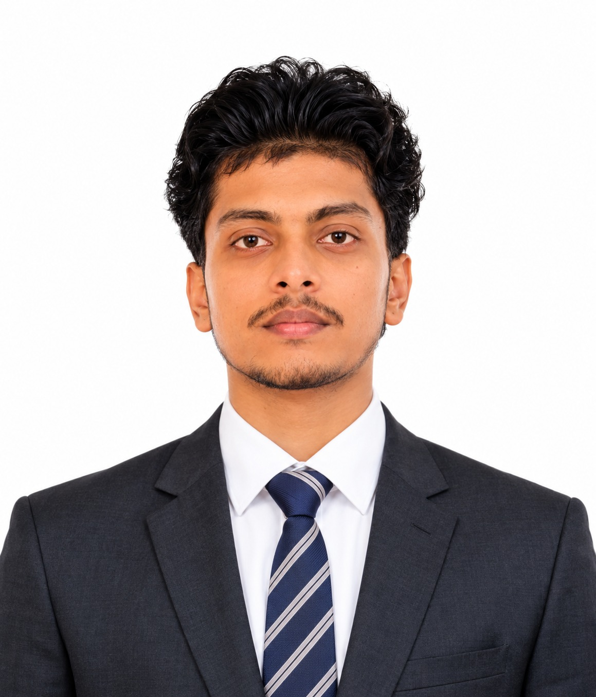
C3
Size Detection
PACKING AREA · BEST-FRAME SELECTION AND MARKER-FREE SIZE MEASUREMENT
Marker-free measurement at a fixed height, classified to a production size.
DATA FLOW
Calibrated camera
100 cm · px per cm
Detect garment
no reference card
Measure
width & length, cm
Best frame
3 frames agree
Size chart → order
SQLite, to target
SCALE AND BEST-FRAME SELECTION
Fixed height gives the scale; agreement gives the frame
Completes the packing record — which box, against which per-size target.
camera
frame 1
=
frame 2
=
frame 3
DEPENDENCIES
DESIGN CHOICES
100 cm
Camera fixed at the 100 cm installation height
calibration.json with a measured pixels-per-cm
Own checkpoint plus the size-chart rules
Best frame by agreement, not by sharpness
Measure first, classify second — rules can change
Order lives in SQLite; counted only after removal
width agrees ± 1.5 cm · length ± 2.0 cm
garment
size recorded, then counted after removal
TEST EVIDENCE
LIMITATIONS
57
3
± 1.5
Moving the camera invalidates every measurement until recalibration.
Measurement error in millimetres is not yet quantified.
platform tests passing
frames must agree
cm width tolerance
IT4010 Research Project · Final Presentation & Viva · R26-IT-054
IT22187796 · Jayarathna W.G.U.C.G.
6
Notes:
The research part is marker-free measurement at a calibrated height. Point at the 100 cm line - that is what converts pixels to centimetres, and it is why moving the camera breaks the measurement. Best frame is chosen by agreement between three frames, not by picking the sharpest one. Measure your error in millimetres before the viva.

Slide 7

C4
Rework Counter
QUALITY CHECKING · REAL-TIME GOOD AND REWORK COUNTING
Separates accepted garments from rework at the quality-checking workstation.
DATA FLOW
Camera / video
operator-selected
YOLO detector
garment detection
Classify
good or rework
SQLite
own record
Analysis view
counts & history
THE QUALITY SPLIT
Two series, never netted into one figure
Turns the output number into a quality number — how much was actually sellable.
GOOD
Inspected
garment
accepted, passes on
own
database
DEPENDENCIES
DESIGN CHOICES
Quality-station camera, or a video file for replay
Its own YOLO checkpoint
Consistent framing of the garment
Recorded video accepted, so an inspection can be audited
Good and rework kept as two separate series
Own database — quality records are isolated
REWORK
returns to the line
TEST EVIDENCE
LIMITATIONS
SHA-256
✓
2
Per-class detection accuracy is not yet measured — add it before the viva.
One inspection station per application instance.
model and seed DB match the source
health and import checks
series, never netted
IT4010 Research Project · Final Presentation & Viva · R26-IT-054
IT22627582 · Pathiraja H.P.M.H.D.S.
7
Notes:
This component has the least quantitative evidence. Before presenting, measure detection accuracy and the good-versus-rework confusion on your own test set. If the panel asks for a number you do not have, say it is being measured - do not improvise.

Slide 8
Results, acceptance and what comes next
Per-component limitations are on each component's own slide.
0.958
107/107
74
7
mAP, style model
style & colour tests
monitoring backend tests
artifacts SHA-256 pinned
USER ACCEPTANCE
SYSTEM LIMITATIONS
FUTURE IMPROVEMENTS
One camera-heavy feature at a time
Lighting, placement and hardware can only be proven by rehearsal
Field accuracy vs a manual count not yet measured
No code-signing credentials yet
Retrain on real captures — every capture stores its own crop
Add a background class
Configurable thresholds with guarded revalidation
Plant-level reporting across lines
Who tested it, and where
How many garments they ran
One quote you can attribute
The criteria they signed off
NEXT hardware rehearsal → F1 and field accuracy measured → signed installer → single-line pilot
IT4010 Research Project · Final Presentation & Viva · R26-IT-054
8
Notes:
Lead with 0.958 and say what it is measured on. State the limitations yourself - the honesty buys credibility for the numbers above them. Finish on the NEXT line and hand over to the demo. Fill the UAT box before presenting.

