Slide 1


Predicting Wine Quality through Data Mining of Physicochemical Properties

Slide 2
Objective The aim of the work is to model the wine quality based on the physicochemical test results.
Motivation Predictive models offer valuable insights and opportunities for improvement in winemaking, marketing, sustainability, and research within the wine industry. Also, a higher availability of past studies and literature on wine quality.
What is the dataset about?
The dataset contains eleven physicochemical test results along with its score of red wine quality. The physicochemical test results are related to Vinho Verde red wine samples.
The dataset contains a total number of 1,599 data points. All the physicochemical test results are continuous variables and the response variable as Quality is integer. Quality is given from 0 to 10.
The dataset contains Quality as the response variable and fixed acidity, volatile acidity, citric acid, residual sugar, chlorides, free sulfur dioxide, total sulfur dioxide, density, pH, sulphates and alcohol as predictor variables.

Slide 3


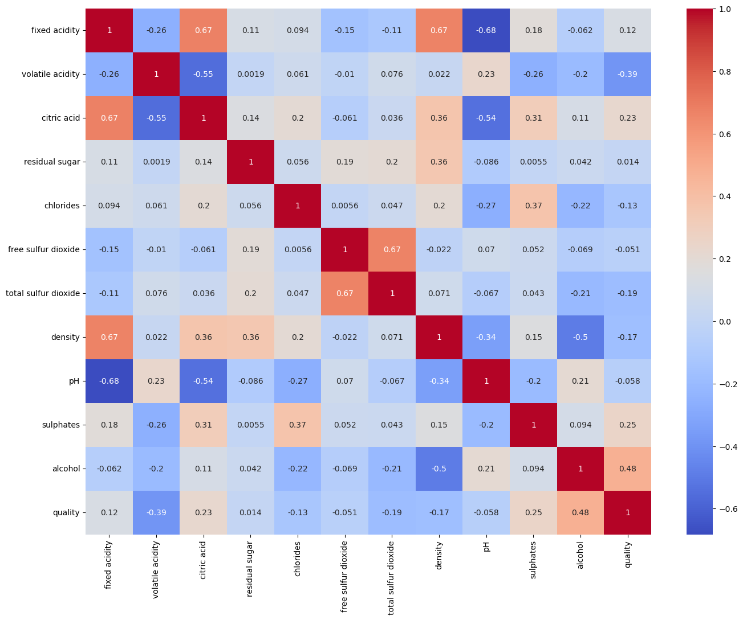
Correlation Analysis

Slide 4
What methods have been used in the study?
The linear regression model is used for understanding the relationships between features and wine quality as a numeric score while classification models (Logistic Regression and Random Forest) are employed to categorize wines into quality classes (High-quality wine, Medium Quality Wine and Low-Quality Wine) based on these features.
Why Regression and Classification?
Linear regression provides interpretability, allowing us to understand the direction and magnitude of feature effects on numeric quality scores. This can be valuable for uncovering relationships. On the other hand, classification models like logistic regression and random forest focus on optimizing predictive accuracy.
Linear regression helps understand how individual features relate to wine quality, whereas classification models help make predictions about wine quality classes.

Slide 5
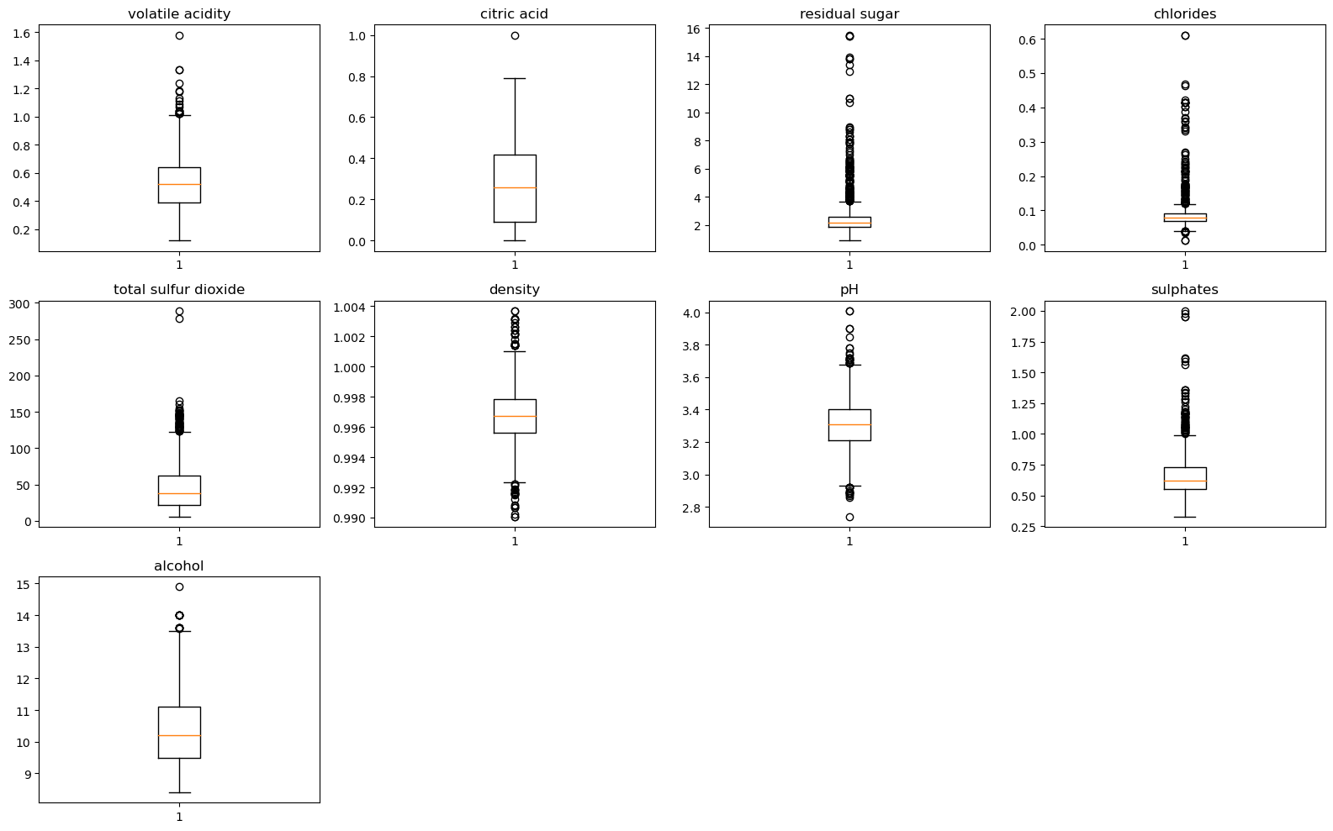
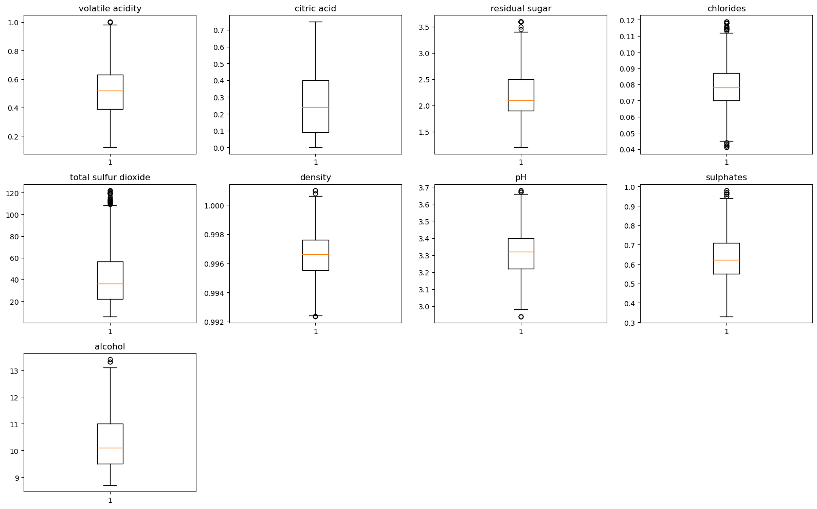
Pre-processing and feature engineering Showing the Boxplot diagram visualizing the dataset before and after removing the outliers.
Before removing outliers
After removing outliers

Slide 6
Result of the Linear Regression model
Results of the Logistic Regression and Random Forest Models
The below table shows the evaluation criteria along with the results of both models.
Evaluation of Linear Regression Model
Mean Squared Error | 0.351
Root Mean Squared Error | 0.593
Mean Absolute Error | 0.467
Residual Sum of Squares | 130.5
R-squared | 0.381
Evaluation type | Logistic Regression | Random Forest
Accuracy | 0.889 | 0.911
F1score | 0.879 | 0.696
Precision | 0.875 | 0.953
Recall | 0.889 | 0.641

Slide 7
Result of K-Fold cross Validation
The performance of both data mining models was assessed using the K-fold cross-validation approach. The dataset was first divided into K sizes (K=5). The remaining K-1 folds served as the training sample, and the procedure was iterated against each fold as the validation dataset. The accuracy results were then reflected by averaging the performance score aggregates.
The result of the K-Fold cross-validation depicts the Random Forest as the best-fit model for wine quality prediction with a mean accuracy of 87%.
Model | Mean Accuracy
Logistic Regression | 0.865
Random Forest | 0.875

Slide 8
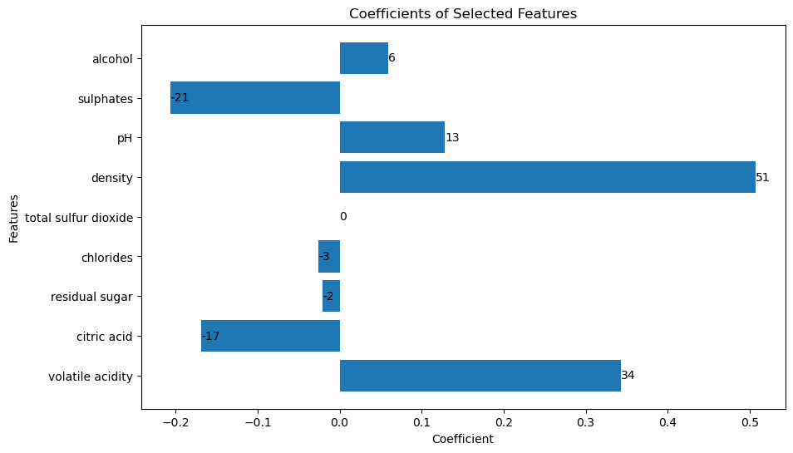
Feature Importance and Conclusion
Below is the feature importance analysis of Random Forest. The results show that density, volatile acidity and pH are the most influencing properties that affect the quality of the red wine. The assumption can be made that the above-mentioned properties are highly influencing the higher quality of the wine.
Feature | Feature Importance
density | 0.507
volatile acidity | 0.342
pH | 0.128
alcohol | 0.058
residual sugar | -0.020
chlorides | -0.025
citric acid | -0.168
sulphates | -0.206
total sulfur dioxide | 0.0

Slide 9
Feature Importance and Conclusion
Among the physicochemical test results the Random Forest model predicts higher influencing/ Important properties such as Density, Volatile Acidity, and pH. By evaluating the result, we can assume these characteristics have a higher influence on the quality of red wine.
With this important information, they are better prepared to make educated decisions during the wine-making process, which raises the taste, aroma, and general quality of the wine. Customer pleasure is another consideration. With the aid of this study, winemakers may create a variety of novel tastes, which will eventually increase client satisfaction with the products. Customers who are seeking a specific flavour profile or degree of quality may make choices based on data-driven predictions.
Recommendation
Predicting wine quality serves both practical and commercial purposes. It helps winemakers, consumers, and the wine industry as a whole make informed decisions, improve product quality, and enhance the overall wine experience. Moreover, it contributes to ongoing research and innovation in the field of winemaking.

Slide 10
Thank you…

