Slide 1
Restaurant Order and Kitchen Billing System
Team 5
Gangavarapu Yasaswi Ram 2620040139
Dondapati Nikhil Reddy 2620040119

Slide 2
Abstract
Problem Context: Restaurant bills written and totaled by hand during peak hours cause calculation mistakes, long customer queues, and unrecorded paper slips.
Upgraded Solution: A Java console application displays a 10-item menu across 4 categories, accepts item codes and quantities in a sentinel loop, and validates inputs using OOP encapsulation and exception handling.
Automated Billing & Promo: Computes running subtotals, applies the Enjoy100G6 coupon, adds 5% Service Tax and 18% GST, and awards a Rs 100 Group6 Theater movie voucher.
Project Outcome (CO1–CO5): Delivers instant, error-free digital billing and saves every formatted receipt to Final_Bill_Receipt.txt using Java File I/O.

Slide 3
Understanding Problem Statement
Handwritten Orders: Waitstaff write item names on paper pads, leading to illegible entries and missed dishes.
Manual Tax Math: Cashiers compute 5% Service Tax and 18% GST on pocket calculators during rush hours.
Zero Input Validation: No automatic check for invalid item codes, negative quantities, or duplicate coupon use.
No Digital Record: Paper bills are easily lost, with no saved file for auditing daily orders.
Market Gap: Commercial POS tools (Petpooja, Posist, Square, Toast) need subscriptions, internet and special hardware, so campus canteens and small eateries still bill on paper.
Our Solution: A fast, zero-cost, offline Java billing system built strictly with CO1–CO5 concepts.

Slide 4
Existing System
Manual Paper Billing: Waitstaff write orders on paper pads and cashiers total the bill by hand or on a pocket calculator.
Commercial POS Software: Petpooja, Posist, Square and Toast offer full billing, but need paid subscriptions, internet and special hardware.
Spreadsheet Billing: Some small eateries type totals into Excel sheets, which has no menu validation and no coupon rules.
Error-Prone Taxes: 5% Service Tax and 18% GST are added by hand, so rush-hour mistakes and wrong totals are common.
No Reliable Record: Paper slips get lost and there is no saved receipt file for auditing daily orders.

Slide 5
Proposed System
Automated Java Billing: A console app shows a 10-item menu in 4 categories and takes item codes and quantities until 0 is entered.
Zero-Cost and Offline: Runs on any computer with Java, with no subscription, internet or special hardware, ideal for campus canteens.
Input Validation: Invalid item codes, wrong categories, and zero or negative quantities are caught using exception handling.
Automatic Tax and Coupon: Adds 5% Service Tax and 18% GST, applies the Enjoy100G6 coupon, and awards a Rs 100 Group6 Theater voucher.
Saved Digital Receipt: Every itemized bill is saved to Final_Bill_Receipt.txt using Java File I/O for easy auditing.

Slide 6
Project Outcomes (CO1 to CO5)
CO1 (Basics): Algorithm, flowchart, IPO model, data types, operators, Scanner input and println output.
CO2 (Control Flow): switch-case, if-else, sentinel while loop and continue.
CO3 (Structure): Methods, method overloading, 1D parallel arrays, linear search and running total.
CO4 (OOP): Classes, constructors, encapsulation, inheritance, interface, static and exception handling.
CO5 (Libraries): String methods, StringBuilder, Arrays.sort, binarySearch and file I/O with java.nio.file.

Slide 7
CO 1 Topics
Computational Thinking: Designed a step-by-step algorithm, RAPTOR flowchart, and IPO model (Input: code/qty, Process: billing math, Output: receipt).
Primitive Data Types: Used int for codes/quantities, double for prices/taxes, and boolean for loop and search flags.
Operators & Expressions: Applied arithmetic (*, +, -), relational (==, >, <=), and logical (&&, !) operators.
Sequential Console I/O: Used Scanner (nextInt, nextLine) and System.out.println with string concatenation.

Slide 8
Co 2 TOPICS
Switch-Case Navigation: Used switch(type) with break and default in showMenu() to filter 4 food categories.
Conditional Branching: Applied if-else statements for item lookup verification, coupon discount rules, and empty-order checks.
Sentinel While Loop: Controlled continuous order entry using while(ordering) until sentinel value 0 is entered.
Loop Control: Used continue when 0 is entered to skip the quantity prompt and proceed directly to billing.

Slide 9
CO 3 Topics
Modular Decomposition: Divided logic into displayCategories(), showMenu(), addOrder(), and printFinalBill().
Method Overloading: Implemented overloaded addOrder(int code) and addOrder(int code, int qty) methods.
1D Parallel Arrays: Stored item_code[], item_name[], item_price[], and item_qty[] across 10 homogeneous elements.
Array Patterns: Used index traversal, linear search by item code, and running total summation.

Slide 10
CO 4
Classes, Objects & Constructors: Created MenuItem class with default and parameterized constructors using the this keyword.
Encapsulation & Data Hiding: Declared private fields (code, name, price, qty) accessed through public getter/setter methods.
Inheritance, Interfaces & Static: Extended BaseRestaurant (static final tax rates) and implemented BillOperations interface with @Override toString().
Robust Exception Handling: Used try-catch-finally for InputMismatchException and threw IllegalArgumentException for negative quantities.

Slide 11
CO 5
String Processing APIs: Applied trim(), toUpperCase(), length(), and equalsIgnoreCase() to validate customer names and coupon Enjoy100G6.
Mutable Text with StringBuilder: Constructed the multi-line itemized receipt efficiently using StringBuilder.append().
Standard Library Algorithms: Sorted item codes with Arrays.sort() and verified item existence using Arrays.binarySearch().
File Persistence (java.nio.file): Saved and verified Final_Bill_Receipt.txt using Path, Files, BufferedWriter, and BufferedReader with try-with-resources.

Slide 12
Program Flow and Topics Used
■ CO1 ■ CO2 ■ CO3
Show categories
Input type (1 to 4)
Type valid?
Yes
Show menu (switch)
Start
Not 1 to 4: prints Wrong Type Selected, carries on
Found?
Search code in array
Input quantity
No
Code = 0?
Input item code (0 = bill)
A
Yes
No
Yes
Update quantity and subtotal
Print Invalid Code
Total > 0?
Yes
Print bill: items, 5% service tax, 18% GST, coupon
No
A
A
Print: No items were ordered
End
CO1 | Basics
CO2 | Control flow
CO3 | Structure
Algorithm and flowchart first, IPO model (input: category, code, quantity; output: bill), int, double and boolean, arithmetic for price x quantity and the taxes, Scanner input and println output.
Switch-case with default and break for the menu, if-else for found or invalid and total > 0, while loops for the menu, the ordering loop that ends on 0 and the search, plus a boolean flag.
Four methods split the program into parts, four parallel 1D arrays hold the data, and we use traversal, linear search by item code and a running total.

Slide 13
Conclusion
Outcome: Built a Java console Restaurant Billing System using only CO1–CO5 concepts.
Impact: Replaces handwritten slips and manual tax math with automated menu ordering, input validation, 5% Service Tax, 18% GST, and the Enjoy100G6 coupon.
Sample Run: 2 x Chicken Biryani gives Subtotal Rs 440.0, Coupon -Rs 50.0, Service Tax Rs 19.5, GST Rs 70.2, Final Total Rs 479.7.
Persistence: Every receipt is saved to Final_Bill_Receipt.txt through File I/O, giving a digital record for auditing.
Gap Bridged: A fast, zero-cost, offline billing option for campus canteens and small eateries.

Slide 14
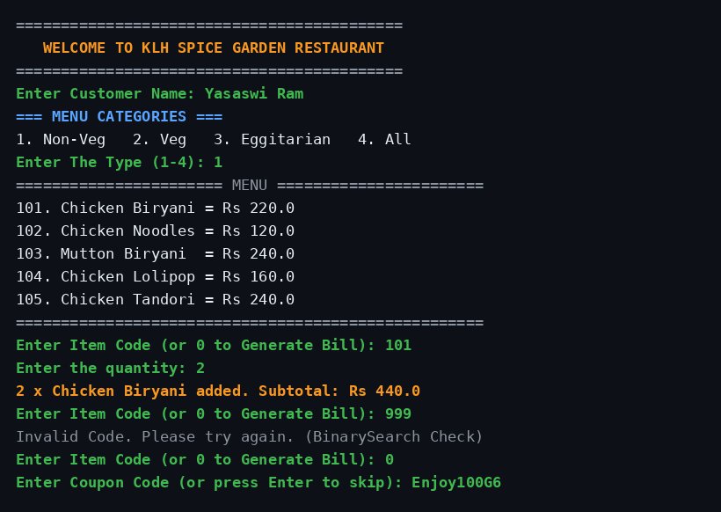
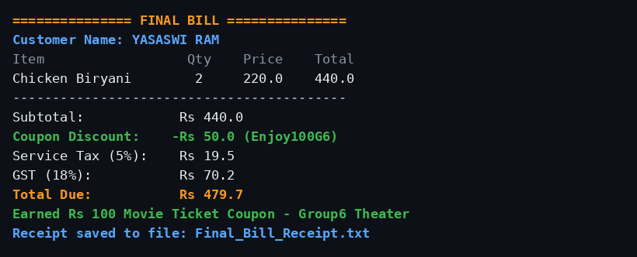
Screen Shots

Slide 15
Geo Tag Photo and git hub link

