Slide 1


public class ResumeAnalyzer { private AIService aIService; }
public AnalysisResult analyze (Resume resume) {
return aIService process( resume);
AI Smart
Resume Analyzer
Enterprise Java 21 LTS & Spring Boot 3.3.4
Team 17
CSE (AI & ML), Kalasalingam University

Slide 2





Problem Statement
Challenges in current resume screening and feedback systems
75%
Candidates face lack of feedback & expensive commercial tools
of resumes
rejected by ATS –
a black box problem
($30-$50/month)

Slide 3








Two-Stage NLP & Gemini GenAI Pipeline
From precise extraction to intelligent mentorship
STAGE 1
STAGE 2
Deterministic
NLP Extraction
Cognitive
Gemini GenAI
Mentorship
keyword parsing
entity recognition
contextual AI feedback and suggestions

Slide 4
















Enterprise 3-Tier System Architecture
Layered design for scalability, maintainability, and performance
PRESENTATION TIER
Responsive user interface and visualization
Thymeleaf
Bootstrap 5
Chart.js
APPLICATION TIER
Spring Boot
Business logic and
request handling
Controllers & Services
DATA / CLOUD TIER
Data persistence, pooling and AI integration
MySQL 8.4
HikariCP
Gemini API

Slide 5









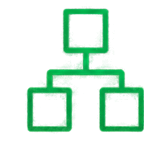
Application of OOPs Concepts
Evaluated through code quality, design clarity, and real-world relevance
Abstraction
Encapsulation
Interfaces
Entities & DTOs
Define contracts that
hide complexity
Bundle data and behavior, protect internal state
Polymorphism
Inheritance
Runtime parsing strategies
JPA repositories &
GoF design patterns
Use one interface,
many implementations
Leverage reuse through hierarchy and patterns

Slide 6












Java Data Structures & AI Integration
15 Marks Focus
LinkedHashMap
for O(1) skill lookups
Google Gemini
2.5 Flash
HashSet
for deduplication
async HTTP/2 calls
PriorityQueue
for job ranking

Slide 7
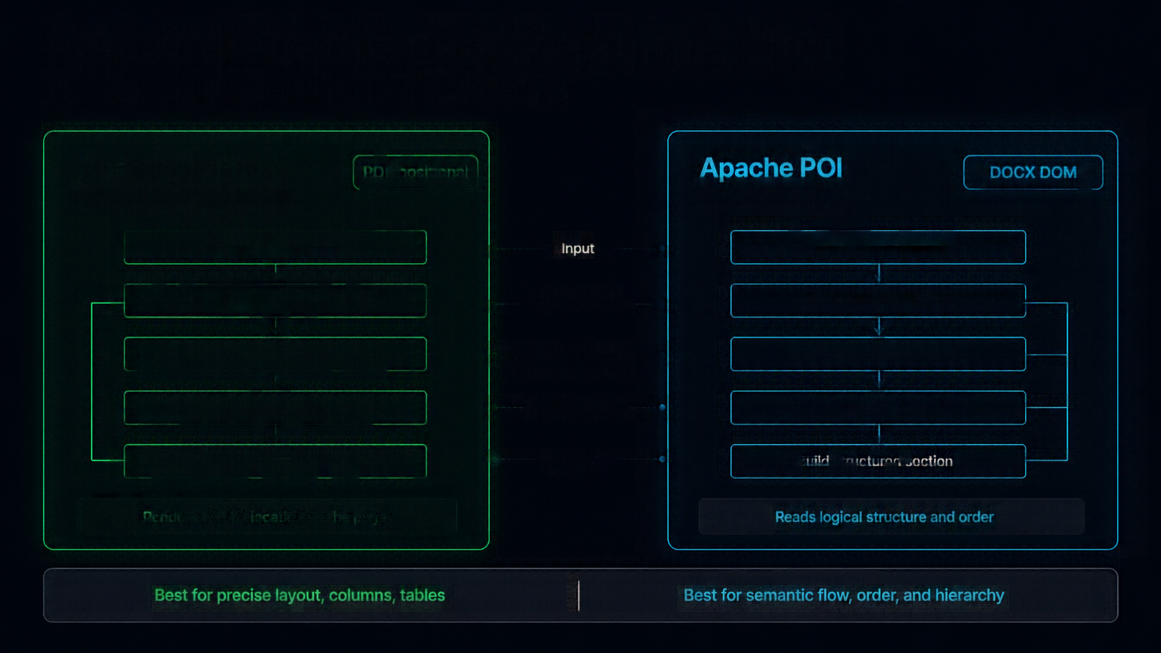
























Document Parsing Engine Comparison
Two parsing strategies. Same goal: structured resume data.
Apache PDFBox
PDF positional
Apache POI
DOCX DOM
positional stream extraction
docx dom traversal
Open PDF document
Input
Open DOCX package
Read page content stream
Access Method
Load document parts
Extract text with coordinates
Extraction Approach
Traverse DOM structure
Group by position & layout
Organization
Extract text by hierarchy
Build structured sections
Output
Build structured sections
Renders text by location on the page
Reads logical structure and order
Best for precise layout, columns, tables
Best for semantic flow, order, and hierarchy

Slide 8





ATS Scoring Metrics Overview
Comprehensive evaluation across key resume dimensions and skill strengths
Java Proficiency
35%
100
10%
Keywords
80
35%
25%
60
Experience
40
15%
OVERALL
ATS SCORE
AI Awareness
OOPs Concepts
15%
20
95%
Education
15%
15%
Structure
25%
10%
Format
System Design Basics
Data Structures & Algorithms

Slide 9






Closed-Loop Career Acceleration
Learn continuously. Discover opportunities. Grow faster.
CURATED YOUTUBE LEARNING ROADMAPS
7-PORTAL REAL-TIME
JOB DISCOVERY
Targets your missing skills
Step-by-step, topic-wise paths
Project-based learning
Track progress and mastery
LinkedIn, Indeed, Remotive API, etc.
Live jobs from multiple sources
Smart filters and relevance ranking
Save, track, and apply with ease

Slide 10









Team Roles & Live System Demo
Yasaswa Brahmam
Mokshith Krishna
Muni Charan
Ramteja
Backend Developer
AI & NLP Engineer
Frontend Developer
QA & DevOps Engineer
Built core Java APIs
Implemented resume parsing
Developed responsive UI
Tested system end-to-end
Integrated AI services
Built matching algorithms
Integrated backend APIs
Deployed and configured
Designed system flow
Optimized AI accuracy
Enhanced user experience
Ensured performance & security
Q&A Time
Ask your questions. We're here to help.

