Slide 1
EcoPlate
Eco-Friendly Recipe & Meal Planner
Flutter 3.41 · Riverpod 3.x · GoRouter · TheMealDB API
TAMK × THWS Collaboration
Yasas Wijethunga · Waruna Bandara Rathnamalala · Maha Maligaspe · Noah Frei
Mobile Applications · May 2026

Slide 2
About EcoPlate
What is EcoPlate?
Key Features
EcoPlate is a Flutter mobile app that helps users discover eco-friendly recipes, understand the environmental impact of their food choices, and plan sustainable weekly meals — all in one place.
🌿 Eco Score System — 1 to 5 leaf rating per food category
📋 Recipe Browsing — Categories with infinite scroll pagination
Why We Chose This Topic
🔍 Smart Search — Live search with input validation
• Food production causes 26% of global CO₂ emissions
• Plant-based diets reduce carbon footprint by up to 73%
• People want sustainable choices but lack easy tools
• Combines environmental awareness with practical daily use
• Technically challenging — covers all required Flutter features
📅 Weekly Meal Planner — Plan meals, saved to device storage
🌙 Dark / Light Mode — Toggle saved in SharedPreferences

Slide 3
Agenda
About EcoPlate
What it is & why we built it
State Management
Riverpod 3.x providers
01
07
App Architecture
Layered folder structure
Search & Validation
Input validator function
02
08
Data Models
Recipe, MealPlan classes
Meal Planner
Weekly planning & persistence
03
09
API Service
TheMealDB integration
Settings & Dark Mode
Theme with SharedPreferences
04
10
Browse & Pagination
Infinite scroll (+5 bonus)
Testing
36 unit & widget tests
05
11
Custom Widgets
RecipeCard, EcoBadge
Live Demo
App in action
06
12

Slide 4
Why EcoPlate?
26%
60×
73%
of global CO₂ emissions
come from food production
more emissions from beef
than plant-based foods
carbon footprint reduction
with plant-based diet
Our Solution
🌿
📅
🔍
Eco Score System
Weekly Meal Planner
Smart Recipe Search
Every recipe rated 1–5 based on environmental impact of its food category
Plan eco-friendly meals for the whole week. Saved locally — no account needed
Search thousands of recipes and filter by the most sustainable categories

Slide 5
How the App is Structured
UI Layer — screens/ · widgets/
// Folder structure
lib/
models/ ← data
services/ ← API
providers/ ← state
router/ ← nav
screens/ ← UI
widgets/ ← components
validators/ ← rules
test/ ← 36 tests
Logic Layer — providers/ (Riverpod)
Service Layer — services/ (API calls)
Data Layer — models/ (data structures)
Router — router/ (GoRouter navigation)

Slide 6
Data Models — Storing Recipe Data
// 3 model classes
// 1. RecipeSummary — for lists
// 2. Recipe — full detail
// 3. MealPlan — weekly plan
class RecipeSummary {
final String id, name, url;
factory fromJson(Map json) =>
RecipeSummary(id: json['idMeal']);
Map toJson() => {'idMeal': id};
}
RecipeSummary
id, name, thumbnailUrl. Used in lists and stored in MealPlan.
Recipe
Full detail: category, area, instructions, up to 20 ingredients, ecoScore.
MealPlan
Maps 7 weekdays → RecipeSummary. withRecipe() returns immutable copy.
✅ 7 unit tests — fromJson, toJson, round-trip

Slide 7
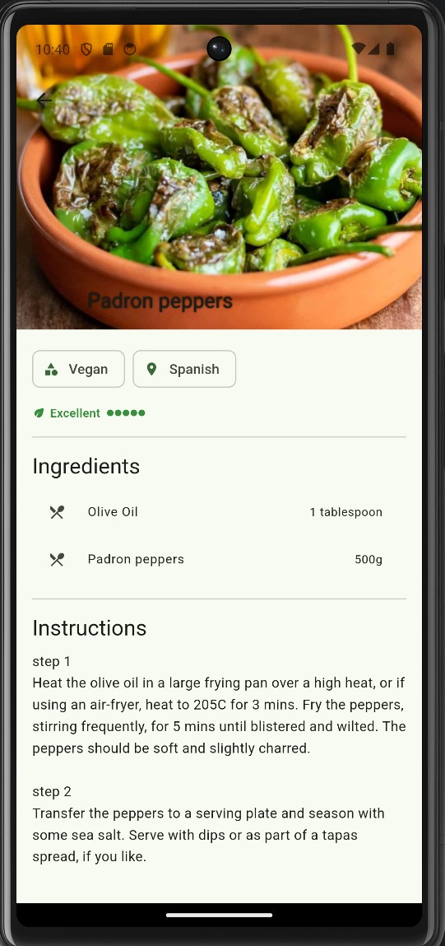
Service Layer — TheMealDB API
3 API Endpoints
// Eco scores by category
// Fetch and parse recipes
_scores = {
'Vegan':5, 'Vegetarian':4,
'Chicken':2, 'Beef':1,
};
Future<List> fetchByCategory(
String cat) async {
final res = await http.get(url);
return meals.map(fromJson)
.toList();
}
GET
/filter.php?c={cat}
Browse — recipes by category
GET
/lookup.php?i={id}
Detail — full recipe by ID
GET
/search.php?s={q}
Search — find by name
Eco Score
Category → score 1–5. Injected into Recipe.fromJson() automatically.

Slide 8
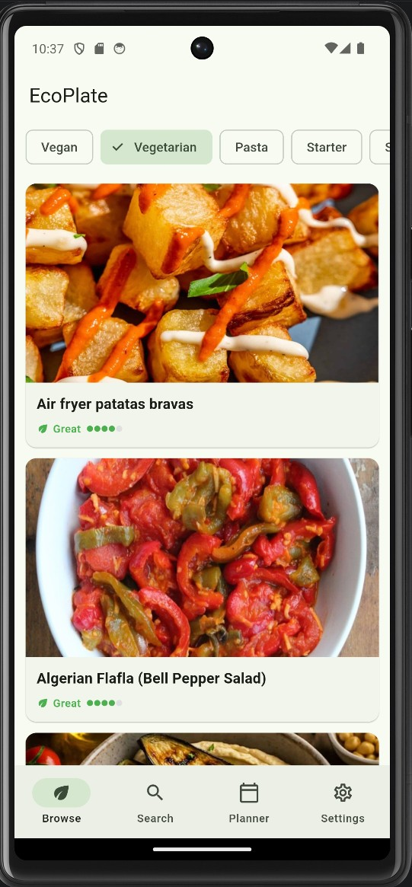
Browse Screen — Infinite Scroll Pagination
How Pagination Works
// Detect near-bottom scroll
void _onScroll() {
if (pixels >= maxExtent - 200)
notifier.loadMore();
}
// Slice next 10 from cached list
_displayed = _all
.take(shown + 10).toList();
state = AsyncData(_displayed);
1
Fetch ALL recipes from API once
2
Show first 10 on screen
3
Scroll near bottom → trigger
4
.take(n+10) slices next page
5
state = AsyncData → UI rebuilds

Slide 9
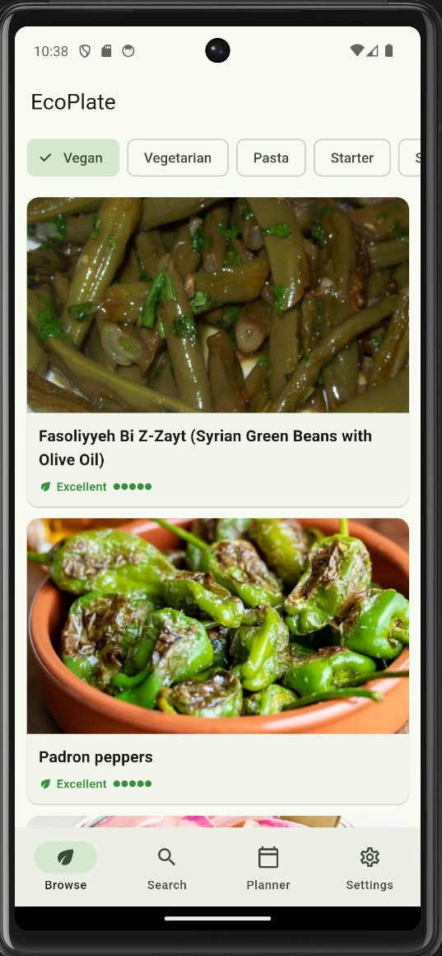
Custom Widgets — RecipeCard & EcoBadge
RecipeCard
Card
clip for rounded image corners
// Card with image + eco badge
Card(clipBehavior: Clip.antiAlias,
child: InkWell(onTap: onTap,
child: Column([
AspectRatio(16/9,
CachedNetworkImage(...)),
EcoBadge(score: ecoScore),
])))
AspectRatio 16:9
consistent card height
CachedNetworkImage
placeholder + error fallback
InkWell
EcoBadge
ripple tap effect
// score 1–5 → color + label + dots
Color get _color => score >= 5
? Colors.green.shade700
: score >= 2 ? Colors.orange
: Colors.red;
EcoBadge
reusable eco score widget
5● Excellent 4● Great 3● Good 2● Fair 1● Low

Slide 10
State Management — Riverpod 3.x
RecipeListNotifier
MealPlanNotifier
ThemeNotifier
AsyncNotifierProvider
NotifierProvider
NotifierProvider
// auto-rebuilds on change
ref.watch(selectedCategory)
→ AsyncData/Loading/Error
// saves to SharedPrefs
state = state.withRecipe()
→ UI updates instantly
// drives app theme
ref.watch(themeProvider)
→ ThemeMode.dark/.light
// ref.watch() → subscribes, widget rebuilds on state change
// ref.read() → one-shot access inside callbacks
recipesAsync.when(
data: (list) => RecipeList(...), // ✅ show data
loading: () => Spinner(), // ⏳ loading
error: (e, _) => RetryButton(), // ❌ show error
);

Slide 11
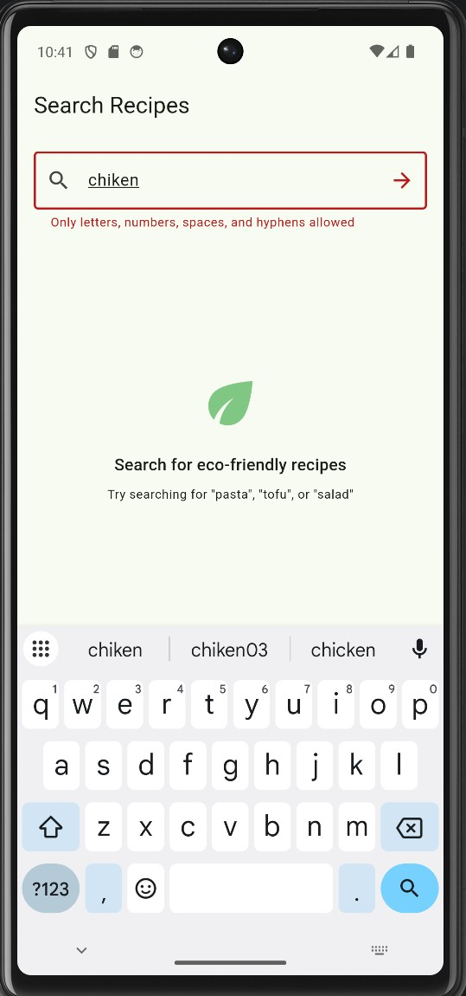
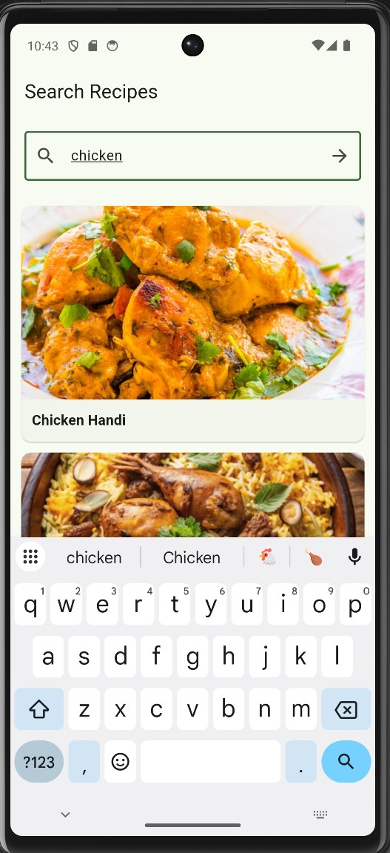
Search Screen — Input Validation
Why outside the widget?
// validators/search_validator.dart
// Pure function, NOT inside widget
String? validateSearch(String? v) {
if (v == null || v.isEmpty)
return 'Enter a search term';
if (v.length < 2)
return 'Min 2 characters';
if (v.length > 50)
return 'Max 50 characters';
return null; // ✅ valid
}
TextFormField(validator: validateSearch)
Pure Function
No BuildContext. Returns null=valid, String=error.
Unit Testable
12 tests: empty, short, long, special chars.
autoDispose.family
Disposes on leave. Each query = own provider.
12 tests — all passing ✅

Slide 12
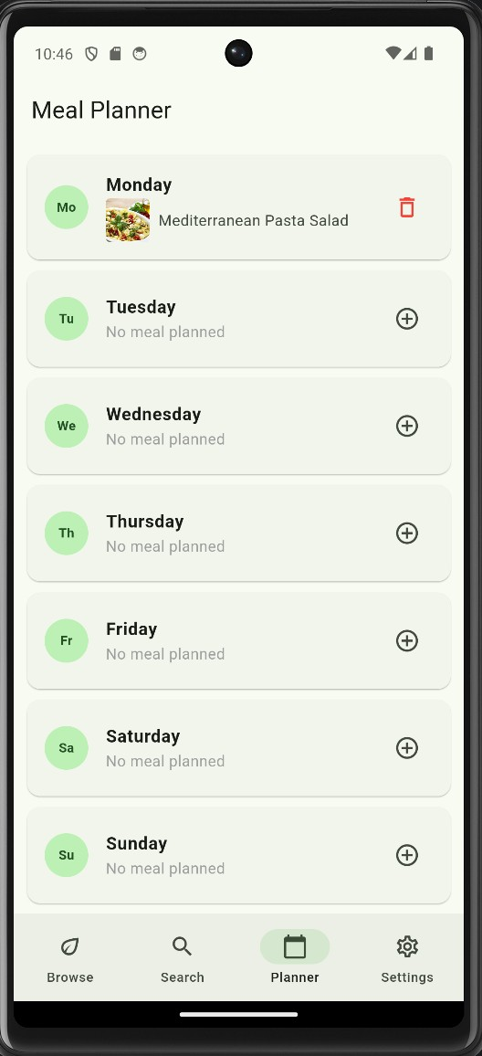
Meal Planner — State & Persistence
How It Works
// Set recipe for a day + save
Future<void> setRecipe(day, r) async {
state = state.withRecipe(day, r);
await _persist();
}
prefs.setString(key, jsonEncode(map));
1
Tap ➕ → bottom sheet opens
2
Search recipes by name
3
Tap → assigned to that day
// Bottom sheet recipe picker
showModalBottomSheet(
builder: (_) =>
DraggableScrollableSheet(
initialChildSize: 0.85,
builder: (ctx, scroll) =>
RecipePickerSheet(day: day)
),
);
4
State updates → UI rebuilds
5
Saved as JSON to device
💾 Persists Between Sessions
Loaded from SharedPreferences on startup.

Slide 13
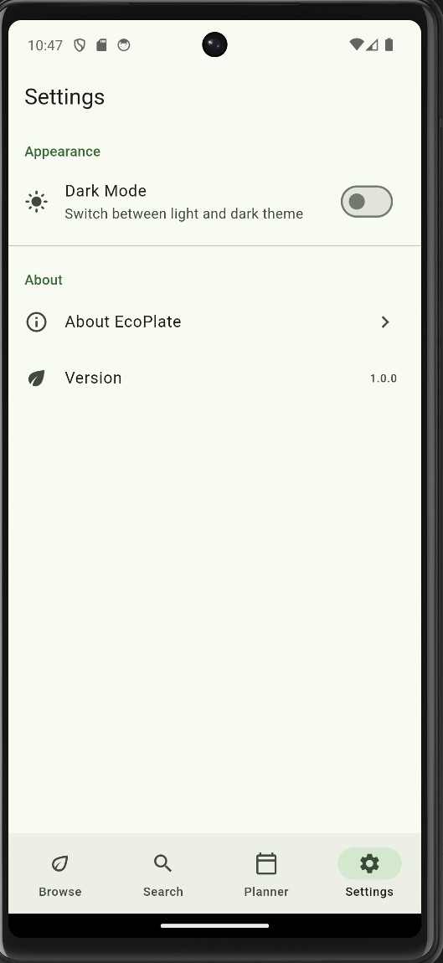
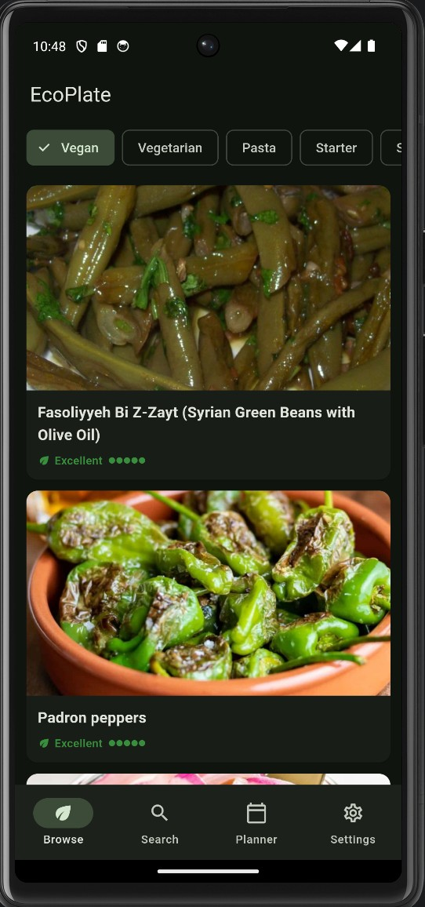
Settings — Theme & SharedPreferences
// Read theme on startup
ThemeMode build() =>
prefs.getBool('is_dark') == true
? ThemeMode.dark
: ThemeMode.light;
// Toggle and save
Future<void> toggle() async {
state = isDark ? light : dark;
prefs.setBool('is_dark', !isDark);
}
// MaterialApp reacts automatically
MaterialApp.router(
themeMode: ref.watch(themeProvider),
)
SharedPreferences initialized in main() before runApp — ThemeNotifier.build() reads it synchronously, no async needed.

Slide 14
Testing — 36 Tests, All Passing
36
tests passing
Unit: Models
Unit: Validators & Services
Widget Tests
test/models/recipe_test.dart
• fromJson parses all fields
• toJson → fromJson round-trip
• 20 ingredient slots parsed
• Empty slots filtered out
search_validator_test.dart
• null/empty/short → error ✅
• long/special chars → error ✅
• valid input → null ✅
recipe_service_test.dart
• Vegan=5, Beef=1 ✅
recipe_card_test.dart
• RecipeCard renders name ✅
• EcoBadge shown/hidden ✅
• onTap fires correctly ✅
• Score labels correct ✅
$ flutter test → ✅ All 36 tests passed.

Slide 15
Live Demo
See EcoPlate in action
1. Browse recipes by eco category
2. Check the Eco Score on recipe cards
3. Open a recipe for full details
4. Search for a specific recipe
5. Add a recipe to the Meal Planner
6. Toggle Dark Mode in Settings

Slide 16
Thank You!
Questions?
What We Built
Repository
✅ Layered Flutter architecture
✅ Riverpod 3.x (Notifier + AsyncNotifier)
✅ GoRouter named navigation
✅ TheMealDB REST API integration
✅ Infinite scroll pagination (+5 bonus)
✅ Input validation — pure function
✅ SharedPreferences persistence
✅ 36 unit & widget tests passing
github.com/yasaswijethunga/Meal-Planner-App
Team
Yasas Wijethunga — TAMK, Finland
Waruna Bandara Rathnamalala — TAMK
Maha Maligaspe — TAMK, Finland
Noah Frei — THWS, Germany

