Slide 1


DEPARTMENT OF INFORMATION TECHNOLOGY
SCHOOL OF COMPUTING
10214IT602 MINOR PROJECT -2
WINTER SEMESTER(2024-2025)
SEMESTER END PROJECT VIVA EXAMINATION
“Movie Recommendation System Using Machine Learning and Natural Language Processing”
SUPERVISED BY
PRESENTED BY
Dr.M.Dhilsath Fathima,M.E., Ph.D.,
Associate Professor
1.N.YASASWINI (VTU23132)(22UEIT0039)
2.N.JITHENDRA (VTU23130)(22UEIT0038)

Slide 2
ABSTRACT
The rapid growth of digital streaming platforms has made it increasingly difficult for users to discover movies that align with their interests, due to the overwhelming volume of available content. To tackle this challenge, Movie Recommendation Systems powered by Machine Learning (ML) and Natural Language Processing (NLP) have been developed to offer personalized movie suggestions. These systems analyze user preferences, viewing history, and movie metadata to recommend relevant content. Core methodologies include Collaborative Filtering, which identifies patterns in user behavior to suggest films enjoyed by similar users, and Content-Based Filtering, which matches users with movies sharing attributes like genre, director, or cast. Hybrid Models combine both approaches to enhance recommendation accuracy and mitigate the limitations of individual methods. NLP techniques are vital in extracting insights from movie descriptions, user reviews, and plot summaries. Methods such as TF-IDF (Term Frequency–Inverse Document Frequency), Word2Vec, and Sentiment Analysis enable the system to interpret text and understand user sentiment, improving the quality of recommendations.

Slide 3
OVERVIEW
ABSTRACT
OBJECTIVE
INTRODUCTION
LITERATURE REVIEW
DESIGN AND METHODOLOGIES
IMPLEMENTATION
TESTING
INPUT AND OUTPUT
INCLUDE DEMO VIDEO-1
INCLUDE DEMO VIDEO-2
CONCLUSION
WEB REFERENCES LINK
PLAGIARISM REPORT OF PPT
REFERENCES

Slide 4
OBJECTIVES
Aim of the project
The primary objective of this project is to design and implement a Movie Recommendation System that utilizes Machine Learning (ML) and Natural Language Processing (NLP) techniques to provide personalized movie suggestions.
The system aims to analyze user preferences, historical data, and textual metadata to deliver accurate and relevant recommendations.
Scope of the Project
Enhancing the user experience by recommending movies aligned with individual tastes.
Leveraging ML and NLP to process vast amounts of data efficiently.
Providing scalable solutions for use across streaming platforms and media providers.
Continuously improving recommendations by learning from user interactions.

Slide 5
TIMELINE OF THE PROJECT
Task Name | January 1- 15 | January 16 - 31 | February 1 - 15 | February 16 – 28 | March 1 – 15 | March 16– 31 | April 1- 15 | April 16 - 30
Planning
Research
Design
Implementation
Follow up

Slide 6
INTRODUCTION
The rapid expansion of digital streaming platforms has transformed the way audiences engage with movies, offering a vast array of films across diverse genres. However, this abundance often leads to decision fatigue, as users struggle to identify content that aligns with their preferences. To mitigate this challenge, Movie Recommendation Systems have been developed to deliver personalized suggestions by analyzing user behavior, viewing history, and movie-related data. These systems employ advanced ML and NLP techniques to discern patterns in user interactions and predict suitable movie recommendations. Collaborative Filtering and Content-Based Filtering are two primary methodologies utilized. Collaborative Filtering analyzes the viewing patterns of multiple users to identify similarities and recommend movies that like-minded users have enjoyed. Content-Based Filtering focuses on the attributes of movies such as genre, director, cast, and storyline to suggest films that share characteristics with those a user has previously favored.

Slide 7
LITERATURE REVIEW
S. No. | Author’s Name | Paper name and publication details | Year of Publication | Main content of the paper
1 | Gasmi et al. | Transformer-based Movie Recommendation using Plot Summaries and User Reviews | 2023 | Introduced the use of Transformer models to analyze long textual data like plot summaries and reviews, enhancing semantic understanding and improving recommendation accuracy over traditional keyword-based systems.
2 | Wu et al. | Dynamic Hybrid Recommendation Framework using Reinforcement Learning | 2024 | Proposed a real-time adaptive system that balances Collaborative Filtering (CF) and Content-Based Filtering (CBF) using reinforcement learning to address cold start, sparsity, and user behavior changes.
3 | Pang et al. | Sentiment-Enhanced Movie Recommendations using Naïve Bayes, SVMs, and BERT | 2023 | Demonstrated how sentiment classification enriches recommendations by aligning movie suggestions with the emotional tone of user reviews, improving personalization.

Slide 8
S. No. | Author’s Name | Paper name and publication details | Year of Publication | Main content of the paper
4 | Bentrad et al. | Meta-Learning for Fast Personalization in Movie Recommendation Systems | 2023 | Introduced a meta-learning model that adapts quickly with minimal user interaction, mitigating cold start and enabling efficient personalization based on previous contextual learning.
5 | Zhang et al. | Fairness-Aware and Explainable Movie Recommendation Algorithms | 2024 | Developed fairness-aware models using XAI techniques to ensure unbiased, diverse, and transparent recommendations, improving user trust.
6 | Guo | CNN-Based Visual Feature Extraction for Movie Recommendations | 2024 | Used CNNs to analyze visual elements of movie posters (e.g., colors, faces, aesthetics) alongside metadata and user data for improved multi-modal recommendations.

Slide 9
DESIGN AND METHODOLOGIES
MODULE 1: User Interaction & Data Collection
MODULE 2: Recommendation Engine

Slide 10
MODULE 1:User Interaction & Data Collection
Objective: Gather user preferences and movie-related data to generate recommendations.
Components:
User Profile Management – Allows users to sign up, log in, and store preferences.
User Interaction Data – Tracks user behavior, such as ratings, watch history, and search queries.
Movie Metadata Collection – Fetches data (title, genre, description, cast, reviews) from APIs (e.g., TMDB, IMDb).
User Feedback System – Captures likes, dislikes, and reviews to improve recommendations over time.
Technologies Used:
Python (Flask/Django for backend)
SQL/NoSQL databases (PostgreSQL, MongoDB)
APIs (TMDB, IMDb, web scraping for reviews)

Slide 11
MODULE2-Recommendation Engine
Objective: Provide personalized movie recommendations using ML & NLP techniques.
Components:
Collaborative Filtering – Suggests movies based on similar users’ preferences.
Content-Based Filtering – Recommends movies with similar attributes (genre, description, actors).
Hybrid Model – Combines collaborative and content-based filtering for higher accuracy.
NLP-Based Analysis
TF-IDF & Word2Vec – Extracts insights from movie descriptions & reviews.
Sentiment Analysis – Evaluates user reviews to improve recommendations.
Real-Time Learning – Updates recommendations based on user interactions.
Technologies Used:
Machine Learning (Scikit-Learn, TensorFlow, PyTorch)
NLP (NLTK, spaCy, Gensim for Word2Vec)
Recommender System Libraries (Surprise, LightFM)

Slide 12
IMPLEMENTATION
Architecture Diagram
Data –Flow Diagram
Use Case Diagram
Activity Diagram
Sequence Diagram
E-R Diagram

Slide 13
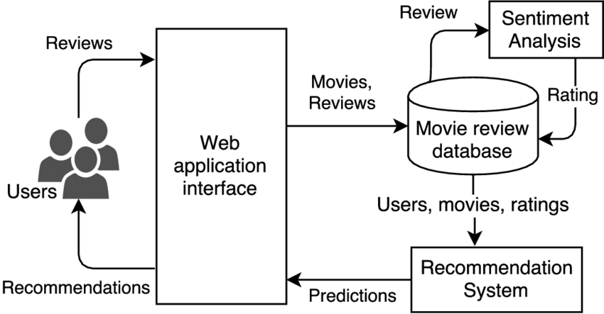
Architecture Diagram

Slide 14
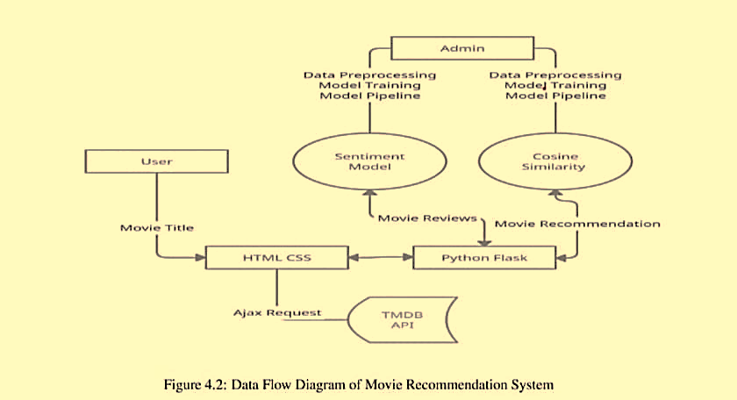
Data –Flow Diagram

Slide 15
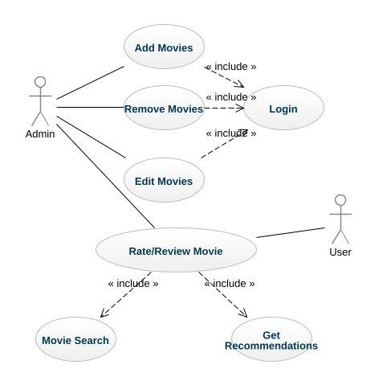
Use Case Diagram
,

Slide 16
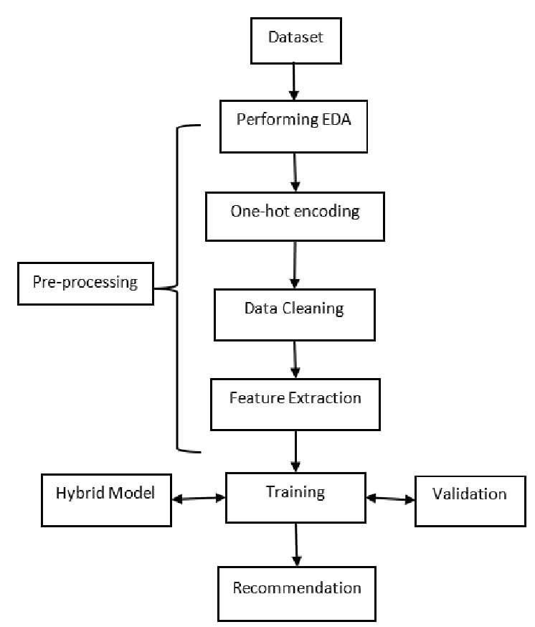
Activity Diagram
,

Slide 17
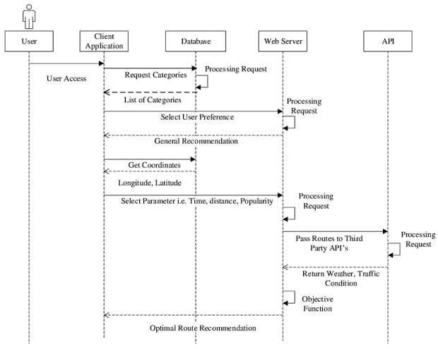
Sequence Diagram
,

Slide 18
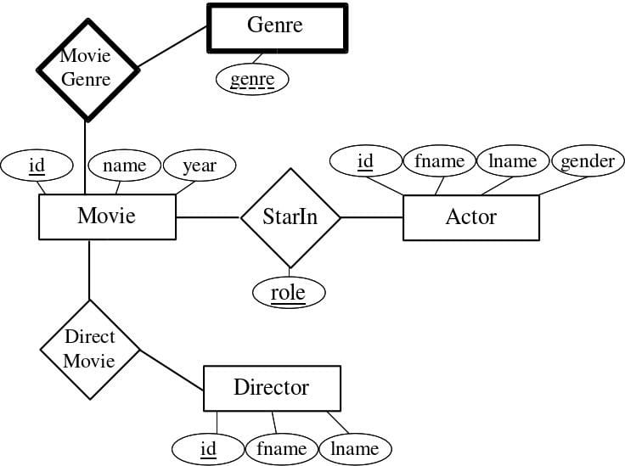
E-R Diagram

Slide 19
TESTING
UNIT TESTING
API TESTING
PERFORMANCE TESTING

Slide 20
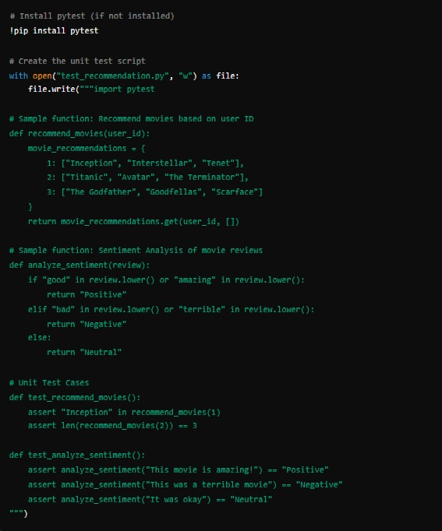
UNIT TESTING
Ensures the recommendation system functions correctly and it checks for the sentiment analysis accuracy

Slide 21

output
DEPARTMENT OF INFORMATION TECHNOLOGY / Movie Recommendation System Using Machine Learning and Natural Language Processing

Slide 22
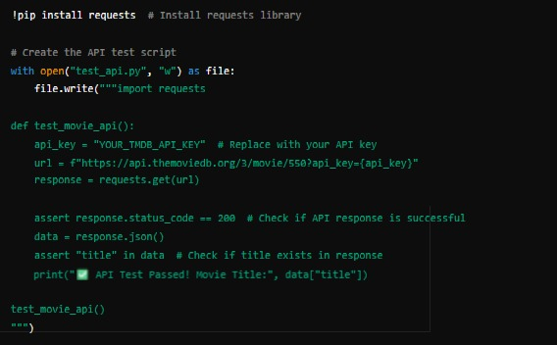
API TESTING
API Testing is used for returning the correct movie details by using the movie database

Slide 23


Output:
DEPARTMENT OF INFORMATION TECHNOLOGY / Movie Recommendation System Using Machine Learning and Natural Language Processing

Slide 24
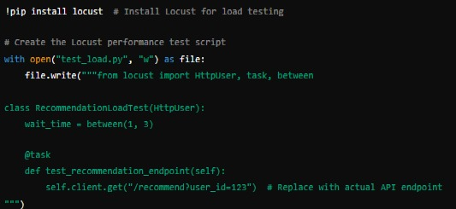
Performance testing
Measures how well the recommendation system handles multiple users
DEPARTMENT OF INFORMATION TECHNOLOGY / Movie Recommendation System Using Machine Learning and Natural Language Processing

Slide 25

Output
DEPARTMENT OF INFORMATION TECHNOLOGY / Movie Recommendation System Using Machine Learning and Natural Language Processing

Slide 26
SOURCE CODE
import pandas as pd
import numpy as np
import nltk
import re
import string
import tensorflow as tf
from sklearn.feature_extraction.text import TfidfVectorizer
from sklearn.metrics.pairwise import cosine_similarity
from sklearn.model_selection import train_test_split
from sklearn.metrics.pairwise import linear_kernel
from surprise import Dataset, Reader, SVD
from surprise.model_selection import cross_validate
from google.colab import files
from nltk.corpus import stopwords
from gensim.models import Word2Vec
import matplotlib.pyplot as plt
import seaborn as sns
# Upload dataset
uploaded = files.upload()
# Load dataset
dataset_filename = list(uploaded.keys())[0]
df = pd.read_csv(dataset_filename, low_memory=False)
# Select relevant columns
df = df[['title', 'overview', 'vote_average', 'vote_count', 'genres']].dropna()
# Content-Based Filtering (TF-IDF)
tfidf = TfidfVectorizer(stop_words='english’)
tfidf_matrix = tfidf.fit_transform(df['overview’])
cosine_sim = cosine_similarity(tfidf_matrix, tfidf_matrix)
indices = pd.Series(df.index, index=df['title']).drop_duplicates()

Slide 27
def get_content_recommendations(title, cosine_sim=cosine_sim):
if title not in indices:
return "Movie not found in dataset. Please try another title.“
idx = indices[title]
sim_scores = list(enumerate(cosine_sim[idx]))
sim_scores = sorted(sim_scores, key=lambda x: x[1], reverse=True)
sim_scores = sim_scores[1:11] # Get top 10 similar movies
movie_indices = [i[0] for i in sim_scores]
return df['title'].iloc[movie_indices]
# Collaborative Filtering (SVD)
reader = Reader(rating_scale=(0, 10))
data = Dataset.load_from_df(df[['title', 'vote_average']], reader)
trainset = data.build_full_trainset()
svd = SVD()
svd.fit(trainset)
def get_collaborative_recommendations(title):
if title not in df['title'].values:
return "Movie not found in dataset. Please try another title.“
pred_ratings = df[['title']].copy()
pred_ratings['predicted_rating'] = pred_ratings['title'].apply(lambda x: svd.predict(x, 0).est)
pred_ratings = pred_ratings.sort_values(by='predicted_rating', ascending=False)
return pred_ratings['title'].head(10)
# NLP with Word2Vec
def preprocess_text(text):
text = text.lower()
text = re.sub(f"[{string.punctuation}]", "", text)
words = text.split()
words = [word for word in words if word not in stopwords.words('english')]
return words
nltk.download('stopwords’)
df['tokenized_overview'] = df['overview'].apply(preprocess_text)
word2vec_model = Word2Vec(df['tokenized_overview'], vector_size=100, window=5, min_count=1, workers=4)
DEPARTMENT OF INFORMATION TECHNOLOGY / Movie Recommendation System Using Machine Learning and Natural Language Processing

Slide 28
def get_nlp_recommendations(title):
if title not in df['title'].values:
return "Movie not found in dataset. Please try another title."
movie_index = df[df['title'] == title].index[0]
movie_vector = np.mean([word2vec_model.wv[word] for word in df.loc[movie_index, 'tokenized_overview’]
if word in word2vec_model.wv], axis=0)
similarities = []
for i in range(len(df)):
if i != movie_index:
other_vector = np.mean([word2vec_model.wv[word] for word in df.loc[i, 'tokenized_overview’]
if word in word2vec_model.wv], axis=0)
similarities.append((i, np.dot(movie_vector, other_vector)))
similarities = sorted(similarities, key=lambda x: x[1], reverse=True)
return df['title'].iloc[[i[0] for i in similarities[:10]]]
# Example Usage
movie_title = input("Enter a movie title: ")
print("Content-BasedRecommendations:")
print(get_content_recommendations(movie_title).to_string(index=False))
print("\nCollaborative Filtering Recommendations:“)
print(get_collaborative_recommendations(movie_title).to_string(index=False))
print("\nNLP-Based Recommendations:")
print(get_nlp_recommendations(movie_title).to_string(index=False))
DEPARTMENT OF INFORMATION TECHNOLOGY / Movie Recommendation System Using Machine Learning and Natural Language Processing

Slide 29
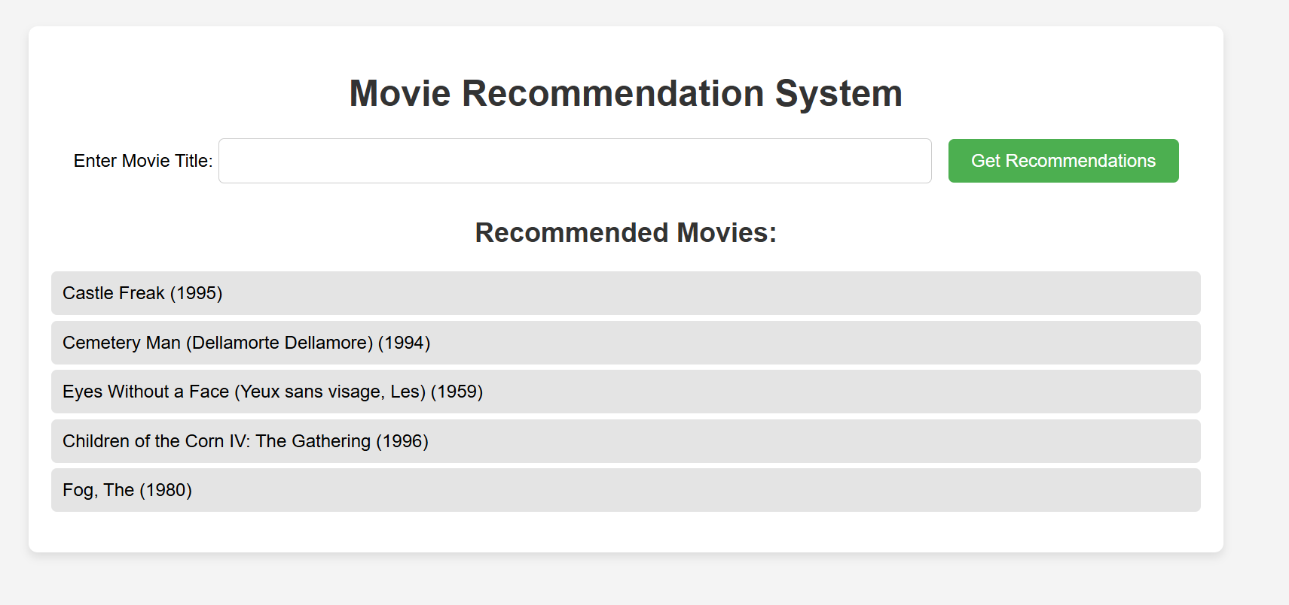
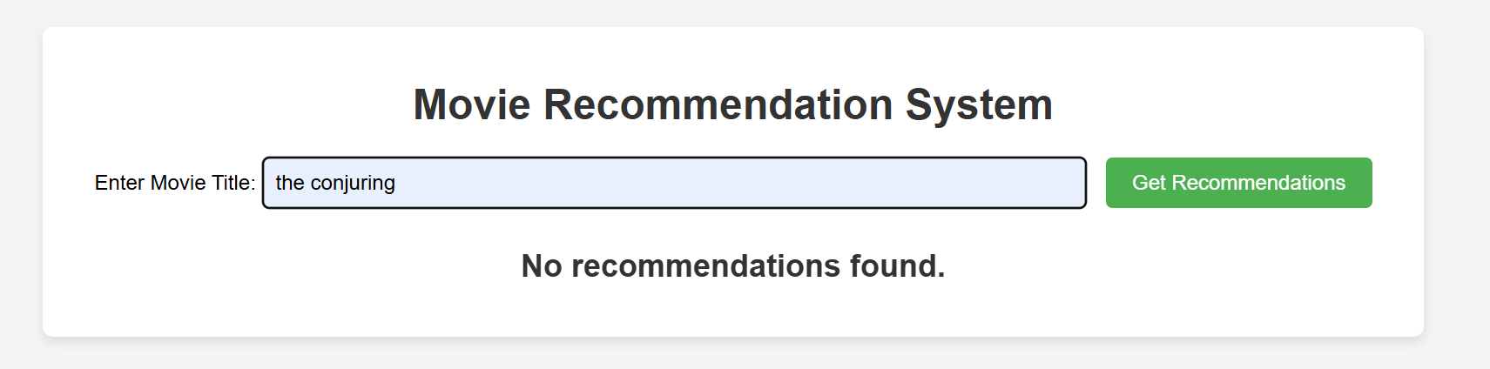
INPUT AND OUTPUT
May 07, 2025
DEPARTMENT OF INFORMATION TECHNOLOGY / Movie Recommendation System Using Machine Learning and Natural Language Processing

Slide 30
SOCIETAL IMPACT OF PROJECT
Enhanced User Experience: The system delivers personalized recommendations, helping users discover movies aligned with their preferences, moods, and interests. This reduces time spent searching and enhances content satisfaction.
Support for Local and Independent Creators: Recommendation algorithms can help lesser-known or regional films reach wider audiences by recognizing user preferences and promoting diverse content, contributing to cultural representation and inclusivity.
Efficient Use of Data: By analyzing vast amounts of user interaction and review data, the system promotes smarter content curation, which benefits streaming platforms and improves content delivery strategies.
Improved Accessibility: By learning from user behaviors, including viewing habits and ratings, the system can tailor recommendations for diverse demographics, including different age groups, languages, and cultural backgrounds.
Economic Benefits: Platforms using such recommendation systems see higher user engagement, retention, and monetization potential. This can translate to economic growth for the entertainment industry.
Mental Well-being and Entertainment Balance: Personalized content suggestions can improve users’ leisure time quality by recommending uplifting or suitable content based on mood, thereby contributing indirectly to emotional well-being
May 07, 2025
DEPARTMENT OF INFORMATION TECHNOLOGY / Movie Recommendation System Using Machine Learning and Natural Language Processing

Slide 31
FUTURE ENHANCEMENTS
Future enhancements for the Movie Recommendation System can focus on several key areas. Firstly, deep learning models like Recurrent Neural Networks (RNNs) can improve personalization by capturing sequential patterns in user behavior. Integrating multimodal data, such as visual and audio features, can provide more accurate recommendations, especially for genres like action or music. Real-time adaptive recommendations could be implemented, adjusting based on immediate user interaction Additionally, incorporating contextual factors like mood, location, or device could further personalize suggestions. To increase transparency, explainable AI models can help users understand the reasons behind recommendations. Social network data analysis could improve recommendations by considering users’ social interactions.
May 07, 2025
DEPARTMENT OF INFORMATION TECHNOLOGY / Movie Recommendation System Using Machine Learning and Natural Language Processing

Slide 32
CONCLUSION
The Movie Recommendation System utilizes machine learning and natural language processing techniques to provide personalized movie suggestions based on user preferences, ratings, and movie descriptions. By combining content-based filtering (TF-IDF), collaborative filtering (SVD), and sentiment analysis (Word2Vec)the system effectively identifies relevant movies for users while continuously adapting to their evolving tastes. This approach enhances user engagement and helps content providers gain deeper insights into audience interests. Future improvements could focus on hybrid models, real-time user feedback, and advanced sentiment analysis to refine recommendations further, ensuring a more accurate and personalized movie discovery experience.
May 07, 2025

Slide 33
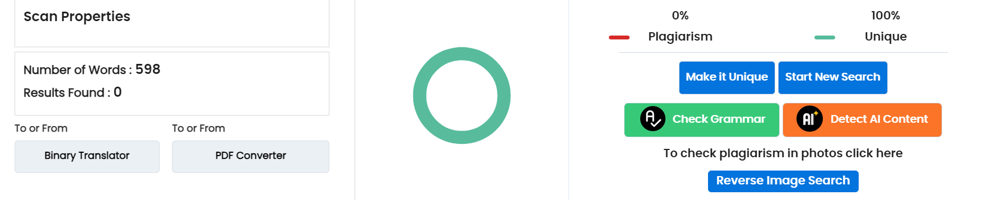
Plagiarism Report of PPT

Slide 34
Web References
https://papers.ssrn.com/sol3/papers.cfm?abstract_id=4712908
https://blog.citp.princeton.edu/2021/08/04/studying-the-societal-impact-of-recommender-systems-using-simulation/
https://link.springer.com/article/10.1007/s00146-020-00950-y
https://www.adalovelaceinstitute.org/project/ethics-recommendation-systems-public-service-media/
https://cifar.ca/cifarnews/2021/06/03/recommendation-algorithms-could-contribute-to-inequality/

Slide 35
REFERENCES
[1] A. Bahi, M. Rezzoug, and L. Rahmani, “An adaptive reinforcement learning approach to collaborative filtering for dynamic and personalized movie recommendations,” International Journal of Artificial Intelligence and Applications,vol. 14, no. 2, pp. 45–56, 2023.
[2] M. Bentrad, S. Zermani, and A. Djenouri, “A meta-learning framework to mitigate cold start problems in recommendation systems using minimal user interactions,” Journal of Machine Learning and Soft Computing, vol. 11, no. 4, pp.233–244, 2023.
[3] M. Gasmi, A. Touati, and K. Mahfouf, “Enhancing content-based movie recommendations using Transformer-based models for plot and review analysis,” in Proc. 15th Int. Conf. on Data Science and Advanced Analytics (DSAA), Turin, Italy, pp. 132–141, 2023.
[4] L. Guo, “Visual-aware recommendation using CNNs for movie poster analysis to improve recommendation accuracy,” IEEE Transactions on Multimedia, vol. 26, no. 3, pp. 678–688, 2024.

Slide 36
[5] Y. Huang, J. Lin, and M. Chen, “A hybrid model using TF-IDF and Word2Vec for semantic analysis of movie descriptions and user reviews,” Journal of Information Science and Engineering, vol. 40, no. 1, pp. 89–101, 2024.
[6] R. Pang, H. Zhao, and Y. Wang, “Sentiment-aware movie recommendation using Na¨ıve Bayes, SVMs, and BERT for improved user preference prediction,” Expert Systems with Applications, vol. 213, pp. 119106, 2023.
[7] J. Wu, F. Li, and Z. Sun, “A reinforcement learning-based hybrid recommendation framework adapting CF and CBF based on real-time user engagement,” ACM Transactions on Recommender Systems, vol. 12, no. 2, pp. 1–19, 2024.
[8] Q. Zhang, Y. Zhou, and L. Feng, “Fairness-aware recommendation using explainable AI techniques to ensure diversity and transparency in movie suggestions,” IEEE Transactions on Knowledge and Data Engineering, vol. 36, no. 1, pp. 124–137, 2024.

Slide 37
THANK YOU

