Slide 1
Customer Churn Analysis
Understanding why customers leave and how to improve retention

Slide 2
Problem Statement
Identify churn patterns, retention drivers, and suggest improvements

Slide 3
Dataset Overview
Customer data including tenure, charges, contract, payment method, churn status

Slide 4
Key Metrics
Churn Rate : 100
Retention Rate : 26
Average Tenure : 26%
Total Customers : 74%

Slide 5
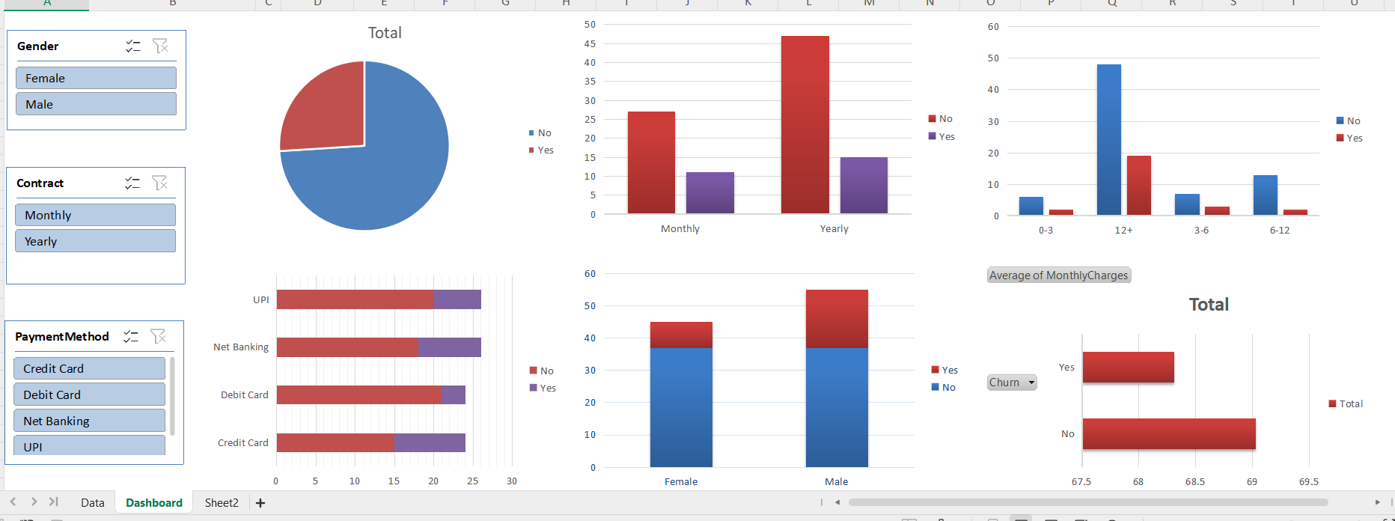
Dash board overview

Slide 6
Insights
Monthly contracts have higher churn
New customers churn more
Long-term users stay longer

Slide 7
Insights
CUSTOMER CHURN ANALYSIS – RECOMMENDATIONS
1. Improve Customer Onboarding Experience
Enhance the first 3–6 months user journey with guided tutorials, walkthroughs, and support. This will help reduce early-stage churn and improve user engagement.
2. Promote Long-Term Subscription Plans
Encourage customers to switch from monthly to yearly plans by offering discounts or benefits. Long-term plans increase commitment and reduce churn.
3. Implement Targeted Retention Campaigns
Identify high-risk customers (low tenure, monthly users) and offer:
Personalized discounts
Special offers
Reminder notifications This helps retain customers before they churn.

Slide 8
4. Enhance Customer Engagement Strategies
Increase engagement through:
Regular updates
Notifications
Loyalty programs Engaged users are less likely to leave.
5. Improve Payment Experience
Optimize payment methods by:
Ensuring smooth transactions
Offering multiple convenient payment options A better payment experience reduces friction and churn.
6. Focus on Value Delivery, Not Just Pricing
Instead of only adjusting pricing, improve:
Service quality
Features
Customer support Customers stay when they perceive real value.

Slide 9
7. Introduce Loyalty & Reward Programs
Reward long-term customers with:
Discounts
Exclusive features
Priority support This strengthens customer relationships and retention.
8. Monitor Churn Regularly
Track churn trends continuously using dashboards and analytics. This allows early detection of issues and faster decision-making.
FINAL RECOMMENDATION
“Businesses should focus on improving early customer experience, encouraging long-term subscriptions, and proactively engaging high-risk users to significantly reduce churn and improve retention.”

Slide 10
Recommendations
Promote yearly plans
Improve onboarding
Offer loyalty rewards

Slide 11
Conclusion
Reducing churn improves revenue and customer lifetime value

