Slide 1
Softare Presentation: Jenkins
Presented by Yaseen Ghani

Slide 2
What is Jenkins?
Open-source automation server.
Helps automate building, testing, and deploying code.
Supports continuous integration (CI) and continuous delivery (CD) processes.
Works with many programming languages, including Python.
Helps detect issues early and speeds up development cycles.

Slide 3
What is CICD?
Stands for Continuous Integration and Continuous Deployement
Continuous Integration (CI): Automatically tests and integrates new code changes into a shared repository.
Continuous Deployment (CD): Automatically deploys code to production without manual steps as well as passing test cases.
Improves code quality, reduces bugs, and speeds up release cycles.
Essential for modern DevOps and agile development practices.

Slide 4
Prerequsites
Docker
Linux commands
Python
Json/Yaml
Shell/Bash commands

Slide 5


Jenkins Architecture
Jenkins

Slide 6
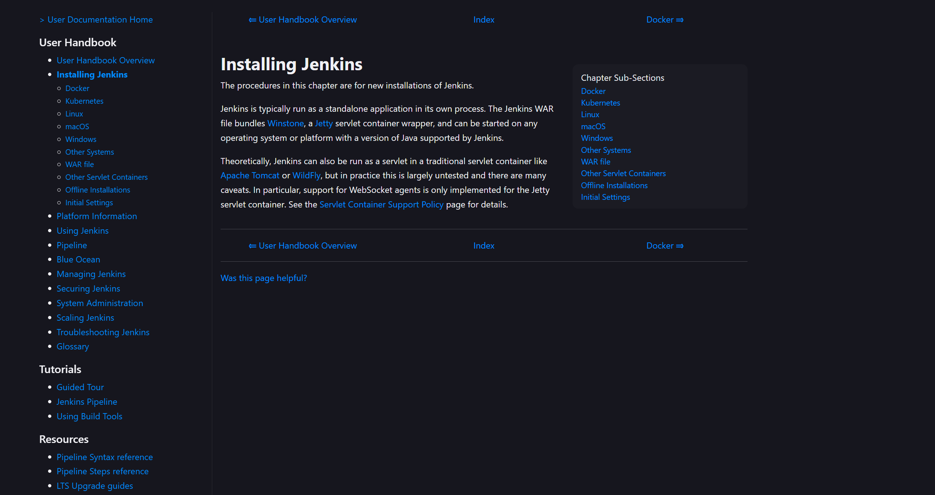
https://www.jenkins.io/doc/book/installing/
Jenkins Installation

Slide 7
Build the Jenkins Image via Docker
Git clone https://github.com/yaseen-ghani/DSC_672_jenkins_demo
docker build -t myjenkins-blueocean:2.492.3-1 .
docker network create Jenkins
docker run --name jenkins-blueocean --restart=on-failure --detach `
--network Jenkins --env DOCKER_HOST=tcp://docker:2376 `
--env DOCKER_CERT_PATH=/certs/client --env DOCKER_TLS_VERIFY=1 `
--volume jenkins-data:/var/jenkins_home `
--volume jenkins-docker-certs:/certs/client:ro `
--publish 8080:8080 --publish 50000:50000 myjenkins-blueocean:2.492.3-1
docker exec jenkins-blueocean cat /var/jenkins_home/secrets/initialAdminPassword
Jenkins url: https://localhost:8080/
jenkins-blueocean

Slide 8
Docker Node Creation
docker run -d --restart=always --network Jenkins -p 2375:2375 -v /var/run/docker.sock:/var/run/docker.sock alpine/socat tcp-listen:2375,fork,reuseaddr unix-connect:/var/run/docker.sock
docker ps
docker inspect <container_id>
jenkins/agent:alpine-jdk21

Slide 9
Jenkins Pipeline
pipeline {
agent {
node {
label 'docker-alpine'
}
}
triggers {
pollSCM '* * * * *'
}
stages {
stage('Build') {
steps {
echo "Building.."
sh '''
echo "doing building stuff.."
'''
}
}
stage('Test') {
steps {
echo "Testing.."
sh '''
echo "doing testing stuff.."
'''
}
}
stage('Deliver') {
steps {
echo 'Deliver....'
sh '''
echo "doing delivery stuff.."
'''
}
}
}
}

