Slide 1
GeneRegulate Tool
By
Yaseen Arab,
DR. Mary Lauren Benton

Slide 2
What is a gene regulatory element?
A Gene regulatory element is a region of non-coding DNA that regulates the transcription of neighboring genes.
They act as molecular switches, turning genes on or off based on external signals or internal cues.
They control when and where a gene is expressed, as well as the level of expression.
Notes:
Add a switch photo for the second one

Slide 3
Why are gene regulatory elements important?
Controlling Gene Expression Levels
Tissue-Specific Processes
Personalized Medicine and Cancer Treatments
Notes:
Their ability to control gene activity makes them critical for proper cell development and differentiation.
Environment example adrenalin.
personalized therapeutic targets for precision medicine.
1 . by controlling gene expression levels and determining how genes are activated or suppressed in cells.
2. Tissue-Specific Processes: These elements regulate tissue-specific processes, allowing cells to perform specialized functions unique to each tissue type.
3. Medical and Cancer Research: Understanding gene regulatory elements can significantly advance medical and cancer research, paving the way for innovative treatment approaches and precision medicine.

Slide 4
Common types of gene regulatory elements
Enhancers: Are DNA sequences that interact with the promoter regions of specific genes to increase gene expression.
Silencers: Decrease or block gene expression by inhibiting the transcriptional machinery.
Notes:
1. They usually do not have to be physically attached to the target gene to influence on it.
2. They act by inhibiting the recruitment of transcriptional machinery, leading to reduced transcription.

Slide 5
Challenges for studying regulatory elements
Complex to understand the landscape
Unraveling Tissue-Specific Expressions
Data Integration Challenges
Notes:
Gene regulation is a complex and intricate process.
many regulatory elements like enhancers and silencers are involved.
And how it affects the level of expiration.
Identifying tissue-specific gene expression patterns is crucial for precision medicine.
Understanding how genes are expressed differently across various tissues presents a significant challenge.
Working with genomic datasets, including gene lists, enhancer data, and silencer data, can be hard.
Efficiently correlating regulatory elements with gene expression data demands specialized tools that do not exsest,
Visualization.

Slide 6
Introducing the GeneRegulate web tool
Notes:
with all that in mind, I want to welcome you to the GeneRegulate tool.
A powerful place that can solve all these problems and it is capable of more.
I may make a logo to the web and add it in this page.

Slide 7
GeneRegulate
Advancing Precision Medicine
Analyzes gene regulatory elements and their impact on tissue-specific gene expression.
Integrating Gene Data
Analyzes gene lists, enhancer, and silencer data effortlessly.
Identifies the presence of regulatory elements for each gene.
Unraveling Gene Regulation Complexity
Easily navigate the landscape of gene regulation.
Discover interactions between regulatory elements and specific tissues.
Powerful Data Visualization
Present complex genomic data with user-friendly visualizations.
Notes:
IdentifyAccelerating Research Progress
Reliable and Accurate Results
Advancing Biomedical Research

Slide 8
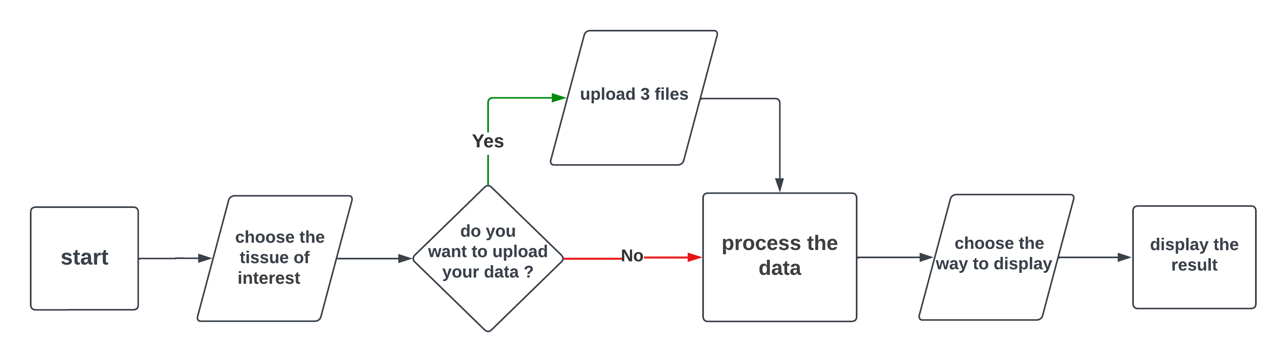
How GeneRegulate Works

Slide 9
How the data is processed:
Data
MySQL
Python
pybedtools

Slide 10
Why do we need pybedtools?
Connect the gene with regulatory elements
Chromatin loop
(Peakachu-merged)
Calculate the number of matches

Slide 11
How the data is processed:
Data
MySQL
Python
pybedtools
Web page
MySQL

Slide 12
GeneRegulate web tool Demonstration
Notes:
with all that in mind, I want to welcome you to the GeneRegulate tool.
A powerful place that can solve all these problems and it is capable of more.
I may make a logo to the web and add it in this page.

Slide 13
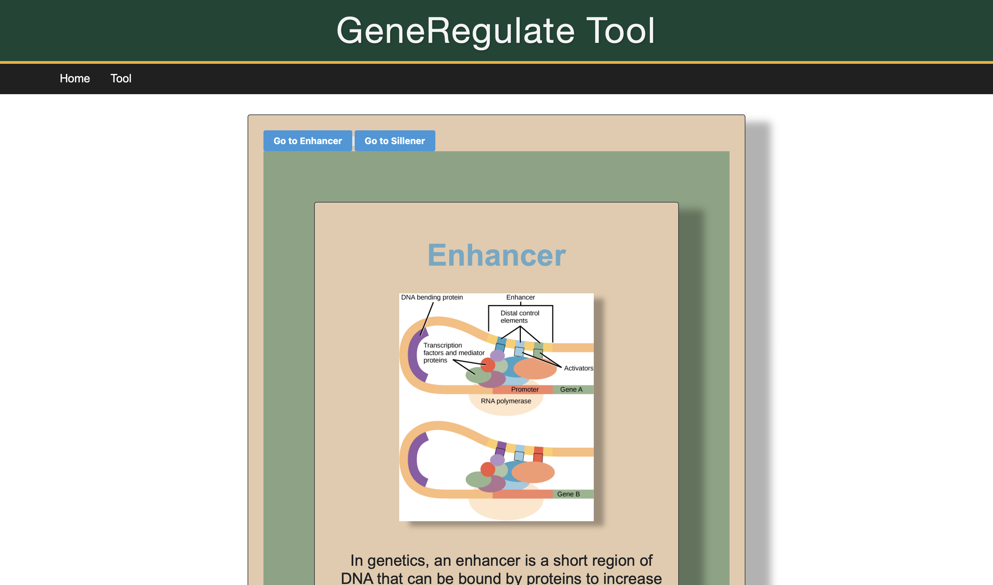

Slide 14
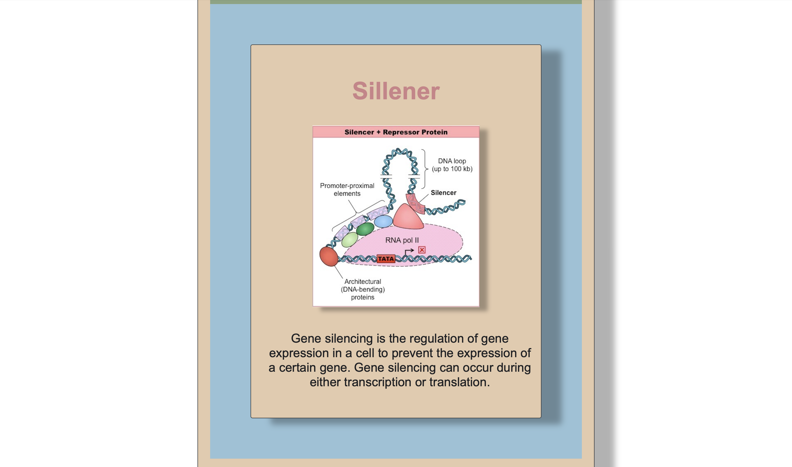

Slide 15
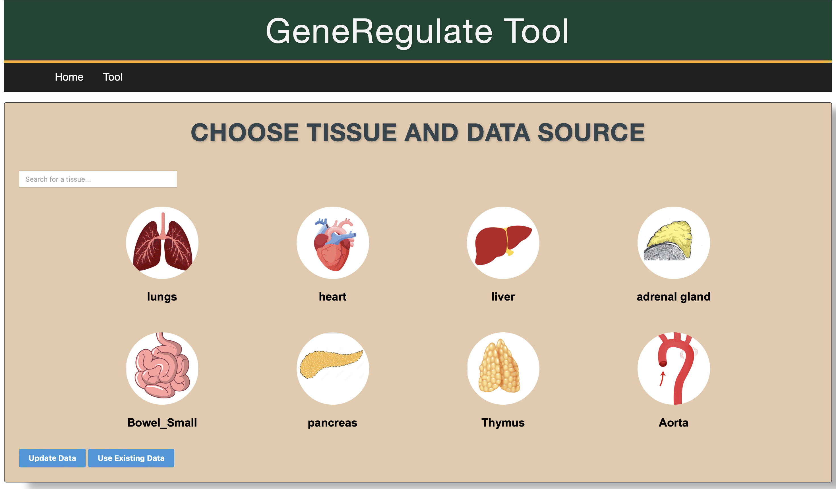

Slide 16
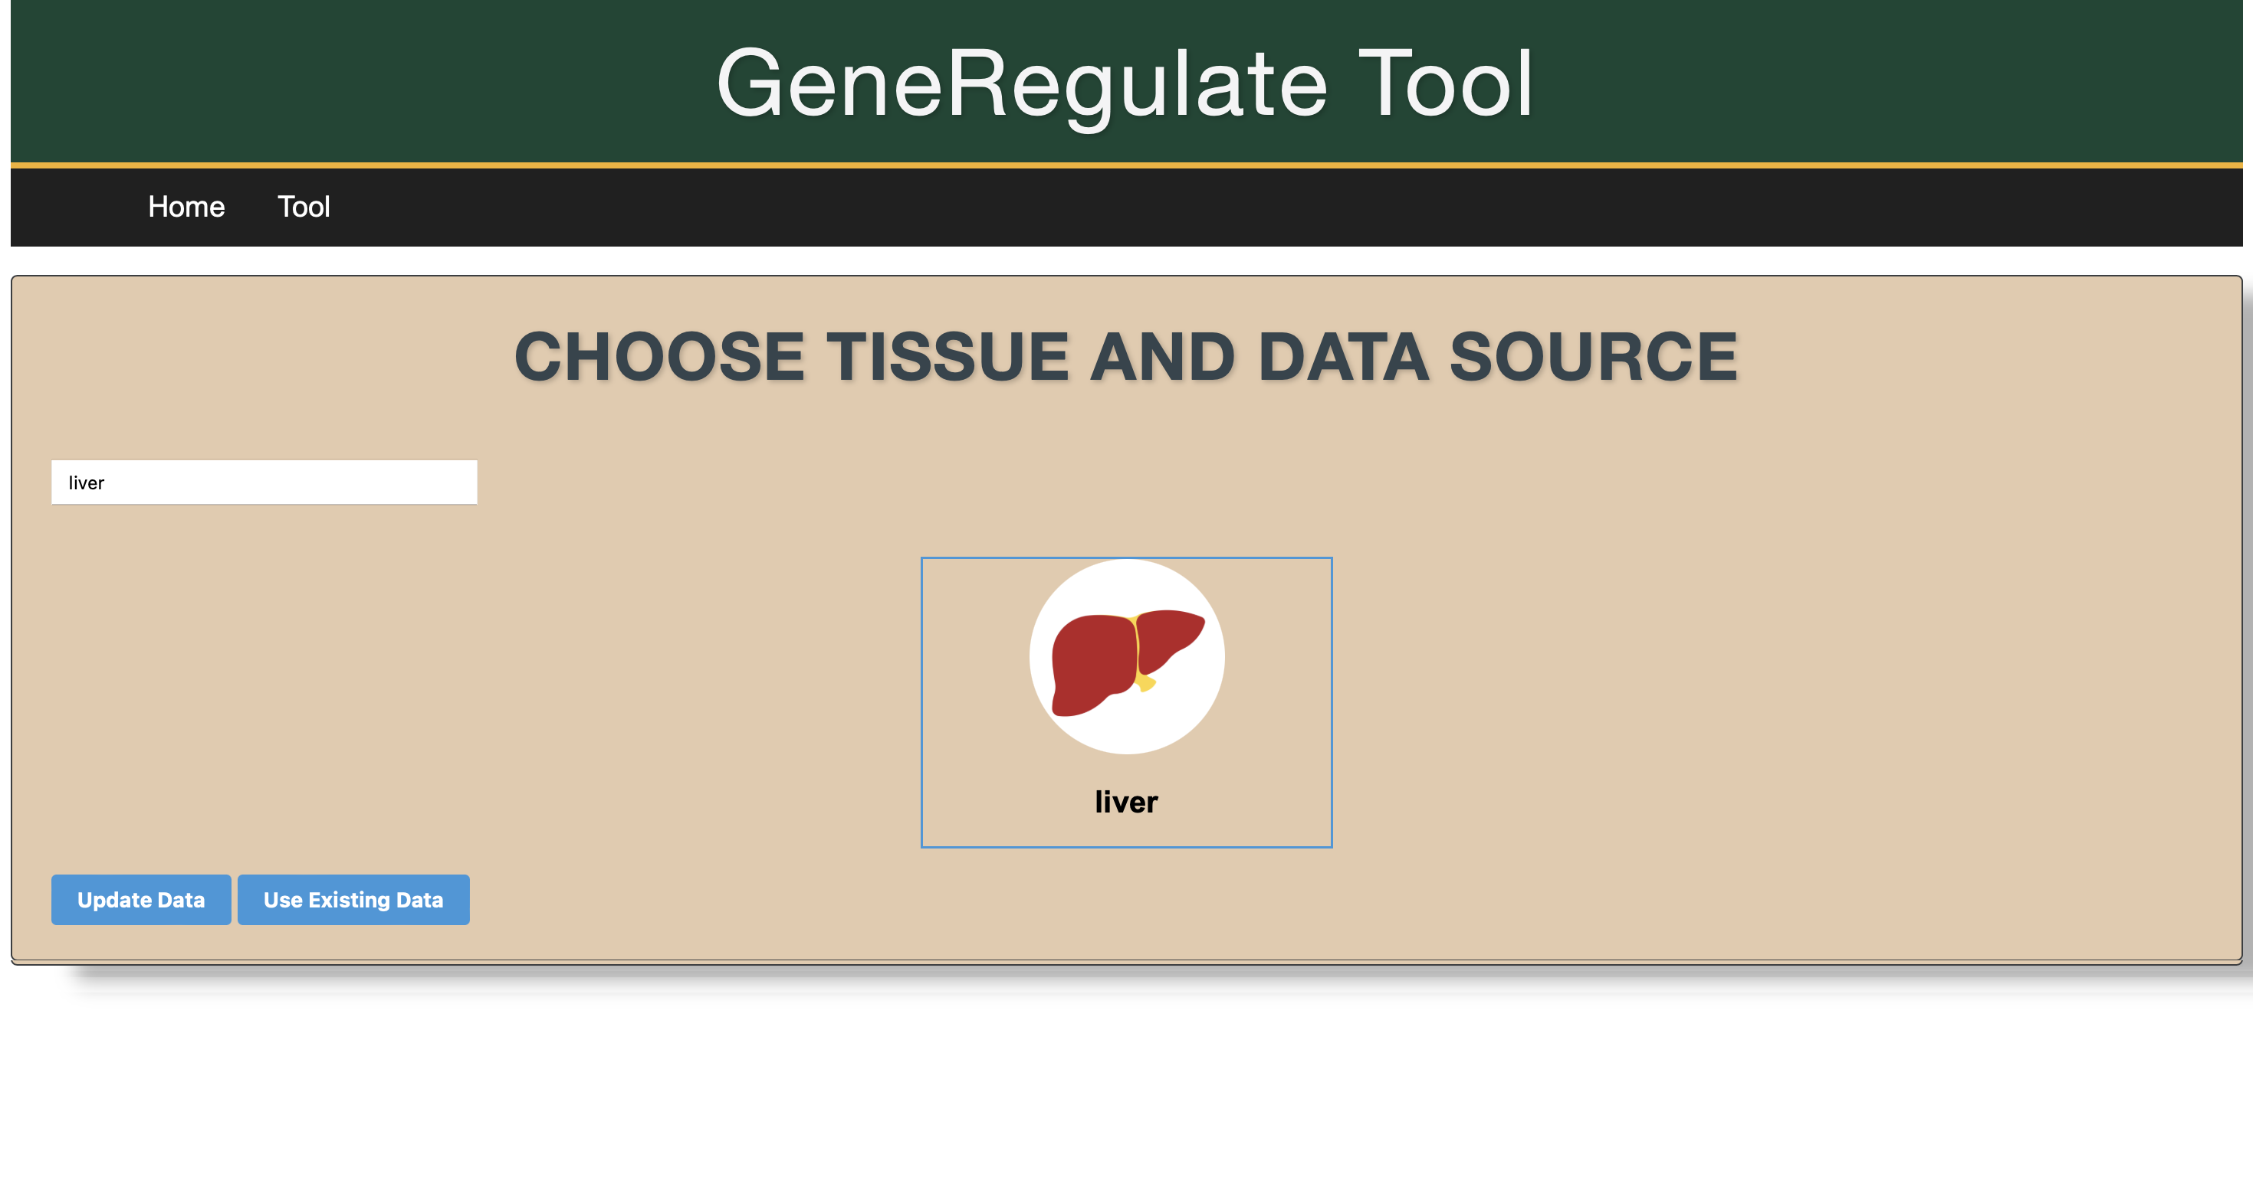

Slide 17
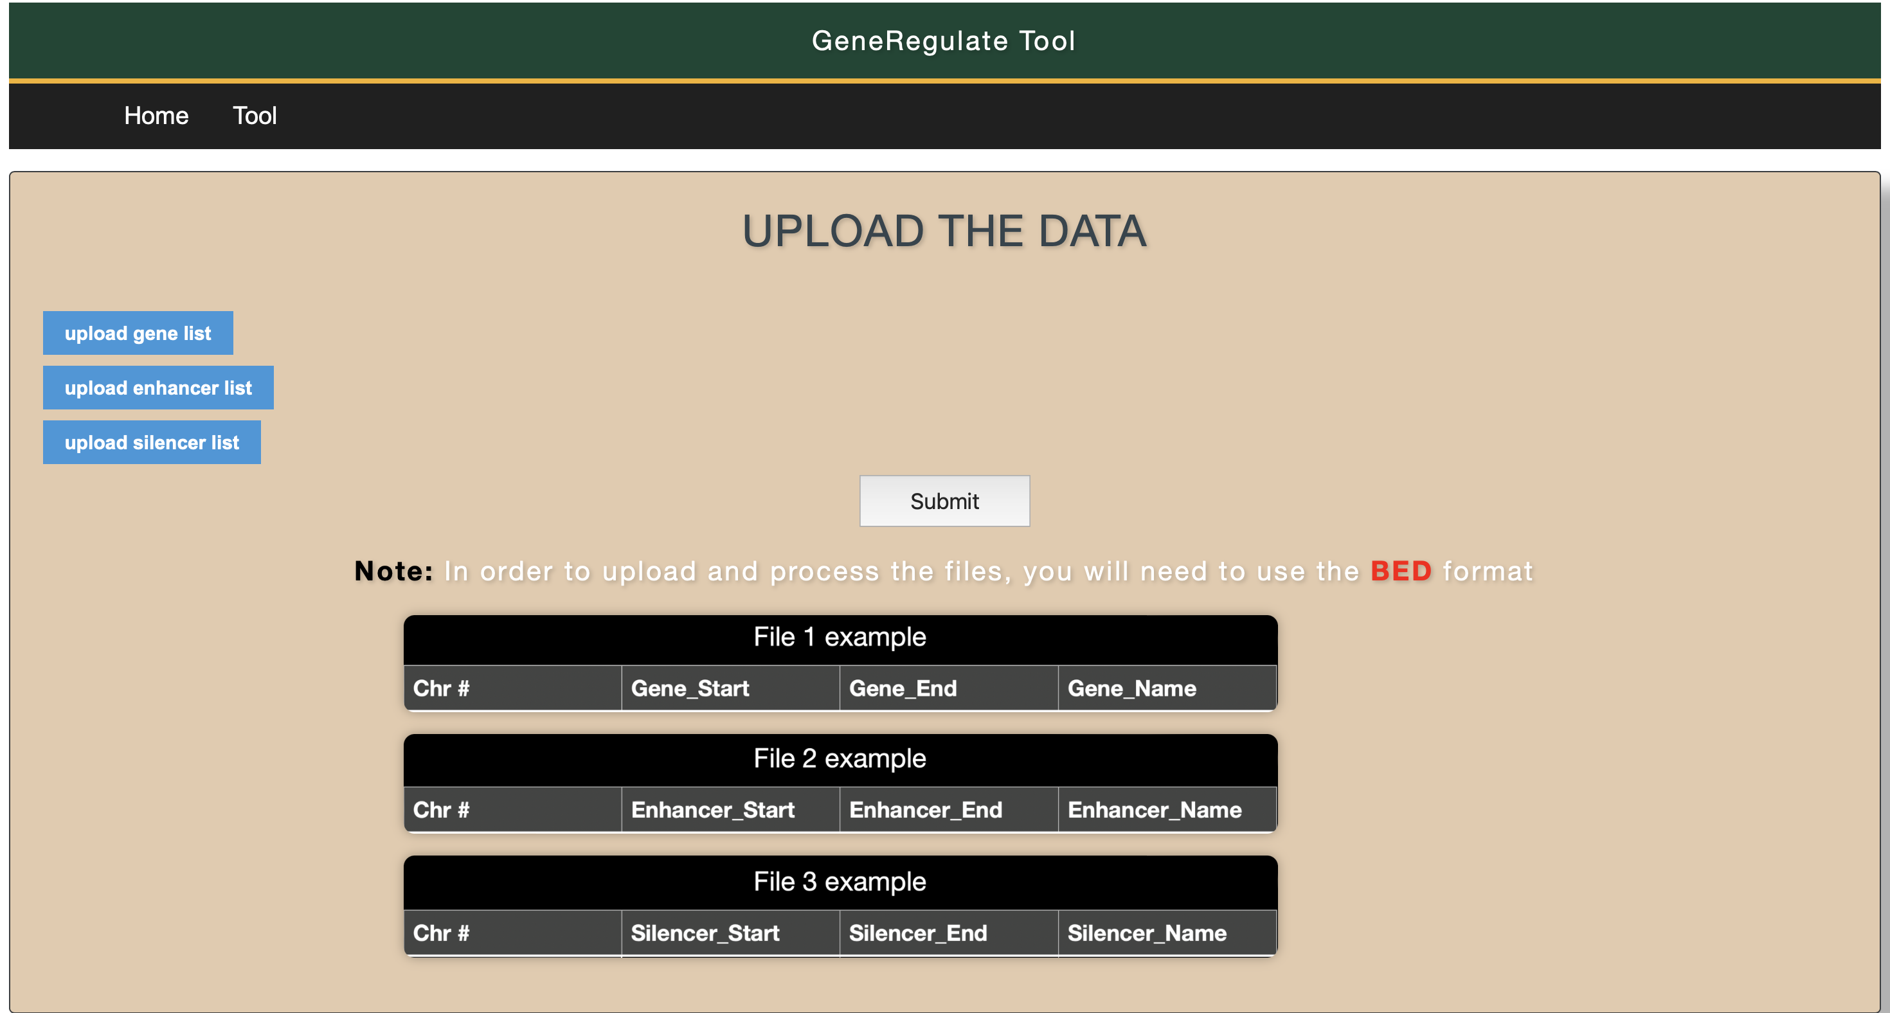

Slide 18
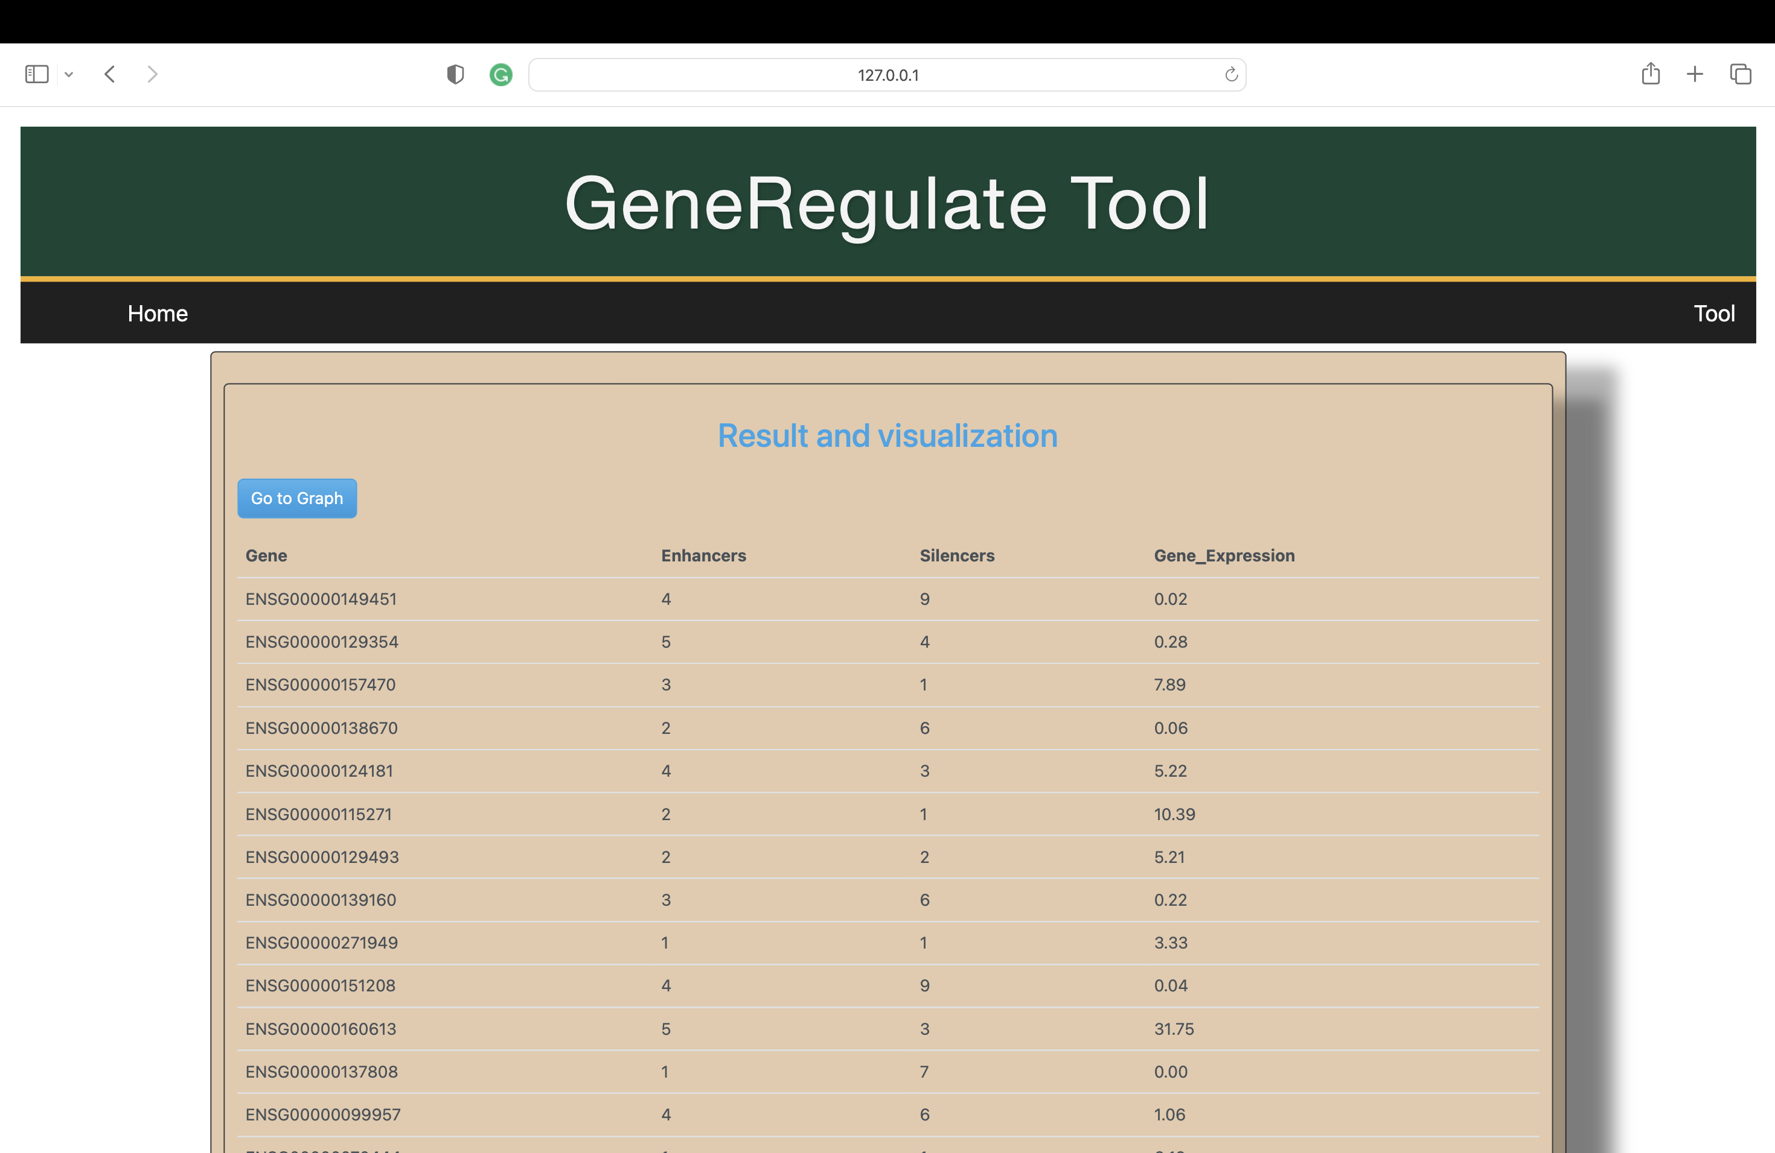

Slide 19
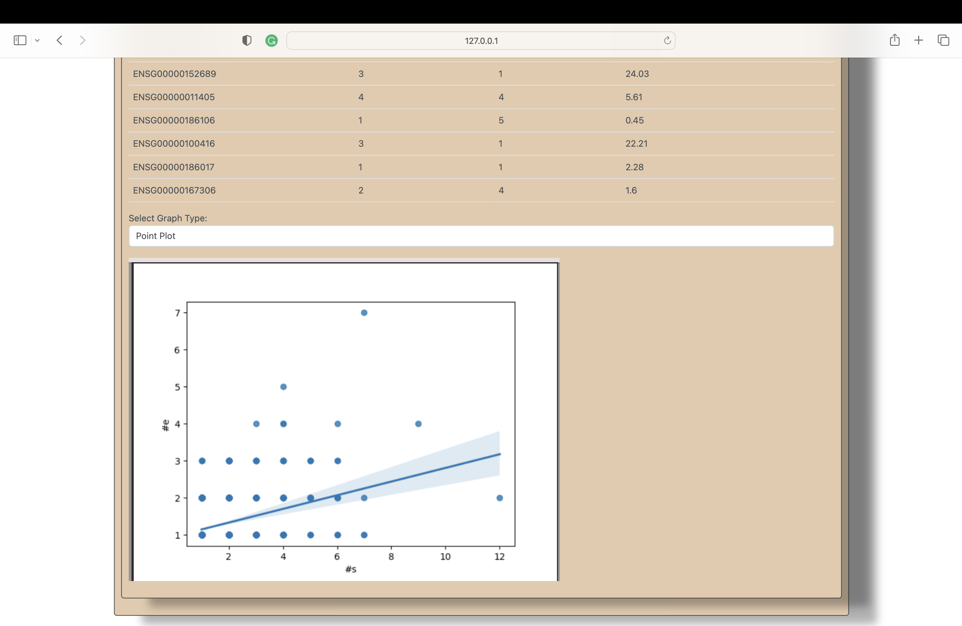
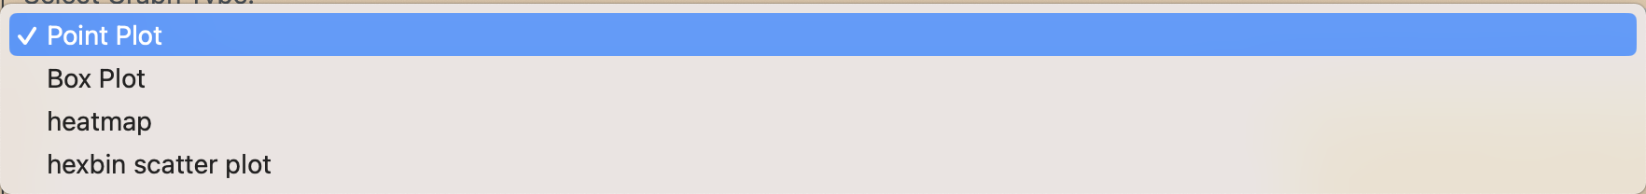

Slide 20
Limitations / Future improvements
using only h19
Files need to be in BED format
Only working with enhancers and silencers
Runtime
Statistic states

Slide 21

Questions?

