Slide 1

MALLA REDDY COLLEGE OF ENGINEERING FOR WOMEN An UGC Autonomous Institution Approved by AICTE New Delhi and Affiliated to JNTU An ISO 9001: 2015 Certified Institution Accredited by NBA and IIC 4-star Rating India Rankings 2023-NIRF Innovation Band 151-300 Maisammaguda , Medchal(Dist) , Hyderabad -500100, Telangana. Tel: 9346118802 Email : rg.mrcew@gmail.com, www.mrcew.ac.in
DEPARTMENT OF COMPUTER SCIENCE AND ENGINEERING
A Travel Direction Recommendation Model Based On Photos Of User Social Network Profile
PRESENTED BY: UNDER GUIDANCE OF:
B.SRIYAMINI 21RG1A0573 K.PRASANTH KUMAR
G.ANJALI 21RG1A0584
MD.AISHA 21RG1A0599
K.SRIKANYA 21RG1A05C2

Slide 2
CONTENT
ABSTARCT
INTRODUCTION
EXISTING SYSTEM
PROPOSED METHOD
SYSTEM REQUIREMENTS
ARCHITECTURE DIAGRAM
ADVANTAGES
APPLICATIONS
RESULT ANALYSIS
FUTURE SCOPE
CONCLUSION
REFERENCES

Slide 3
ABSTARCT
Main goal: The model suggests travel destinations by looking at people's Instagram photos and the info that comes with them.
How it works: It uses four main tools—finding objects in photos, comparing similarities, sorting things into groups, and grouping similar photos together.
What’s special: It mixes results from different methods to give better travel suggestions.
Good results: It correctly matched 63% of the places people actually visited, and 96% when including other places not shown in their photos.
Smart and automatic: The system runs on its own and keeps getting better as it learns from new photos and data.

Slide 4
INTRODUCTION
Photo-based recommendations: Instead of relying only on user data or metadata, this model analyzes Instagram photos to recommend travel destinations based on detected objects and activities.
AI-drive Post-pandemic travel boom: After COVID restrictions were lifted, people resumed traveling more, making the travel industry both lucrative and highly competitive.
n model: The proposed recommendation system uses artificial intelligence (AI), combining supervised and unsupervised methods (like similarity measures and self-organizing maps) to suggest travel destinations.
Unique approach: The system goes beyond traditional methods by using visual data and modifying self-organizing maps to work better with high-dimensional photo features, offering more accurate and personalized travel suggestions.

Slide 5
EXISTING SYSTEM
Photo-based recommendations: Unlike many systems that rely on detecting locations or users in photos, this model focuses on identifying common objects (like food or animals) in users’ photos to understand their interests.
Data challenges: There’s no existing public dataset suitable for training such a model, so creating and preparing custom datasets is essential and complex.
Object detection complexity: Detecting too many or overly specific objects (e.g., identifying a specific dish instead of just "food") can reduce accuracy, so a balance between detail and simplicity is necessary.
Similarity and classification methods: The model uses both traditional and newer similarity measures along with various classification (SVM, decision trees, deep learning) and clustering (K-means, hierarchical, KNN) techniques.

Slide 6
PROPOSED METHOD
Social network API integration: Integrate with social network APIs (e.g., Facebook, Instagram) to collect user-uploaded photos.
Photo metadata extraction: Extract metadata from photos, such as location, timestamp, and user interactions (e.g., likes, comments).
Object detection: Use computer vision techniques (e.g., YOLO, SSD) to detect objects, scenes, and activities in photos.
Image classification: Classify photos into categories (e.g., landmarks, nature, food, culture).
Sentiment analysis: Analyze user sentiment and emotions expressed in photos.
Travel history analysis: Analyze user's travel history and preferences

Slide 7
SYSTEM REQUIREMENTS
Hardware System Configuration:-
➢ Processor - Pentium –IV
➢ RAM - 4 GB (min)
➢ Hard Disk - 20 GB
➢ Key Board - Standard Windows Keyboard
➢ Mouse - Two or Three Button Mouse
➢ Monitor - SVGA
Software Requirements:
Operating System - Windows XP
Coding Language - Java/J2EE(JSP,Servlet)
Front End - HTML&CSS
Back End - MySQL

Slide 8
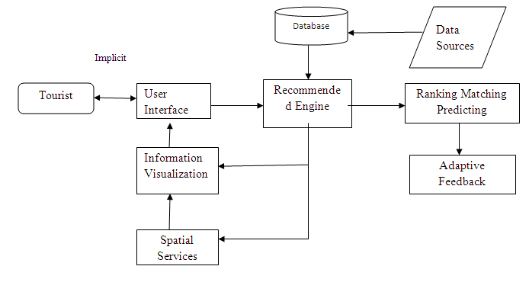
ARCHITECTURE DIAGRAM

Slide 9
ADVANTAGES
Personalized Recommendations
Tailored suggestions: By analyzing a user's photos, the model can understand their interests and preferences, providing personalized travel recommendations.
Improved User Experience
Visual inspiration: Photos can inspire users to explore new destinations and activities, making the travel planning process more engaging and enjoyable.
Potential Applications
Travel planning platforms: Integrating this model into travel planning platforms can enhance the user experience and provide more personalized recommendations.

Slide 10
APPLICATIONS
Personalized Travel Planning: Suggests destinations and activities that match the user’s visual preferences, such as nature spots, urban areas, or cultural sites.
Social Media-Based Itinerary Generation: Automatically creates travel plans by analyzing frequently featured themes or locations in the user’s and their friends’ photos.
Targeted Marketing for Travel Agencies: Helps travel companies deliver customized ads and offers based on the user’s travel style inferred from their photos.
Group Travel Recommendations: Analyzes group photos to identify shared interests and suggest destinations suitable for friends, families, or couples.
Smart Travel Apps Integration: Enhances travel apps with AI-powered suggestions based on visual data, offering smarter destination choices and experiences

Slide 11
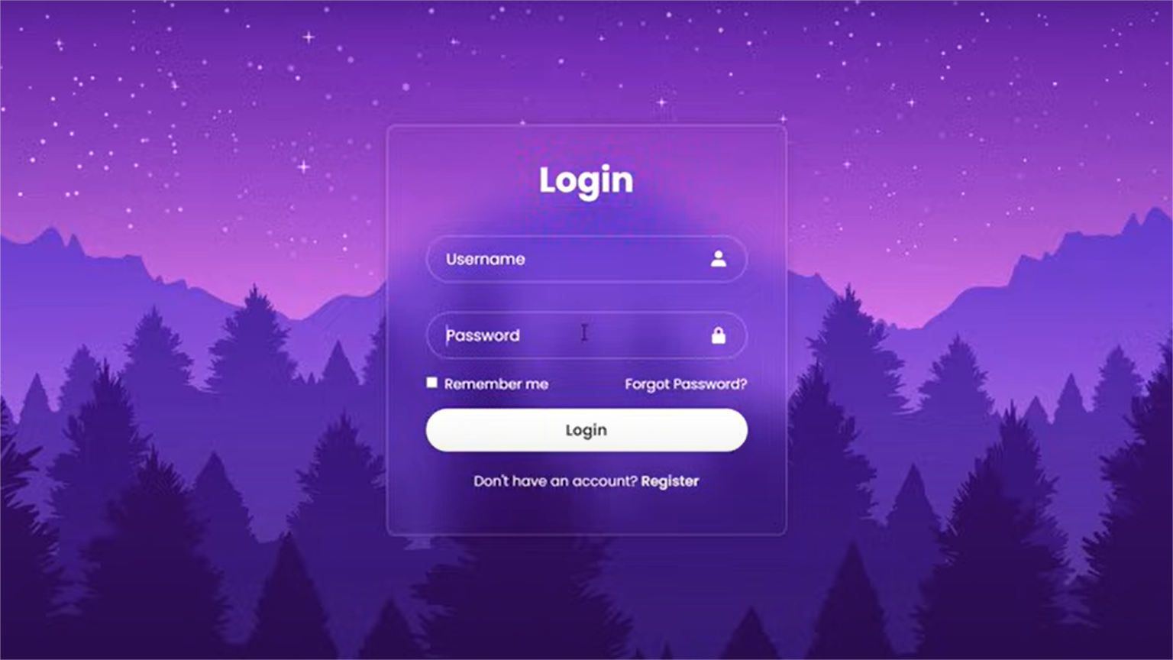
RESULT ANALYSIS

Slide 12
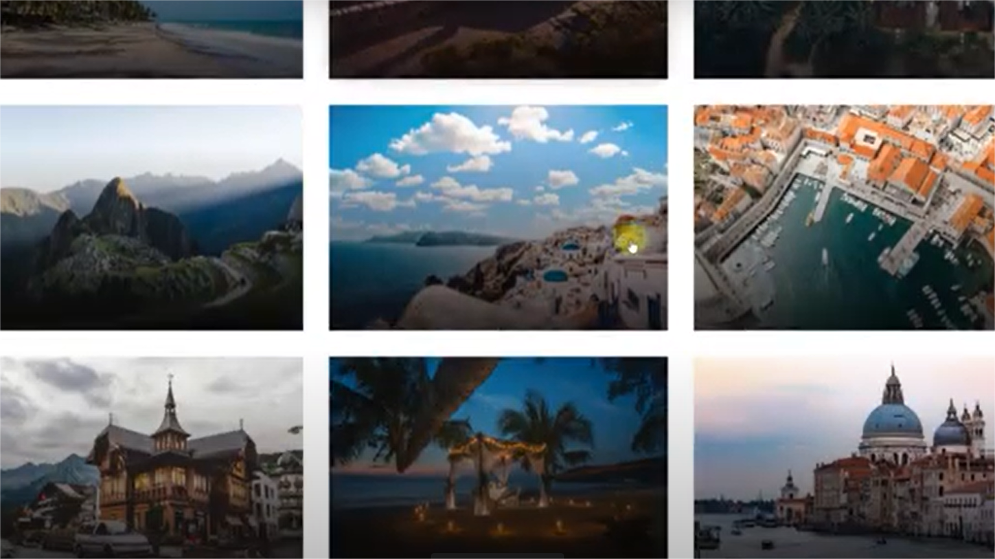

Slide 13
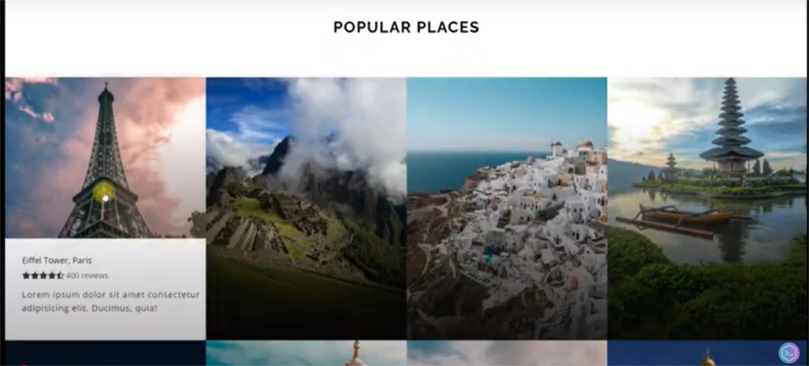

Slide 14
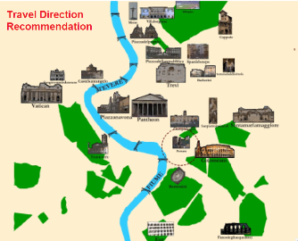

Slide 15
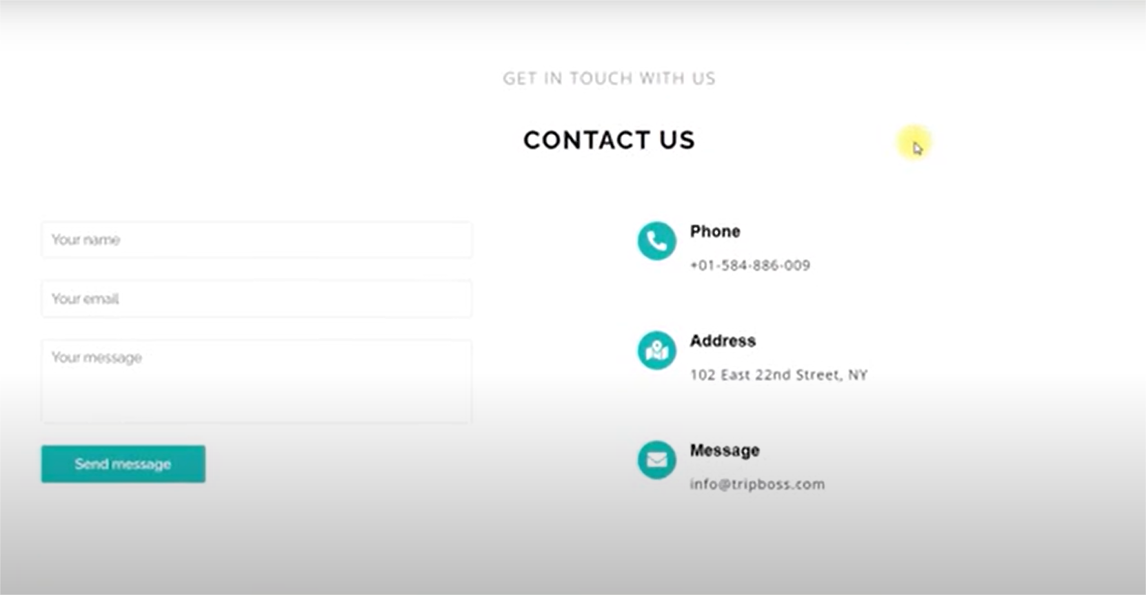

Slide 16
FUTURE SCOPE
Enhanced Personalization with AI:- Integrate more advanced AI to analyze deeper visual and contextual cues from photos (like mood, setting, and activity) to refine travel recommendations.
Cross-Platform Data Integration:- Expand the model to gather and analyze data from multiple social media platforms (e.g., Instagram, Facebook, TikTok) for a more comprehensive user profile.
Real-Time Trend Adaptation:-
Use real-time travel and social media trends to suggest trendy or emerging travel spots aligned with the user’s interests and photo style.
Augmented Reality Previews:- Integrate AR features to let users visualize destinations and experiences that match their photo vibe before booking or visiting.
Community and Social Recommendations:- Allow users to see where their friends or similar users have traveled based on photo similarity and shared interests, enhancing social travel planning.

Slide 17
CONCLUSION
Automated system: The model automatically collects and analyzes Instagram photos to detect objects and build a dataset for recommending travel destinations.
Effective results: The model can recommend 10 countries with a 63% match to places users have visited, and 96% accuracy when including other traveled countries not shown in the input photos.
Photo-based comparison: Travel suggestions are made by comparing object vectors from user photos with a dataset, avoiding repeated analysis but making the model sensitive to changes in the object detection algorithm.
Future improvements: The model currently recommends countries, but it can be expanded to suggest more specific regions or areas using the existing dataset for more precise travel planning.

Slide 18
REFERENCES
Personalized Travel Suggestions:- Many systems use user preferences, travel personalities, or past behaviors to suggest personalized destinations or routes. (e.g., [1], [6], [18])
Recommendation Techniques:- Different methods like collaborative filtering, content-based filtering, and hybrid models are commonly used. Some also use machine learning like decision trees or K-means clustering. (e.g., [2], [4], [23], [25])
Use of Social and Contextual Data:- Some systems analyze geo-tagged images, social media posts, or community-contributed data to improve travel recommendations. (e.g., [8], [11], [16])
Integration of Smart Technology:- IoT devices and smartphones are used to gather real-time user data, enhancing the travel experience and suggestions. (e.g., [9])
Improving Accuracy and User Experience:- Researchers focus on improving the accuracy of suggestions using better similarity measures, knowledge graphs, and dialogue strategies. (e.g., [10], [12], [22], [24])

Slide 19


