Slide 1
Learning Management System
Group 19
Team Members : Yaseen Junaid Mohammed, Hardhiq Choudhary
GWID : G28705598, G36170854

Slide 2
Project Description
The Learning Management System (LMS) helps students and instructors manage courses, assignments, and communication. Students can sign in, enroll in courses, view content, and submit assignments. Instructors can grade assignments and send notifications. The system ensures secure access, organized learning, and effective communication.

Slide 3
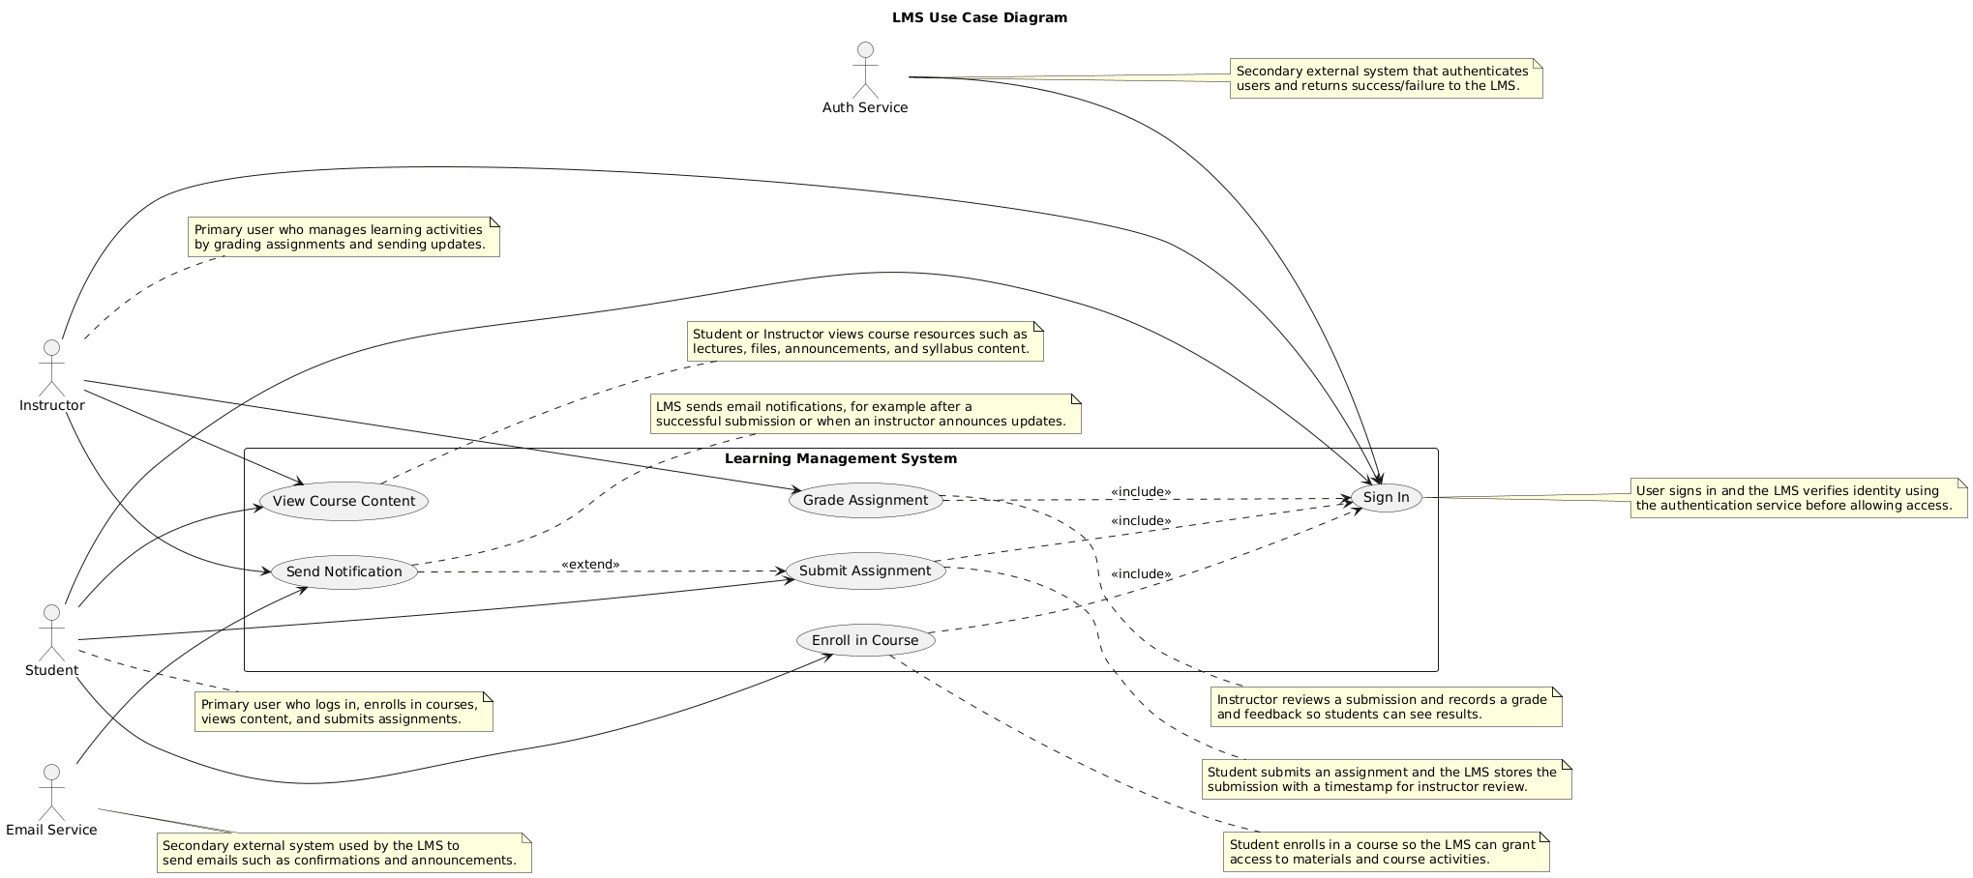
Use Case Model

Slide 4
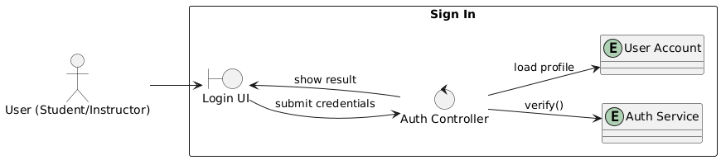
Robustness Diagram - Sign In

Slide 5
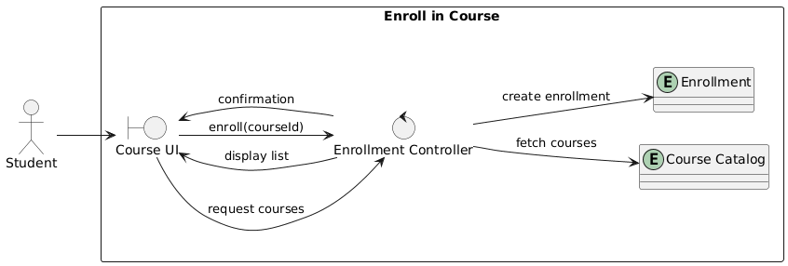
Robustness Diagram - Enroll in Course

Slide 6
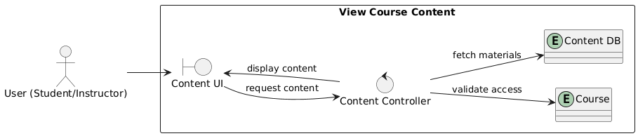
Robustness Diagram - View Course Content

Slide 7
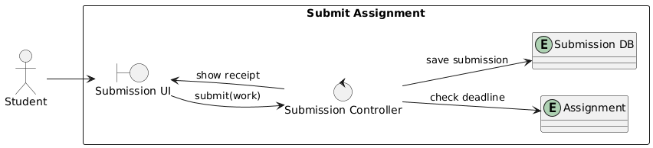
Robustness Diagram - Submit Assignment

Slide 8
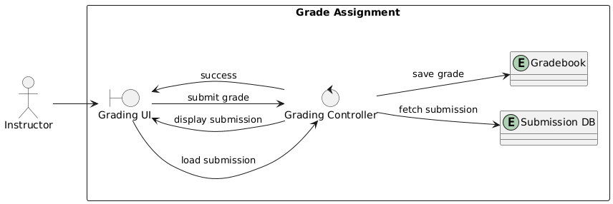
Robustness Diagram - Grade Assignment

Slide 9
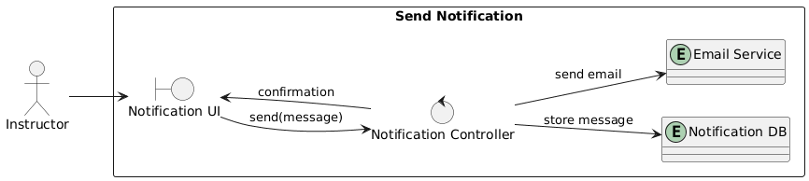
Robustness Diagram - Send Notification

Slide 10
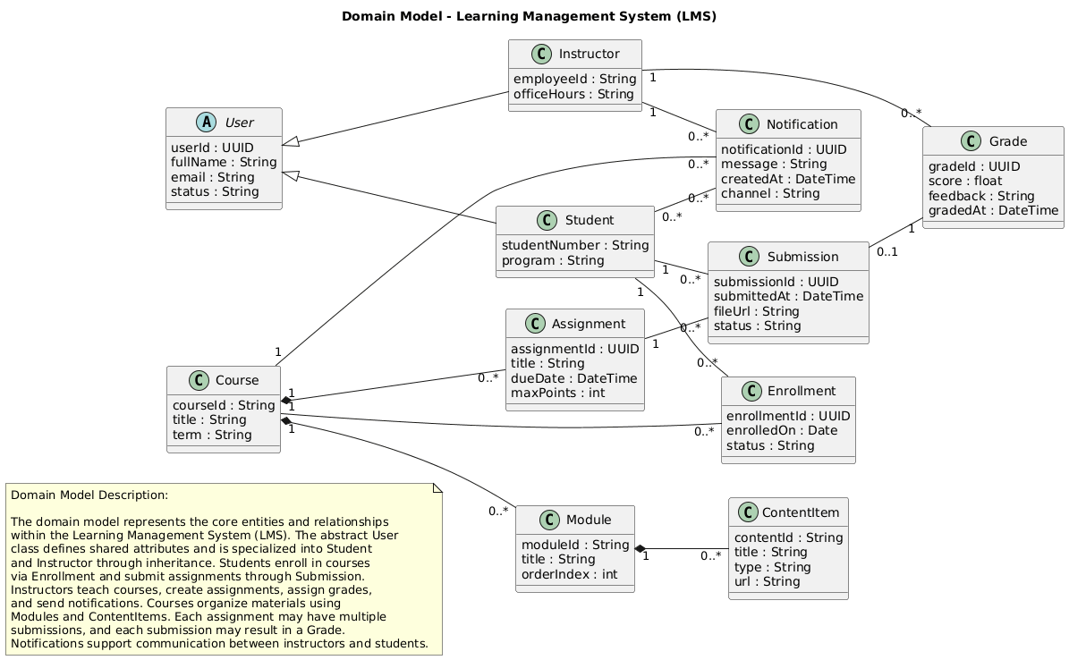
Domain Model

Slide 11

GitHub Repository
https://github.com/yaseenjunaid657/CSCI_6234_Spring_2026_G19

