Slide 1
GRAPE LEAF DISEASE IDENTIFICATION USING
MACHINE LEARNING TECHNIQUES
College Name: K.CHANDRAKALA PG COLLEGE,TENALI
Submitted to: Mr.V.V.S.VENU GOPAL
Presented by: JYESHTA DEVAKUMARI
Roll No: Y23MC47034 Date: 4th May, 2024

Slide 2
Table of Contents
Abstract
Introduction
Literature Survey
System Analysis
Feasibility Study
System Requirements
Hw/Sw Requirements
UML Diagrams
Code Overview
Testing
Conclusion
Future Scope

Slide 3
ABSTRACT
Natural crop diseases influenced by changing climatic and environmental conditions.
Grape, a widely grown crop in India, susceptible to leaf diseases caused by fungi, bacteria, and viruses.
Proposed automatic system for grape disease detection using image processing and machine learning.
System segments grape leaf using grab cut segmentation.
Diseased regions further segmented using global thresholding and semi-supervised technique.
Features extracted for classification (healthy, rot, esca, leaf blight) using SVM, adaboost, and Random Forest tree.
Achieved 93% testing accuracy with SVM

Slide 4
INTRODUCTION and Motivation
Indian Economy heavily relies on agricultural productivity, with grapes being a significant commercial fruit due to its adaptability to various climates and soils.
Diseases affecting grape plants, caused by viral, bacterial, and fungal infections transmitted through insects, rust, and nematodes, can significantly reduce yield and growth.
Current disease detection methods, based on farmer experience or expert observation, are inaccurate and time-consuming.
Proposed system aims to address the need for early disease detection in agriculture and horticulture, focusing on grape plant leaves.
Motivated by existing web-enabled disease detection systems, utilizing segmentation methods like mean-based threshold computation and textual feature extraction, followed by SVM classification.
Prior studies, such as Vijai et al.'s survey, explore different disease classification techniques, including genetic algorithms for image segmentation.
Mention of an integrated approach using particle swarm optimization and SVM for plant leaf disease detection and classification.
Limitations include the reliance on genetic algorithms for image segmentation and potential scalability issues.

Slide 5
Literature Survey 1
Authors: H. Wagner, T. Finkenzeller, S.Wurth, and S. P. Von Duvillard
Title: "Individual and team performance in team-handball: A review"
Journal: J. Sports Sci. Med., vol. 13, no. 4, p. 808, 2014
Summary:
Team handball is a complex sport determined by individual performance, tactical components, and team interaction.
Aim of the review: Specify elements of team-handball performance based on scientific studies and practical experience, provide perspectives for practical implication.
Methodology: Scientific studies identified via various databases. A total of 56 articles met inclusion criteria, supplemented by 13 additional articles, proceedings, and book sections.
Findings:
Specific characteristics of team-handball (intensity changes, techniques, confrontations, mental skills, social factors) determine coordination, endurance, strength, and cognition.
Comprehensive studies on individual performance exist, but a lack of studies on team-handball-specific training, cognition, and social factors.
Key Points:
Specific characteristics define determinants of coordination, endurance, strength, and cognition.
Suggested specific training based on these determinants to enhance individual and team performance.
Gap in research: Lack of studies on team-handball-specific techniques, endurance, cognition, and social factors.

Slide 6
Literature Survey 2
Survey Title: "Using Virtual Reality to Analyze Sports Performance"
Authors: B. Bideau, R. Kulpa, N. Vignais, S. Brault, F. Multon, and C. Craig
Journal: IEEE Comput. Graph. Appl., vol. 30, no. 2, pp. 14-21, Mar./Dec. 2010
Summary:
Improvement of sports performance challenging due to biomechanical, physiological, and psychological factors.
Understanding perception-action loop crucial, necessitating isolation of contributing factors.
Video playback limitations overcome by interactive, immersive virtual reality (VR) for in-depth analysis of sports performance.
VR facilitates behavioral-neuroscience perspective in understanding sports performance.
VR applications highlighted through two case studies: Demonstrates practical implementation and effectiveness of VR in analyzing sports performance.
Potential for VR to revolutionize sports training and coaching methodologies by providing more accurate and detailed performance analysis.
Enhanced understanding of individual player performance and team dynamics through VR-based analysis.
Opportunities for customized training programs tailored to individual athlete needs and performance characteristics.
Integration of VR technology into sports science research and coaching practices for improved performance outcomes.
Future directions may include further exploration of VR applications in sports performance analysis and development of advanced VR-based training systems.

Slide 7
Literature Survey 3
Survey Title: "Stages to Predict VO2max in Adults"
Journal: Can. J. Sport Sci. J. Canadien Sci. Sport, vol. 14, no. 1, pp. 21-26, 1989
Summary:
Direct estimation of cardiorespiratory fitness (VO2max) typically requires well-equipped laboratory settings.
Study conducted on 84 sedentary male university students from the University of Calcutta, Kolkata, India.
Aimed to validate the applicability of the 20-meter shuttle run test (SRT) for indirect estimation of VO2max in young male sedentary university students.
Participants divided into "study group" (N=54) for testing the existing SRT protocol and "confirmatory group" (N=30) for validating modified equations.
VO2max measured directly and indirectly using SRT method with a four-day gap between tests.
Statistically significant difference observed between mean values of directly measured VO2max and indirectly predicted VO2max (PVO2max) in the "study group."
Findings suggest potential for indirect estimation of VO2max using shuttle run test in sedentary university students.
Indirect estimation offers practical alternative to costly and resource-intensive direct measurement methods.
Further research may explore refinement and validation of indirect estimation methods for broader application in assessing cardiorespiratory fitness.
Implications for health and fitness assessments, particularly in contexts where direct measurement of VO2max is not feasible.

Slide 8
System Analysis
Existing System:
Segmentation method based on mean-based strategy and SVM classification.
Vijai et al. surveyed disease classification techniques, including genetic algorithm for image segmentation.
Integrated approach of particle swarm optimization and SVM proposed for plant leaf disease detection.
Pomegranate leaf disease detection system utilized color-based segmentation and feature extraction.
Drawbacks: Reliance on genetic algorithm for image segmentation.
Proposed System:
Automated disease detection and classification for grape leaves using image processing and machine learning.
Segmentation of regions of interest (ROI) using grab cut algorithm.
Classification of segmented leaves into healthy, black-rot, esca, and leaf blight.
Key Processes:Image preprocessing, segmentation, feature extraction, disease detection, and identification.

Slide 9
Feasibility Study
Feasibility Aspect | Description
Economic Feasibility | Evaluation of development costs against ultimate benefits derived. Nominal expenditure due to utilization of existing resources and technologies. No additional hardware or software required. Financial benefits must equal or exceed costs, ensuring economic feasibility.
Operational Feasibility | Important to ensure proposed projects meet organizational operating requirements Key considerations include management support, user acceptance, and resistance Well-planned design ensures optimal utilization of resources and performance improvement Management and user requirements addressed to mitigate resistance and ensure successful implementation.
Technical Feasibility | Evaluation of technical capacity and readiness of proposed system Existing technology and equipment capable of supporting system requirements Web-based user interface ensures easy access and workflow management System provides technical guarantees of accuracy, reliability, and security Utilization of current equipment and software technology with available bandwidth for fast feedback.

Slide 10
System REQUIREMENTS
Functional Requirements:
Define the functions of a system or its components.
Describe behavior between outputs and inputs.
Involve calculations, technical details, and data manipulation.
Captured in use cases to specify how the system should behave.
Expressed as "system must do <requirement>."
Drive the application architecture of a system.
Non-Functional Requirements:
Specify quality attributes of a software system.
Judge the system based on responsiveness, usability, security, and portability.
Expressed as "system shall be <requirement>."
Constraints or restrictions imposed on the design of the system.
Example: "The site should load in 3 seconds with >10,000 simultaneous users."
Description of non-functional requirements is as critical as functional requirements.

Slide 11
Hw/Sw Requirements
Hardware Requirements:
Minimum hardware requirements depend on the specific software being developed.
RAM requirements vary based on memory storage needs and processing speed.
Recommended:
System: Pentium i3
Hard Disk: 500 GB
Monitor: 14" Colour Monitor
Mouse: Optical Mouse
RAM: 4 GB
Software Requirements:
Functional requirements include product perspective, features, and operating environment.
Design constraints and user documentation are also considered.
Operating System: Windows 8/10
Coding Language: Python
Software: Jupyter

Slide 12
UML DIAGRAMS
Definition of UML: UML is a standardized general-purpose modeling language used in object-oriented software engineering, managed by the Object Management Group.
Components of UML: UML consists of a meta-model and a notation, serving as a common language for creating models of object-oriented computer software.
Goals of UML: The primary goals of UML include providing users with a ready-to-use, expressive visual modeling language, ensuring extendibility and specialization mechanisms, independence from specific programming languages and development processes, formal basis for understanding the modeling language, and support for higher-level development concepts.
Importance of UML: UML represents a collection of best engineering practices for modeling large and complex systems, playing a crucial role in the development of object-oriented software and the software development process.
Benefits of UML: UML encourages the growth of object-oriented tools market, supports collaboration, frameworks, patterns, and components, and integrates best practices in software modeling.

Slide 13
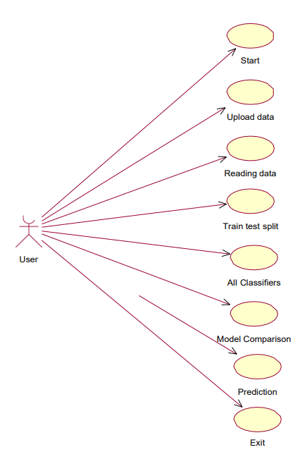
USE CASE DIAGRAM
Definition of Use Case Diagram: A use case diagram in UML is a type of behavioral diagram created from a use-case analysis. It provides a graphical overview of the functionality offered by a system in terms of actors, their goals (represented as use cases), and any dependencies between those use cases.
Purpose of Use Case Diagram: The main purpose of a use case diagram is to illustrate the system functions performed for each actor. It helps in identifying the roles of actors within the system and understanding how they interact with the system to achieve their goals.
Components of Use Case Diagram: Use case diagrams consist of actors, use cases, and relationships between them. Actors represent roles played by users or external systems interacting with the system, while use cases represent the specific functionality provided by the system. Relationships, such as associations and dependencies, depict how actors and use cases are connected.
Significance in System Analysis and Design: Use case diagrams are essential tools in system analysis and design, as they help in visualizing and understanding the system's functionality from a user's perspective. They serve as a basis for defining system requirements, identifying system boundaries, and facilitating communication between stakeholders.

Slide 14
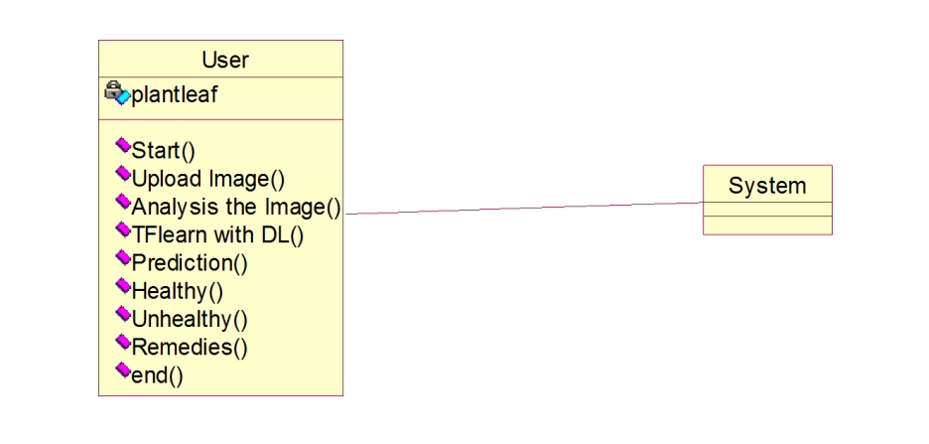
CLASS DIAGRAM
Definition of Class Diagram: A class diagram in UML is a type of static structure diagram used to describe the structure of a system. It illustrates the system's classes, their attributes, operations (or methods), and the relationships among the classes.
Components of Class Diagram: The main components of a class diagram include:
Classes: Represented as rectangles, classes encapsulate data (attributes) and behavior (operations or methods). Each class contains attributes that describe its properties and operations that define its behavior.
Attributes: Represented as properties or fields of a class, attributes describe the characteristics or properties of the class.
Operations (Methods): Represented as functions or behaviors associated with a class, operations define the actions that can be performed by the class.
Relationships: Depict the associations, dependencies, and constraints among classes. Relationships include associations (e.g., aggregation, composition), generalization (inheritance), and dependencies.
Role in Software Engineering: Class diagrams are fundamental tools in software engineering for modeling and designing object-oriented systems. They provide a visual representation of the system's structure, enabling developers to understand class hierarchies, relationships, and dependencies. Class diagrams serve as blueprints for software development, facilitating communication among stakeholders and guiding the implementation process.

Slide 15
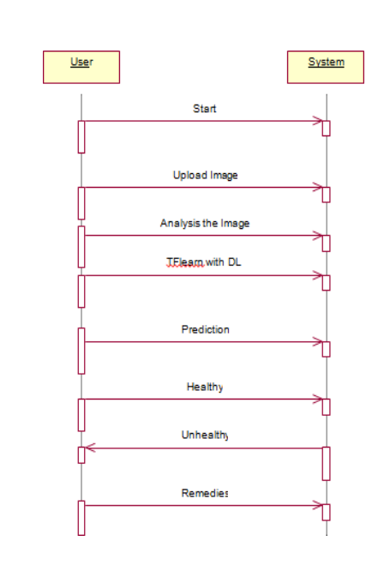
SEQUENCE DIAGRAM
Definition of Sequence Diagram: A sequence diagram in UML is a type of interaction diagram that illustrates how processes interact and communicate with each other in a particular order or sequence. It depicts the flow of messages between objects or components over time, emphasizing the chronological order of interactions.
Purpose: The primary purpose of a sequence diagram is to visualize the dynamic behavior of a system or process by representing the sequence of messages exchanged between objects or components. It helps developers understand the runtime behavior of a system, including the order of method invocations, collaborations, and interactions between various elements.
Characteristics: Sequence diagrams typically consist of the following elements:
Objects: Represented as rectangles, objects or instances of classes participate in interactions within the system.
Lifelines: Represented as vertical dashed lines extending from objects, lifelines depict the lifespan of objects during the sequence of interactions.
Messages: Represented as arrows between lifelines, messages denote communication between objects. They can be synchronous (solid arrows) or asynchronous (dashed arrows), indicating the timing of message exchanges.
Activation Bars: Represented as horizontal bars on lifelines, activation bars indicate the period during which an object is active or executing a particular operation.
Return Messages: Represented as dashed arrows returning from method calls, return messages indicate the flow of control back to the calling object after executing a method.
Alternative Names: Sequence diagrams are also known by other names such as event diagrams, event scenarios, and timing diagrams, depending on their specific context and usage.

Slide 16
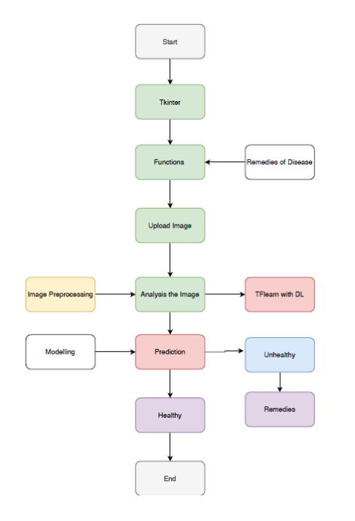
FLOW CHART

Slide 17
SYSTEM IMPLEMENTATION
MODULES
Data Collection: Collect sufficient data samples and legitimate software samples
Feature Extraction: For each image extract the features ubsing image processing and save in „.csv‟ extension
Train and Test Modelling: Split the data into train and test data Train will be used for trainging the model and Test data to check the performace.
Modelling: SVM Navie bayes, Random FOrest, KNN, Ada boost, Decision tree, Ada boost with random forest. Combine the training using machine learning algorithms and establish a classification model

Slide 18
ALGORITHMS
Support Vector Machine (SVM):
Functionality:
Supervised learning algorithm used for classification (and regression).
Classifies data points by finding the hyperplane that best separates the classes.
Application:
Effective for high-dimensional data with clear class separation.
Determines the optimal hyperplane to maximize margin between classes.
Advantages:
Works well in high-dimensional spaces.
Effective in scenarios with complex decision boundaries.
Limitations:
Memory-intensive for large datasets.
Less effective in noisy datasets or when classes overlap significantly.
Logistic Regression:
Functionality:
Utilizes the logistic function (sigmoid function) at its core.
Maps real-valued numbers to a range between 0 and 1.
Application:
Commonly used for binary classification tasks.
Models the probability of a binary outcome based on one or more predictor variables.
Advantages:
Provides interpretable probabilities for outcomes.
Simple to implement and understand.
Limitations:
Assumes a linear relationship between predictors and the log-odds of the outcome.
Prone to overfitting with high-dimensional data.

Slide 19
ALGORITHMS
Naive Bayes Classifier:
Type: Probabilistic classifier based on Bayes' theorem with strong independence assumptions.
Operation: Estimates the likelihood of a class given predictor variables using conditional probabilities.
Application: Widely used for text classification, spam filtering, and sentiment analysis.
Advantages: Simple, fast, and performs well with high-dimensional data.
Limitations: Assumes independence between features, which may not hold true in practice.
Random Forest Algorithm:
Type: Ensemble learning method consisting of multiple decision trees.
Operation: Builds a multitude of decision trees and combines their predictions for final output.
Application: Versatile algorithm used for classification, regression, and outlier detection tasks.
Advantages: Robust against overfitting, handles missing data, and provides feature importance.
Limitations: May be computationally expensive and less interpretable compared to single decision trees.

Slide 20
ALGORITHMS
AdaBoost Classifier:
Type: Adaptive boosting ensemble method that combines weak learners to create a strong classifier.
Operation: Iteratively trains weak classifiers and adjusts the weights of incorrectly classified instances.
Application: Commonly used for binary classification problems, especially in face detection and text categorization.
Advantages: Boosts classification accuracy, less prone to overfitting, and handles noisy data.
Limitations: Sensitive to outliers and noisy data, may require careful parameter tuning.
Decision Tree Algorithm:
Type: Supervised learning algorithm for classification and regression tasks.
Operation: Divides the dataset into subsets based on feature values to make sequential decisions.
Application: Used in various domains including healthcare, finance, and marketing.
Advantages: Easy to interpret and visualize, handles non-linear relationships.
Limitations: Prone to overfitting, sensitive to small variations in data, and may create complex trees.

Slide 21
Python Code Overview
GUI Setup:
The code imports necessary modules from Tkinter for building the GUI.
It creates a main window (main) for the GUI with a specified title and geometry.
The filename variable is declared to store the path of the uploaded dataset.
Data Loading:
The upload() function opens a file dialog to allow the user to upload a dataset.
Upon selection, the path of the uploaded file is displayed on the GUI (pathlabel).
Model Generation:
The generateModel() function reads the uploaded dataset and splits it into training and testing sets using train_test_split() from scikit-learn.
Information about the dataset length and the lengths of the training and test sets are displayed on the GUI.
Algorithm Execution:
Functions like runSVM(), runSVMGenetic(), runNN(), and runNNGenetic() are provided to execute different machine learning algorithms.
SVM and NN models are trained on the training data, and their accuracies are evaluated on the test data.
Genetic algorithms are used for feature selection in the SVM and NN models.
Prediction and Evaluation:
The prediction() function predicts the class labels for the test dataset using the trained models.
The cal_accuracy() function calculates the accuracy of the predictions and displays the classification report and confusion matrix on the GUI.
Visualization:
The graph() and timeGraph() functions generate bar graphs to visualize the accuracy and execution time of different algorithms, respectively.
Matplotlib is used for plotting the graphs.

Slide 22
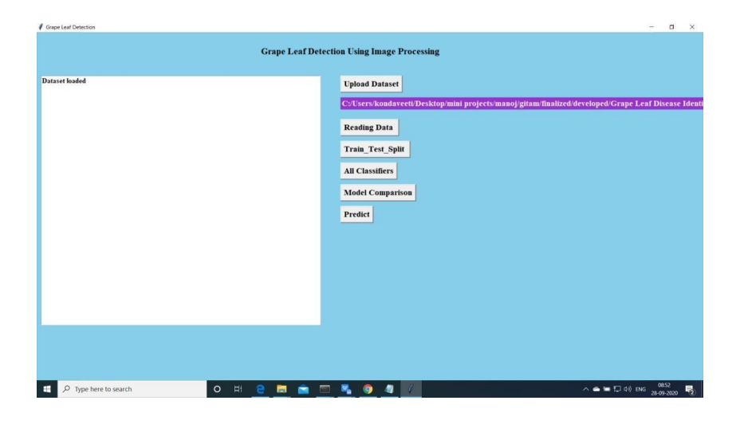
Python Code RUNTIME UI

Slide 23
Testing
Testing: Process of executing a program to find errors and ensure performance.
White Box Testing: Internal logic-based technique, including code coverage and conditions. Conducted by developers.
Black Box Testing: Verifies functionality without knowledge of internal code. Relies on requirements and functionality.
Unit Testing: Verifies individual units of source code, typically by the development team.
Integration Testing: Combines and tests software modules as a group, usually by testing teams.
Alpha Testing: Conducted at the developer's site, often by end users.
Beta Testing: Final testing before commercial release, typically by end users or others.
Performance Testing: Evaluates compliance with performance requirements, usually by performance engineers.

Slide 24
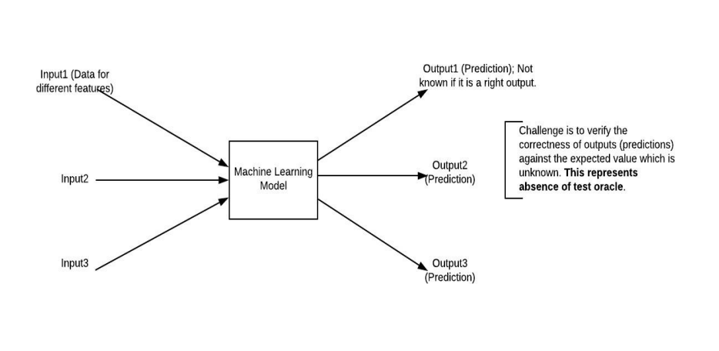
Black Box Testing
Definition: Testing application functionality without knowledge of internal implementation details.
Approach: Test cases based on requirement specifications. Also known as specification-based testing.
In Machine Learning Models: Testing ML models without knowing internal details (features, algorithms).
Challenge: Verifying test outcomes against expected values without internal model knowledge.

Slide 25
CONCLUSION
Objective: Proposed an automatic leaf recognition system for disease identification in grape leaves using machine learning techniques.
Segmentation Technique: Utilized the GrabCut segmentation technique to isolate leaf parts from the background effectively.
Disease Identification: Employed two methods for identifying diseased regions: global thresholding and semi-supervised learning techniques.
Feature Extraction: Extracted texture and color features from identified diseased parts for further analysis.
Classification Algorithms: Utilized SVM, Random Forest, and AdaBoost algorithms for disease classification.
Performance Evaluation: Achieved a testing accuracy of 93.035% by combining global thresholding with SVM classification.
Future Directions: Further refinement of segmentation techniques, exploration of advanced machine learning methods, and integration into precision agriculture practices for early disease detection and crop management.

Slide 26

FUTURE SCOPE
Improved Segmentation Techniques: Enhancing segmentation algorithms to achieve more accurate and precise isolation of leaf parts from backgrounds.
Refinement of Algorithms: Continuously refining and optimizing algorithms to improve disease identification accuracy and efficiency.
Integration of Advanced Machine Learning Techniques: Exploring advanced machine learning approaches such as deep learning and reinforcement learning to further enhance disease detection capabilities.
Automation and Scalability: Developing automated systems capable of scaling to handle larger datasets and diverse environmental conditions.
Collaborative Research: Collaborating with experts in fields like computer vision, agronomy, and data science to incorporate domain-specific knowledge and expertise into the system.
Field Testing and Validation: Conducting extensive field testing and validation studies to assess the real-world effectiveness and practicality of the developed system.
Deployment in Precision Agriculture: Implementing the system as part of precision agriculture practices to assist farmers in early disease detection and efficient crop management.
User-Friendly Interfaces: Designing intuitive and user-friendly interfaces for farmers and agricultural experts to easily interact with and benefit from the system.

Slide 27
Thank you
JYESHTA DEVAKUMARI
+91 9848337696
devakumari723@gmail.com

