Slide 1
DIGITAL PORTFOLIO
Student Name: Mohammed Yaseen A
Register NO: bruau2422K1177
NM.ID : 7F9A5A58B5D8AA998044D72019D3633E
DEPARTMENT :II-B.Sc. (Computer Science)
College: Government Arts & Science (CO-Education) College -Avinashi

Slide 2

Project title
DIGITAL PORTFOLIO

Slide 3
Agenda
Problem Statement Project Overview End Users Tools And Technologies Portfolio Design And Layout Features and Functionality Results and Screenshots Conclusion Github link

Slide 4
Problem Statement
Traditional resumes and portfolios are static and fail to showcase interactivity, responsiveness, and modern design skills.
This project aims to build a digital portfolio that highlights my technical expertise, creativity, and user experience design skills in a dynamic and engaging way.

Slide 5
Project Overview
Developed a responsive and interactive personal portfolio dashboard using HTML, CSS, and JavaScript.
The project includes sections such as About Me, Education, Projects, Certificates, Skills, and Contact, all presented with modern UI/UX principles and responsive design.

Slide 6
End Users
• Recruiters and Hiring Managers reviewing my profile.
• Potential clients looking for web development and UI/UX services.
• Fellow developers and collaborators exploring my work and skills.

Slide 7
Tools and Technologies
• HTML5, CSS3, JavaScript
• FontAwesome for icons
• Local Storage for theme persistence
• Responsive Design with Flexbox/Grid
• GitHub for version control and hosting

Slide 8
Portfolio Design and Layout
• Sidebar navigation with profile and quick links.
• Main dashboard with interactive cards (Projects, Skills, Certificates).
• Light/Dark mode toggle with saved preferences.
• Sections: About Me, Education, Projects, Certificates, Skills, Contact.
• Clean, modern, and responsive layout with consistent typography and colors.

Slide 9
Features and Functionality
• Interactive dashboard navigation.
• Theme toggle (light/dark mode) stored in local storage.
• Typing animation showcasing roles: Web Developer, UI/UX Designer, Problem Solver.
• Resume download button.
• Responsive project and certificate grids with images and embedded previews.

Slide 10
Results and Screenshots
• Successfully built a fully functional and visually appealing portfolio.
• Demonstrated frontend skills with modern design practices.
• Screenshots showcase responsive design, interactive features, and structured content.

Slide 11
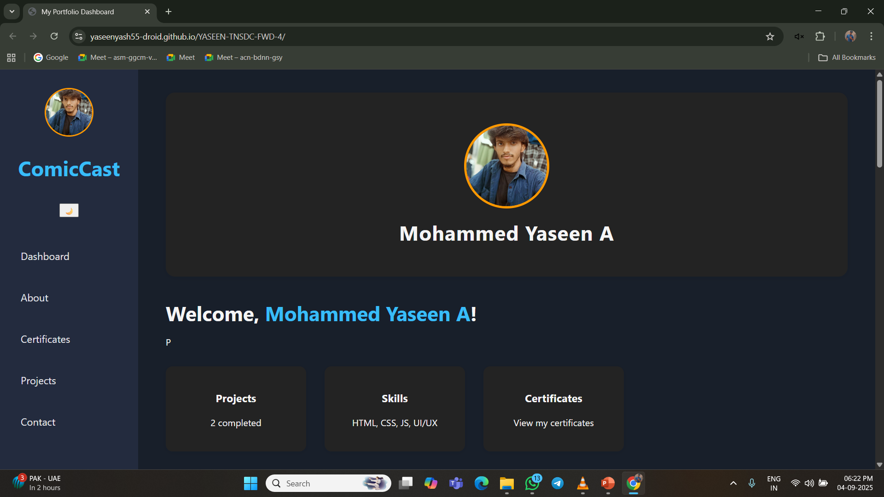
screenshots

Slide 12
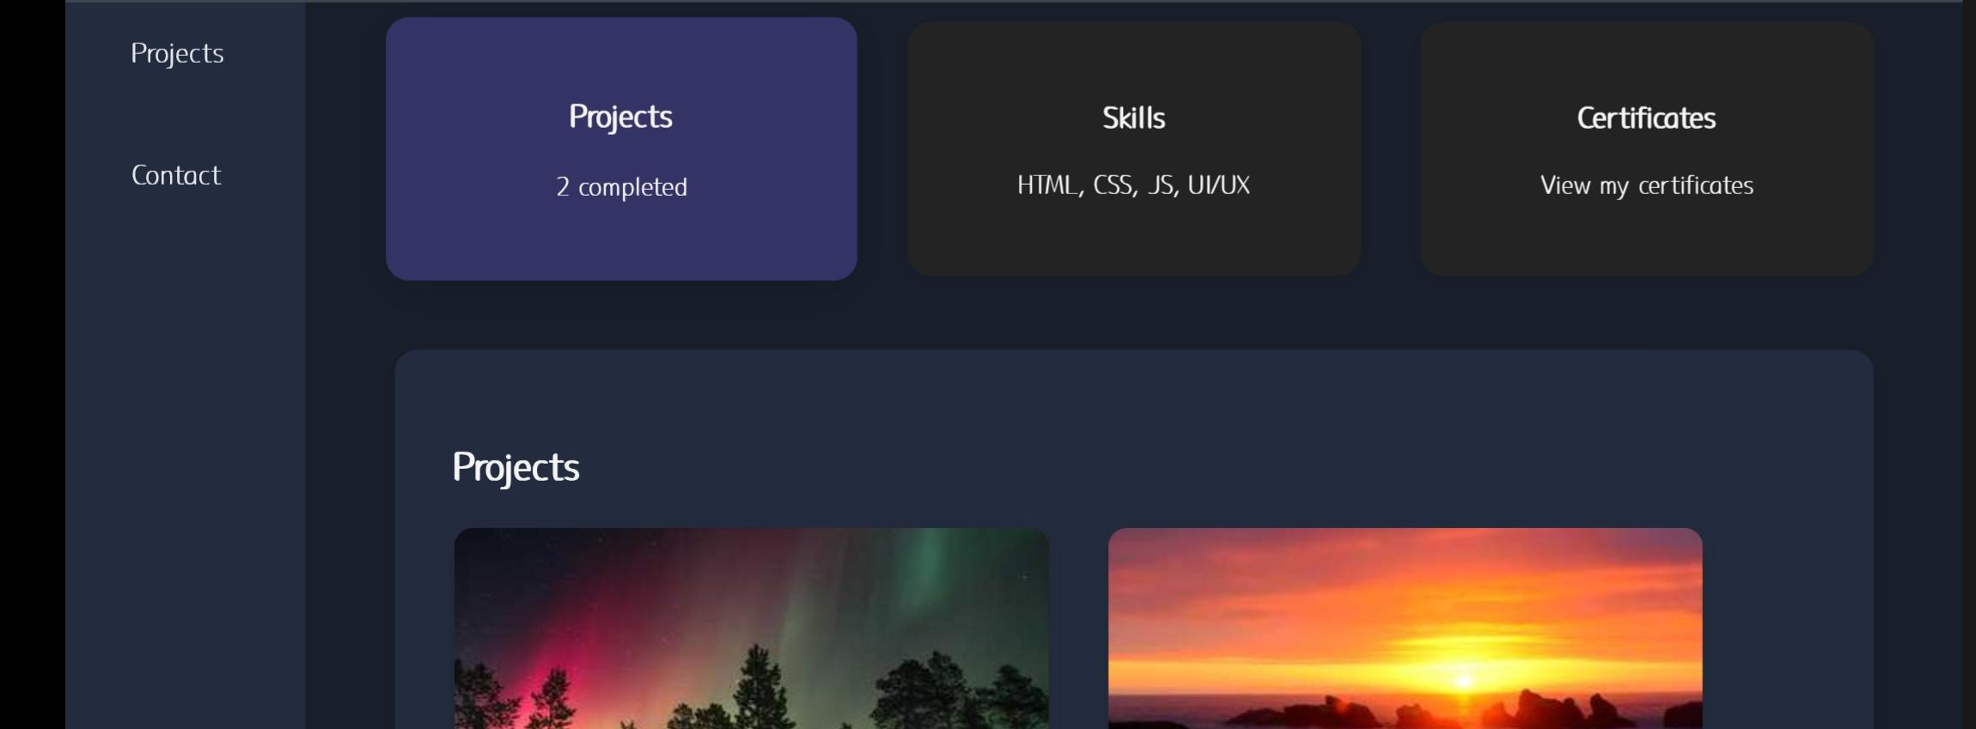
PROJECTS

Slide 13
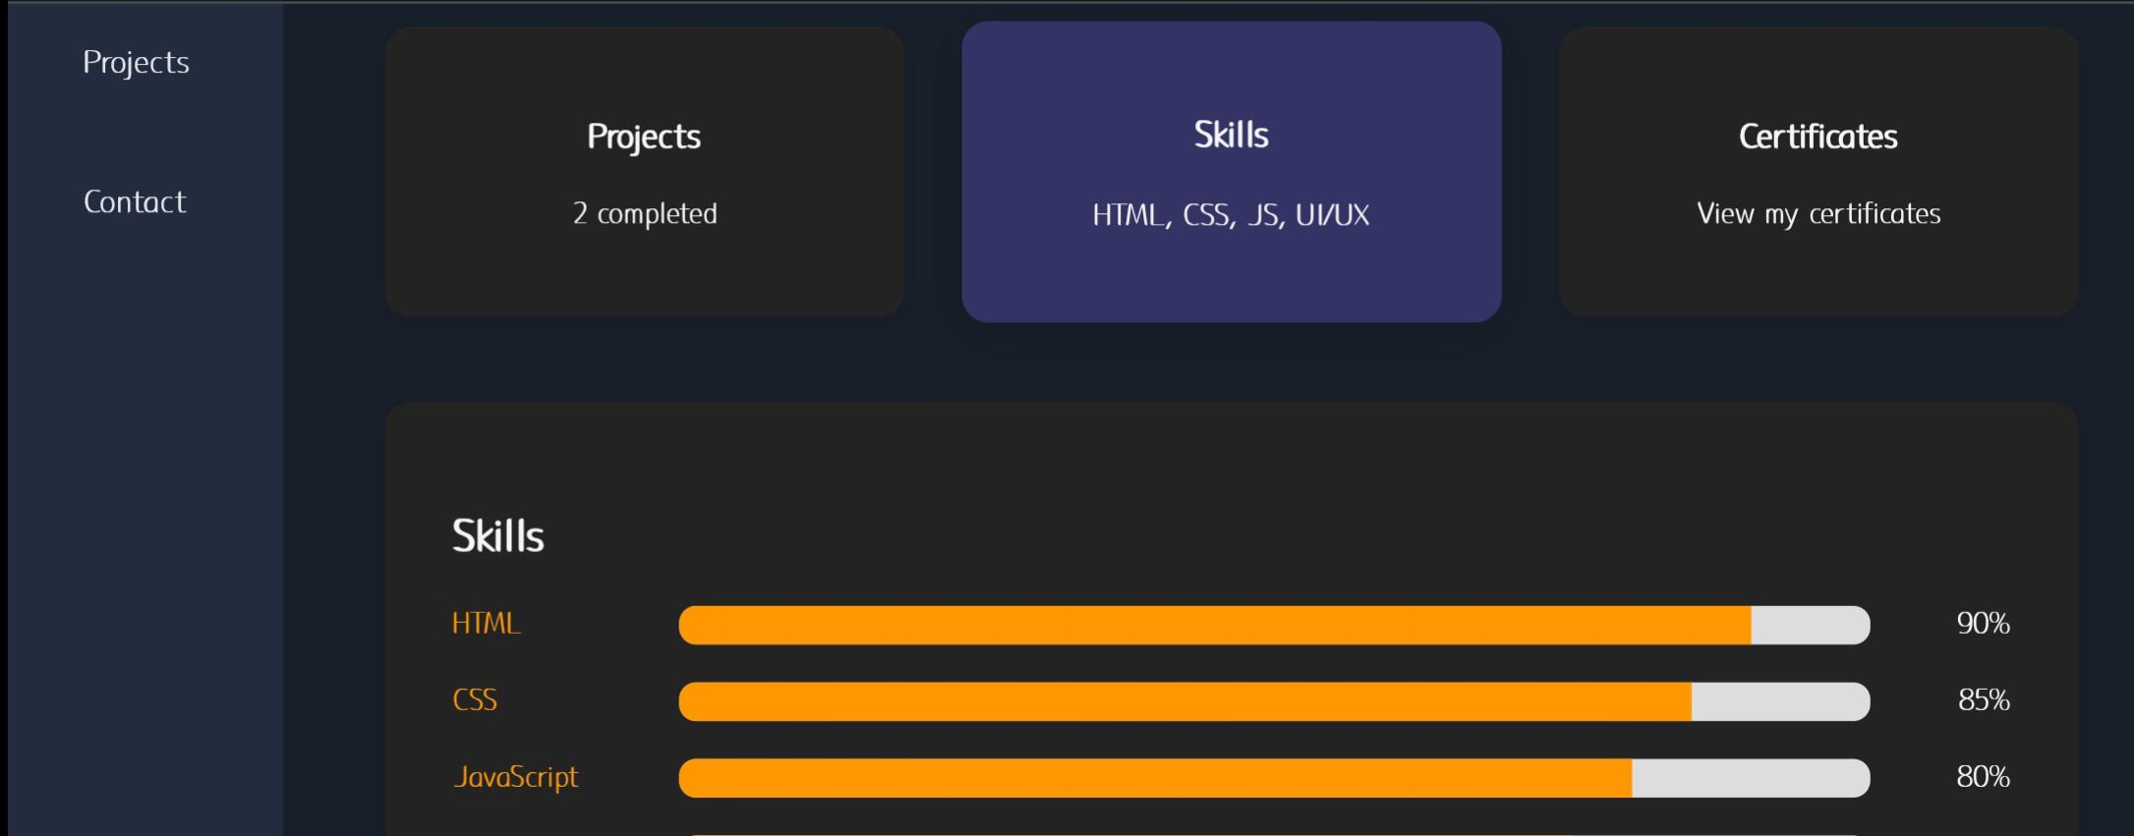
Skills

Slide 14
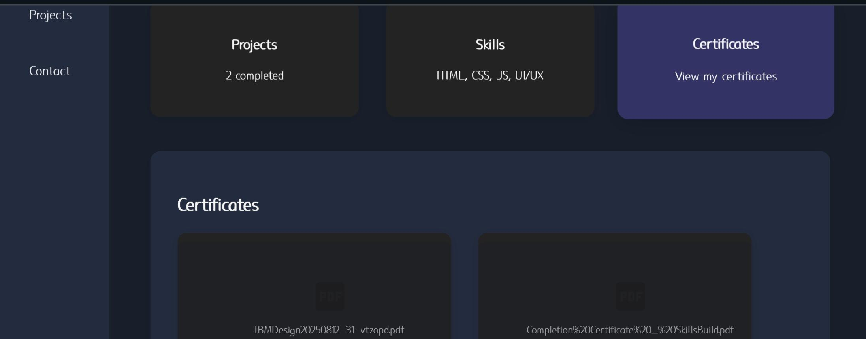
CERTIFICATES

Slide 15
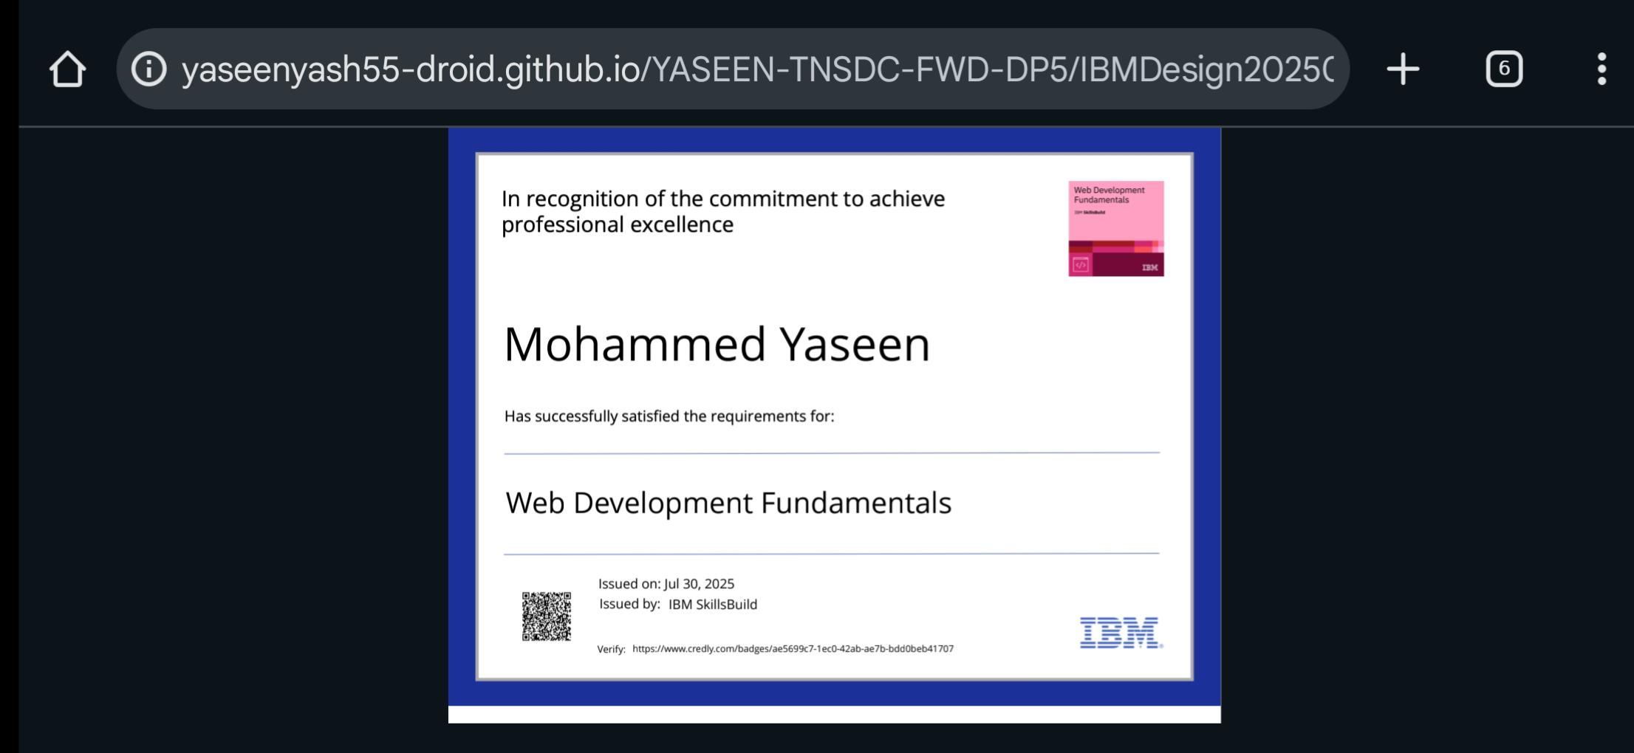
CERTIFICATE

Slide 16
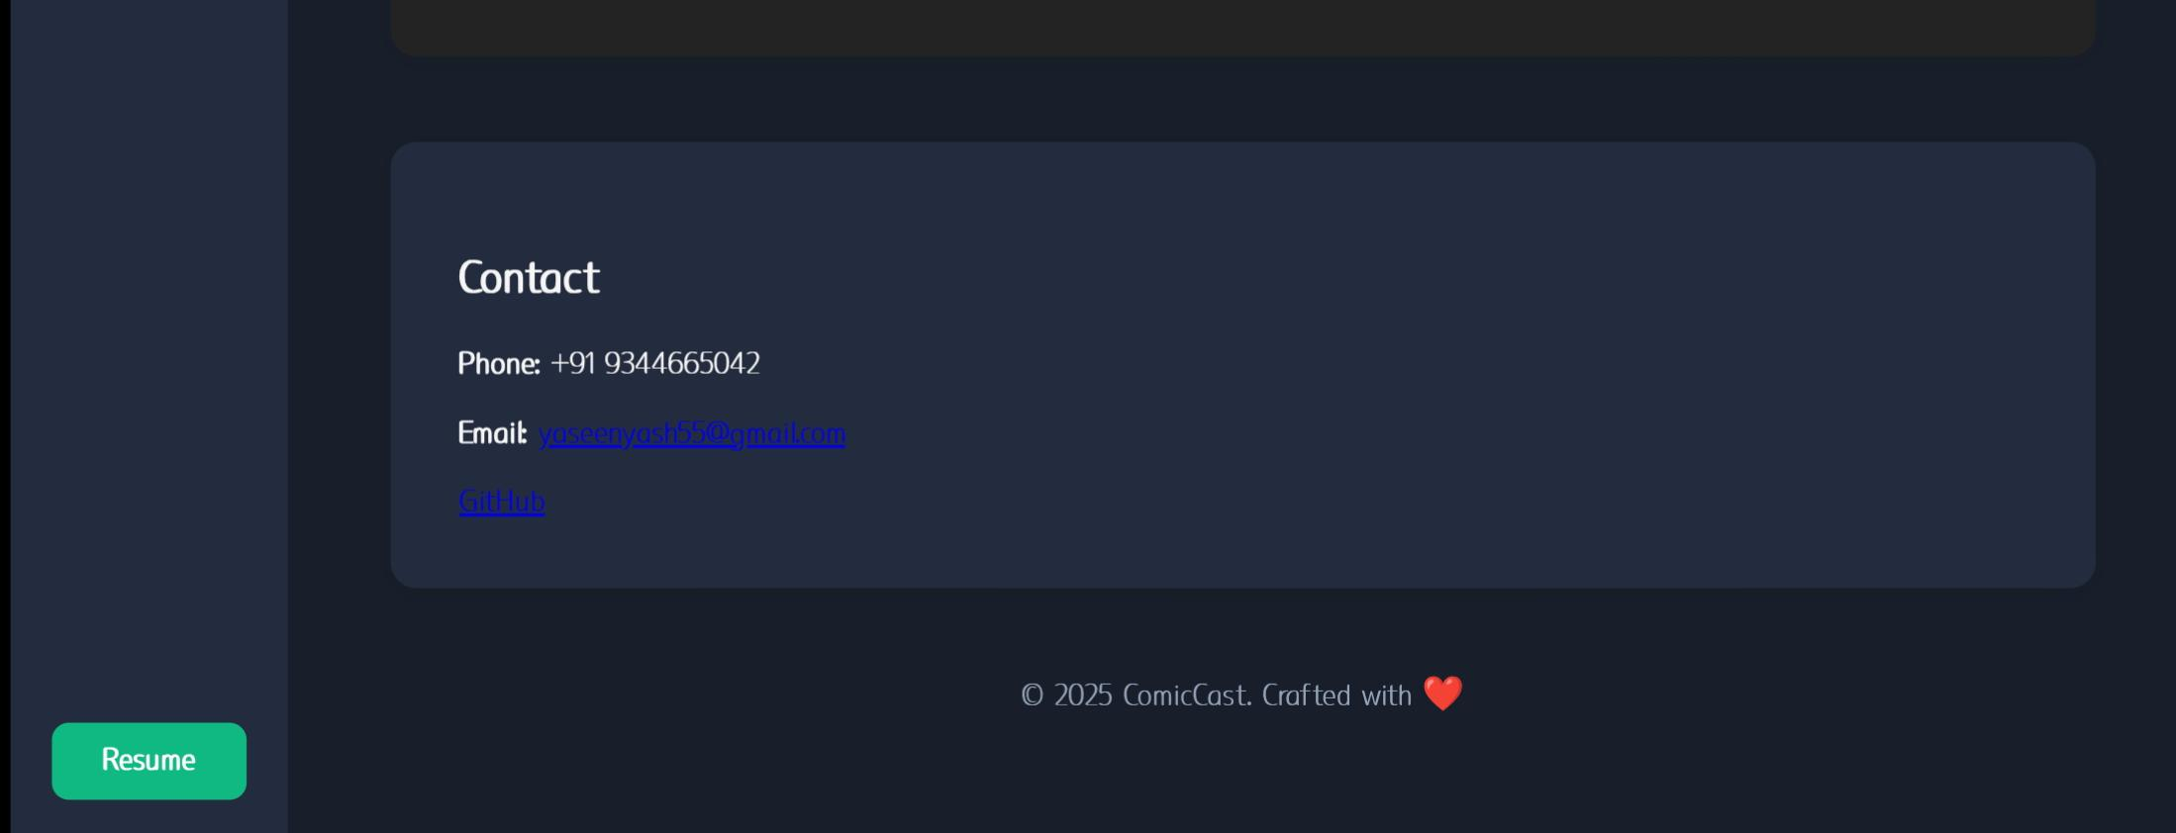
CONTACT

Slide 17
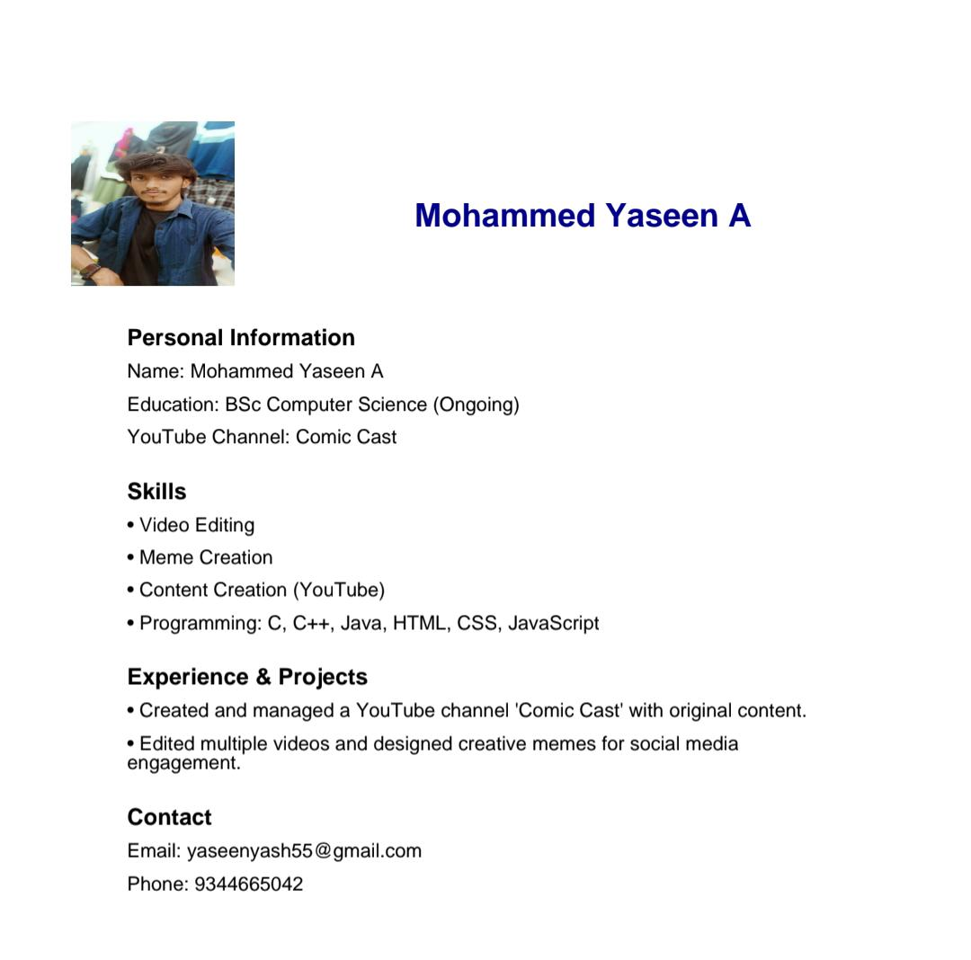
RESUME

Slide 18
Conclusion
This project highlights my ability to design and develop interactive web-based portfolios using modern frontend technologies.
It demonstrates creativity, technical expertise, and attention to detail, making it an effective tool for showcasing skills to recruiters and collaborators.

Slide 19
GitHub Link
https://github.com/yaseenyash55-droid/YASEEN-TNSDC-FWD-DP6.git
Notes:
https://github.com/yaseenyash55-droid/YASEEN-TNSDC-FWD-DP5.git

