Slide 1
Community Information Processing Application: Motive
Yasemin Alpay

Slide 2
Purpose of The Project
Motive is a community information processing project.
Meaning; it allows you to share your ideas in a limitless way.
You can create motives, what motivates you in your life, and collaborate with people all over the world about these motives.

Slide 3
Main Features
Create new motives each having custom fields to suit your needs
Create content under these motives
View content details
Comment, share your ideas

Slide 4
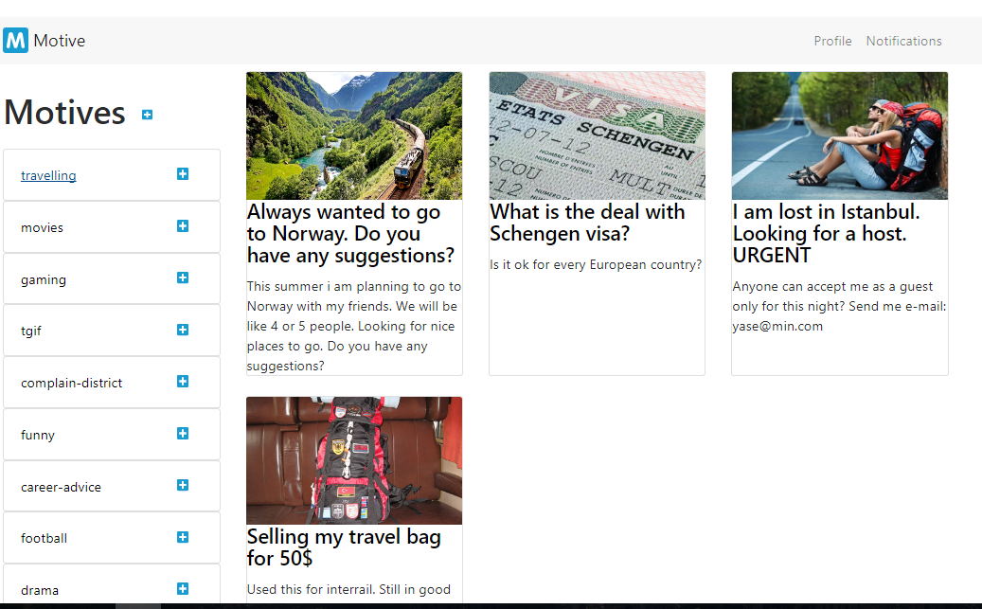
User Interface

Slide 5
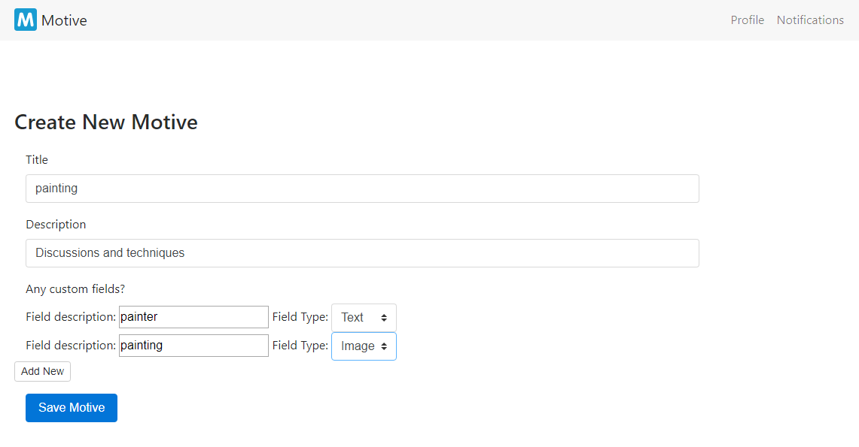
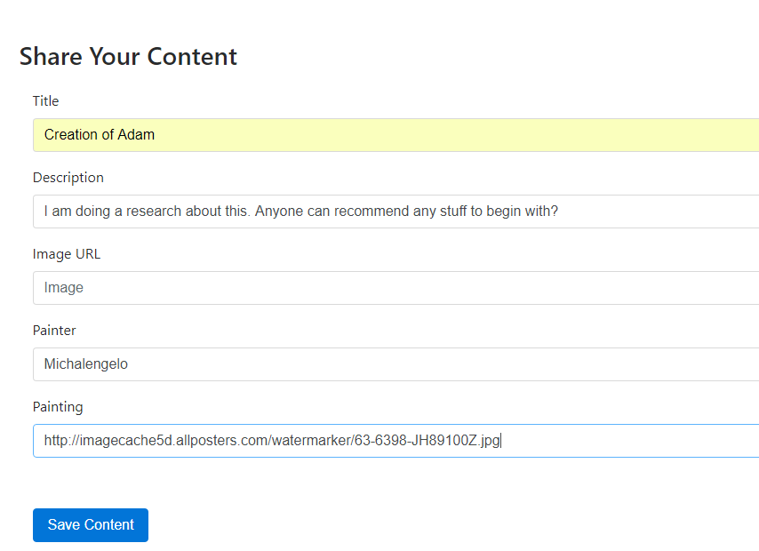
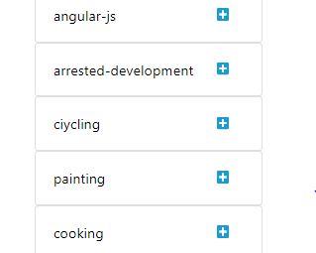

Slide 6
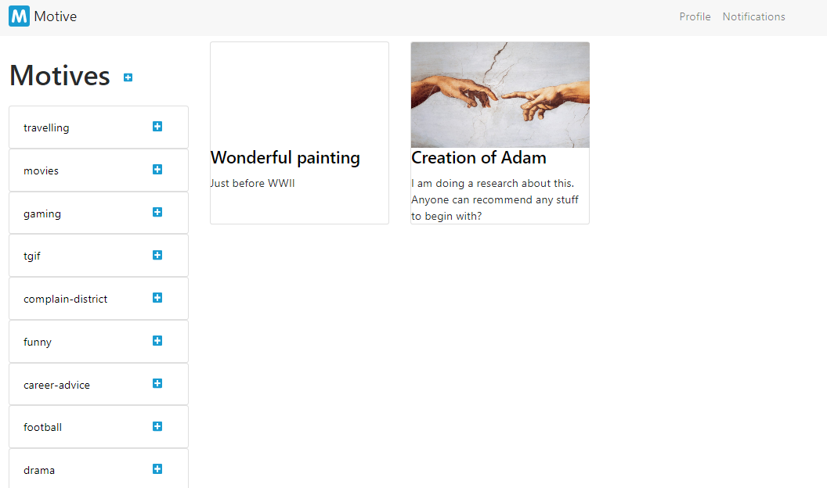

Slide 7
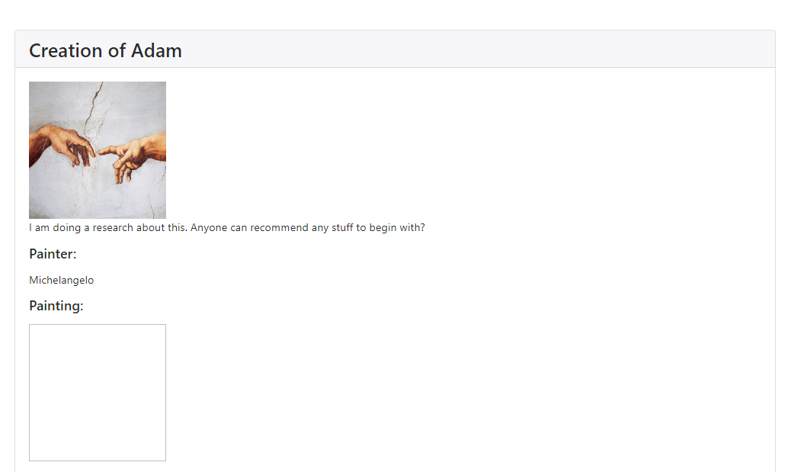
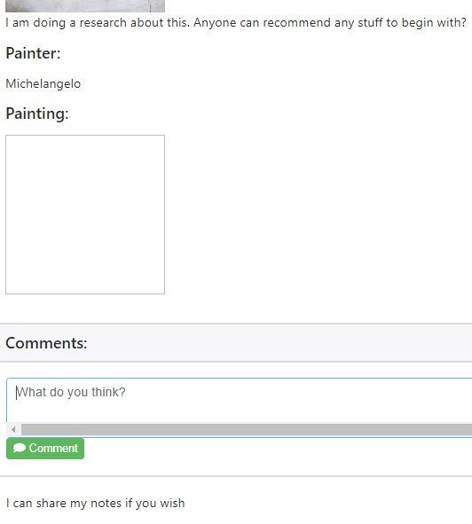

Slide 8
Technical Overview
IDE and Tools:
Robo 3T (Previously Robomongo) for MongoDB
IntelliJ Idea 2017
Eclipse Oxygen
Source Control:
Git with GitHub (https://github.com/yaseminalpay/motive)
Continuous Integration:
Travis CI with Github integration
Deployment
Amazon Web Services (Elastic Beanstalk and EC2)
Project Process Management:
GitHub
Backend
Spring Boot
Gradle 4.4
MongoDB 3.6
Frontend
Angular JS 1.5.8
Bootstrap 4
Font Awesome 4
jQuery
Testing
Mockito
JUnit

Slide 9
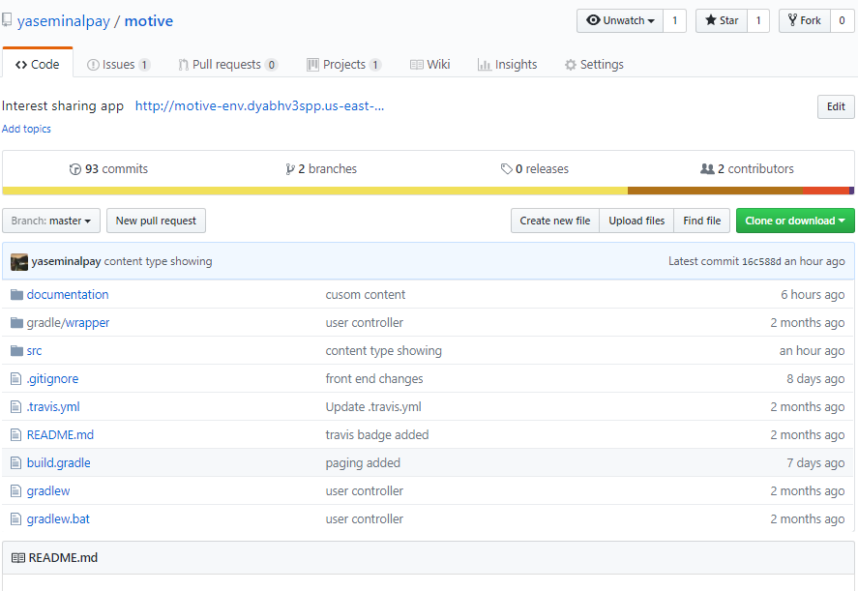
Process Management

Slide 10
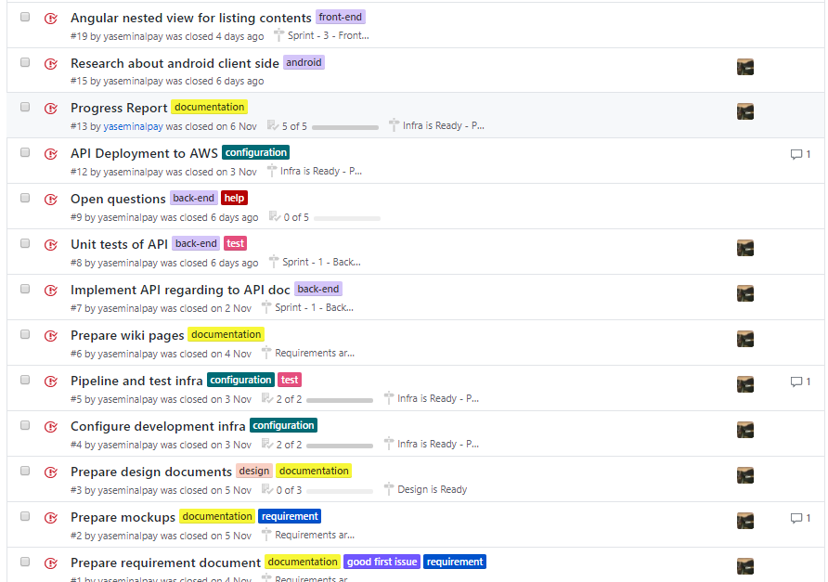

Slide 11
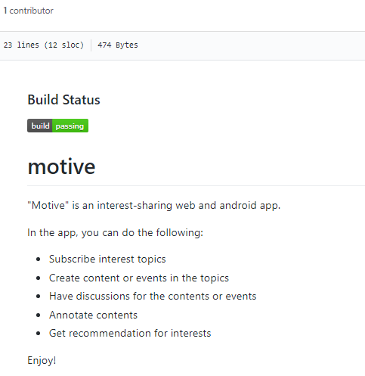
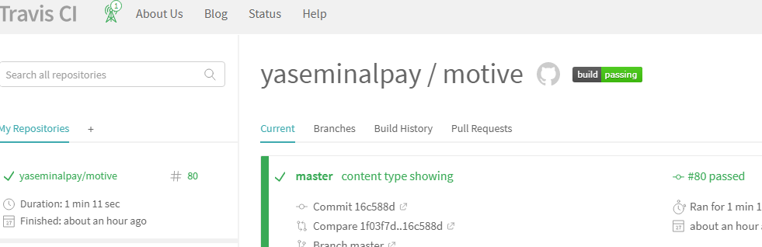
Continuous Integration

Slide 12
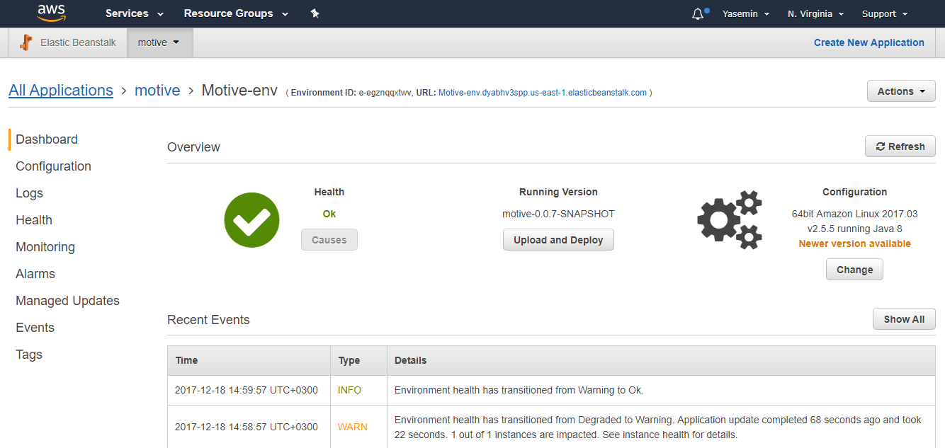
Deployment

Slide 13
Demo
http://motive-env.dyabhv3spp.us-east-1.elasticbeanstalk.com/index.html

