Slide 1




Build Ontology View on ArchiMate 3.2 Specification
001
Opening

Slide 2

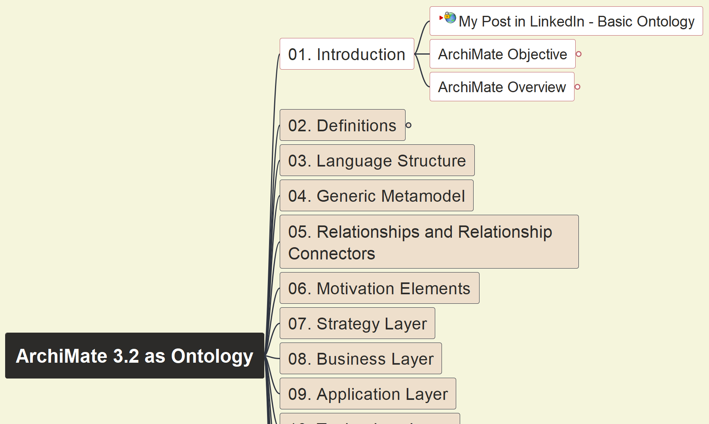
Build Ontology View on ArchiMate 3.2
002
ArchiMate Language Objective

Slide 3
Build Ontology View on ArchiMate 3.2
003
ArchiMate Language Overview

Slide 4
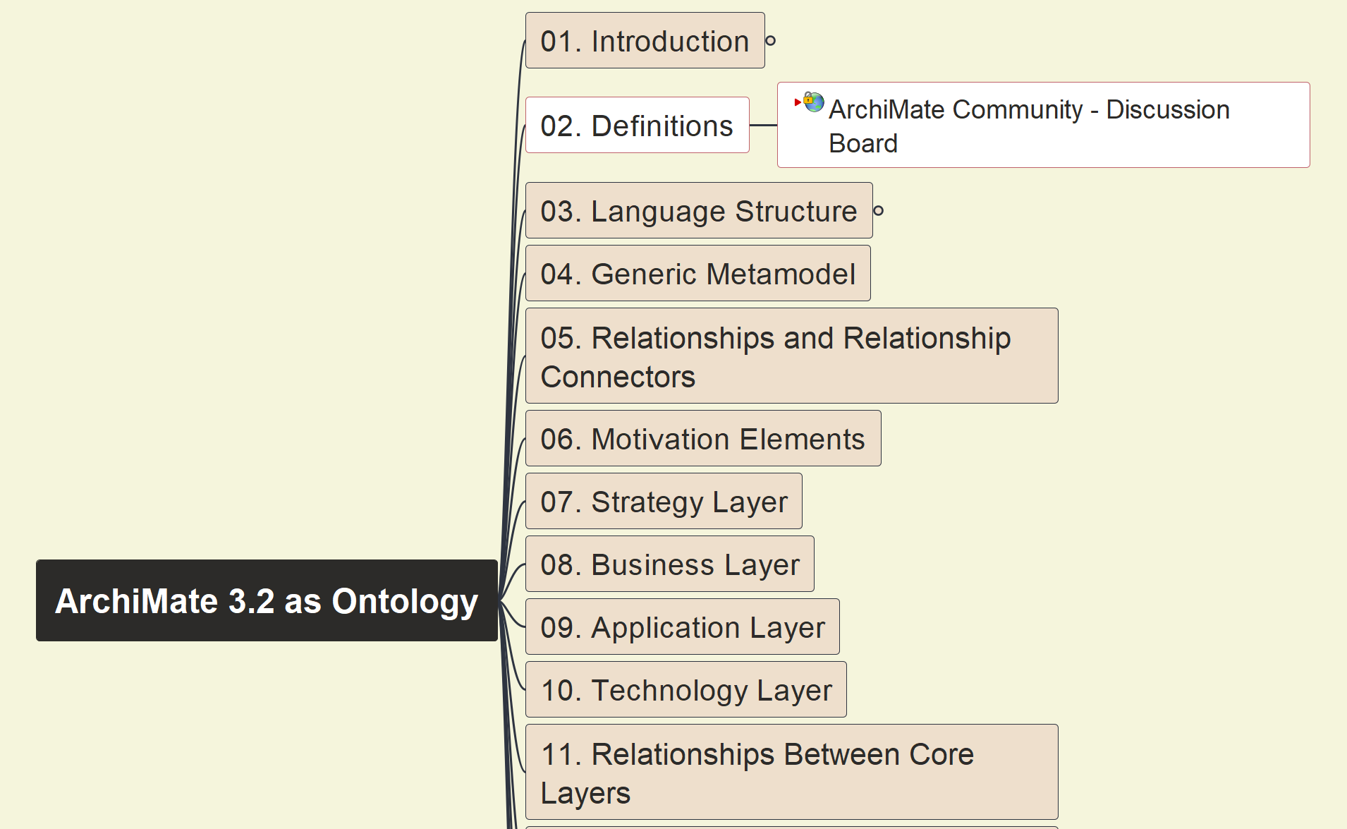
Build Ontology View on ArchiMate 3.2
004
ArchiMate Definition

Slide 5
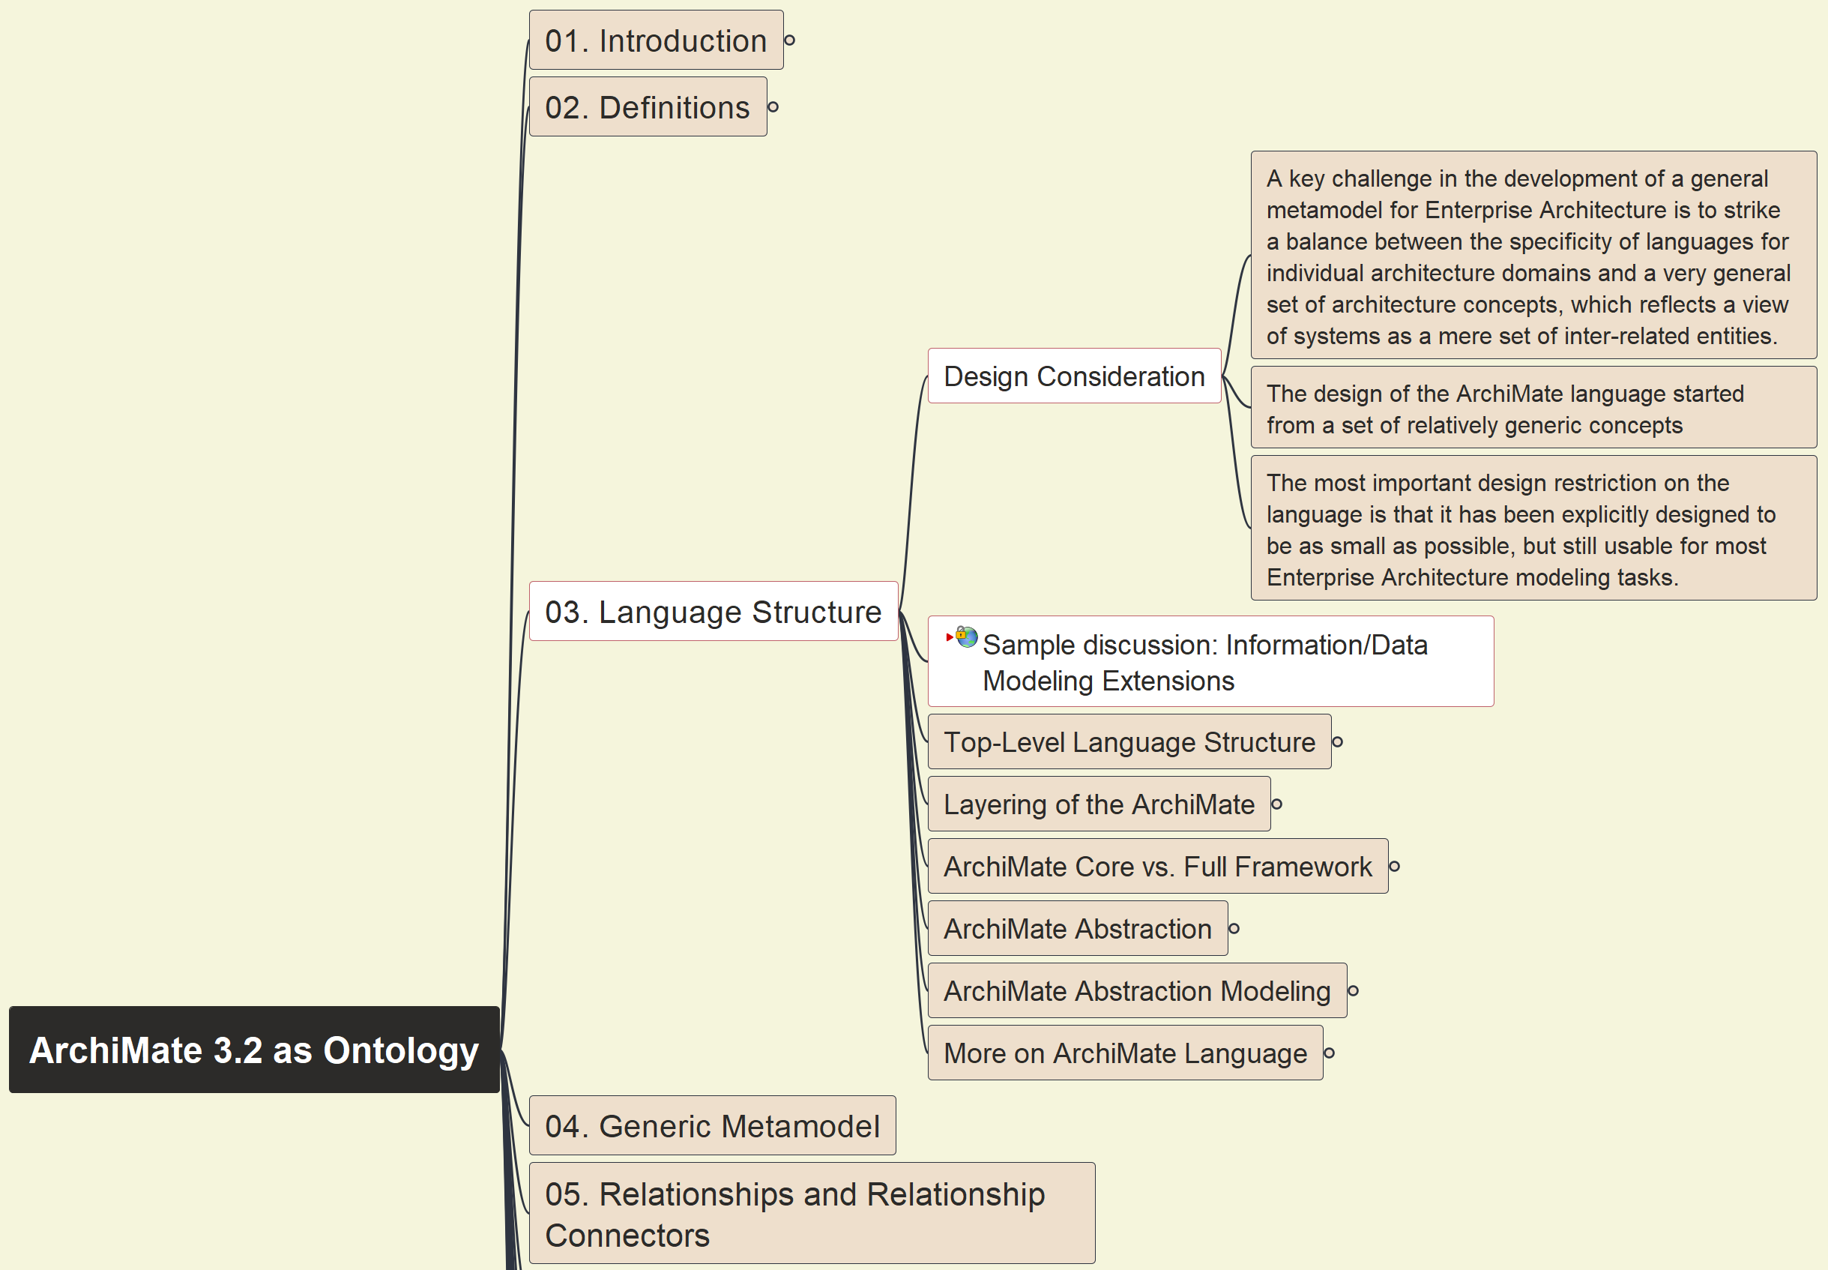
Build Ontology View on ArchiMate 3.2
005
ArchiMate Structure – Design Consideration

Slide 6
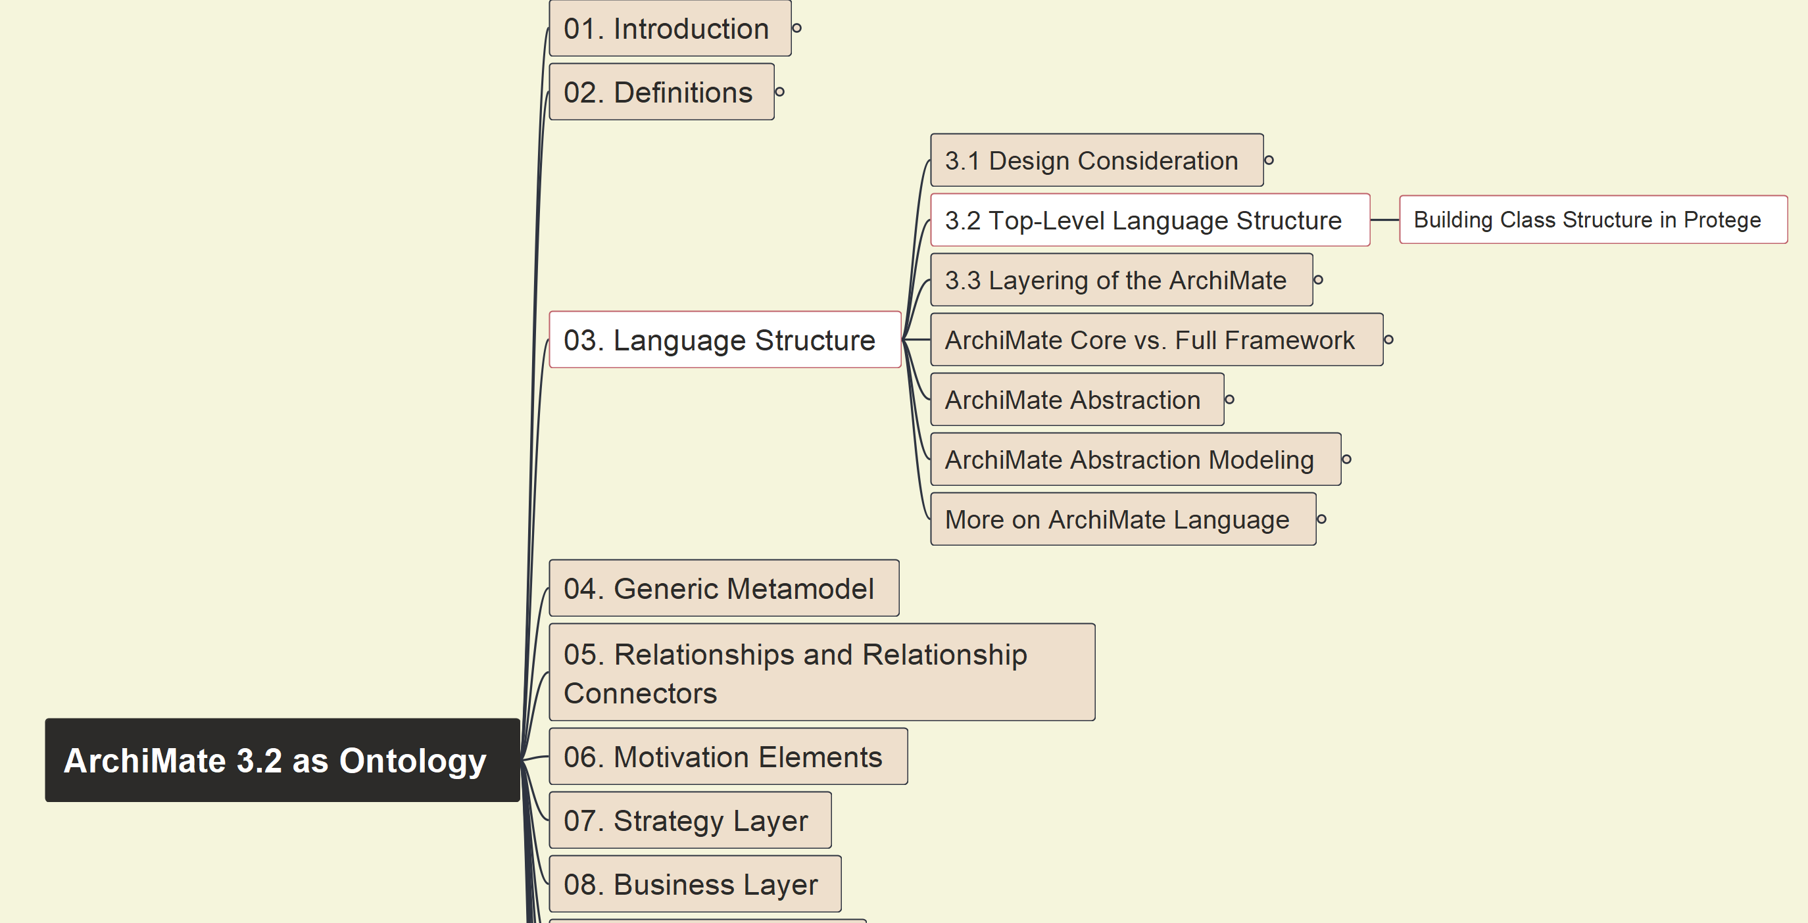
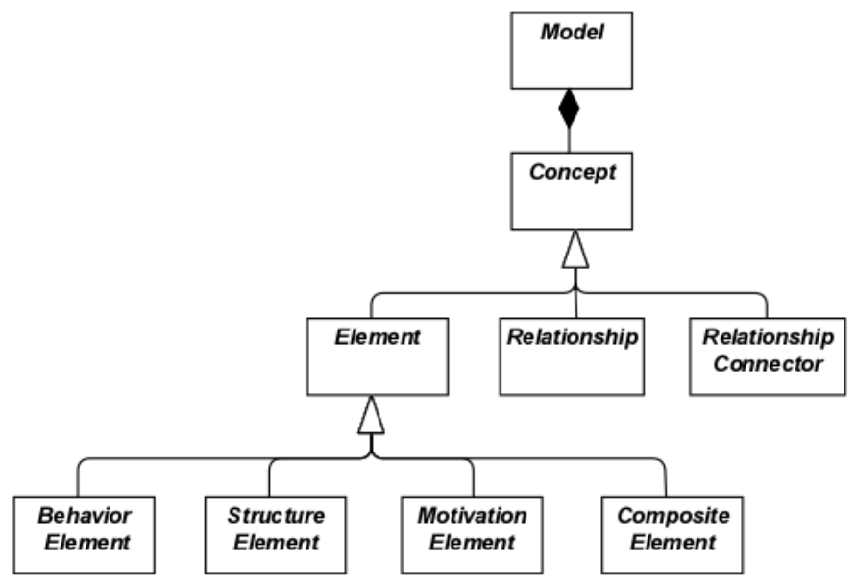
Build Ontology View on ArchiMate 3.2
006
ArchiMate Top-Level Structure

Slide 7
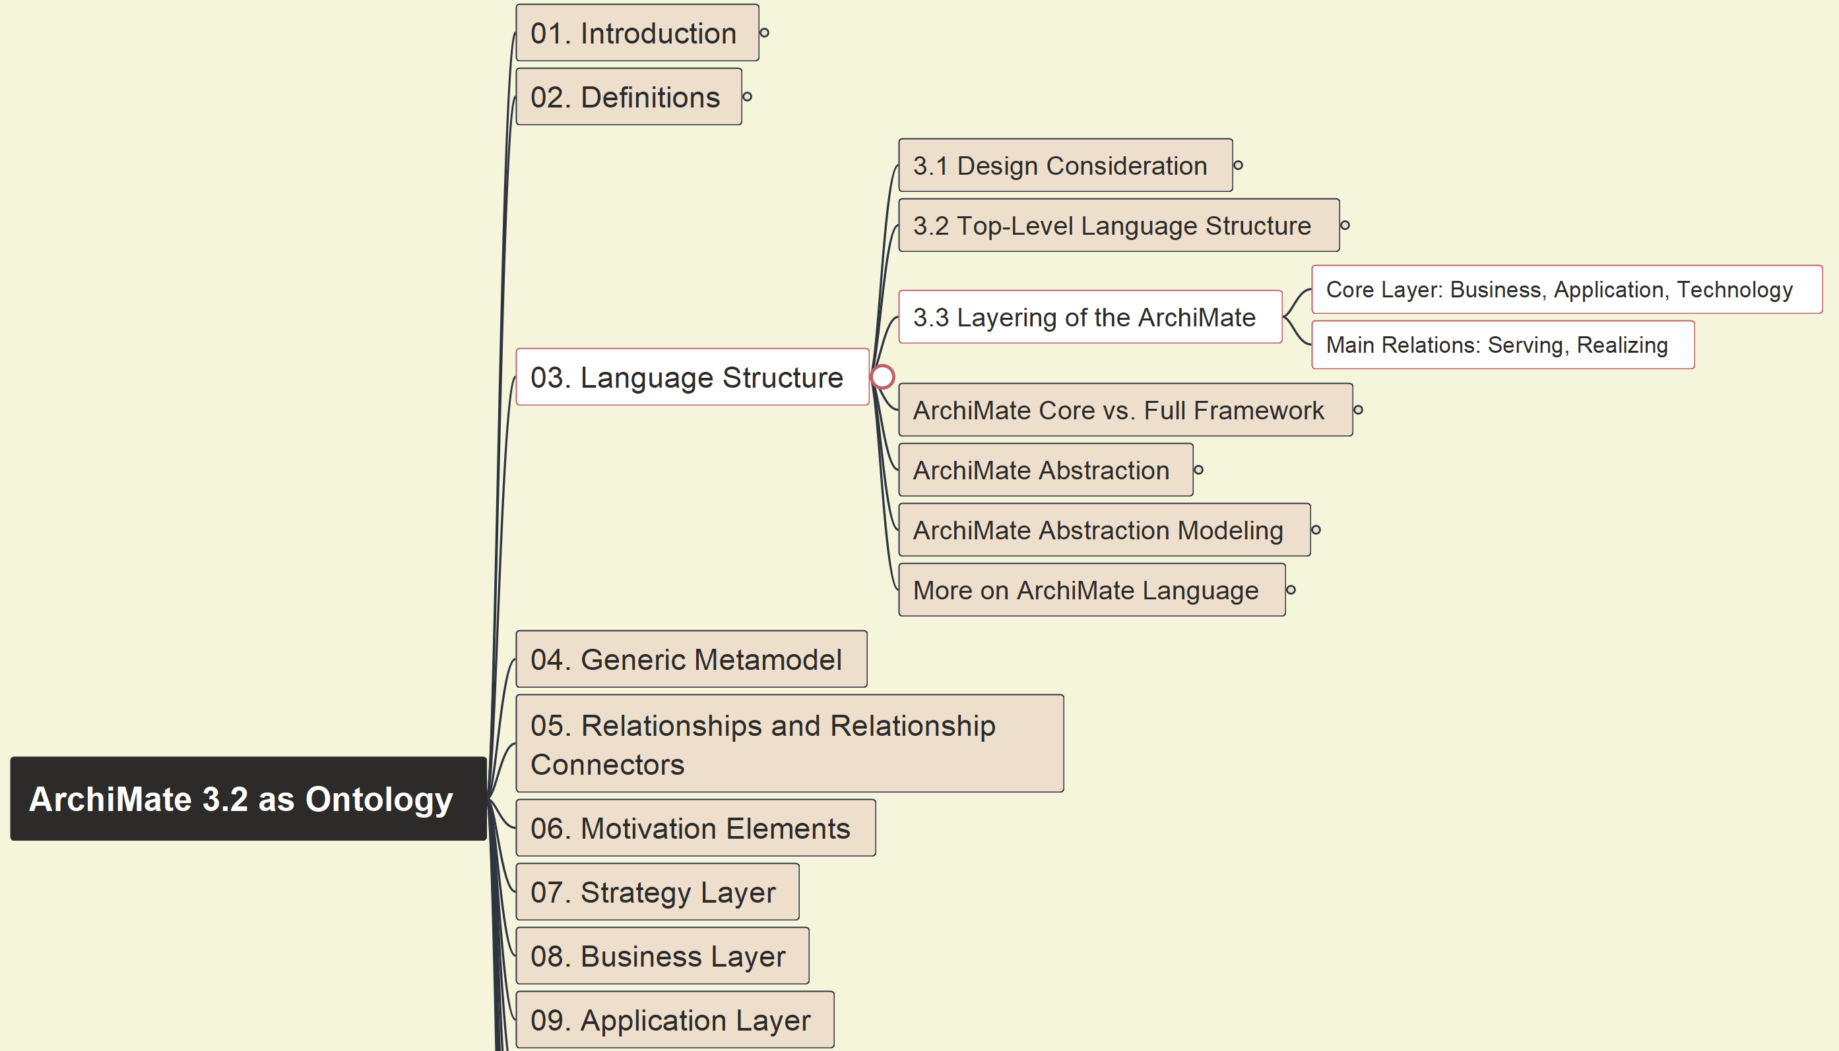
Build Ontology View on ArchiMate 3.2
007
ArchiMate Layering

Slide 8
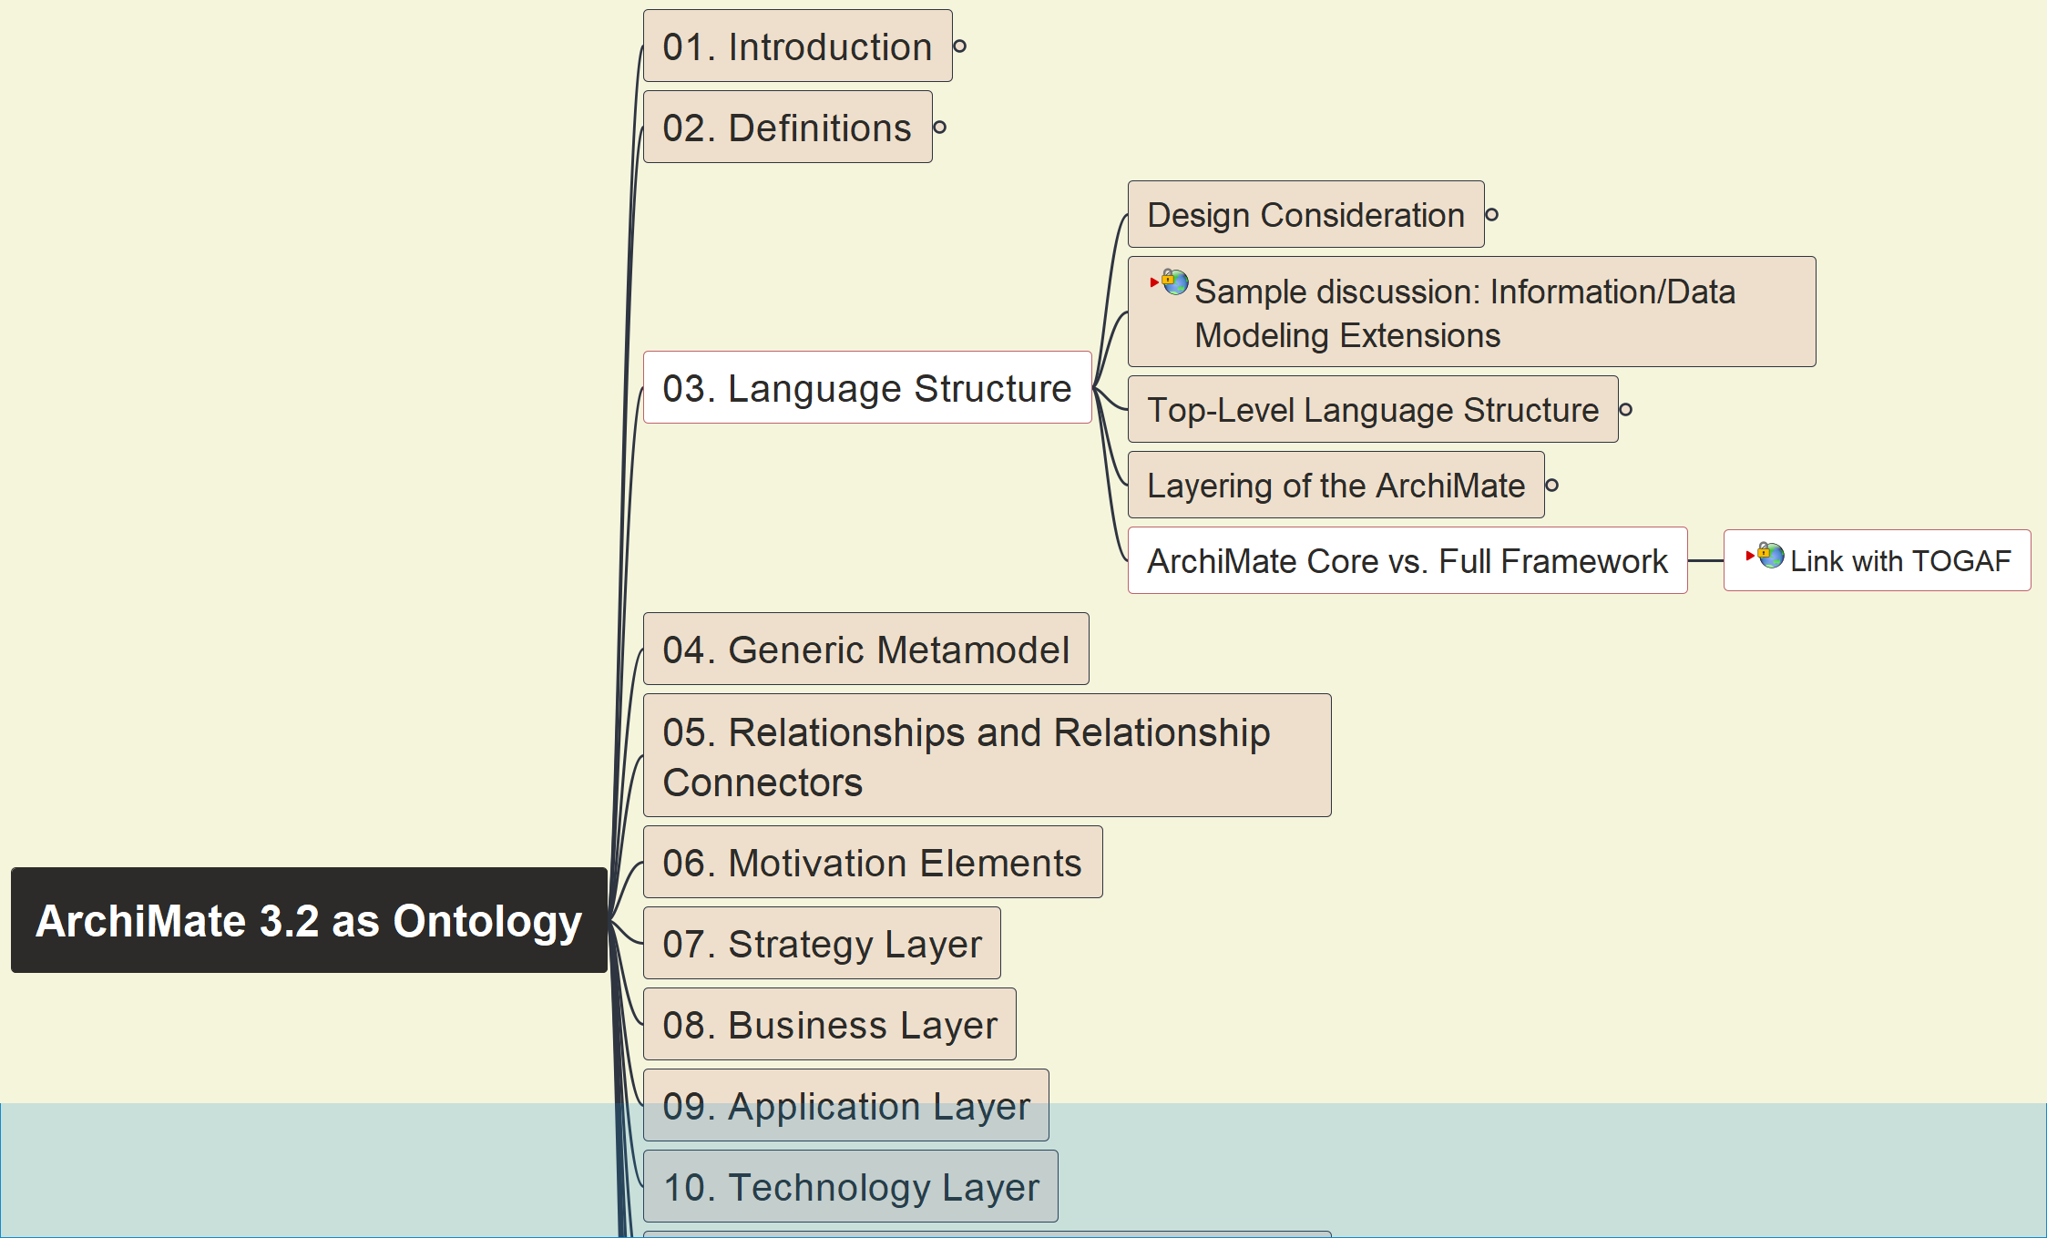
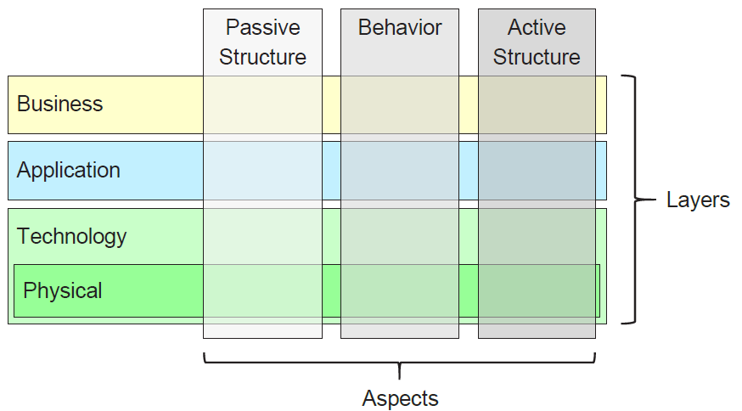
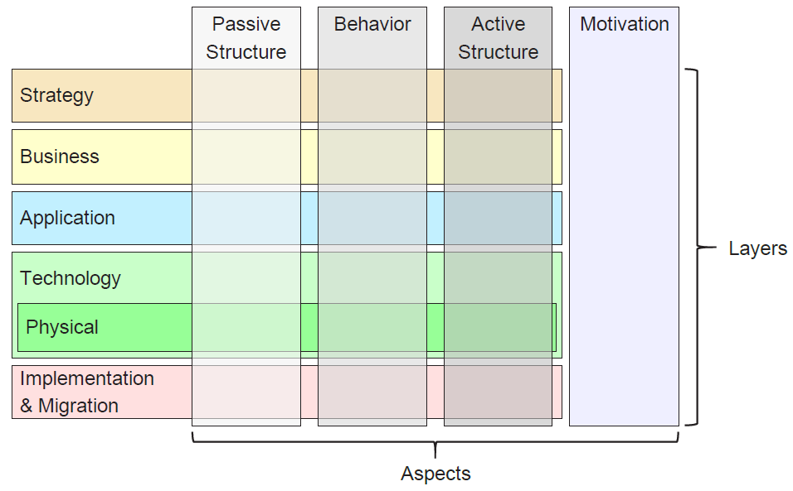
Build Ontology View on ArchiMate 3.2
008
ArchiMate Core vs. Full Framework

Slide 9
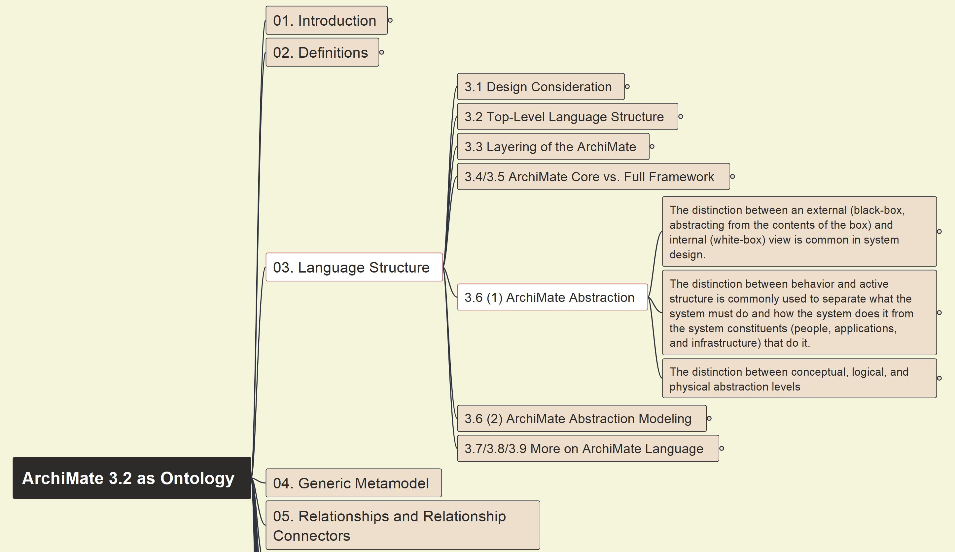
Build Ontology View on ArchiMate 3.2
009
ArchiMate Language Abstraction

Slide 10
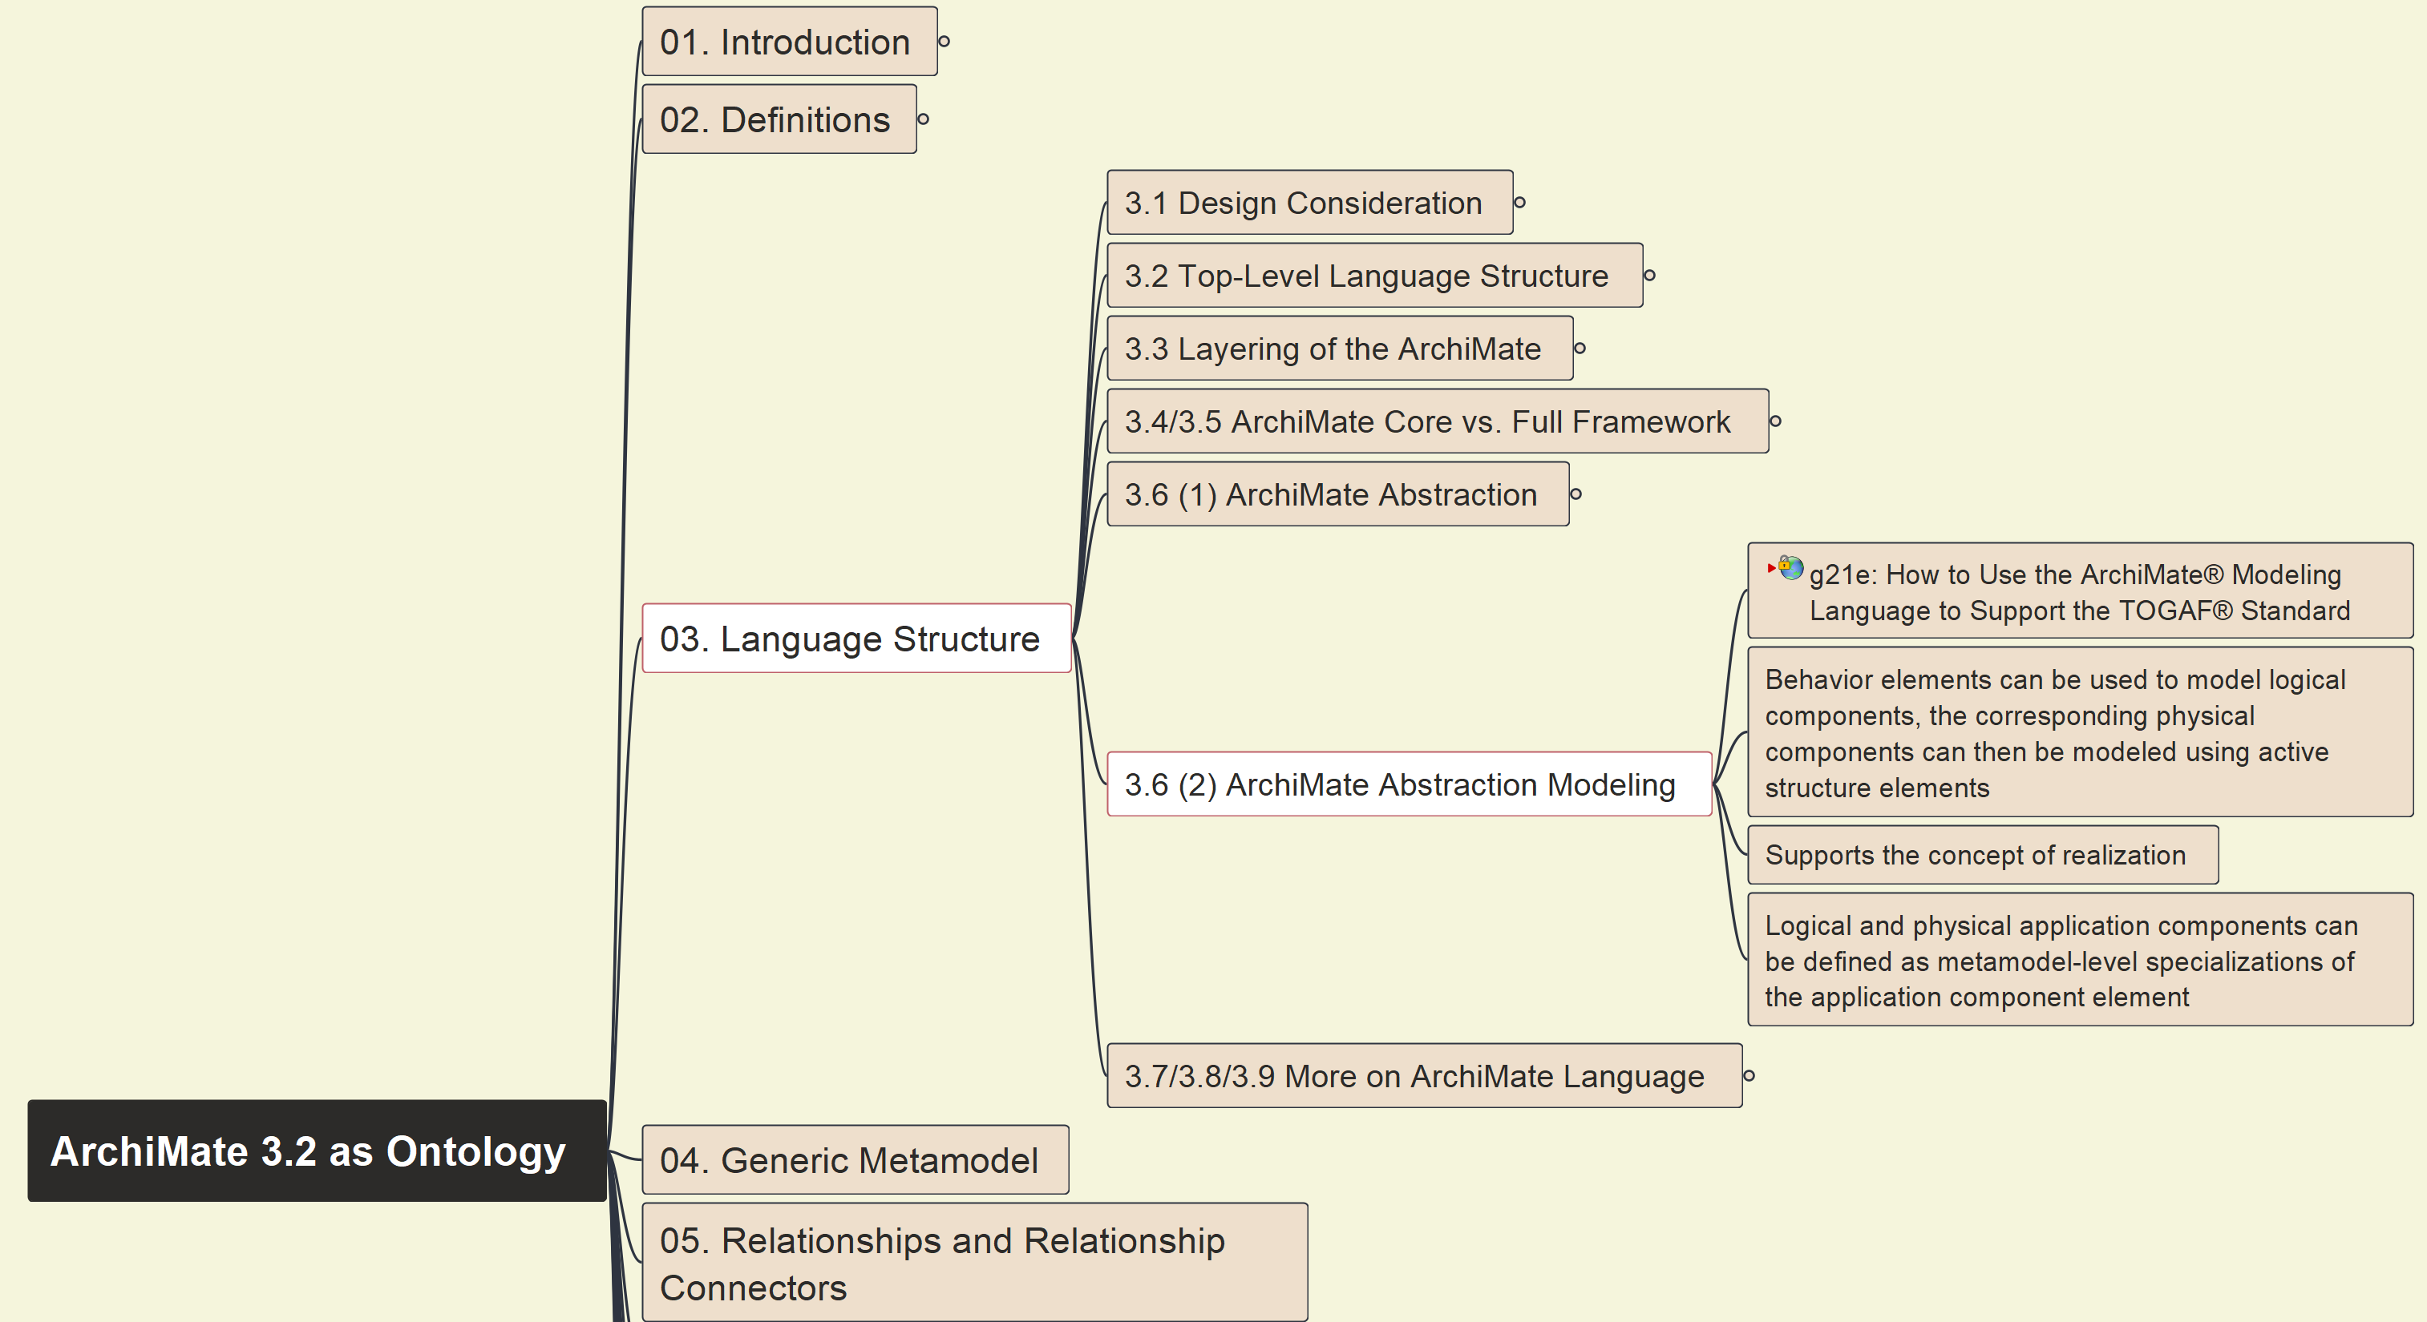
Build Ontology View on ArchiMate 3.2
010
ArchiMate Abstraction and Modeling

Slide 11
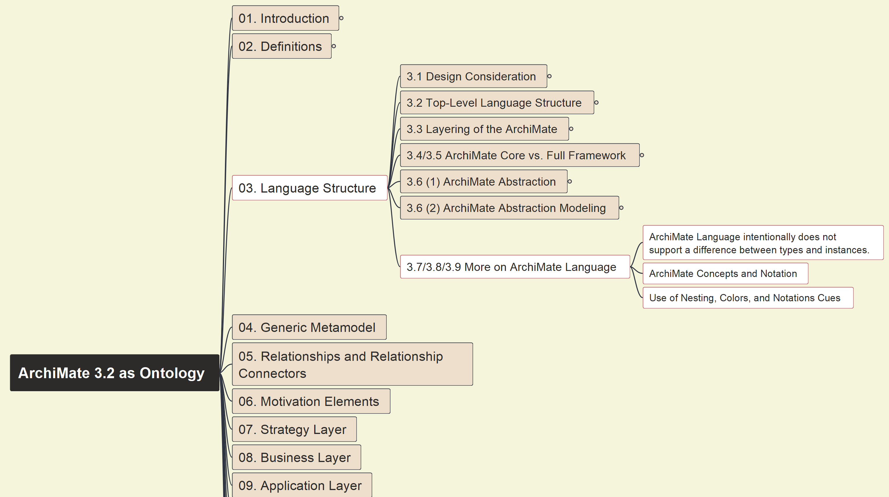
Build Ontology View on ArchiMate 3.2
011
More on ArchiMate Language Structure

Slide 12
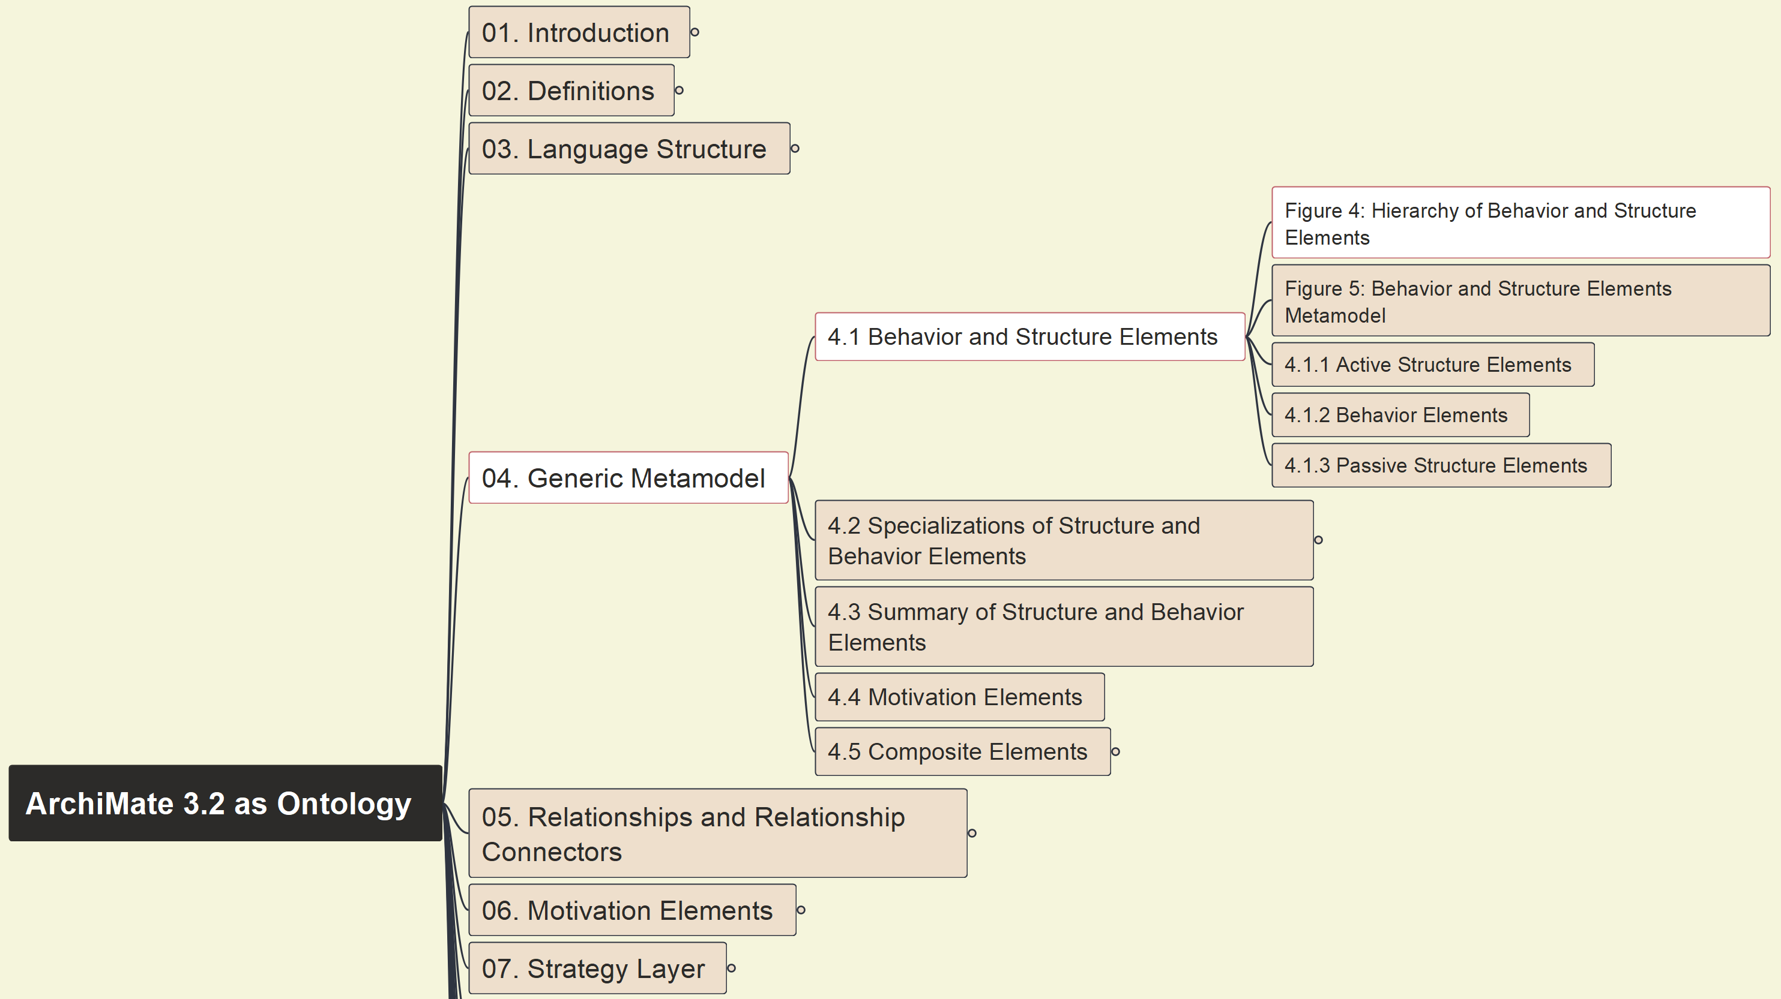
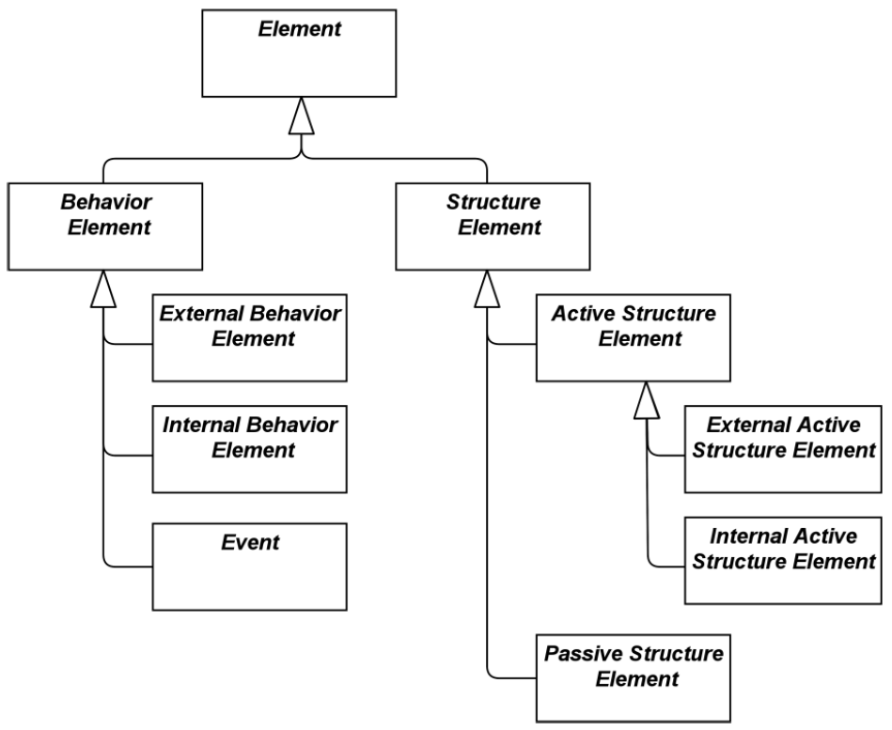
Build Ontology View on ArchiMate 3.2
012
4.1 Behavior and Structure Elements (1)

Slide 13
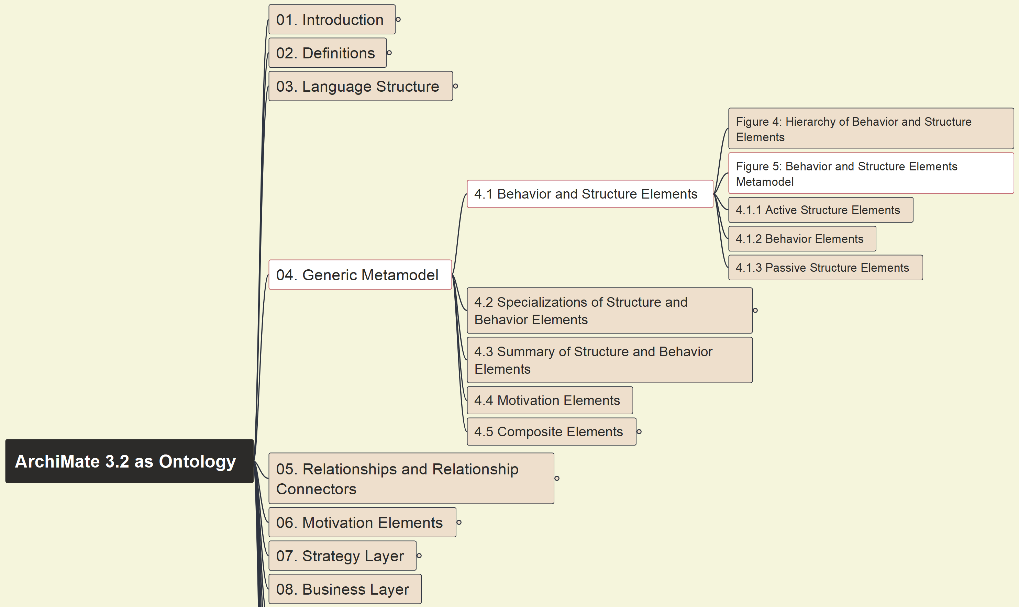
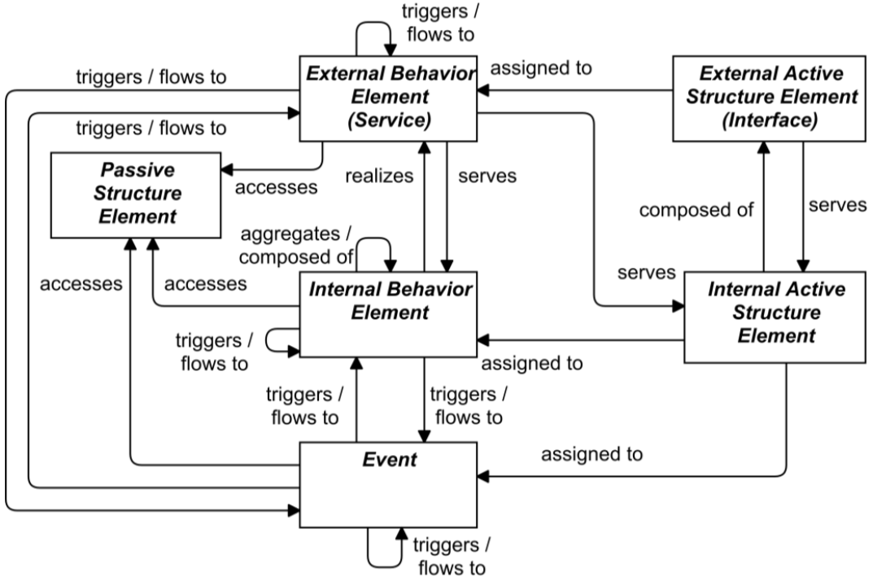
Build Ontology View on ArchiMate 3.2
013
4.1 Behavior and Structure Elements (2)

Slide 14
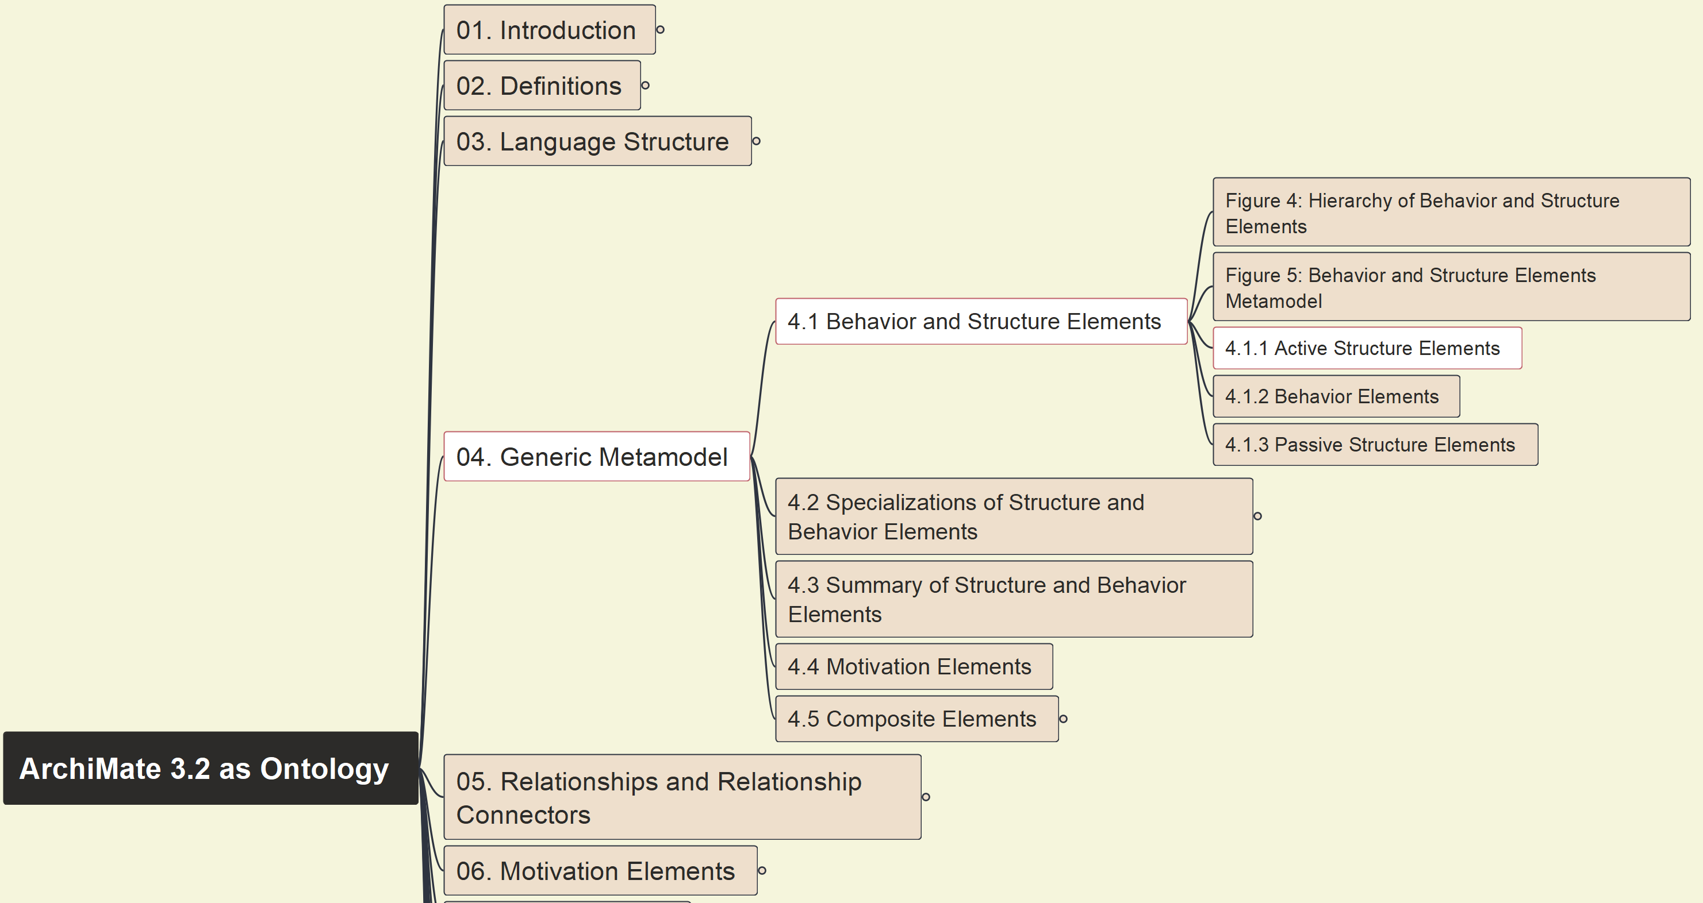
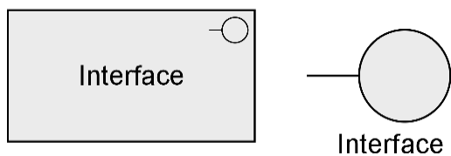

Build Ontology View on ArchiMate 3.2
014
4.1.1 Active Structure Elements

Slide 15
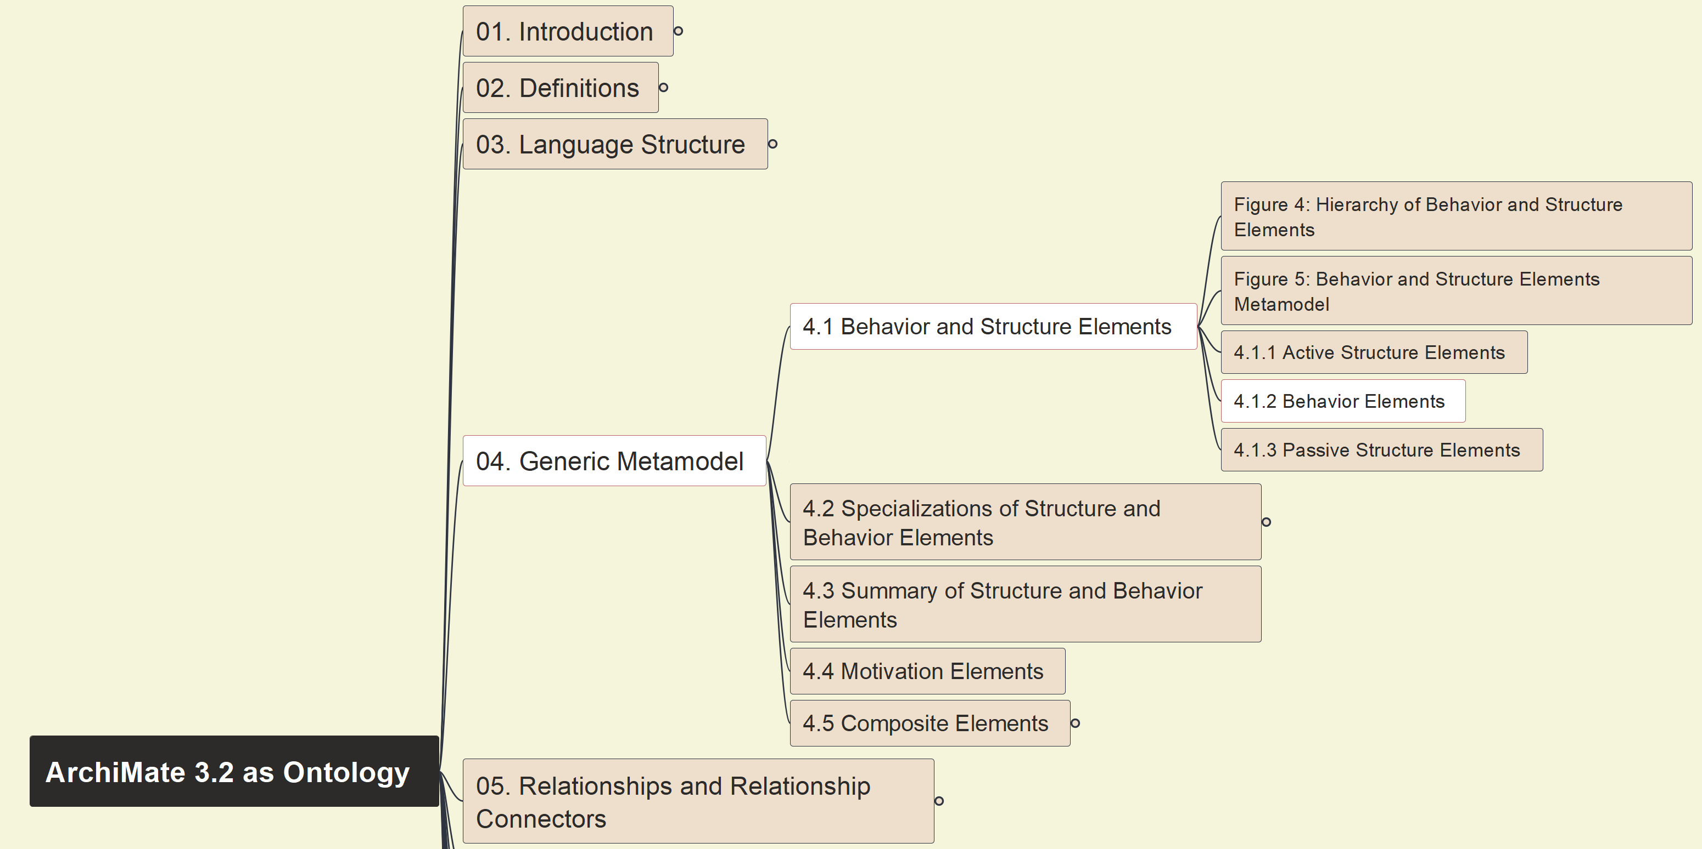
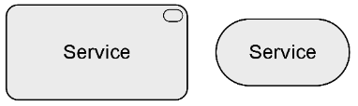
Build Ontology View on ArchiMate 3.2
015
4.1.2 Behavior Elements

Slide 16
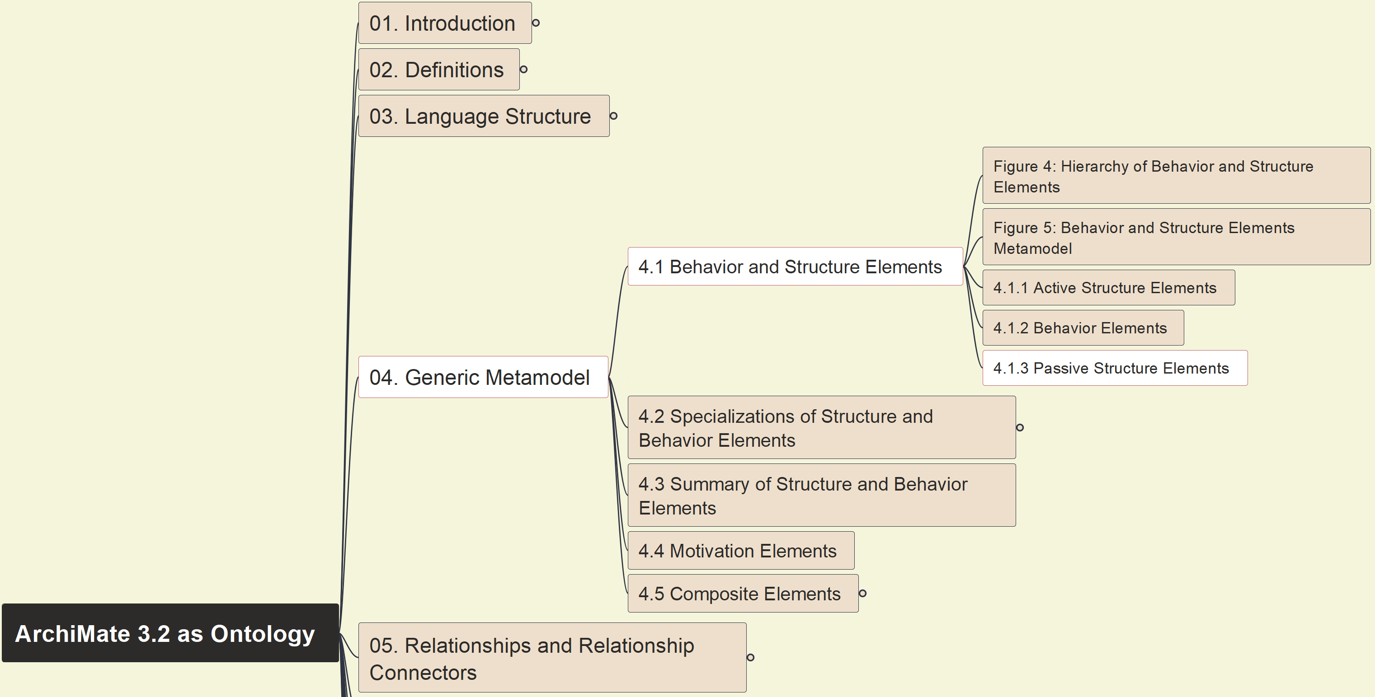
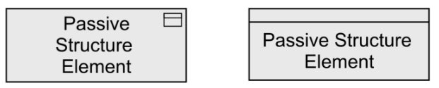
Build Ontology View on ArchiMate 3.2
016
4.1.3 Passive Structure Elements

Slide 17
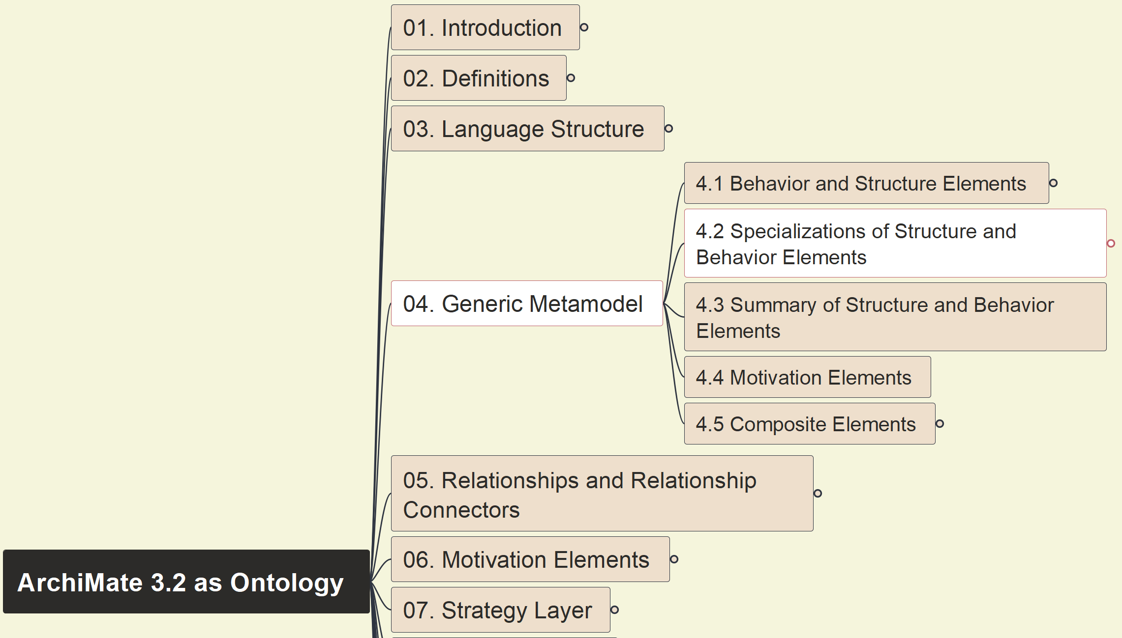
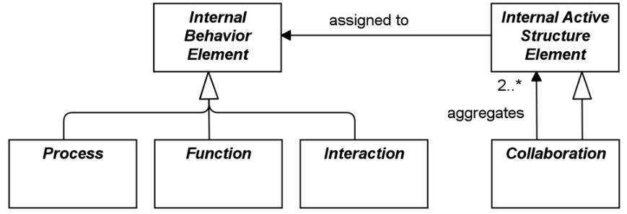
Build Ontology View on ArchiMate 3.2
017
4.2 Specialization of Structure and Behavior Element

Slide 18
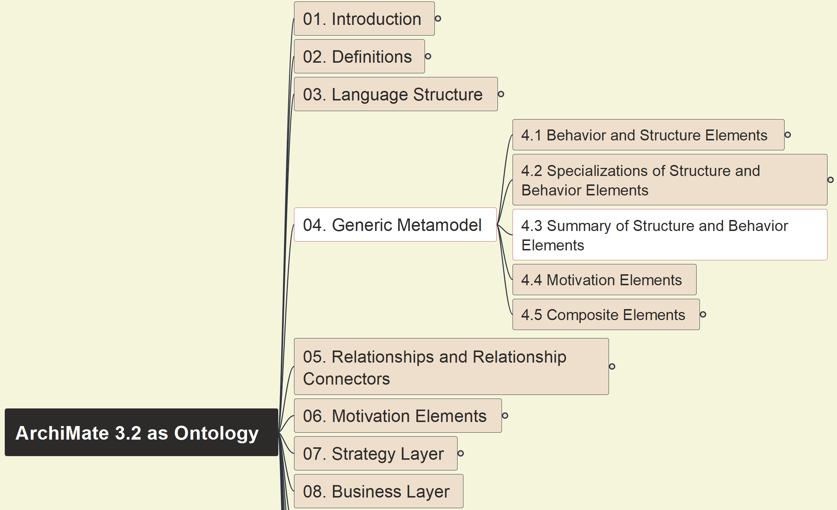
Build Ontology View on ArchiMate 3.2
018
4.3 Summary of Structure and Behavior Elements

Slide 19
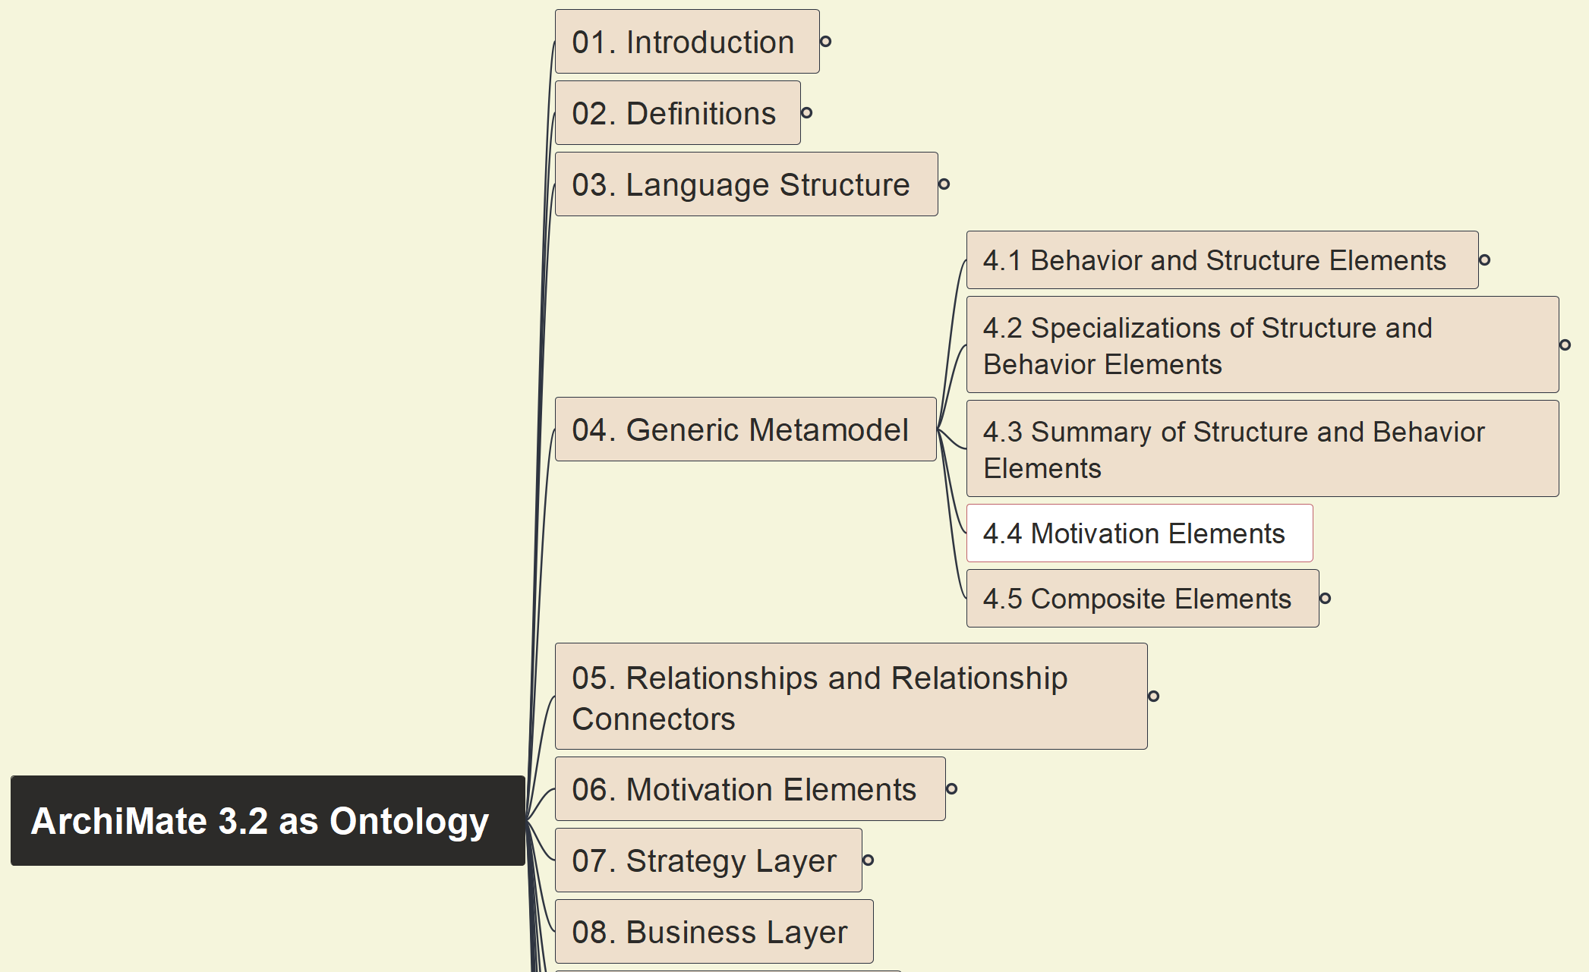
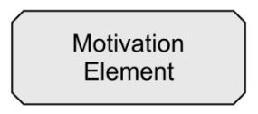
Build Ontology View on ArchiMate 3.2
019
4.4 Motivation Elements

Slide 20
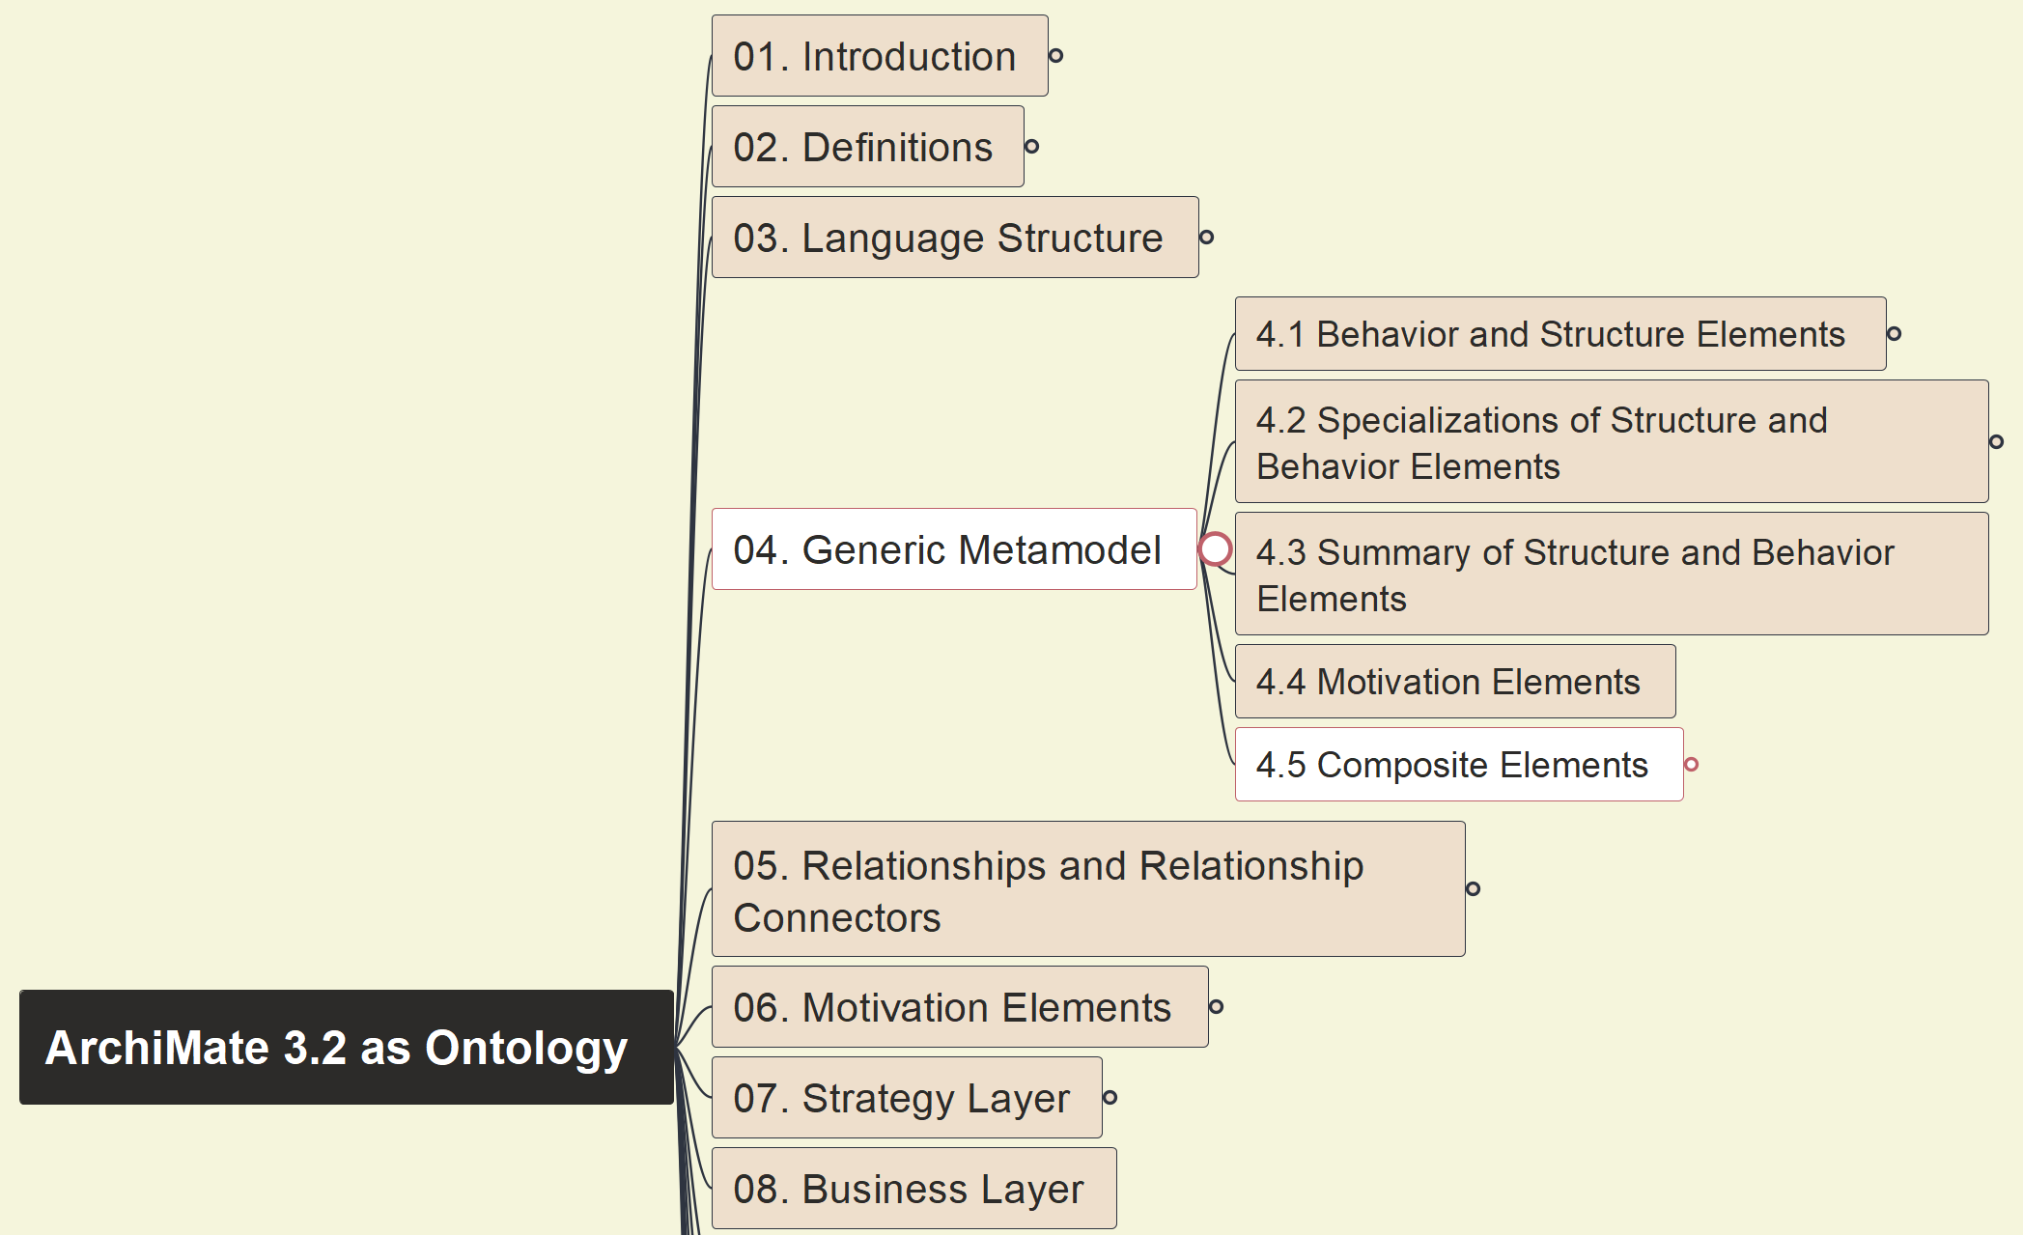
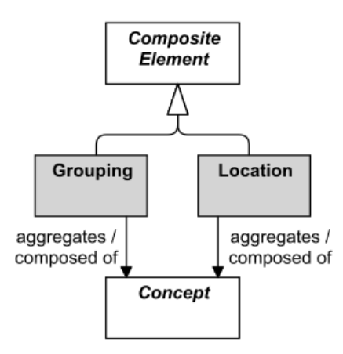
Build Ontology View on ArchiMate 3.2
020
4.5 Composite Elements

Slide 21
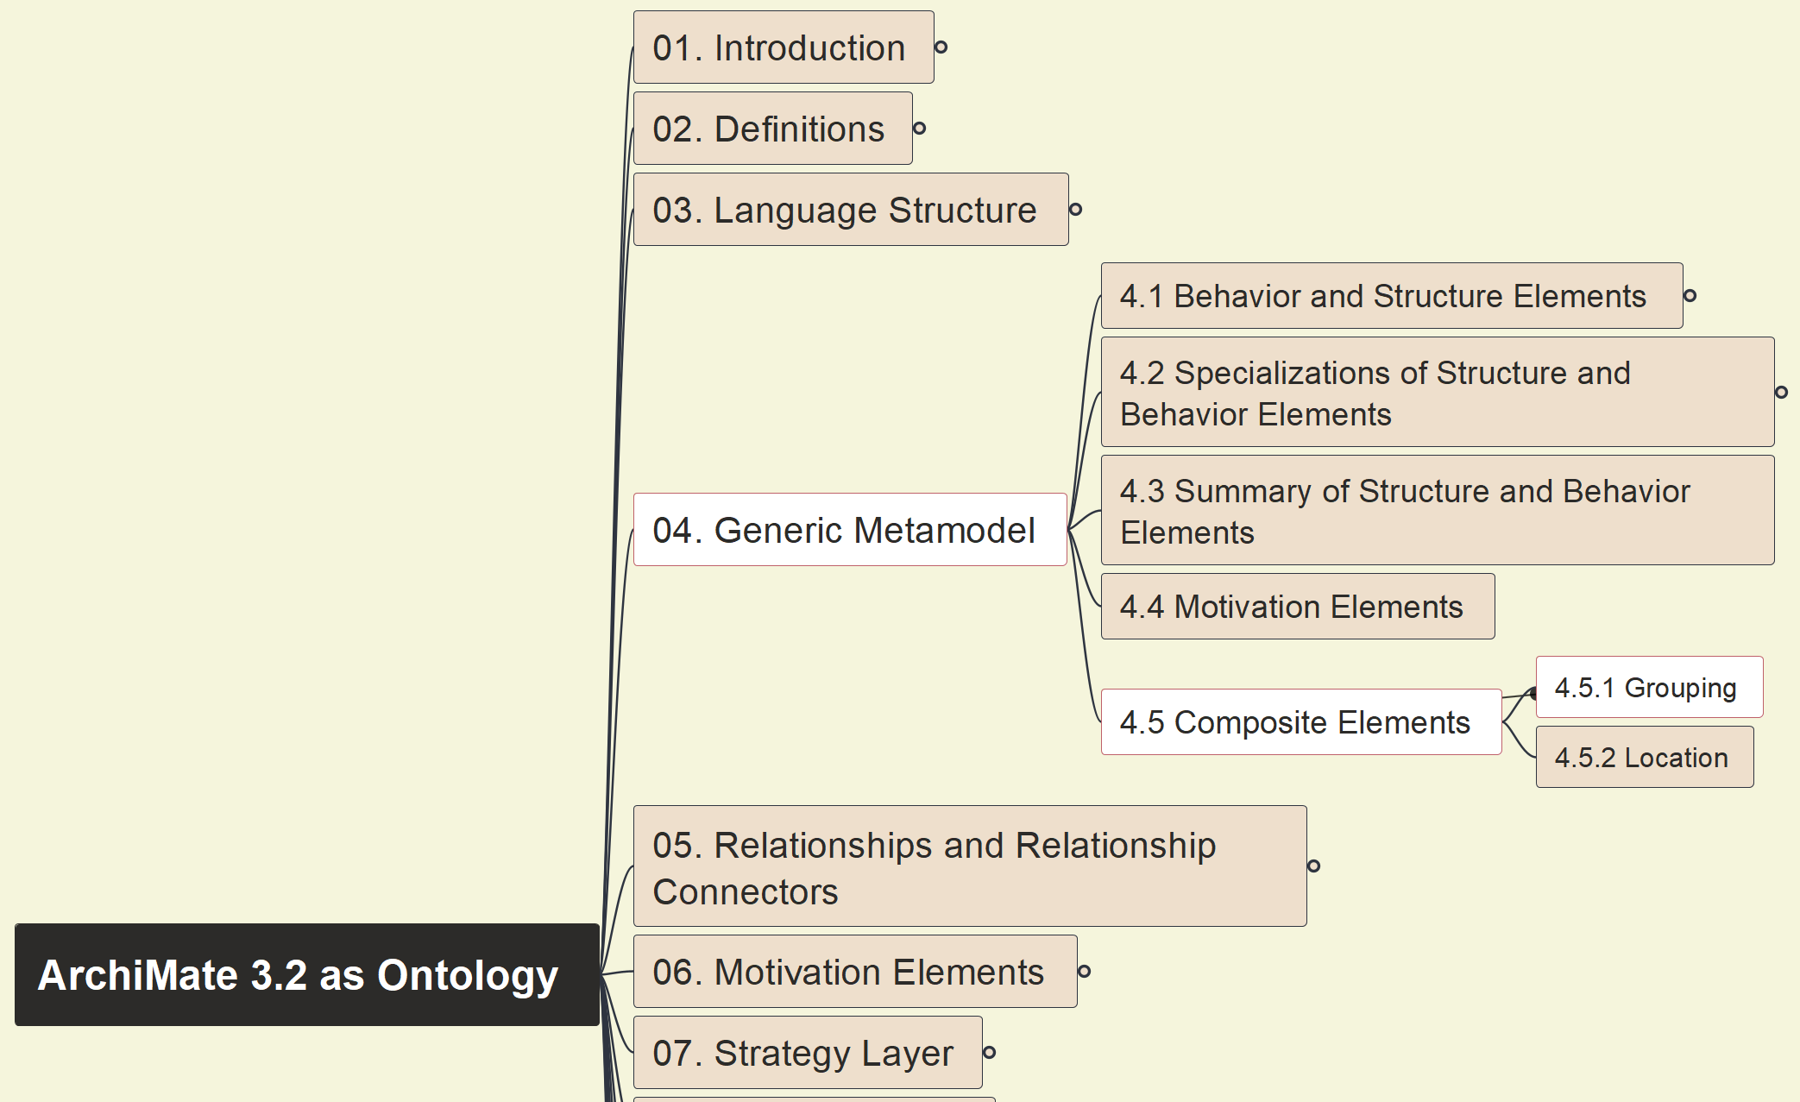
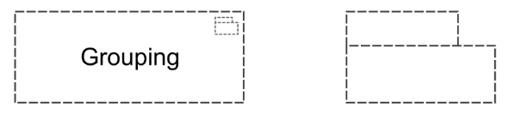
Build Ontology View on ArchiMate 3.2
021
4.5.1 Composite Elements - Grouping

Slide 22
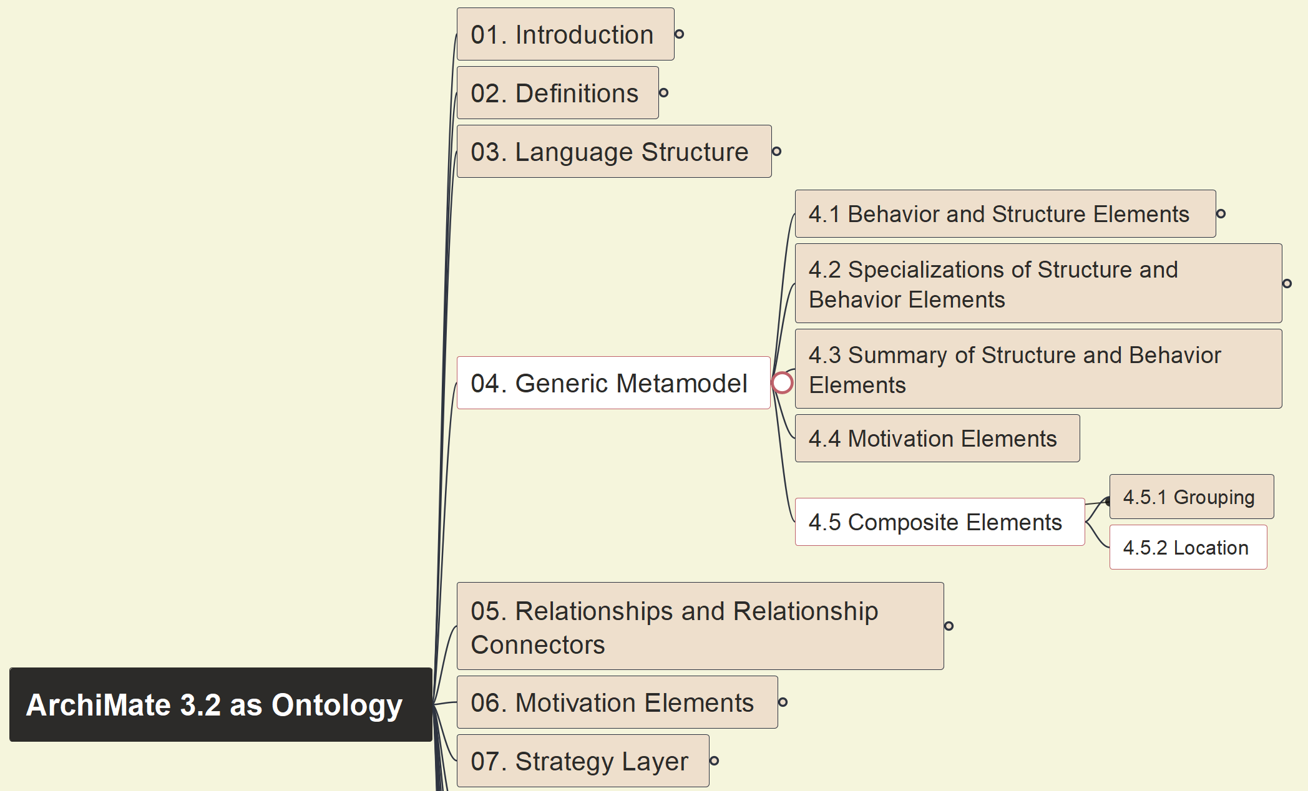
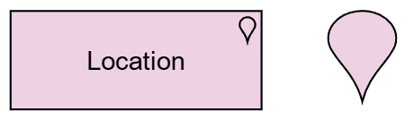
Build Ontology View on ArchiMate 3.2
022
4.5.2 Composite Elements - Location

