Slide 1

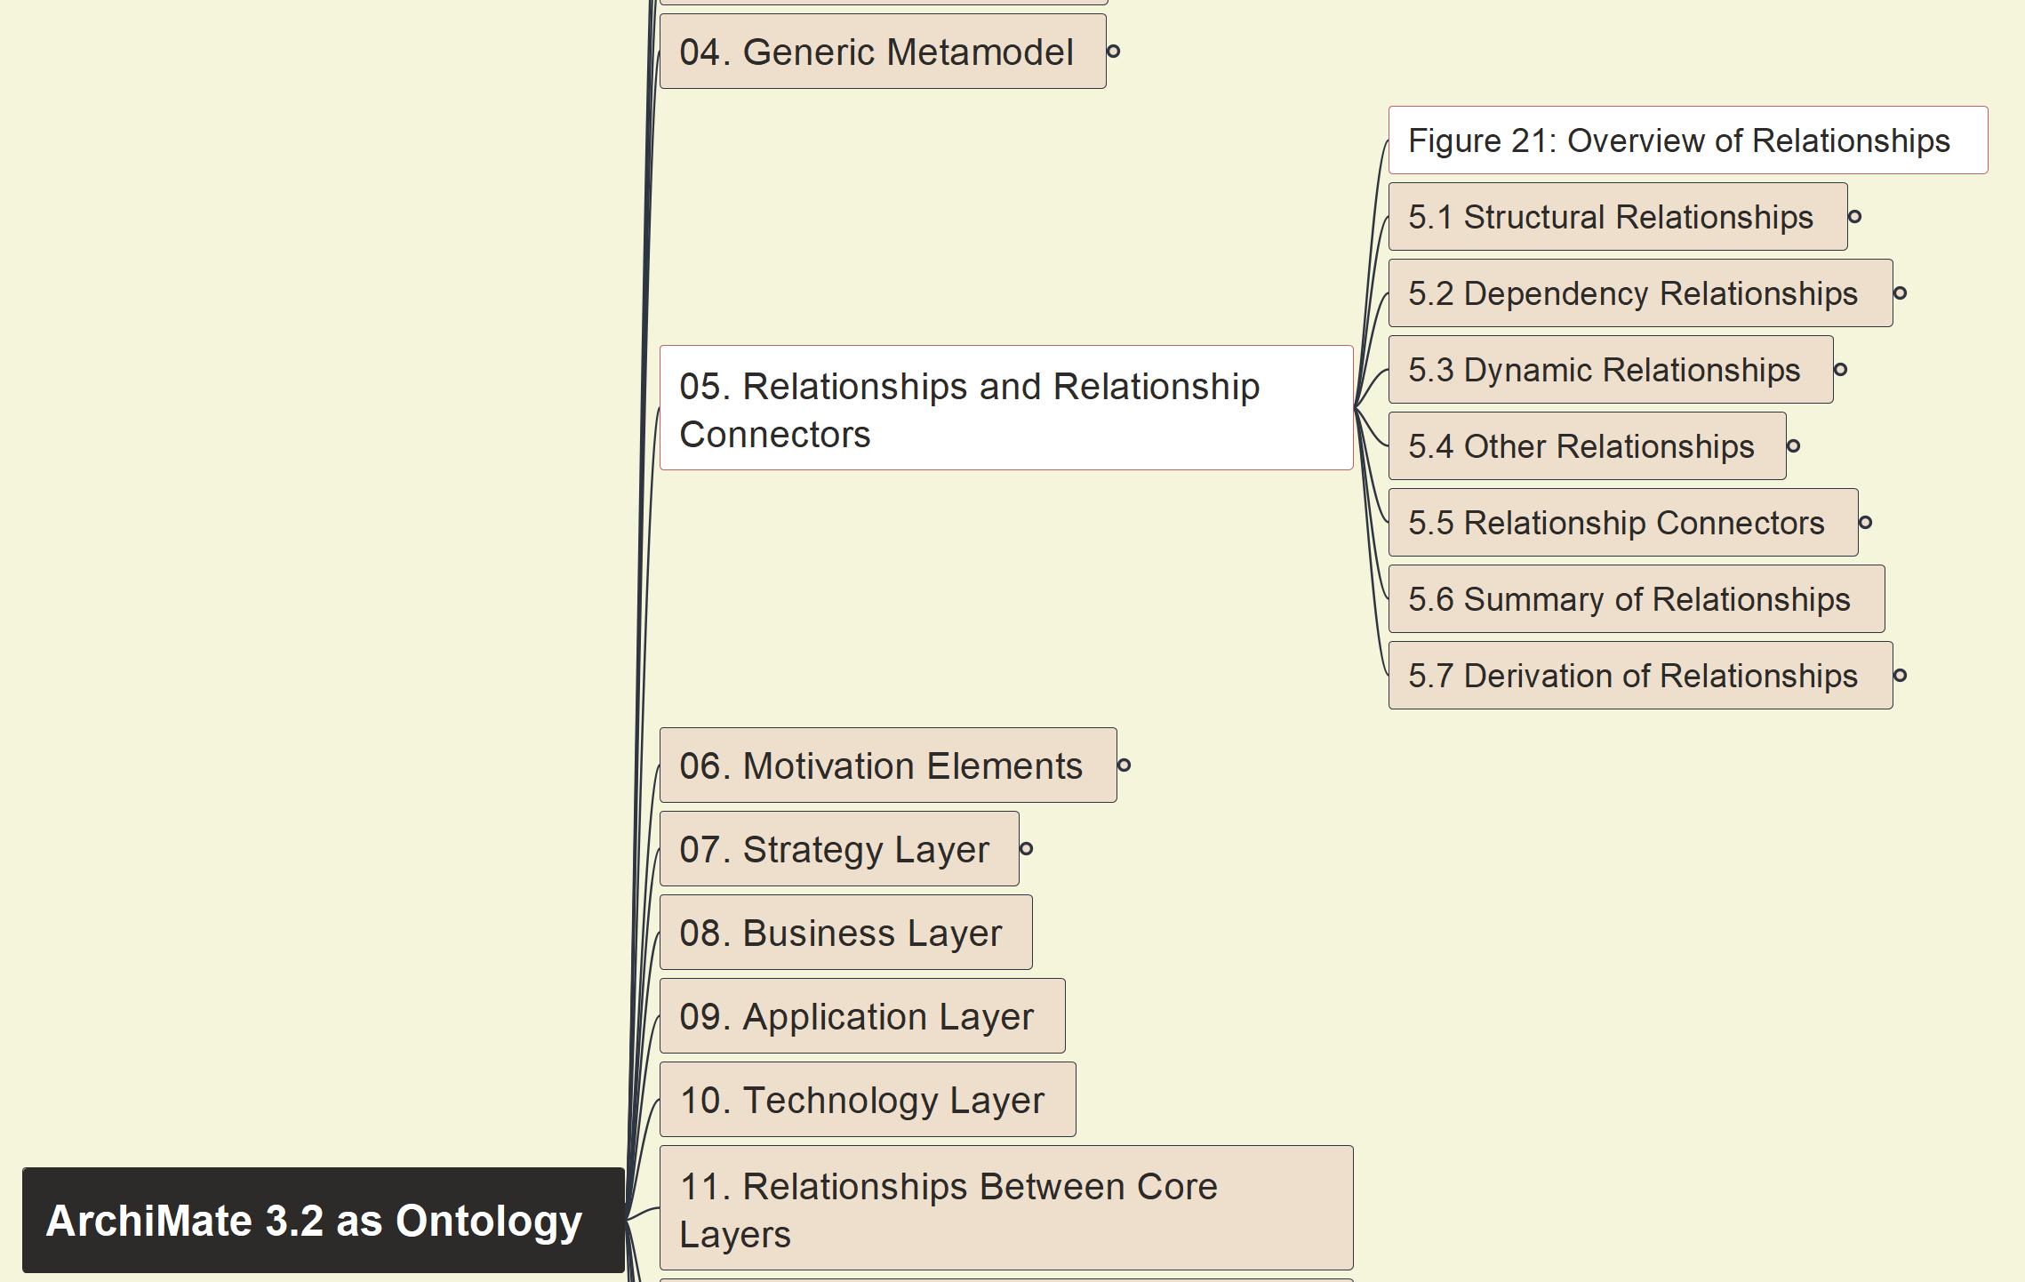
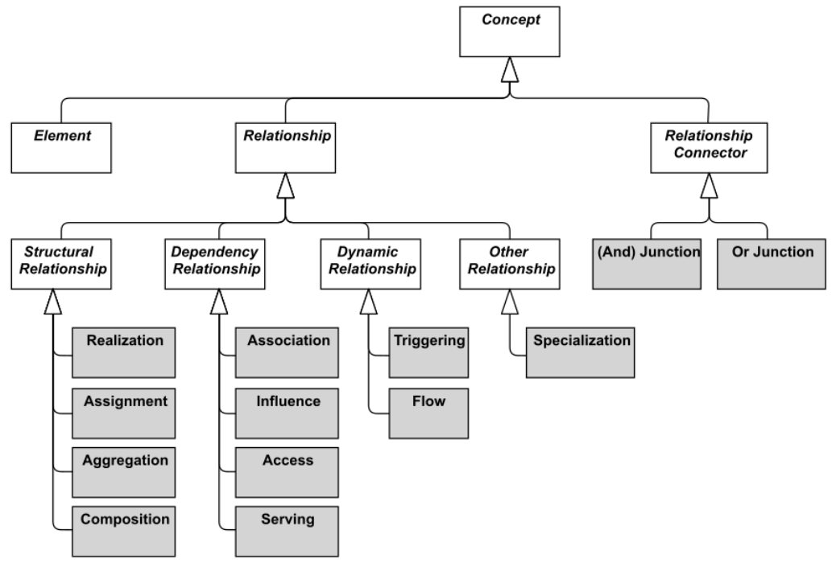



Build Ontology View on ArchiMate 3.2
023
Overview of Relationships

Slide 2
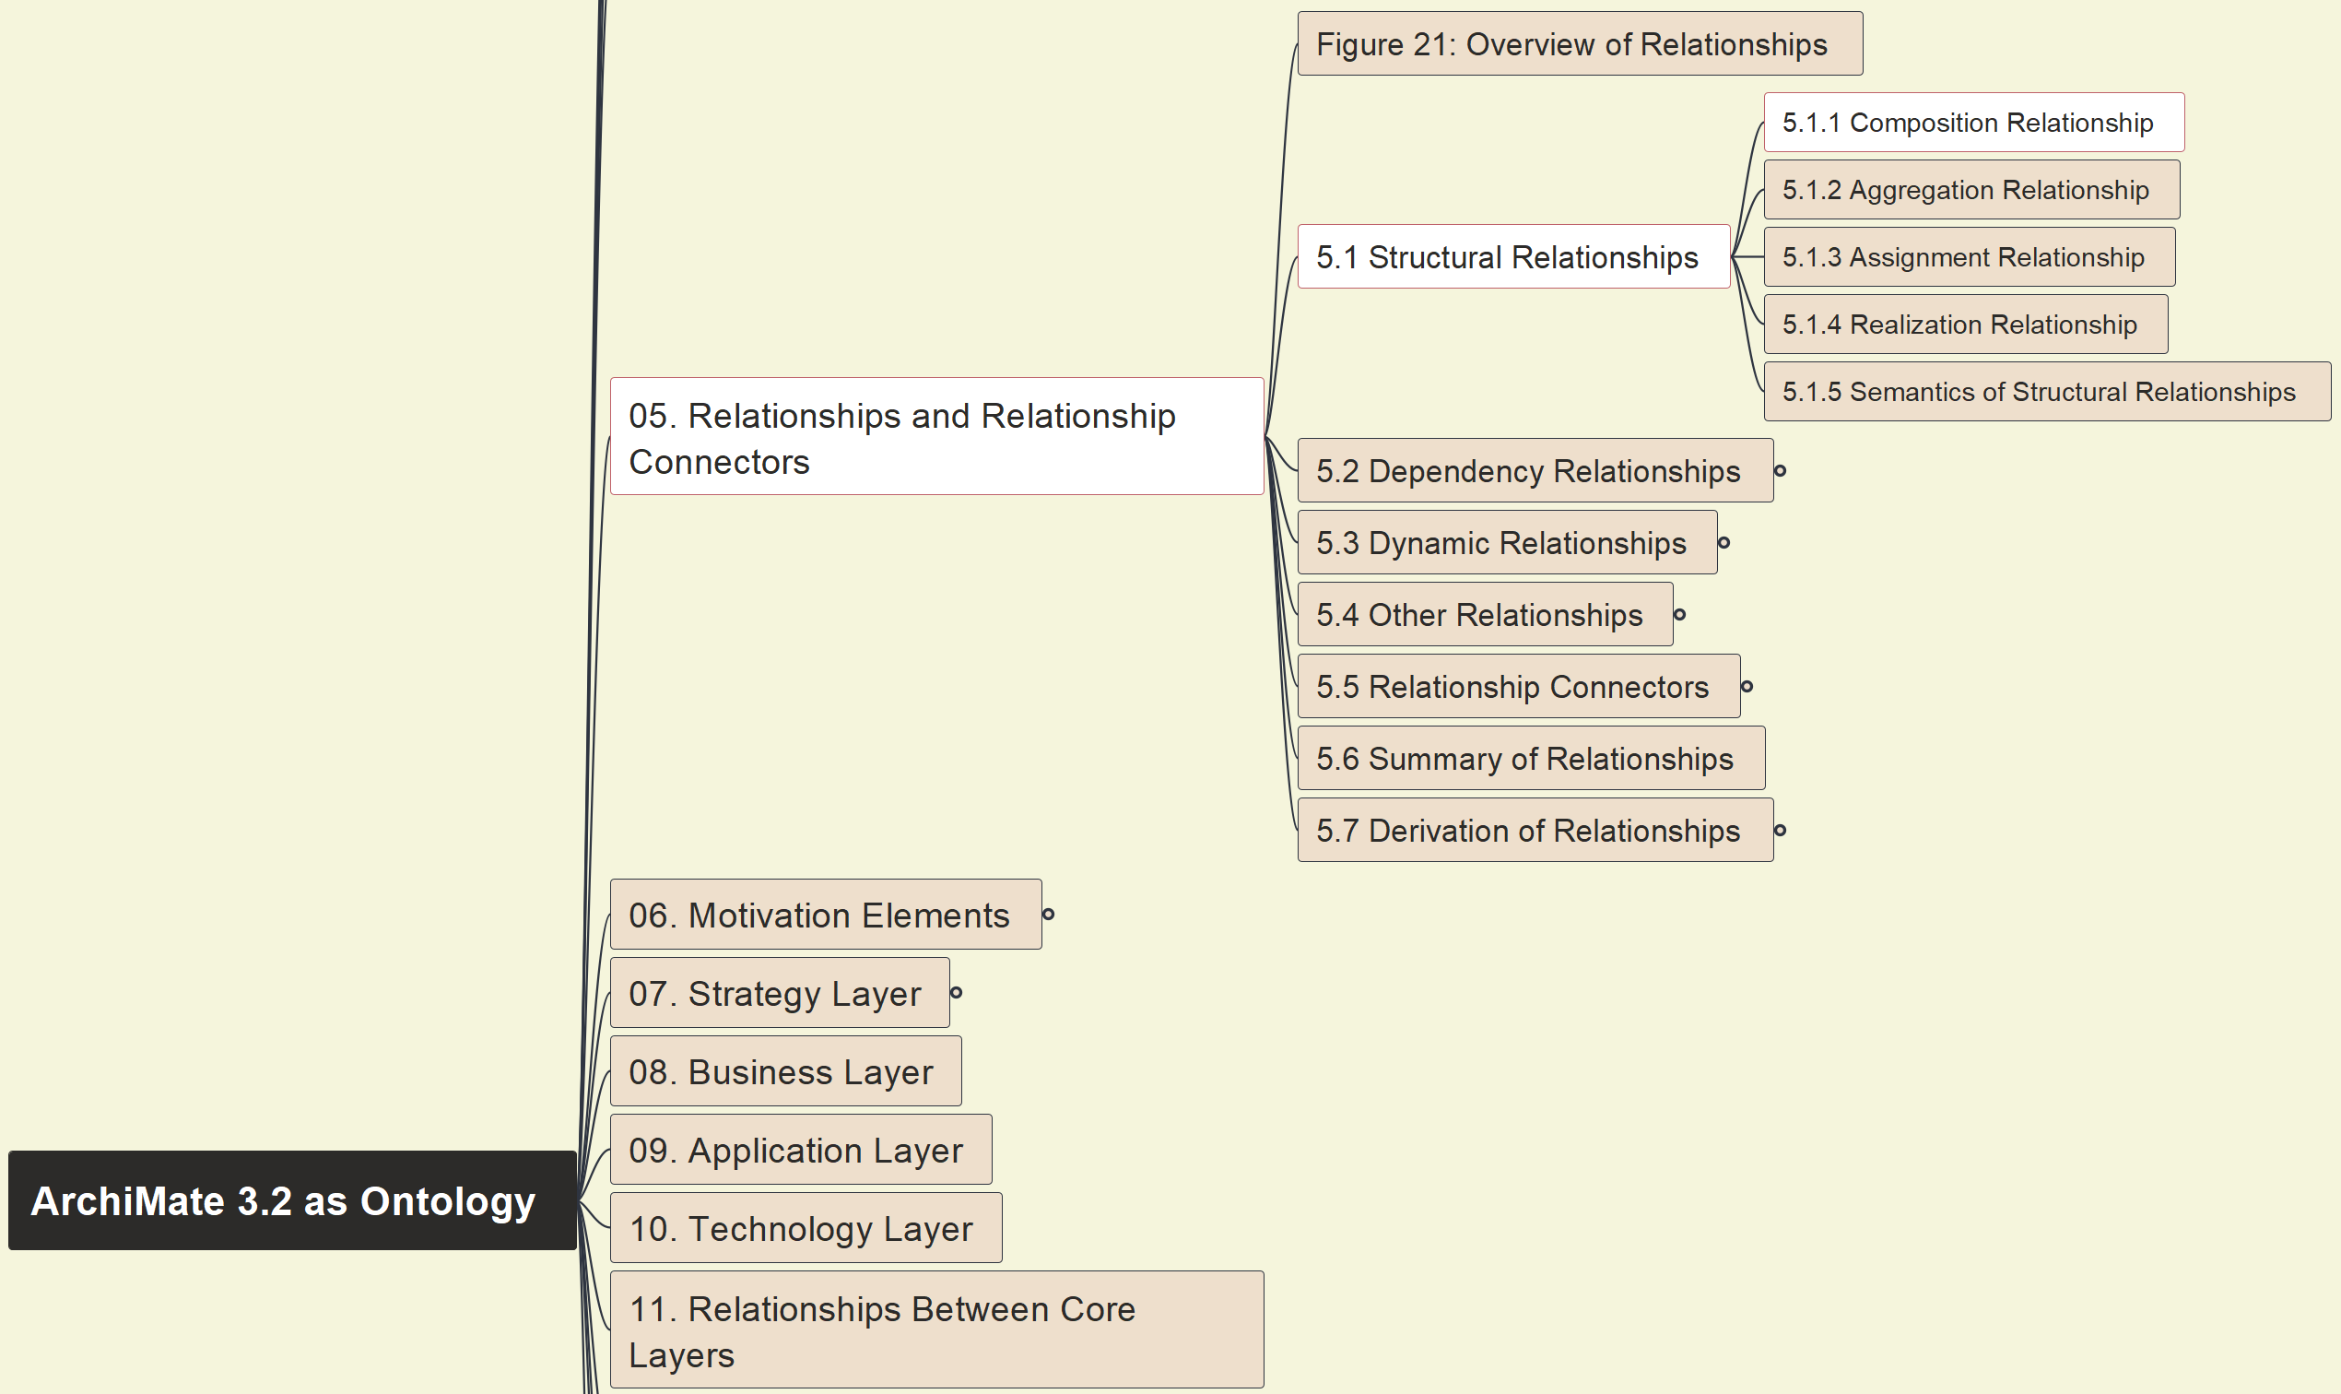
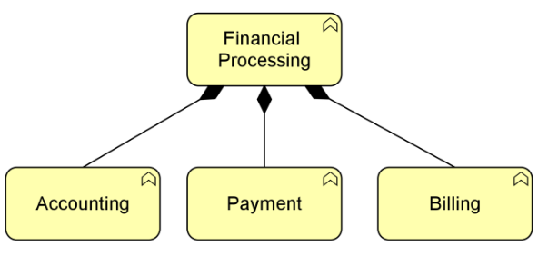
Build Ontology View on ArchiMate 3.2
024
5.1 Structural 5.1.1 Composition

Slide 3
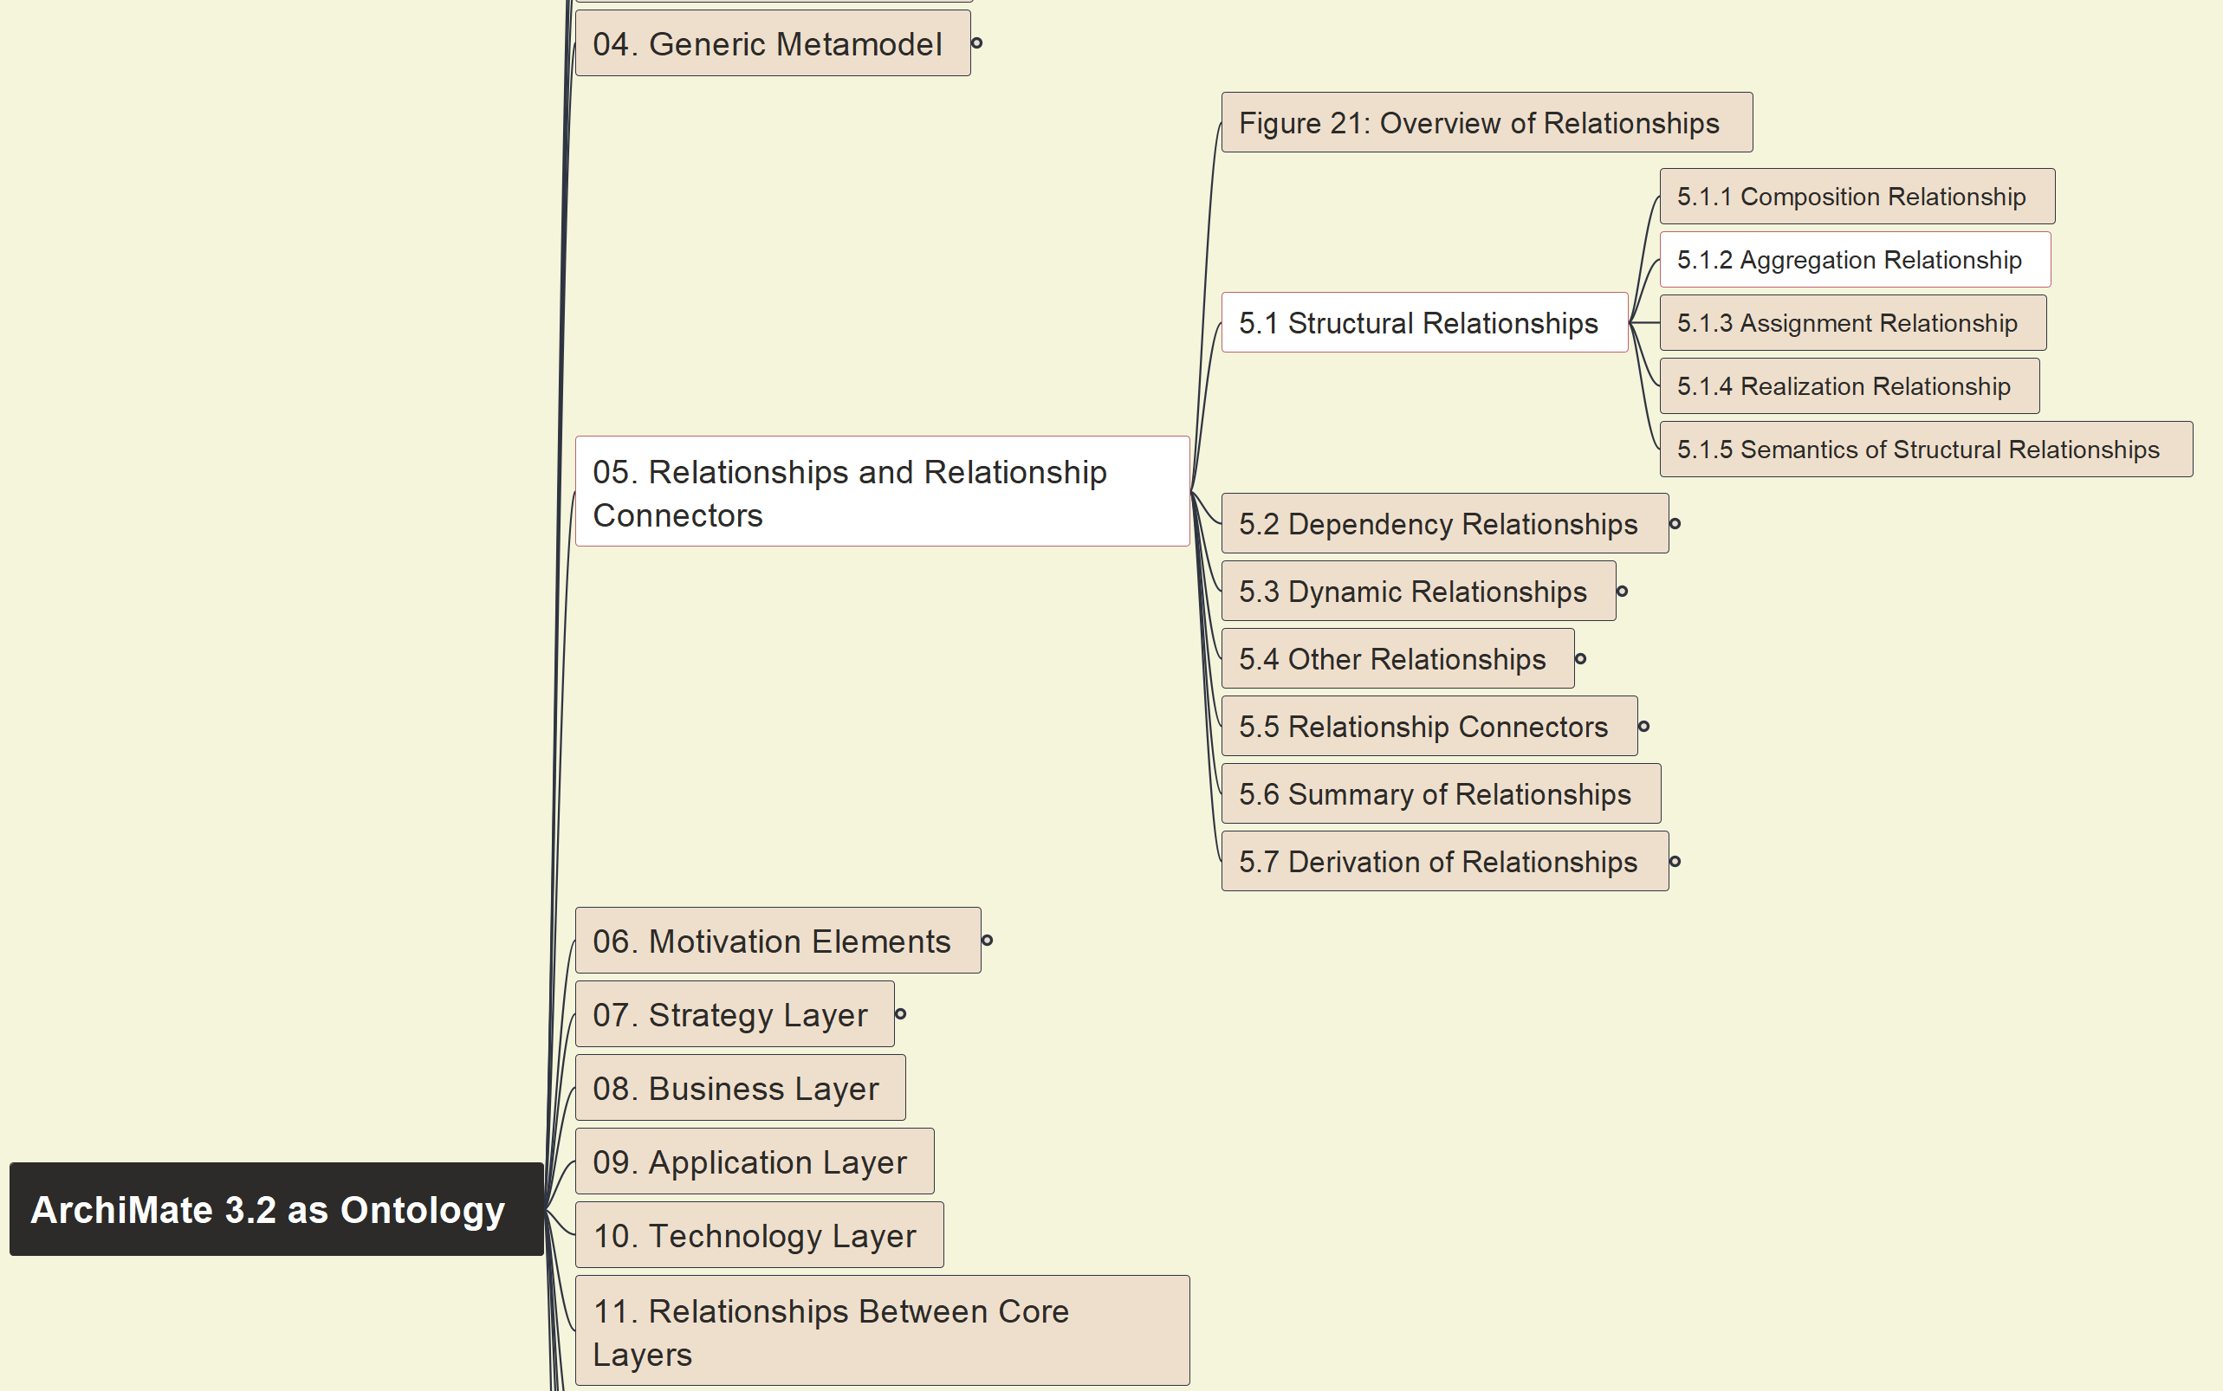
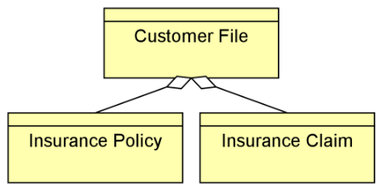
Build Ontology View on ArchiMate 3.2
025
5.1 Structural 5.1.2 Aggregation

Slide 4
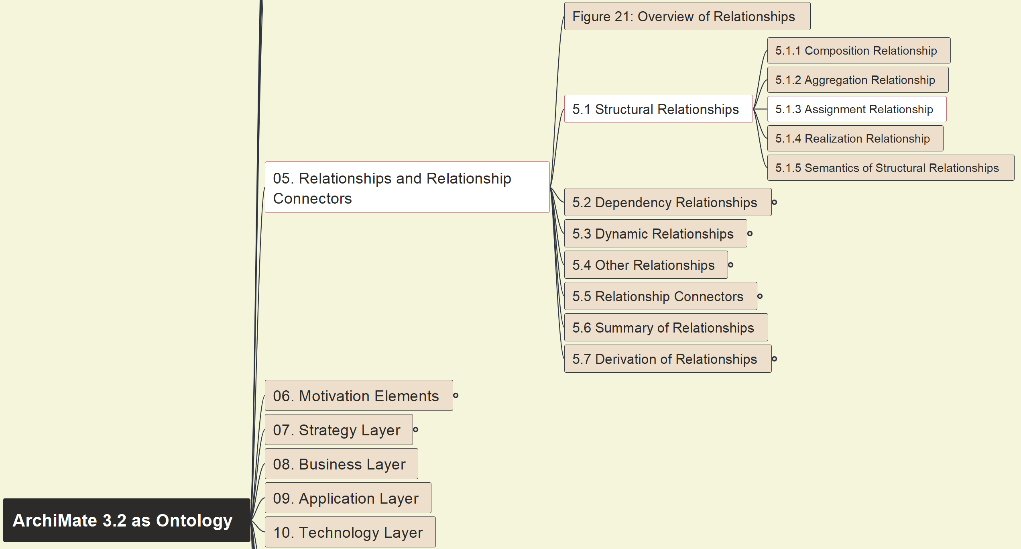
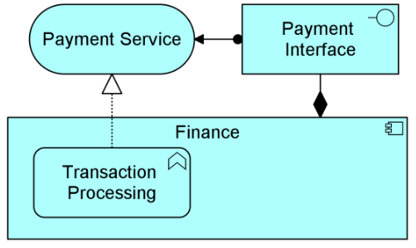
Build Ontology View on ArchiMate 3.2
026
5.1 Structural 5.1.3 Assignment

Slide 5
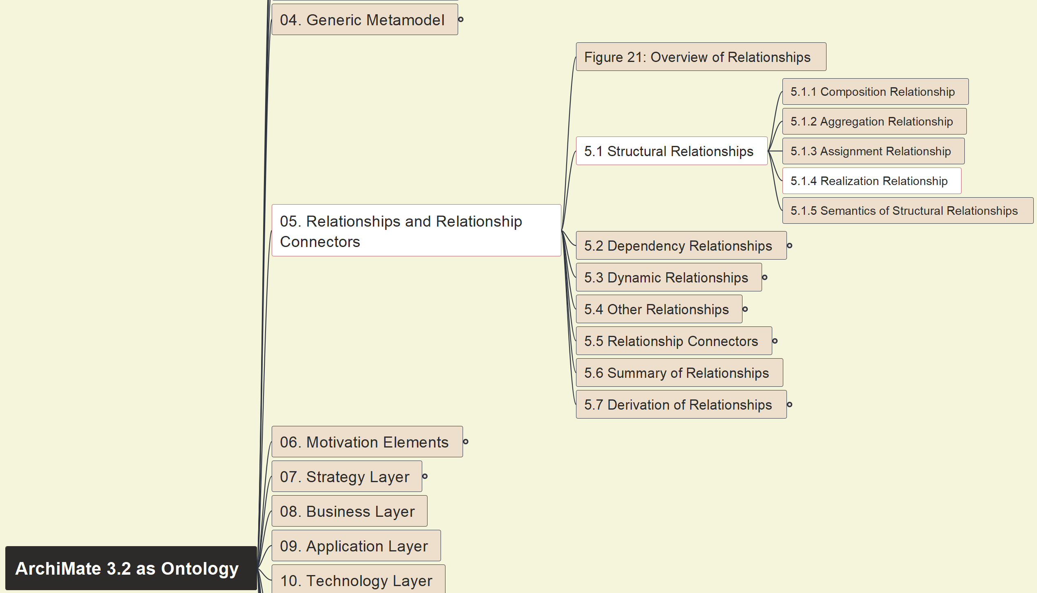
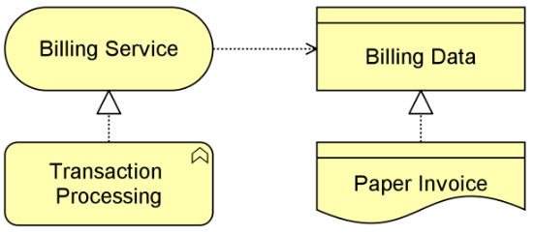
Build Ontology View on ArchiMate 3.2
027
5.1 Structural 5.1.4 Realization

Slide 6
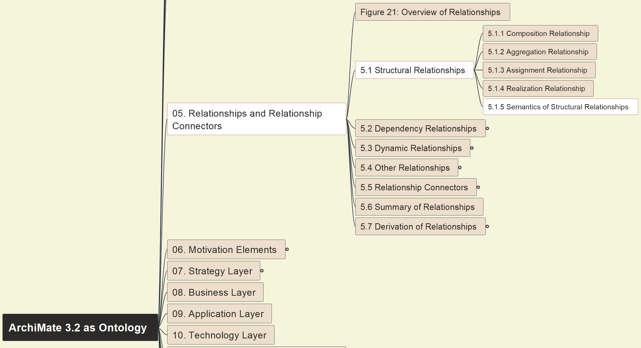
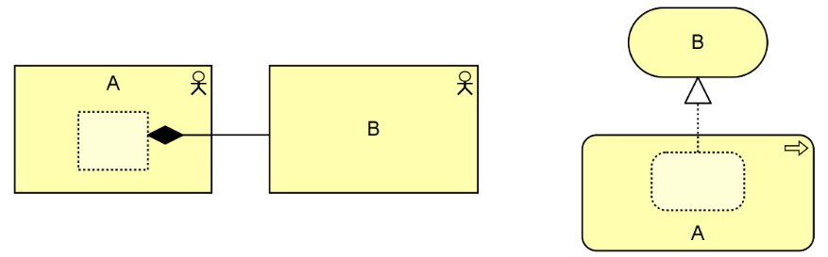
Build Ontology View on ArchiMate 3.2
028
5.1 Structural 5.1.5 Semantics View

Slide 7
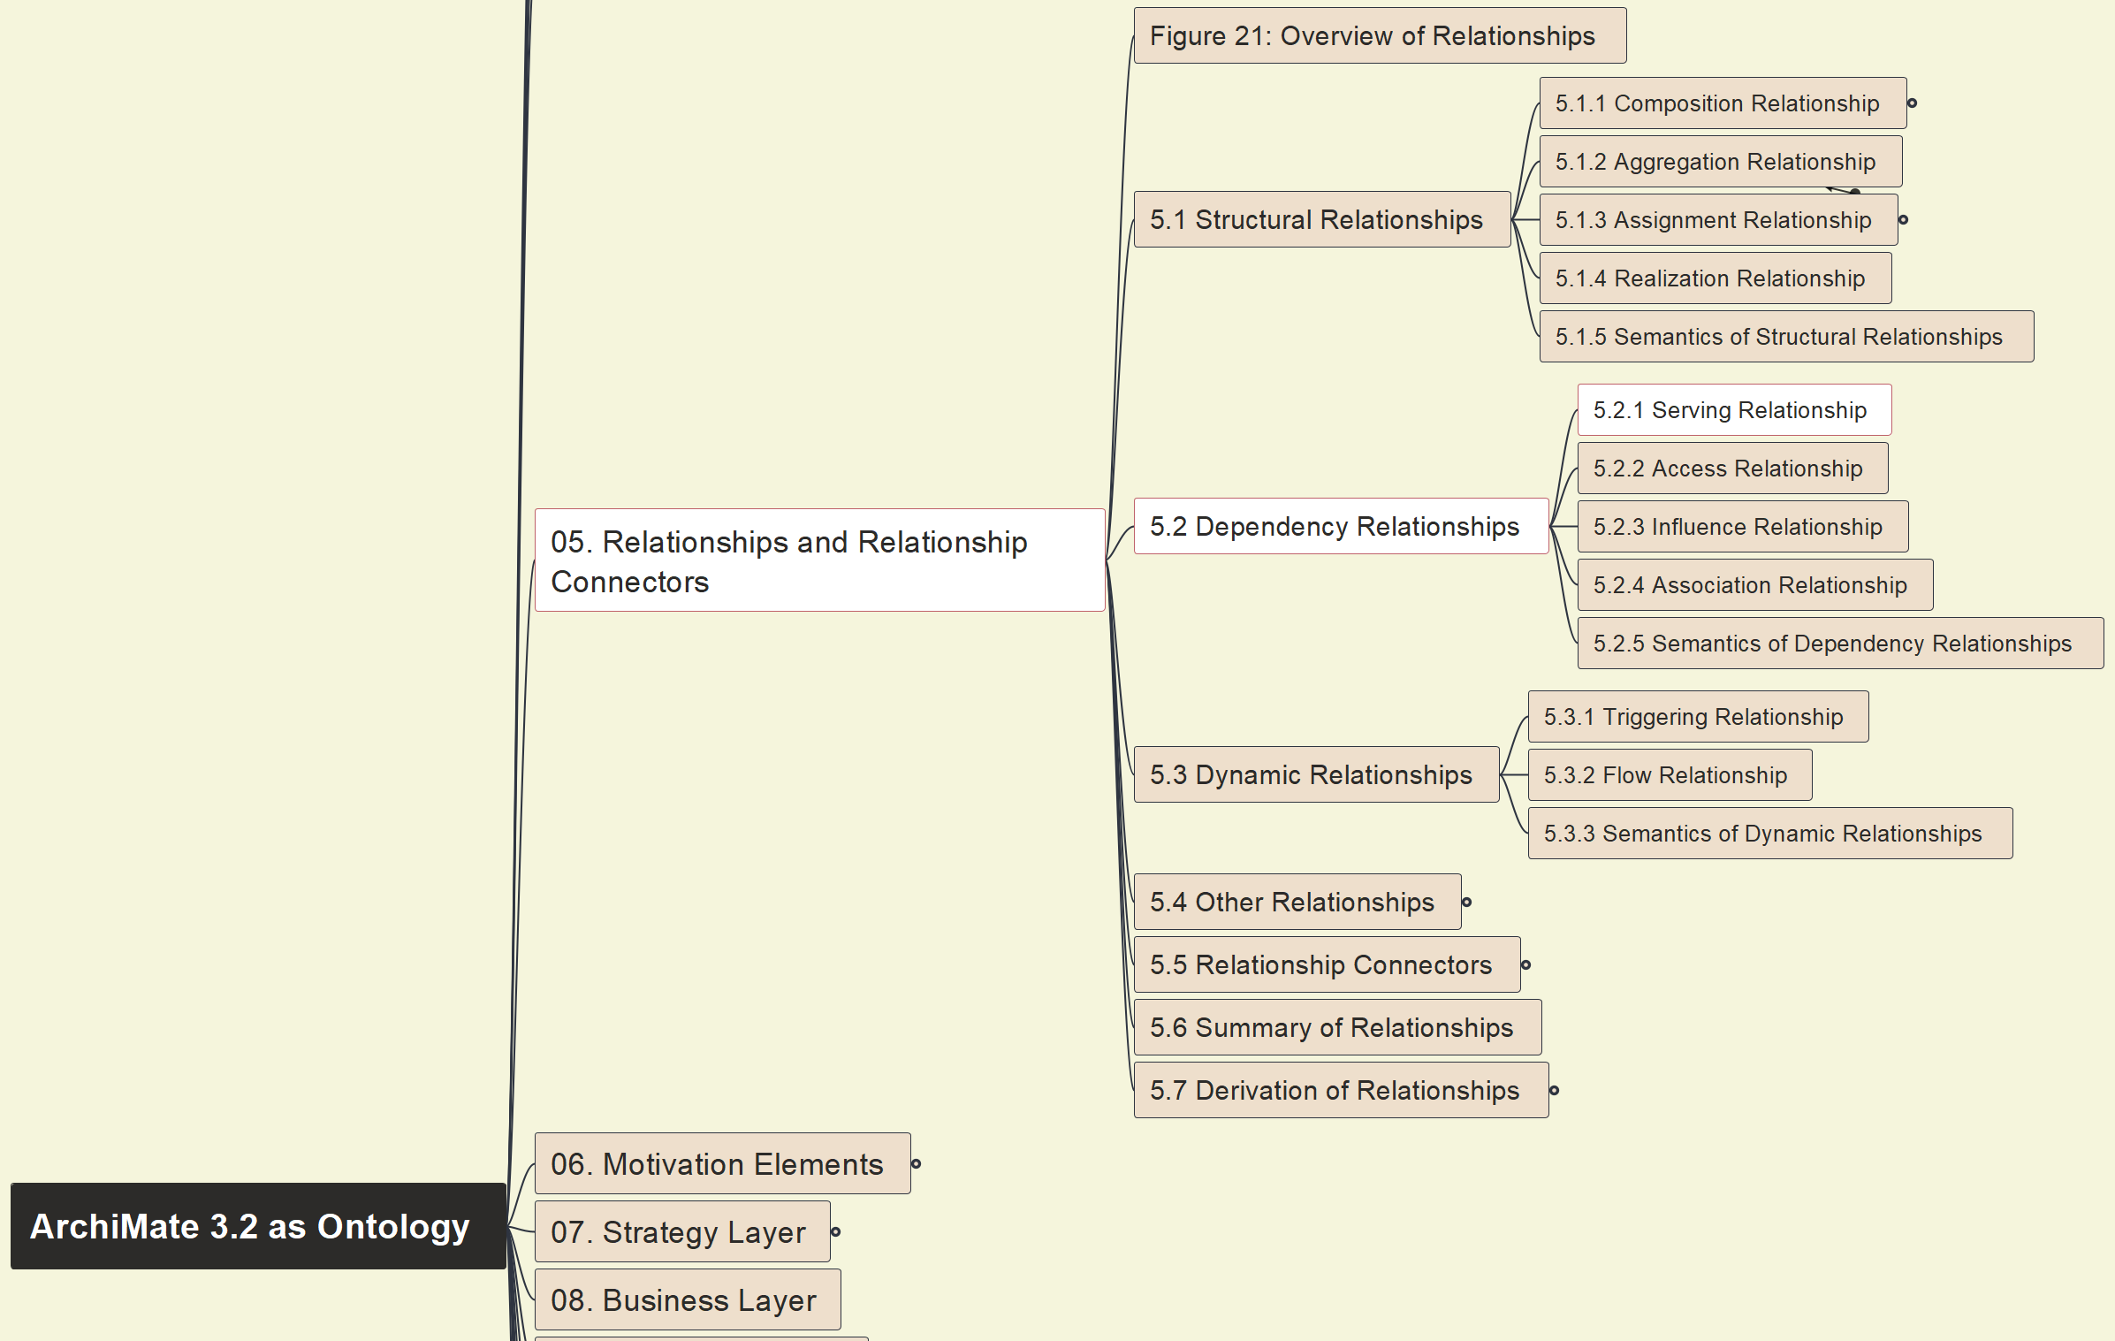
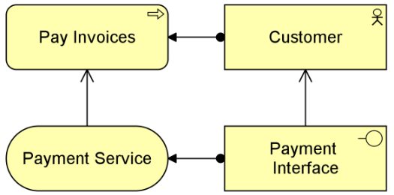
Build Ontology View on ArchiMate 3.2
029
5.2 Dependency 5.2.1 Serving

Slide 8
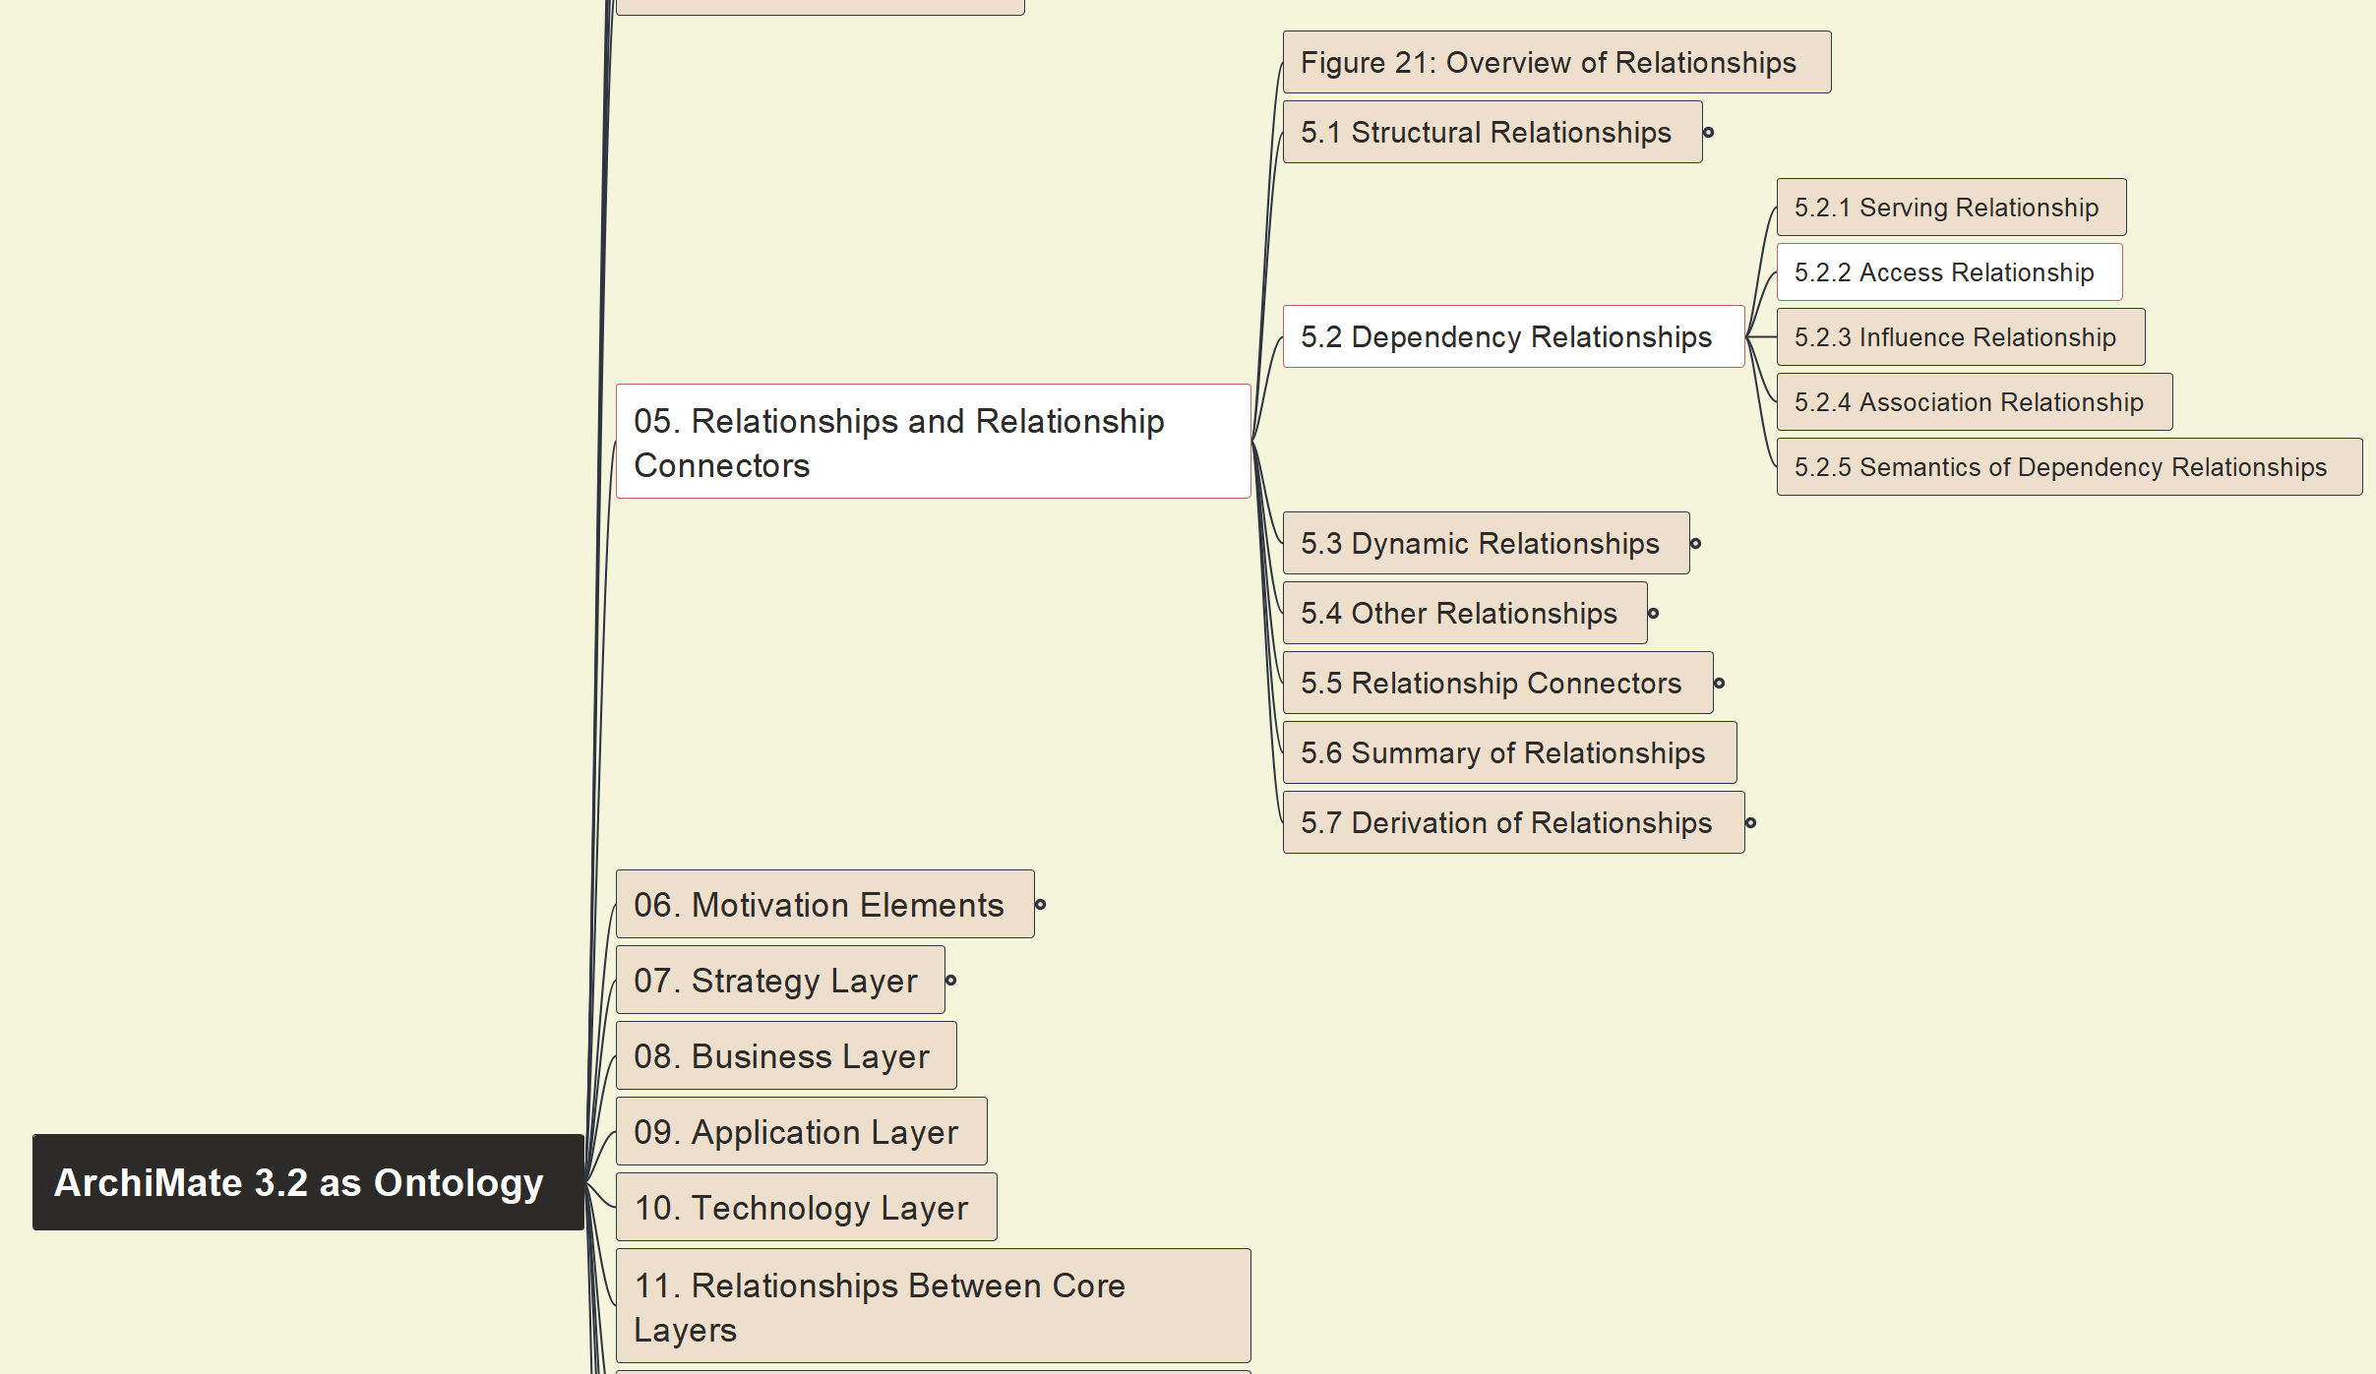
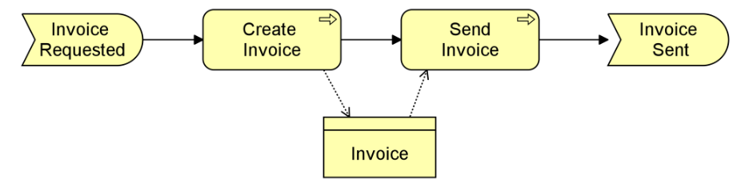
Build Ontology View on ArchiMate 3.2
030
5.2 Dependency 5.2.2 Access

Slide 9
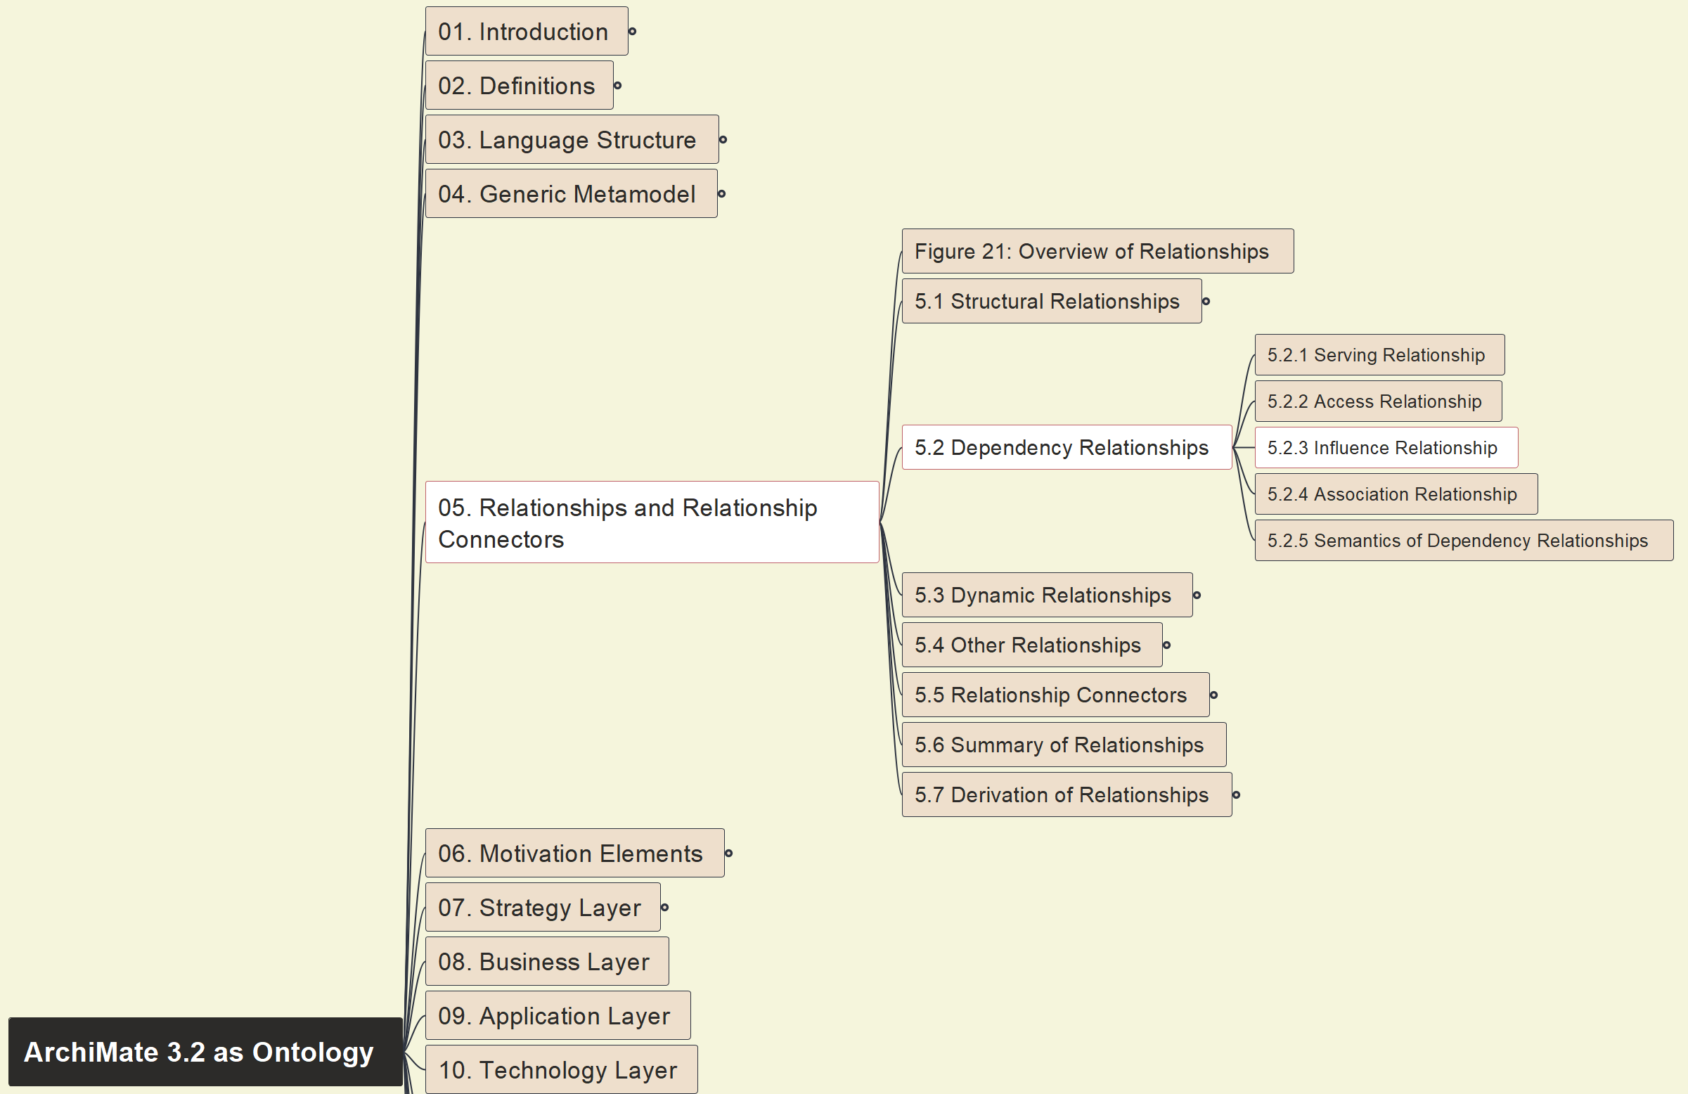
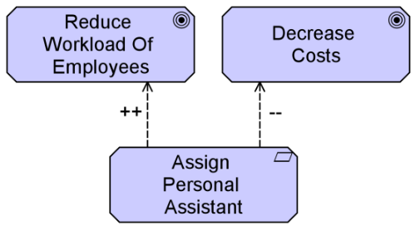
Build Ontology View on ArchiMate 3.2
031
5.2 Dependency 5.2.3 Influence

Slide 10
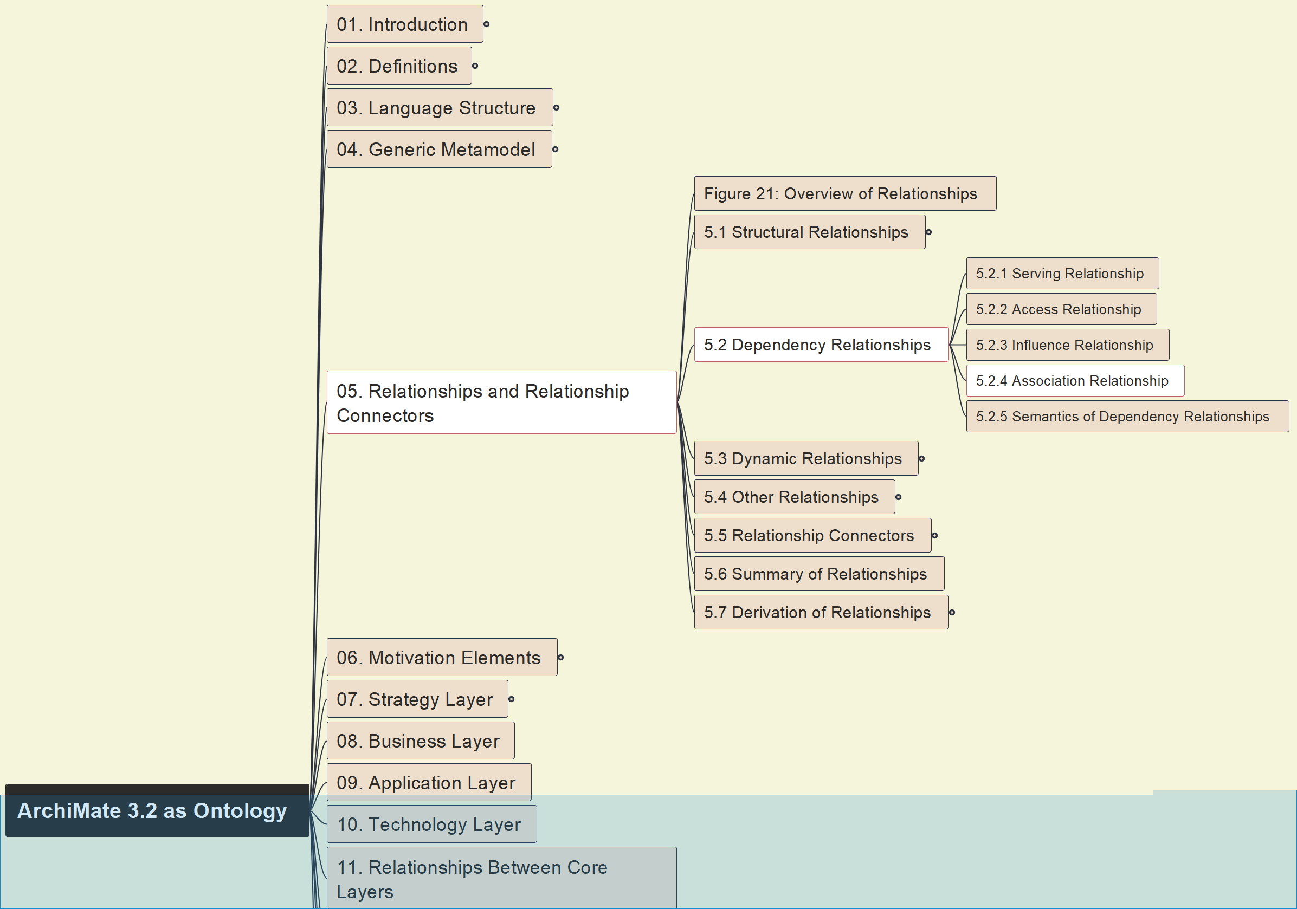
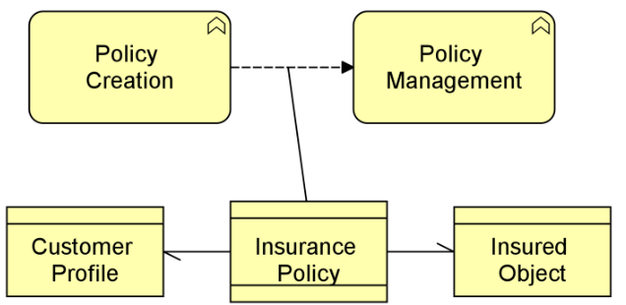
Build Ontology View on ArchiMate 3.2
032
5.2 Dependency 5.2.4 Association

Slide 11
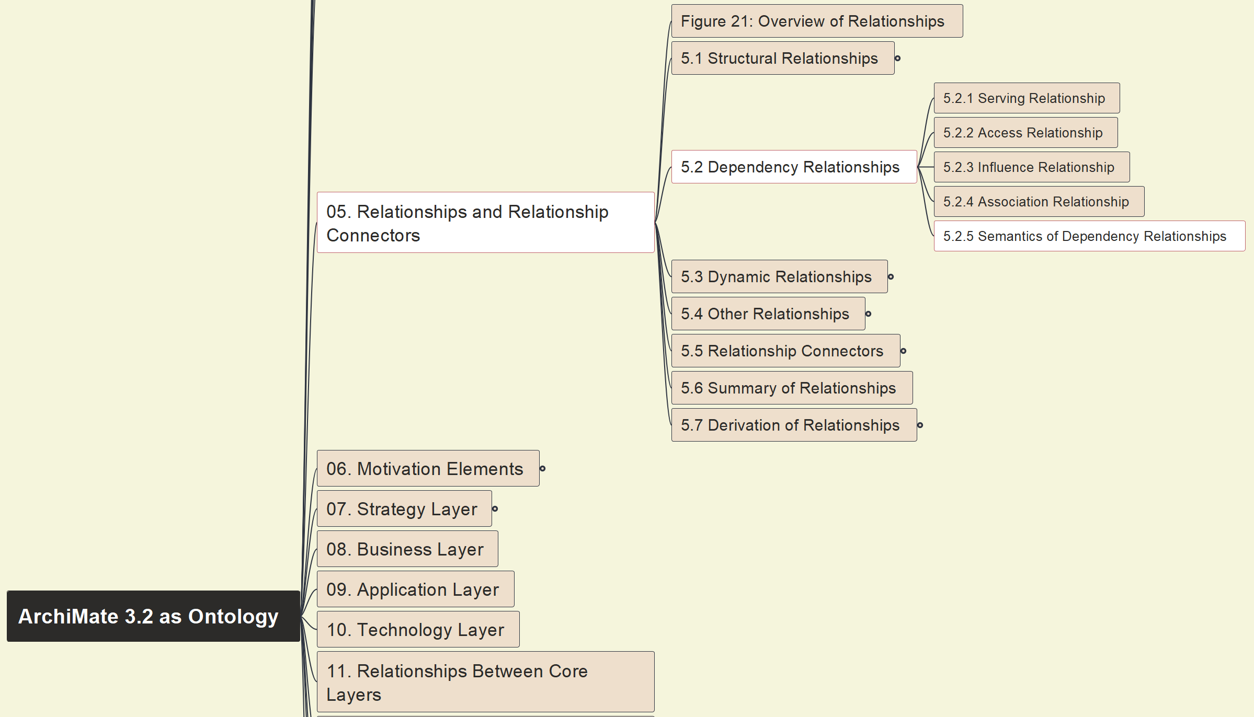
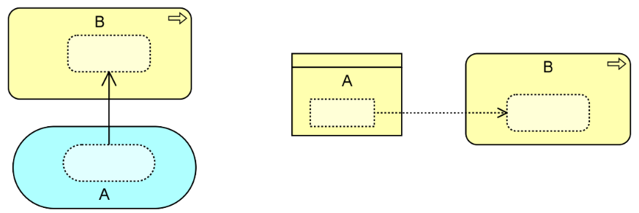
Build Ontology View on ArchiMate 3.2
033
5.2 Dependency 5.2.5 Semantics View

Slide 12
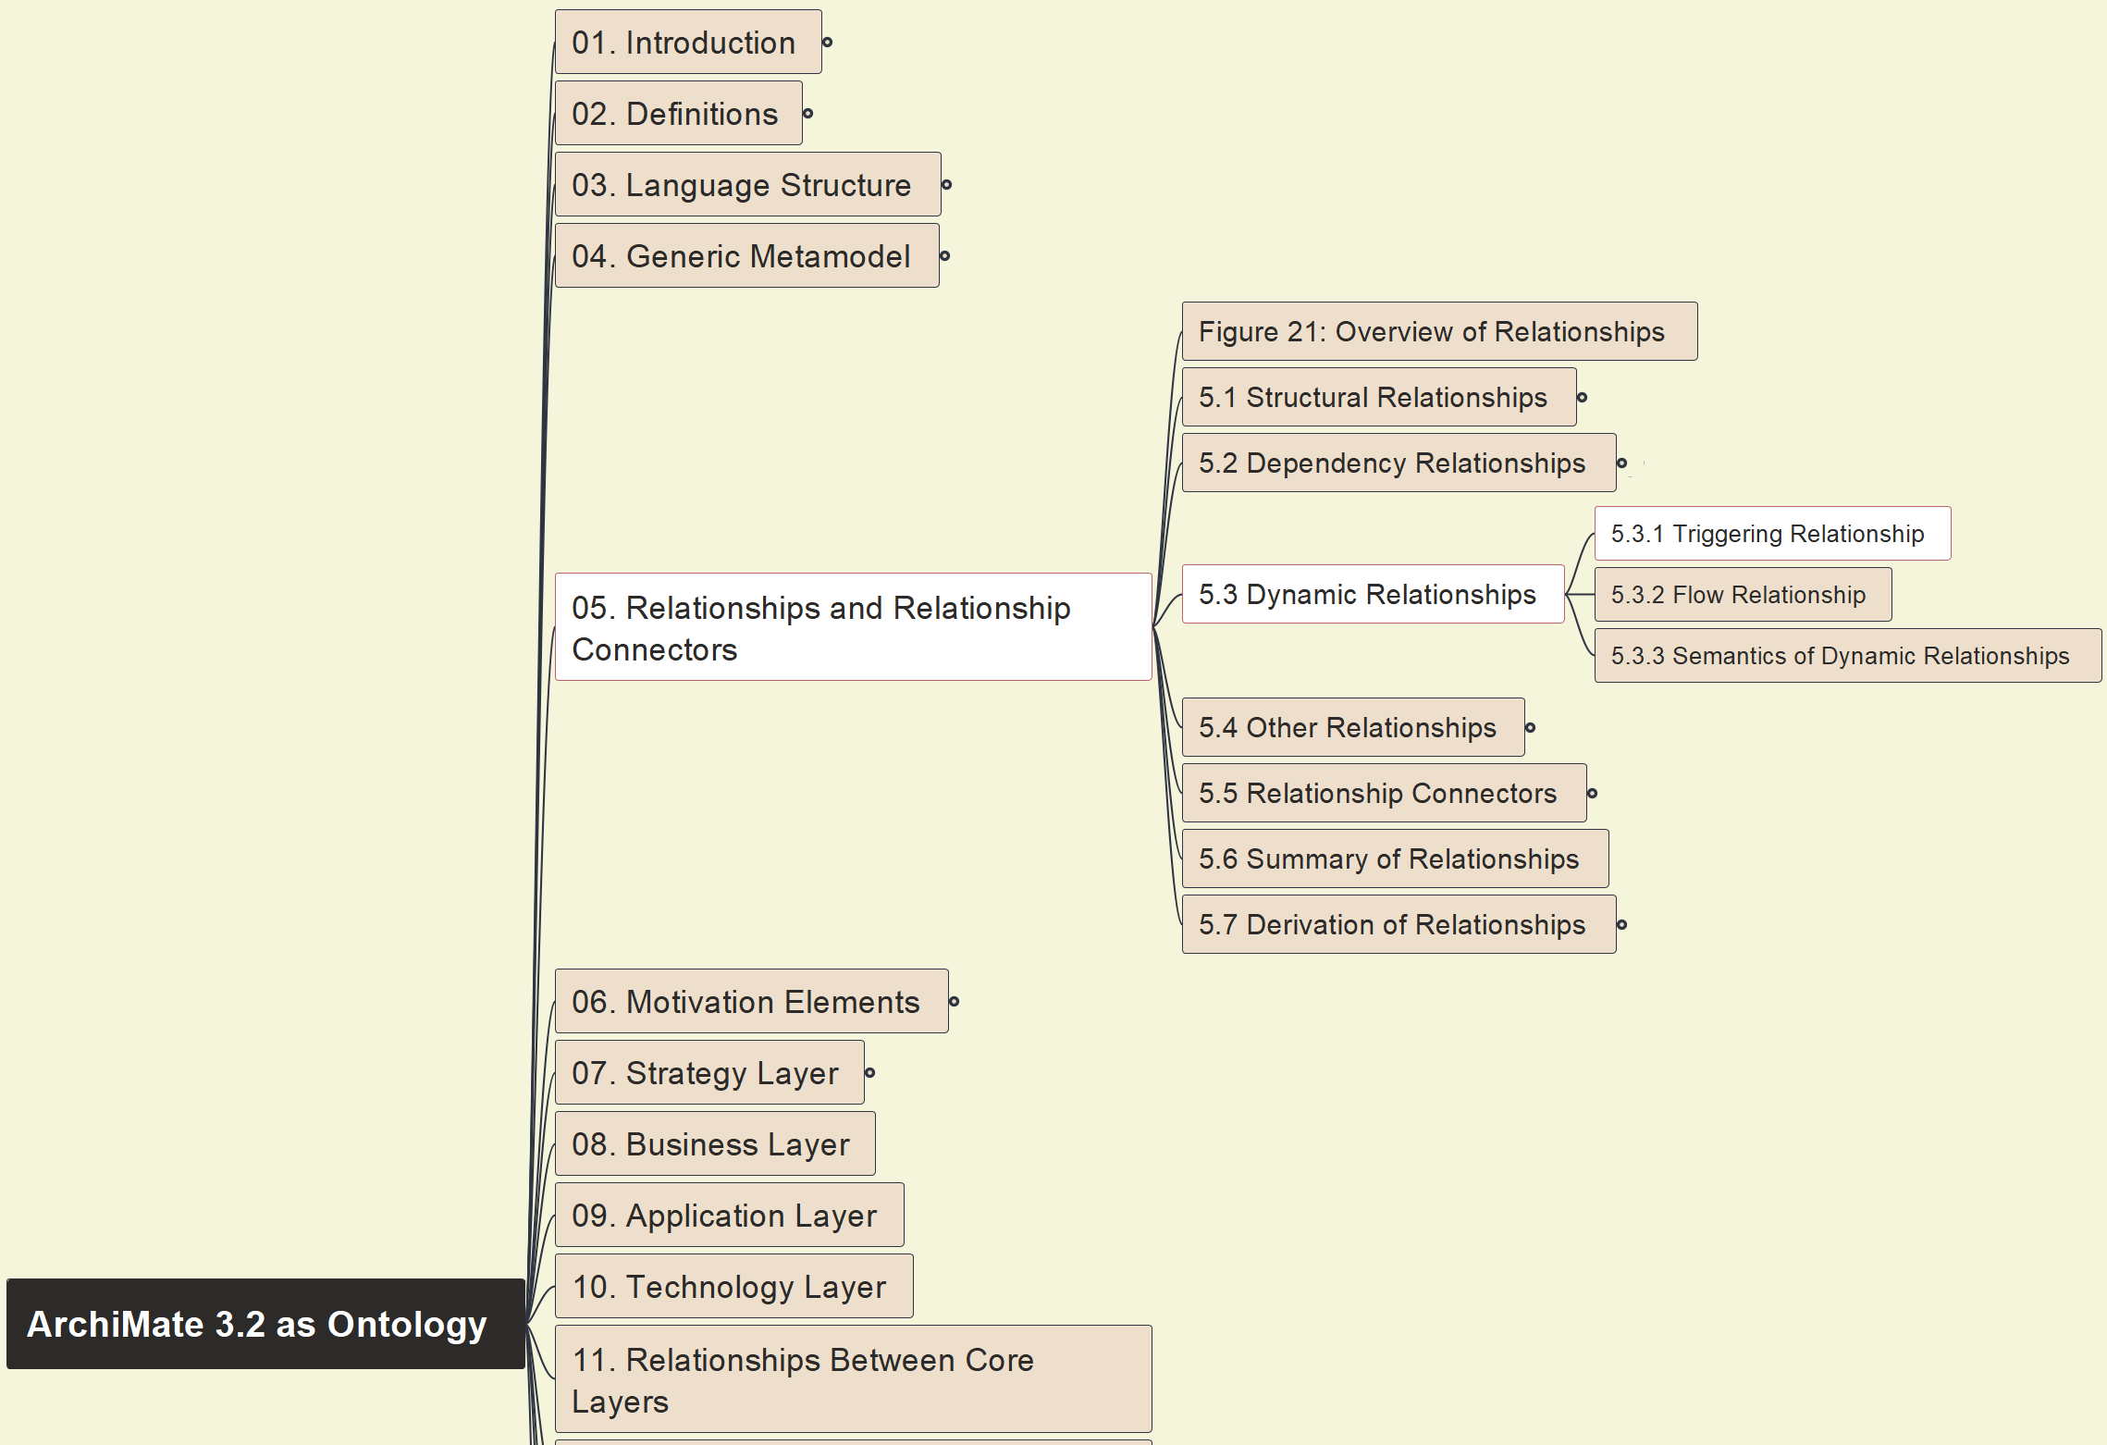
Build Ontology View on ArchiMate 3.2
034
5.3 Dynamic 5.3.1 Triggering

Slide 13
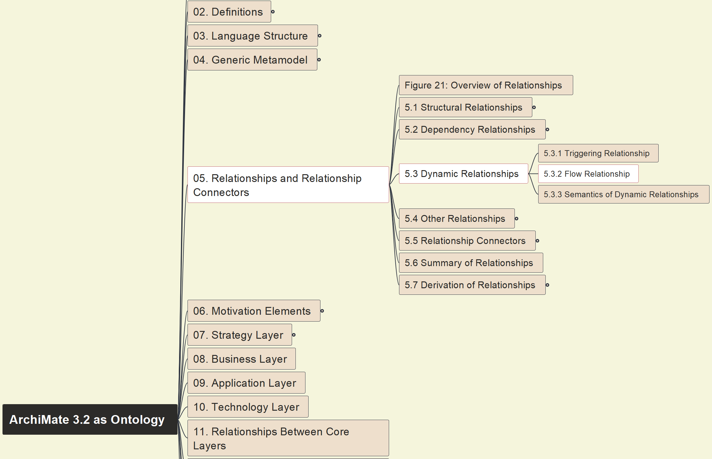
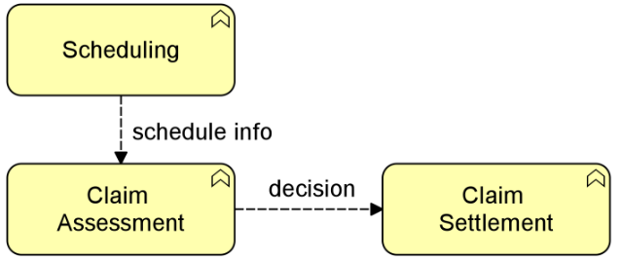
Build Ontology View on ArchiMate 3.2
035
5.3 Dynamic 5.3.2 Flow Relationship

Slide 14
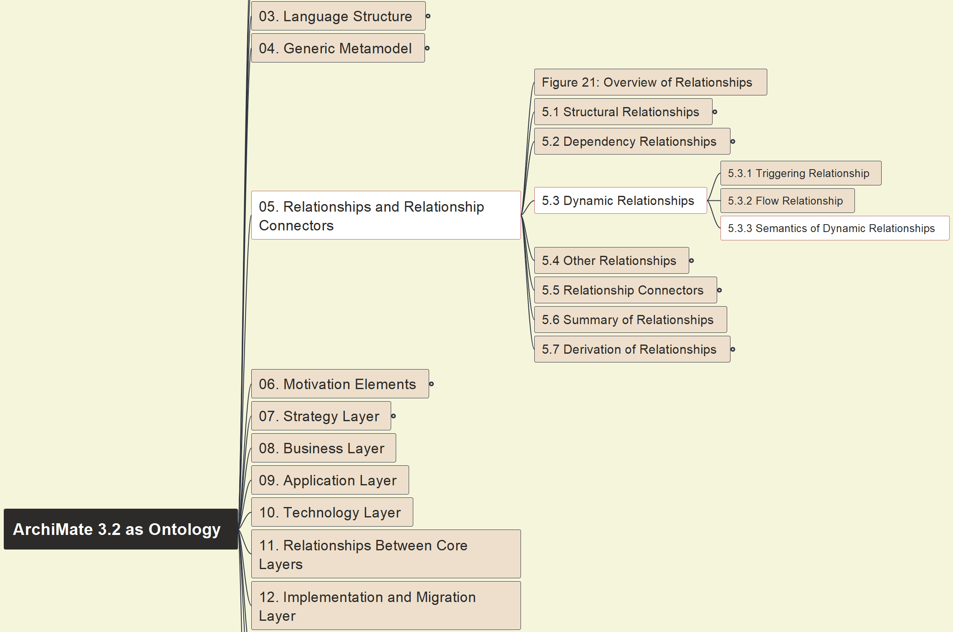
Build Ontology View on ArchiMate 3.2
036
5.3 Dynamic 5.3.3 Semantics View

Slide 15
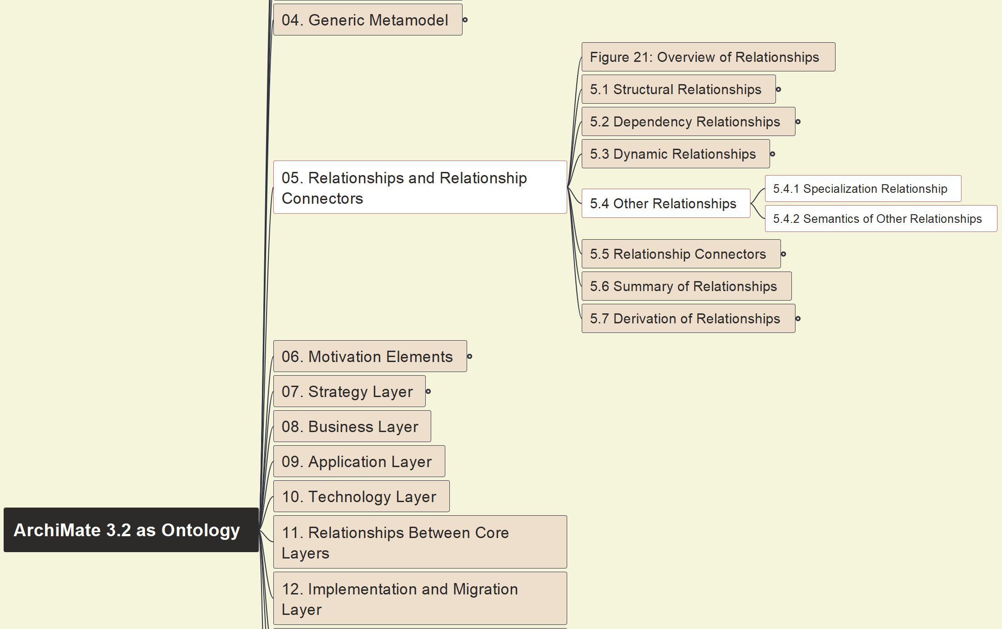
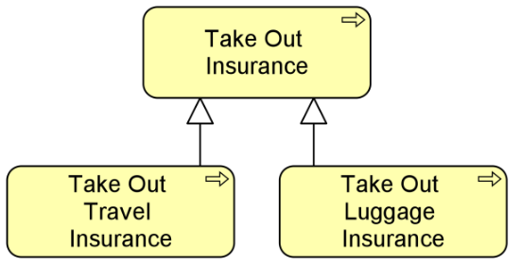
Build Ontology View on ArchiMate 3.2
037
5.4 Other Relations

Slide 16
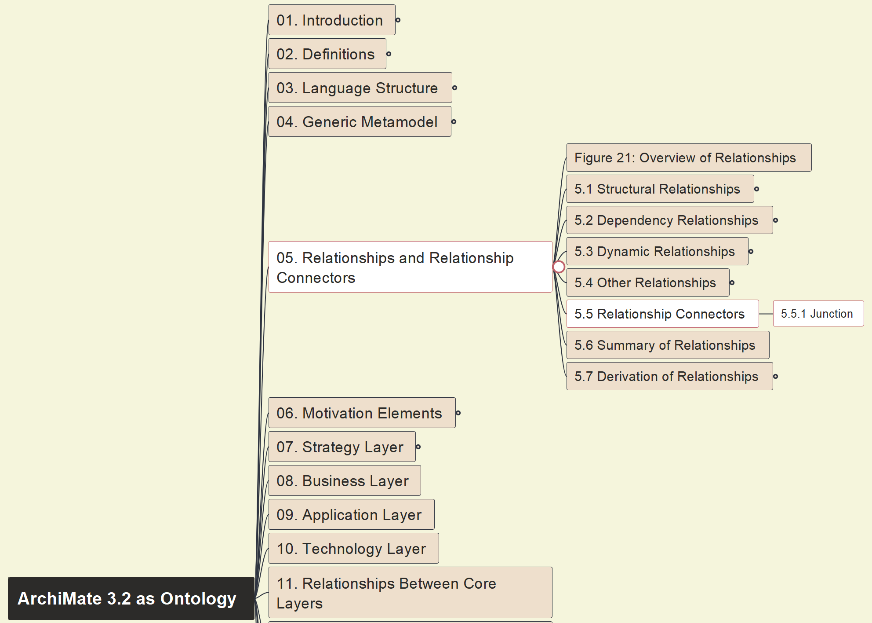

Build Ontology View on ArchiMate 3.2
038
5.5 Relationship Connectors

Slide 17
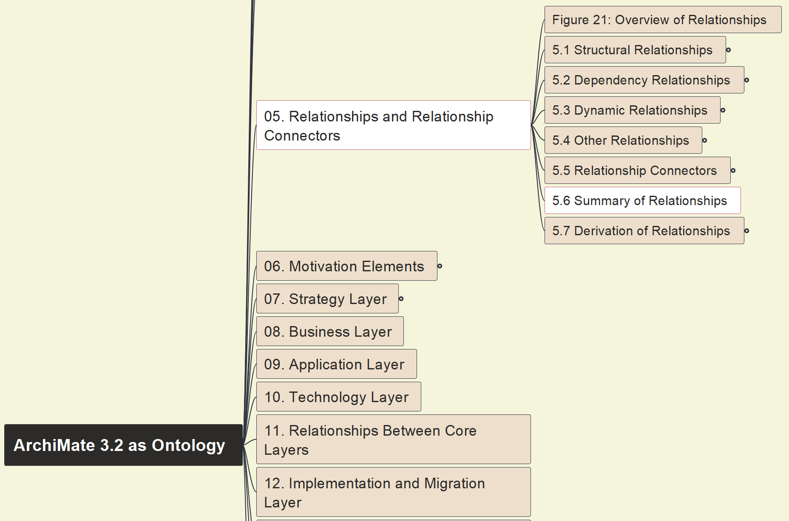
Build Ontology View on ArchiMate 3.2
039
5.6 Summary of Relationships

Slide 18
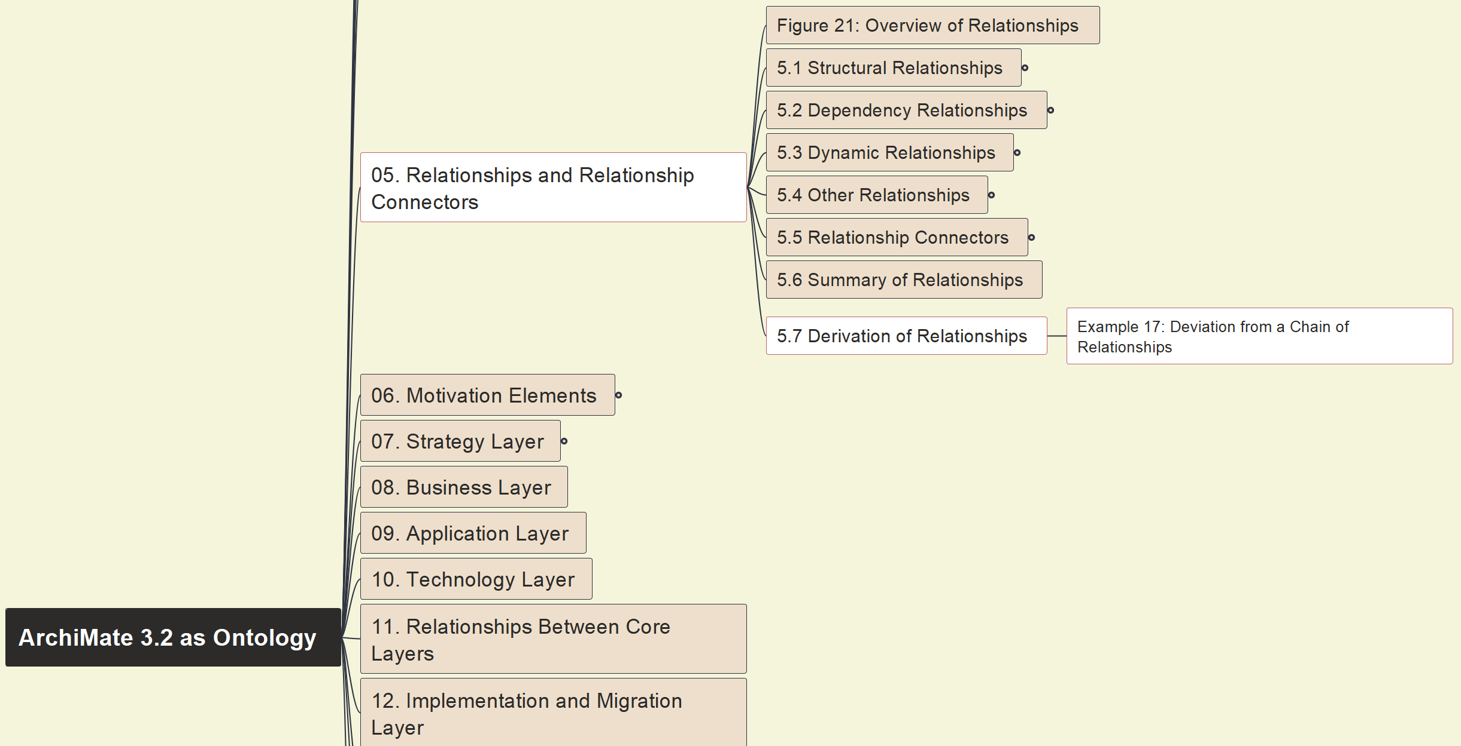
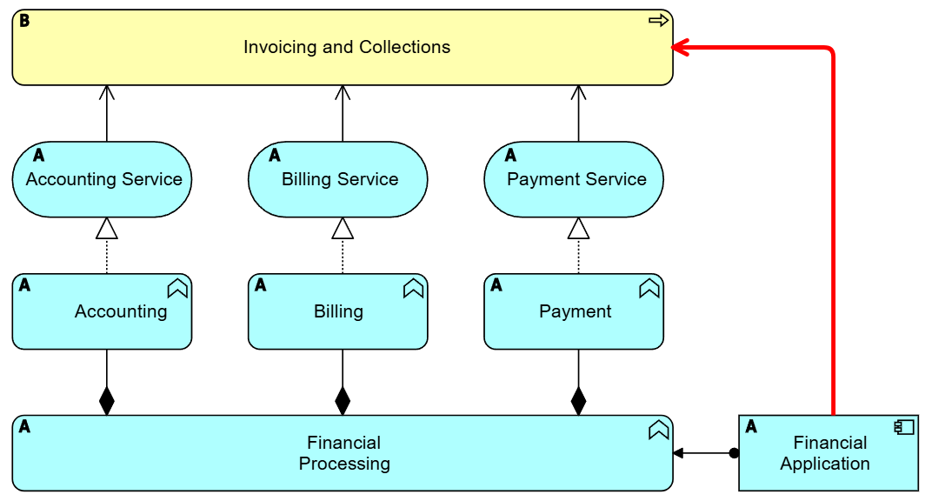

Build Ontology View on ArchiMate 3.2
040
5.7 Derivation of Relationships

