Slide 1

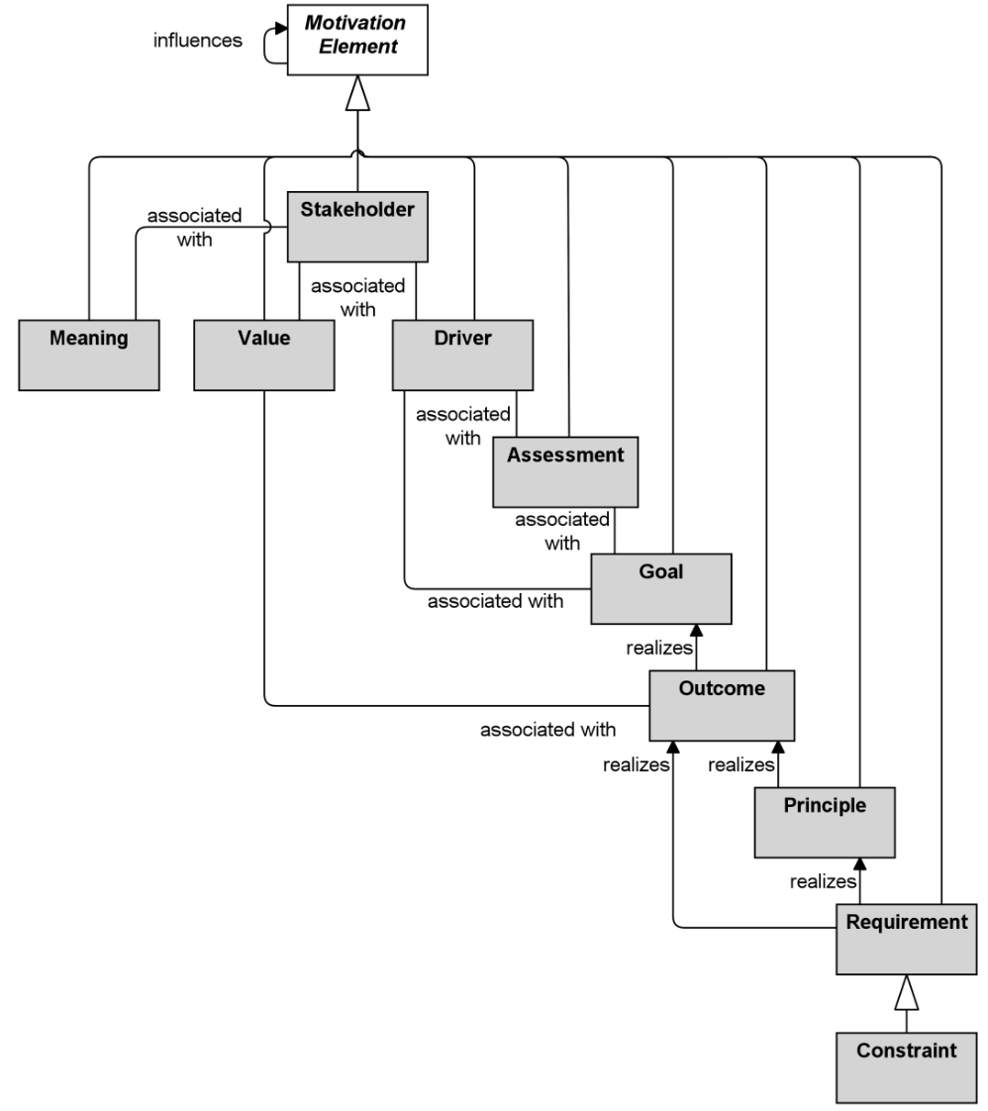
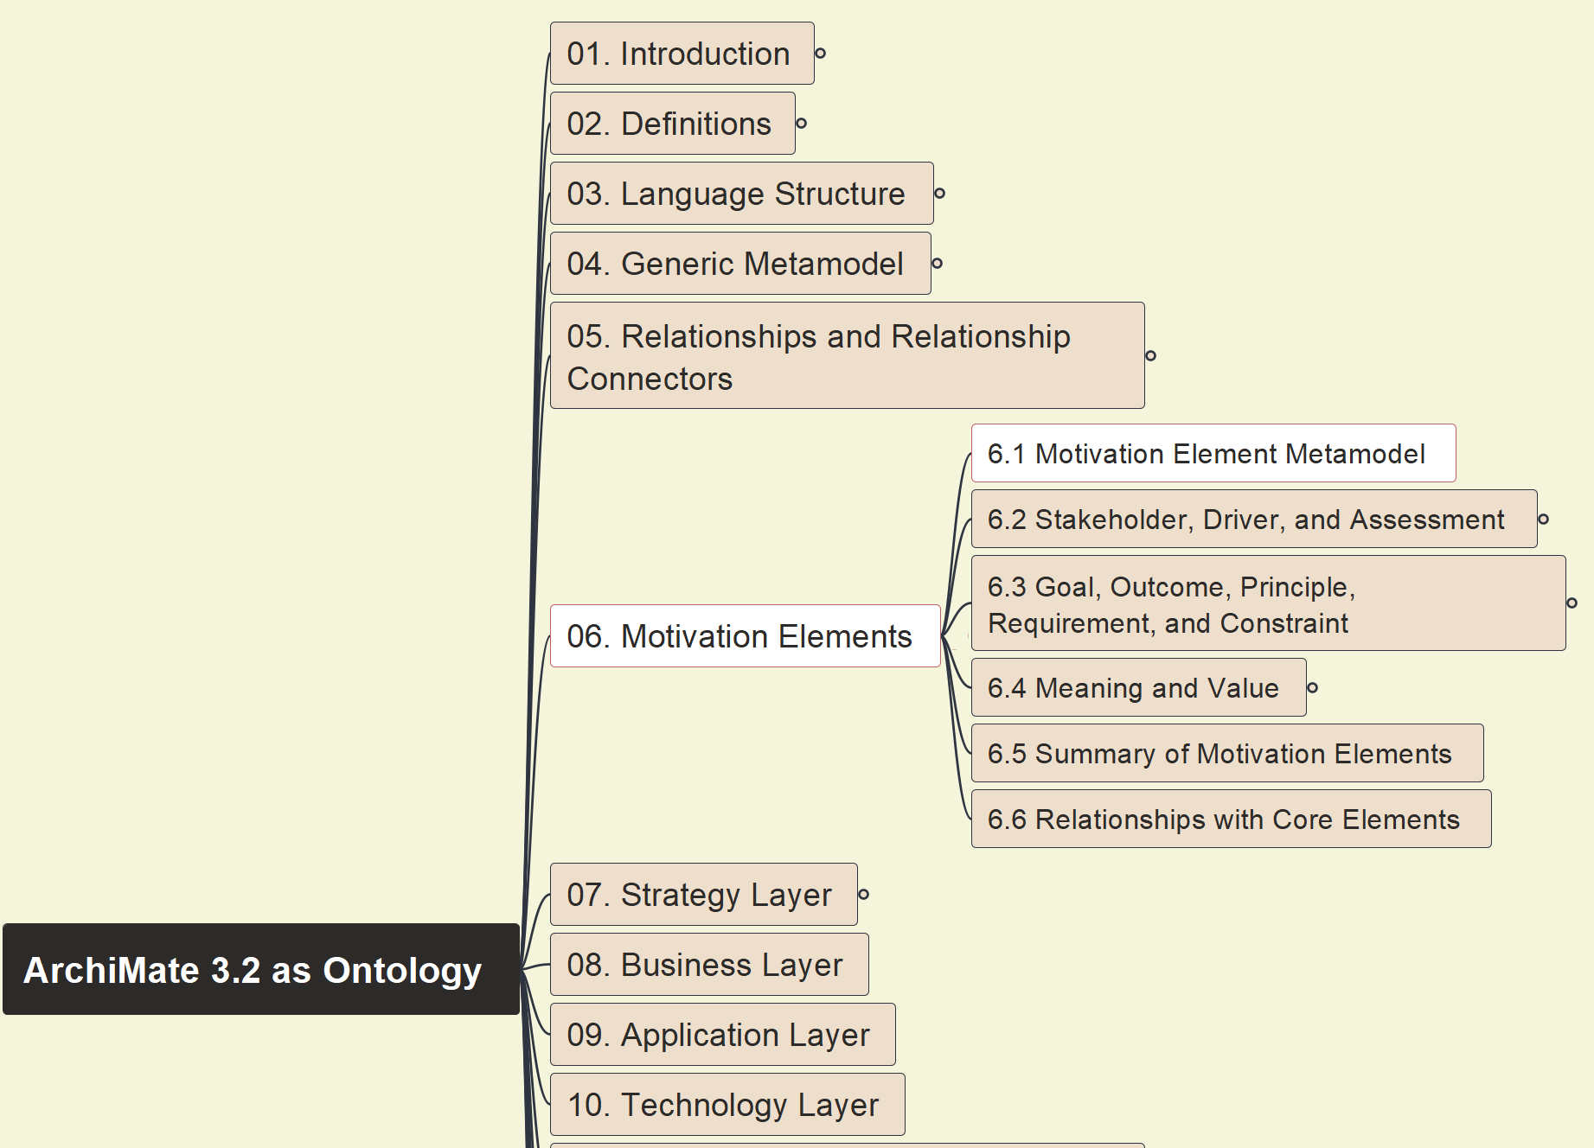



Build Ontology View on ArchiMate 3.2
041
6. Motivation Elements 6.1 Metamodel

Slide 2
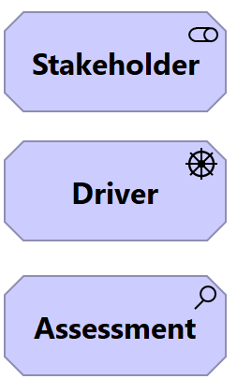
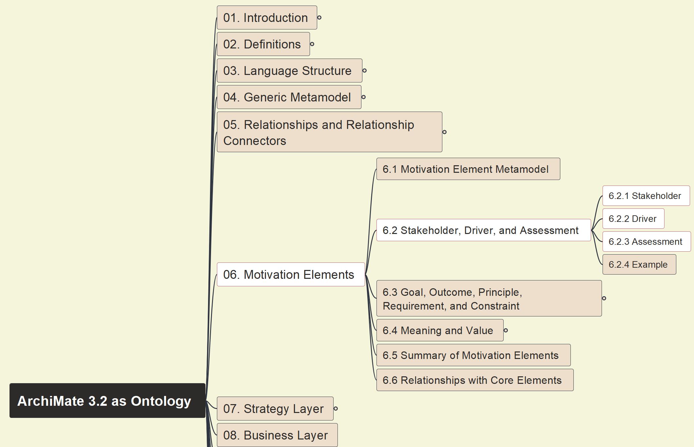
Build Ontology View on ArchiMate 3.2
042
6.2 Stakeholder, Driver, and Assessment

Slide 3
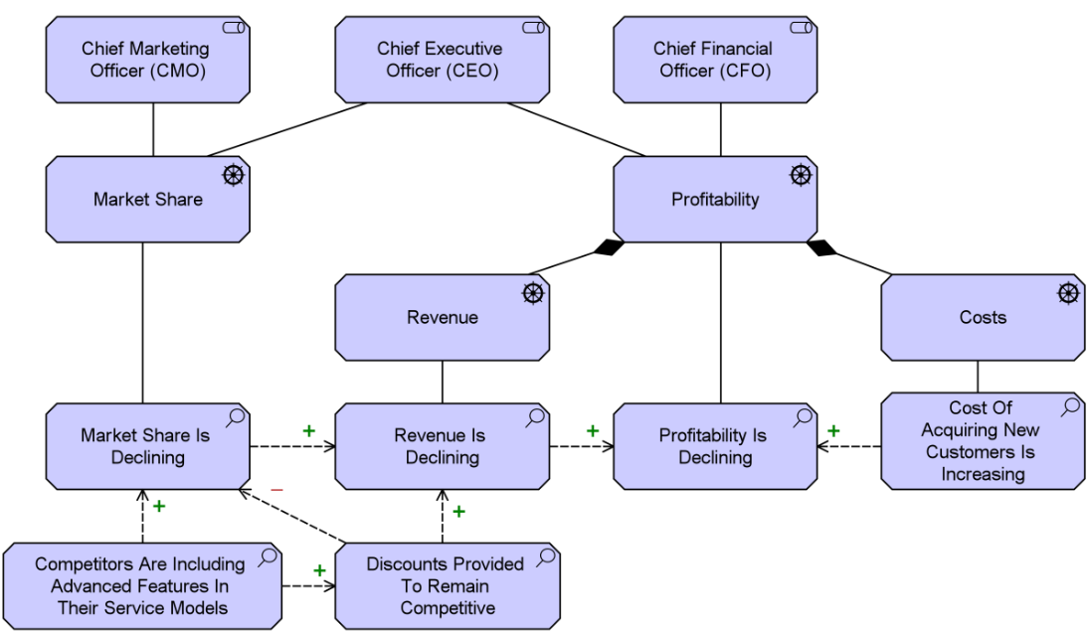
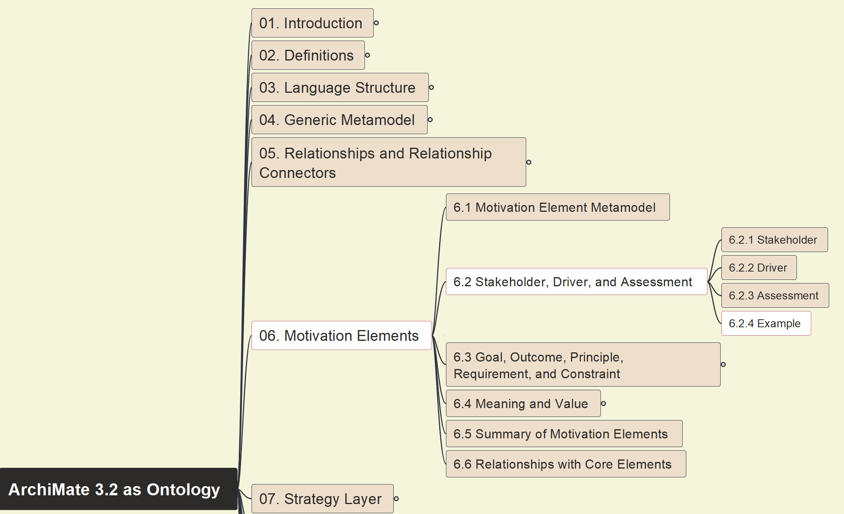
Build Ontology View on ArchiMate 3.2
043
6.2.4 Example 18

Slide 4
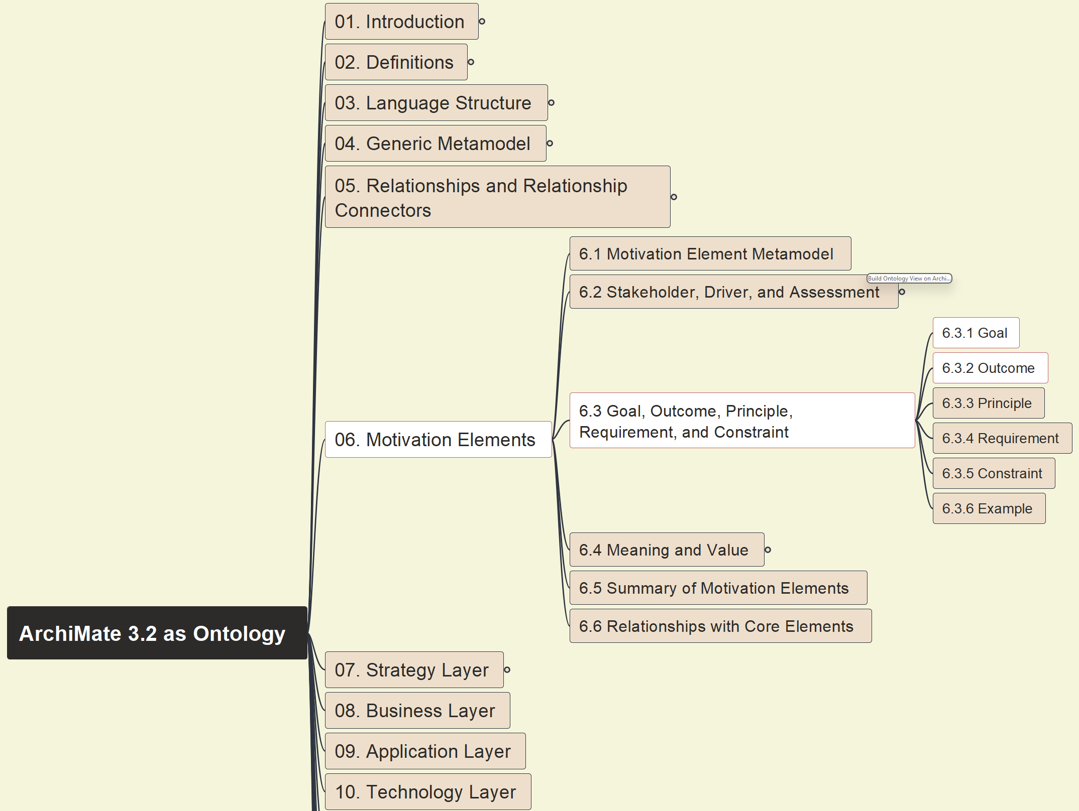
Build Ontology View on ArchiMate 3.2
044
6.3 – 6.3.1 Goal, 6.3.2 Outcome

Slide 5
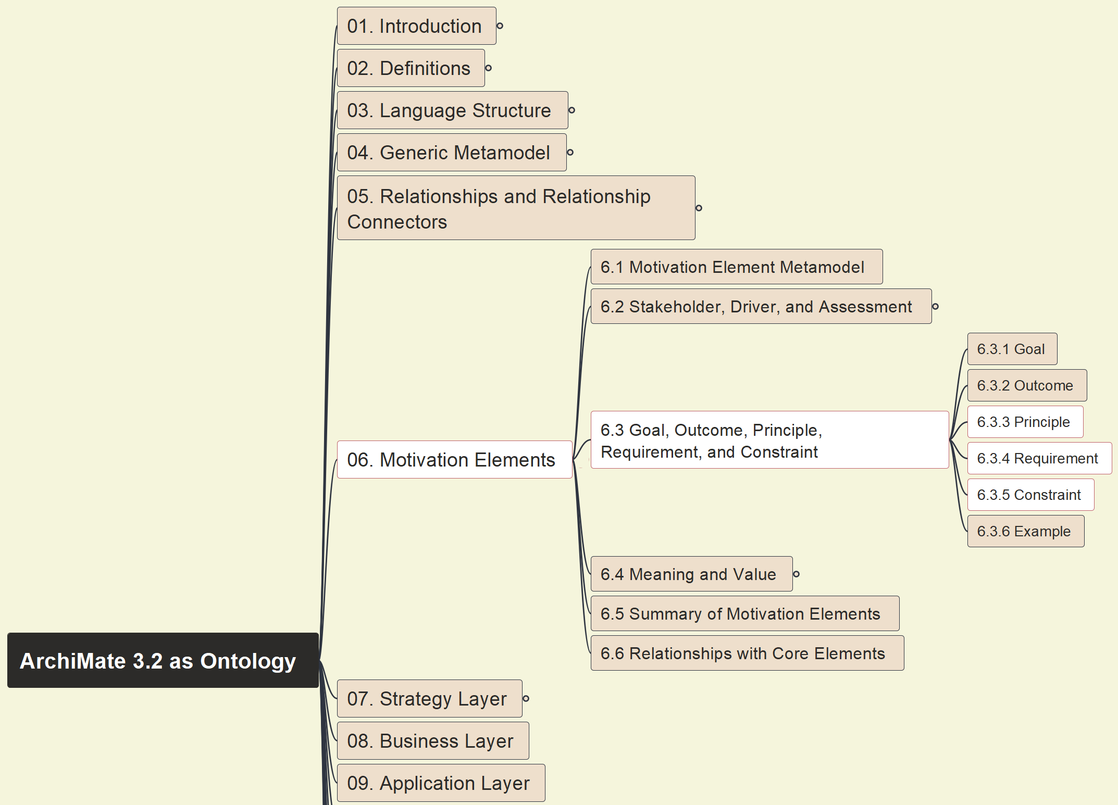
Build Ontology View on ArchiMate 3.2
045
6.3.3 – 6.3.5 Principle, Req. and Constraint

Slide 6
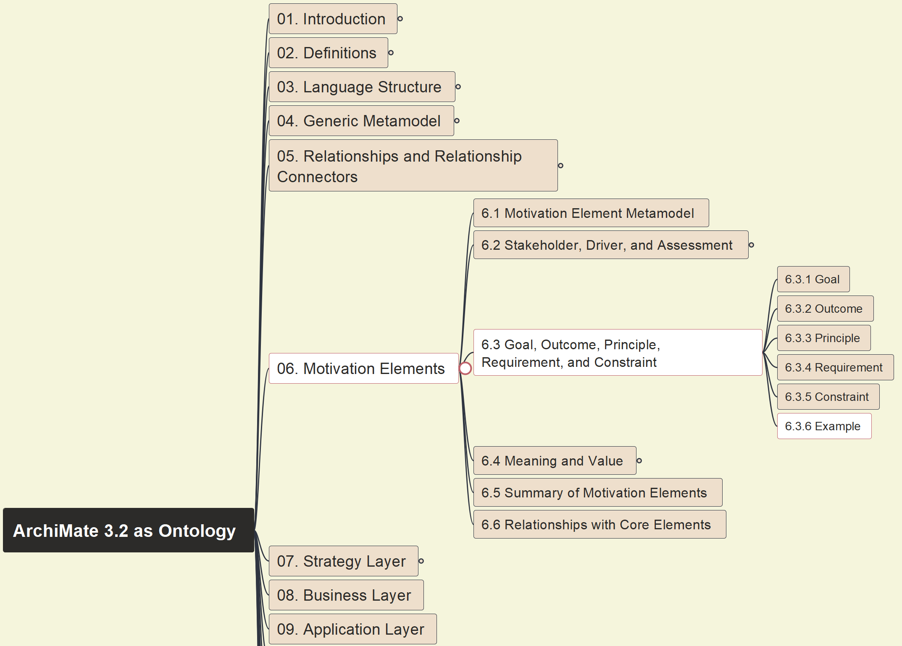
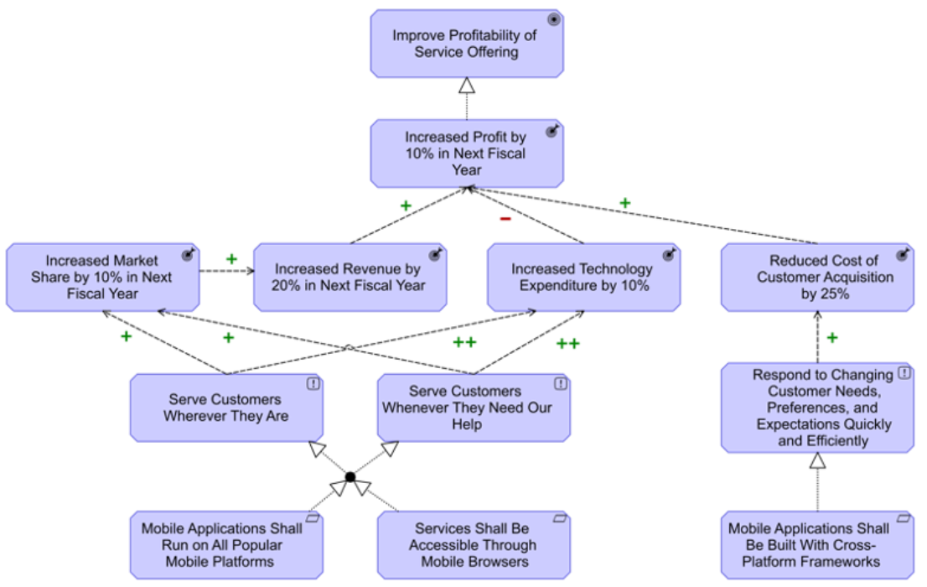
Build Ontology View on ArchiMate 3.2
046
6.3 Example 19

Slide 7
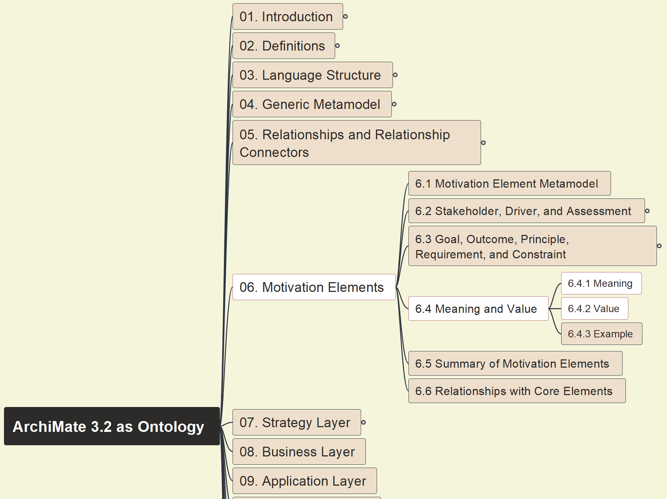
Build Ontology View on ArchiMate 3.2
047
6.4 – 6.4.1 Meaning, 6.4.2 Value

Slide 8
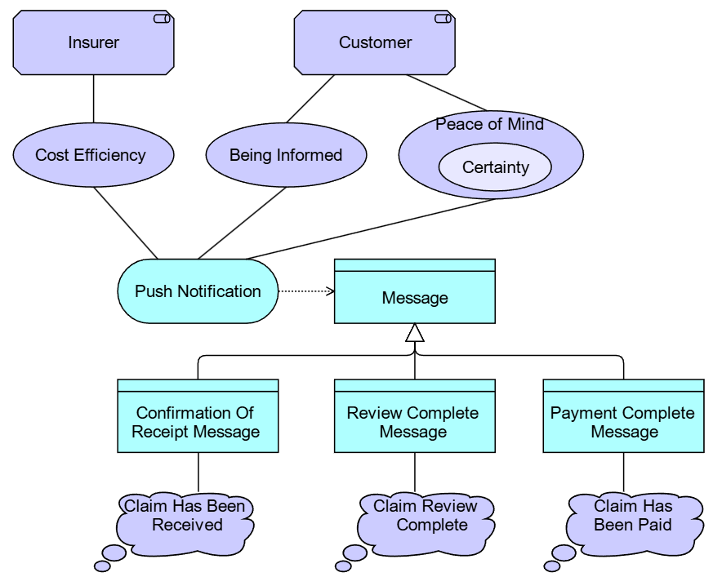
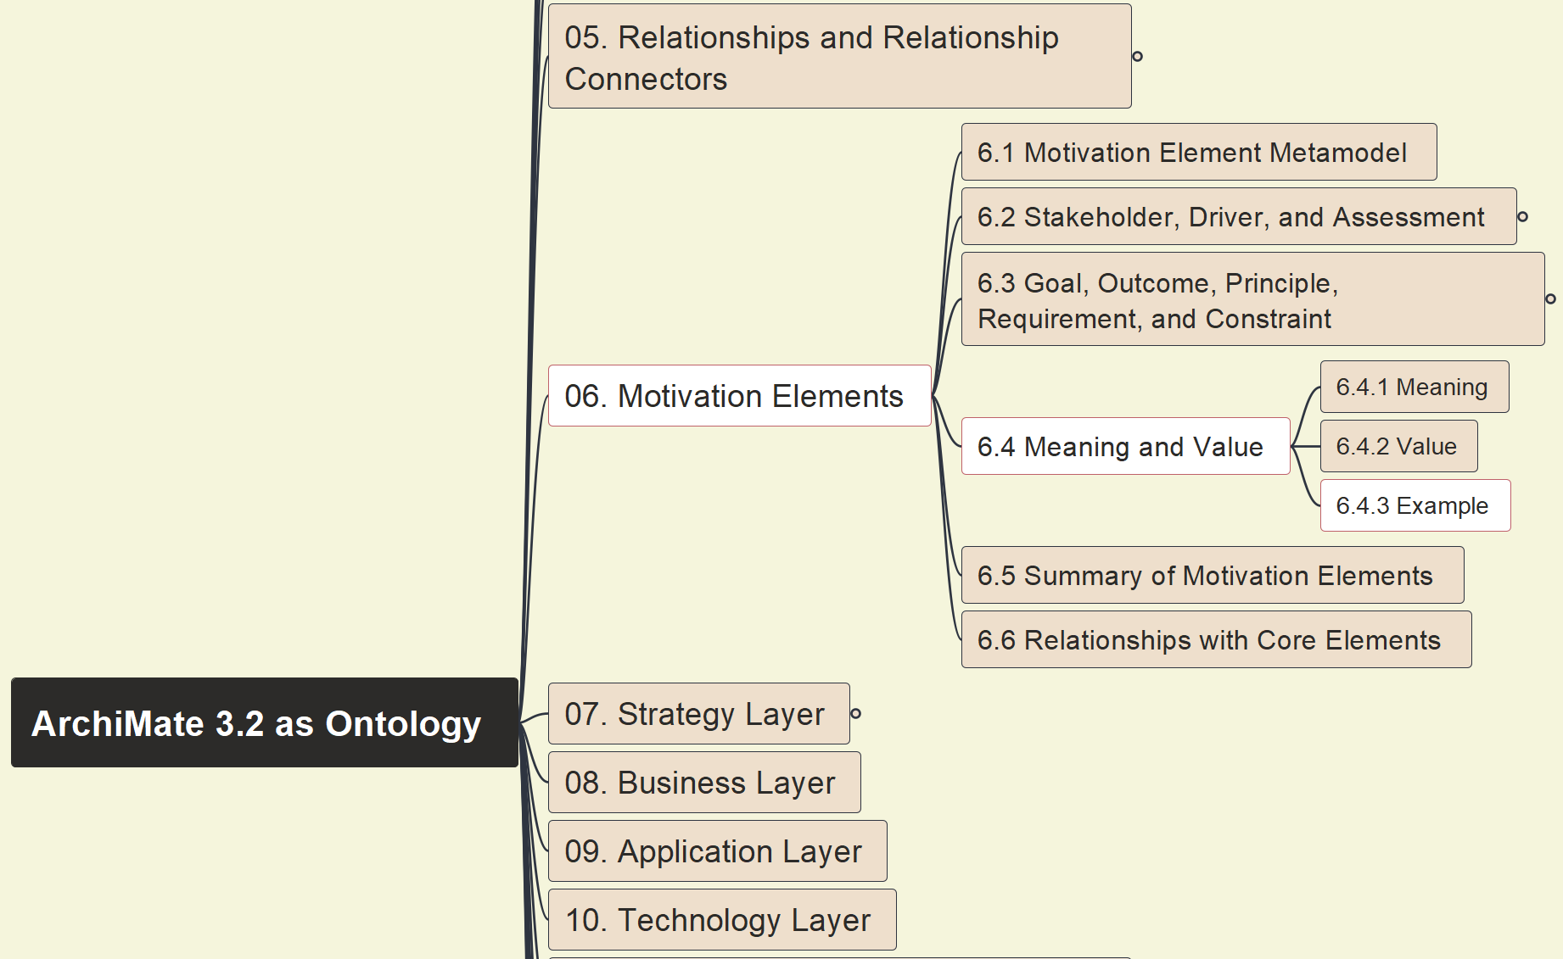
Build Ontology View on ArchiMate 3.2
048
6.4 Meaning & Value 6.4.3 Example 20

Slide 9
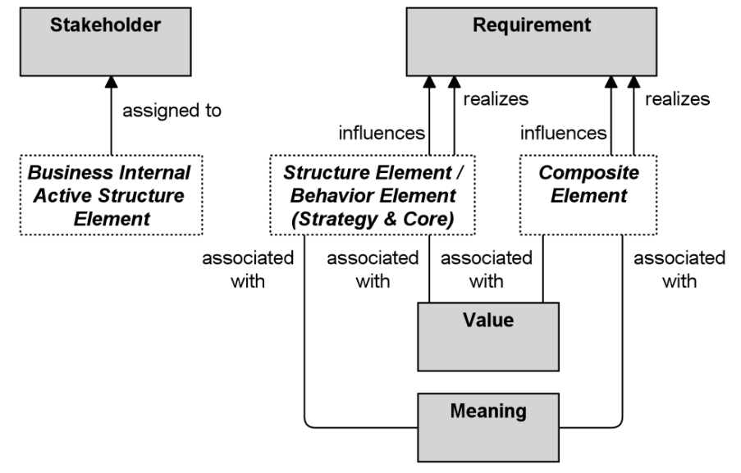
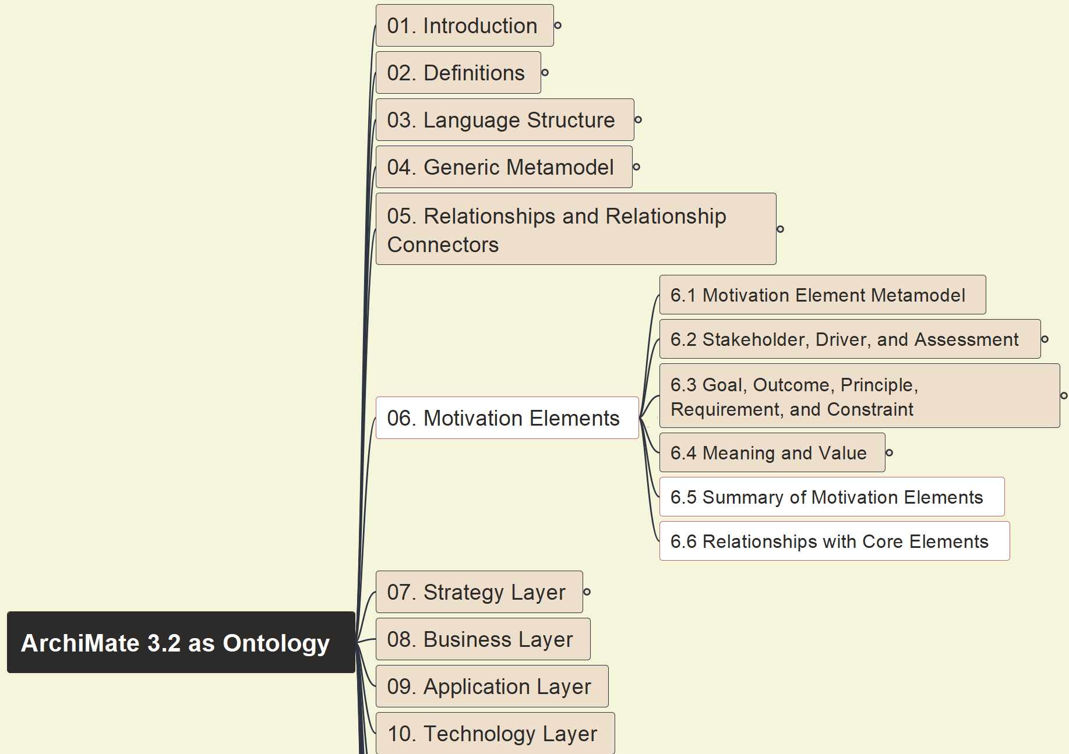
Build Ontology View on ArchiMate 3.2
049
6.5 Summary of Motivation 6.6 Rel. w/ Core

Slide 10
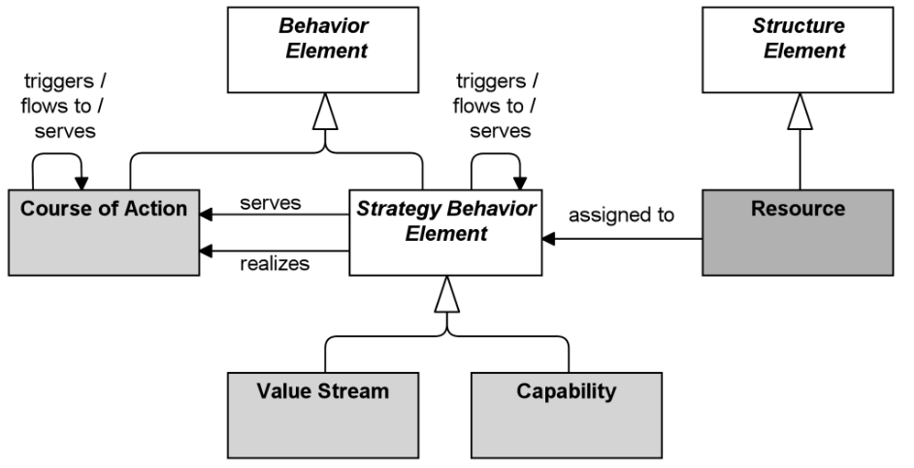
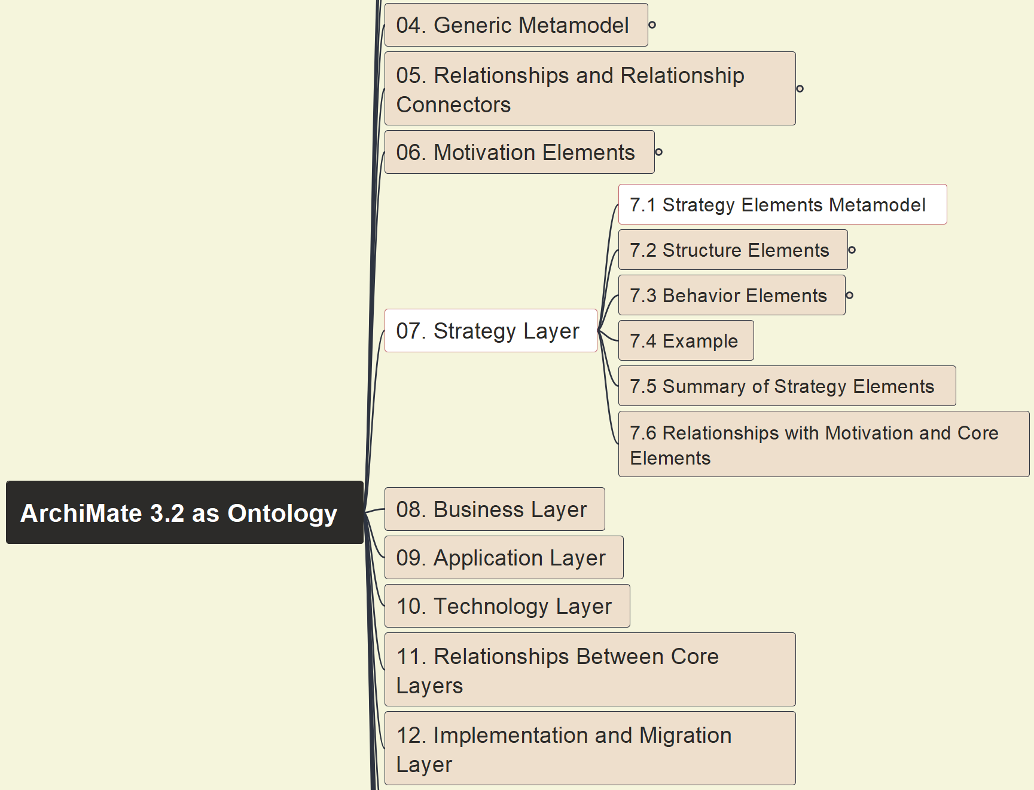
Build Ontology View on ArchiMate 3.2
050
7. Strategy Layer – 7.1 Metamodel

Slide 11
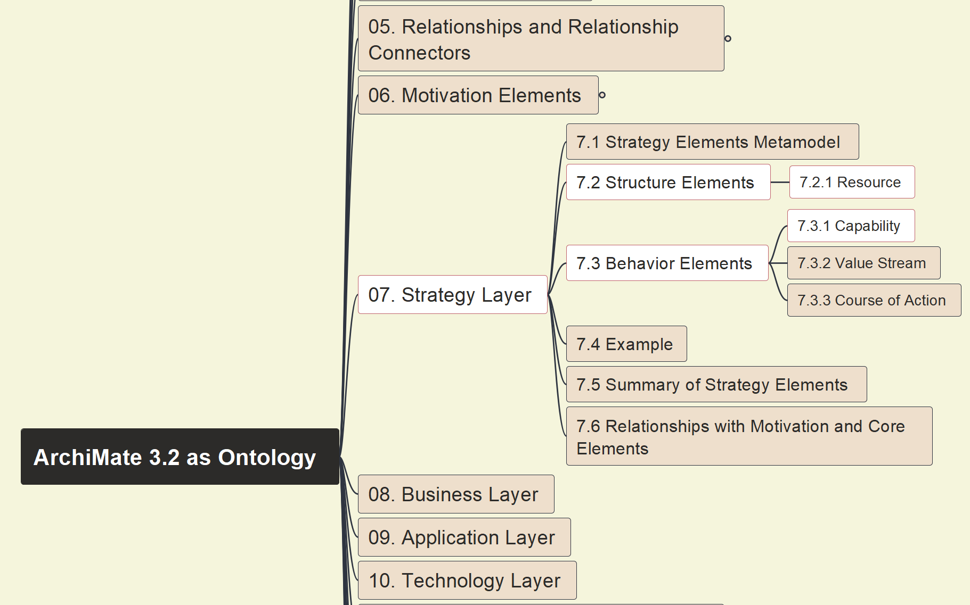
Build Ontology View on ArchiMate 3.2
051
7.2.1 Resource, 7.3.1 Capability

Slide 12
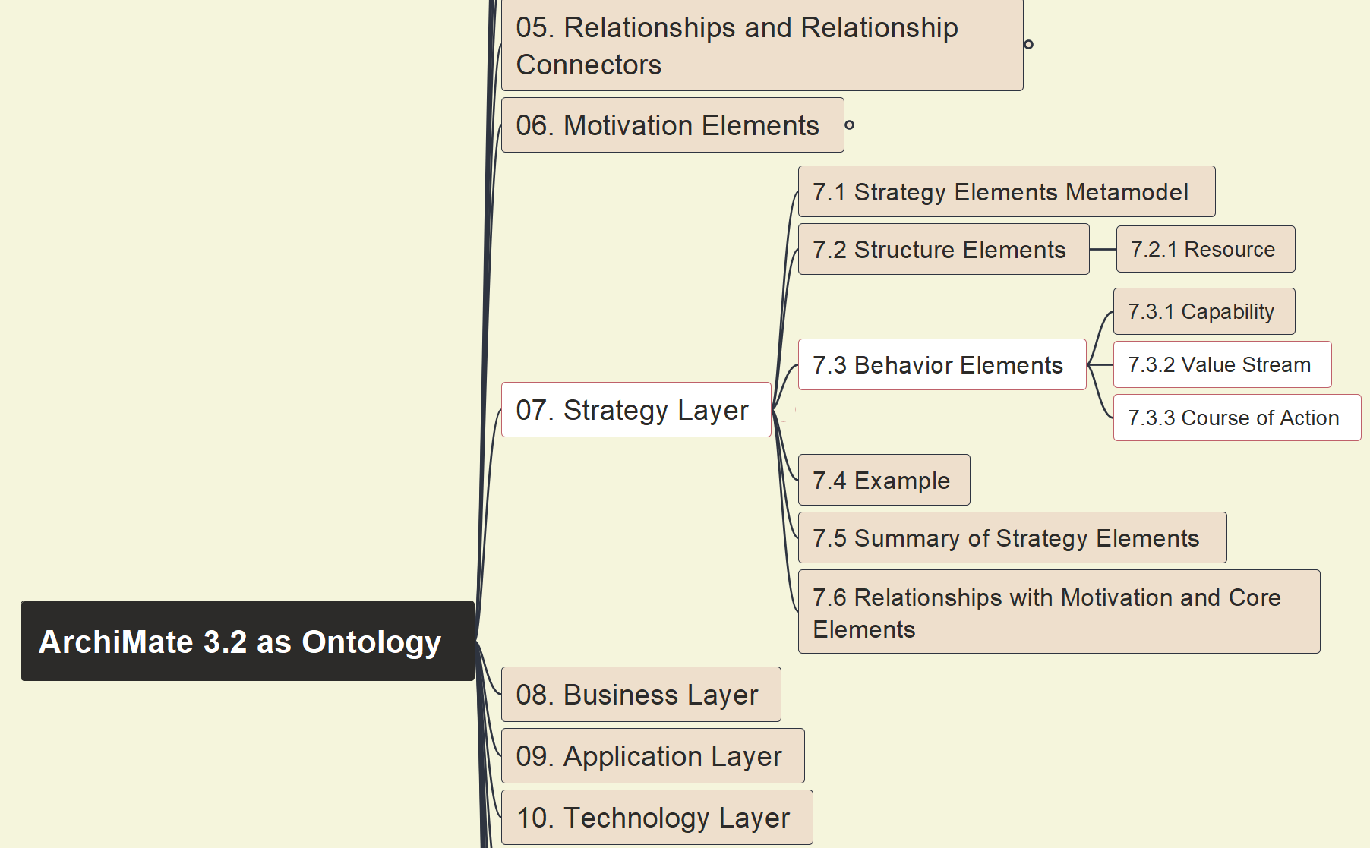
Build Ontology View on ArchiMate 3.2
052
7.3.2 Value Stream, 7.3.3 Course of Action

Slide 13
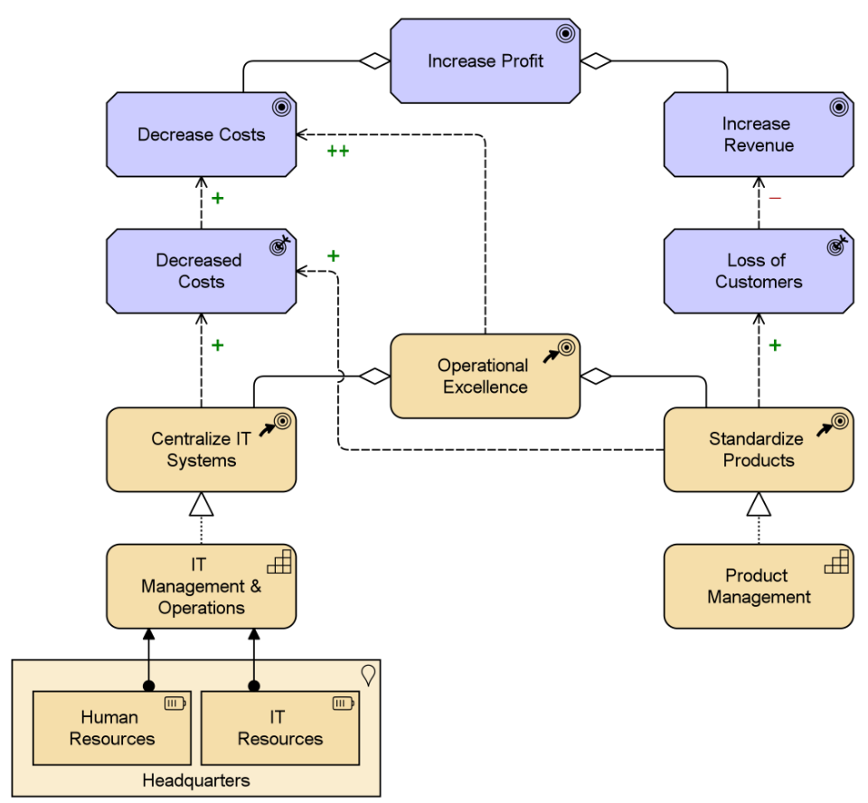
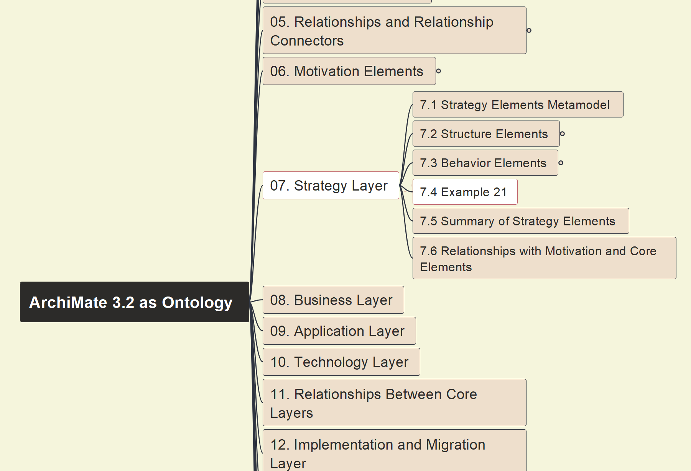
Build Ontology View on ArchiMate 3.2
053
7.4 Example 21 on Capability, Resource and Course of Action

Slide 14
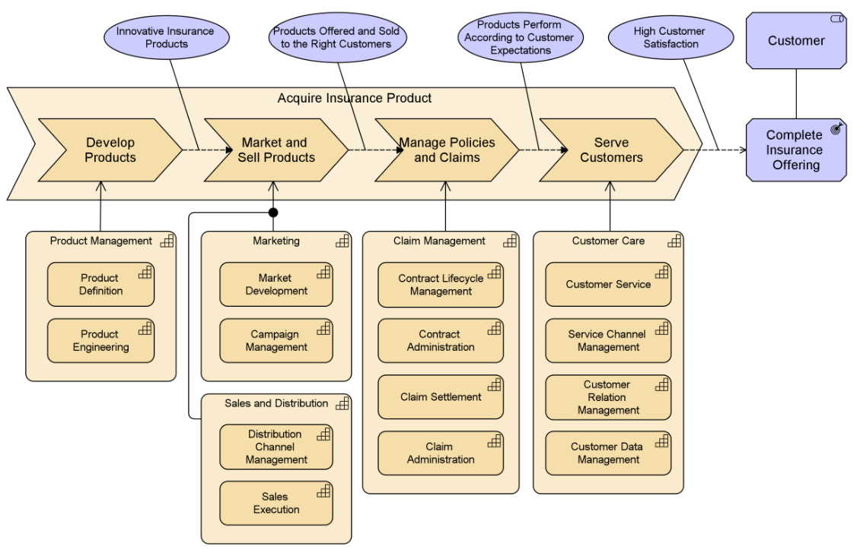
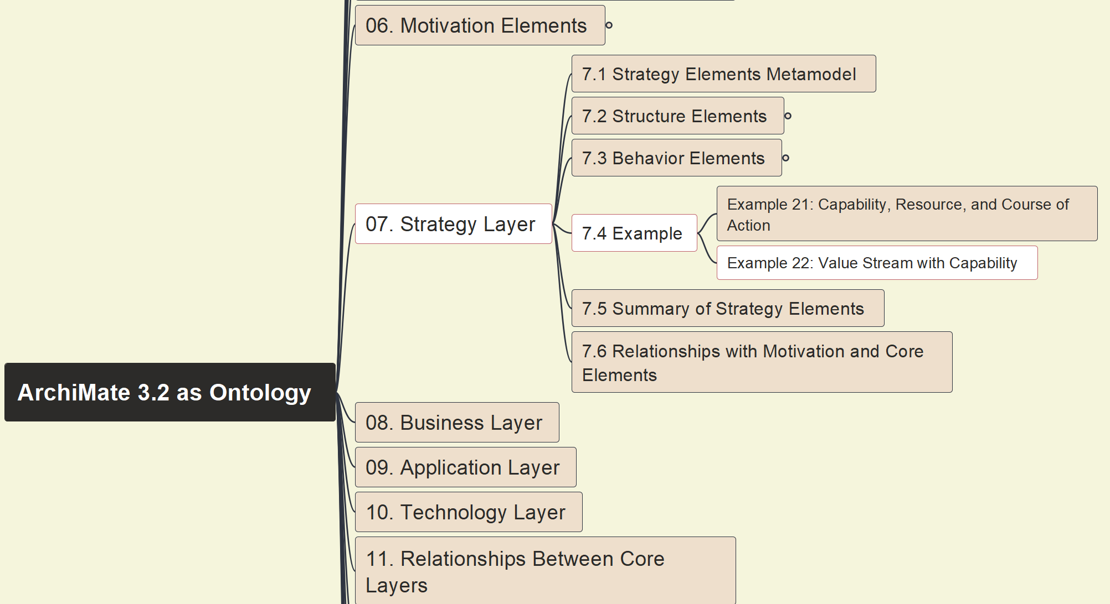
Build Ontology View on ArchiMate 3.2
054
7.4 Example 22 on Value Stream with Capability Cross-Mapping

Slide 15
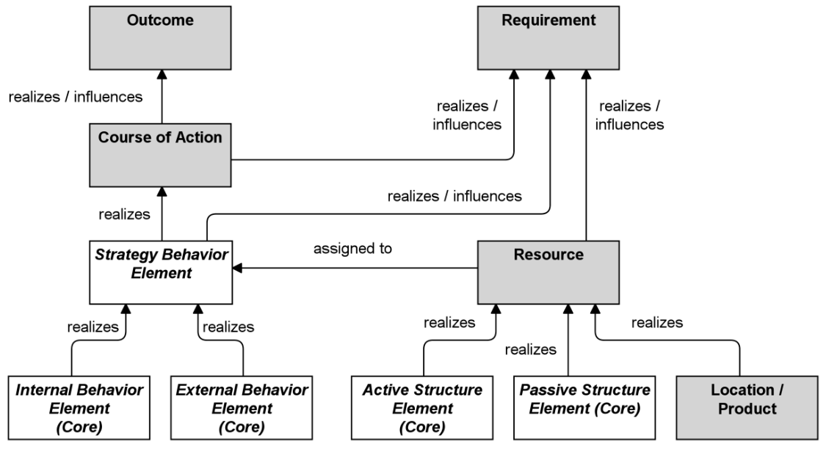
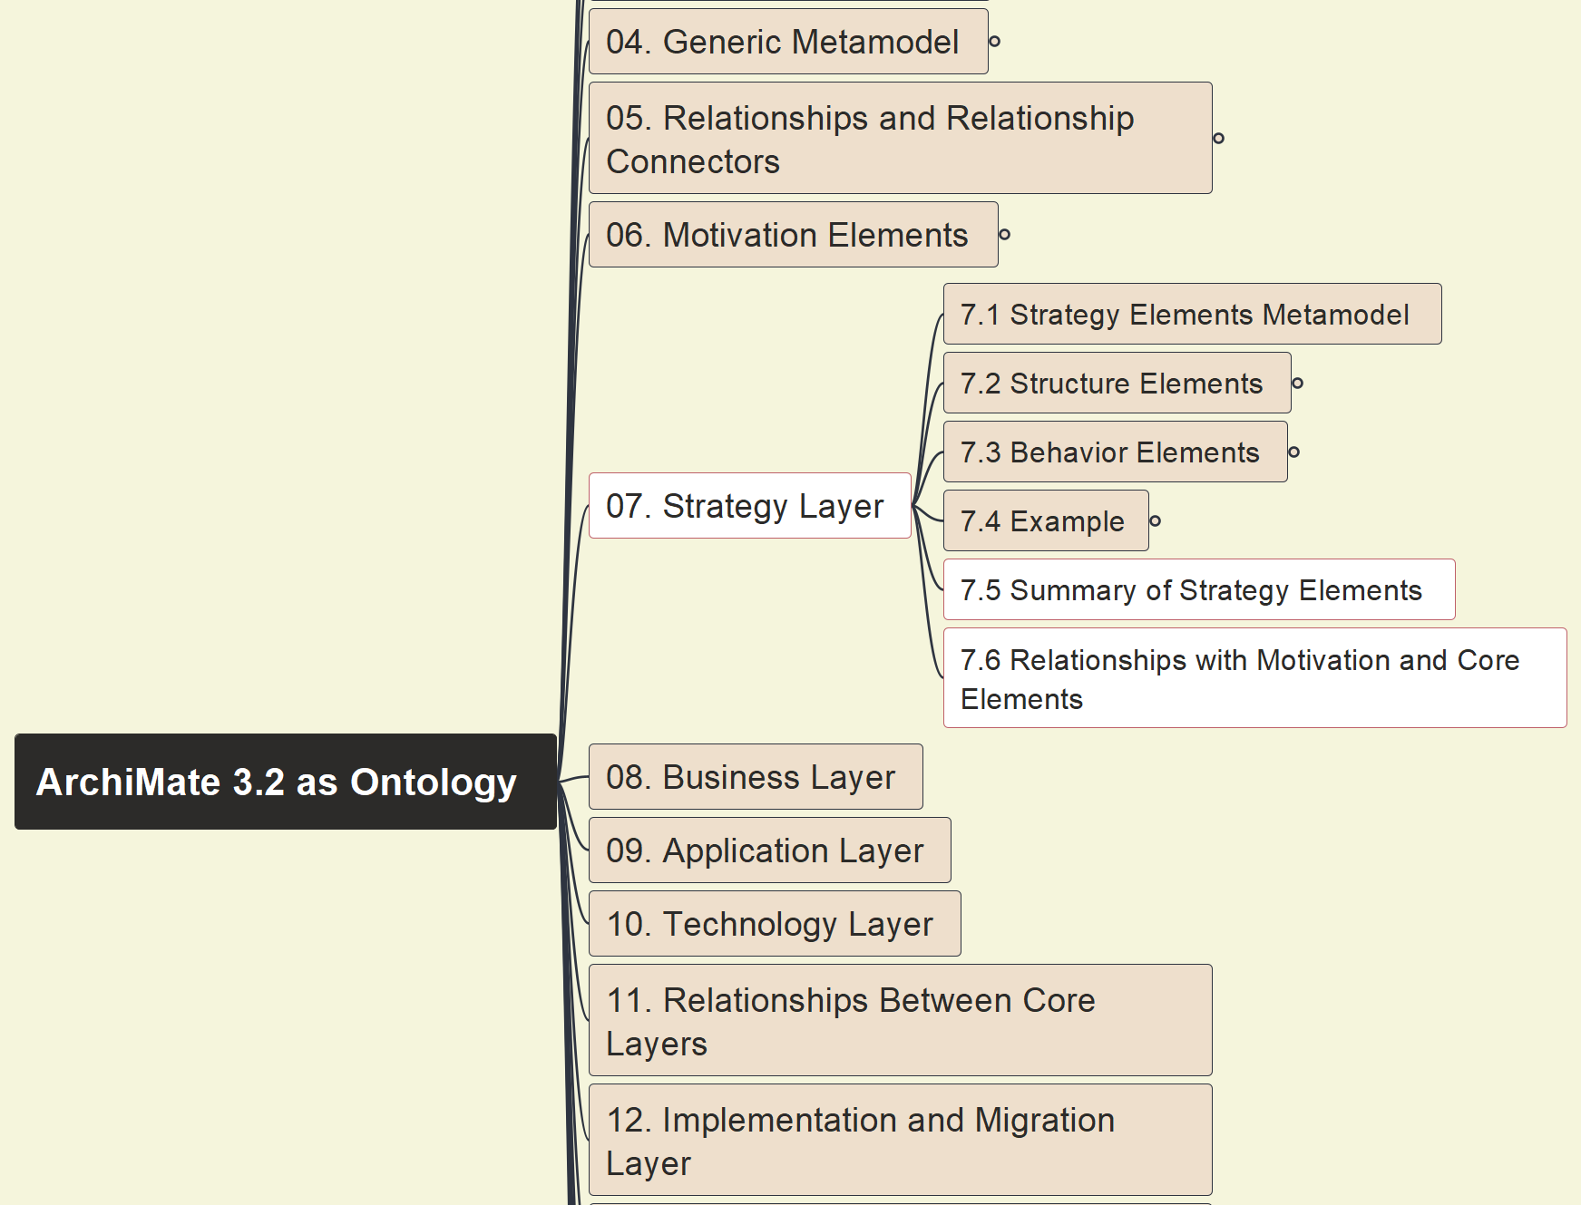
Build Ontology View on ArchiMate 3.2
055
7.5 Summary of Strategy Element, 7.6 Relationships with Motivation & Core Elements

