Slide 1

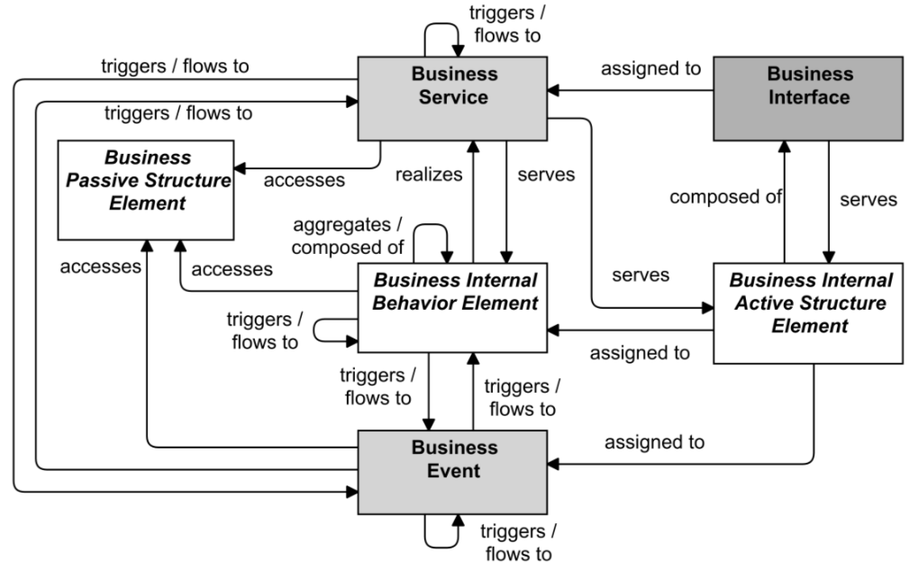
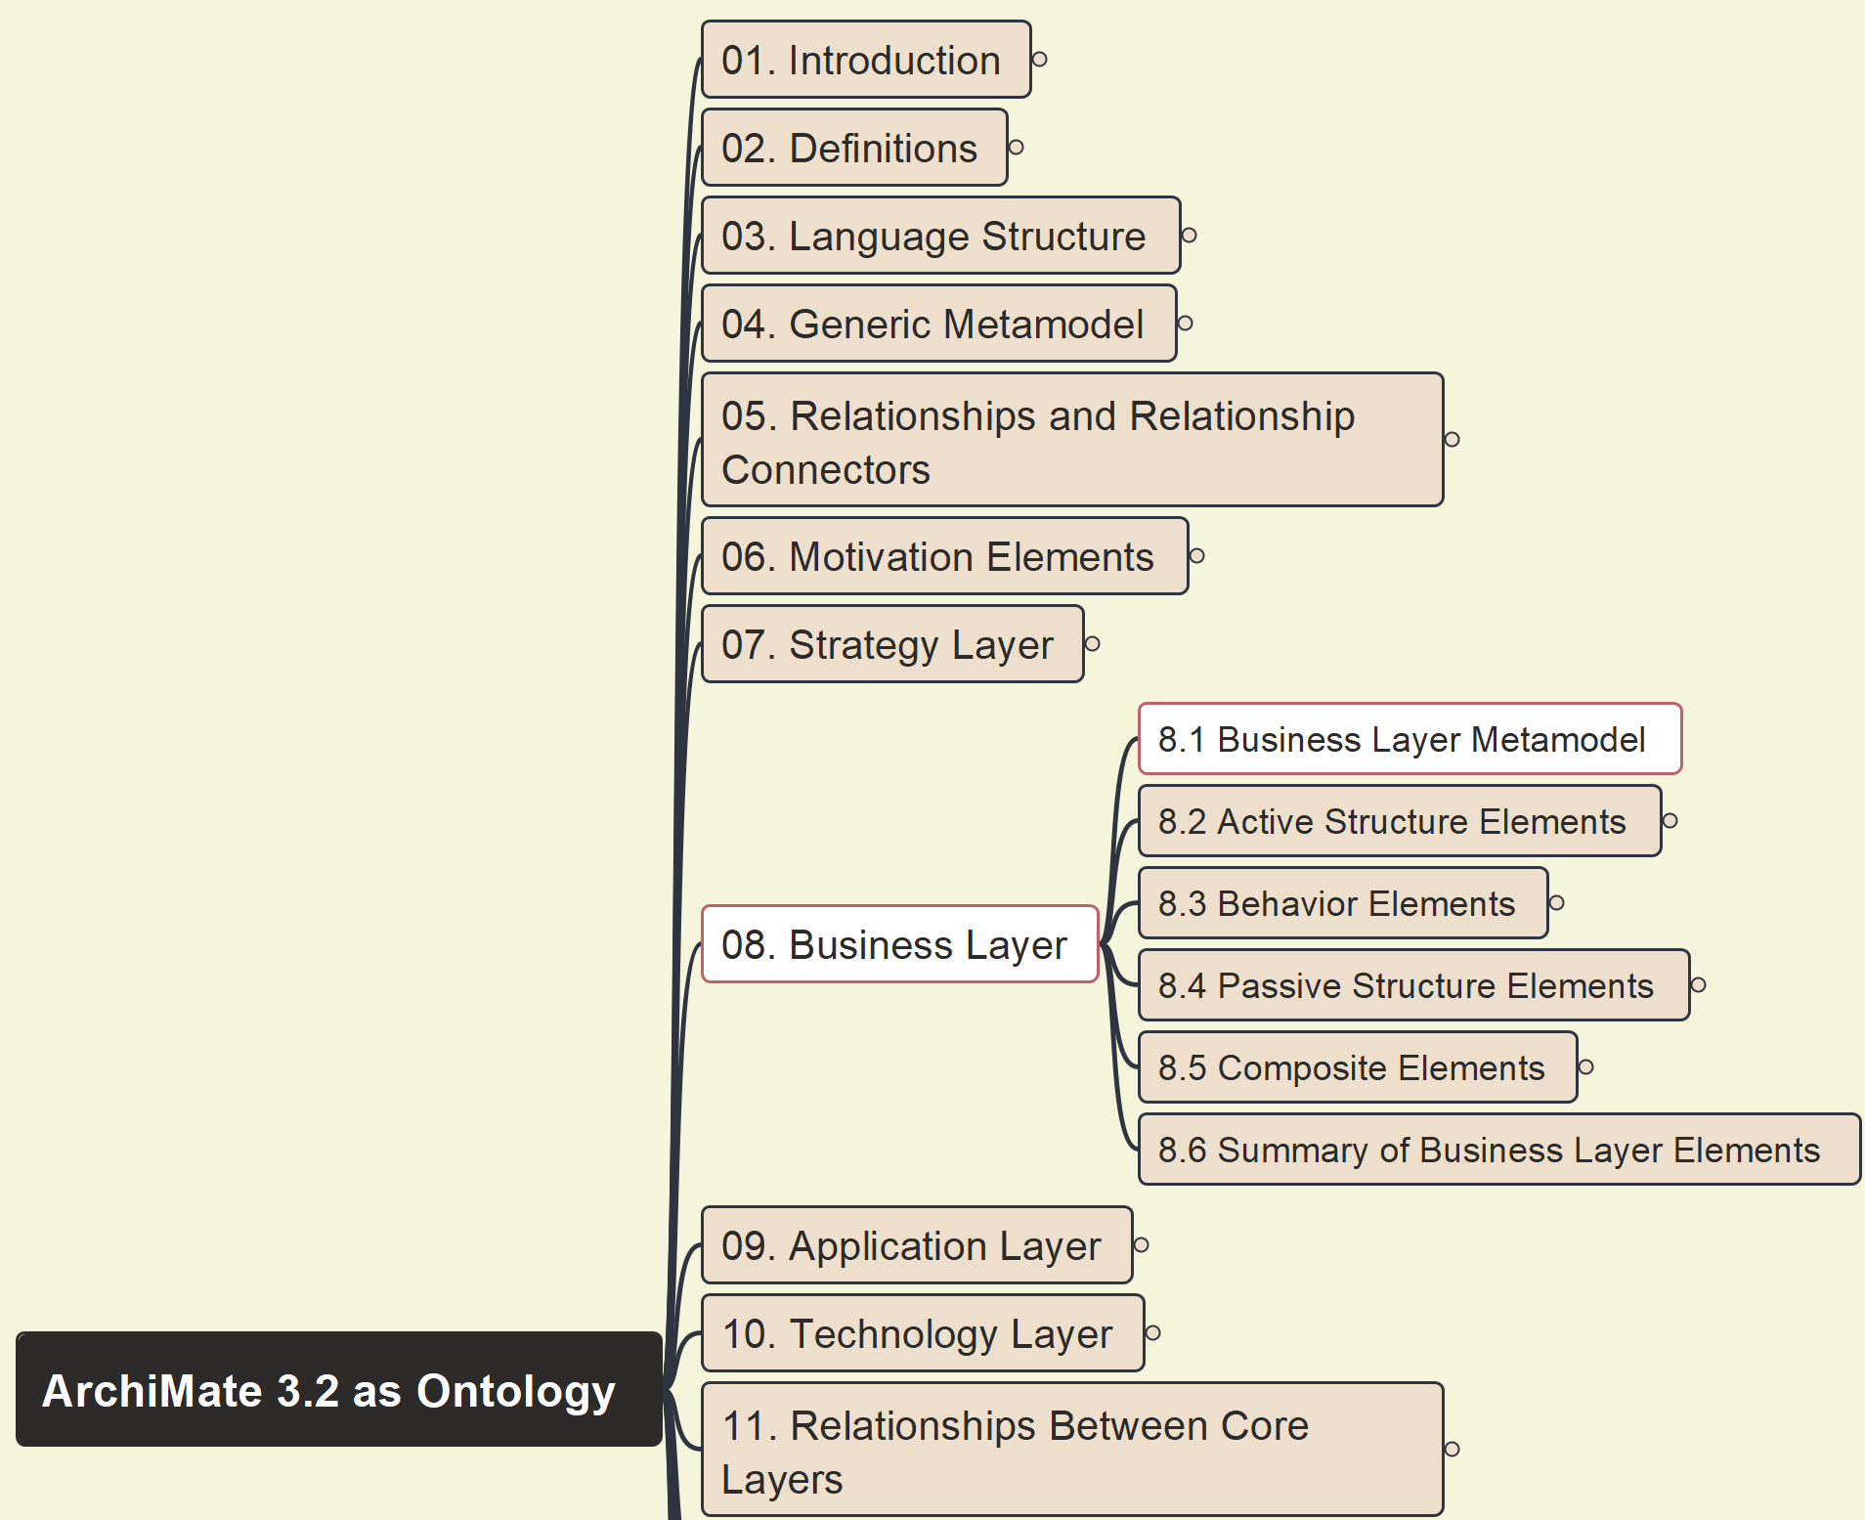



Build Ontology View on ArchiMate 3.2
056
8.1 Business Layer Metamodel

Slide 2
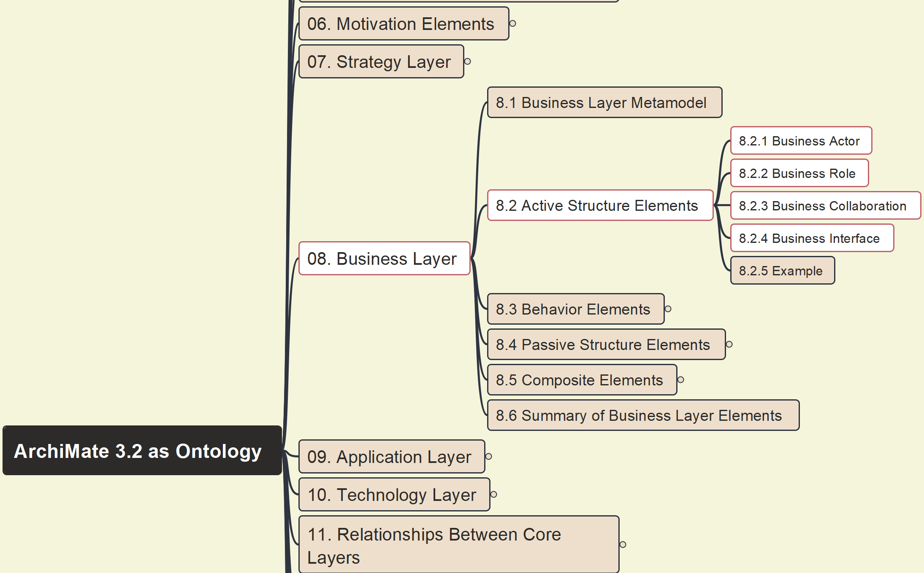
Build Ontology View on ArchiMate 3.2
057
8.2 Active Structure Elements

Slide 3
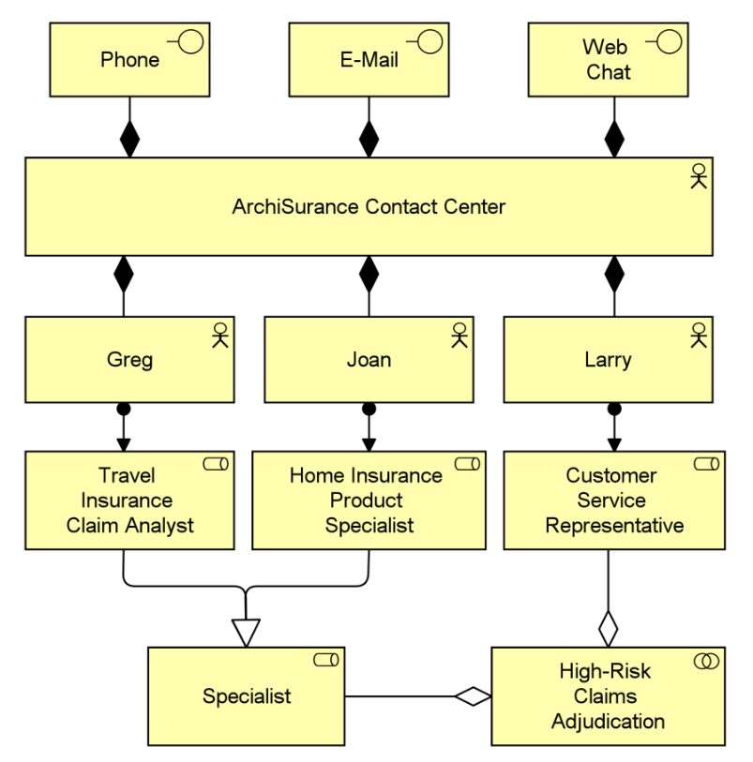
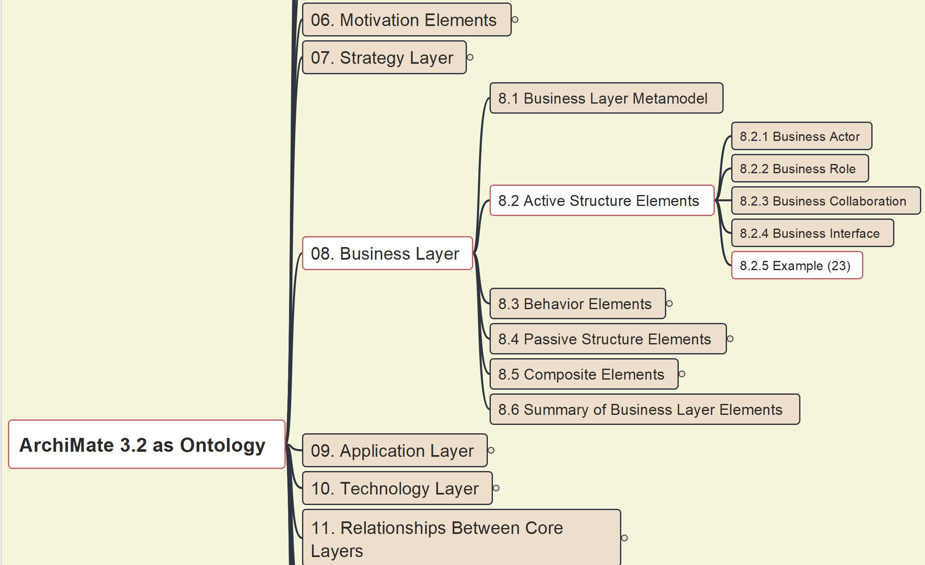
Build Ontology View on ArchiMate 3.2
058
8.2 Active Structure Elements – Example 23

Slide 4
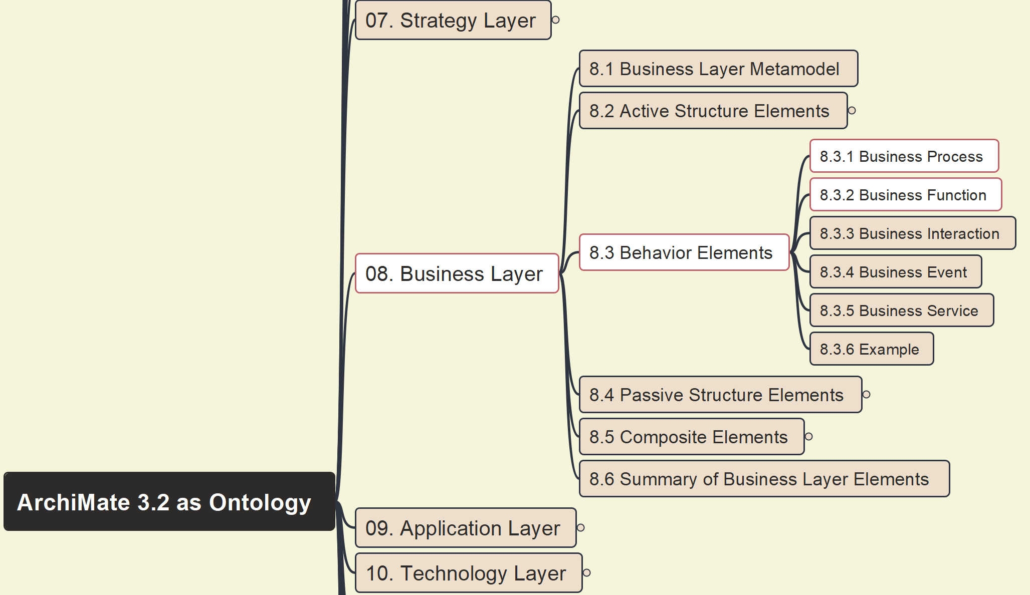

Build Ontology View on ArchiMate 3.2
059
8.3 Behavior Elements – 8.3.1, 8.3.2

Slide 5
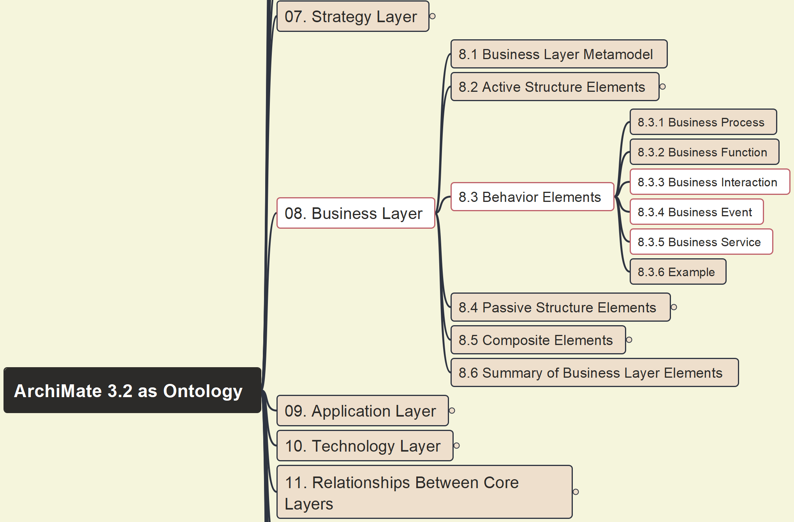
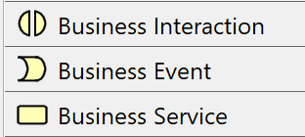
Build Ontology View on ArchiMate 3.2
060
8.3 Behavior Elements – 8.3.3, 8.3.4, 8.3.5

Slide 6
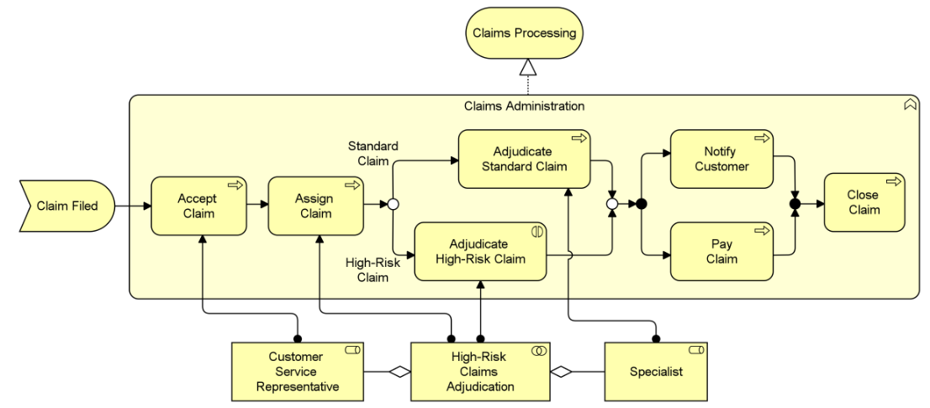
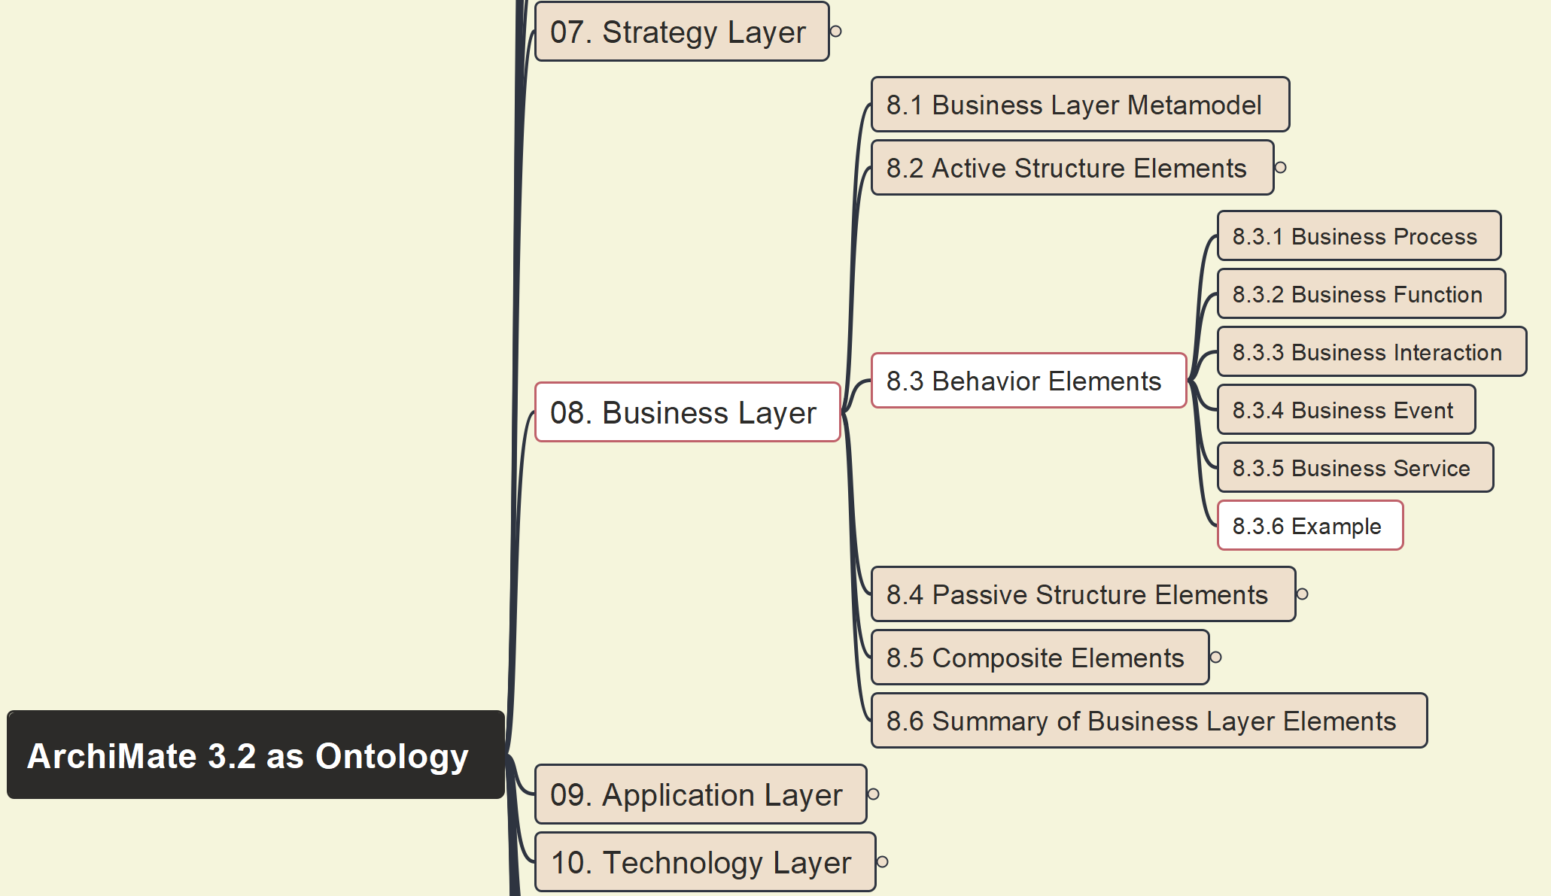
Build Ontology View on ArchiMate 3.2
061
8.3 Behavior Elements – 8.3.6 Example 24

Slide 7
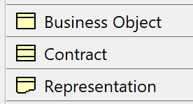
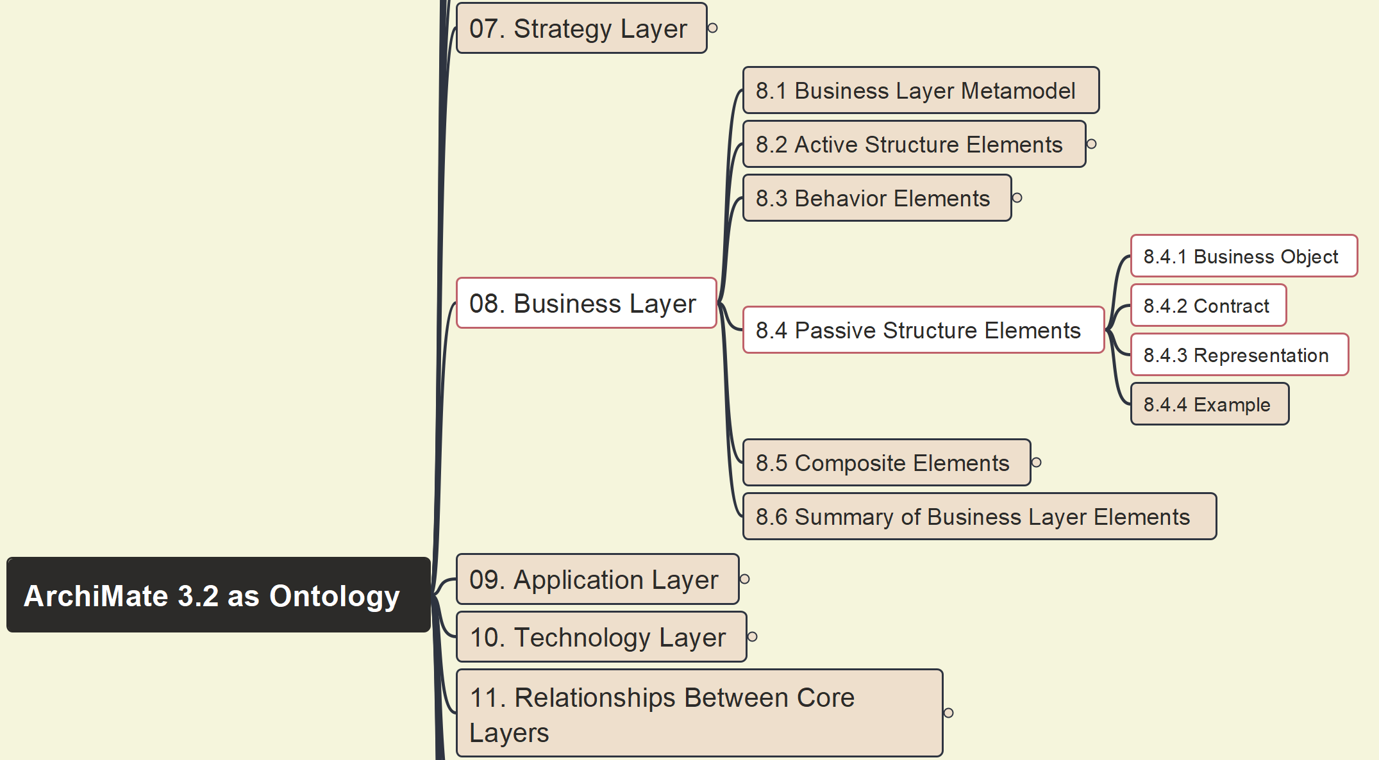
Build Ontology View on ArchiMate 3.2
062
8.4 Passive Structure Elements

Slide 8
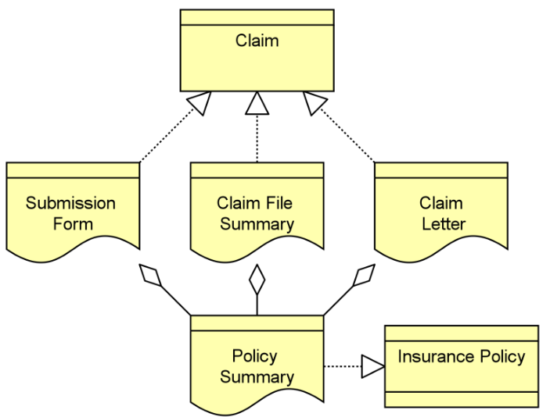
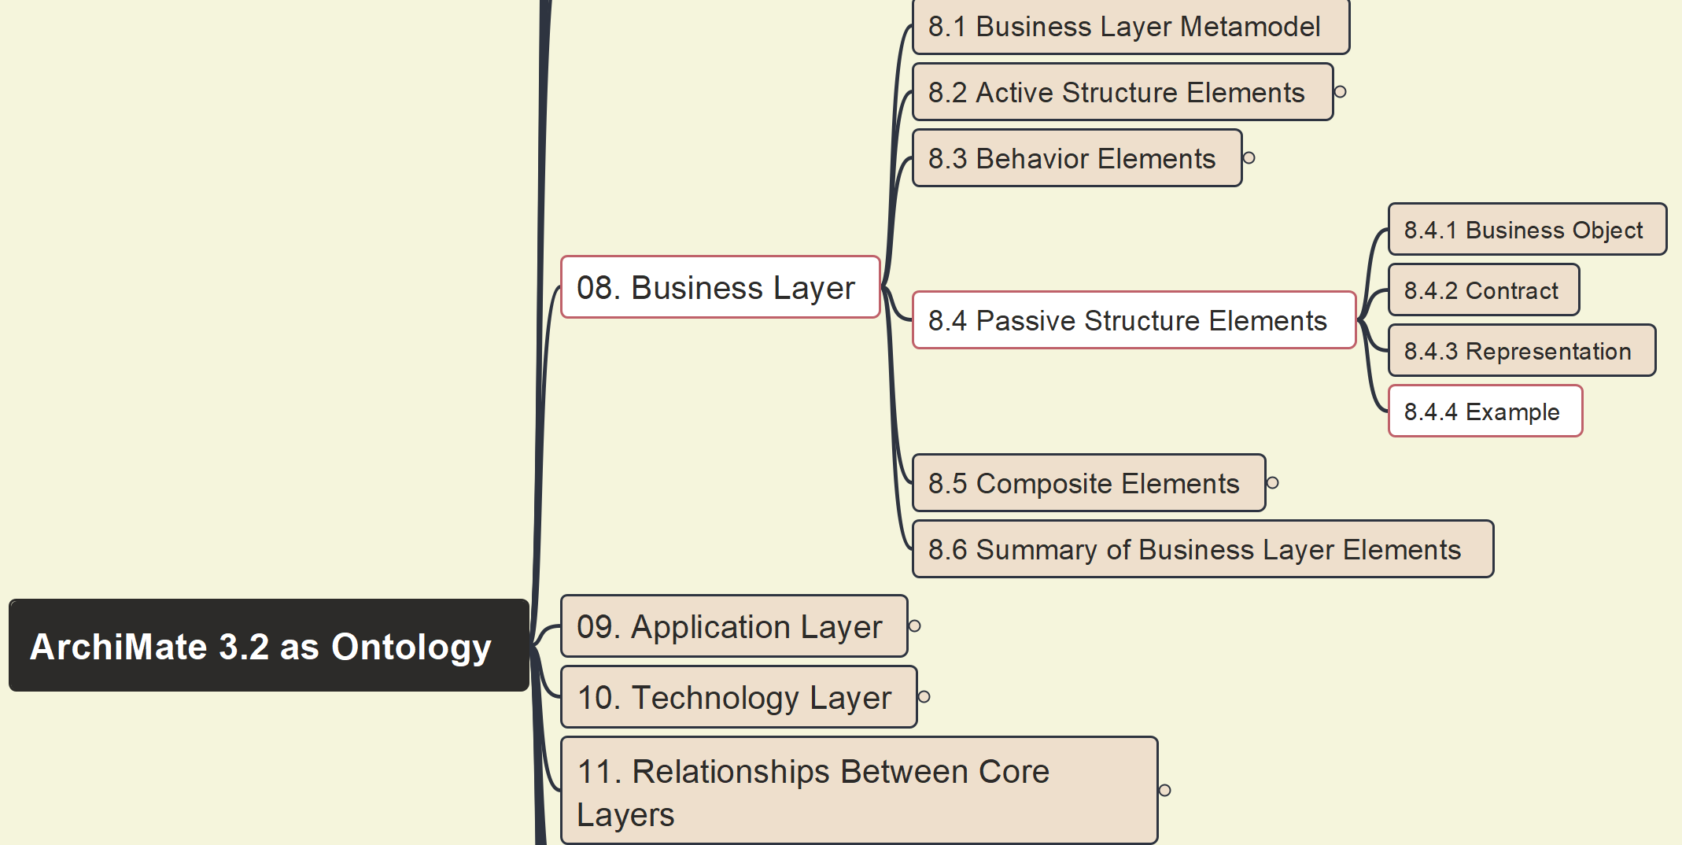
Build Ontology View on ArchiMate 3.2
063
8.4.4 Passive Structure Elements – Example

Slide 9
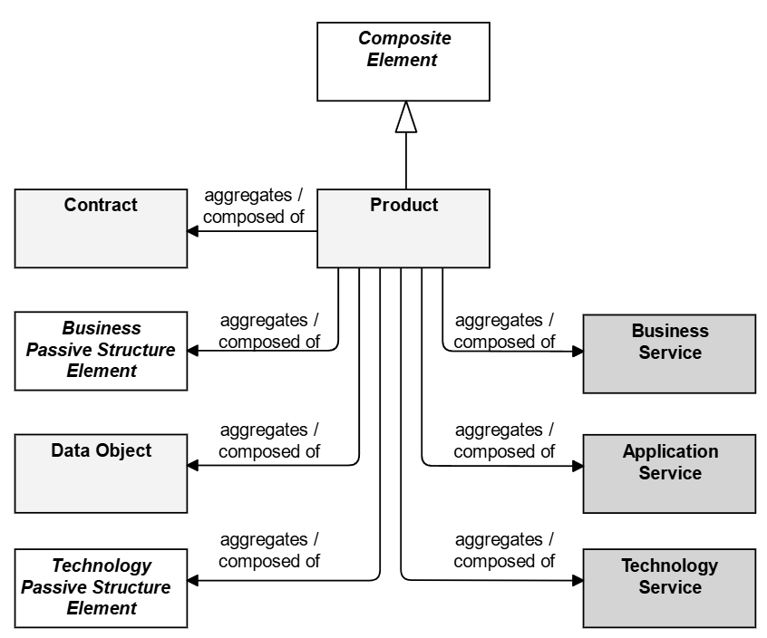
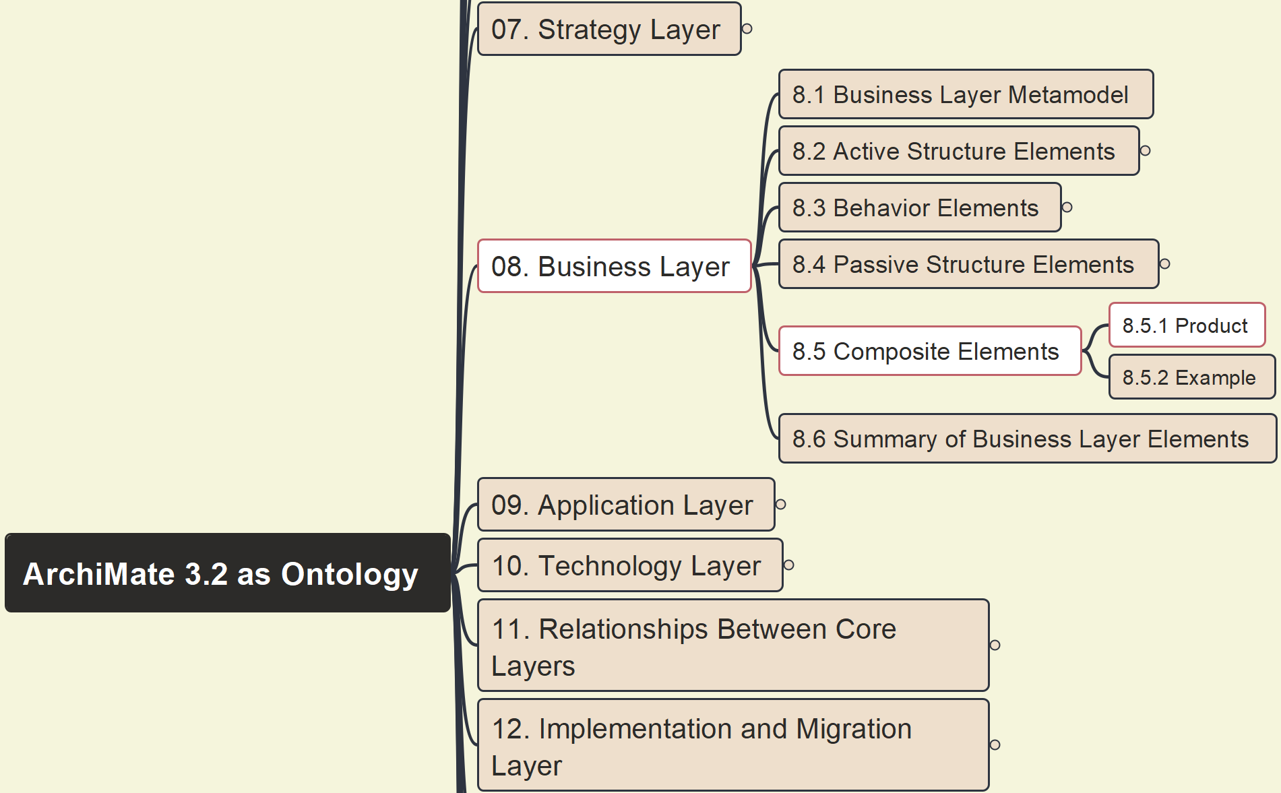
Build Ontology View on ArchiMate 3.2
064
8.5 Composite Elements – 8.5.1 Product

Slide 10
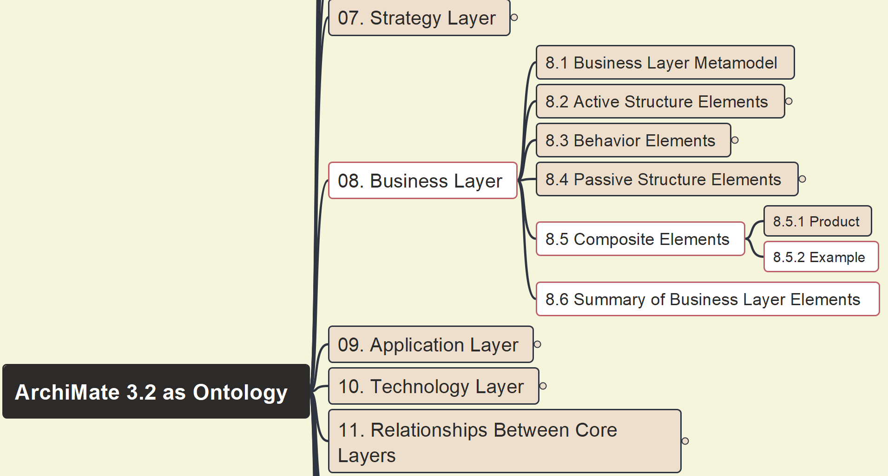
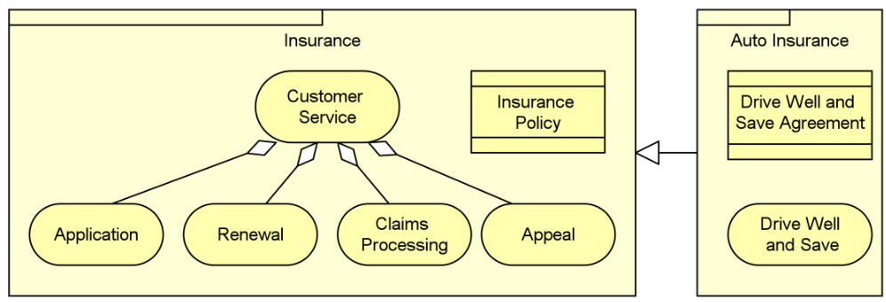
Build Ontology View on ArchiMate 3.2
065
8.5 Composite Elements – 8.5.2 Example 26

Slide 11
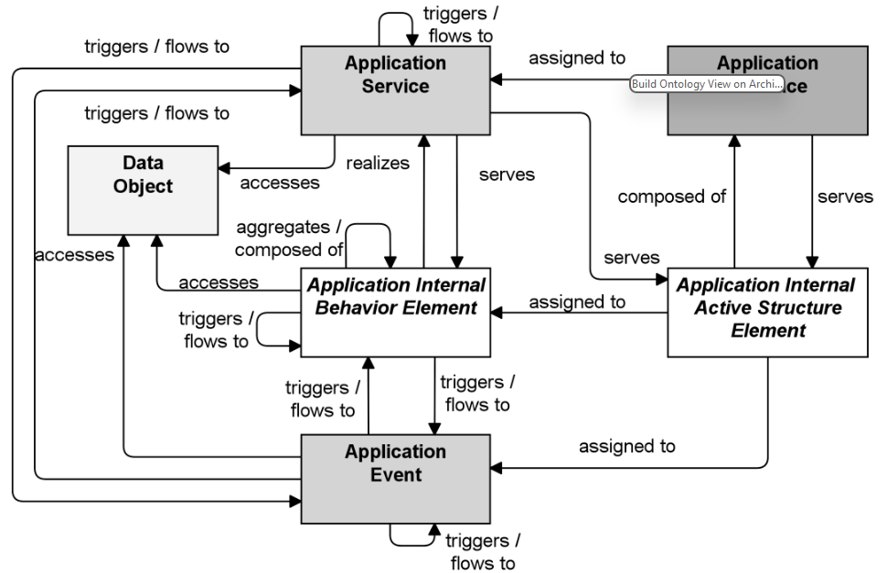
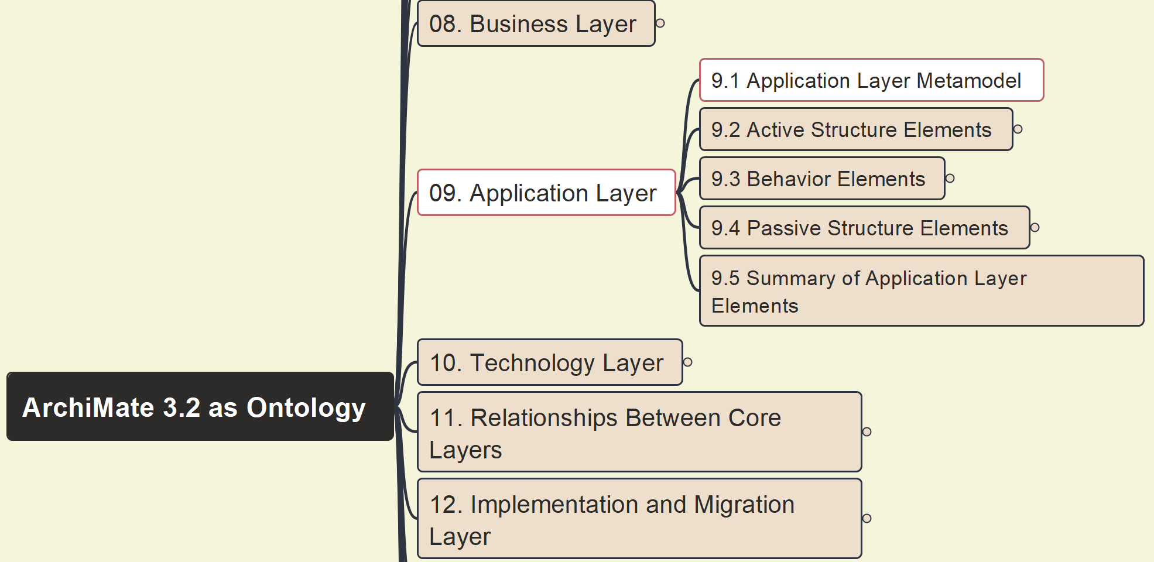
Build Ontology View on ArchiMate 3.2
066
09 Application Layer – 9.1 Application Layer Metamodel

Slide 12
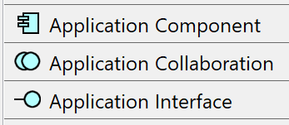
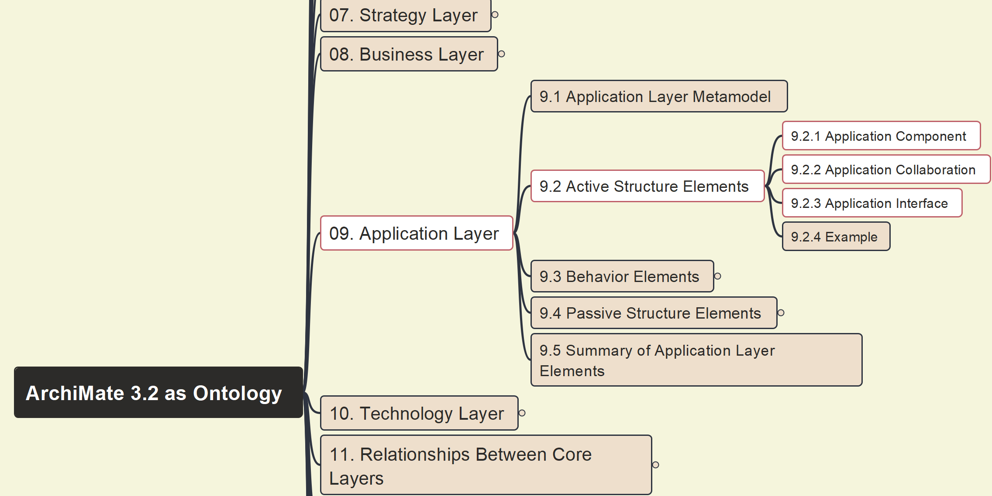
Build Ontology View on ArchiMate 3.2
067
09 Application Layer – 9.2 Active Structure Elements

Slide 13
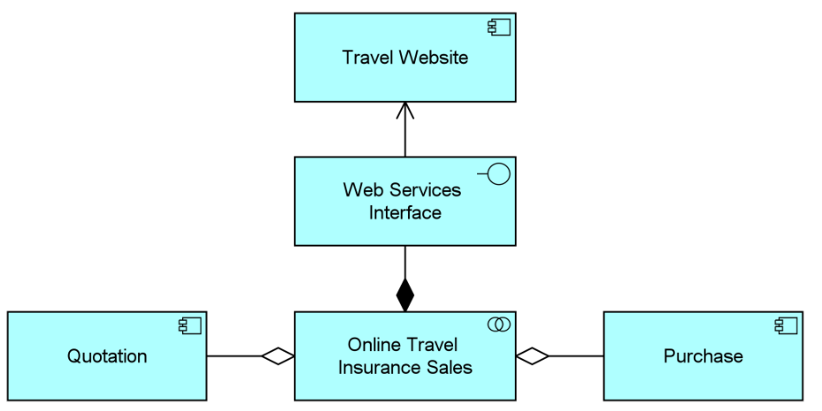
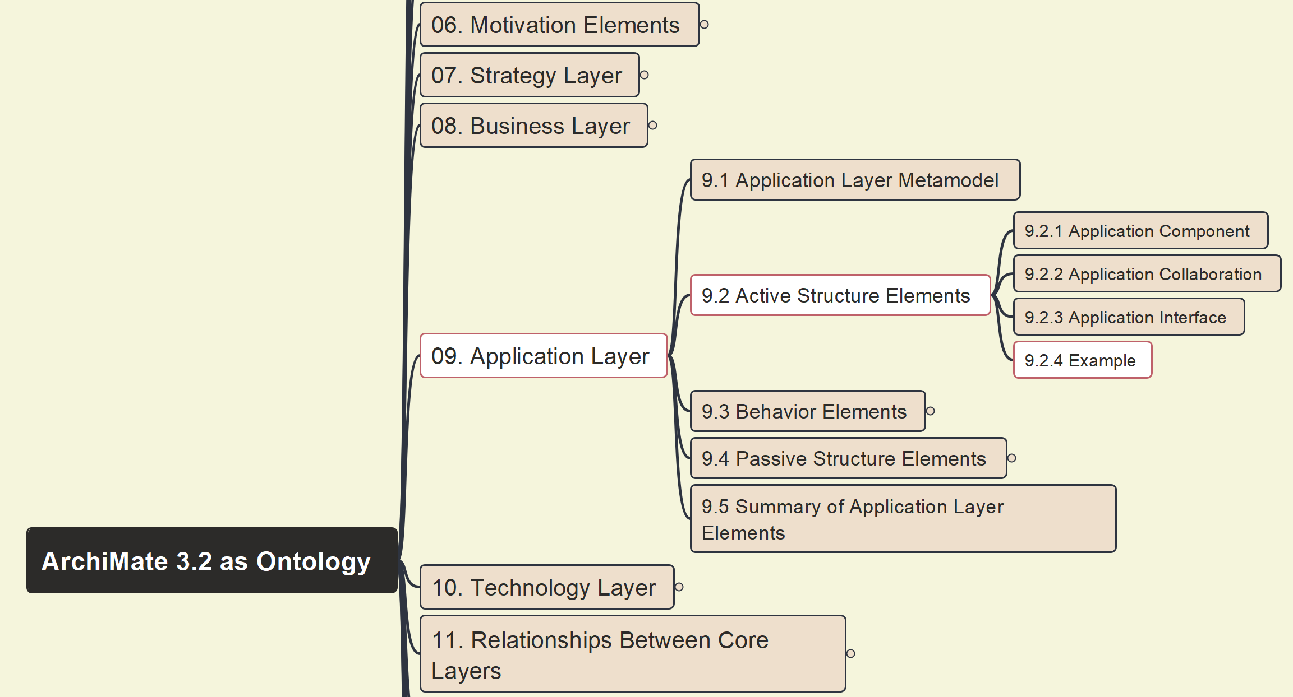
Build Ontology View on ArchiMate 3.2
068
09 Application Layer – 9.2 Active Structure Elements - Example

Slide 14
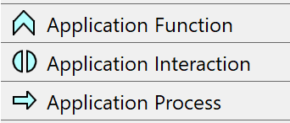
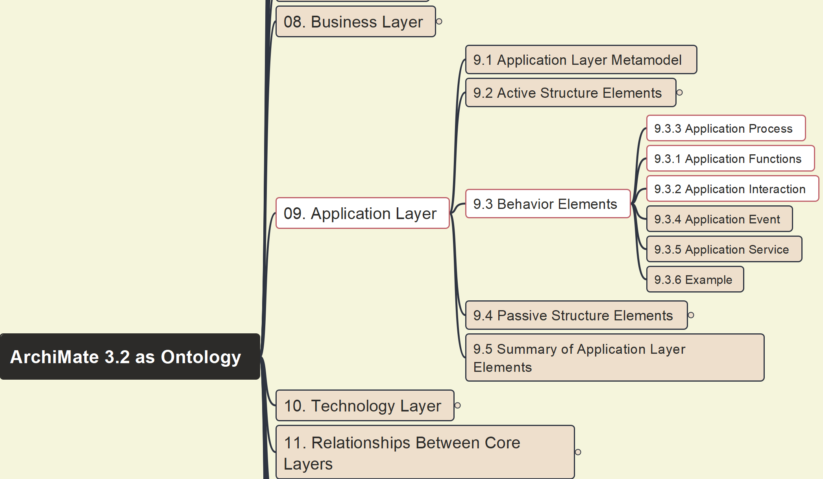
Build Ontology View on ArchiMate 3.2
069
09 Application Layer – 9.3.1~9.3.3 Application Function, Interaction, Process

Slide 15
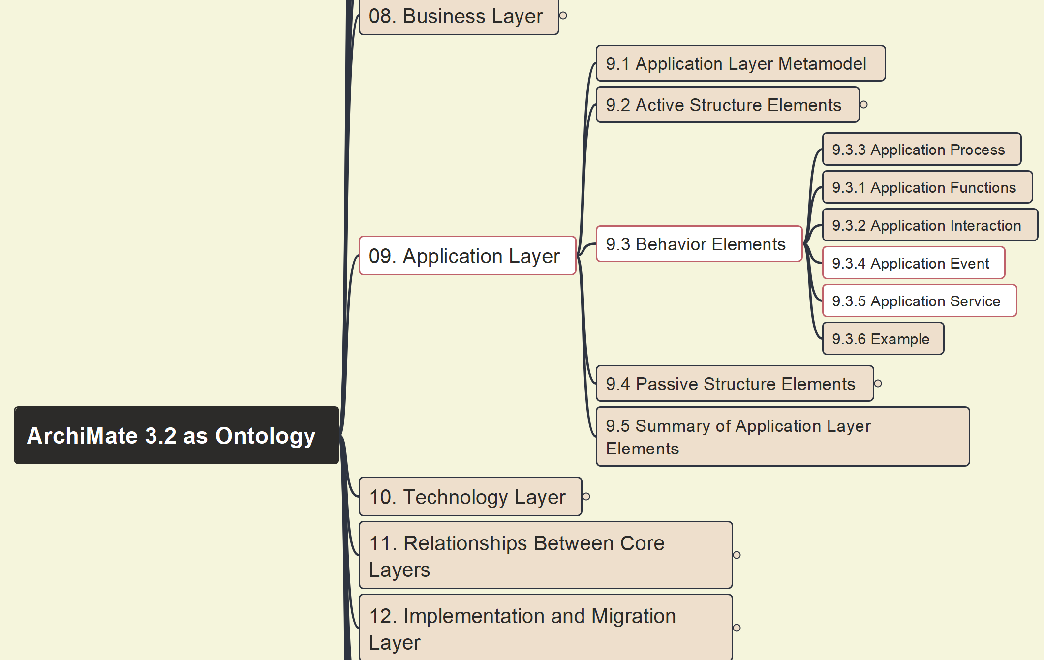

Build Ontology View on ArchiMate 3.2
070
09 Application Layer – 9.3.4 Application Event, 9.3.5 Application Service

Slide 16
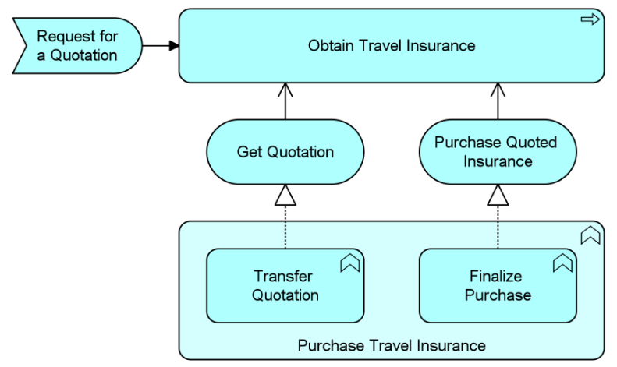
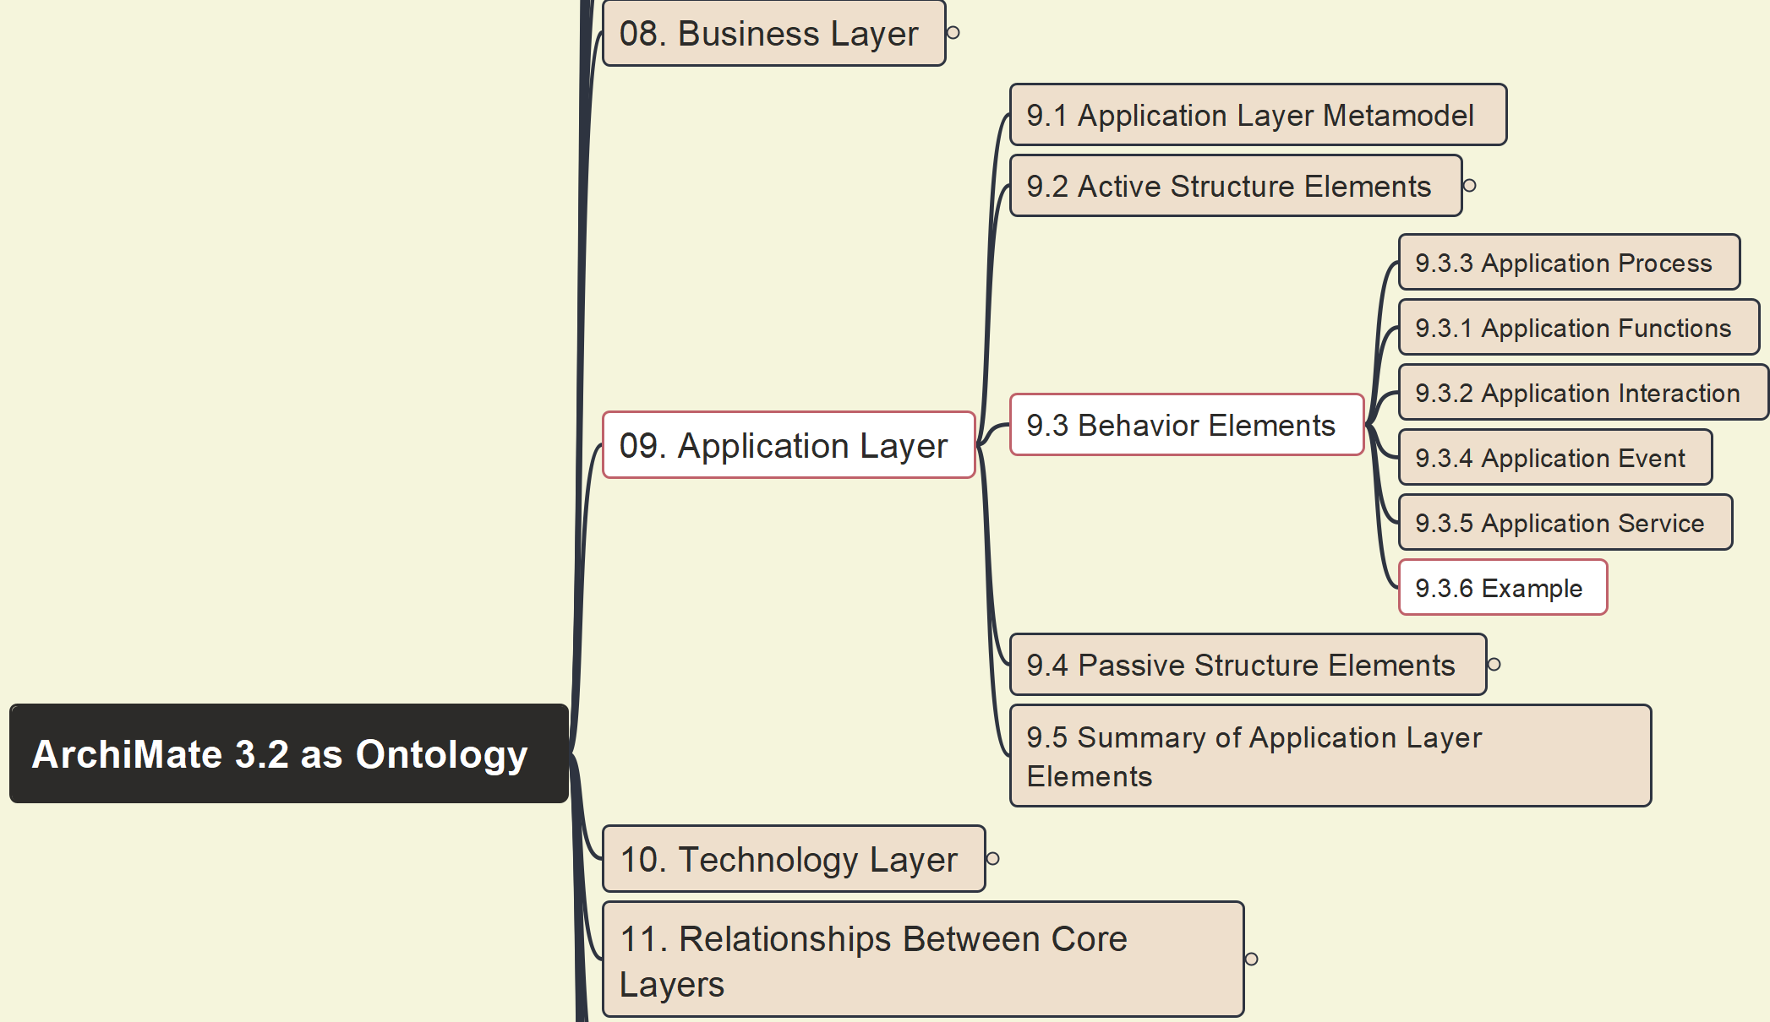
Build Ontology View on ArchiMate 3.2
071
09 Application Layer – 9.3.6 Example

Slide 17
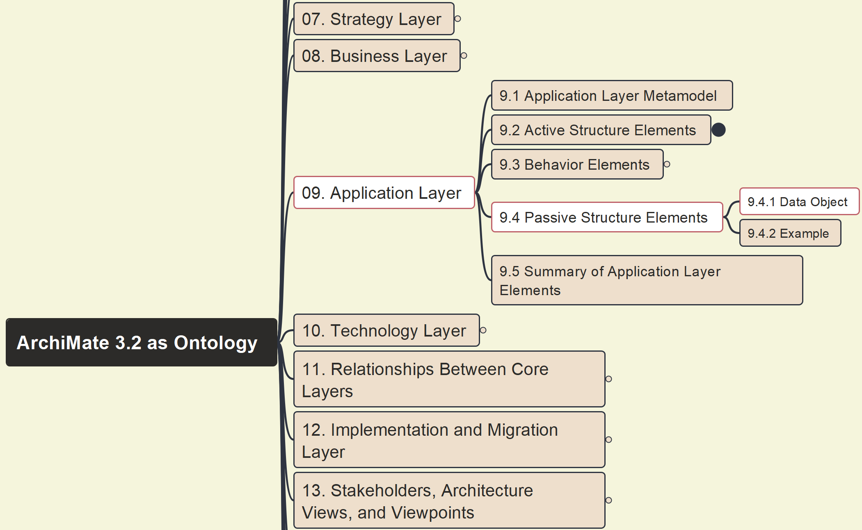

Build Ontology View on ArchiMate 3.2
072
09 Application Layer – 9.4.1 Data Object

Slide 18
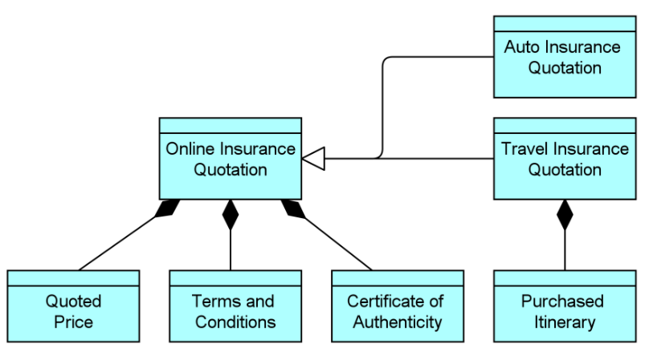
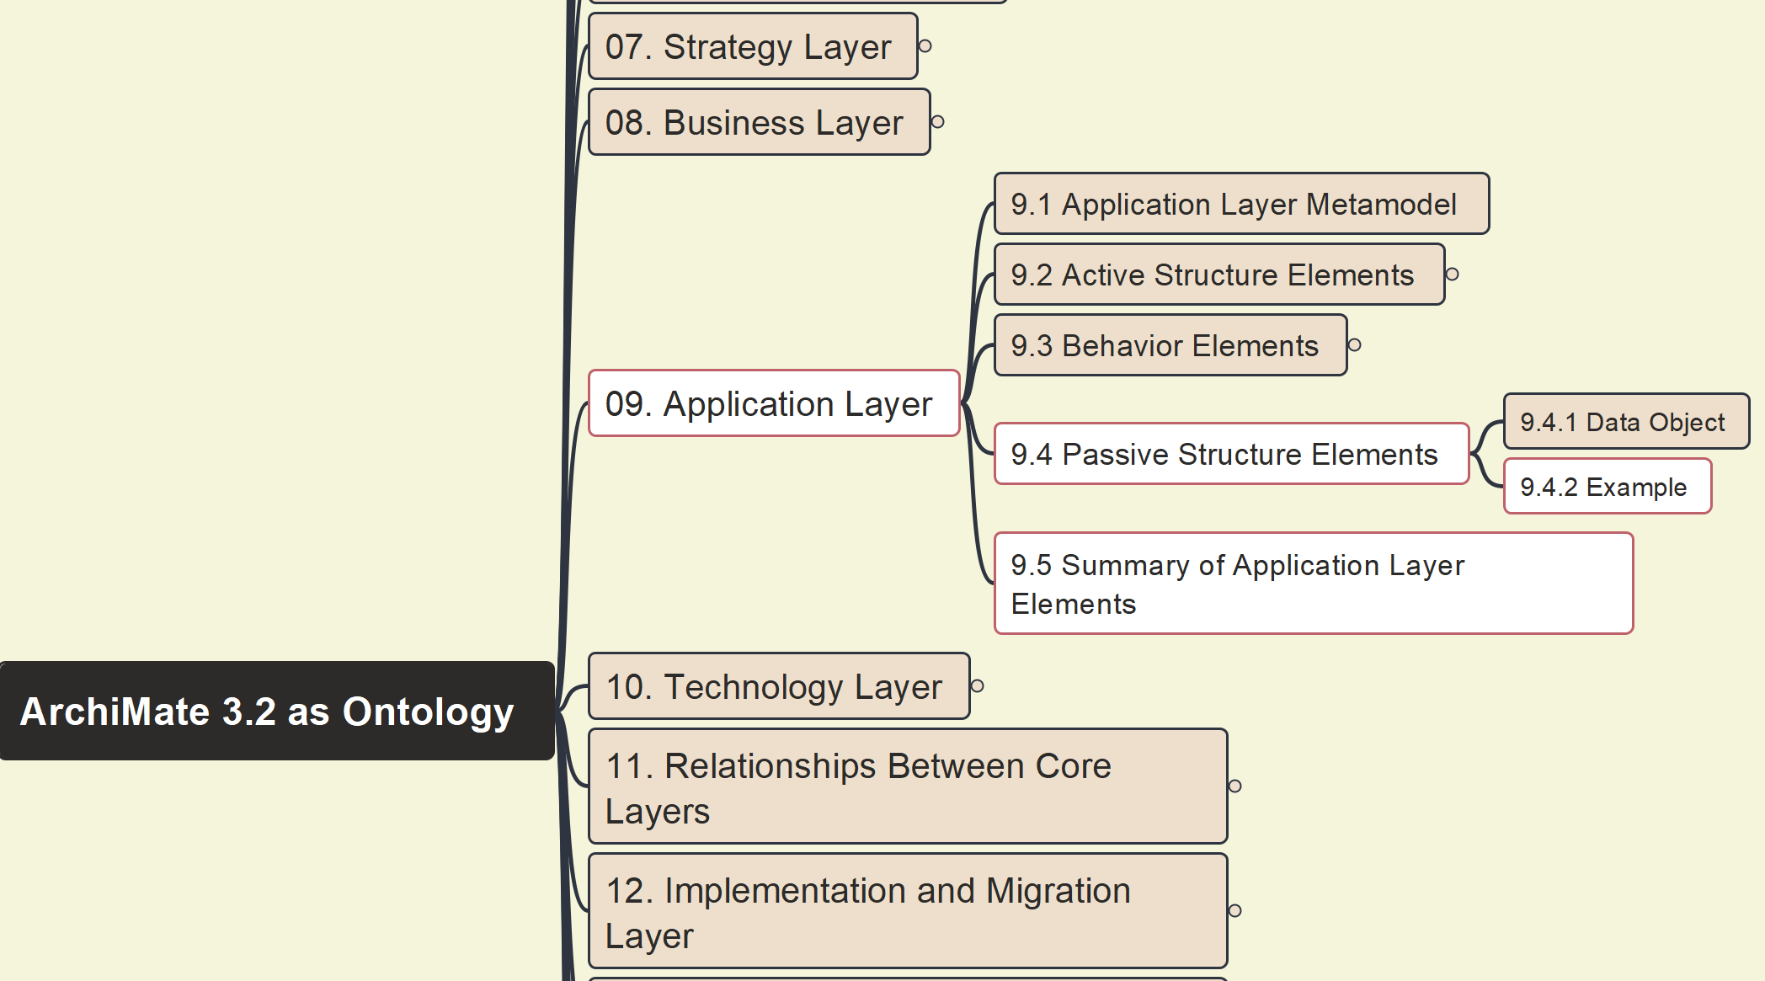
Build Ontology View on ArchiMate 3.2
073
09 Application Layer – 9.4.2 Example, 9.5 Summary

