Slide 1

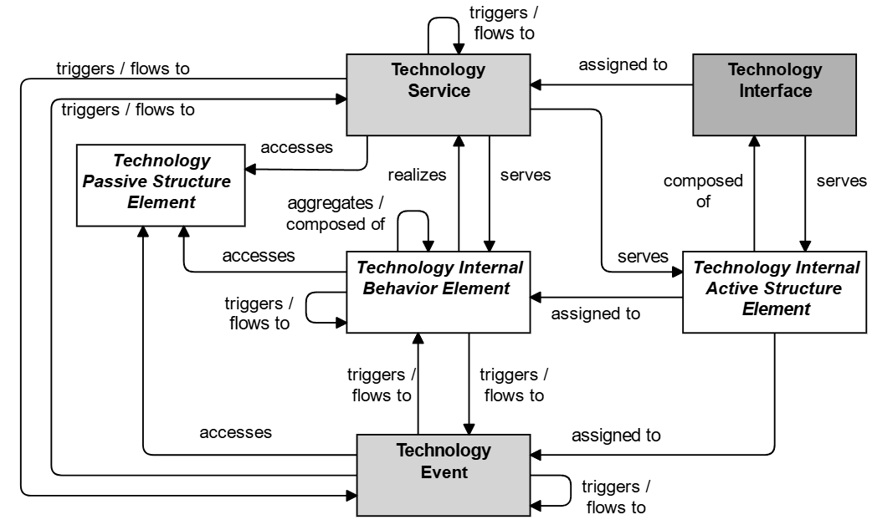
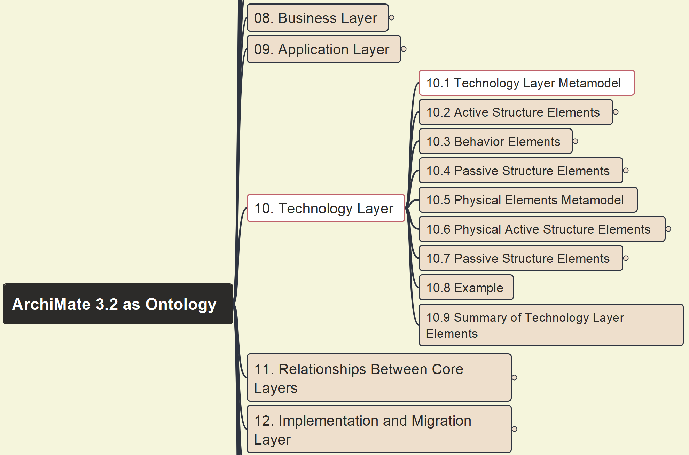



Build Ontology View on ArchiMate 3.2
074
10 Technology Layer – 10.1 Metamodel

Slide 2
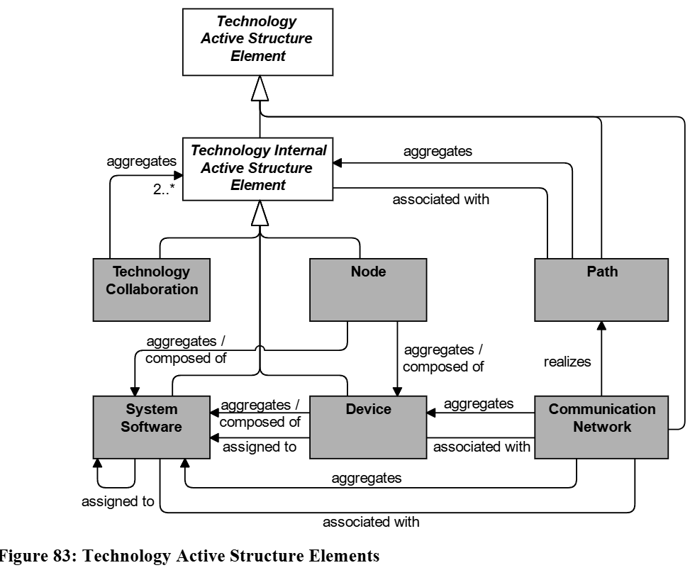
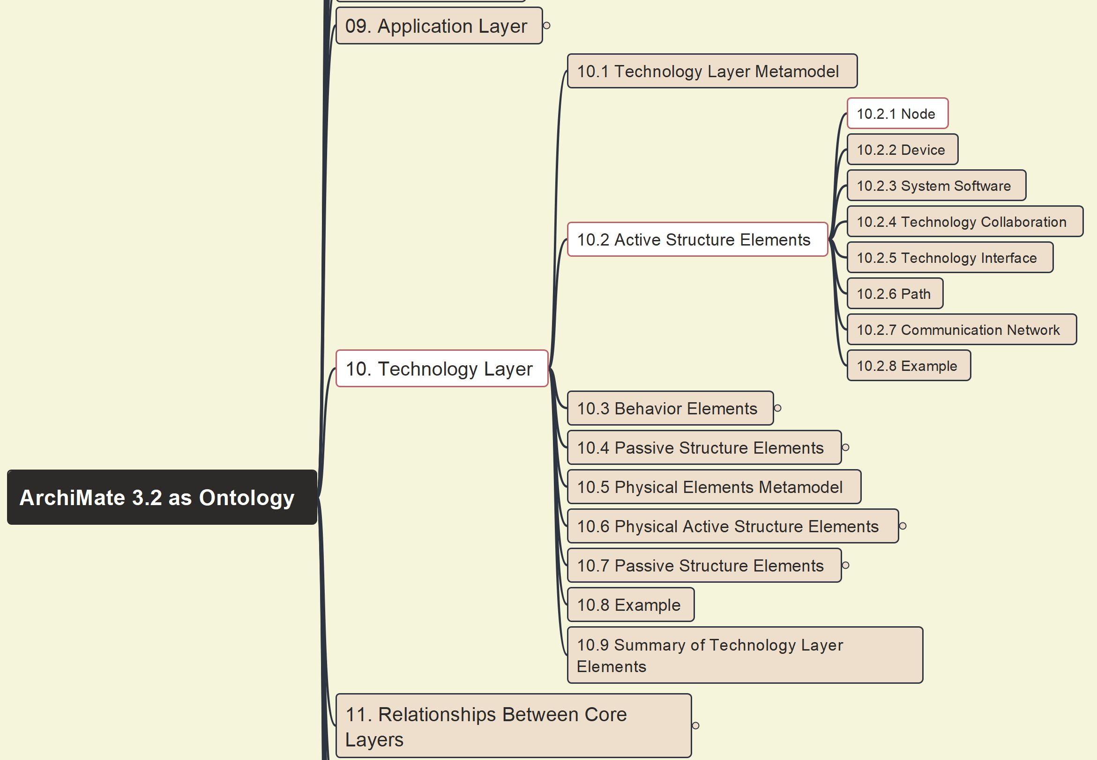
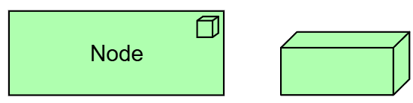
Build Ontology View on ArchiMate 3.2
075
10 Technology Layer – 10.2 Active Structure Elements – Overview & 10.2.1 Node

Slide 3
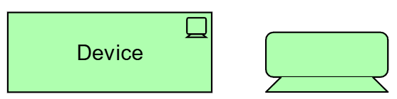
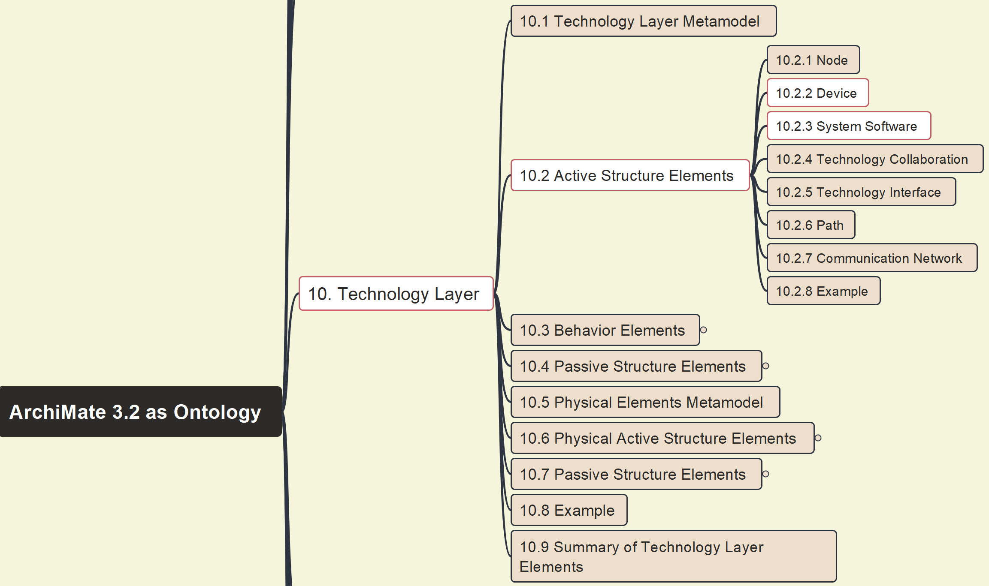
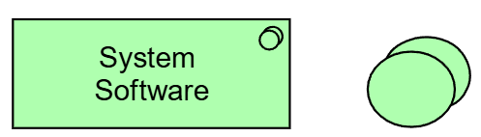
Build Ontology View on ArchiMate 3.2
076
10 Technology Layer – 10.2 Active Structure Elements –10.2.2 Device & 10.2.3 System Software

Slide 4
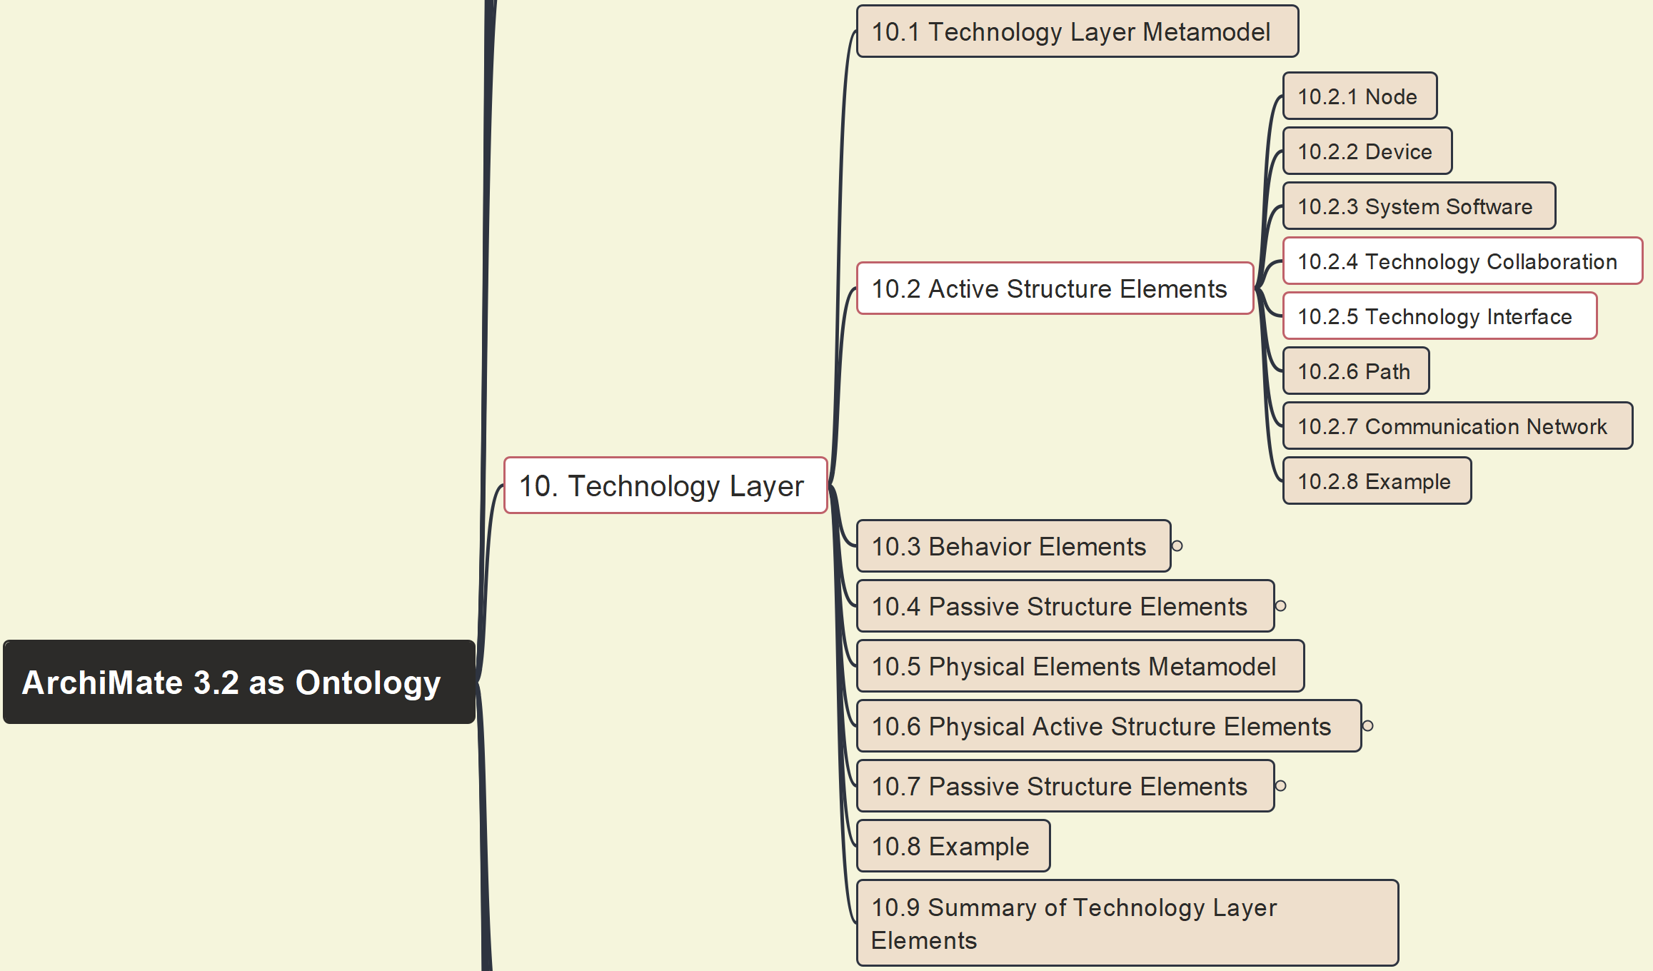
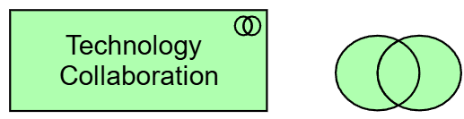
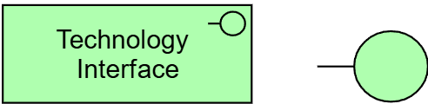
Build Ontology View on ArchiMate 3.2
077
10 Technology Layer – 10.2 Active Structure Elements –10.2.4 & 10.2.5 Technology Collaboration & Interface

Slide 5
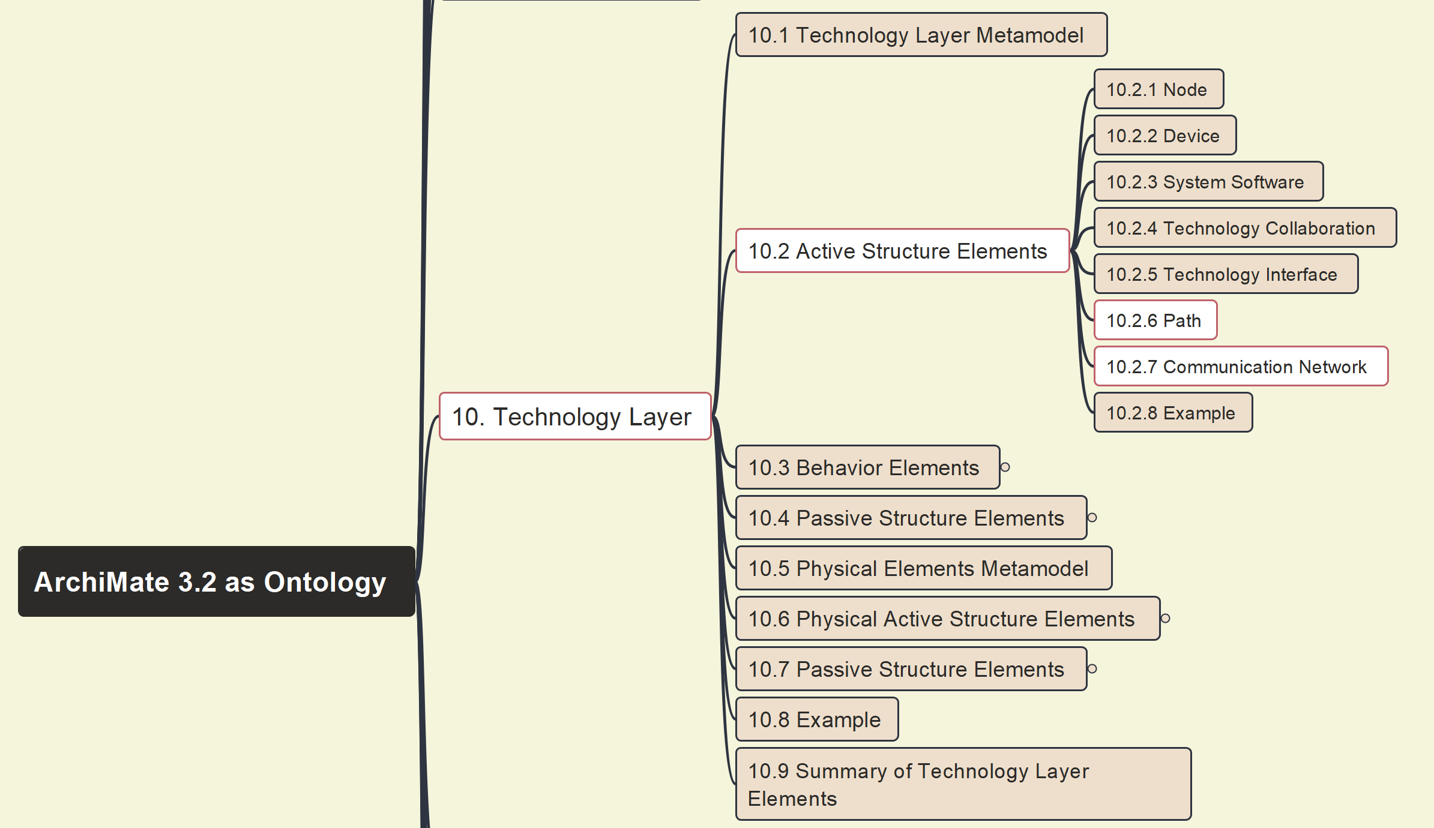

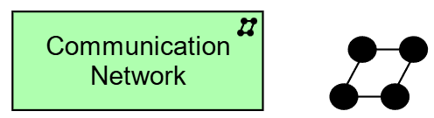
Build Ontology View on ArchiMate 3.2
078
10 Technology Layer – 10.2 Active Structure Elements –10.2.6 Path & 10.2.7 Communication Network

Slide 6
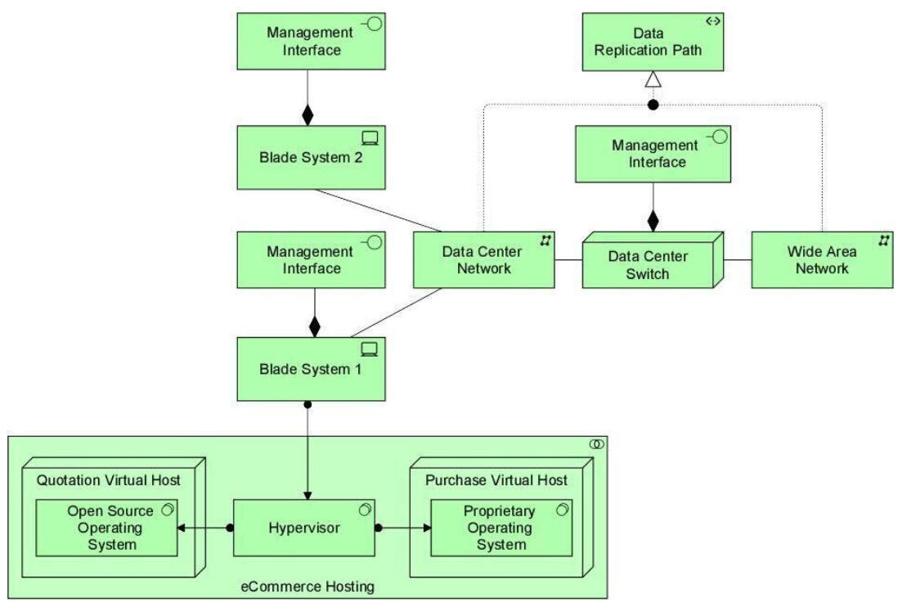
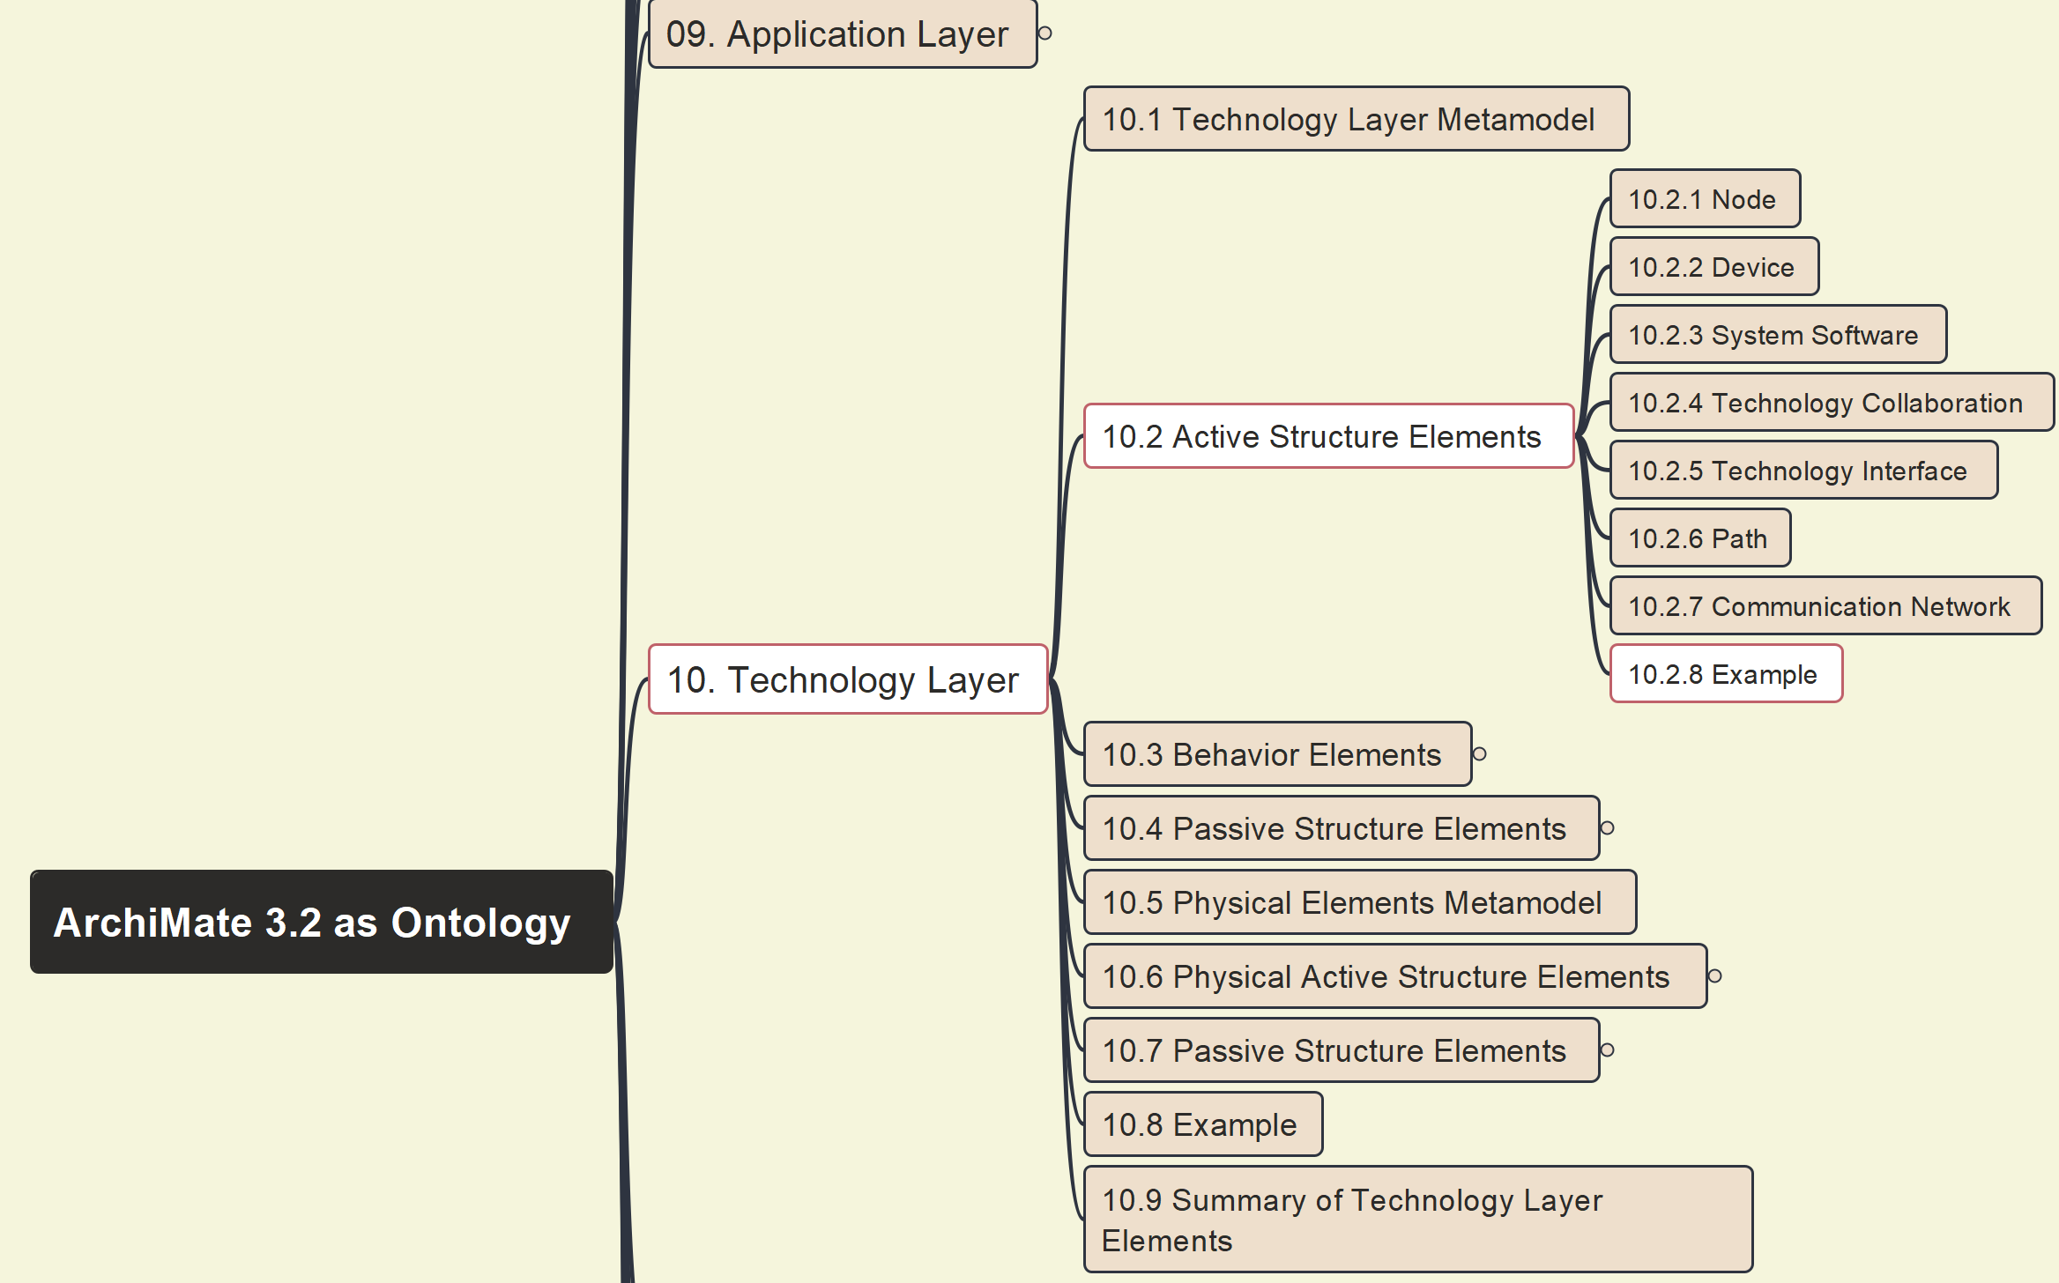
Build Ontology View on ArchiMate 3.2
079
10 Technology Layer – 10.2 Active Structure Elements –10.2.8 Example(30)

Slide 7
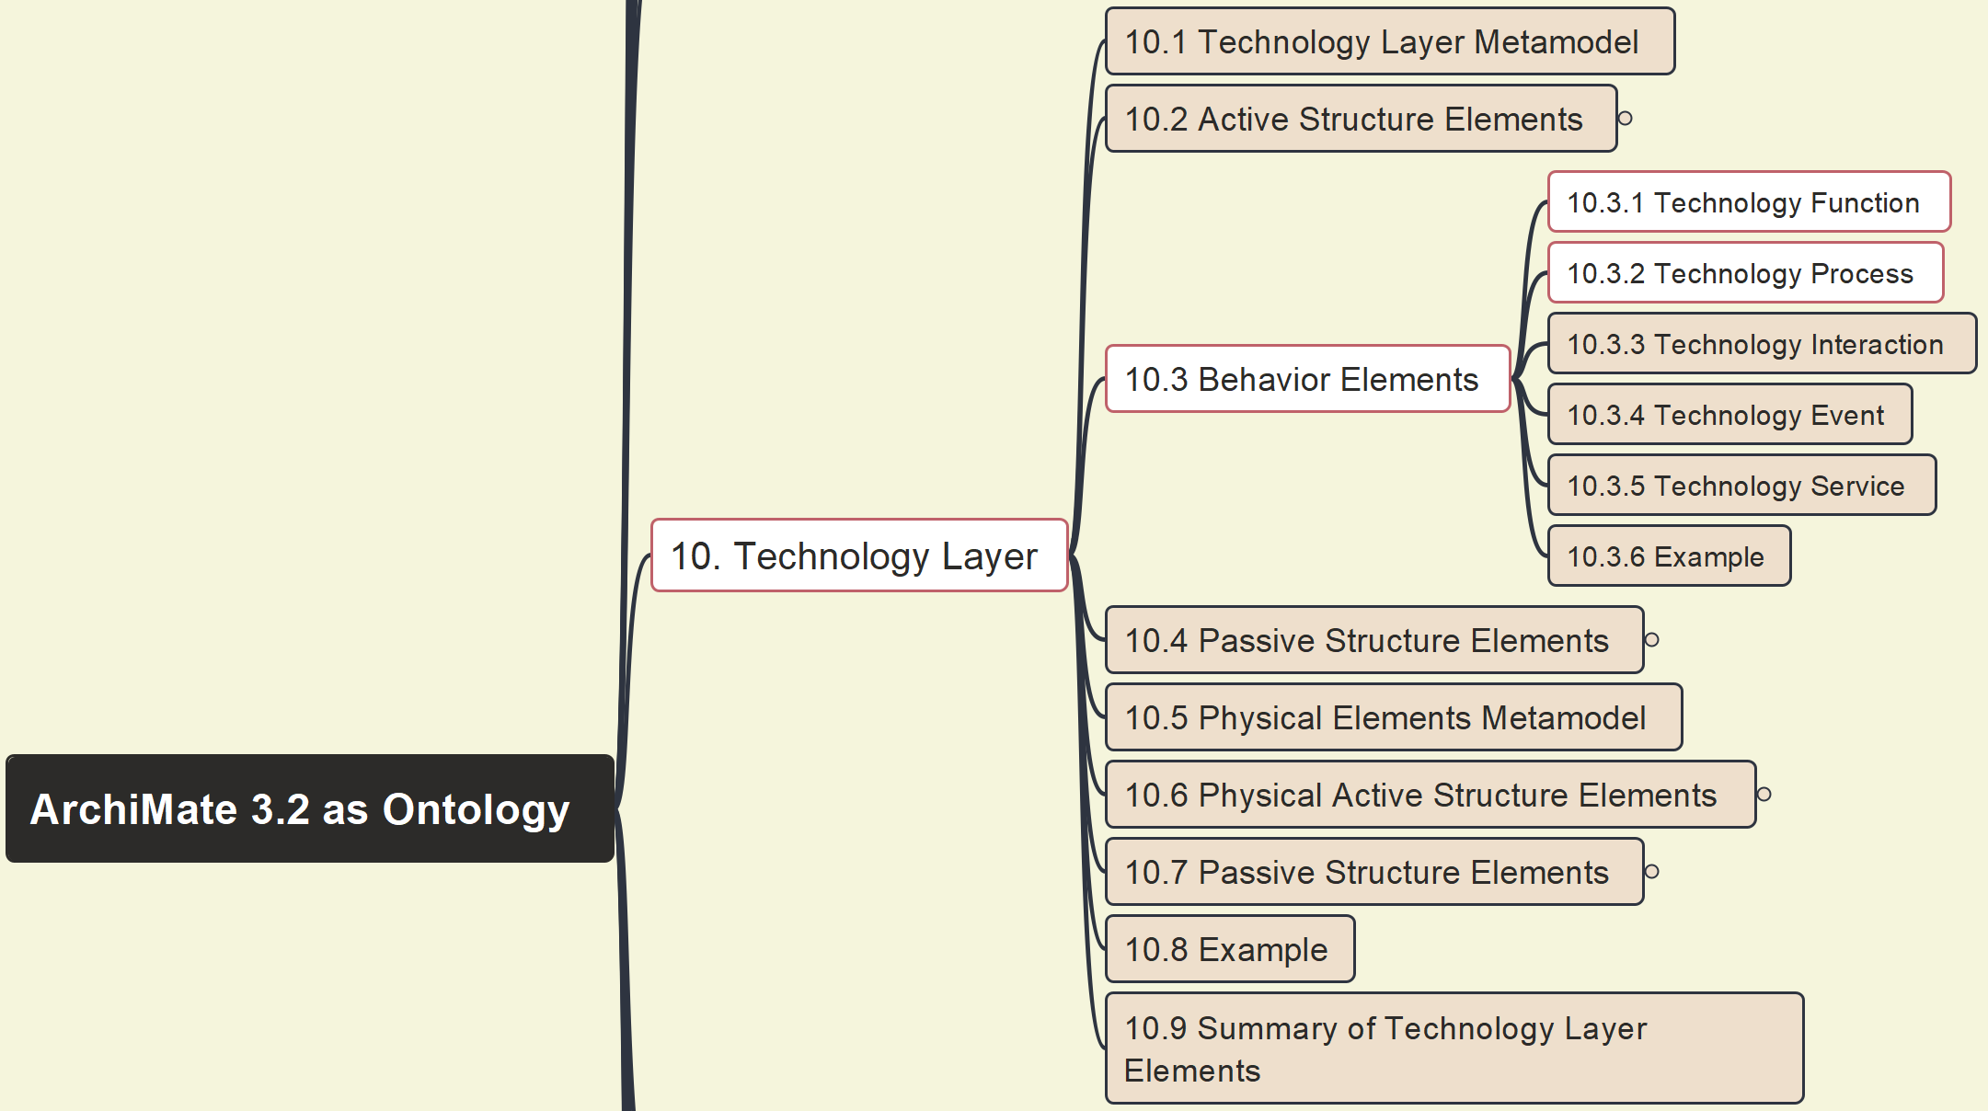
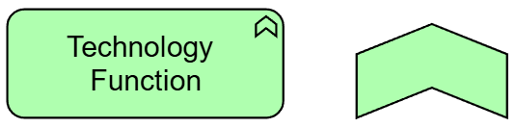
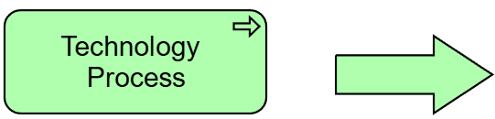
Build Ontology View on ArchiMate 3.2
080
10 Technology Layer – 10.3 Behavior Elements – 10.3.1 & 10.3.2 Technology Function & Process

Slide 8
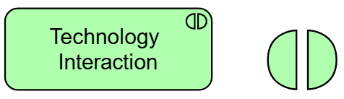
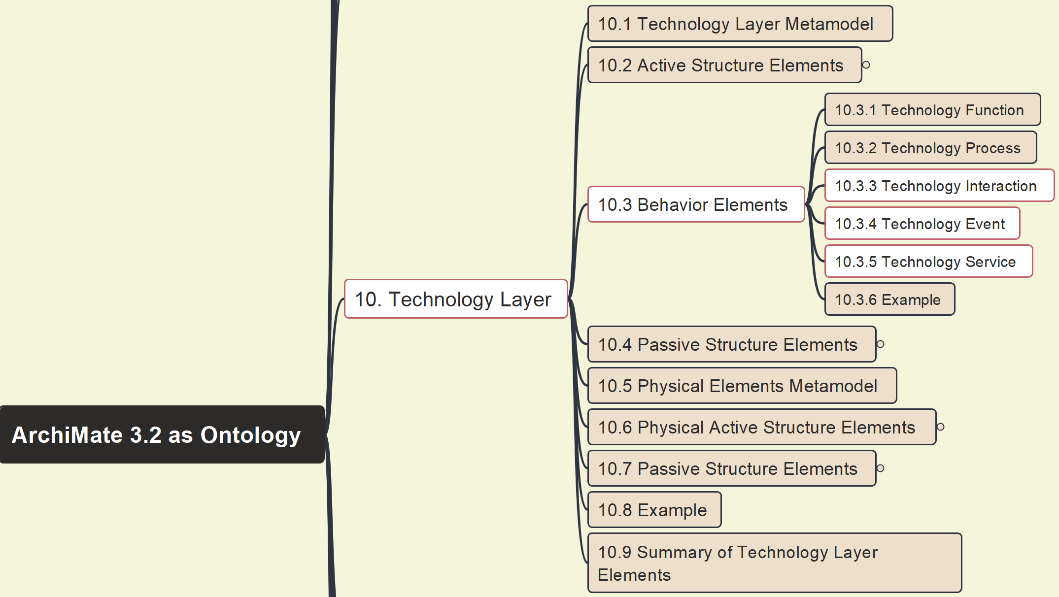
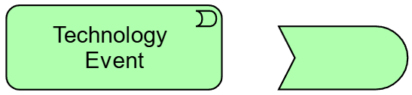
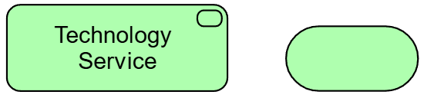
Build Ontology View on ArchiMate 3.2
081
10 Technology Layer – 10.3 Behavior Elements – 10.3.3~10.3.5 Technology Interaction & Event & Service

Slide 9
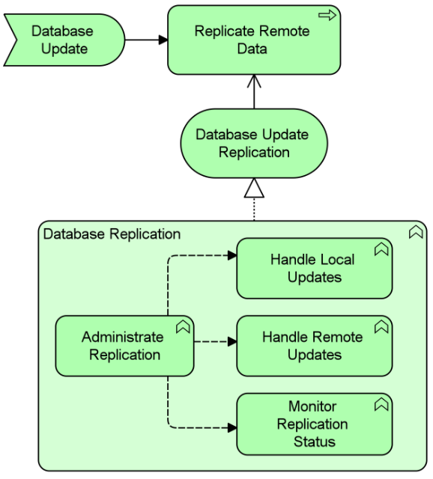
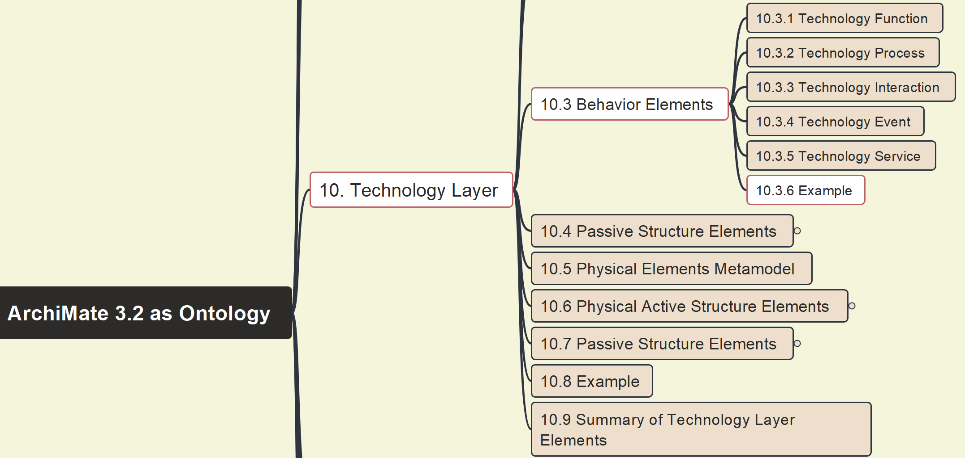
Build Ontology View on ArchiMate 3.2
082
10 Technology Layer – 10.3 Behavior Elements – 10.3.6 Example(31)

Slide 10
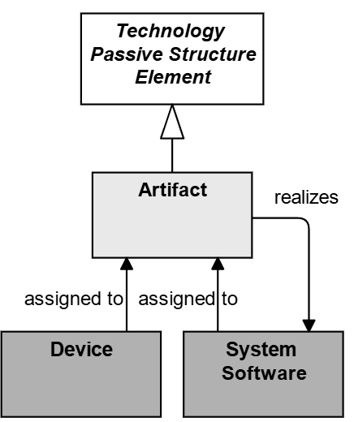
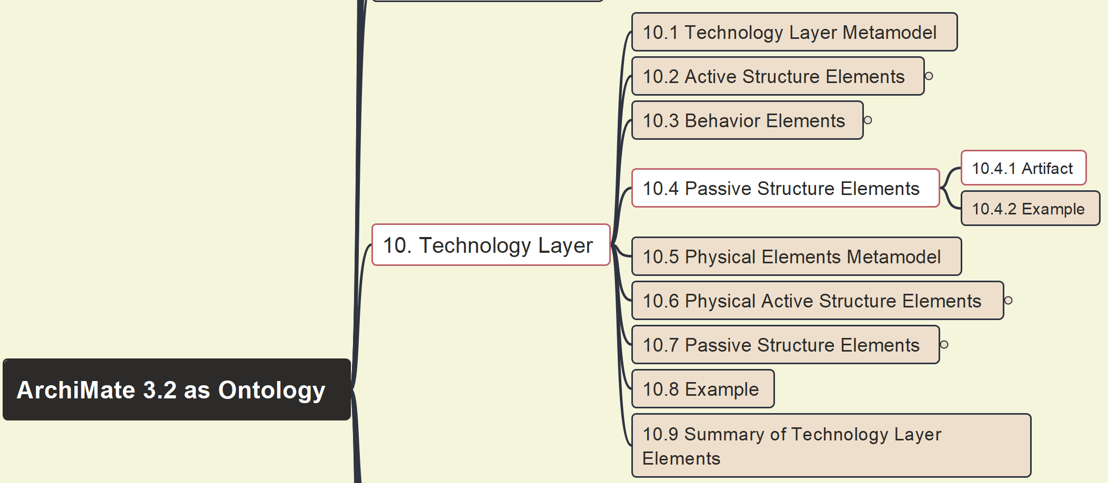
Build Ontology View on ArchiMate 3.2
083
10 Technology Layer – 10.4 Passive Structure Elements – 10.4.1 Artifact

Slide 11
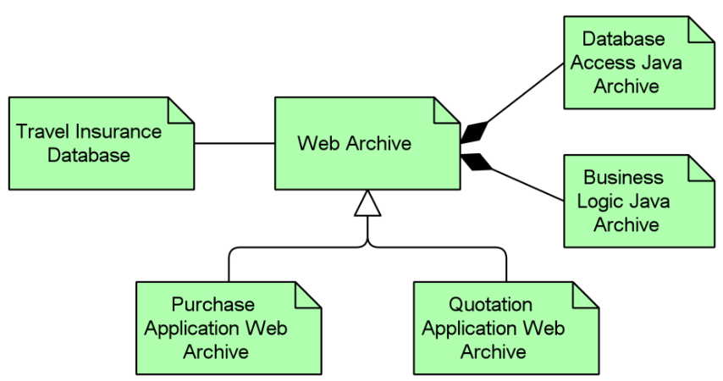
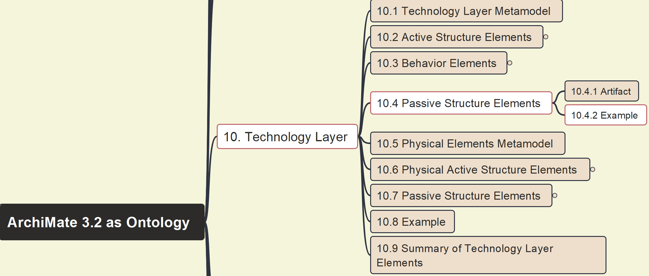
Build Ontology View on ArchiMate 3.2
084
10 Technology Layer – 10.4 Passive Structure Elements – 10.4.2 Example(32)

Slide 12
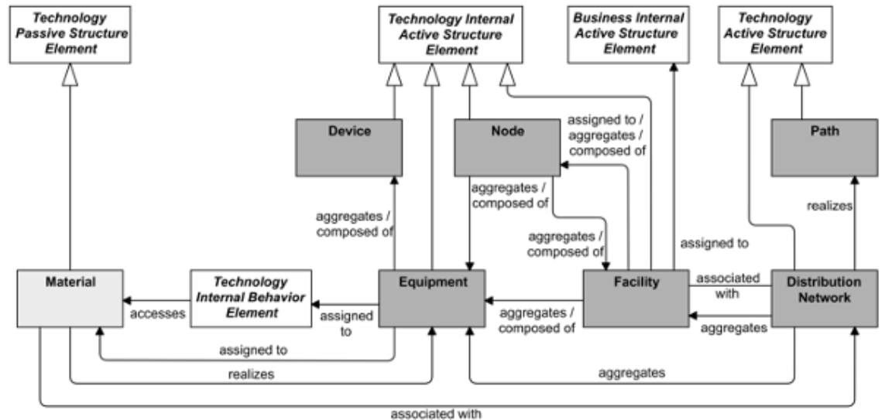
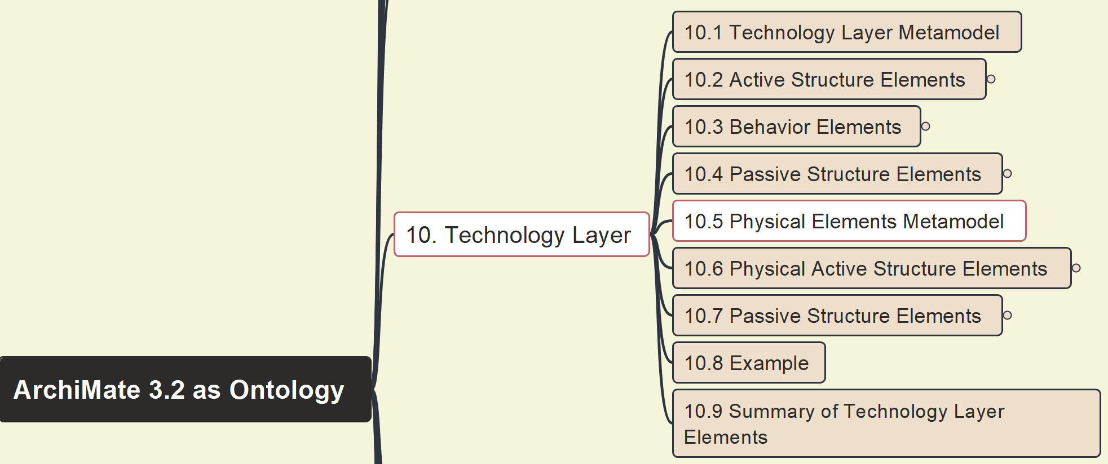
Build Ontology View on ArchiMate 3.2
085
10 Technology Layer – 10.5 Physical Elements Meta-Model

Slide 13
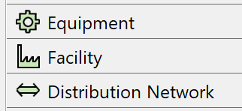
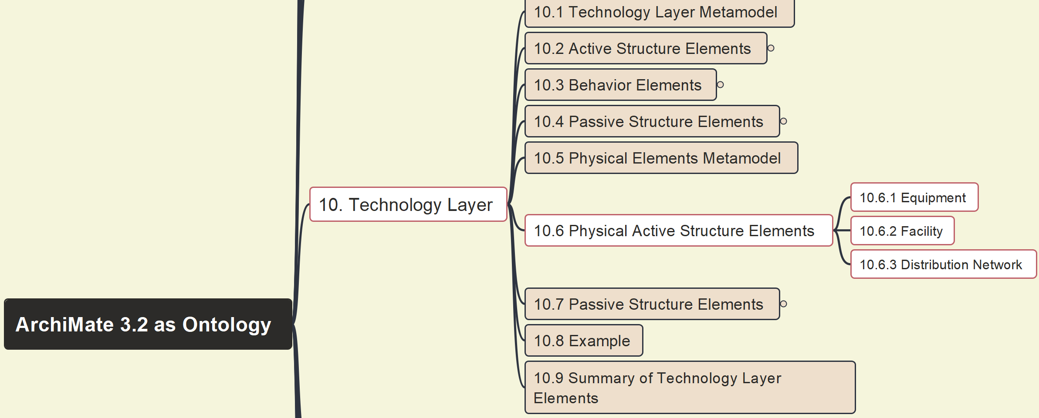
Build Ontology View on ArchiMate 3.2
086
10 Technology Layer – 10.6 Physical Active Structure Elements

Slide 14
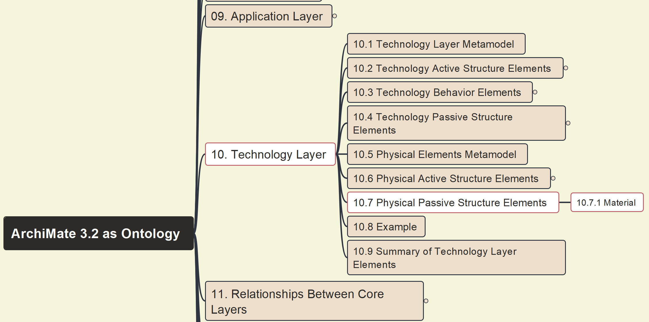
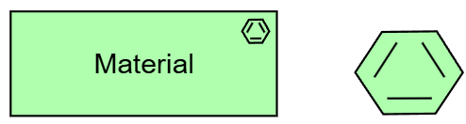
Build Ontology View on ArchiMate 3.2
087
10 Technology Layer – 10.7 Physical Passive Structure Elements

Slide 15
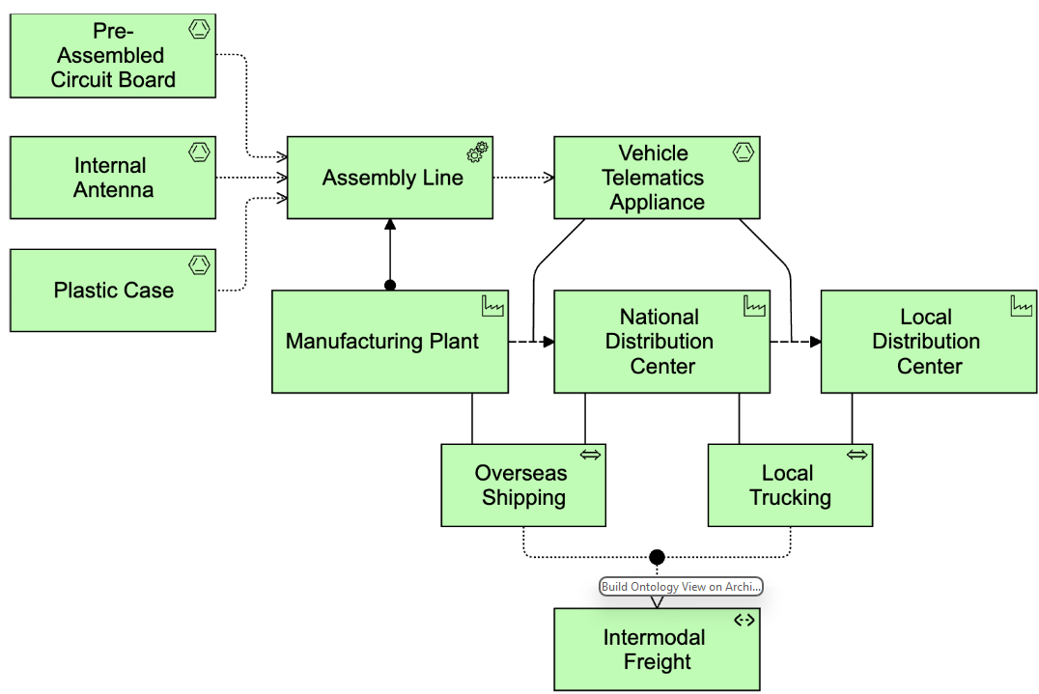
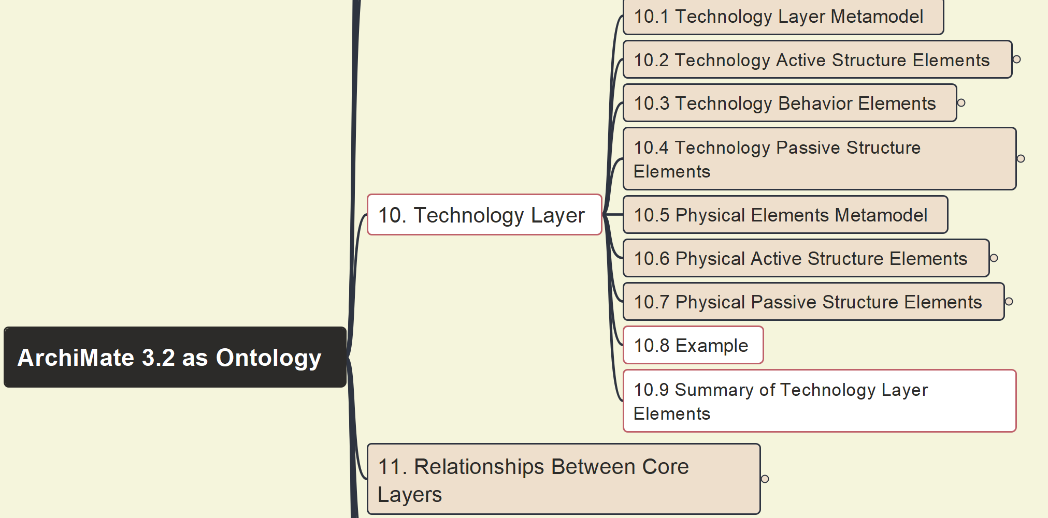
Build Ontology View on ArchiMate 3.2
088
10 Technology Layer – 10.8 Example & 10.9 Summary

Slide 16
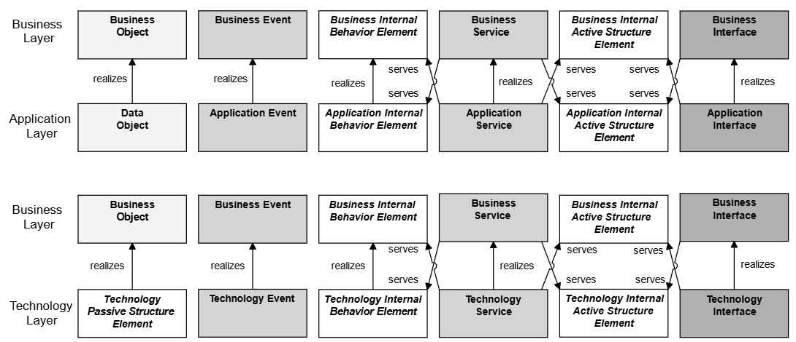
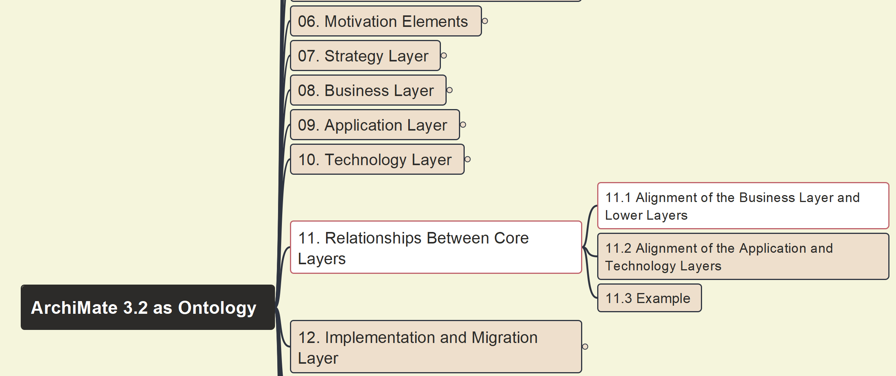
Build Ontology View on ArchiMate 3.2
089
11.1 Alignment of the Business Layer and Lower Layers

Slide 17
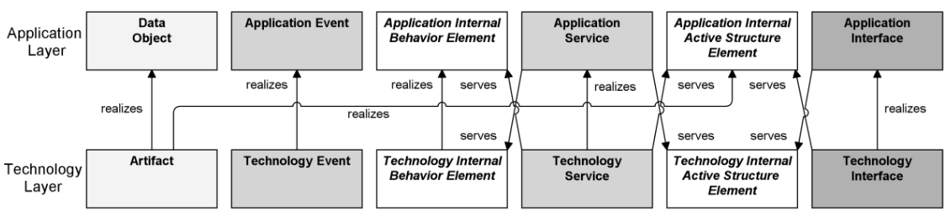
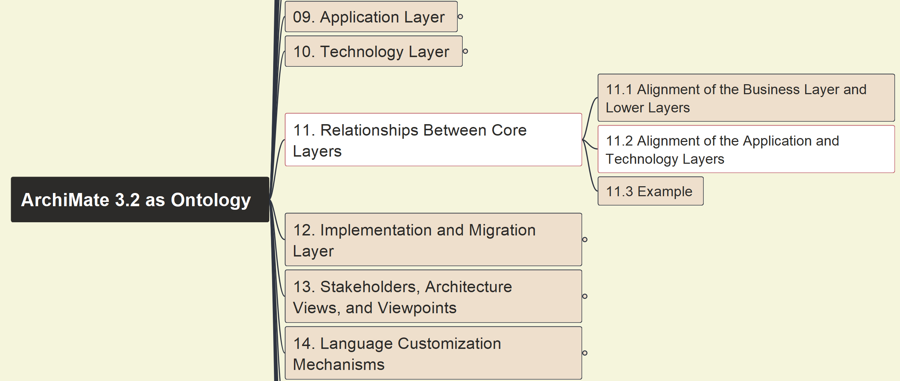
Build Ontology View on ArchiMate 3.2
090
11.2 Alignment of the Application Layer and Technology Layers

Slide 18
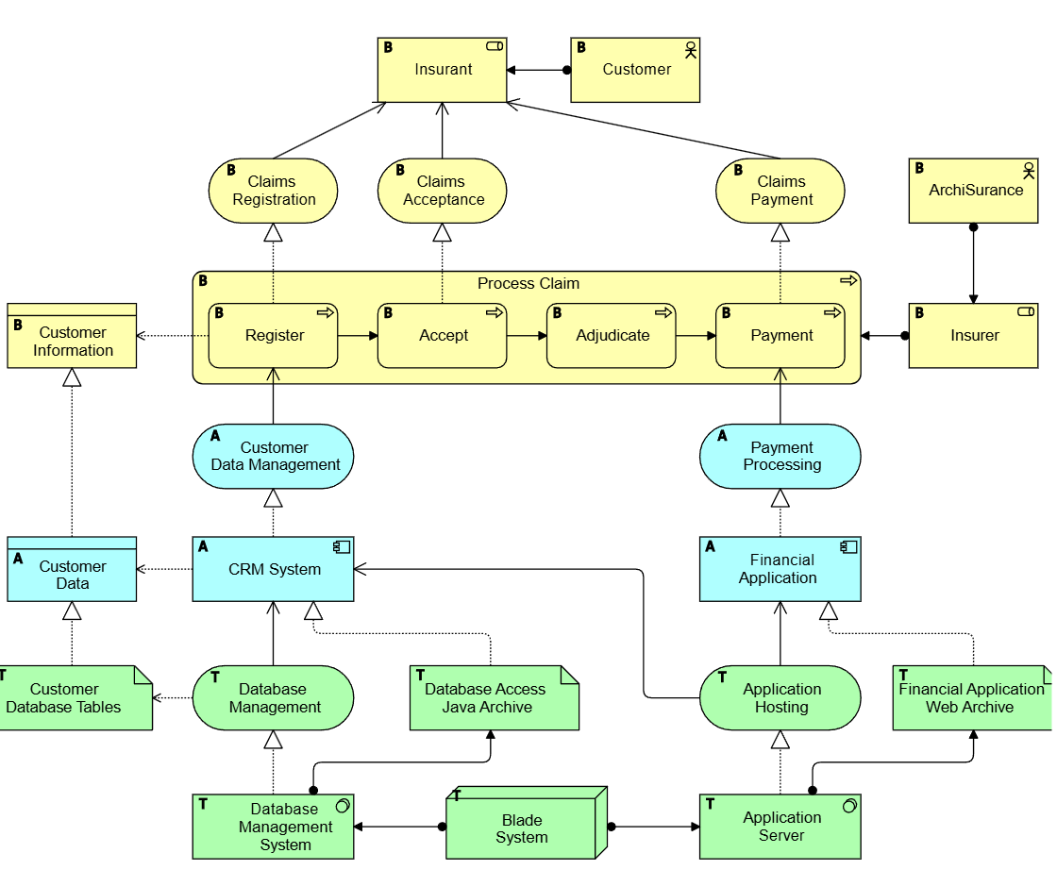
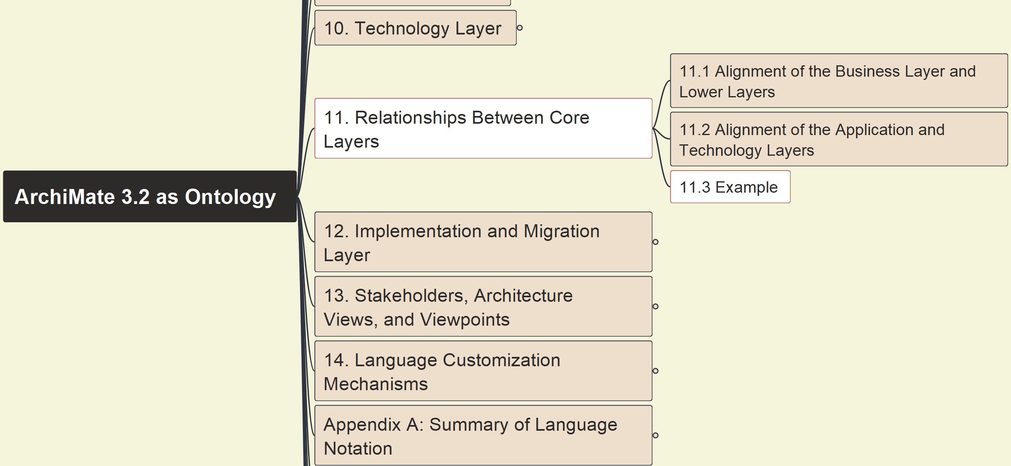
Build Ontology View on ArchiMate 3.2
091
11. Relationships between Core Layers
11.3 Example

