Slide 1

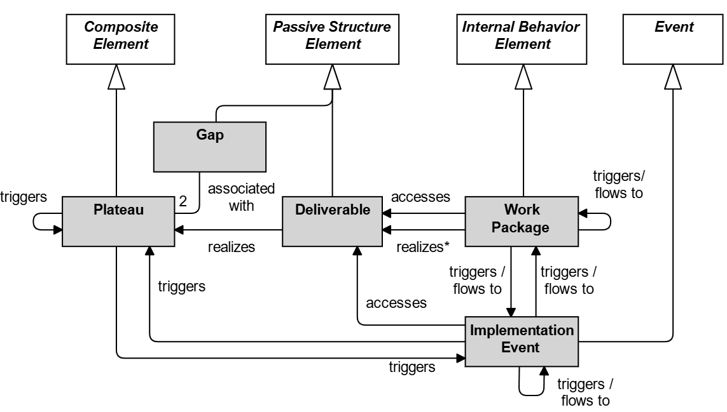
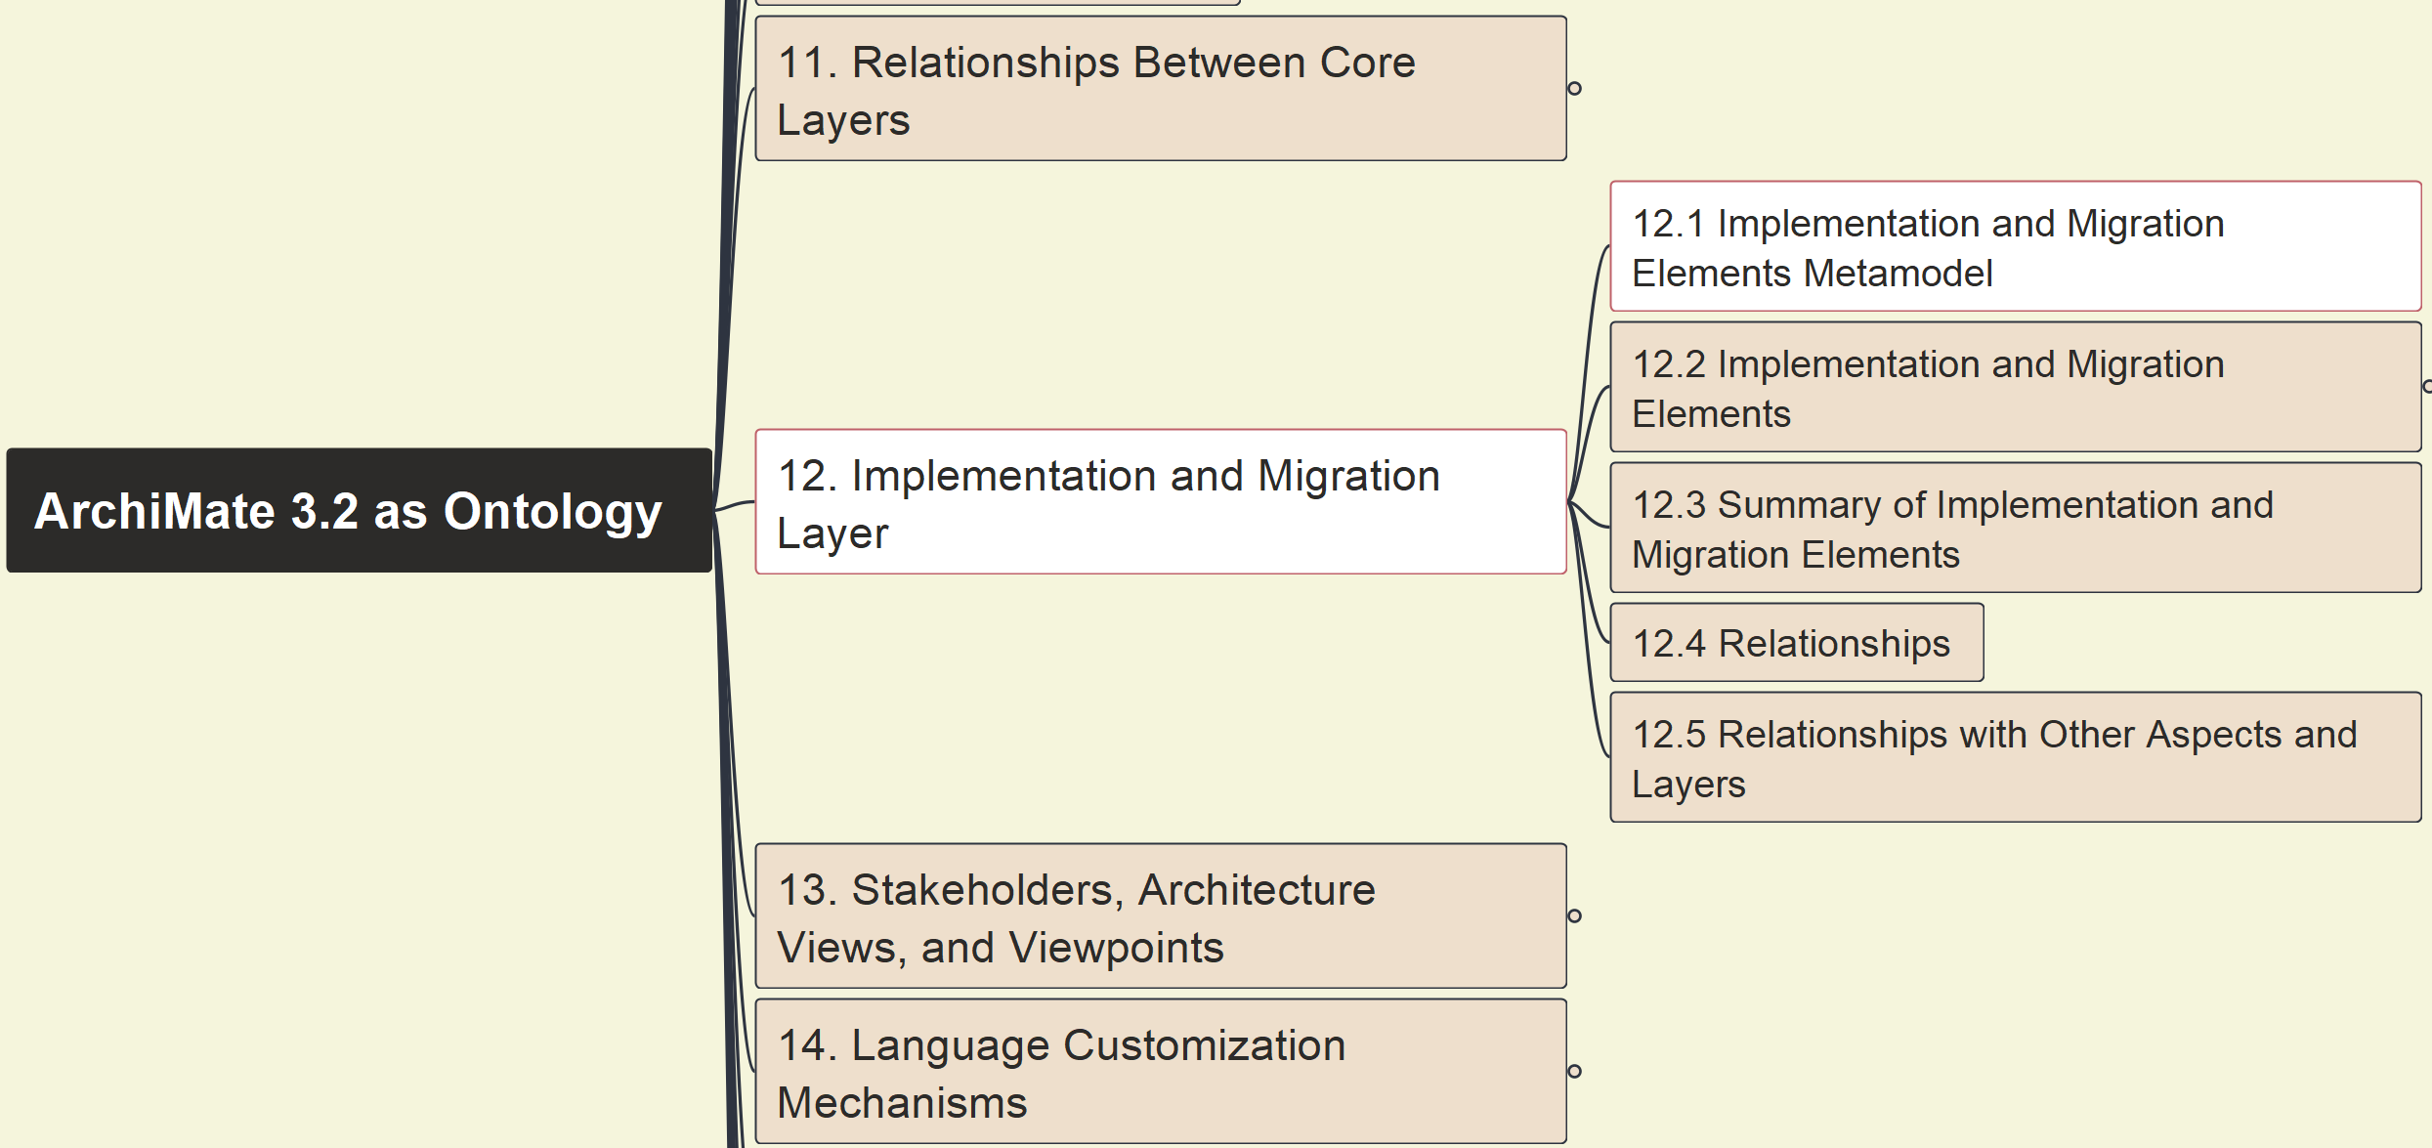



Build Ontology View on ArchiMate 3.2
092
12. Implementation and Migration Layer
12.1 Elements Metamodel

Slide 2
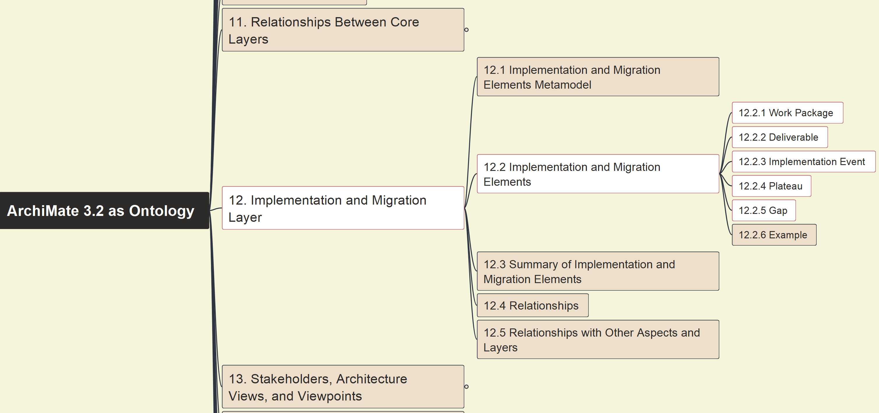

Build Ontology View on ArchiMate 3.2
093
12. Implementation and Migration Layer
12.2 Elements Ontology Setup

Slide 3
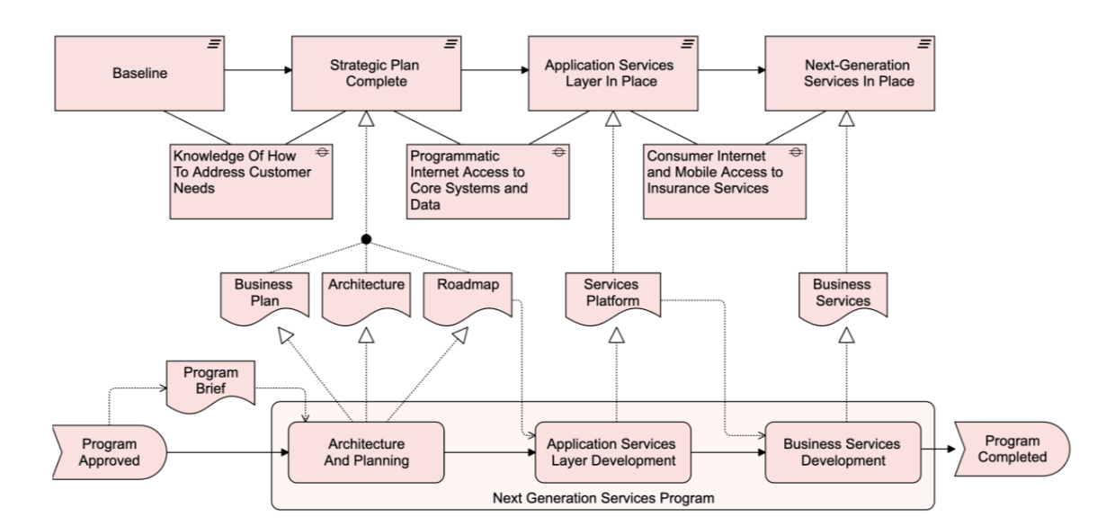
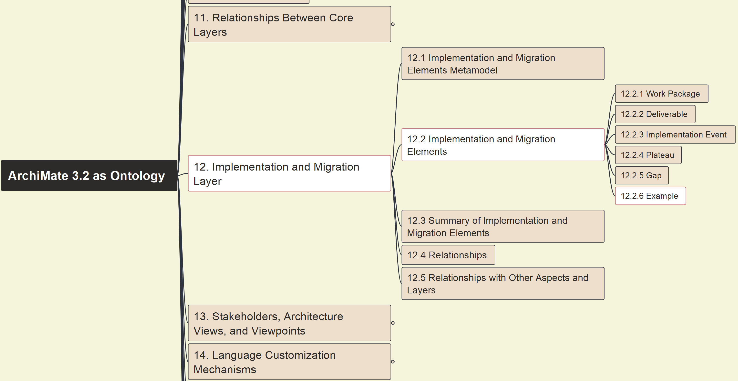
Build Ontology View on ArchiMate 3.2
094
12. Implementation and Migration Layer
12.2.6 Example

Slide 4
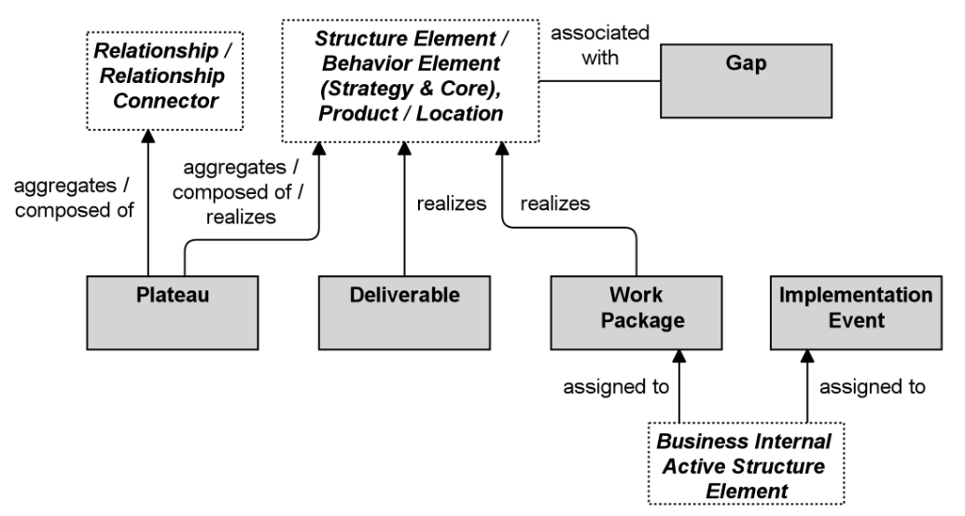
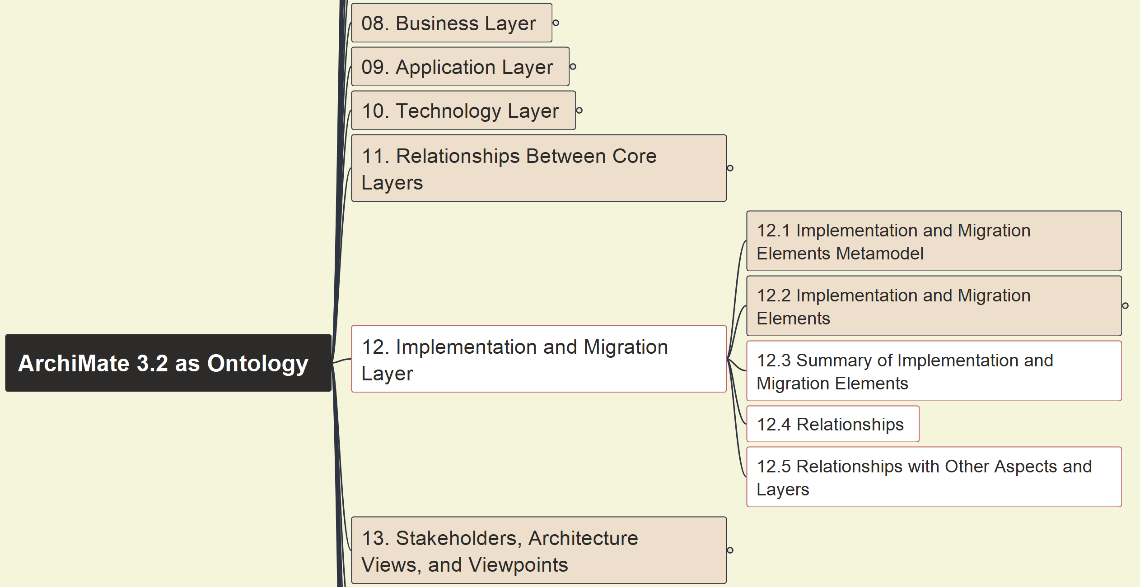
Build Ontology View on ArchiMate 3.2
095
12. Implementation and Migration Layer
12.3 Summary 12.4~5 Relationships

Slide 5
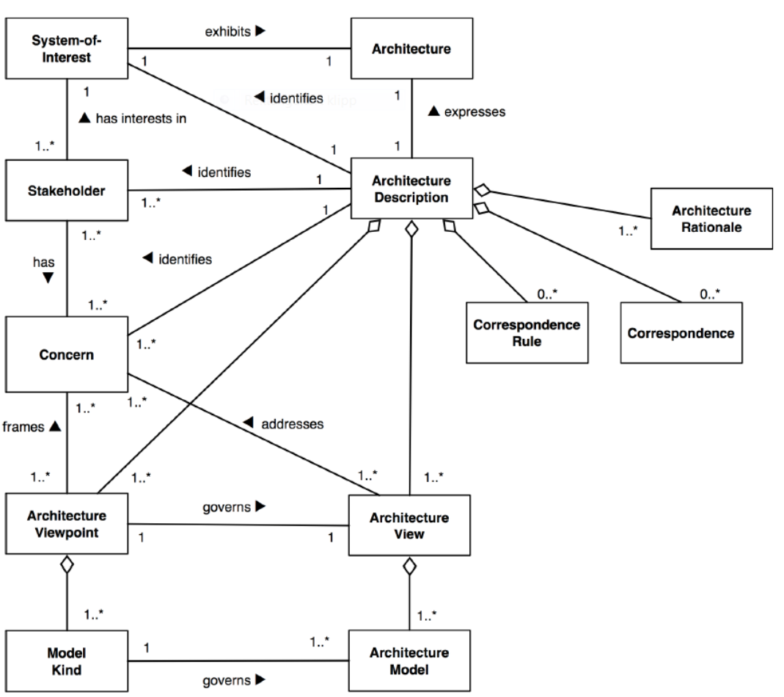
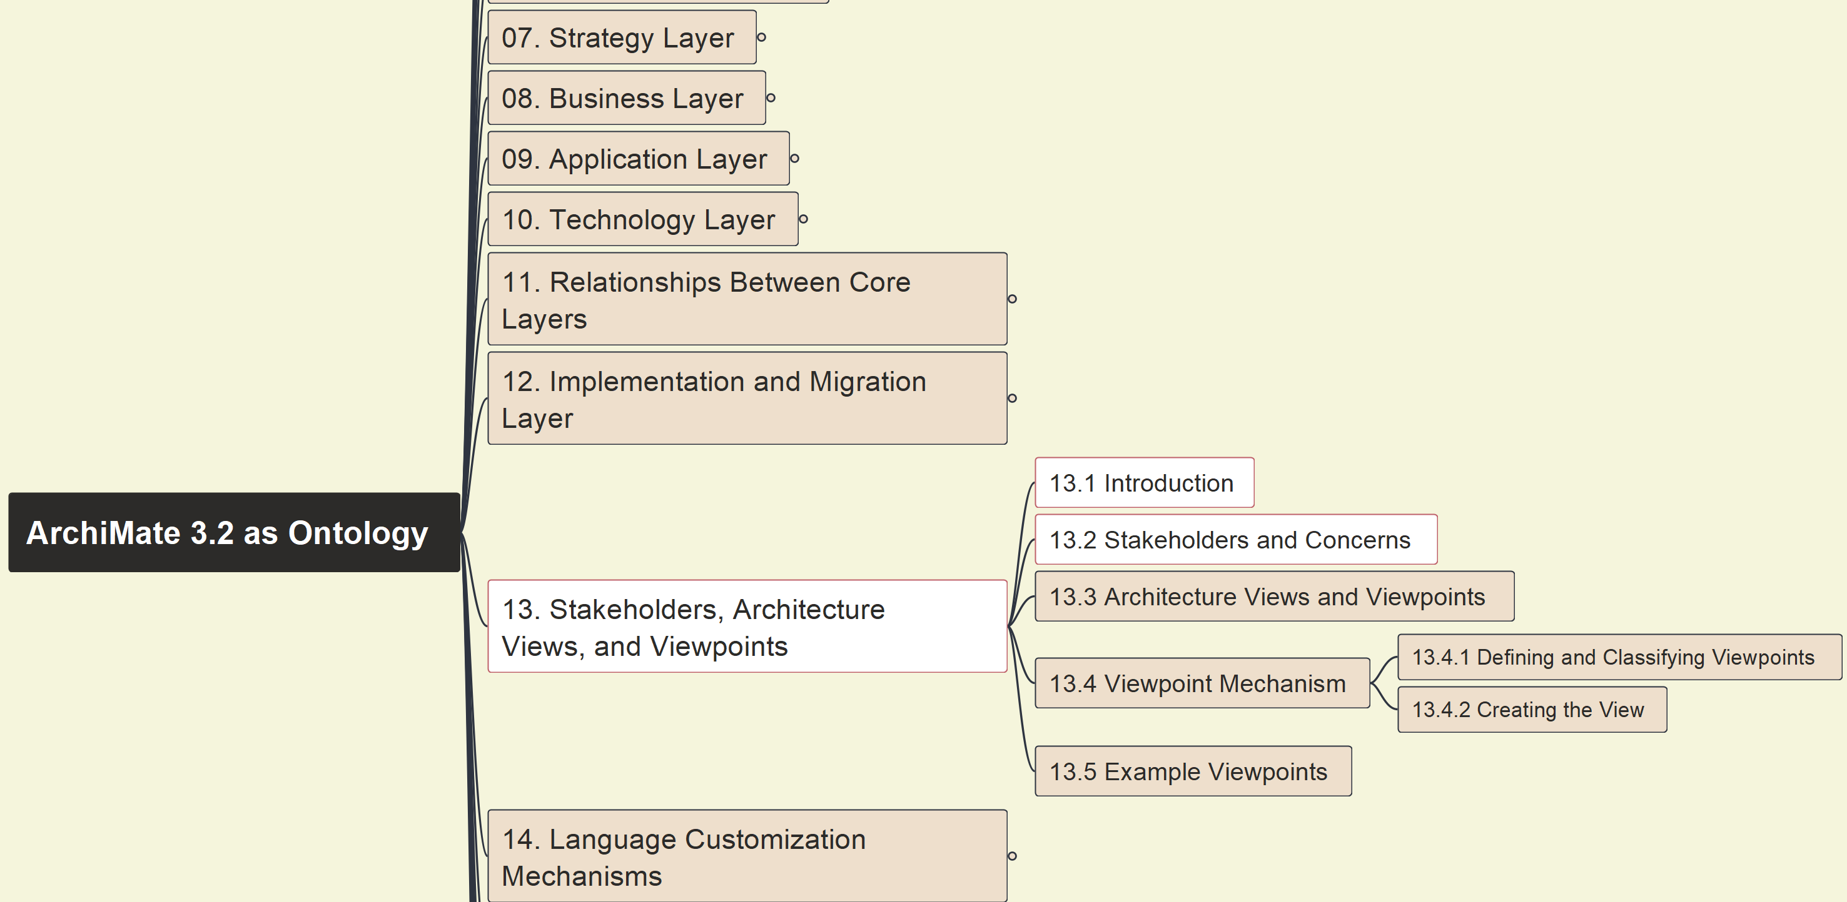
Build Ontology View on ArchiMate 3.2
096
13 Stakeholders, Archi Views/Viewpoints
13.1 Introduction 13.2 Stakeholders & Concerns

Slide 6
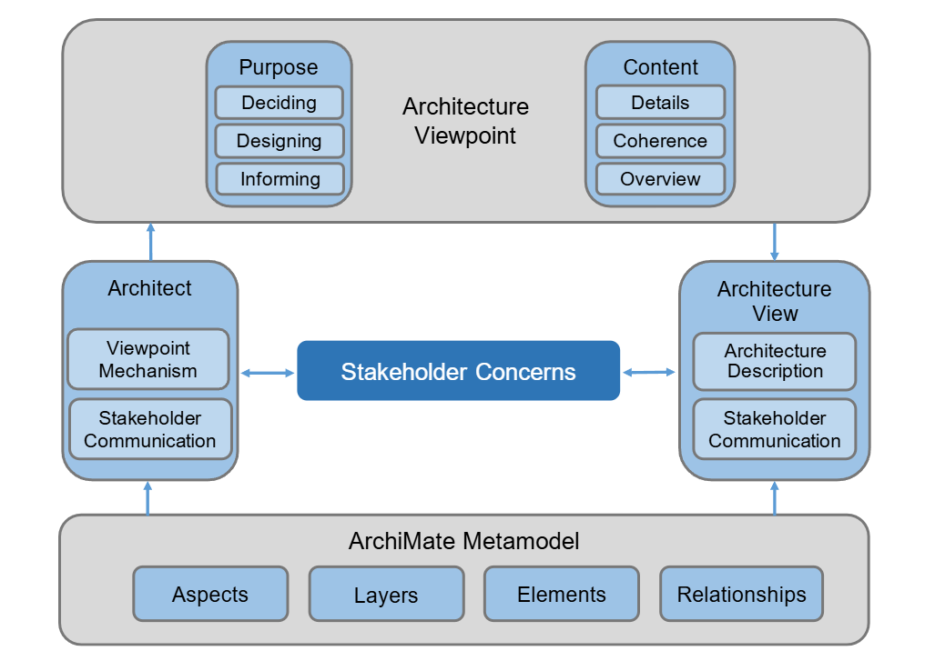
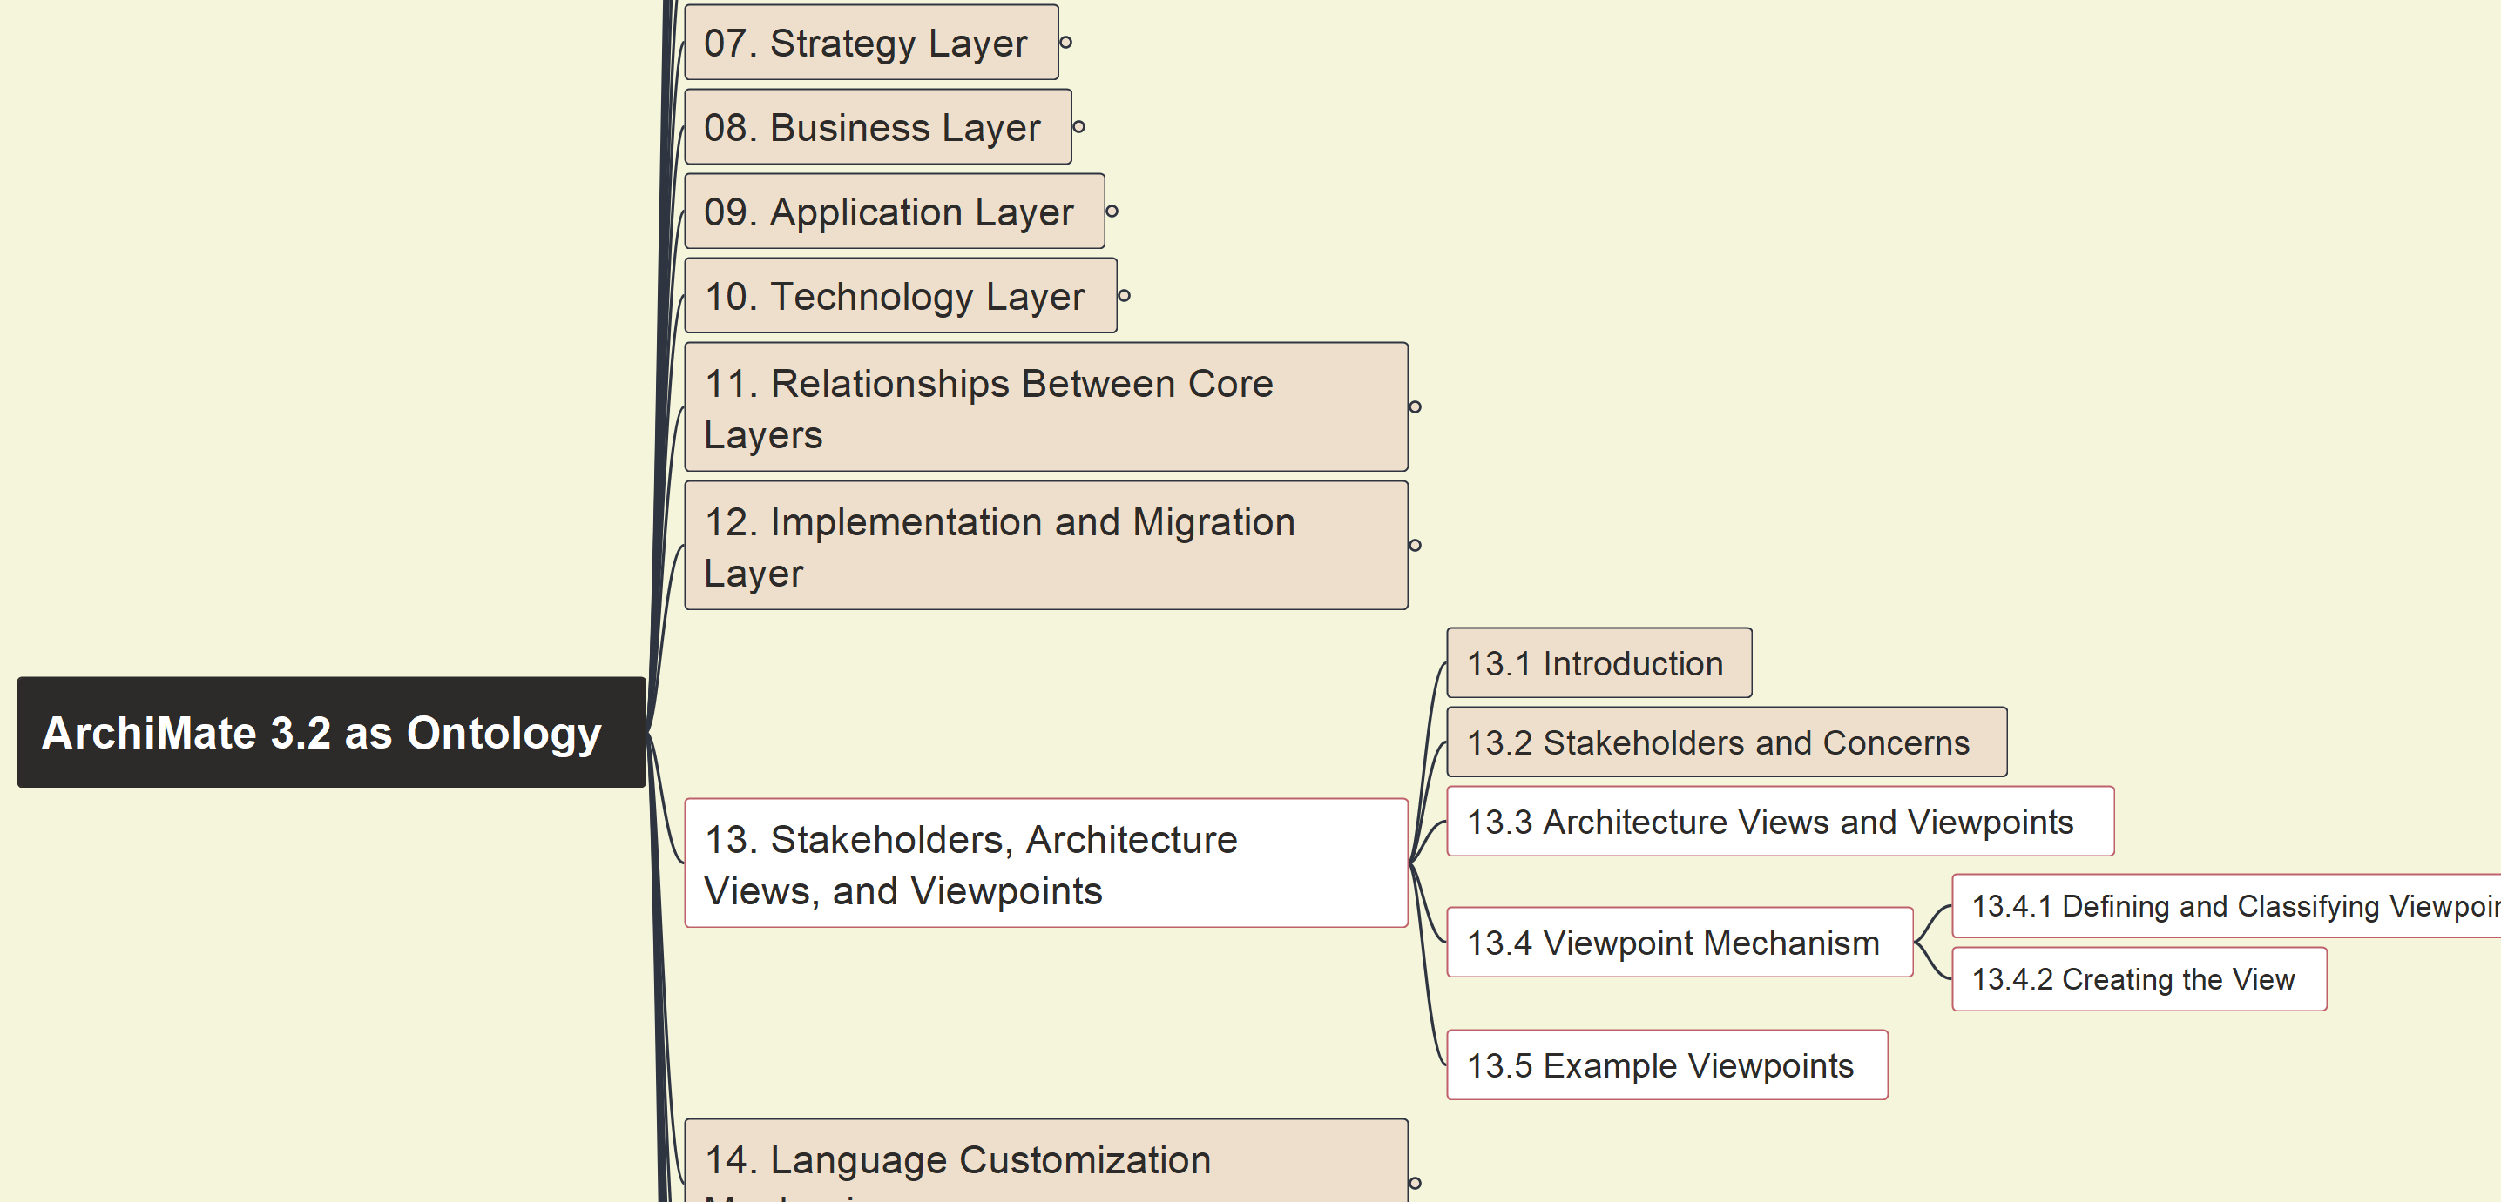
Build Ontology View on ArchiMate 3.2
097
13 Stakeholders, Archi Views/Viewpoints
13.3~5 Architecture Views & Viewpoints

Slide 7
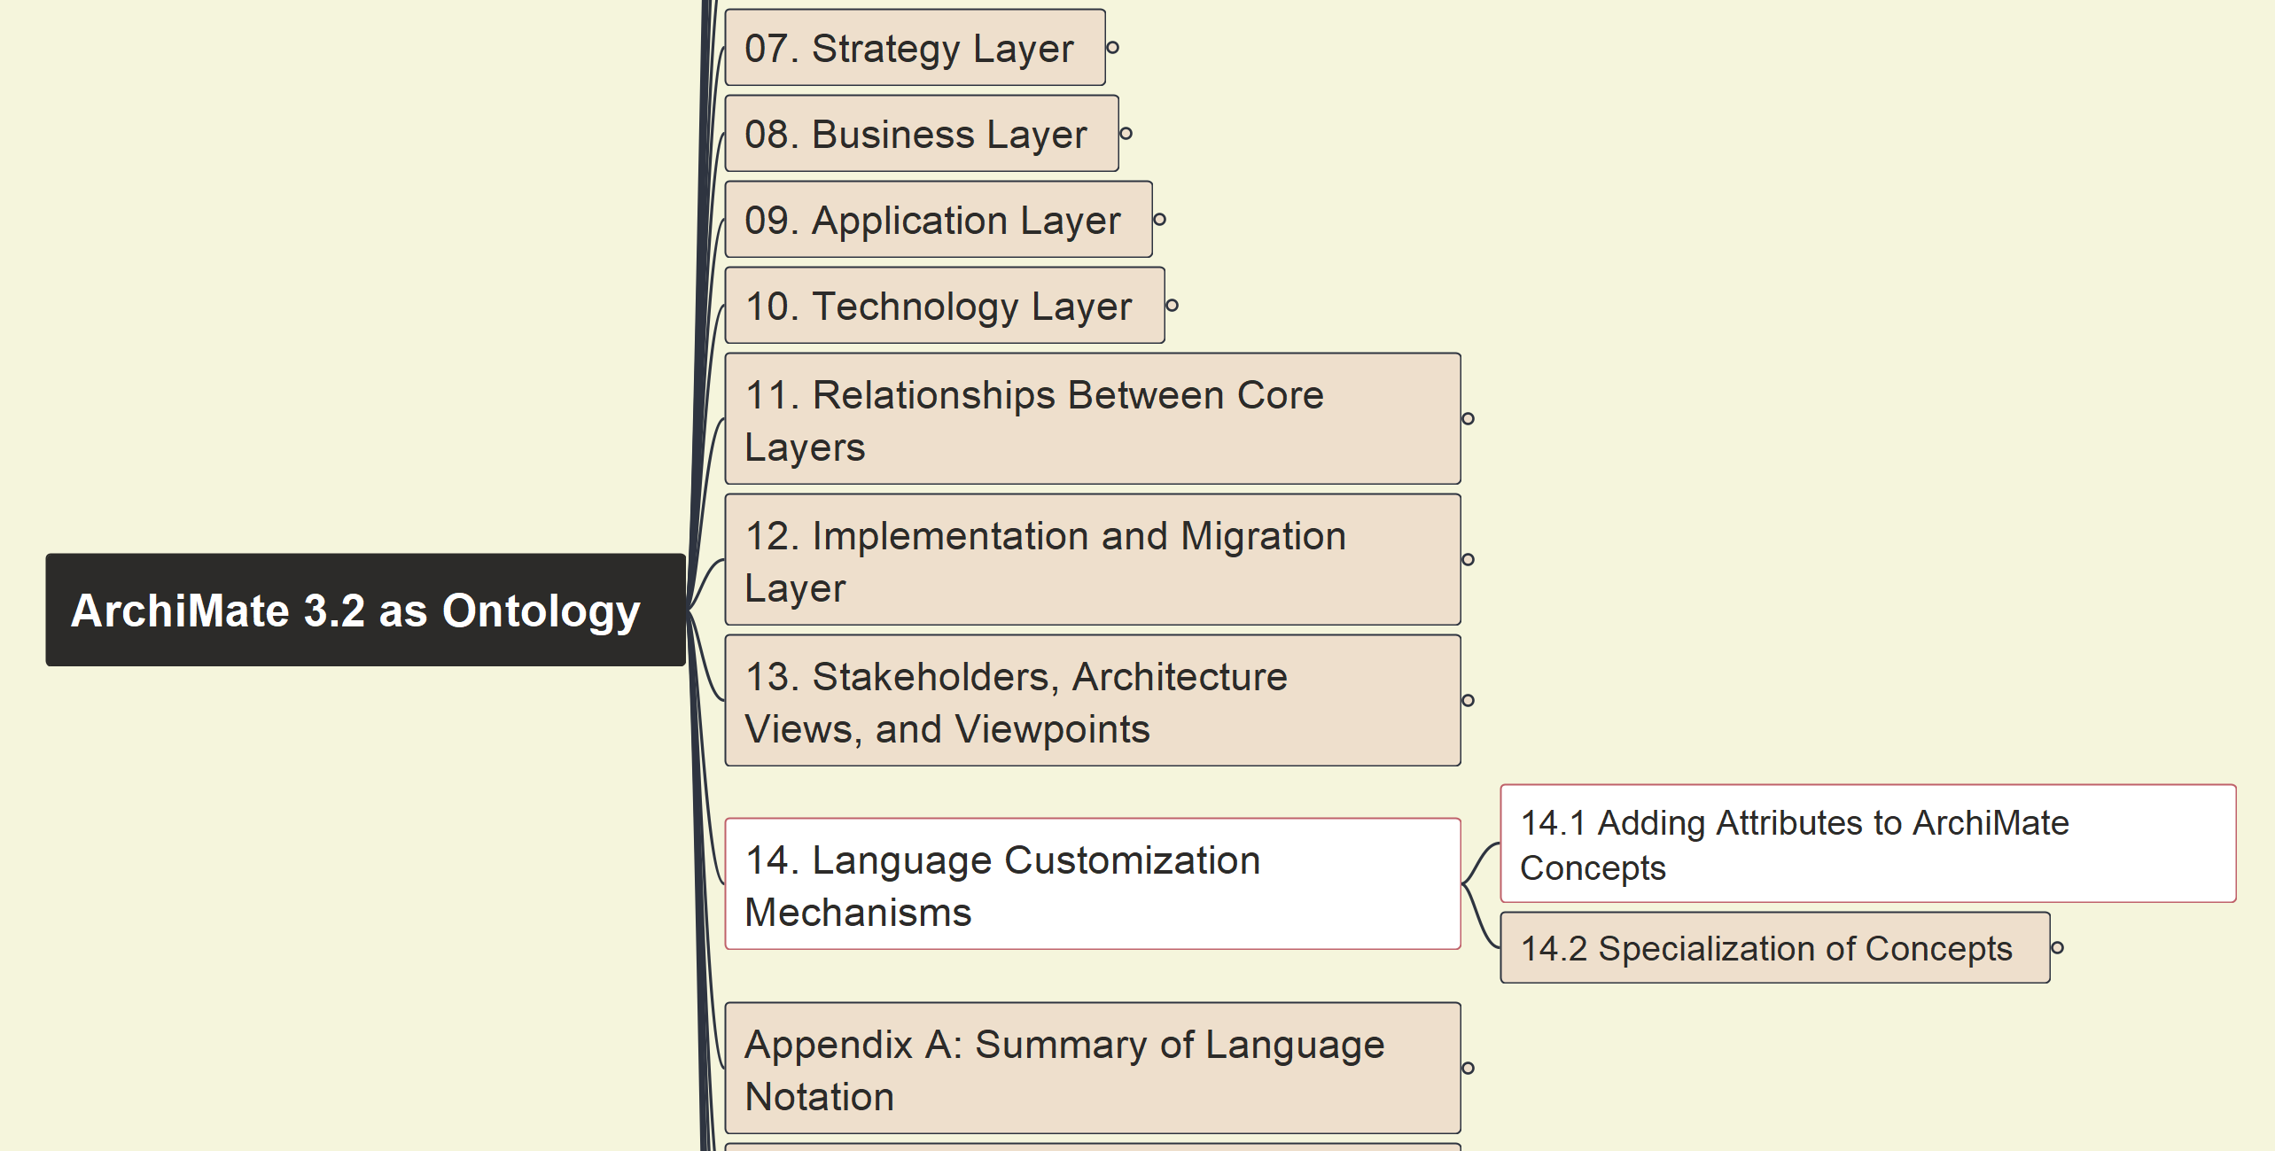
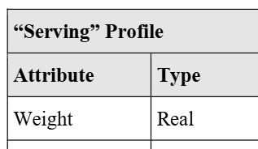
Build Ontology View on ArchiMate 3.2
098
14 Language Customization Mechanisms
14.1 Adding Attributes to ArchiMate Concepts

Slide 8
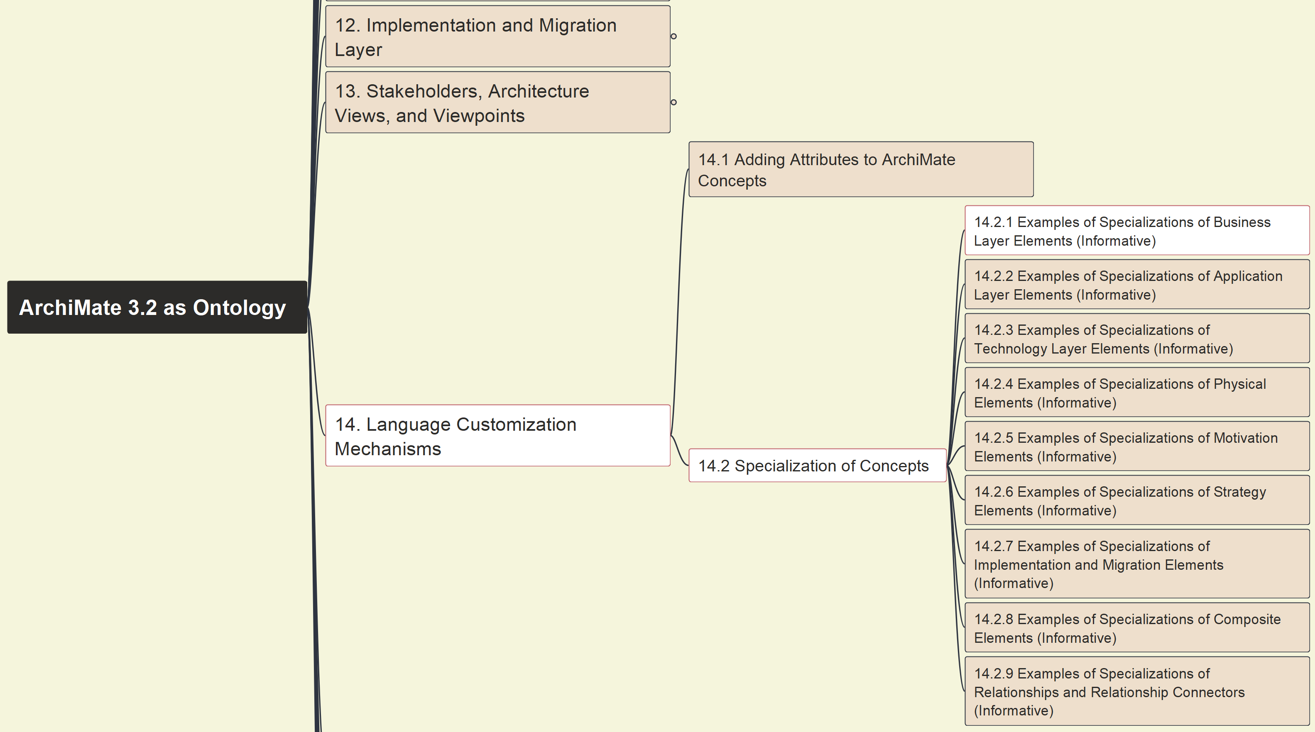
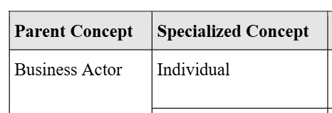
Build Ontology View on ArchiMate 3.2
099
14 Language Customization Mechanisms
14.2 Concepts Specialization – 14.2.1

Slide 9
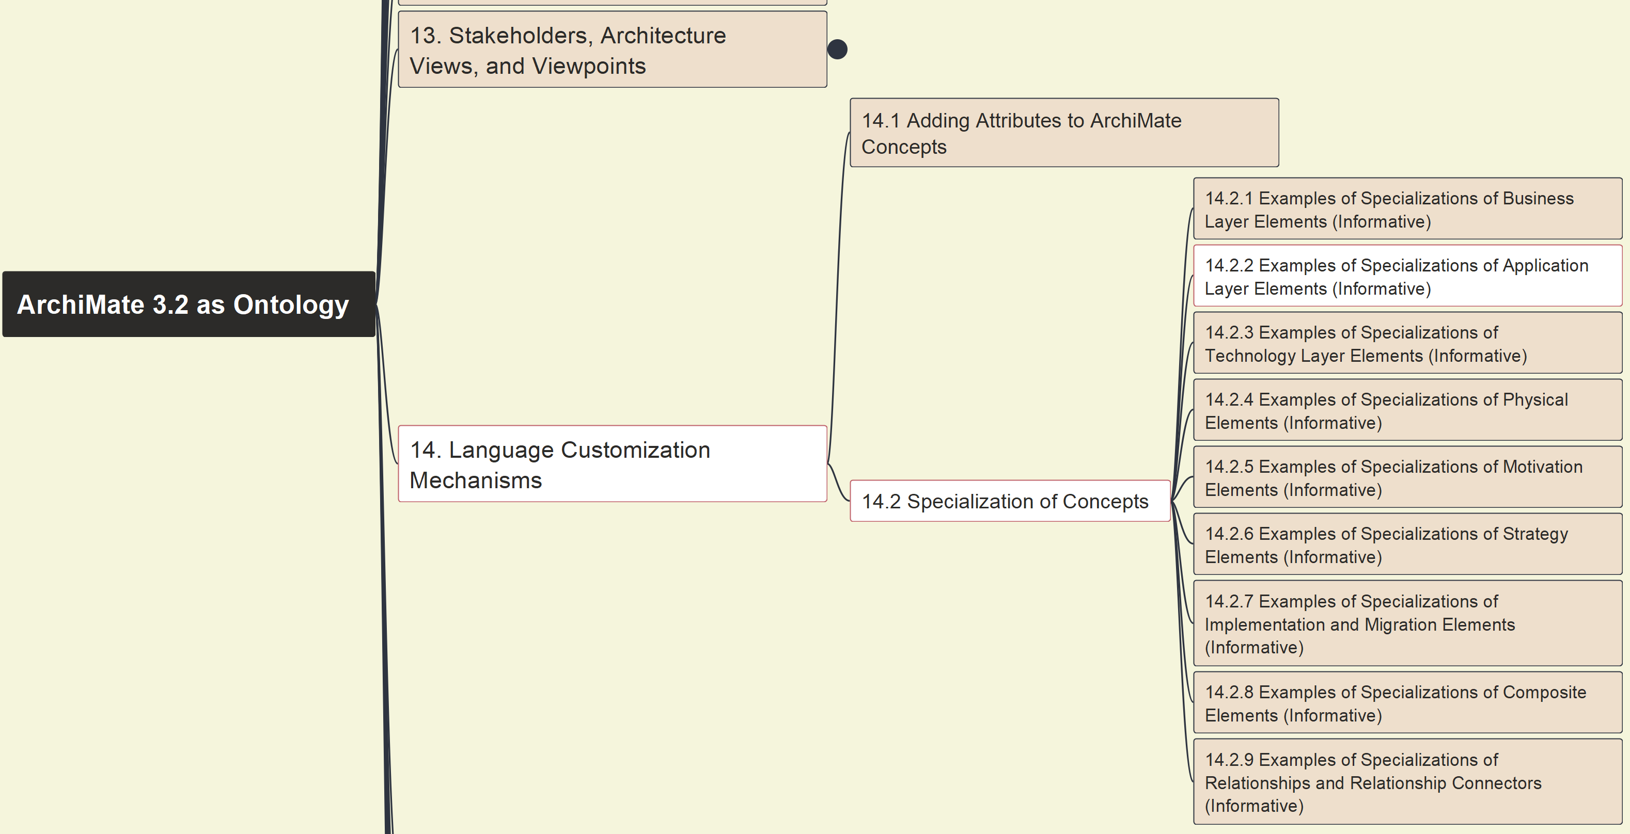
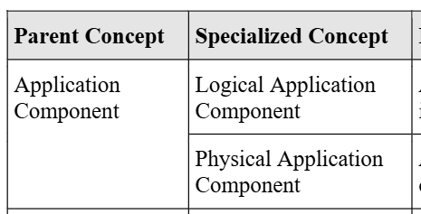
Build Ontology View on ArchiMate 3.2
100
14 Language Customization Mechanisms
14.2 Concepts Specialization – 14.2.2

Slide 10
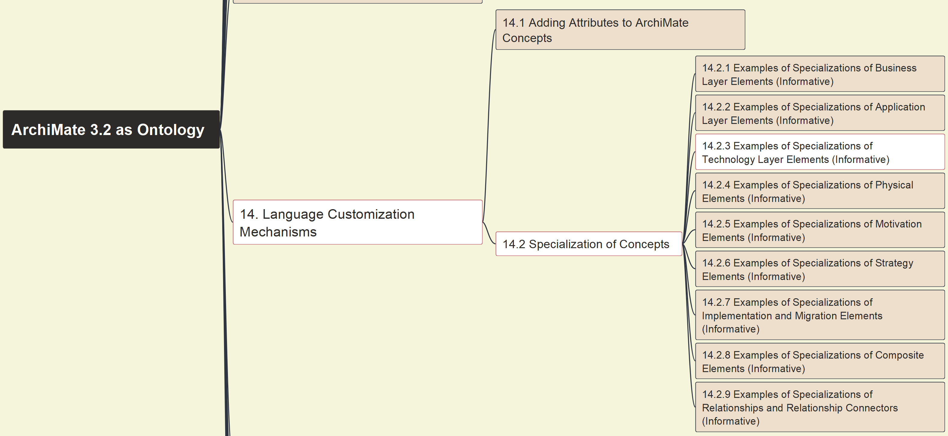
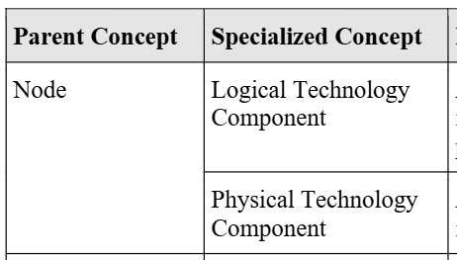
Build Ontology View on ArchiMate 3.2
101
14 Language Customization Mechanisms
14.2 Concepts Specialization – 14.2.3

Slide 11
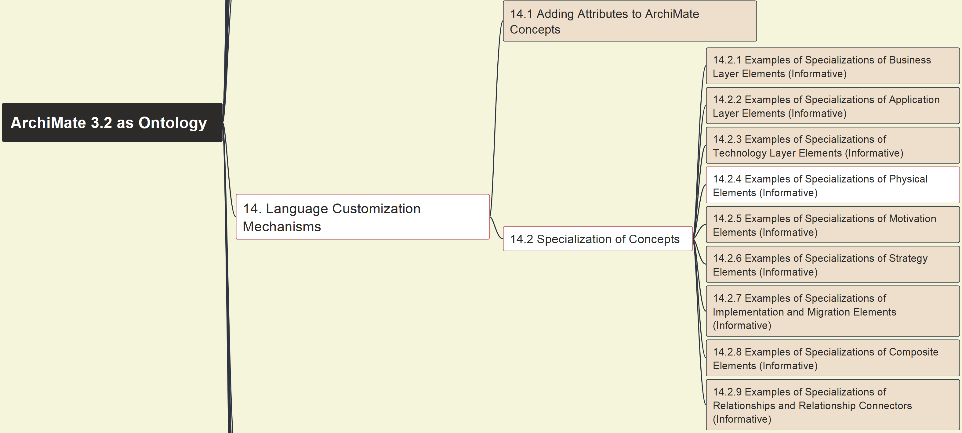
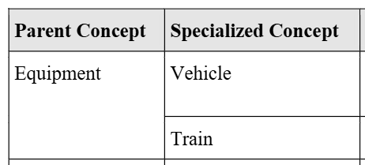
Build Ontology View on ArchiMate 3.2
102
14 Language Customization Mechanisms
14.2 Concepts Specialization – 14.2.4

Slide 12
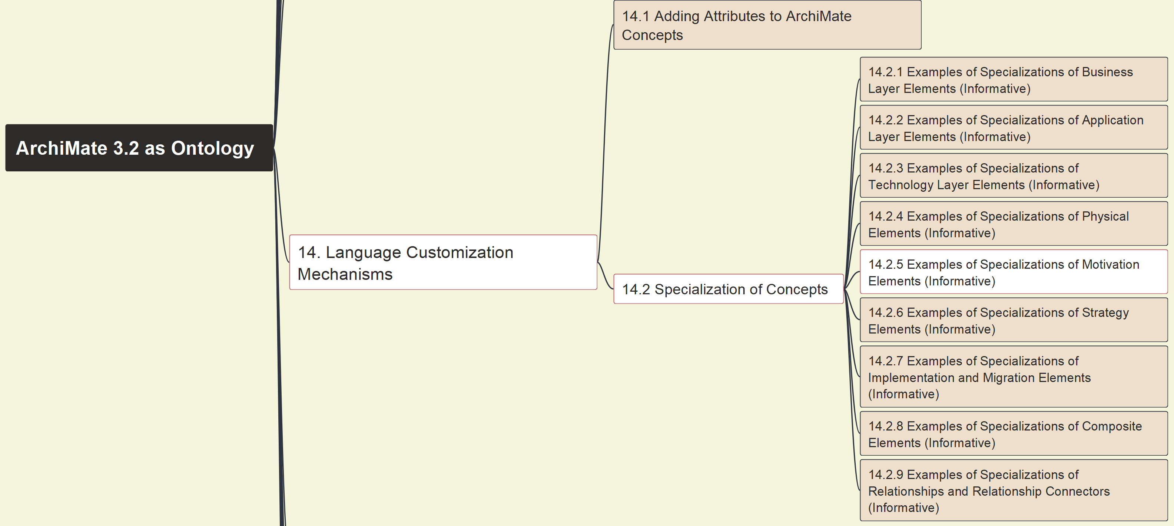
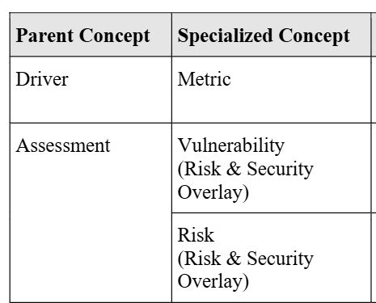
Build Ontology View on ArchiMate 3.2
103
14 Language Customization Mechanisms
14.2 Concepts Specialization – 14.2.5

Slide 13
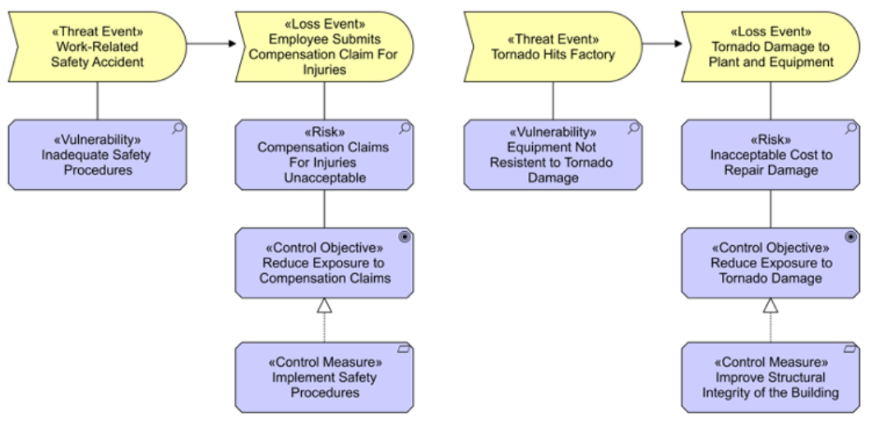
Build Ontology View on ArchiMate 3.2
104
14 Language Customization Mechanisms
14.2 Concepts Specialization – 14.2.5 Example

Slide 14
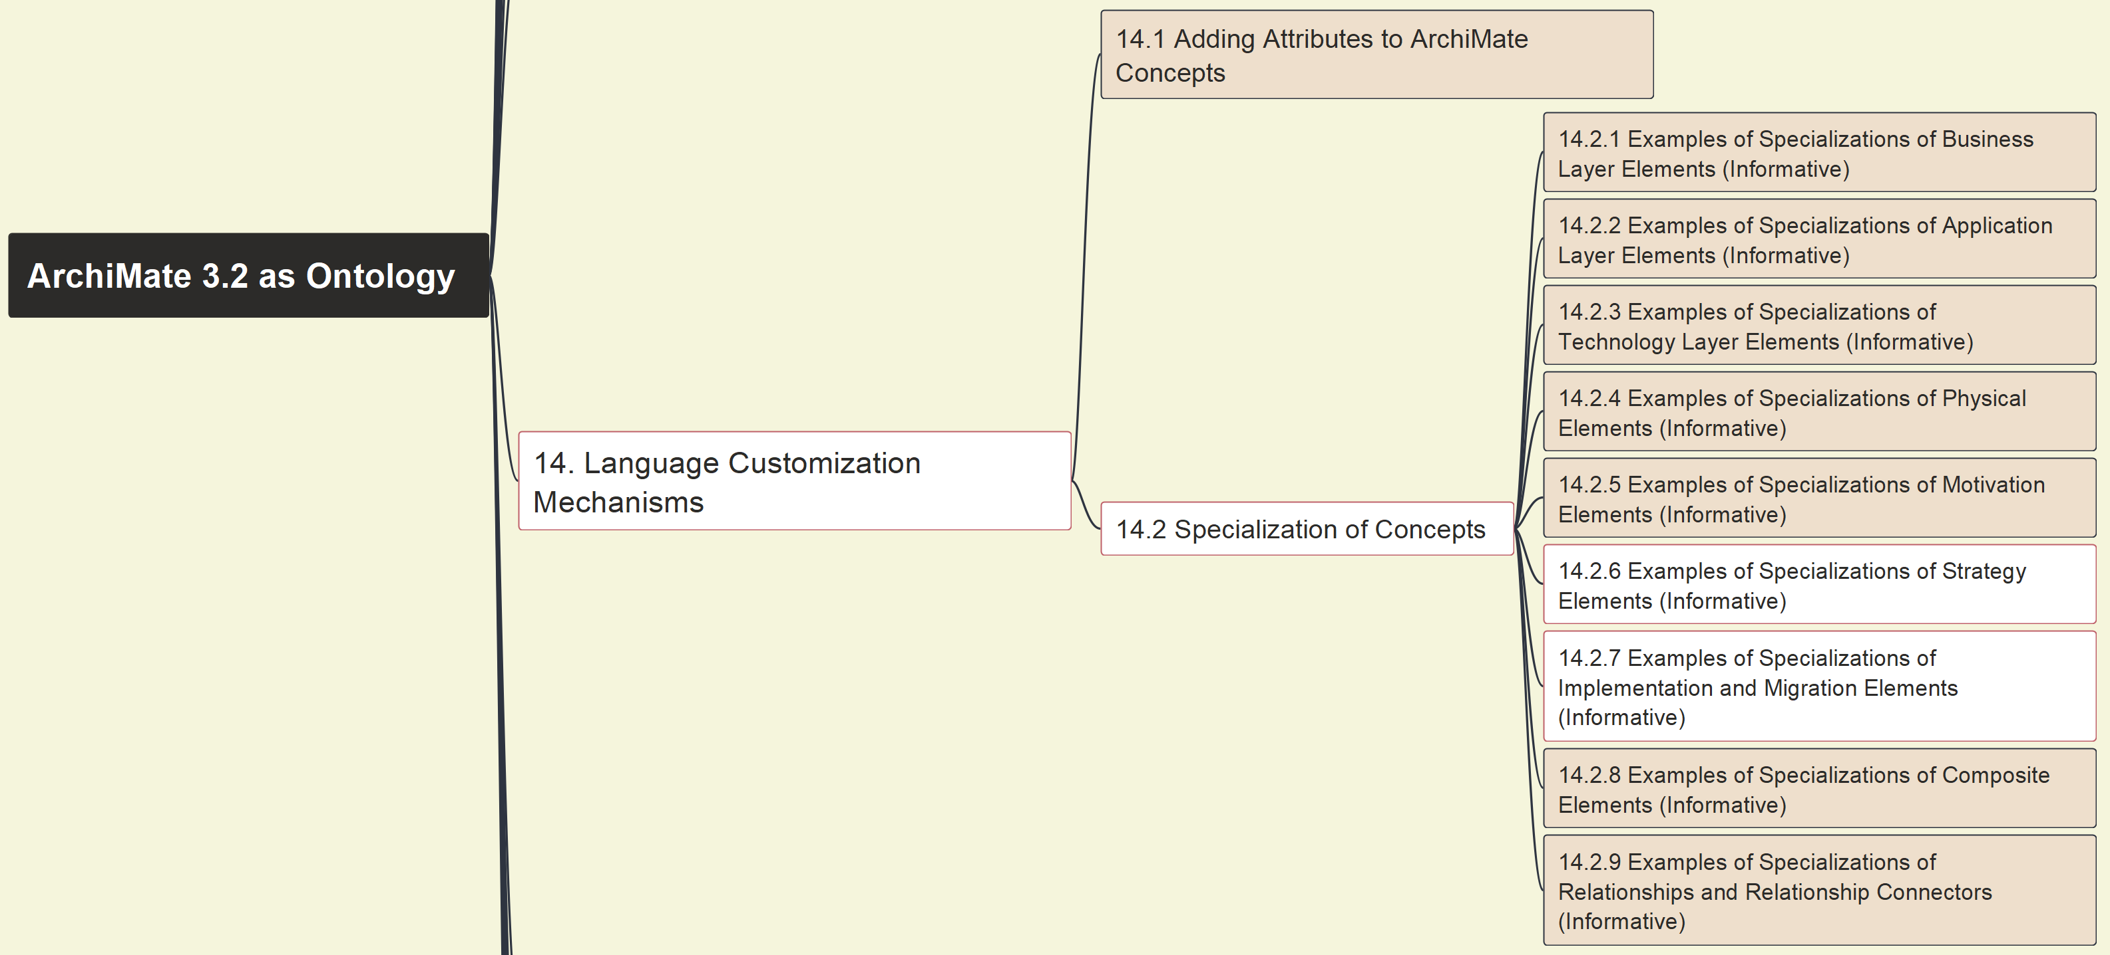
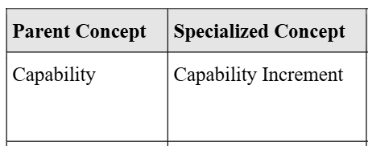
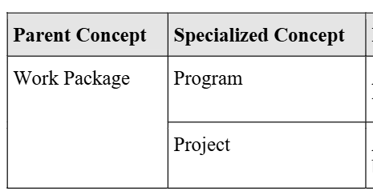
Build Ontology View on ArchiMate 3.2
105
14 Language Customization Mechanisms
14.2 Concepts Specialization – 14.2.6 & 14.2.7

Slide 15
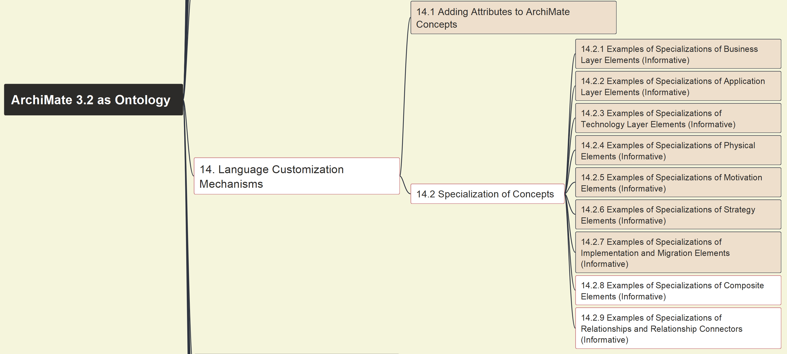
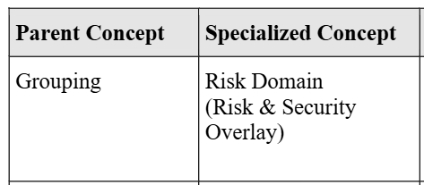
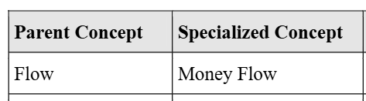
Build Ontology View on ArchiMate 3.2
106
14 Language Customization Mechanisms
14.2 Concepts Specialization – 14.2.8 & 14.2.9

