Slide 1



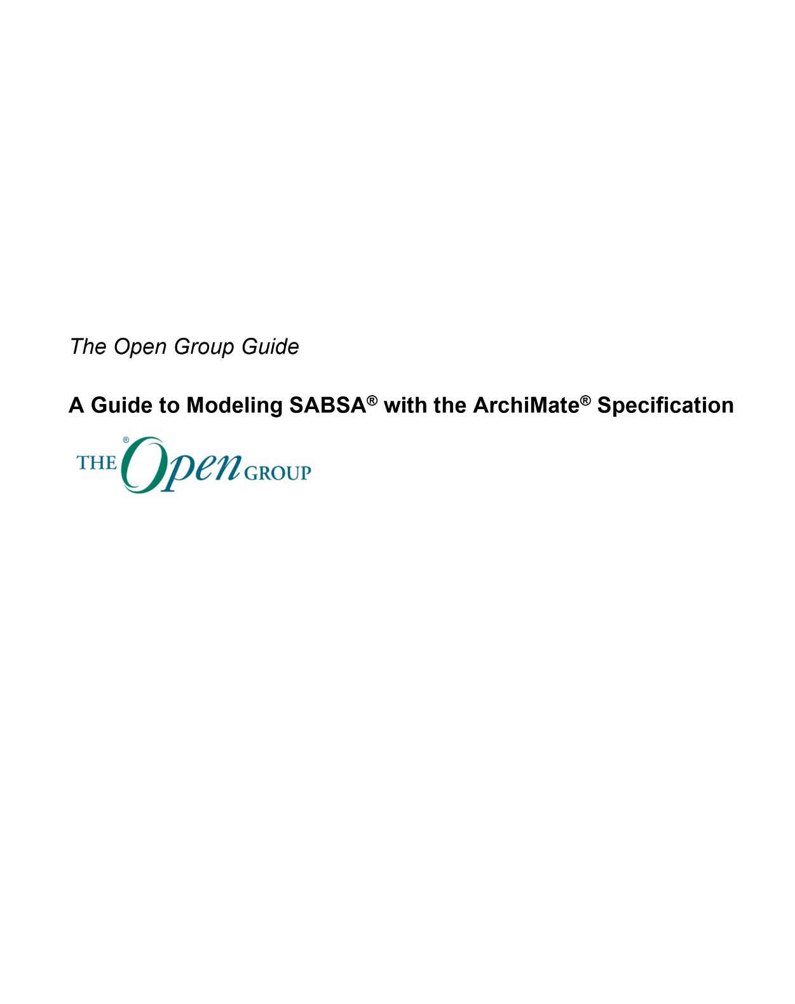
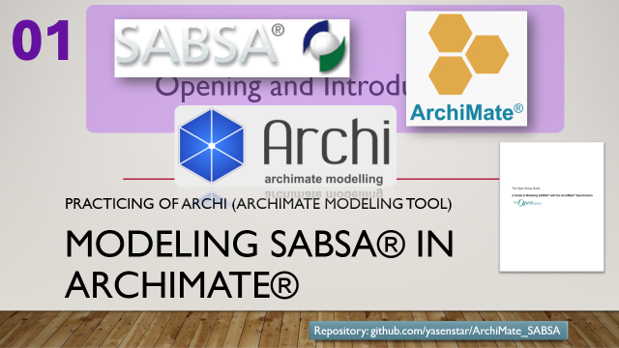

Modeling SABSA® in ArchiMate®
01
Opening and Introduction
Practicing of Archi (ArchiMate Modeling Tool)
Repository: github.com/yasenstar/ArchiMate_SABSA

Slide 2








About Me – An Enterprise Architecture Practitioner
Journey with The Open Group
TOGAF 9 Certified: 2013
ArchiMate 3 Practitioner: 2021
Professional Level 2 Architect: 2021
ArchiMate Essential 3.2: 2025
Other Architecture Learning
Certified Business Architect: 2021
Journey with ISACA
CobiT Certified: 2006
CISA – Info Sys Auditor: 2007
CISM – Info Sec Mgr: 2007
CGEIT GrandFather Certified: 2008
CRISC – Risk & InfoSys Control: 2017
CDPSE – Data Privacy Solution: 2020
Other Security and Service Mgmt
ITIL Manager Certified: 2002
PMP: 2003
CISSP: 2016
Security Journey – White/Yellow/Green Belt: 2024
Repository: github.com/yasenstar/ArchiMate_SABSA
Notes:
COBIT: Control Objectives for Information and Related Technology

Slide 3


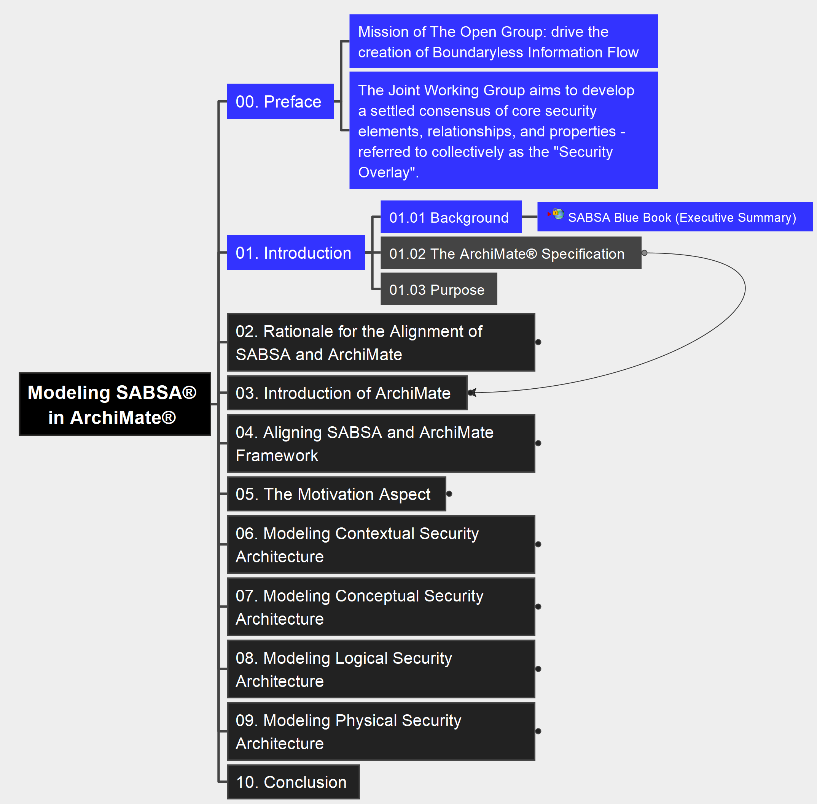
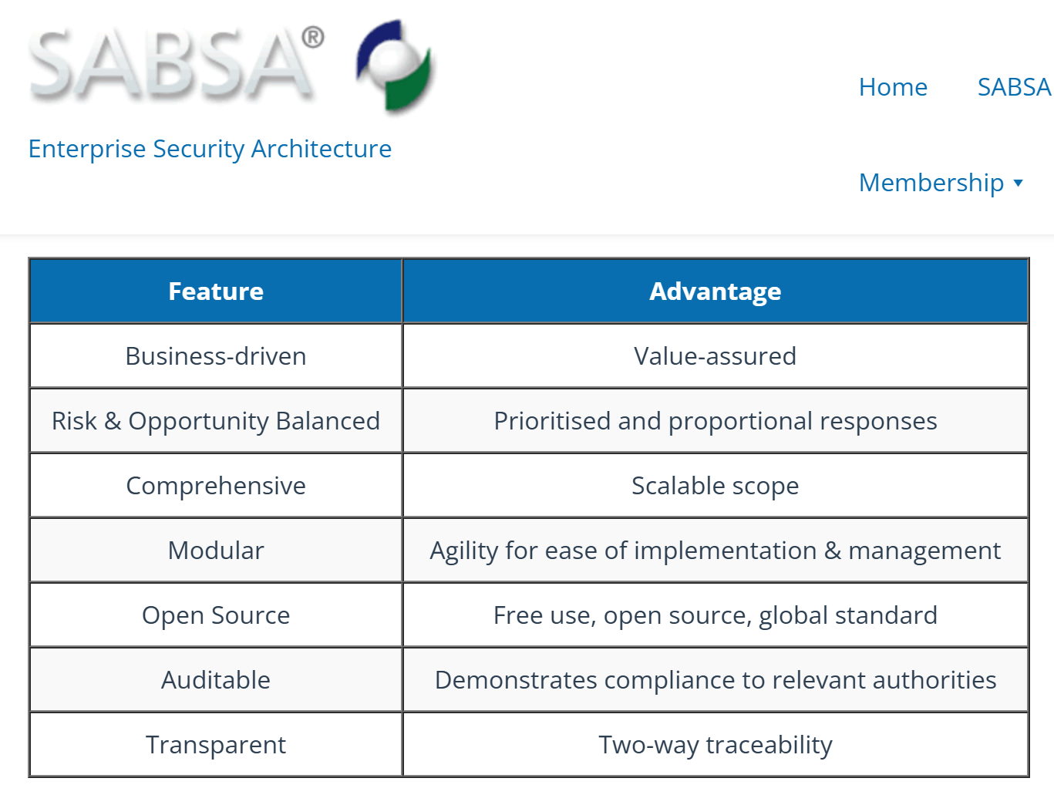
01 Introduction – Preface & Background
02
Modeling SABSA® in ArchiMate® Specification

Slide 4

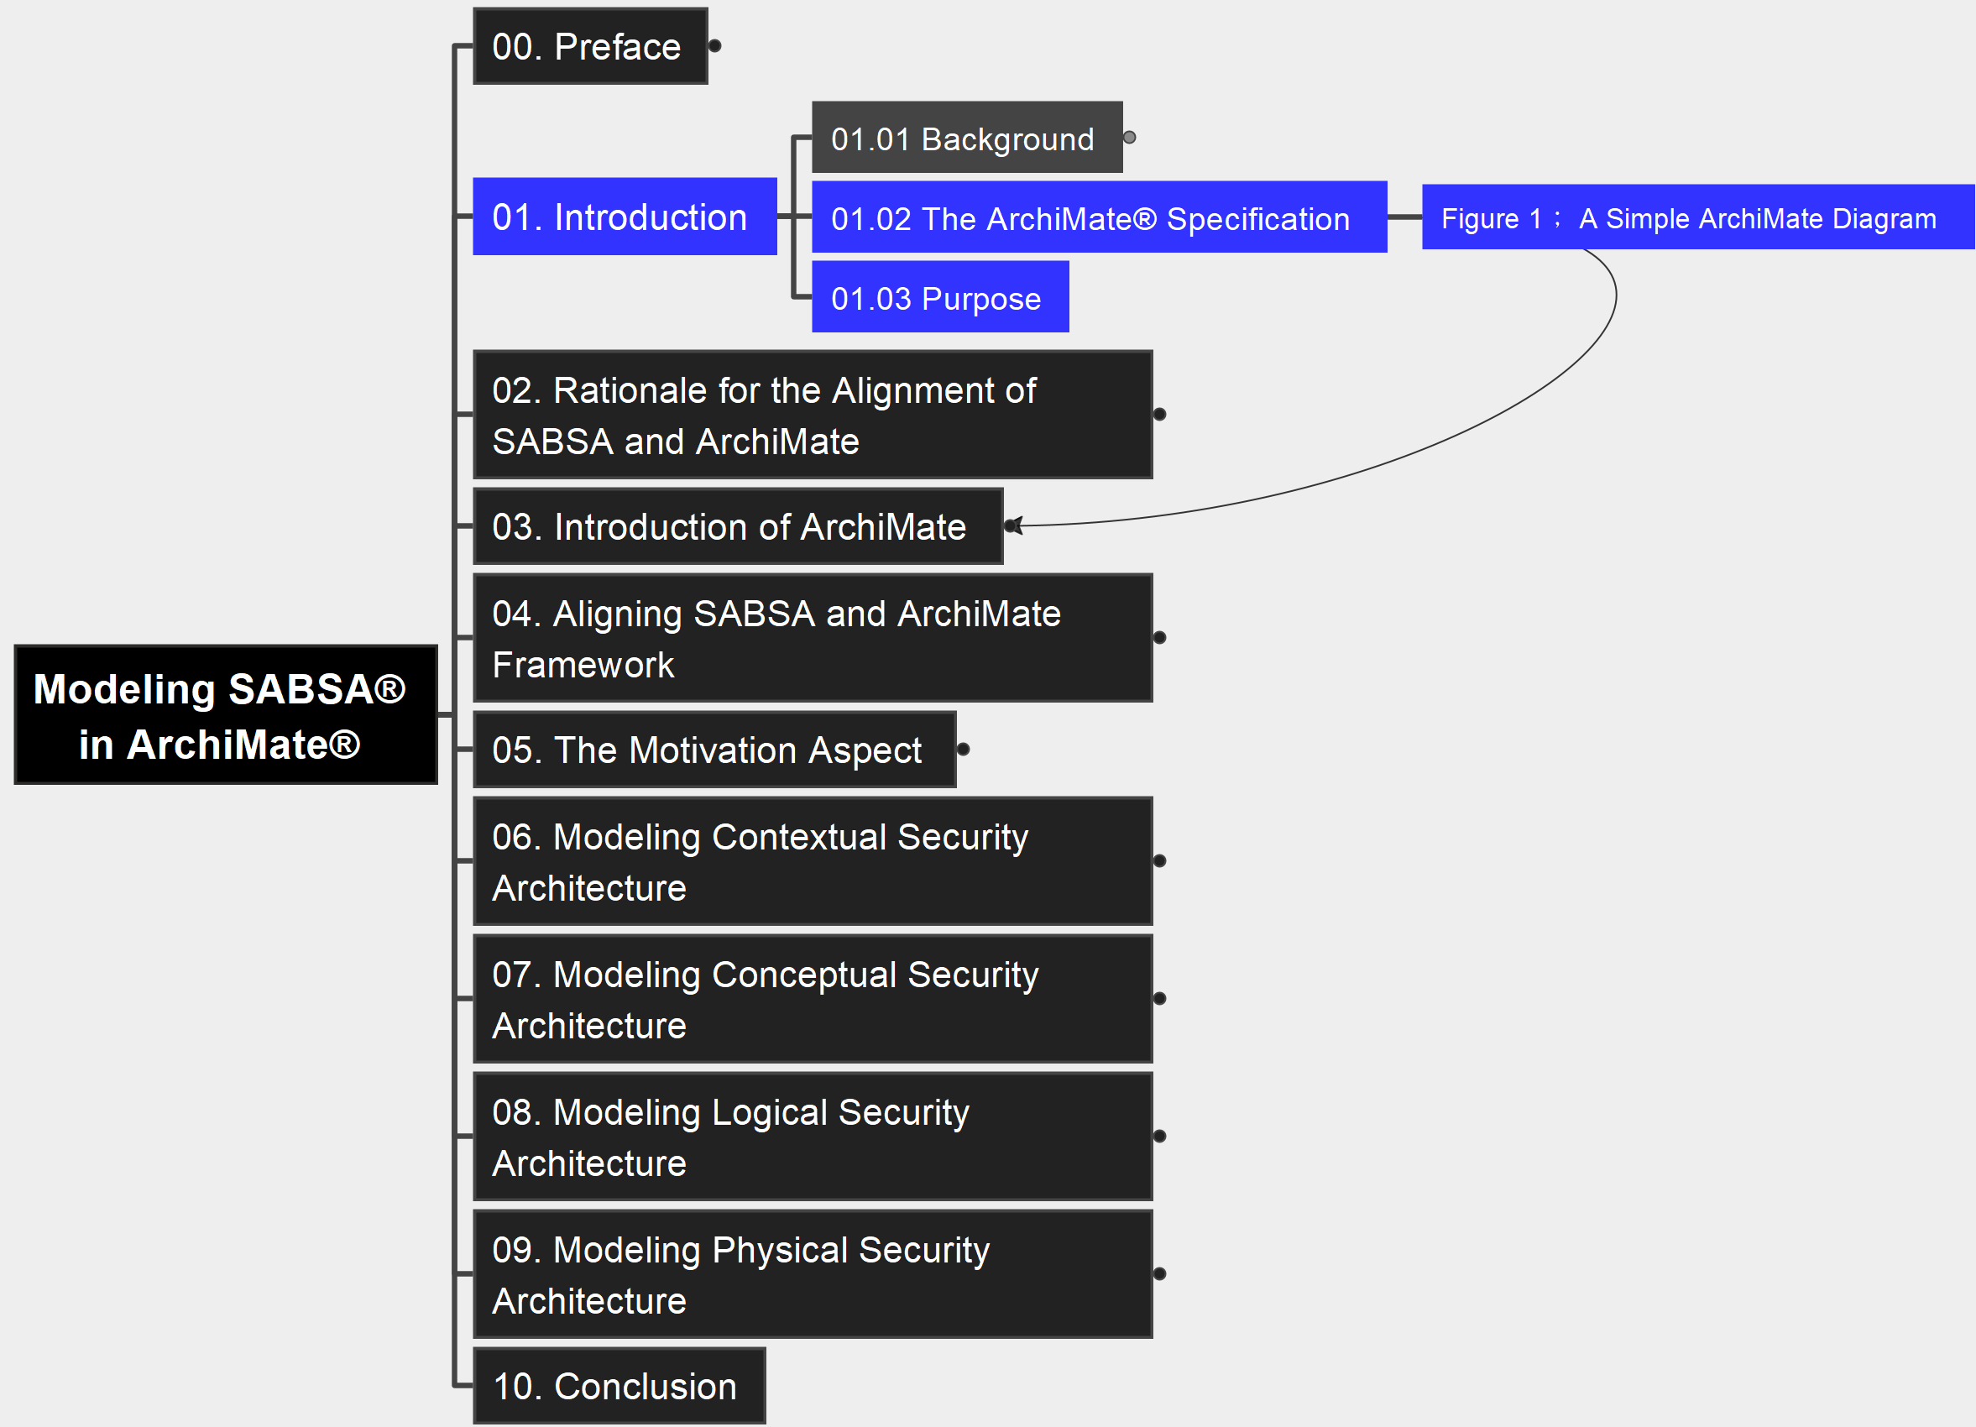
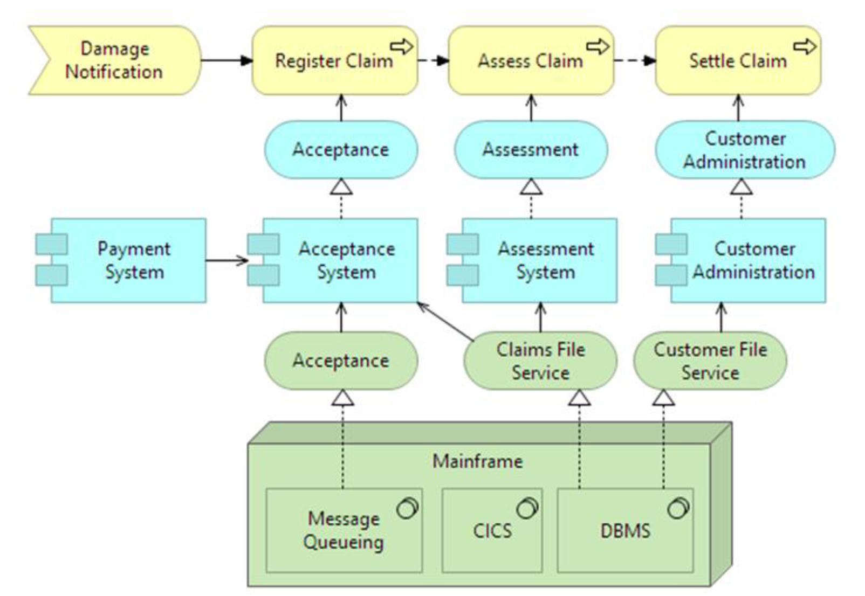

01 Introduction Figure 1: A Simple ArchiMate Diagram
03
Modeling SABSA® in ArchiMate® Specification

Slide 5
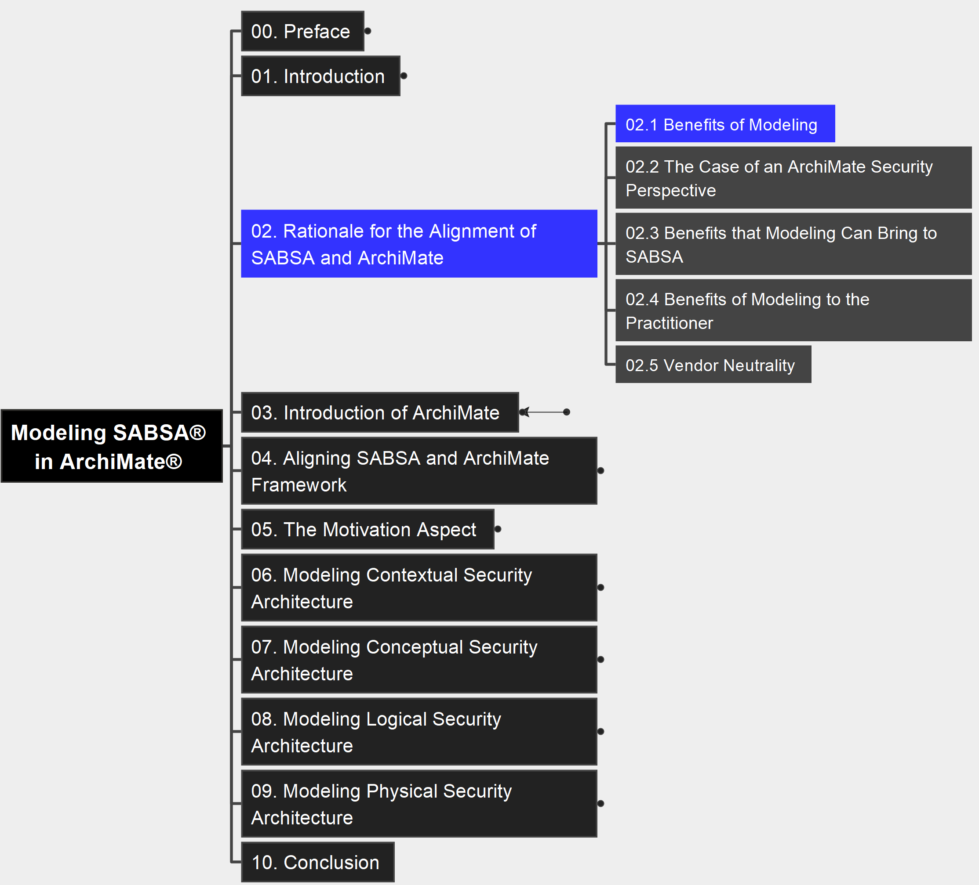
02 Rationale for the Alignment 2.1 Benefits of Modeling
04
Modeling SABSA® in ArchiMate® Specification
Modeling
Resolving Complexity
Quality of Documentation
Efficiency
Better Collaboration
Reuse
Stakeholder Buy-in
Standardization

Slide 6
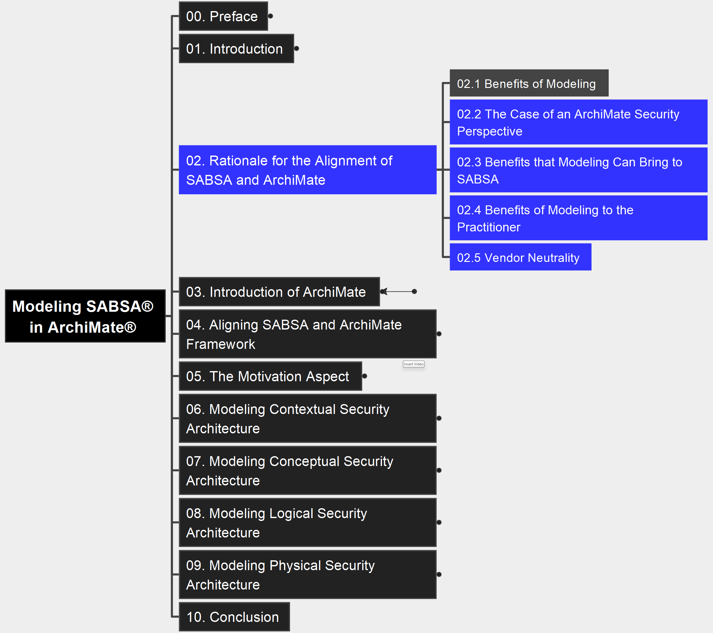
02 Rationale for the Alignment 2.2~2.5 Benefits to Variable Parties
05
Modeling SABSA® in ArchiMate® Specification
Security Overlay

Slide 7
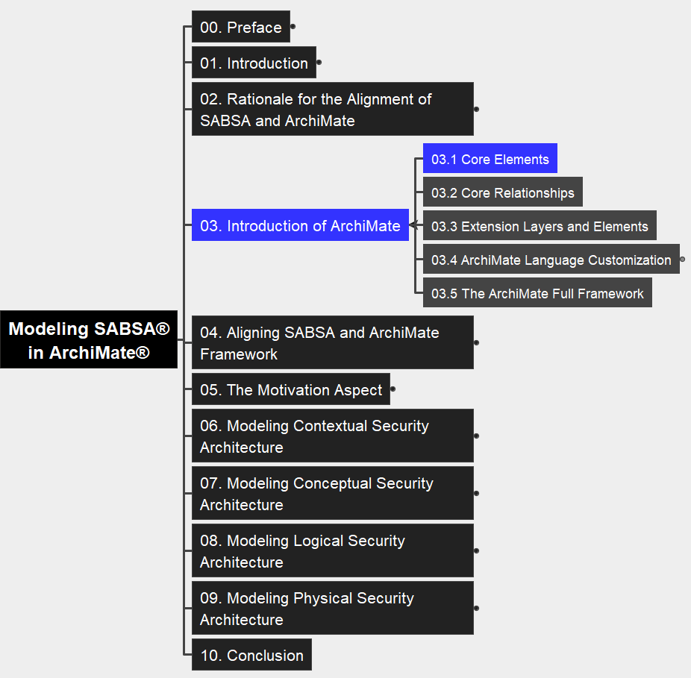
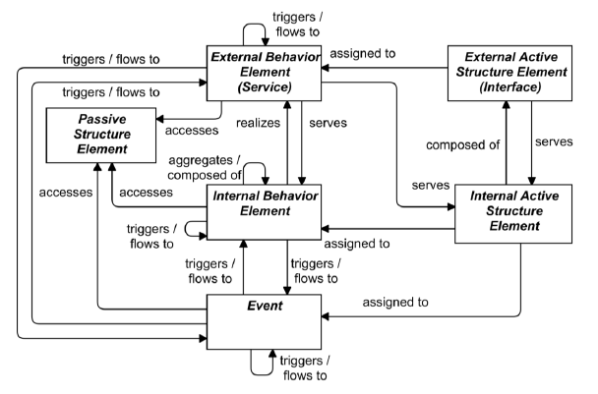
03 An Introduction to ArchiMate Language 3.1 Core Elements
06
Modeling SABSA® in ArchiMate® Specification

Slide 8
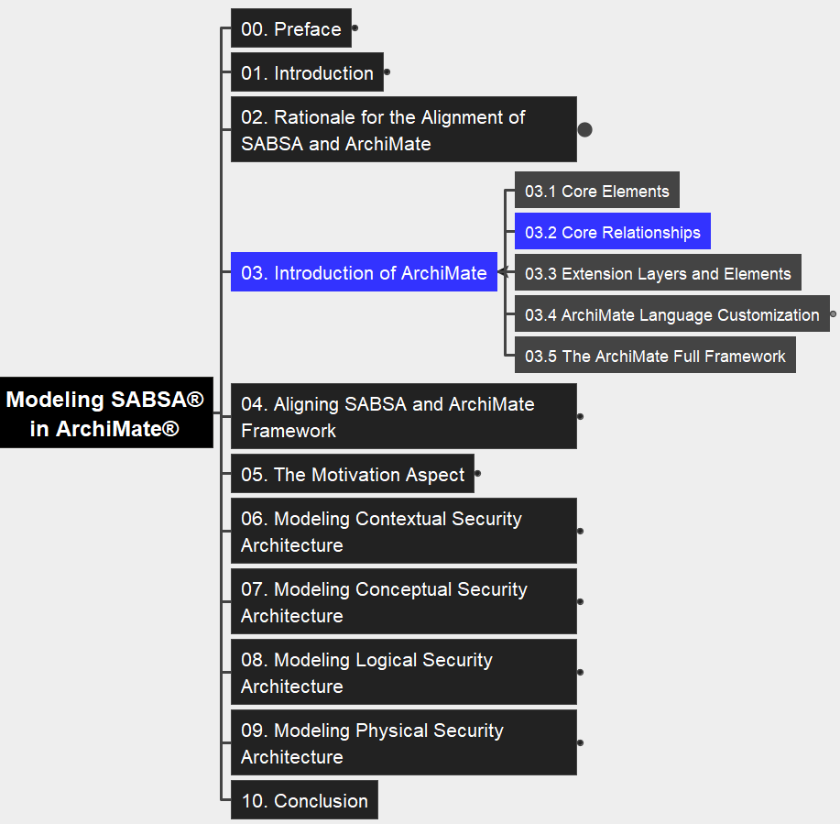
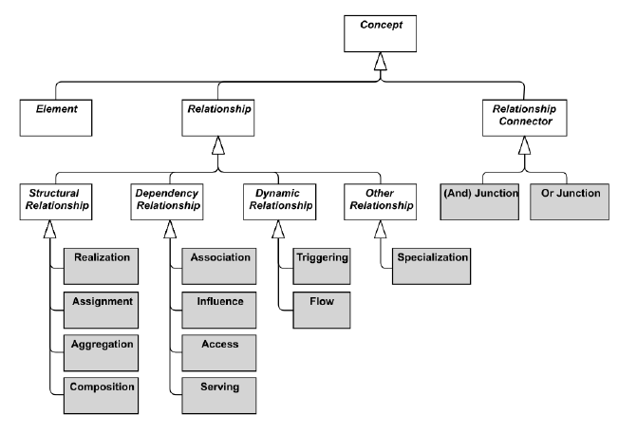
03 An Introduction to ArchiMate Language 3.2 Core Relationships
07
Modeling SABSA® in ArchiMate® Specification

Slide 9
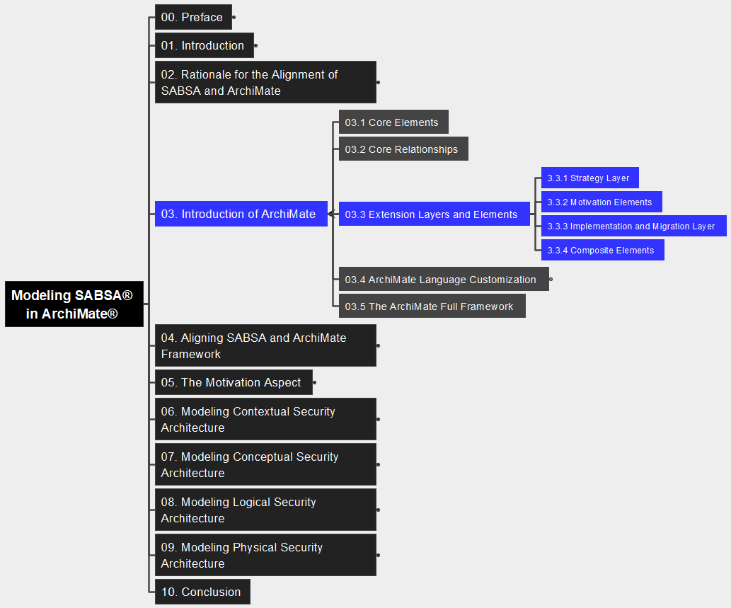
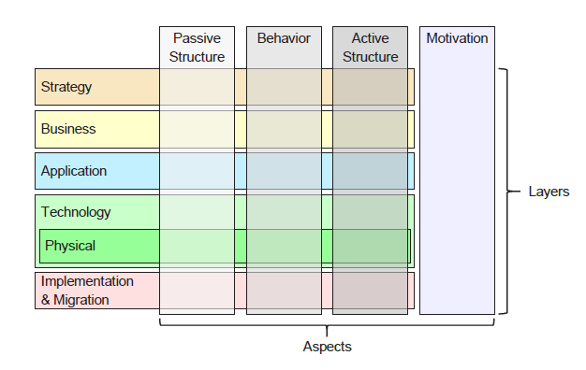
03 An Introduction to ArchiMate Language 3.3 Extension Layers and Elements
08
Modeling SABSA® in ArchiMate® Specification

Slide 10
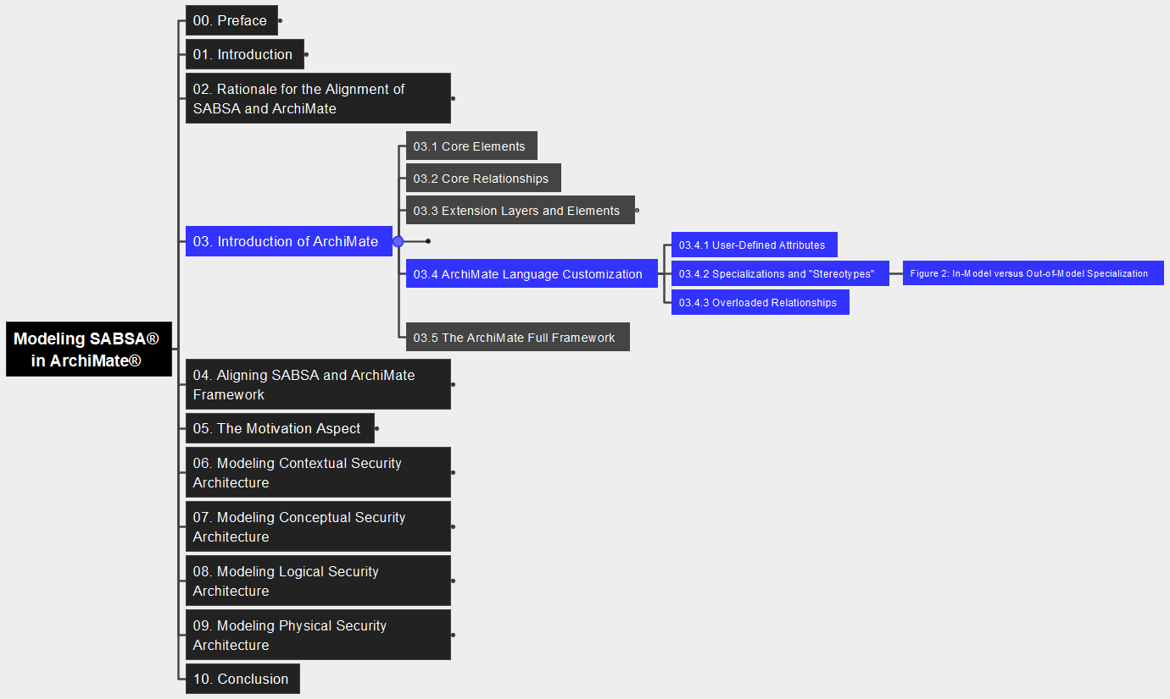
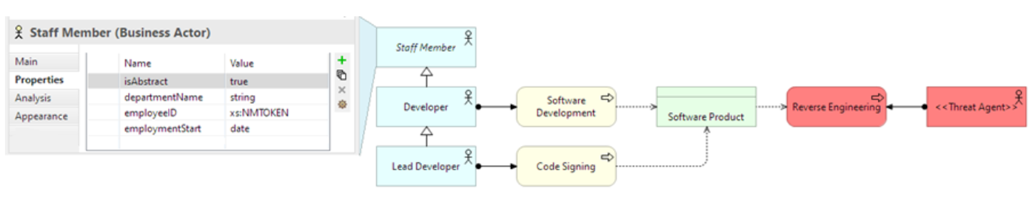
03 An Introduction to ArchiMate Language 3.4 ArchiMate Language Customization
09
Modeling SABSA® in ArchiMate® Specification

Slide 11
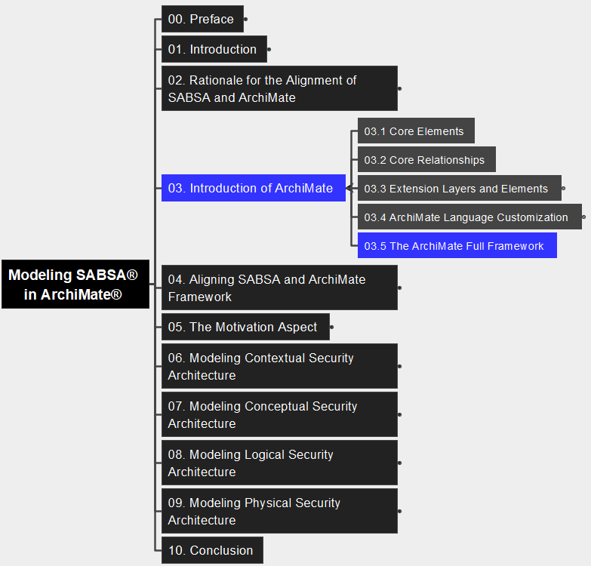
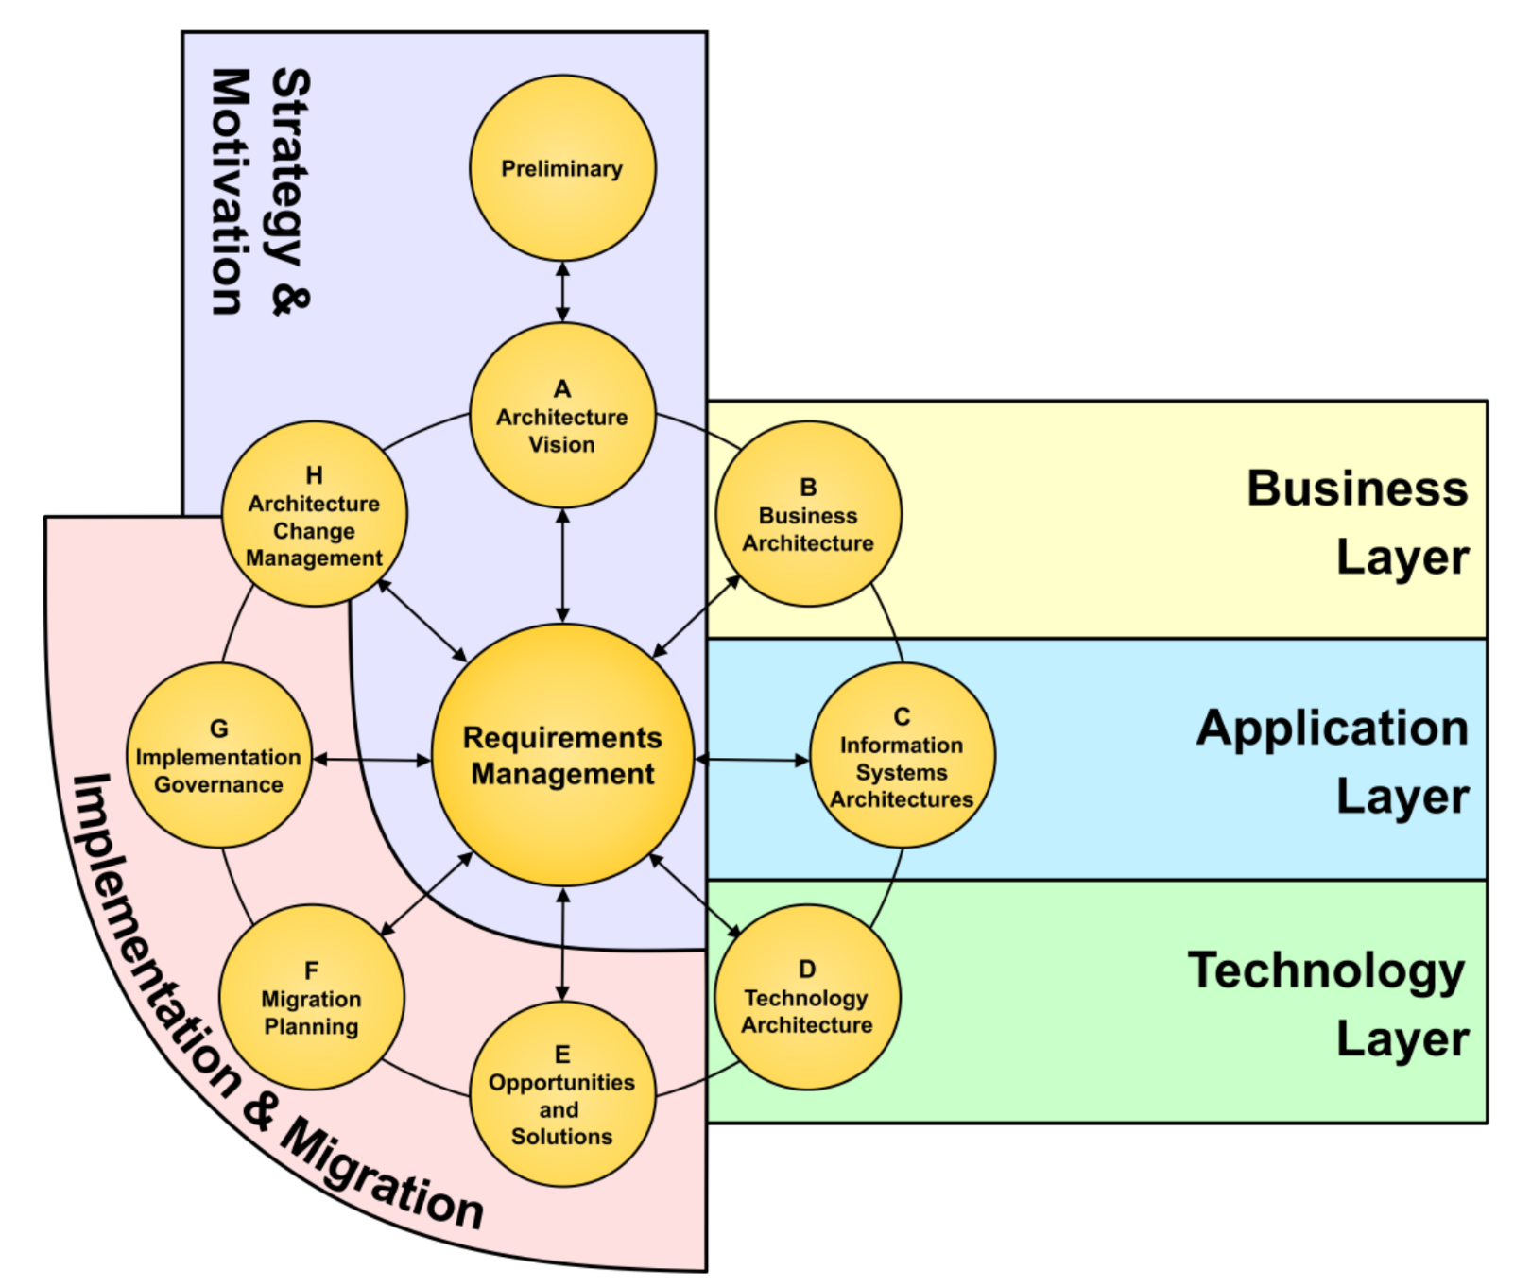
03 An Introduction to ArchiMate Language 3.5 The ArchiMate Full Framework
10
Modeling SABSA® in ArchiMate® Specification

Slide 12
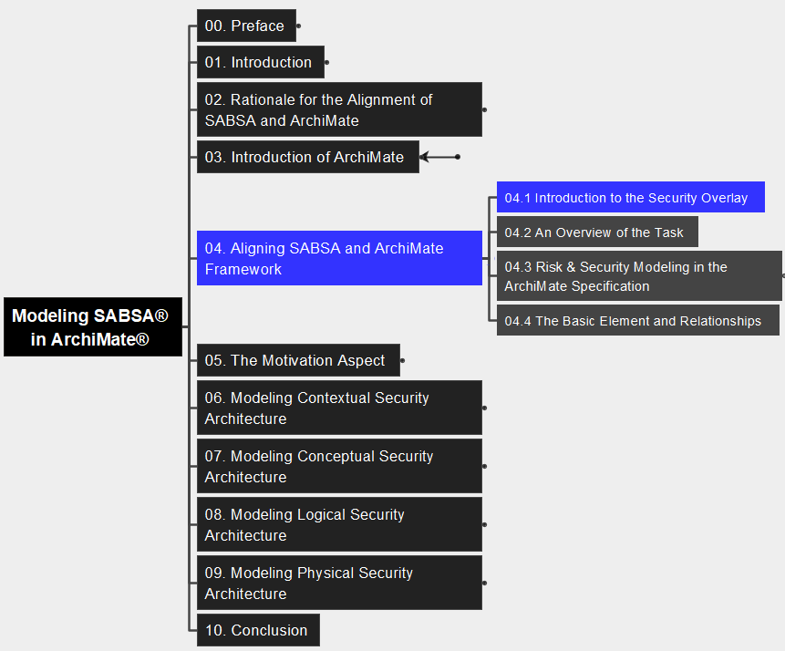
04 Aligning SABSA and ArchiMate 4.1 Intro to the Security Overlay
11
Modeling SABSA® in ArchiMate® Specification
A Security Overlay is a set of security profiles for existing ArchiMate elements, supplemented by a set of new stereotyped elements, to express security concepts.

Slide 13
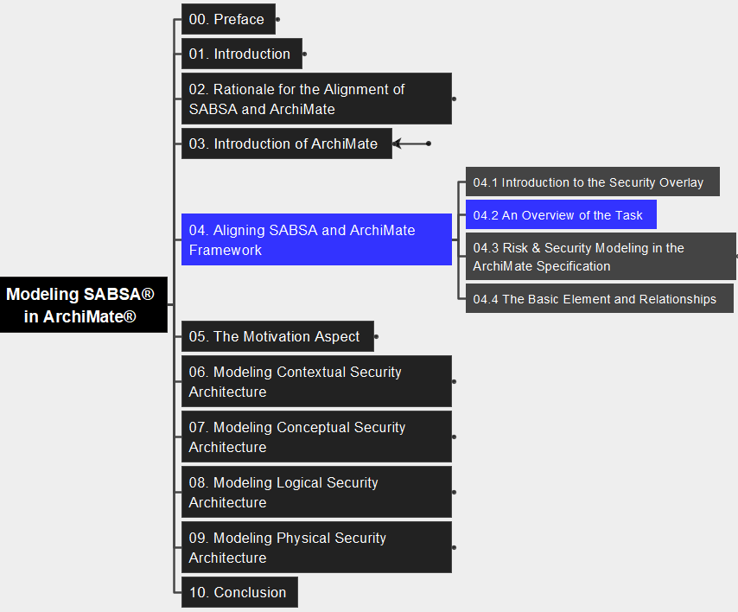
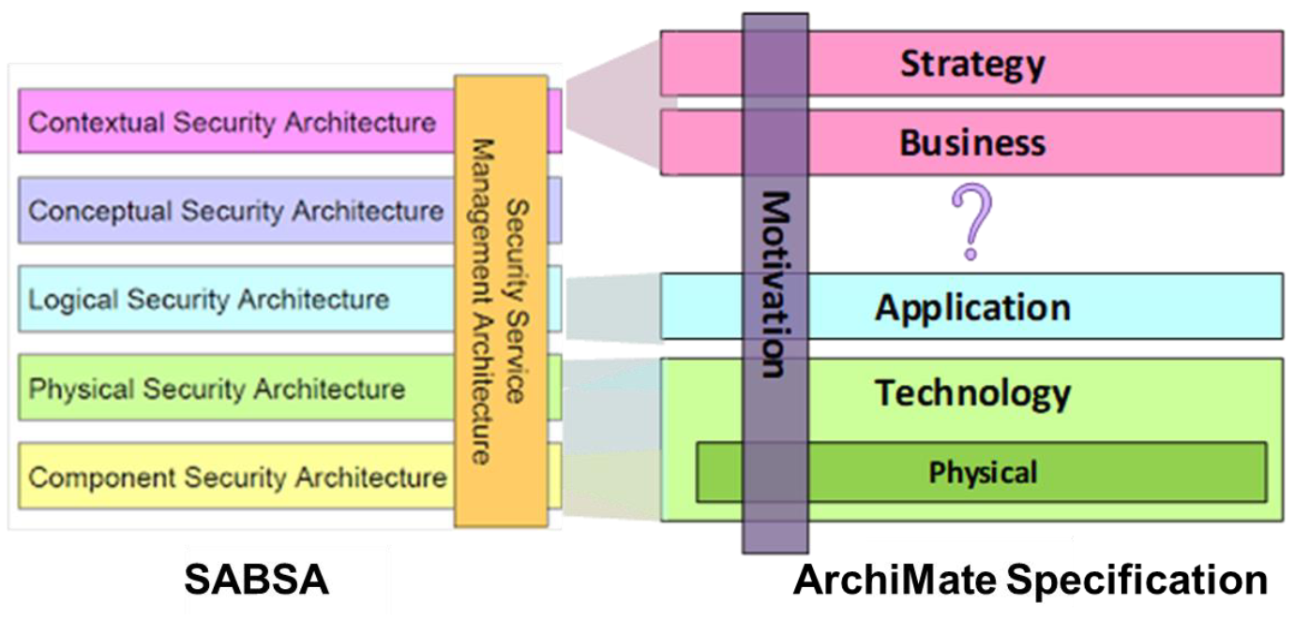
04 Aligning SABSA and ArchiMate 4.2 An Overview of the Task
12
Modeling SABSA® in ArchiMate® Specification

Slide 14
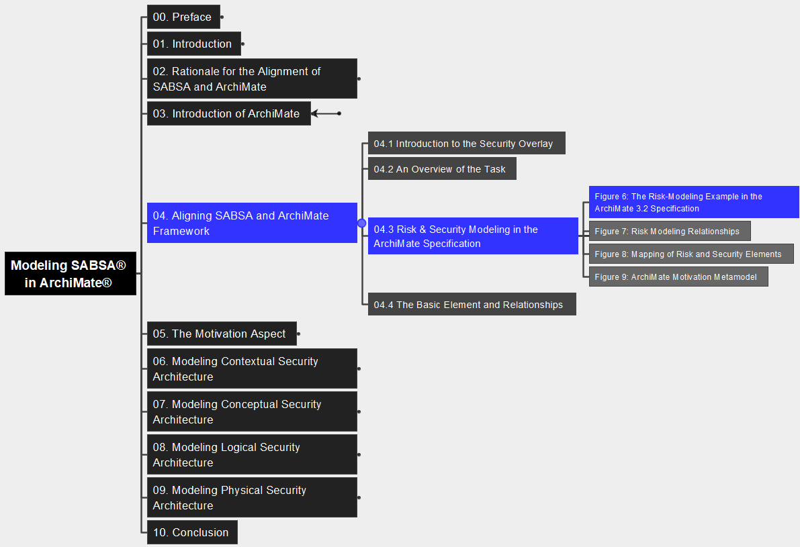
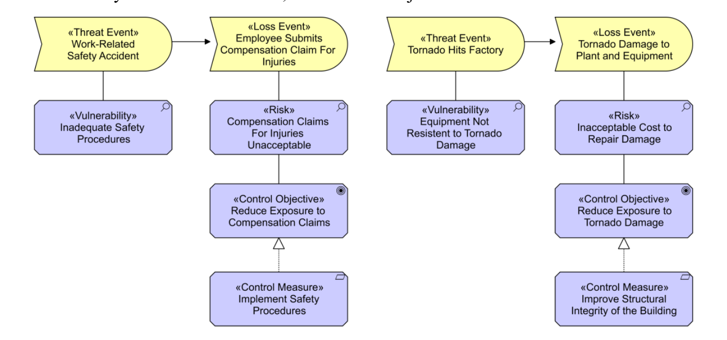
04 Aligning SABSA and ArchiMate 4.3 Risk & Security Modeling – Figure 6
13
Modeling SABSA® in ArchiMate® Specification

Slide 15
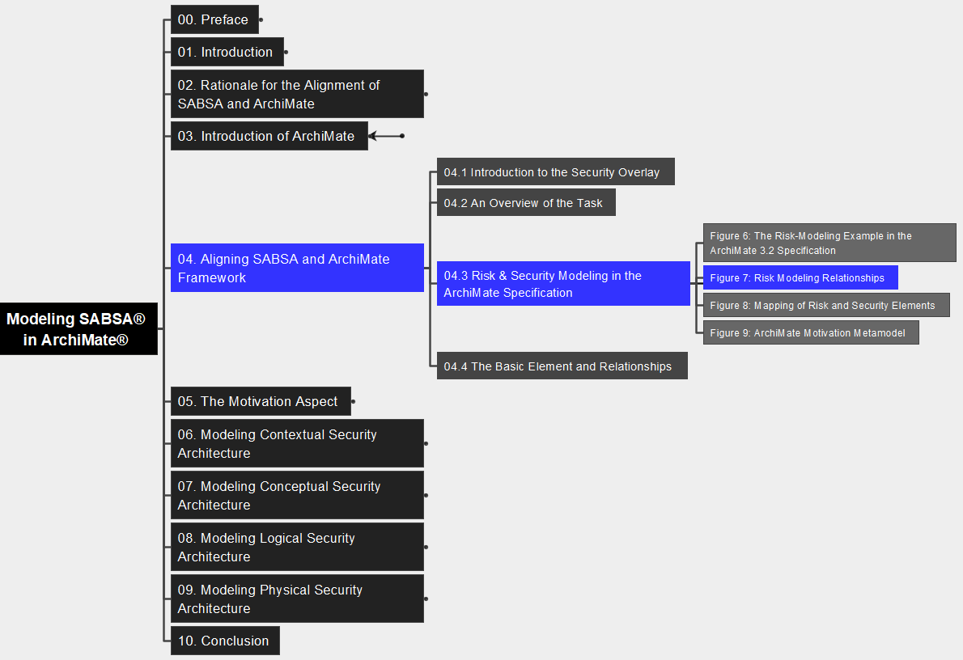
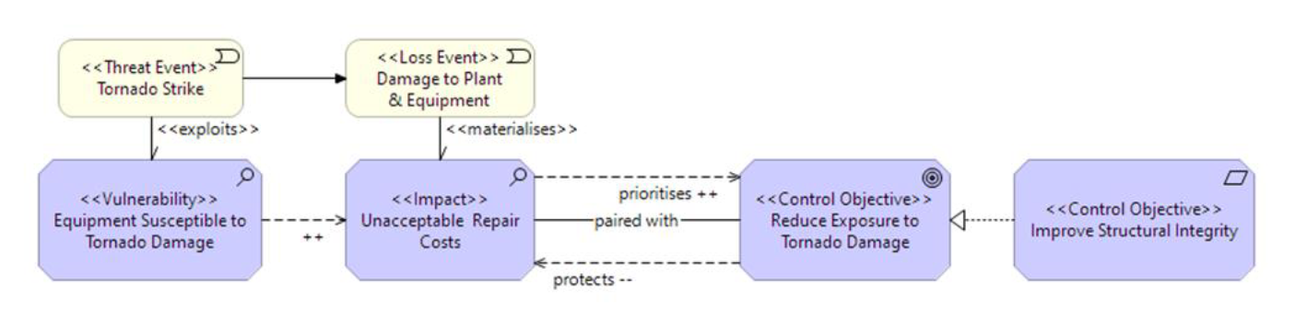
04 Aligning SABSA and ArchiMate 4.3 Risk & Security Modeling – Figure 7
14
Modeling SABSA® in ArchiMate® Specification

Slide 16
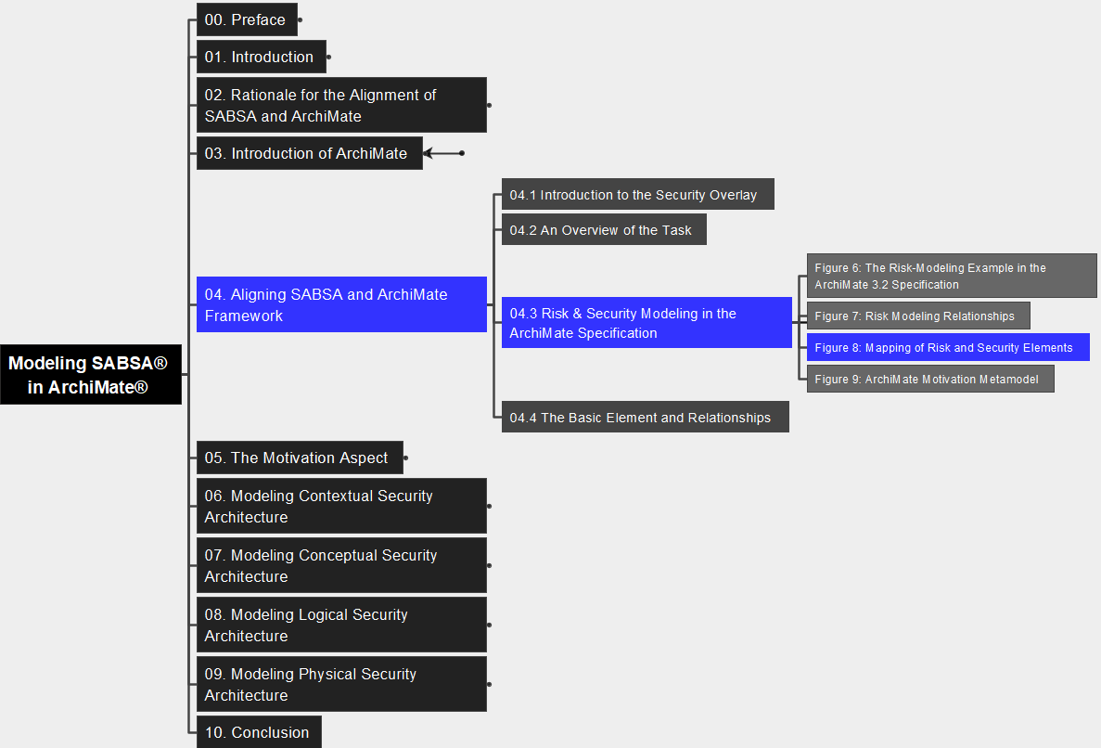
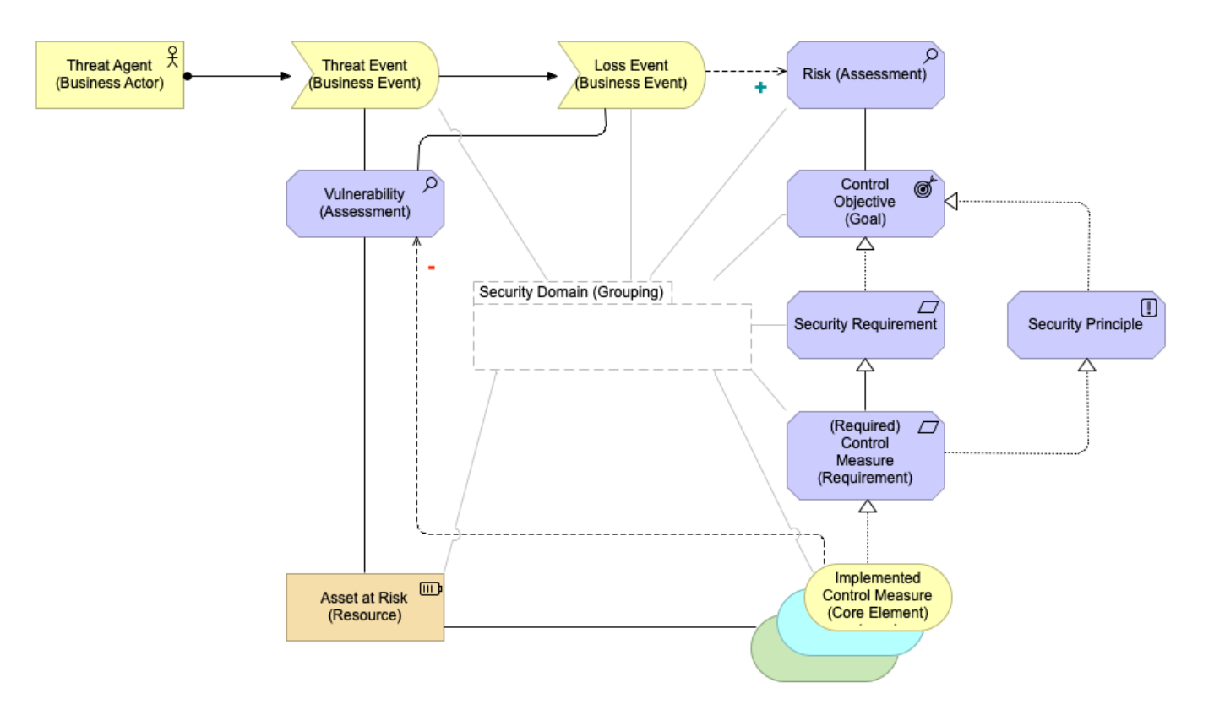
04 Aligning SABSA and ArchiMate 4.3 Risk & Security Modeling – Figure 8
15
Modeling SABSA® in ArchiMate® Specification

Slide 17
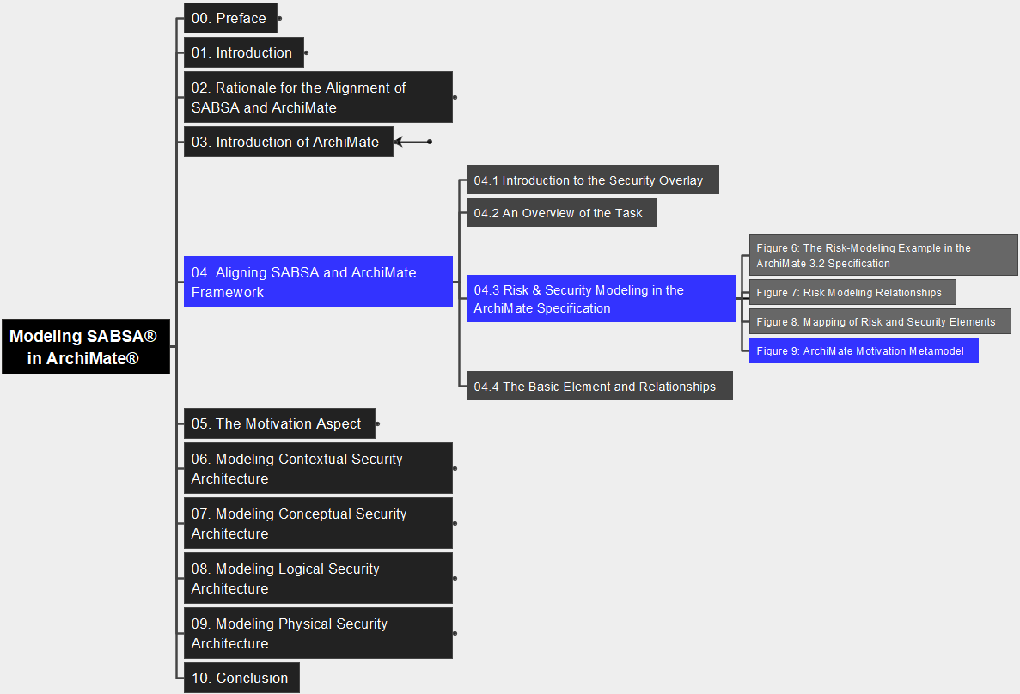
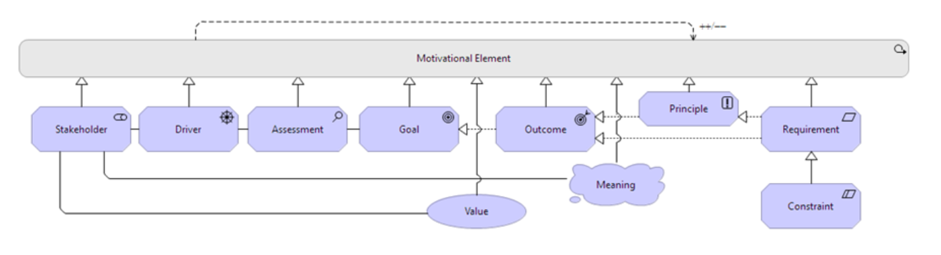
04 Aligning SABSA and ArchiMate 4.3 Risk & Security Modeling – Figure 9
16
Modeling SABSA® in ArchiMate® Specification

Slide 18
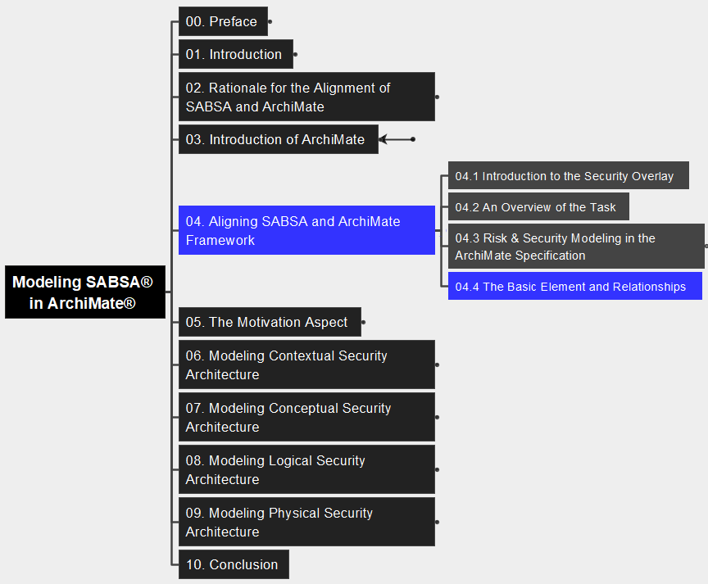
04 Aligning SABSA and ArchiMate 4.4 Basic Element and Relationships
17
Modeling SABSA® in ArchiMate® Specification
identifier
isAbstract
Stereotype / stereotypeOf
Cardinality

Slide 19
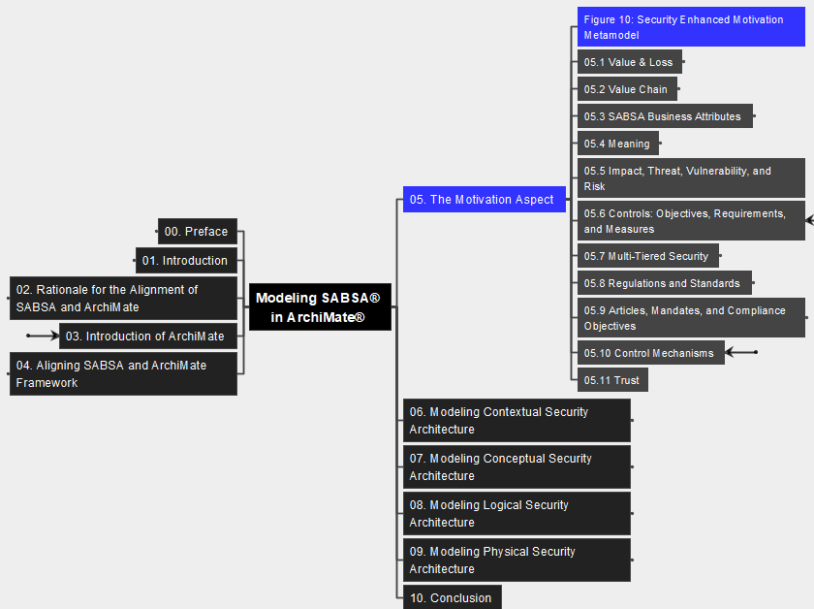
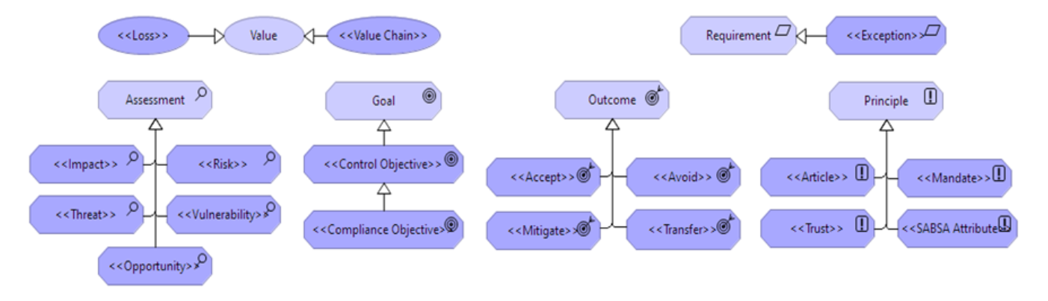
05 The Motivation Aspect
18
Modeling SABSA® in ArchiMate® Specification

Slide 20
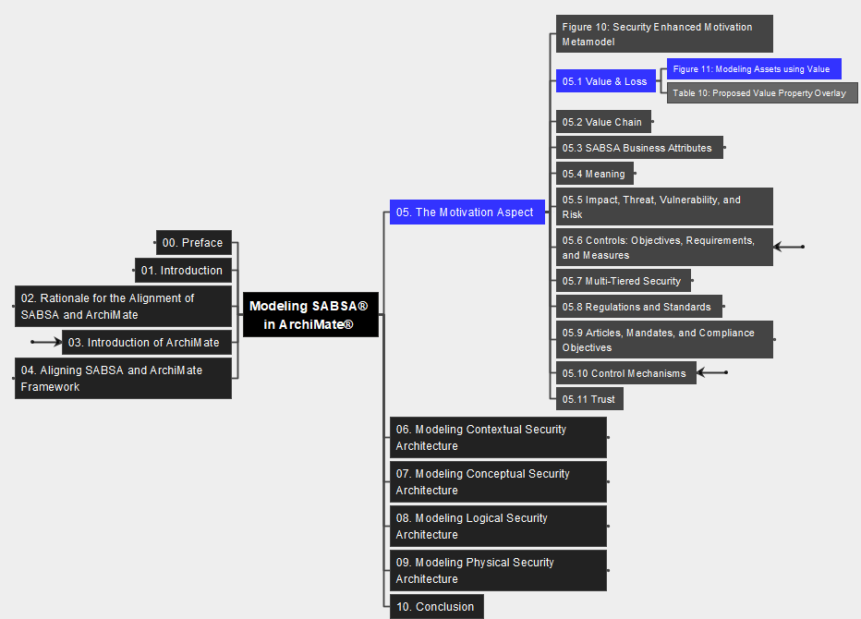
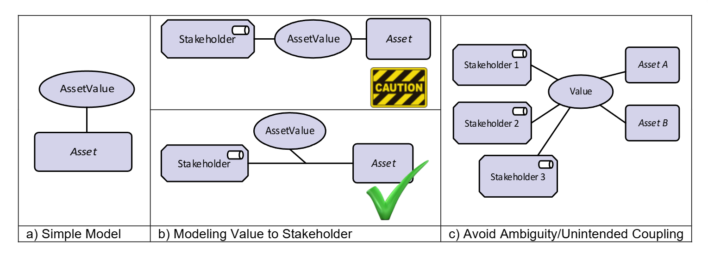

05 The Motivation Aspect 5.1 Value & Loss – Figure 11
19
Modeling SABSA® in ArchiMate® Specification

Slide 21

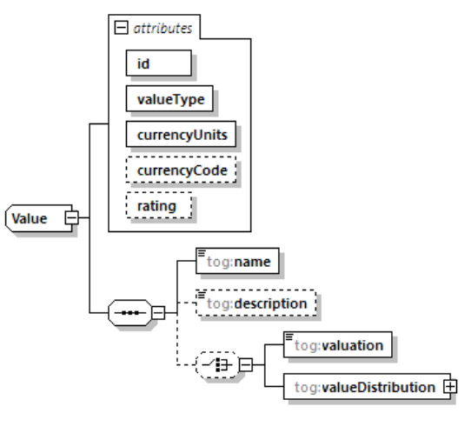

05 The Motivation Aspect 5.1 Value & Loss – Table 10: Schema
20
Modeling SABSA® in ArchiMate® Specification

Slide 22
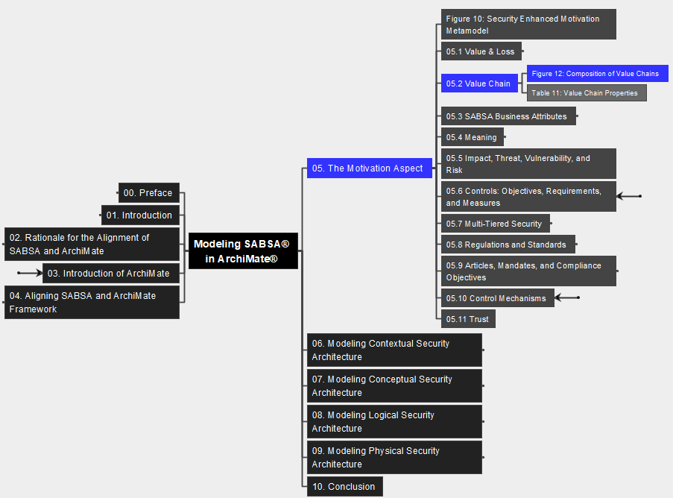
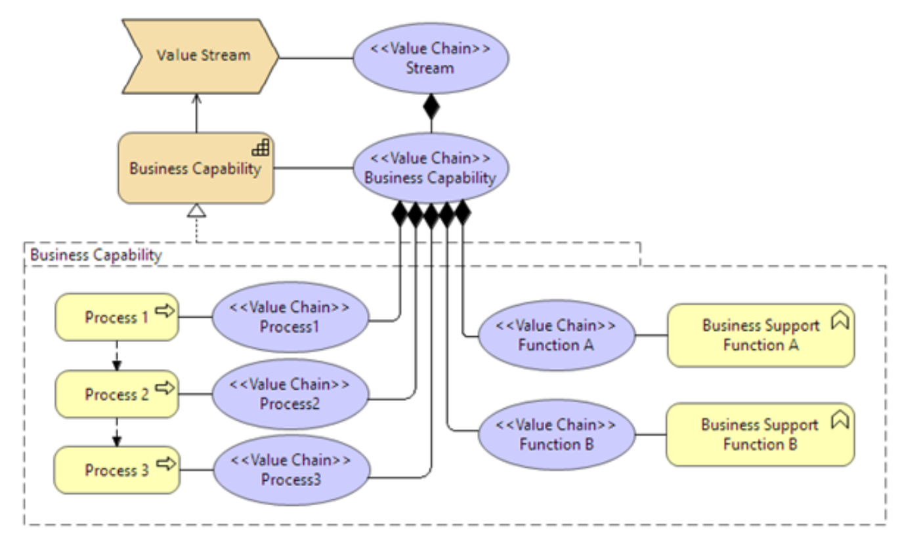
05 The Motivation Aspect 5.2 Value Chain – Figure 12
21
Modeling SABSA® in ArchiMate® Specification

Slide 23
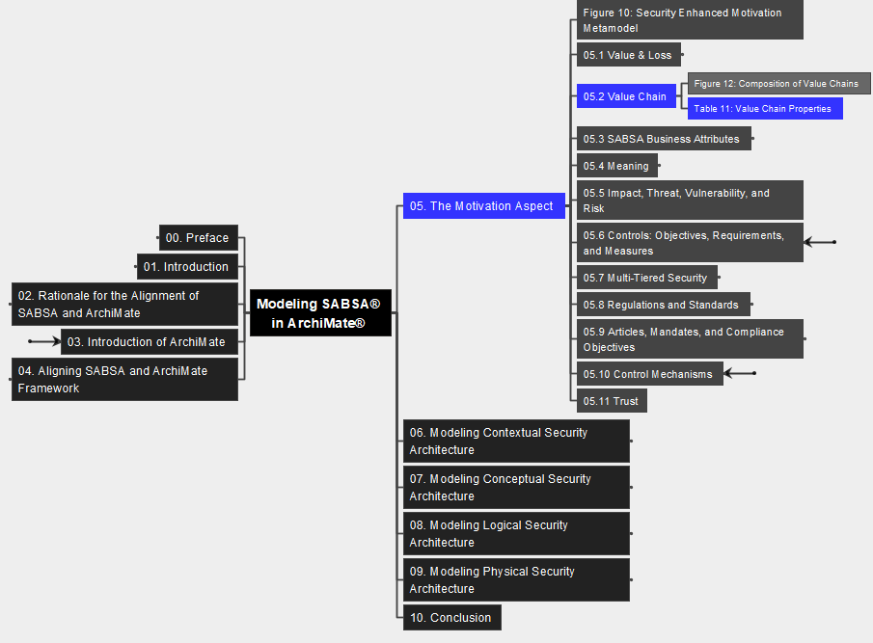
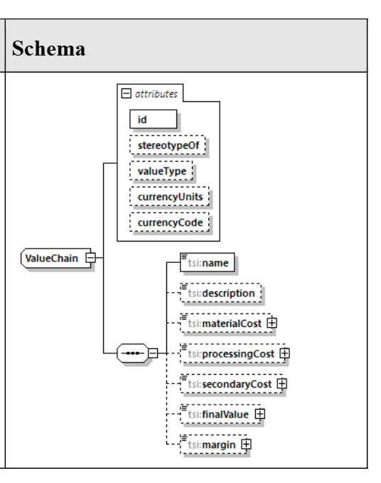
05 The Motivation Aspect 5.2 Value Chain – Table 11: Properties
22
Modeling SABSA® in ArchiMate® Specification

Slide 24
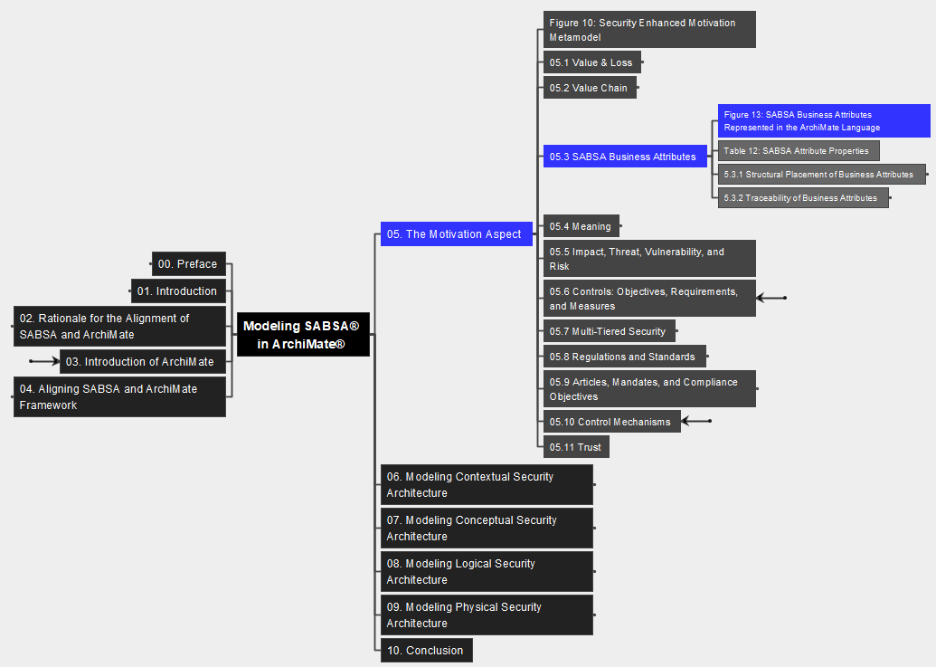
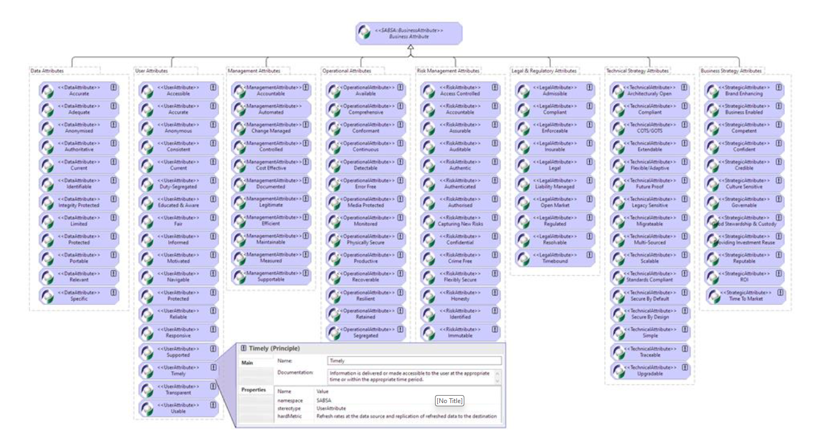
05 The Motivation Aspect 5.3 SABSA Business Attributes – Figure 13
23
Modeling SABSA® in ArchiMate® Specification

Slide 25
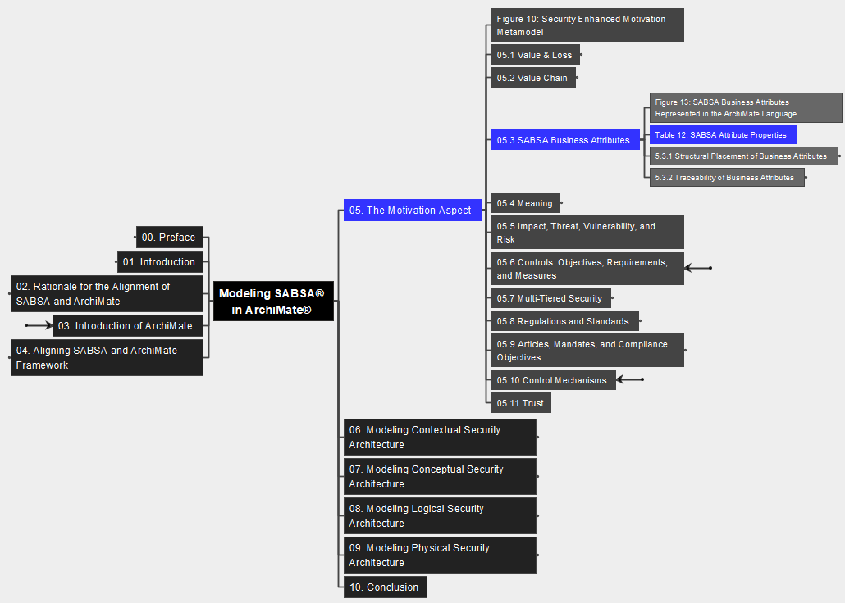
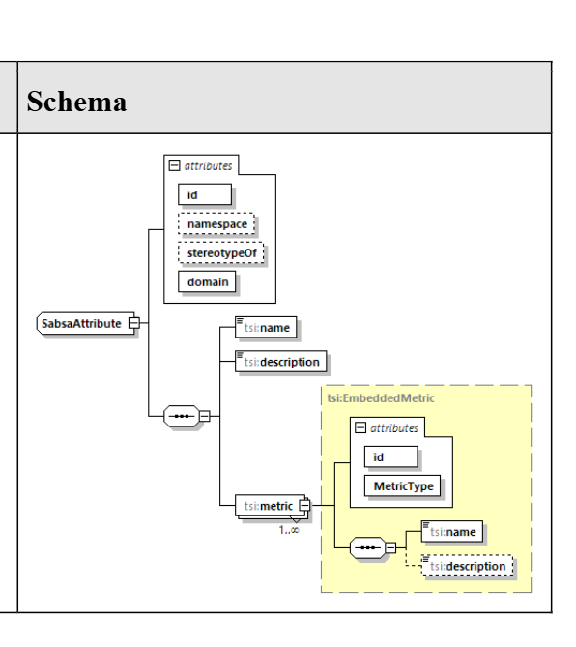
05 The Motivation Aspect 5.3 SABSA Business Attributes – Table 12
24
Modeling SABSA® in ArchiMate® Specification

Slide 26
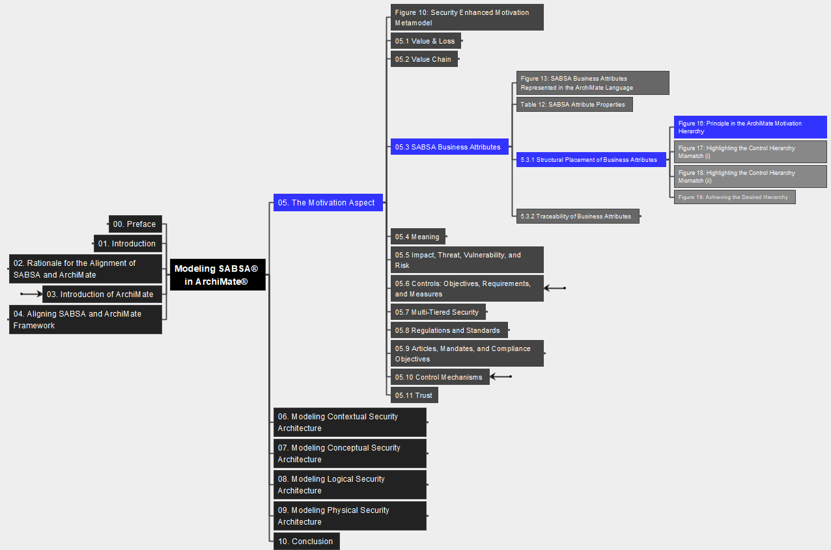
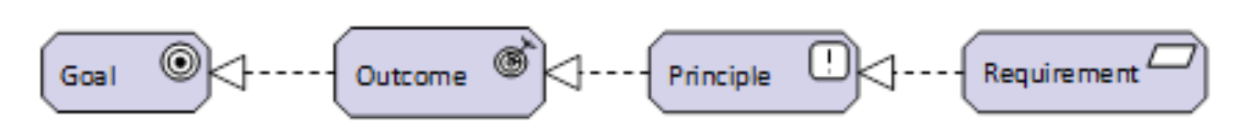
05 The Motivation Aspect 5.3.1 Structural Placement of Business Attributes – Figure 16
25
Modeling SABSA® in ArchiMate® Specification

Slide 27
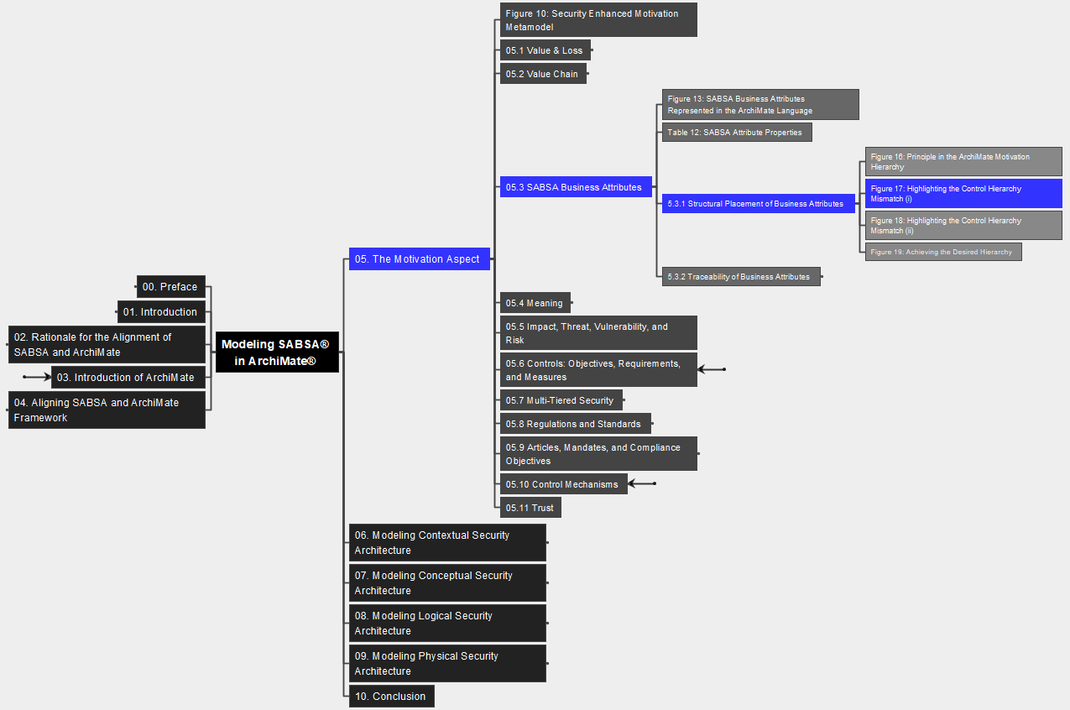
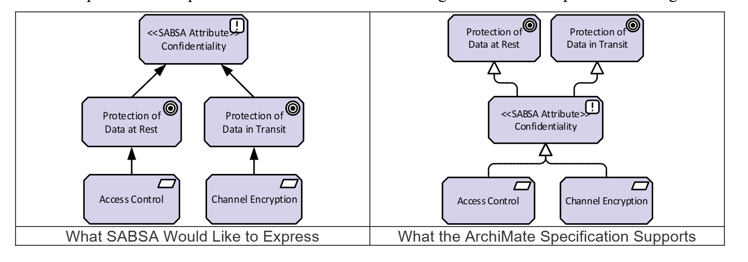
05 The Motivation Aspect 5.3.1 Structural Placement of Business Attributes – Figure 17
26
Modeling SABSA® in ArchiMate® Specification

Slide 28
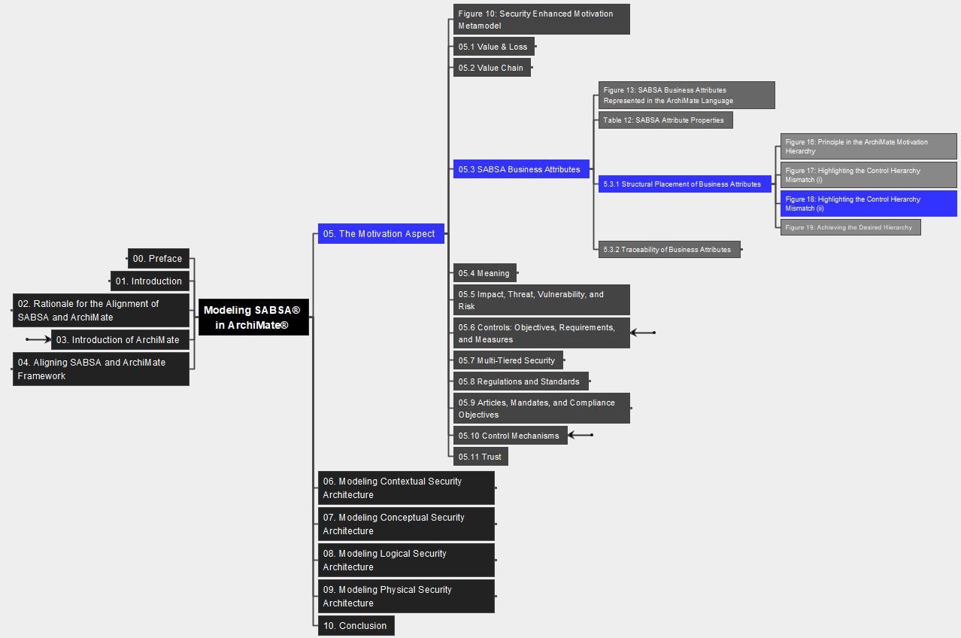
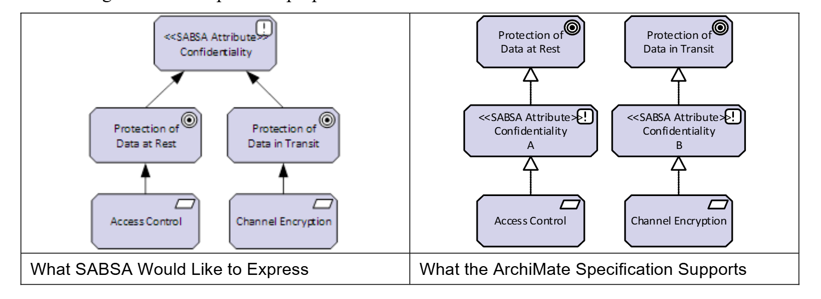
05 The Motivation Aspect 5.3.1 Structural Placement of Business Attributes – Figure 18
27
Modeling SABSA® in ArchiMate® Specification

Slide 29
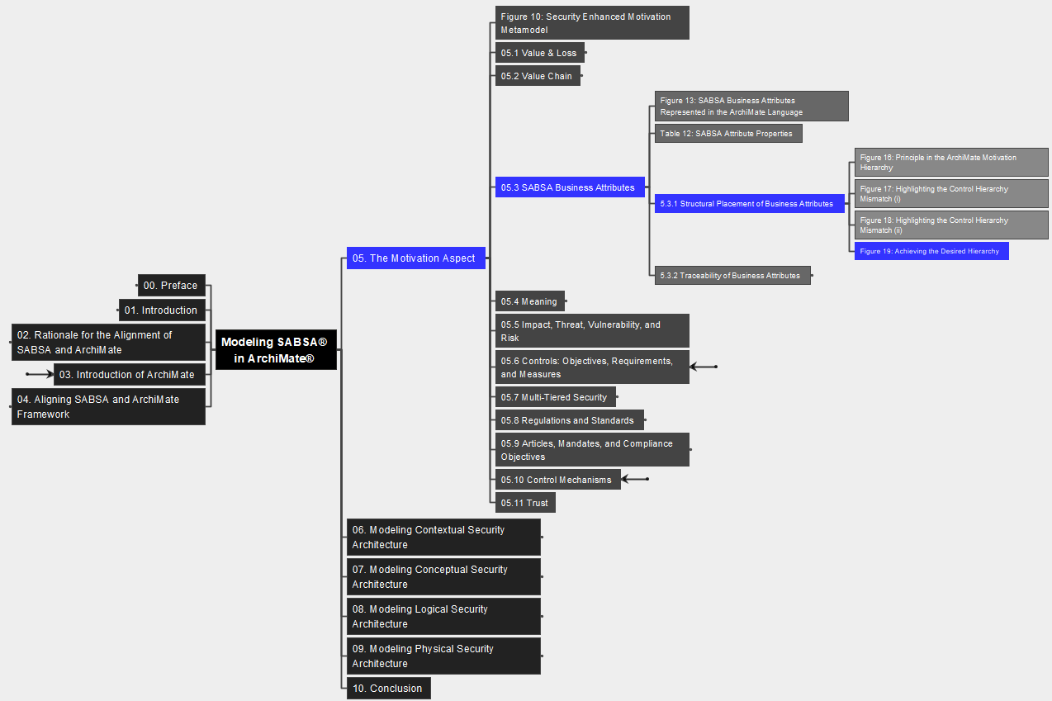

05 The Motivation Aspect 5.3.1 Structural Placement of Business Attributes – Figure 19
28
Modeling SABSA® in ArchiMate® Specification

Slide 30


05 The Motivation Aspect 5.3.2 Traceability of Business Attributes – Figure 20
29
Modeling SABSA® in ArchiMate® Specification

Slide 31


05 The Motivation Aspect 5.4 Meaning – Figure 21: Apply Attribute Matrics
30
Modeling SABSA® in ArchiMate® Specification

Slide 32


05 The Motivation Aspect 5.4 Meaning – Figure 22: Externalize Metrics
31
Modeling SABSA® in ArchiMate® Specification

Slide 33



05 The Motivation Aspect 5.5 Impact, Threat, Vulnerability, and Risk – Table 13
32
Modeling SABSA® in ArchiMate® Specification

Slide 34


05 The Motivation Aspect 5.6 Controls: Objectives, Requirements, & Measures: Fig23
33
Modeling SABSA® in ArchiMate® Specification

Slide 35


05 The Motivation Aspect 5.6 Controls: Objectives, Requirements, & Measures: Fig24
34
Modeling SABSA® in ArchiMate® Specification

Slide 36


05 The Motivation Aspect 5.7 Multi-Tiered Security – Table 14: Control Elem. Prop.
35
Modeling SABSA® in ArchiMate® Specification

Slide 37


05 The Motivation Aspect 5.7 Multi-Tiered Security – Figure 25
36
Modeling SABSA® in ArchiMate® Specification

Slide 38


05 The Motivation Aspect 5.8 Regulations and Standards – Figure 26
37
Modeling SABSA® in ArchiMate® Specification

Slide 39


05 The Motivation Aspect 5.8 Regulations and Standards – Table 15
38
Modeling SABSA® in ArchiMate® Specification

Slide 40


05 The Motivation Aspect 5.9 Articles, Mandates, and Compliance Objects – Fig 27
39
Modeling SABSA® in ArchiMate® Specification

Slide 41


05 The Motivation Aspect 5.9 Articles, Mandates, and Compliance Objects – Tab 16
40
Modeling SABSA® in ArchiMate® Specification

Slide 42


05 The Motivation Aspect 5.10 Control Mechanisms – Figure 28
41
Modeling SABSA® in ArchiMate® Specification

Slide 43



05 The Motivation Aspect 5.10 Control Mechanisms – Table 17
42
Modeling SABSA® in ArchiMate® Specification

Slide 44


05 The Motivation Aspect 5.11 Trust – Table 18: Trust Profile
43
Modeling SABSA® in ArchiMate® Specification

Slide 45



06 Modeling Contextual Security Archi. Table 19: SASBA Contextual Architecture
44
Modeling SABSA® in ArchiMate® Specification

Slide 46


06 Modeling Contextual Security Archi. Figure 29: Dev. And Maintain Contextual Sec. Archi.
45
Modeling SABSA® in ArchiMate® Specification

Slide 47


06 Modeling Contextual Security Archi. Table 20: Contextual Elements
46
Modeling SABSA® in ArchiMate® Specification

Slide 48


06 Modeling Contextual Security Archi. 6.1 Business Assets – 6.1.1 Cap & VS - Table 21, Figure 30
47
Modeling SABSA® in ArchiMate® Specification

Slide 49


06 Modeling Contextual Security Archi. 6.1 Business Assets – 6.1.2 Biz Objects - Table 22
48
Modeling SABSA® in ArchiMate® Specification

Slide 50


06 Modeling Contextual Security Archi. 6.1 Business Assets – 6.1.2 Biz Objects – Figure 31
49
Modeling SABSA® in ArchiMate® Specification

Slide 51


06 Modeling Contextual Security Archi. 6.1 Business Assets – 6.1.3 Business Service, Interface, SLA – Table 23
50
Modeling SABSA® in ArchiMate® Specification

Slide 52


06 Modeling Contextual Security Archi. 6.2 Business Risk & 6.3 Business Process / Function / Interaction – Table 24
51
Modeling SABSA® in ArchiMate® Specification

Slide 53


06 Modeling Contextual Security Archi. 6.4 Business Roles and Actors – Table 25 Properties
52
Modeling SABSA® in ArchiMate® Specification

Slide 54


06 Modeling Contextual Security Archi. 6.4 Business Roles and Actors – 6.4.1 Governance – Figure 32
53
Modeling SABSA® in ArchiMate® Specification

Slide 55


06 Modeling Contextual Security Archi. 6.4 Business Roles and Actors – 6.4.1 Governance – Figure 33
54
Modeling SABSA® in ArchiMate® Specification

Slide 56


06 Modeling Contextual Security Archi. 6.4 Business Roles and Actors – 6.4.1 Governance – Figure 34
55
Modeling SABSA® in ArchiMate® Specification

Slide 57


06 Modeling Contextual Security Archi. 6.4 Business Roles and Actors – 6.4.1 Governance – Table 26
56
Modeling SABSA® in ArchiMate® Specification

Slide 58


06 Modeling Contextual Security Archi. 6.4 Business Roles and Actors – 6.4.2 Threat Actors – Figure 35
57
Modeling SABSA® in ArchiMate® Specification

Slide 59


06 Modeling Contextual Security Archi. 6.4 Business Roles and Actors – 6.4.2 Threat Actors – Figure 36
58
Modeling SABSA® in ArchiMate® Specification

Slide 60


06 Modeling Contextual Security Archi. 6.4 Business Roles and Actors – 6.4.2 Threat Actors – Table 27
59
Modeling SABSA® in ArchiMate® Specification

Slide 61

06 Modeling Contextual Security Archi. 6.5 Business Geography & 6.6 Business Time Dependencies
60
Modeling SABSA® in ArchiMate® Specification

Slide 62

07 Modeling Conceptual Security Archi. Table 28: SABSA Conceptual Architecture
61
Modeling SABSA® in ArchiMate® Specification

Slide 63
07 Modeling Conceptual Security Archi. Figure 37: Developing the SABSA Conceptual Sec. Archi.
62
Modeling SABSA® in ArchiMate® Specification

Slide 64







Slide 66




ArchiMate
UML
BPMN

